Slide 1
Teaching in 2025: Data-Driven Trends, Practical Charts, and an Implementation Roadmap
Generated by AgentFire AI

Slide 2
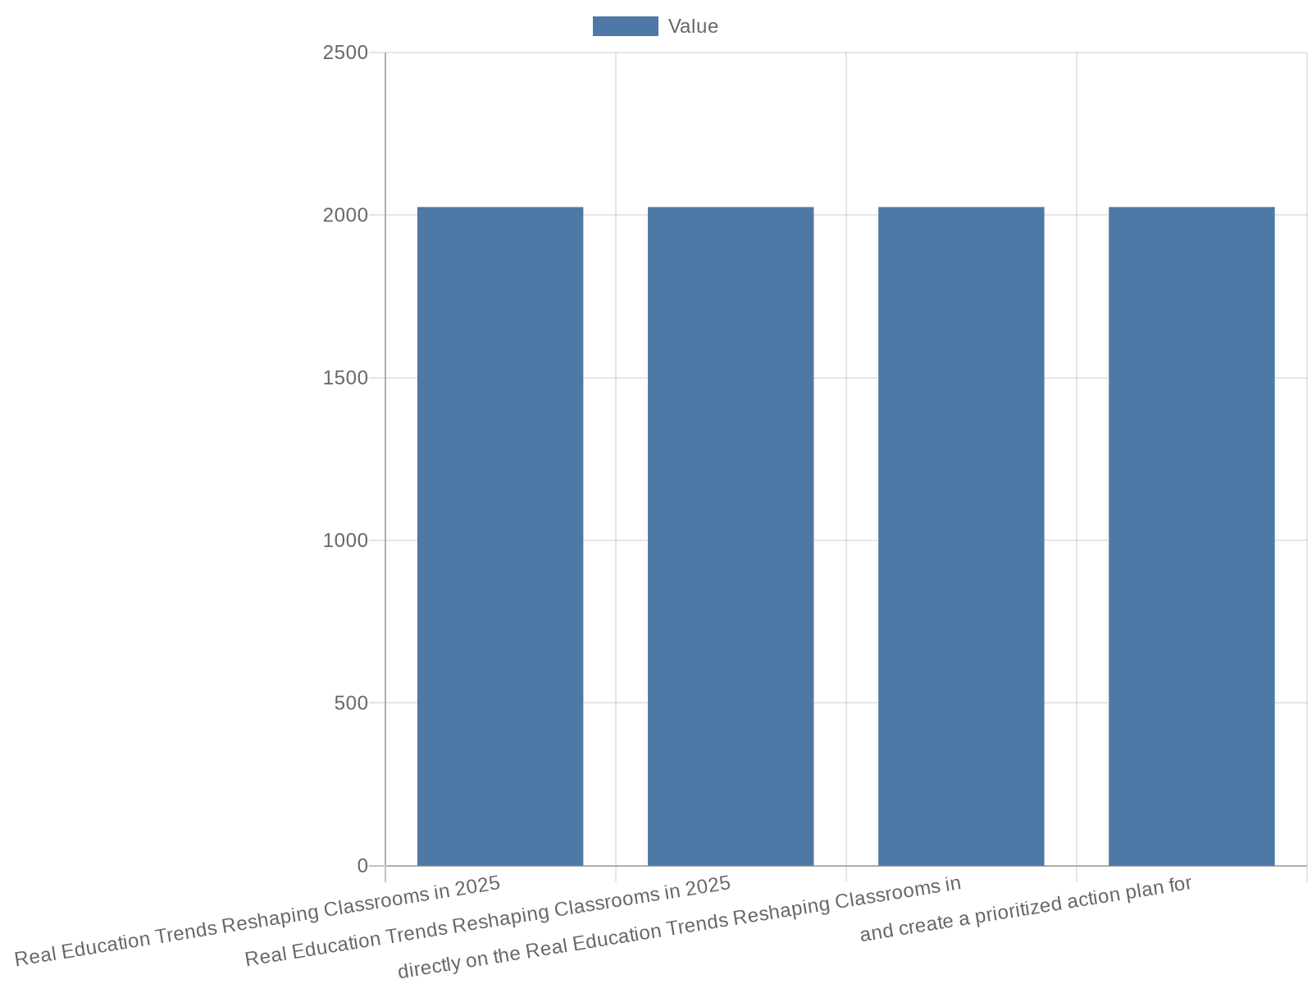
Overview: Teaching in 2025 — Core Themes
Real Education Trends Reshaping Classrooms in 2025 2025 Education Trends That Actually Matter By Kelly Denzler Dec 17, 2024 12:00:00 AM They’ll tell you about …
Frame: trends are present — measure their classroom impact
Four lenses: tech, workforce, student-centered design, policy
Numerical indicators to seek: adoption, outcomes, time, funding
Goal: find data, visualize trends, define action steps
Notes:
Real Education Trends Reshaping Classrooms in 2025 2025 Education Trends That Actually Matter By Kelly Denzler Dec 17, 2024 12:00:00 AM They’ll tell you about AI. We tell you so much more. If you follow education trends like I do, you'll see the same list of predictions pop up every year. Publications love to forecast how education will transform in the coming year, and their predictions typically center on familiar themes like AI, online learning, and STEAM education. Here's the thing: these aren't really predictions anymore—they're just part of our educational reality. This presentation begins by adopting that exact framing from Kelly Denzler's Carnegie Learning piece, using it to orient our priorities: accept that AI and blended models are now baseline realities, then ask where measurable improvement is required. In this overview slide I summarize the four strategic lenses used throughout: technology adoption and measurable impact; teaching practice and workforce dynamics; student-centered design and wellbeing; and policy/funding constraints that enable or limit change. The narrative draws directly on the Real Education Trends Reshaping Classrooms in 2025 context to argue that presenters should focus not on whether these trends will arrive, but on tracking and measuring their effect in classrooms. I include a short list of the types of numerical indicators we will seek (adoption rates, learning outcome differentials, time allocation shifts, and resource/funding distribution) and close with the presentation's goal: show how to locate reliable numerical data, visualize it with clear charts, and create a prioritized action plan for 2025 implementation.

Slide 3
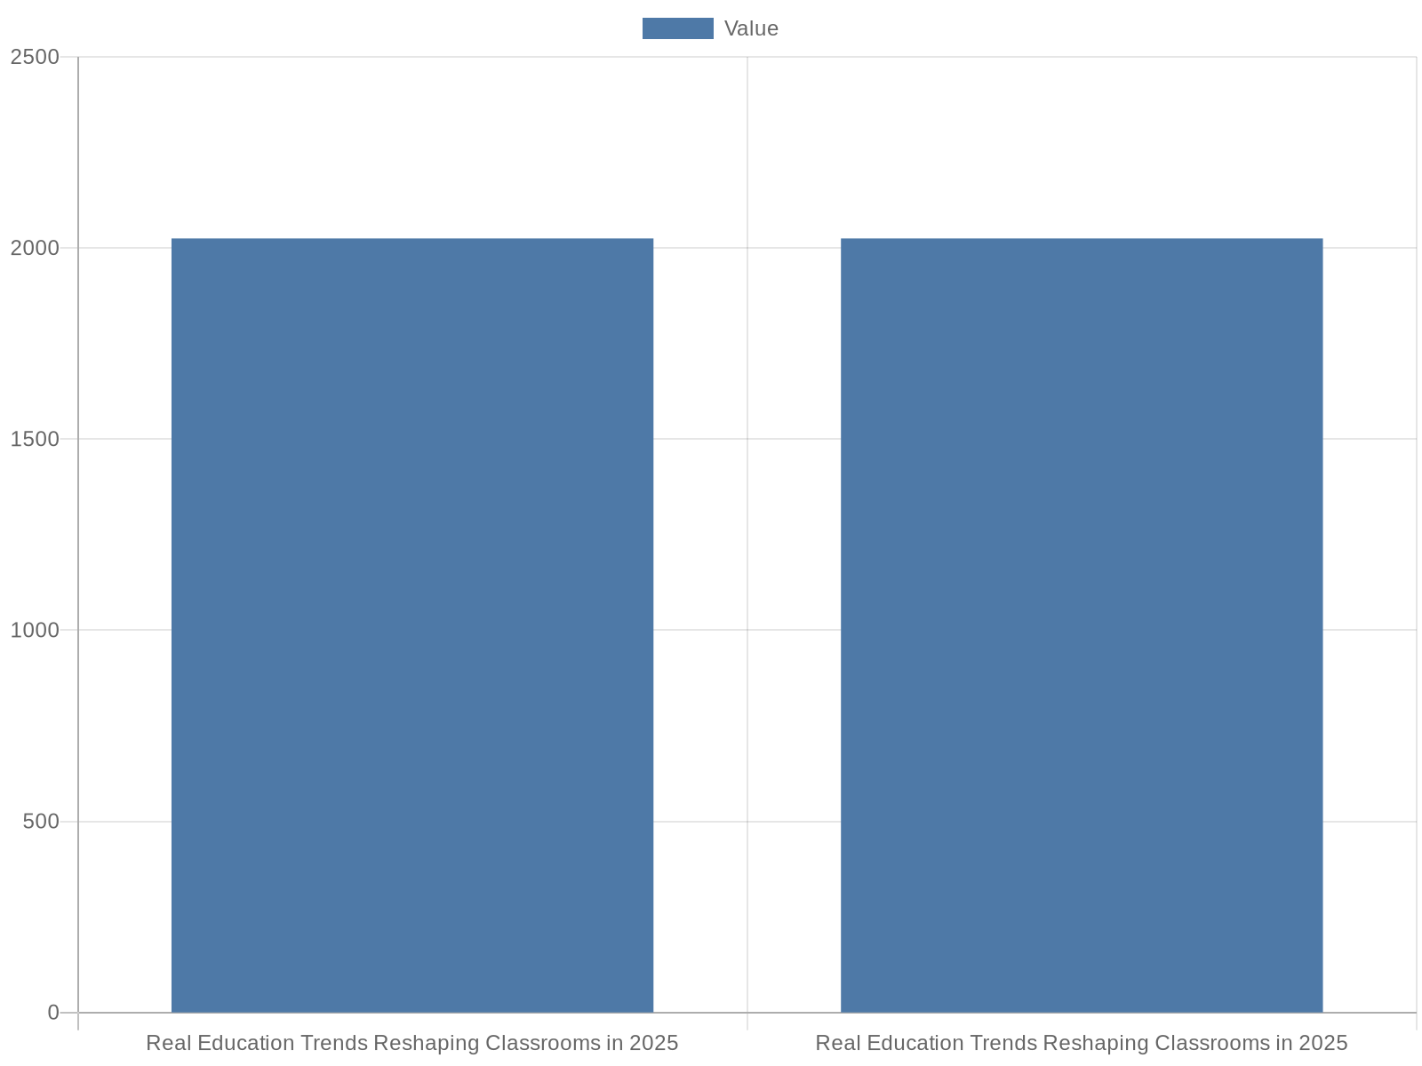
AI in Instruction: Adoption vs. Impact
Real Education Trends Reshaping Classrooms in 2025 2025 Education Trends That Actually Matter By Kelly Denzler Dec 17, 2024 12:00:00 AM They’ll tell you about …
Separate metrics: adoption rates and impact measures
Target data: % classrooms with AI, growth by tool category
Impact metrics: change in mastery, time-to-feedback, teacher hours
Recommended visuals: multi-series line and pre/post bar charts
Notes:
Real Education Trends Reshaping Classrooms in 2025 2025 Education Trends That Actually Matter By Kelly Denzler Dec 17, 2024 12:00:00 AM They’ll tell you about AI. We tell you so much more. The Carnegie Learning framing is essential here: AI is no longer a speculative item but an operational tool in many classrooms. Use that statement as the starting point for two separate data tracks: adoption (how many schools/teachers use AI tools, and which categories — content generation, formative assessment, intelligent tutoring) and impact (measurable changes in student mastery, time-to-feedback, grading time, or differentiated instruction reach). Because the research context asserts AI is already mainstream, this slide recommends locating numerical benchmarks such as percent-of-classrooms with at least one AI tool, annual growth in AI tool installations, and relative time savings for teachers measured in hours/week. I emphasize sources to query: district edtech inventories, vendor dashboards (anonymized aggregate adoption), and national surveys (for example instead of fabricating numbers, query NCES survey results and vendor reports). For visualizing these two tracks I recommend two complementary charts: a multi-series line chart showing year-over-year AI adoption by tool category, and a bar chart comparing teacher time-on-task before/after AI adoption. These visual recommendations are grounded in the Carnegie Learning insight that AI is a current reality and must be evaluated for practical classroom outcomes.

Slide 4
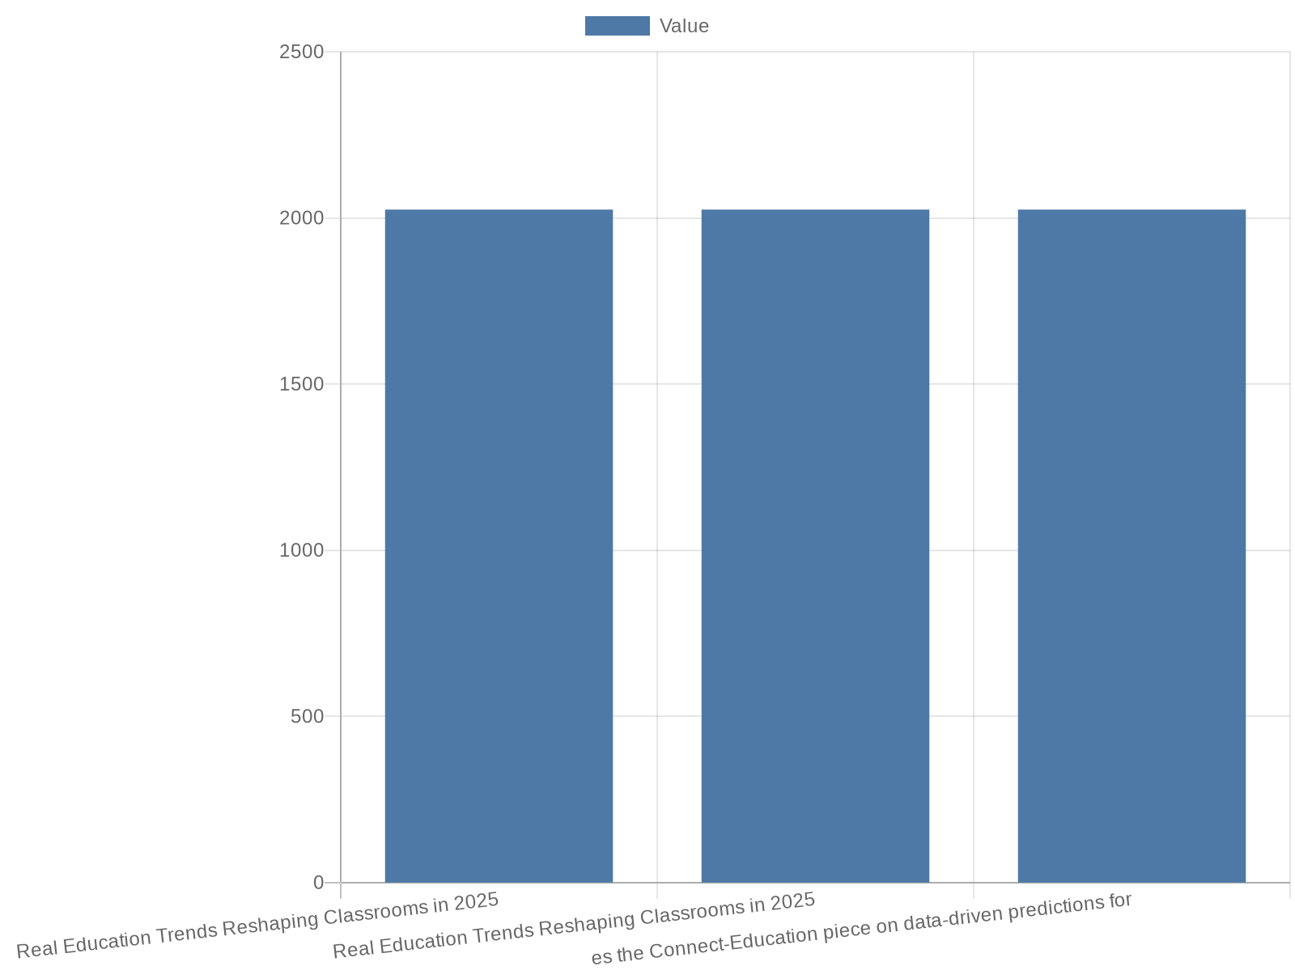
Personalized & Data‑Driven Learning — What to Measure
Real Education Trends Reshaping Classrooms in 2025 2025 Education Trends That Actually Matter By Kelly Denzler Dec 17, 2024 12:00:00 AM They’ll tell you about …
Key metrics: ILP coverage, adaptive lessons per student, mastery gains
Data sources: LMS exports, adaptive platform reports, benchmark tests
Visuals: grouped bar for gains, stacked area for adaptive curriculum share
Goal: quantify personalization's effect on learning outcomes
Notes:
Real Education Trends Reshaping Classrooms in 2025 2025 Education Trends That Actually Matter By Kelly Denzler Dec 17, 2024 12:00:00 AM They’ll tell you about AI. We tell you so much more. Drawing from the Carnegie Learning premise that familiar themes like personalized learning are now embedded realities, this slide defines concrete numerical variables that show whether personalization is working: proportions of students with individualized learning plans, average number of adaptive learning lessons completed per student per term, gains in formative-assessment mastery rates for personalized cohorts versus whole-class instruction, and frequency of teacher interventions triggered by data alerts. The slide also references the Connect-Education piece on data-driven predictions for 2025 to stress the importance of robust analytics pipelines and learning dashboards. I recommend collecting LMS analytics exports, adaptive platform outcome reports, and pre/post benchmark assessment results to support charts. Visualization suggestions include a grouped bar chart comparing learning gains across personalized and traditional cohorts and a stacked area chart showing proportion of curriculum delivered adaptively across the school year. These recommendations are explicitly aligned with the research context's call to treat personalization as operational and measurable, not merely aspirational.

Slide 5
Blended & Hybrid Models: Participation and Engagement Metrics
Real Education Trends Reshaping Classrooms in 2025 2025 Education Trends That Actually Matter By Kelly Denzler Dec 17, 2024 12:00:00 AM They’ll tell you about …
Track: instructional minutes by modality and attendance/log-in rates
Engagement KPIs: session duration, completion of asynchronous modules
Data sources: LMS logs, scheduling systems, attendance records
Visuals: donut for time distribution, line for engagement over time
Notes:
Real Education Trends Reshaping Classrooms in 2025 2025 Education Trends That Actually Matter By Kelly Denzler Dec 17, 2024 12:00:00 AM They’ll tell you about AI. We tell you so much more. The Carnegie Learning narrative positions online and blended learning as normalized modalities. To move from assertion to evidence, this slide lists numerical indicators to capture: percentage of weekly instructional minutes delivered remotely vs in-person, attendance and log-in rates for online components, student completion rates for asynchronous modules, and engagement metrics such as average session duration and active participation rates. I draw additional context from the Prezi and SlideTeam summaries that catalog blended models and templates for delivery, and recommend extracting time-allocation data from school scheduling systems and LMS logs. Suggested visualizations are a donut chart for distribution of instructional minutes (remote vs in-person vs synchronous online) and a line chart following weekly engagement rates across a semester. The slide stresses the research-context point that blended learning is part of the educational reality and therefore merits careful tracking of participation and engagement to evaluate efficacy.

Slide 6
Teacher Workforce: PD, Retention, and Role Evolution
Real Education Trends Reshaping Classrooms in 2025 2025 Education Trends That Actually Matter By Kelly Denzler Dec 17, 2024 12:00:00 AM They’ll tell you about …
Workforce KPIs: PD hours by domain, vacancy and attrition rates
Time-allocation measurement: instruction vs planning vs intervention
Data sources: HR systems, PD LMS, substitute logs
Visuals: clustered bar for PD hours, stacked column for time allocation
Notes:
Real Education Trends Reshaping Classrooms in 2025 2025 Education Trends That Actually Matter By Kelly Denzler Dec 17, 2024 12:00:00 AM They’ll tell you about AI. We tell you so much more. Multiple sources cited in the research context predict not only technological change but also evolving teacher roles, autonomy, and collaboration. As Moreland University's infographic and the Carnegie Learning piece highlight, teacher professional development and support systems are central to implementation success. This slide enumerates numeric indicators to monitor workforce health: average PD hours per teacher per year (with breakdowns by domain: AI, assessment, SEL), teacher vacancy and hard-to-fill subject vacancy rates, annual teacher attrition percentages, and time allocation shifts (instruction vs planning vs intervention). The slide recommends pulling HR records, PD management system exports, and substitute teacher logs. Visualization proposals include a clustered bar chart for PD hours by domain and a stacked column showing time-allocation changes pre/post major initiatives. The narrative emphasizes the research-context claim that teacher autonomy and collaboration must be accompanied by measurable supports and metrics to ensure sustainable change.

Slide 7
Assessment: From Summative to Continuous, Competency-Based Metrics
Real Education Trends Reshaping Classrooms in 2025 2025 Education Trends That Actually Matter By Kelly Denzler Dec 17, 2024 12:00:00 AM They’ll tell you about …
Assessment metrics: formative vs summative share, competency checkpoints
Operational KPIs: feedback latency, item-level mastery rates
Data sources: assessment platforms, item banks, gradebooks
Visuals: stacked bar for assessment mix, scatter for frequency vs gains
Notes:
Real Education Trends Reshaping Classrooms in 2025 2025 Education Trends That Actually Matter By Kelly Denzler Dec 17, 2024 12:00:00 AM They’ll tell you about AI. We tell you so much more. The research context argues that classroom practice is shifting; assessment must follow. This slide defines measurable changes for assessment strategy: percent of graded outcomes that are formative vs summative, number of competency checkpoints per term, average time between assessment and actionable feedback, and item-level mastery rates enabling targeted interventions. The Connect-Education article on data-driven predictions supports this move toward continuous assessment powered by analytics. Practical data sources include assessment platforms, item-banking systems, and teacher gradebooks. I recommend charts such as a stacked bar showing the proportion of formative vs summative assessments over time and a scatter plot of assessment frequency versus average student mastery gains. These metrics translate the research-context position into concrete KPIs that track whether assessment practice is improving instruction and outcomes.

Slide 8
Equity, Accessibility & Student Well‑Being Indicators
Real Education Trends Reshaping Classrooms in 2025 2025 Education Trends That Actually Matter By Kelly Denzler Dec 17, 2024 12:00:00 AM They’ll tell you about …
Equity KPIs: device/student, home broadband %, counselor ratios
Well-being measures: chronic absenteeism and SEL instrument scores
Data sources: IT inventories, student services, state attendance data
Visuals: heatmap for device distribution, grouped bar for subgroup gaps
Notes:
Real Education Trends Reshaping Classrooms in 2025 2025 Education Trends That Actually Matter By Kelly Denzler Dec 17, 2024 12:00:00 AM They’ll tell you about AI. We tell you so much more. The Carnegie Learning framing emphasizes that while technology and new methods are widespread, equitable access and student wellness remain decisive variables. This slide lists measurable equity indicators: device-to-student ratios by school and subgroup, percent of students with home broadband access, counselor-to-student ratios, chronic absenteeism rates disaggregated by subgroup, and standardized measures of student social-emotional learning (SEL) administered via validated instruments. The Connect-Education summary endorses prioritizing mental health and accessibility in data-driven strategies. Suggested charts include a heatmap showing device distribution across districts and a grouped bar chart comparing absenteeism and SEL risk indicators by subgroup. The slide insists that the research-context assertion—trends are here—must be evaluated through an equity lens to ensure innovations do not widen gaps.

Slide 9
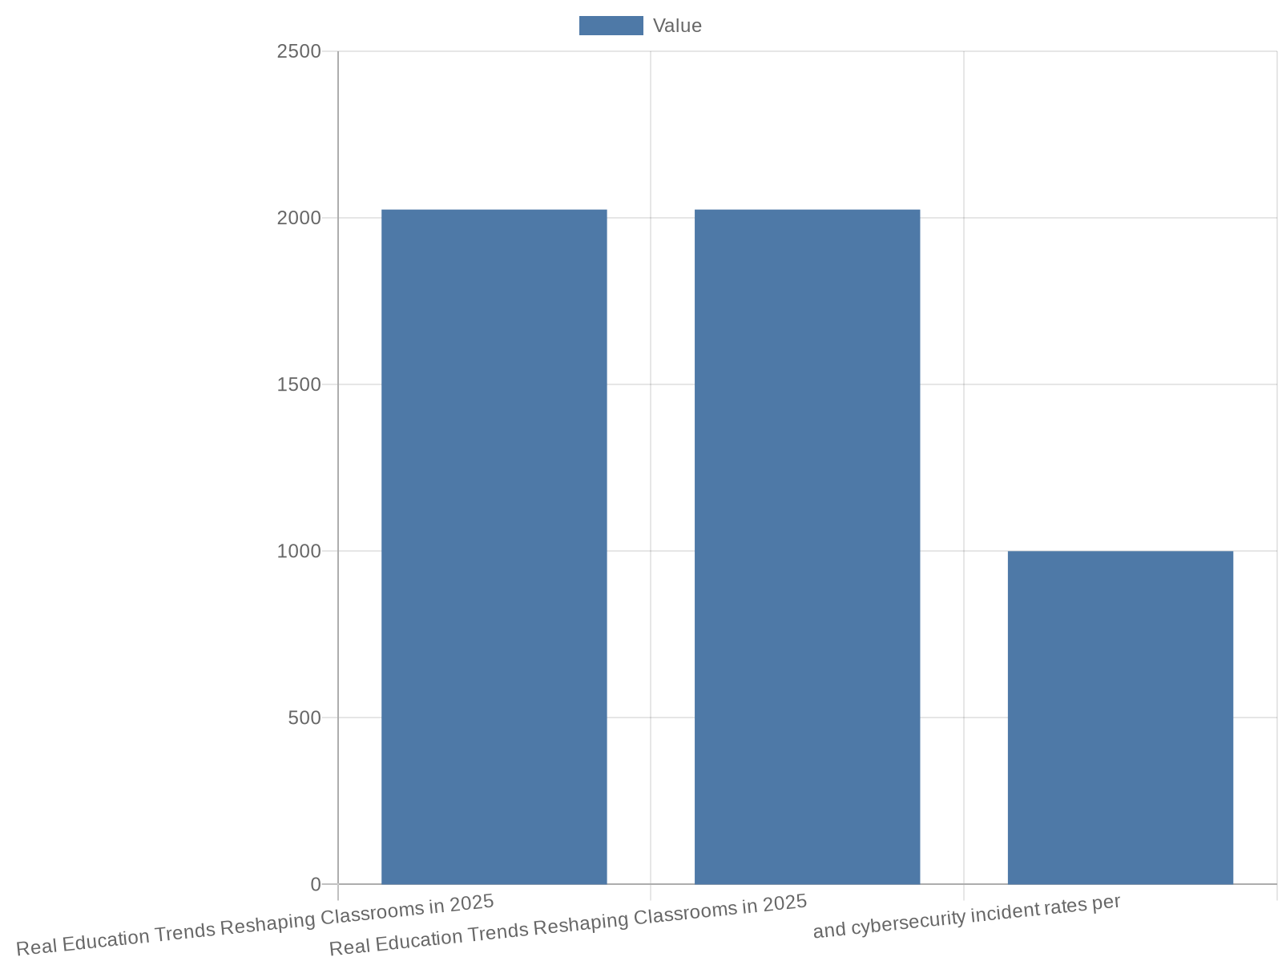
Classroom Tech Stack & Infrastructure Metrics
Real Education Trends Reshaping Classrooms in 2025 2025 Education Trends That Actually Matter By Kelly Denzler Dec 17, 2024 12:00:00 AM They’ll tell you about …
Infrastructure KPIs: bandwidth/student, Wi-Fi-compliant rooms %, device refresh
Operational metrics: LMS uptime, API integrations, incident rates
Data sources: ITAM, network monitoring, vendor SLAs
Visuals: line for bandwidth trend, bar for refresh cycles
Notes:
Real Education Trends Reshaping Classrooms in 2025 2025 Education Trends That Actually Matter By Kelly Denzler Dec 17, 2024 12:00:00 AM They’ll tell you about AI. We tell you so much more. Understanding that AI and blended modalities are part of the landscape, this slide focuses on infrastructure numbers that enable those trends: average bandwidth per student, percentage of classrooms meeting recommended Wi-Fi standards, device lifecycles and refresh rates, LMS uptime and API integration counts, and cybersecurity incident rates per 1000 devices. SlideTeam templates and Prezi trend overviews reinforce the need to present tech stacks clearly alongside pedagogy. Recommended data collectors are IT asset management systems, network monitoring logs, and vendor SLAs. Visualization ideas include a line chart showing bandwidth growth over time and a bar chart for device refresh cycles across schools. This slide ties technical readiness to the research-context claim that trends are operational — if infrastructure lags, outcomes will too.

Slide 10
Workforce Shifts: New Roles and Hiring Metrics
Real Education Trends Reshaping Classrooms in 2025 2025 Education Trends That Actually Matter By Kelly Denzler Dec 17, 2024 12:00:00 AM They’ll tell you about …
Track new roles: headcount, vacancy fill time, contract vs FTE share
Skill demand: PD enrollment by competency (data, AI pedagogy)
Data sources: HRIS, contract logs, PD systems
Visuals: stacked area for role distribution, bar for fill times
Notes:
Real Education Trends Reshaping Classrooms in 2025 2025 Education Trends That Actually Matter By Kelly Denzler Dec 17, 2024 12:00:00 AM They’ll tell you about AI. We tell you so much more. The research context highlights role evolution: paraprofessionals, learning designers, AI teaching assistants, and community tutors are increasingly part of school staffing. To quantify these changes track headcount per role, vacancy fill times, percent contract vs. full-time staff, and hours delivered by non-traditional providers (tutors, contractors). Also monitor skills demand by analyzing PD enrollment by competency (data literacy, AI pedagogy). Data sources include HRIS exports, contract logs, and PD registration systems. Visuals could be a stacked area chart showing role distribution over multiple years and a bar chart for fill times by role. This slide translates the Carnegie Learning observation about classroom realities into concrete labor-market metrics that districts can track to manage capacity and cost.

Slide 11
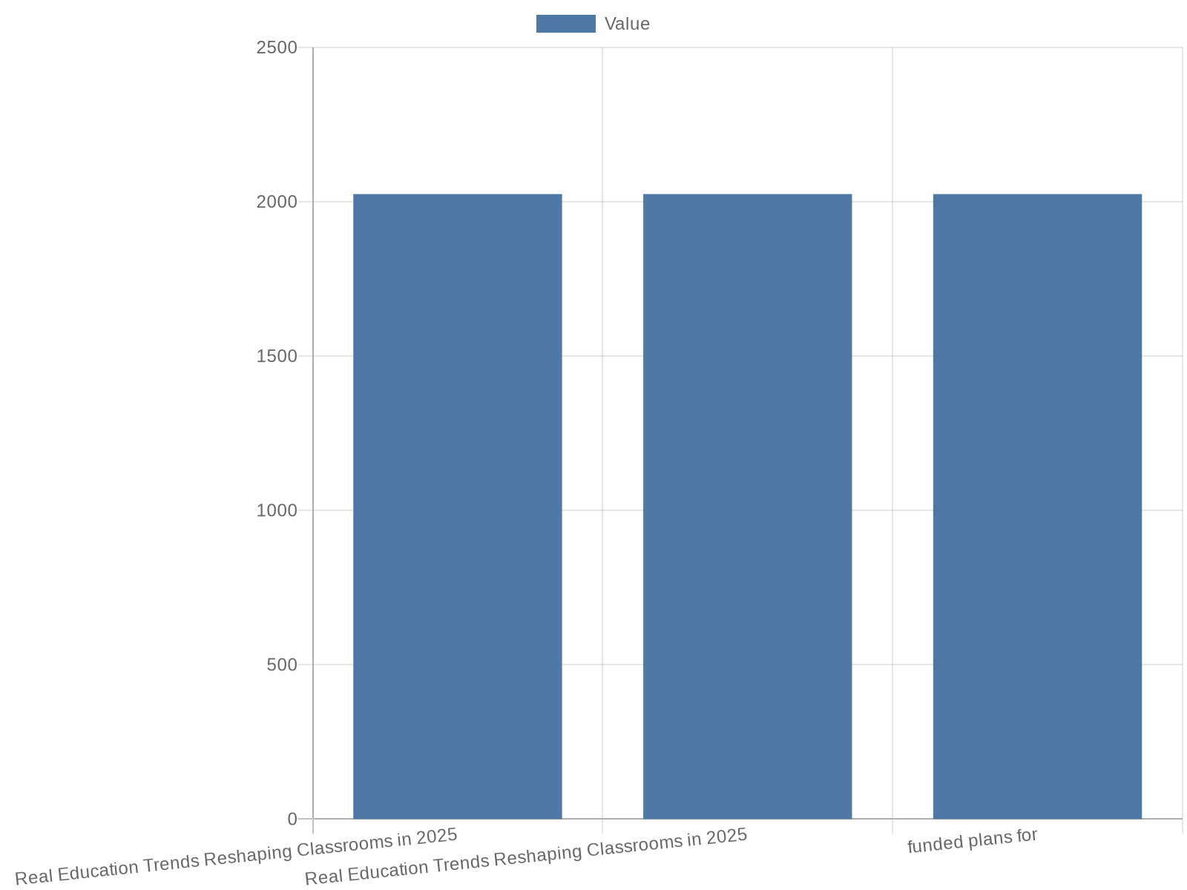
Policy, Funding & Procurement Metrics
Real Education Trends Reshaping Classrooms in 2025 2025 Education Trends That Actually Matter By Kelly Denzler Dec 17, 2024 12:00:00 AM They’ll tell you about …
Fiscal KPIs: per-pupil edtech spend, % budget for instructional tech
Procurement: contract count/value, grant funding awarded
Data sources: district budgets, state/federal reports, grant databases
Visuals: time-series per-pupil spend, doughnut for funding sources
Notes:
Real Education Trends Reshaping Classrooms in 2025 2025 Education Trends That Actually Matter By Kelly Denzler Dec 17, 2024 12:00:00 AM They’ll tell you about AI. We tell you so much more. Policy and funding determine which trends scale. This slide lists measurable fiscal and procurement indicators: per-pupil edtech spend (annual, capital vs operating), percentage of district budget allocated to instructional technology, number and value of edtech contracts, and grant funding awarded for innovation pilots. I draw on the broader research context that recognizes policy effects on classroom practice and recommend triangulating district budget documents, state grant awards, and federal funding reports. Visualizations include a time-series of per-pupil edtech spend and a doughnut chart breaking funding sources (local, state, federal, private grants). Emphasize that tracking these policy metrics is what converts trend awareness (as in the Carnegie Learning article) into feasible, funded plans for 2025.

Slide 12
Designing Effective Charts: Practical Guidelines
Real Education Trends Reshaping Classrooms in 2025 2025 Education Trends That Actually Matter By Kelly Denzler Dec 17, 2024 12:00:00 AM They’ll tell you about …
Show denominators and disaggregate by subgroup to surface gaps
Use multi-series lines for adoption, clustered bars for impact comparison
Include confidence ranges and accessible color palettes
Primary data sources: NCES, state dashboards, OECD, vendor reports
Notes:
Real Education Trends Reshaping Classrooms in 2025 2025 Education Trends That Actually Matter By Kelly Denzler Dec 17, 2024 12:00:00 AM They’ll tell you about AI. We tell you so much more. Given the research-context emphasis that these trends are already present, this slide provides specific charting guidance to prevent common misinterpretations: always show denominators (e.g., % of schools, not just counts), use disaggregation (by subgroup, school type, or grade) to reveal equity gaps, prefer multi-series lines for adoption trends and clustered bars for comparison of impacts, and include error bars or confidence ranges where sample sizes are small. I recommend color palettes that are accessible to color-blind viewers, axis labels with units and time ranges, and callouts for effect sizes (not only p-values). Sources for clean data: NCES, state education dashboards, UNESCO, OECD, vendor aggregated reports, and district data warehouses. The slide ties these charting principles to the Carnegie Learning argument: since these trends are not hypothetical, high-quality evidence visualization is required to inform decisions rather than hype.

Slide 13
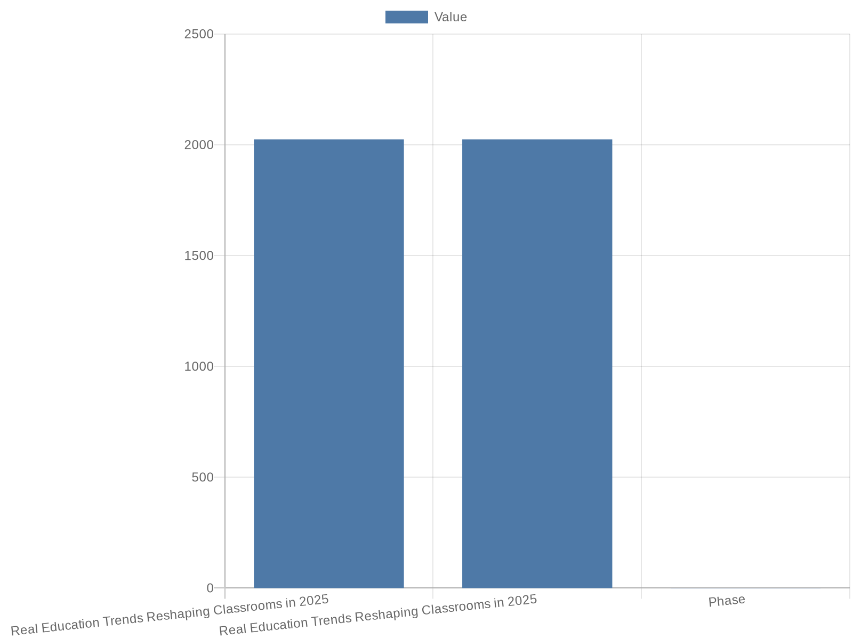
Recommended Data Sources & Collection Plan
Real Education Trends Reshaping Classrooms in 2025 2025 Education Trends That Actually Matter By Kelly Denzler Dec 17, 2024 12:00:00 AM They’ll tell you about …
National: NCES, OECD, UNESCO for benchmarks and comparators
Market/practitioner: vendor reports, ISTE/EdWeek surveys, state dashboards
Local: HRIS, LMS, ITAM, PD registries for operational metrics
Phased plan: baseline, district extraction, two-month pilot validation
Notes:
Real Education Trends Reshaping Classrooms in 2025 2025 Education Trends That Actually Matter By Kelly Denzler Dec 17, 2024 12:00:00 AM They’ll tell you about AI. We tell you so much more. This slide furnishes a prioritized list of authoritative sources to obtain the numeric data recommended earlier. National and international datasets: NCES (U.S. Common Core of Data and surveys), OECD Education at a Glance for international comparisons, and UNESCO Institute for Statistics for connectivity and enrollment benchmarks. Practitioner and market datasets: vendor aggregate reports (anonymized adoption numbers), ISTE and EdWeek survey results, and state education department dashboards for attendance, assessment, and staffing. Local operational sources: district HRIS, LMS and assessment platforms, IT asset management, and PD registries. The slide also recommends a phased collection plan: Phase 1 — obtain national benchmarks and vendor summaries for baseline context; Phase 2 — extract district-level operational data for comparative charts; Phase 3 — run a two-month pilot to validate dashboard metrics and refine collection. This plan is consistent with the research-context emphasis on moving from trend recognition to measurable evaluation and continuous improvement.

Slide 14
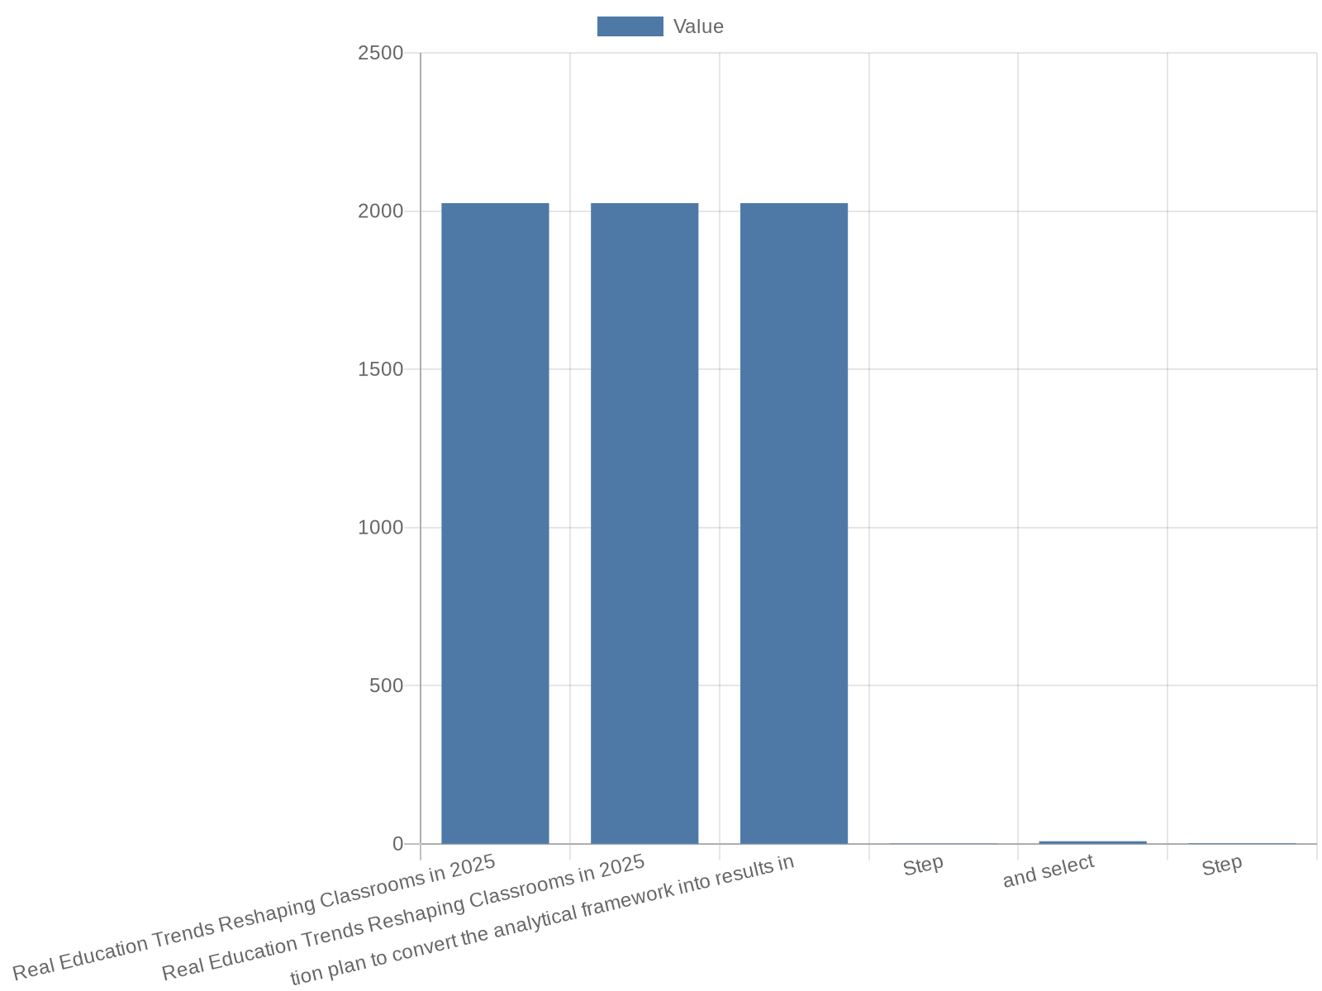
Action Plan: Pilot Metrics, Dashboard & Governance
Real Education Trends Reshaping Classrooms in 2025 2025 Education Trends That Actually Matter By Kelly Denzler Dec 17, 2024 12:00:00 AM They’ll tell you about …
Pilot steps: scope, KPI selection, dashboard prototype, 12-week run
Data governance: privacy rules, data steward, evaluation lead
Scale criteria: demonstrable outcome improvements and cost-effectiveness
Common pitfalls: poor denominators, lack of disaggregation, no governance
Notes:
Real Education Trends Reshaping Classrooms in 2025 2025 Education Trends That Actually Matter By Kelly Denzler Dec 17, 2024 12:00:00 AM They’ll tell you about AI. We tell you so much more. Closing the presentation, this slide lays out a practical action plan to convert the analytical framework into results in 2025. Step 1: Define the pilot scope (grade bands, subject areas, and pilot schools) and select 8–12 measurable KPIs from earlier slides (e.g., AI adoption %, teacher time saved hours/week, mastery gains for personalized cohorts, device/student ratio, counselor ratio). Step 2: Build a lightweight dashboard prototype that consumes LMS logs, assessment exports, and HRIS extracts with automated weekly refresh; ensure privacy and data governance rules are enforced. Step 3: Run the pilot for 12 weeks, collect baseline and midline numbers, and iterate visuals to surface decision-relevant signals. Step 4: Scale what demonstrably improves outcomes, and embed continuous monitoring. The action plan explicitly references the Carnegie Learning assertion that trends are realities; therefore the organization must move rapidly from awareness to evidence-driven pilots and funded scale. The slide finishes with suggested governance roles (data steward, evaluation lead, instructional coach), success criteria for scaling, and a short list of common pitfalls to avoid.

Slide 15
References
https://www.carnegielearning.com/blog/education-trends-for-2025
https://www.slideteam.net/top-10-future-trends-in-education-powerpoint-presentation-templates
https://teach.moreland.edu/ed-predictions-2025-infographic
https://www.connect-education.com/post/the-future-of-education-data-driven-predictions-for-2025
https://prezi.com/p/vvsdzgvece7j/education-2025-key-trends-shaping-the-future-of-teaching-and-learning/
https://edthings.com/blog/top-teaching-tr
https://edthings.com/blog/top-teaching-trends-to-watch-in-2025/
https://www.eduettu.com/post/what-s-next-trends-in-education-teachers-should-watch-in-2025
https://learn.aippt.com/how-to-present-data-trends-using-powerpoint-graphs/
https://ahaslides.com/blog/10-methods-of-data-presentation/
https://www.slideteam.net/top-10-data-trends-powerpoint-presentation-templates

