Slide 1
Teaching in 2025: Trends, Evidence, and Practical Guidance
Generated by AgentFire AI

Slide 2

Executive Summary: The 2025 Teaching Landscape
Key Data-Driven Predictions and Trends," ensuring that policy-level observations and classroom implications are grounded in published research. The slide also …
Data and AI now core to instructional decision-making
Student wellbeing and equity rising as measurable priorities
Teacher roles expanding toward facilitation and data coaching
Infrastructure and professional development require urgent alignment
Notes:
Key Data-Driven Predictions and Trends," ensuring that policy-level observations and classroom implications are grounded in published research. The slide also flags that many trends once labeled as 'predictions' are now operational realities, echoing analysis from Carnegie Learning and education thought leadership that emphasize implementation over speculation.

Slide 3
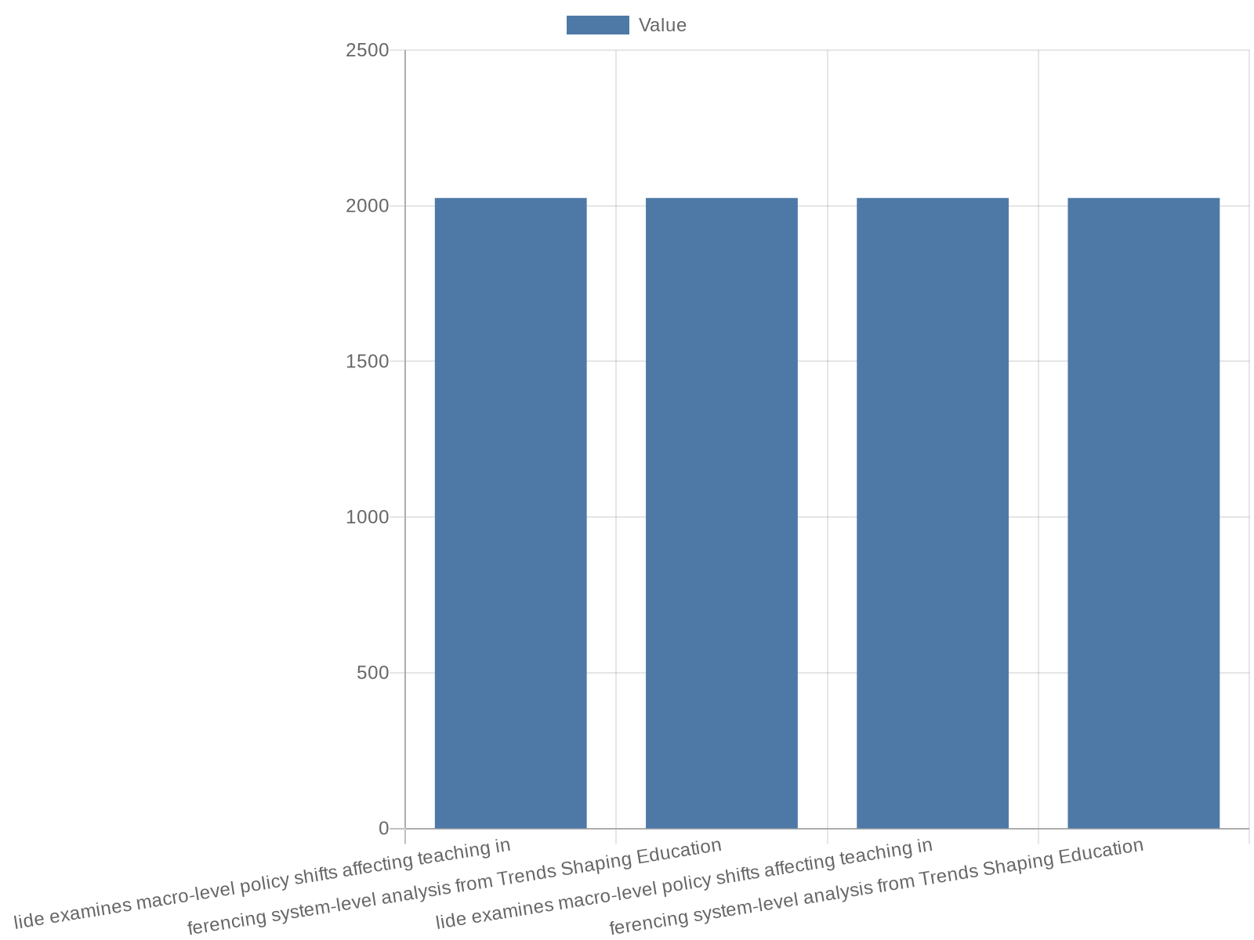
Policy & System Shifts Affecting Teaching
This slide examines macro-level policy shifts affecting teaching in 2025, referencing system-level analysis from Trends Shaping Education 2025 - OECD and cross…
Demographic and funding patterns shape teacher supply and demand
Policy pushes for digital transformation and skills frameworks
Licensure and professional standards are being updated
Local implementation needs to align with national strategy
Notes:
This slide examines macro-level policy shifts affecting teaching in 2025, referencing system-level analysis from Trends Shaping Education 2025 - OECD and cross-sector forecasts. OECD's analysis describes demographic shifts, budgetary constraints, and evolving qualification frameworks that influence classroom practice, while sector reports highlight decentralization and localized accountability mechanisms as drivers of change. The narrative connects how national strategies for digital transformation and skills-based curricula are reshaping teacher standards, certification expectations, and performance metrics. It explains the consequences for hiring, licensure renewal, and funding flows, and outlines how policy choices cascade into school-level priorities such as investment in learning analytics platforms and targeted professional learning. This slide prepares leaders to align local initiatives with national policy trajectories, using the OECD report and industry trend summaries as the basis for recommended strategic alignment.

Slide 4
Data-Driven Decision Making: Learning Analytics and Insights
Key Data-Driven Predictions and Trends," the slide describes how schools are deploying learning analytics to personalize instruction, identify early warning si…
Learning analytics for personalization and early intervention
Interoperability and data governance are essential
Teacher dashboards must be action-focused, not just descriptive
Address privacy, equity, and data literacy challenges
Notes:
Key Data-Driven Predictions and Trends," the slide describes how schools are deploying learning analytics to personalize instruction, identify early warning signs, and evaluate program impact. It synthesizes practical lessons from NU's '65 Teaching and Education Statistics for 2025' about which metrics schools monitor and what data maturity looks like across districts. The narrative explains necessary architecture: interoperable SIS/LMS systems, clear data governance, and teacher-facing dashboards designed for action. It also highlights common pitfalls—over-reliance on summative scores, insufficient teacher training in interpretation, and privacy risk management—and outlines governance and PD responses to ensure ethical, effective use of learner data.

Slide 5

AI in the Classroom: Opportunities and Guardrails
while AI can accelerate personalization and reduce teacher administrative load, it also raises questions about bias, transparency, and the integrity of assessm…
AI enables adaptive tutoring and assessment automation
Evaluation rubrics must assess pedagogy, bias, and privacy
Teachers need PD for AI-augmented instruction design
Pilot programs with clear KPIs reduce implementation risk
Notes:
while AI can accelerate personalization and reduce teacher administrative load, it also raises questions about bias, transparency, and the integrity of assessment. Building on commentary from "The Future of Education: Data-Driven Predictions for 2025," the slide recommends governance frameworks, vendor evaluation rubrics, and teacher training pathways that prioritize pedagogical alignment and ethical use. It emphasizes that AI should augment, not replace, the relational and pedagogical expertise of teachers and that careful piloting with measurable KPIs is a prudent strategy.

Slide 6

Personalized & Competency-Based Learning Models
alignment to standards, scalable formative assessment, teacher scaffolds for differentiating instruction, and pathways for credential portability. The emphasis…
Mastery-based progression replaces seat-time in many pilots
Modular credentials and micro-credentials gain traction
Formative assessment anchors personalization at scale
Systems must ensure equitable access and consistent standards
Notes:
alignment to standards, scalable formative assessment, teacher scaffolds for differentiating instruction, and pathways for credential portability. The emphasis is on designing systems that enable learners to progress based on demonstrated mastery while maintaining equity safeguards.

Slide 7
Teacher Professional Development & New Role Definitions
job-embedded coaching, micro-credential stacks, collaborative professional learning communities, and vendor-partnered pilots with iterative evaluation. It also…
Teachers as facilitators, data coaches, and blended designers
PD moves toward job-embedded coaching and micro-credentials
Career pathways link new competencies to progression and pay
Retention strategies must address workload and wellbeing
Notes:
job-embedded coaching, micro-credential stacks, collaborative professional learning communities, and vendor-partnered pilots with iterative evaluation. It also addresses teacher wellbeing and retention strategies, linking compensation and career pathways to digital and pedagogical competencies highlighted in multi-source trend literature.

Slide 8

Assessment Innovation and Credentialing Trends
new evidence standards, equivalency frameworks, and methods for validating AI-assisted assessments. The narrative cites sector analyses indicating that assessm…
Formative and portfolio assessments gain institutional credibility
Micro-credentials and digital badges support lifelong pathways
Validation and transparency are essential for new assessment modes
Accreditation must adapt to modular and competency-based records
Notes:
new evidence standards, equivalency frameworks, and methods for validating AI-assisted assessments. The narrative cites sector analyses indicating that assessment innovations must be accompanied by robust validity studies and transparency measures to maintain public trust and portability of credentials.

Slide 9
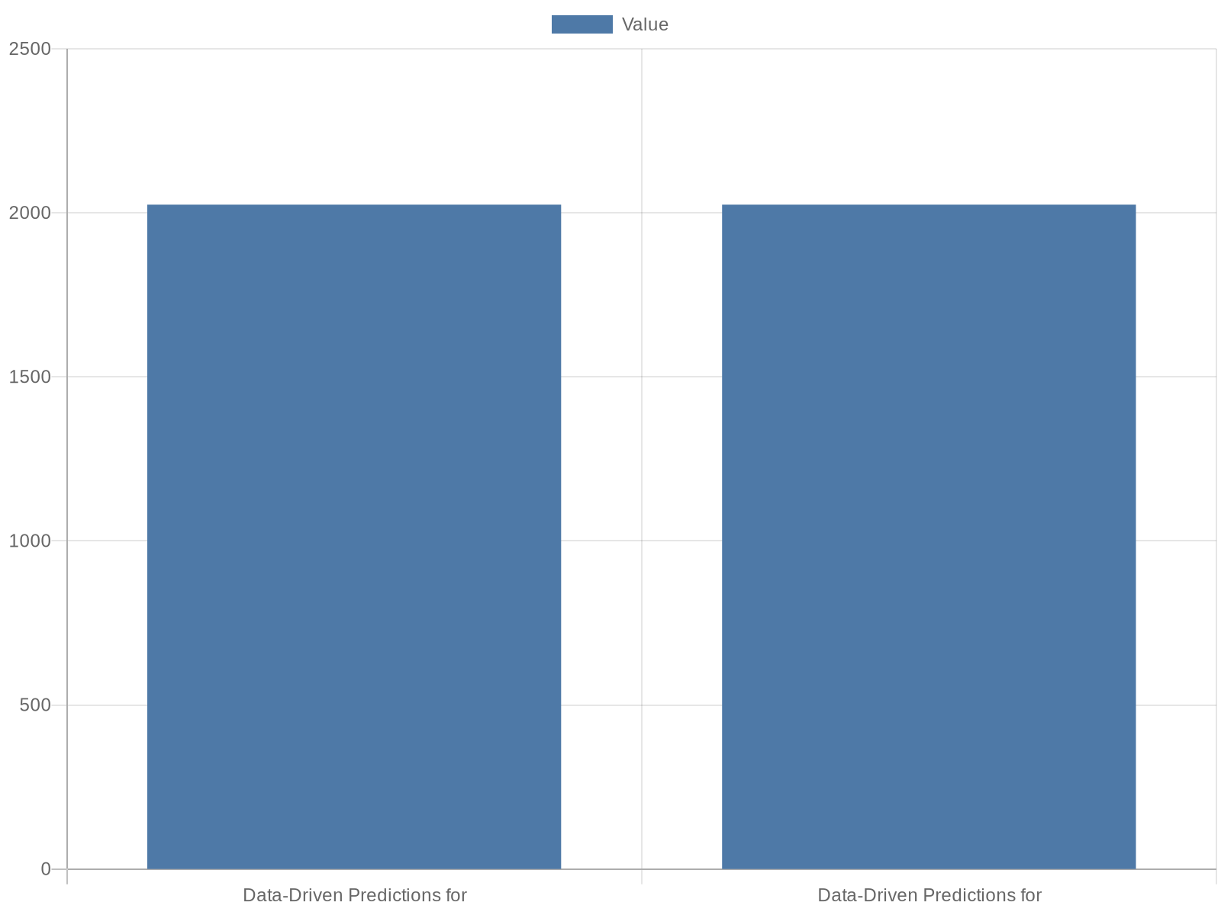
Wellbeing, Inclusion, and Equity Priorities
Data-Driven Predictions for 2025" as well as practitioner commentary from Carnegie Learning and EduEttu's trend summaries. The research context emphasizes that…
Mental health supports integrated into school service models
Data used to identify disparities and drive resource allocation
Culturally responsive practices and MTSS anchor inclusivity
Measure wellbeing alongside academic outcomes
Notes:
Data-Driven Predictions for 2025" as well as practitioner commentary from Carnegie Learning and EduEttu's trend summaries. The research context emphasizes that academic outcomes are intertwined with social-emotional supports; schools are implementing layered systems of support, integrating mental health resources, and using data to identify and respond to disparities. The slide outlines program models—multi-tiered systems of support (MTSS), trauma-informed pedagogy, and culturally responsive practices—while stressing measurement: attendance, engagement, wellbeing indices, and disaggregated outcome reporting. It recommends aligning resource allocation and staffing models to address inequities revealed by data.

Slide 10

Technology Infrastructure: Connectivity, Devices, and Cost Models
consortium purchasing, performance-based contracts, and open standards to reduce lock-in. It also addresses digital equity: subsidized device programs, offline…
Broadband and device equity are preconditions for innovation
Plan for total cost of ownership beyond initial procurement
Open standards and interoperable systems reduce vendor lock-in
Targeted investments needed for high-need communities
Notes:
consortium purchasing, performance-based contracts, and open standards to reduce lock-in. It also addresses digital equity: subsidized device programs, offline-capable platforms, and targeted investments for high-need sites with reference to the systemic evidence presented in the OECD report and supporting industry analyses.

Slide 11

Classroom & Learning Design: Hybrid and Flexible Models
flexibility, clear transitions between modes, teacher workflow alignment, and evidence-based scheduling (e.g., dedicated diagnostics and small-group interventi…
Hybrid models combine synchronous teaching with asynchronous tasks
Flexible spaces support collaboration and small-group interventions
Schedule redesigns for diagnostics and personalized instruction
Teacher co-design prevents superficial or ineffective changes
Notes:
flexibility, clear transitions between modes, teacher workflow alignment, and evidence-based scheduling (e.g., dedicated diagnostics and small-group intervention blocks). It also addresses practical change management: pilot spaces, phased rollouts, and teacher co-design to ensure pedagogical coherence and avoid superficial tech-driven redesigns.

Slide 12

Implementation Roadmap: From Pilot to Scale (2025–2027)
define strategic goals aligned with national and district policy; select pilot sites with clear evaluation metrics; invest in teacher professional learning and…
Define strategic goals aligned to policy and measurable KPIs
Pilot with rigorous evaluation and rapid iteration cycles
Invest in PD and infrastructure before wide rollout
Scale with supports for fidelity, equity, and governance
Notes:
define strategic goals aligned with national and district policy; select pilot sites with clear evaluation metrics; invest in teacher professional learning and data infrastructure; iterate using short-cycle evaluation and scale successful models with fidelity supports. The roadmap emphasizes governance (steering groups, data privacy officers), financial planning (TCO, grant alignment), and stakeholder engagement (families, unions, and community partners) to mitigate resistance. The slide recommends embedding rigorous evaluation at every stage to ensure that scaling preserves student outcomes and equity impacts.

Slide 13
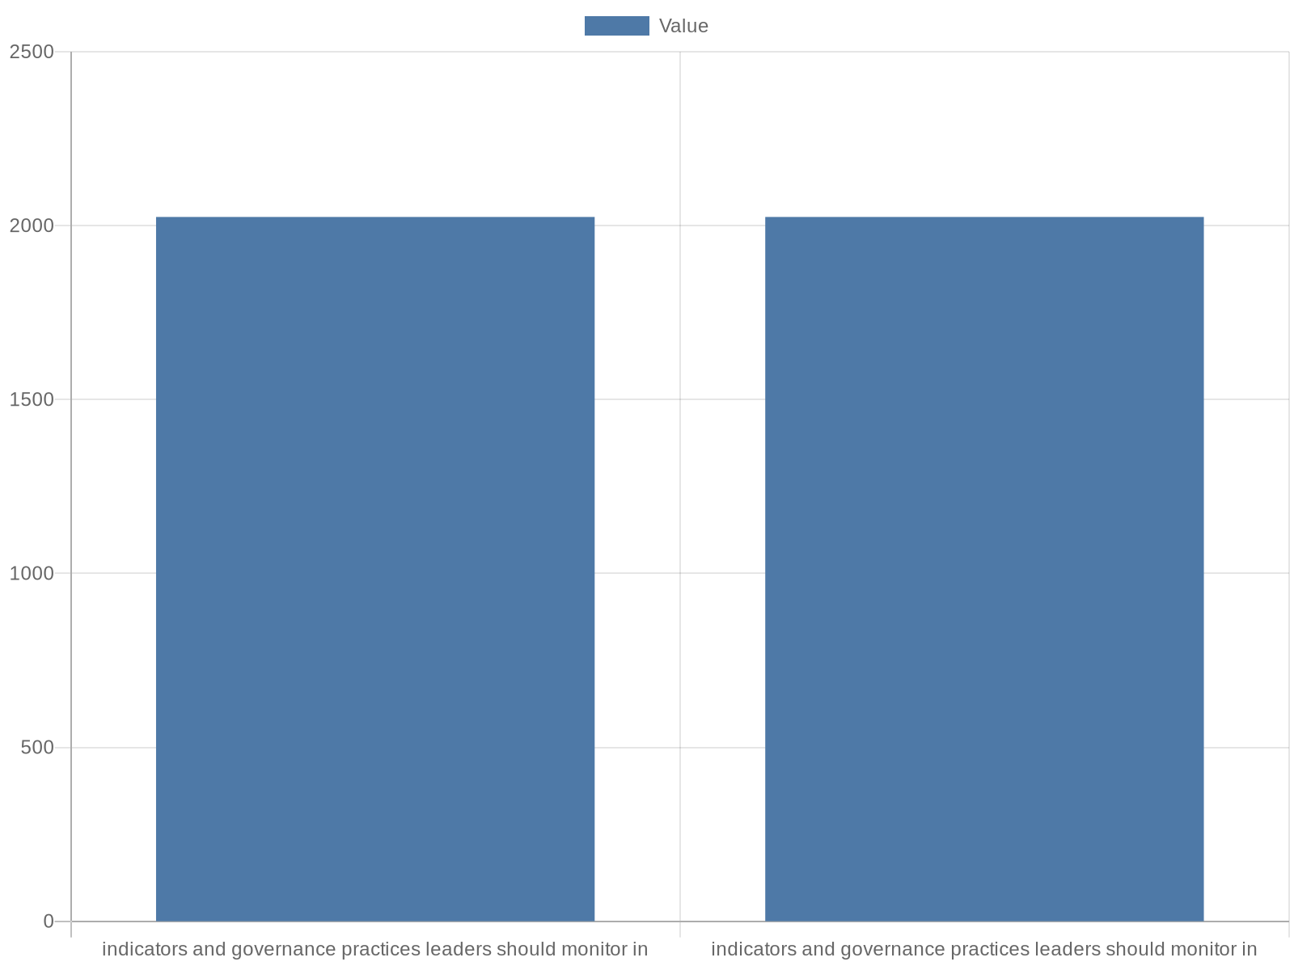
Key Indicators to Monitor and Governance Recommendations
This slide lists the most actionable indicators and governance practices leaders should monitor in 2025, synthesizing recommendations from the OECD report, NU …
Monitor disaggregated learning growth and wellbeing indices
Track early warning indicators and technology utilization
Establish data stewardship and ethical AI procurement criteria
Use quarterly reviews for operational metrics and annual strategy checks
Notes:
This slide lists the most actionable indicators and governance practices leaders should monitor in 2025, synthesizing recommendations from the OECD report, NU statistics, and sector foresight pieces. Recommended indicators include learning growth measures disaggregated by subgroup, wellbeing indices, early warning indicators (attendance, engagement), technology utilization and uptime, and teacher professional learning hours tied to outcomes. Governance recommendations include establishing data stewardship roles, clear vendor procurement criteria emphasizing interoperability and ethical AI, and stakeholder advisory bodies that include students and families. The slide advises frequent review cycles—quarterly for operational metrics, annual for strategy—so that leaders can adapt investments and policies responsively to evidenced results.

Slide 14
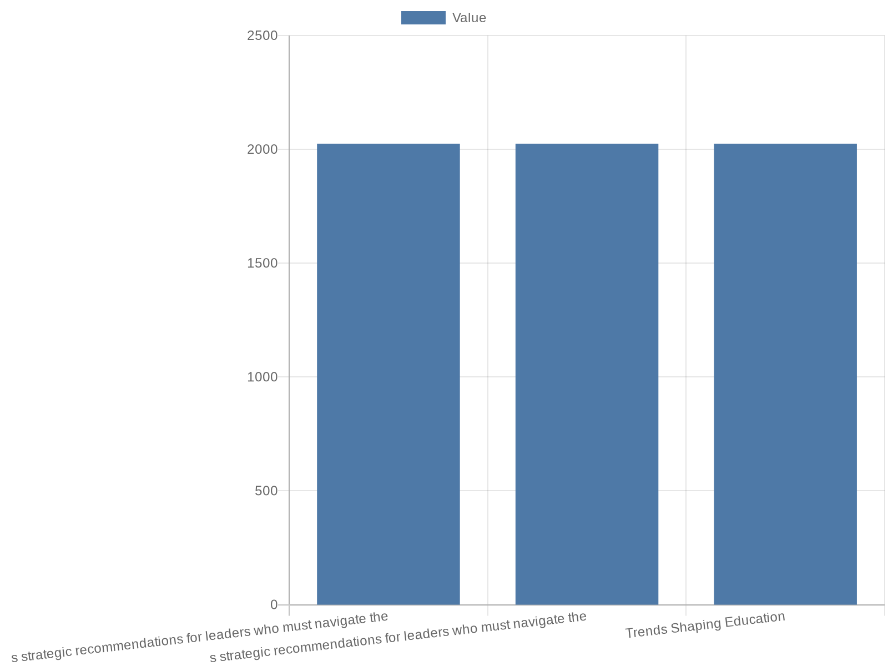
Conclusions & Strategic Recommendations for Leaders
The final slide synthesizes strategic recommendations for leaders who must navigate the 2025 teaching landscape. Drawing on the OECD 'Trends Shaping Education …
Prioritize teacher capacity and robust data infrastructure
Pilot innovations with rigorous evaluation before scaling
Align procurement and PD with equity and governance goals
Adopt iterative, evidence-based reform anchored in student outcomes
Notes:
The final slide synthesizes strategic recommendations for leaders who must navigate the 2025 teaching landscape. Drawing on the OECD 'Trends Shaping Education 2025' analysis and supporting industry forecasts, it recommends prioritizing investments that enhance teacher capacity and data infrastructure, adopting measured pilots for AI and personalized learning, and aligning policy, procurement, and professional development with equity goals. It underscores that meaningful change requires coupling technological adoption with human-centered design: time for collaboration, sustained PD, and governance structures that safeguard learners. The slide closes with a call to action: adopt an evidence-based, iterative approach to reform that uses the research context to guide decisions while maintaining a relentless focus on equitable student outcomes.

Slide 15
References
https://www.oecd.org/en/publications/trends-shaping-education-2025_ee6587fd-en.html
https://www.connect-education.com/post/the-future-of-education-data-driven-predictions-for-2025
https://www.nu.edu/blog/education-statistics/
https://teach.moreland.edu/ed-predictions-2025-infographic
https://www.carnegielearning.com/blog/education-trends-for-2025
https://www.eduettu.com/post/what-to-watch-in-education-10-trends-shaping-2025
https://www.slideteam.net/top-10-education-statistic-powerpoint-presentation-templates
https://www.slideteam.net/top-10-future-trends-in-education-powerpoint-presentation-templates
https://prezi.com/p/vvsdzgvece7j/education-2025-key-trends-shaping-the-future-of-teaching-and-learning/
https://edthings.com/blog/top-teaching-trends-to-watch-in-2025/

