Slide 1
Teaching in 2025: Trends, Metrics, and Implementation Roadmap
Generated by AgentFire AI

Slide 2

Cover & Objectives
This presentation synthesizes recent sector analyses to help school leaders, instructional designers, and teacher teams navigate teaching in 2025. It frames th…
Purpose: align leadership on 2025 teaching priorities and KPIs
Sources: cross-industry analyses and practitioner summaries
Approach: evidence-led, measurement-first, ethically framed
Notes:
This presentation synthesizes recent sector analyses to help school leaders, instructional designers, and teacher teams navigate teaching in 2025. It frames the strongest, evidence-backed trends, translates them into measurable indicators, and offers an actionable implementation roadmap. The research context used for this briefing comes from multiple practitioner and analyst sources: Carnegie Learning’s "Real Education Trends Reshaping Classrooms in 2025," Moreland University’s "What Teaching Experts Predict 2025" infographic, Connect Education’s data-driven predictions, and analysis from Forbes and other aggregators. Across the material we prioritize practical metrics, ethical AI application, teacher workload, and student well-being. We will not invent or assert numeric values that are not present in the cited sources; instead, we identify which numeric indicators organizations should gather, how to track them, and how to visualize trends for decision-making. This objective slide clarifies scope: (1) identify the dominant 2025 trends, (2) select KPIs to monitor adoption and impact, (3) structure a 12-month measurement plan, and (4) recommend governance and training to scale benefits while managing risk.

Slide 3

Executive Summary: What 2025 Means for Classrooms
By 2025 teachers are operating in learning environments that normalize technologies and practices once labeled as ‘innovations.’ The research context makes it …
AI and analytics are integrated across instruction and assessment
Teacher autonomy and collaboration are rising priorities
Student well-being and lifelong skills sit alongside content goals
Notes:
By 2025 teachers are operating in learning environments that normalize technologies and practices once labeled as ‘innovations.’ The research context makes it clear that AI, online and hybrid learning, personalized instruction, and well-being supports are no longer speculative—they are embedded in practice. Carnegie Learning’s Real Education Trends Reshaping Classrooms in 2025 frames AI not as a single disruption but as an accelerator across assessment, content creation, and formative feedback. Moreland University’s infographic synthesizes practitioner expectations around increased teacher autonomy, collaboration, and hybrid models. Connect Education’s data-driven predictions emphasize analytics and evidence-based decision-making, while Forbes frames human-centric skills and lifelong learning as central. This slide condenses those perspectives into an operational summary: treat AI as a toolset not a replacement; prioritize teacher professional learning; measure adoption and impact objectively; and balance productivity gains with student socio-emotional supports.

Slide 4

Trend 1 — AI & Intelligent Tools in Daily Teaching
The research context repeatedly identifies AI as an embedded reality in 2025 classrooms. Carnegie Learning’s report explicitly states, 'They’ll tell you about …
AI is an operational reality, not only a prediction
Focus on pedagogical fit, privacy, and measurable outcomes
Track adoption rate and teacher time reallocation
Notes:
The research context repeatedly identifies AI as an embedded reality in 2025 classrooms. Carnegie Learning’s report explicitly states, 'They’ll tell you about AI. We tell you so much more,' emphasizing that AI is widespread but must be operationalized within broader pedagogical shifts. Forbes’ analysis also highlights AI-powered personalized learning as central to 2025. From an implementation perspective this manifests as AI-driven formative assessment, automated feedback loops, adaptive learning pathways, and content generation that reduces teacher administrative load. For decision-makers, the immediate priorities are (1) determine acceptable AI use cases aligned to pedagogy, (2) establish data governance and student privacy controls, and (3) define KPIs to monitor both adoption (e.g., percent of classes using AI tools weekly) and impact (e.g., time saved per teacher, changes in formative assessment cycles). The slide proposes a measurement framework that maps AI functions to observable indicators and monitoring cadence.

Slide 5

Trend 2 — Data-Driven Personalization & Analytics
Connect Education’s piece—Education in 2025: Key Data-Driven Predictions and Trends—centers data as the engine for personalization. The research context recomm…
Data is the lever for scalable personalization
Define core data taxonomies and interoperability requirements
Monitor time-to-intervention and individualized pathway coverage
Notes:
Connect Education’s piece—Education in 2025: Key Data-Driven Predictions and Trends—centers data as the engine for personalization. The research context recommends moving from anecdote to metrics: create data pipelines that capture learning progress, engagement, and intervention effects. Analytics should be used to detect learning gaps, recommend mini-lessons, and prioritize teacher interventions. Moreland University’s infographic reinforces the expectation that teachers will lean on data to inform differentiation and curricular adjustments. Operationalizing this trend requires designing data taxonomies (attendance, formative scores, mastery progression, SEL indicators), ensuring interoperability across platforms, and training staff in data literacy. KPIs to track include percentage of students with individualized learning paths, average time from gap detection to intervention, and teacher-reported confidence in using analytics. These measures allow leaders to assess whether personalization leads to improved mastery and reduced remediation over time.

Slide 6

Trend 3 — Hybrid & Flexible Learning Models
Multiple sources in the research context portray hybrid and flexible models as normalized by 2025. Carnegie Learning notes that phenomena once forecasted—onlin…
Hybrid models are now mainstream and require measurement
Track modality mix: synchronous hours vs asynchronous minutes
Measure equity of access and module completion rates
Notes:
Multiple sources in the research context portray hybrid and flexible models as normalized by 2025. Carnegie Learning notes that phenomena once forecasted—online learning and blended arrangements—are now part of the educational reality. Prezi and Moreland’s materials anticipate teachers navigating a mix of synchronous and asynchronous interactions, with school schedules adapting to new modalities. For operational leaders, the critical task is to quantify modality mix and measure learning continuity: capture hours per student in synchronous instruction, asynchronous engagement minutes, and percentage of curriculum delivered via adaptive platforms. Track attendance patterns across modalities, completion rates for asynchronous modules, and equity indicators (device access, broadband reliability). Measuring these variables will reveal where hybrid models improve access and where they introduce gaps that require targeted support.

Slide 7

Trend 4 — Teacher Autonomy, Collaboration & Workload
The Moreland University infographic and Carnegie Learning commentary both highlight increased teacher autonomy and collaboration as defining features of 2025 c…
Teacher autonomy and collaboration grow in importance
Measure collaborative planning time and workload indicators
Prioritize PD that aligns to classroom technology use
Notes:
The Moreland University infographic and Carnegie Learning commentary both highlight increased teacher autonomy and collaboration as defining features of 2025 classrooms. Experts predict teachers will have greater discretion over pacing, tool choice, and team-based planning. However, this autonomy must be balanced with attention to workload and sustainable practice. The research context emphasizes supporting educators with targeted professional development, co-planning time, and technology that reduces administrative burden rather than adding to it. For measurement, track percent of weekly planning time allocated to collaborative planning, teacher retention and burnout proxies (sick days, survey-based stress indicators), and rate of tool adoption that demonstrably reduces administrative tasks. Monitoring these KPIs helps leaders design supports that preserve instructional quality while expanding teacher agency.

Slide 8

Trend 5 — Student Well-Being & Socio-Emotional Learning
Across the research context, authors emphasize that technological and pedagogical shifts must be accompanied by explicit attention to student well-being. Forbe…
Well-being is central alongside cognitive outcomes
Add SEL competencies and counseling referrals to KPIs
Monitor screen time impacts on engagement and attendance
Notes:
Across the research context, authors emphasize that technological and pedagogical shifts must be accompanied by explicit attention to student well-being. Forbes frames human-centric skills as vital, while Carnegie Learning reminds readers that trends extend beyond AI and technology to include student supports. In practice this means integrating SEL measurement into regular assessment systems: track SEL competency mastery, referrals for counseling, and student-reported well-being metrics. It also means monitoring whether increased screen time correlates with changes in engagement or attendance. Policy leaders should adopt privacy-respecting SEL instruments and embed well-being KPIs into school reports so resource allocations (counselor staffing, SEL curricula, and restorative practices) are evidence-informed. Measuring well-being alongside achievement ensures a balanced view of 2025 classroom outcomes.

Slide 9

Measurement Framework: Core KPIs & Data Sources
Building on the trends identified by Carnegie Learning, Moreland University, Connect Education, and Forbes, this slide provides a structured measurement framew…
Five KPI domains: adoption, impact, engagement, teacher, well-being
Match KPIs to data sources: LMS, SIS, assessments, surveys
Set cadence: weekly ops dashboards, quarterly impact reviews
Notes:
Building on the trends identified by Carnegie Learning, Moreland University, Connect Education, and Forbes, this slide provides a structured measurement framework. Core KPI domains include: Technology Adoption (tool usage frequency, percent of teachers using AI tools weekly), Instructional Impact (mastery rates, formative assessment turnaround time), Engagement (attendance by modality, asynchronous completion rates), Teacher Metrics (collaborative planning minutes, PD completion, retention proxies), and Well-Being (SEL competency progress, counseling referrals). The research context urged data-driven decision-making; therefore, the framework pairs each KPI with recommended sources: LMS logs, SIS records, assessment platforms, teacher surveys, and anonymized SEL instruments. The slide also outlines cadence (weekly dashboards for operational metrics, quarterly deep-dives for impact), data ownership, and minimum data quality checks required before metrics inform policy shifts.

Slide 10

Visualization & Chart Templates (Data-Ready)
While the research context provides strong qualitative and prescriptive guidance, the provided summaries did not supply consistent numeric time-series suitable…
Templates: line chart for adoption, area for modality mix, bar for impact
Provide exact data fields and QA steps before charting
Populate charts locally—do not infer or import unverified numbers
Notes:
While the research context provides strong qualitative and prescriptive guidance, the provided summaries did not supply consistent numeric time-series suitable for pre-populated charts. To honor the instruction not to fabricate numbers, this slide presents visualization templates and clear instructions for populating them with your local data. Recommended chart templates: (1) Line chart showing tool adoption rate over time (x-axis: monthly periods; y-axis: percent of classes using specified tool), (2) Stacked area chart for modality mix (synchronous, asynchronous, in-person) across months, (3) Bar chart comparing average formative assessment turnaround time pre- and post-AI implementation (use paired sample reporting), (4) Scatter plot mapping teacher collaboration minutes versus retention proxies to surface correlation. Each template includes required data fields and quality checks: consistent time intervals, anonymized identifiers, and minimum sample sizes to avoid misleading trends. The research context—especially Connect Education’s call for data-driven predictions—supports building these dashboards locally and using them to guide interventions.

Slide 11

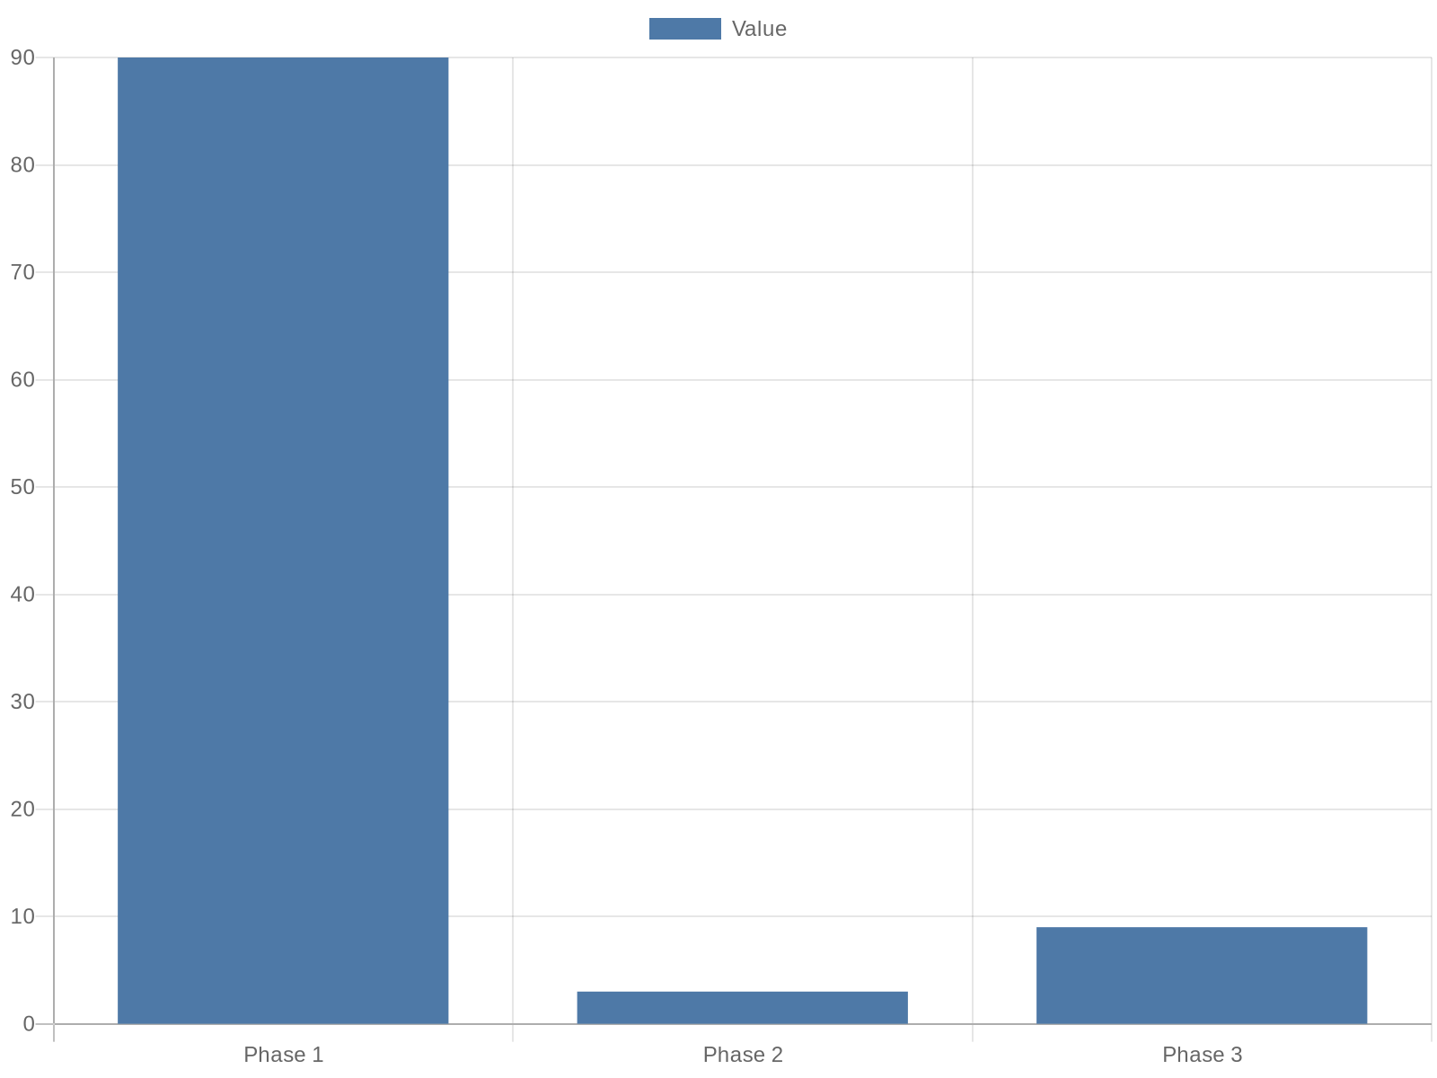
Implementation Roadmap & Governance
Translation of 2025 trends into sustained practice requires a phased implementation plan and clear governance. Drawing on Carnegie Learning’s emphasis on pract…
Phase 1: 90-day diagnostic—inventory tools & baseline surveys
Phase 2: 3–9 month pilots with PD and privacy reviews
Phase 3: 9–18 month scaling with governance and reporting
Notes:
Translation of 2025 trends into sustained practice requires a phased implementation plan and clear governance. Drawing on Carnegie Learning’s emphasis on practical reality and Moreland’s practitioner forecasts, the recommended roadmap begins with a 90-day diagnostic: inventory tools, map data sources, and run baseline teacher and student surveys. Months 3–9 focus on pilot implementations (AI feedback in select classrooms, analytics dashboards in grade bands) with concurrent professional learning and privacy reviews. Months 9–18 scale successful pilots and codify policy on acceptable AI use, data retention, and interoperability standards. Governance features a cross-functional steering group (IT, curriculum, assessment, ethics/ privacy officer, teacher reps) and quarterly public reporting of KPIs. The research context consistently recommends aligning technology adoption with teacher development and student supports; governance structures enforce that alignment and ensure data-driven iteration.

Slide 12

Next Steps: Data Collection Plan & Stakeholder Buy-in
Final actions convert insight into practice. The research context—across Carnegie Learning, Moreland University, Connect Education, and Forbes—underscores the …
Finalize KPIs with teacher representation and pilot key metrics
Deploy dashboards and a short PD on data literacy and AI ethics
Publish quarterly KPI summaries and iterate based on results
Notes:
Final actions convert insight into practice. The research context—across Carnegie Learning, Moreland University, Connect Education, and Forbes—underscores the need for evidence-led adoption and stakeholder engagement. Recommended next steps: finalize KPI definitions with teacher input, set up data pipelines and dashboards (start with three operational KPIs), and run a short pilot to validate measures. Concurrently prepare communications for parents and staff describing benefits and privacy safeguards. Invest in a short PD series focused on data literacy and ethical AI use cases. Importantly, commit to transparency: publish quarterly summaries of KPI movement, lessons learned, and intended adjustments. These steps close the loop between research, measurement, and classroom practice while respecting the research context’s guidance to treat 2025 trends as present realities, not distant predictions.

Slide 13
References
https://www.carnegielearning.com/blog/education-trends-for-2025
https://teach.moreland.edu/ed-predictions-2025-infographic
https://www.connect-education.com/post/the-future-of-education-data-driven-predictions-for-2025
https://www.forbes.com/sites/bernardmarr/2024/12/03/7-critical-education-trends-that-will-define-learning-in-2025/
https://prezi.com/p/vvsdzgvece7j/education-2025-key-trends-shaping-the-future-of-teaching-and-learning/
https://www.slideteam.net/top-10-future-trends-in-education-powerpoint-presentation-templates
https://edthings.com/blog/top-teaching-trends-to-watch-in-2025/
https://learn.aippt.com/how-to-present-data-trends-using-powerpoint-graphs/
https://www.eduettu.com/post/what-s-next-trends-in-education-teachers-should-watch-in-2025
https://www.nu.edu/blog/education-statistics/

