Slide 1
Ants: A Professional PPTX Presentation Outline for Education and Outreach
Generated by Agent Diaz AI

Slide 2
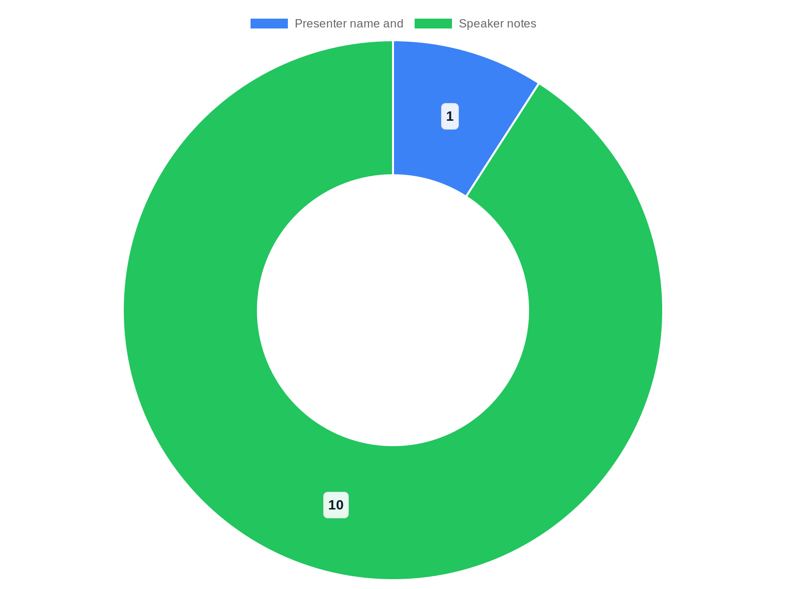
Title slide — Ants: Small Insects, Big Impact
This opening slide establishes the presentation theme and prepares the audience for a structured exploration of ant biology, ecology, behavior and human intera…
Clear title, subtitle with audience and date
High-resolution ant photo and institutional branding
One-line hook summarizing significance
Citation note pointing to Genially resource for styling
Presenter name and 1-line bio in speaker notes
Notes:
This opening slide establishes the presentation theme and prepares the audience for a structured exploration of ant biology, ecology, behavior and human interactions. Use a strong, concise title and a subtitle indicating the target audience (e.g., middle-school science, university seminar, general public). Visually, pair a high-resolution macro photo of an ant with a logotype or institutional affiliation and presenter name and date. Include a brief opening sentence or hook: "Ants are among the world's most numerous and ecologically influential insects." For presenters who want to reference prepared sources, note the research context below and how it informed slide selection: Research context: Source: Ants PRESENTATION III | Genially URL: https://view.genially.com/650060cbc8f6df001bdb381c/presentation-ants-presentation-iii. The Genially sample influenced slide styling and interactive suggestions; use it as a model for layered visuals and embedded media. Keep this slide minimal — name, affiliation, talk title, date, and an optional short outline of sections to follow so the audience knows what to expect. Speaker notes: 10–20 words summarizing presenter background and presentation goals.

Slide 3

Presentation overview and learning objectives
understand ant anatomy and caste structure; explain ant life cycles and colony dynamics; describe communication methods and ecological roles; and evaluate huma…
3–5 clear, measurable learning objectives
Table of contents with section time estimates
Reference to SlideShare resource for sequencing
Icons for visual clarity and rapid scanning
Presenter note: state outcomes aloud
Notes:
understand ant anatomy and caste structure; explain ant life cycles and colony dynamics; describe communication methods and ecological roles; and evaluate human–ant interactions and management options. Include a brief table of contents listing each major section of the deck. Research context: Materials like 'AntsPresentation for School Students.pptx' (SlideShare) influenced the selection and wording of learning objectives and the sequencing of educational slides because that resource prioritizes clear learning goals and stepwise explanations. Use bullets or icons for each objective and consider adding estimated time per section if delivering live (e.g., 5–7 minutes per core section). Speaker notes: advise the presenter to explicitly state outcomes at the beginning; this improves retention and provides assessment anchors for teachers or trainers planning follow-up activities.

Slide 4
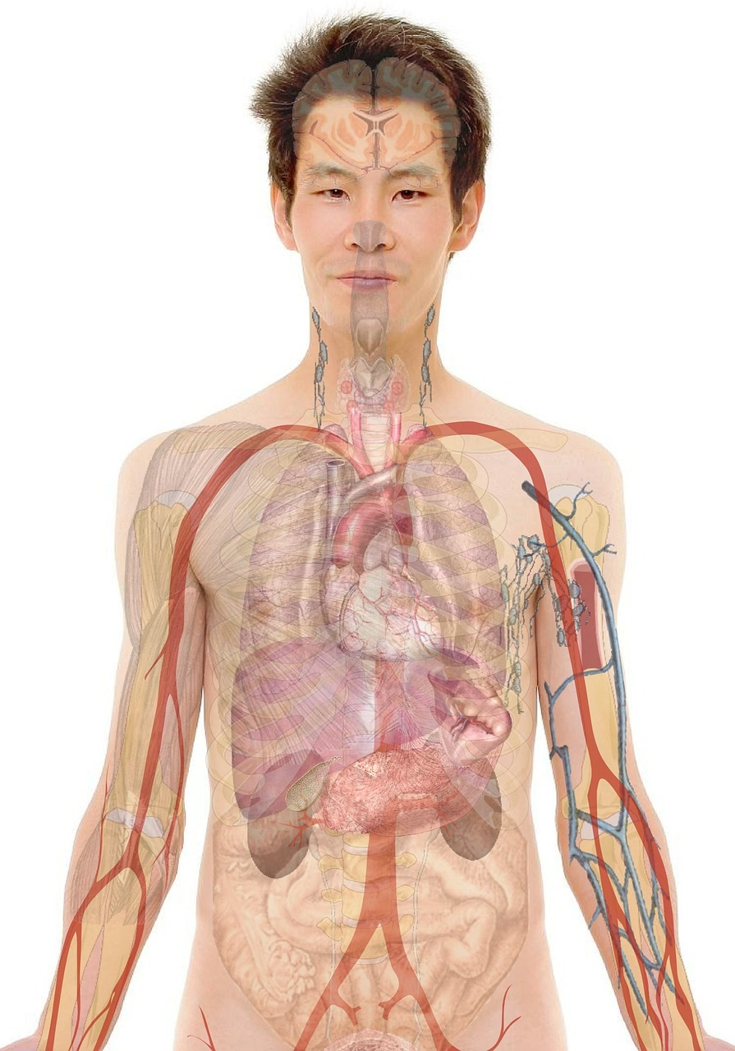
Ant anatomy — external structure and functions
Detail ant external anatomy with labeled visuals: head, thorax (alitrunk), petiole(s), gaster, antennae, mandibles, legs, compound eyes and sensory hairs. Prov…
Labeled diagram: head, thorax, petiole, gaster, legs
Functional notes for major structures (mandibles, antennae)
Highlight morphological variation and ecological links
Interactive reveal or short quiz to engage audience
Sources simplified for non-specialist comprehension
Notes:
Detail ant external anatomy with labeled visuals: head, thorax (alitrunk), petiole(s), gaster, antennae, mandibles, legs, compound eyes and sensory hairs. Provide short functional notes: mandibles for manipulation and defense, antennae for chemoreception, petiole for flexibility, and exoskeleton for protection. Use a clear macro photo or vector diagram and a callout box for each structure with one sentence describing its role. Research context: The Slidesgo 'Ant Life Cycle for Pre-K' template and Twinkl 'All About Ants' resources informed how to simplify anatomical jargon for broad audiences while retaining accuracy. Mention common anatomical variations across taxa (e.g., one or two petiole nodes) and link those variations to ecological roles such as seed-harvesting or predatory behavior. Include a short activity suggestion: quick spot-the-feature quiz slide or an overlay to progressively reveal labels. Speaker notes: recommend 1–2 analogies (e.g., 'ant mandibles are like pliers') and a reminder to avoid excessive technical terms unless audience is specialized.

Slide 5
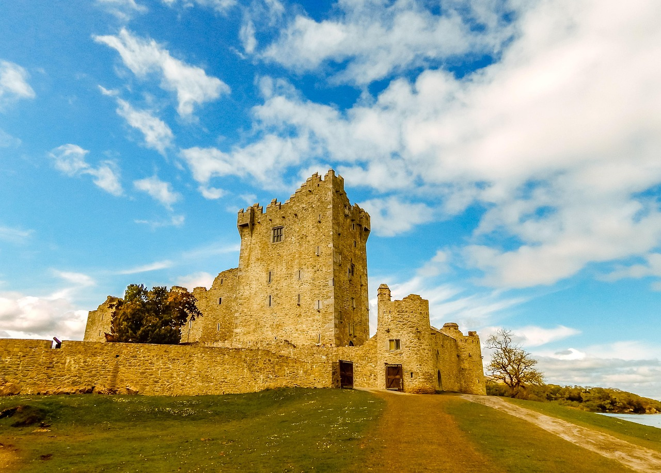
Ant castes and species diversity
Explain the social structure in colonies: queen(s), workers, soldiers, and reproductive males. Describe morphological and behavioral differences between castes…
Define queen, worker, soldier, and males
Examples of genus-level diversity (Formica, Camponotus)
Concepts: monogyny, polygyny, polymorphism
Comparison: single-queen vs multi-queen colonies
Visual side-by-side photos to illustrate castes
Notes:
Explain the social structure in colonies: queen(s), workers, soldiers, and reproductive males. Describe morphological and behavioral differences between castes, including polymorphism and division of labor. Provide examples from common genera (e.g., Formica, Camponotus, Solenopsis) without fabricating quantitative counts; rely on qualitative differences and observable traits. Research context: SlideShare content 'AntsPresentation for School Students.pptx' assisted in how to communicate caste roles clearly for learners; additionally, the Genially presentation influenced recommended visual layouts to compare castes side-by-side. Discuss how caste systems vary by species: some have multiple queens (polygyny), some are monogynous; some species show distinct soldier castes with hardened heads and enlarged mandibles. Add a short comparison box: single-queen vs multi-queen colonies, plus a brief note on reproductive timing and nuptial flights. Speaker notes: encourage using labeled photos to show size differences and recommending field-safety disclaimers when observing wild colonies.

Slide 6
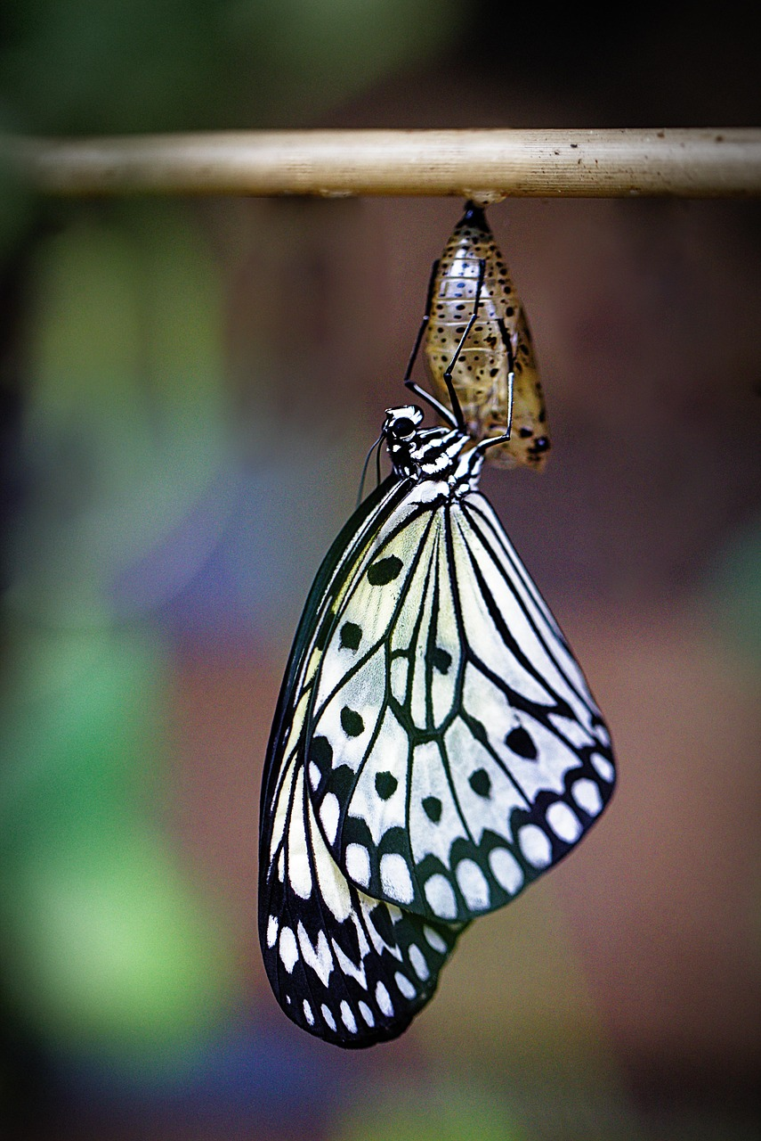
Life cycle: eggs to adults and colony growth
Describe the ant life cycle stages: egg, larva, pupa, and adult. Explain how caste determination can be influenced by genetics, nutrition and colony needs rath…
List and describe egg, larva, pupa, adult stages
Explain nutrition and environmental influences on caste fate
Use a flow diagram or timeline for visual learners
Classroom activities: flip cards, compare metamorphosis
Speaker note: conditions affecting brood development
Notes:
Describe the ant life cycle stages: egg, larva, pupa, and adult. Explain how caste determination can be influenced by genetics, nutrition and colony needs rather than fixed chronological development alone. Include life-stage durations as typical ranges when possible for temperate species (note variability and avoid presenting fabricated numbers for all species). Research context: The 'Ant Life Cycle for Pre-K' Slidesgo resource guided how to present life stages clearly and visually for learning purposes while the SlideShare presentation provided practical examples of how teachers structure stage-by-stage explanations. Provide an illustrative flow diagram or simple timeline to show transitions and include a speaker note describing conditions that affect brood development (temperature, food availability, colony stress). Suggest classroom activities: examine pre-made slides, create life-cycle flip cards, or compare ant life cycle to other insects (e.g., butterflies) to highlight complete metamorphosis.

Slide 7
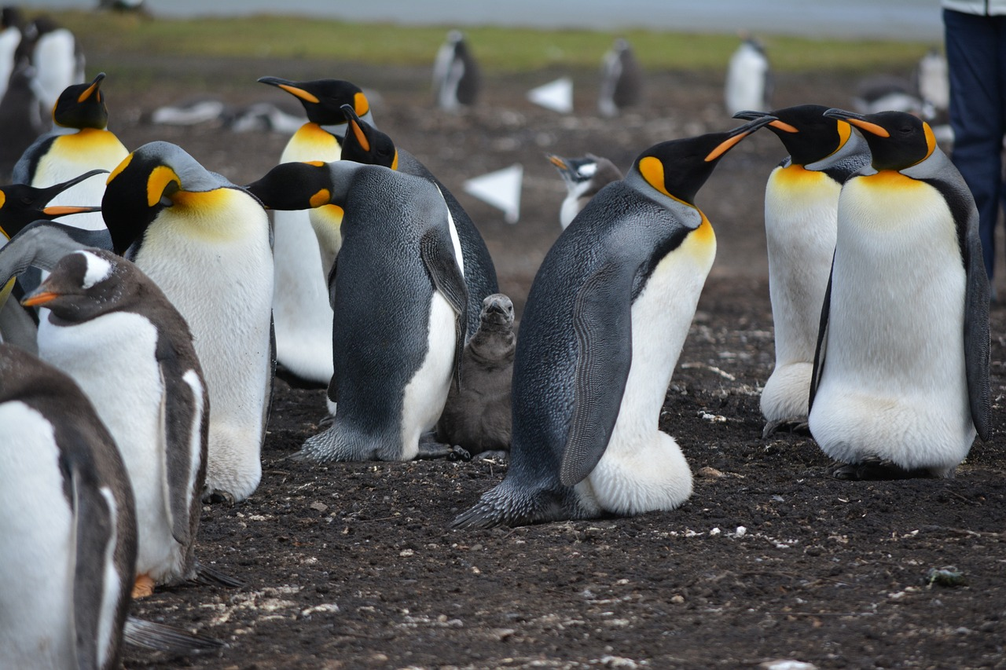
Colony structure, division of labor and nest types
Explore colony-level organization: task allocation, age polyethism (role changes as individuals age), and specialized subgroups (foragers, nurses, waste manage…
Describe task allocation and age polyethism
Compare nest architectures: subterranean, carton, mounds
Diagram cross-section: brood, queen, storage, refuse
Colony founding strategies and early vulnerability
Use animation to reveal structural complexity
Notes:
Explore colony-level organization: task allocation, age polyethism (role changes as individuals age), and specialized subgroups (foragers, nurses, waste management). Discuss nest architecture variation: subterranean chambers, carton nests in trees, mound-building species, and simple surface nests. Research context: The Genially Ants PRESENTATION III and SlideShare material both shaped recommendations about illustrating colony organization via cross-section nest diagrams and pedigreed role charts. Provide tips for presenting nest cross-sections: label locations for brood chambers, food storage, queen chamber, and refuse piles; contrast species that excavate complex tunnel systems with species that inhabit pre-formed cavities. Add a short note on colony founding strategies (claustral founding vs dependent founding) and how founding strategy affects early colony vulnerability and growth rate. Speaker notes: suggest using animated reveals to show how tasks shift over time and to make nest cross-sections intuitive for audiences.

Slide 8

Communication: pheromones, tactile signals and trails
Explain ant communication channels: chemical (pheromones), tactile (antennal contact), acoustic (stridulation in some species), and visual cues in species with…
List communication modes: chemical, tactile, acoustic, visual
Explain pheromone trail formation and recruitment
Use video/animation to demonstrate trail dynamics
Avoid anthropomorphic language; emphasize emergent behavior
Speaker tip: short demos increase comprehension
Notes:
Explain ant communication channels: chemical (pheromones), tactile (antennal contact), acoustic (stridulation in some species), and visual cues in species with good eyesight. Emphasize the central role of pheromone trails in foraging and recruitment, and how trail persistence and volatility influence path formation. Research context: Both the Genially presentation and educational slide templates from Slidesgo and SlideShare guided the recommended combination of concise text and clear visuals to explain pheromone-guided behavior. Describe classic experiments and observable behaviors (e.g., recruitment to food, trail-following dynamics) in conceptual terms without inventing experimental numbers. Provide presenter tips: use short video clips or animated diagrams to show how a single ant laying pheromone can lead to rapid trail consolidation when food is abundant. Include a cautionary note about interpreting behavior—avoid anthropomorphism while acknowledging emergent colony-level problem solving.

Slide 9
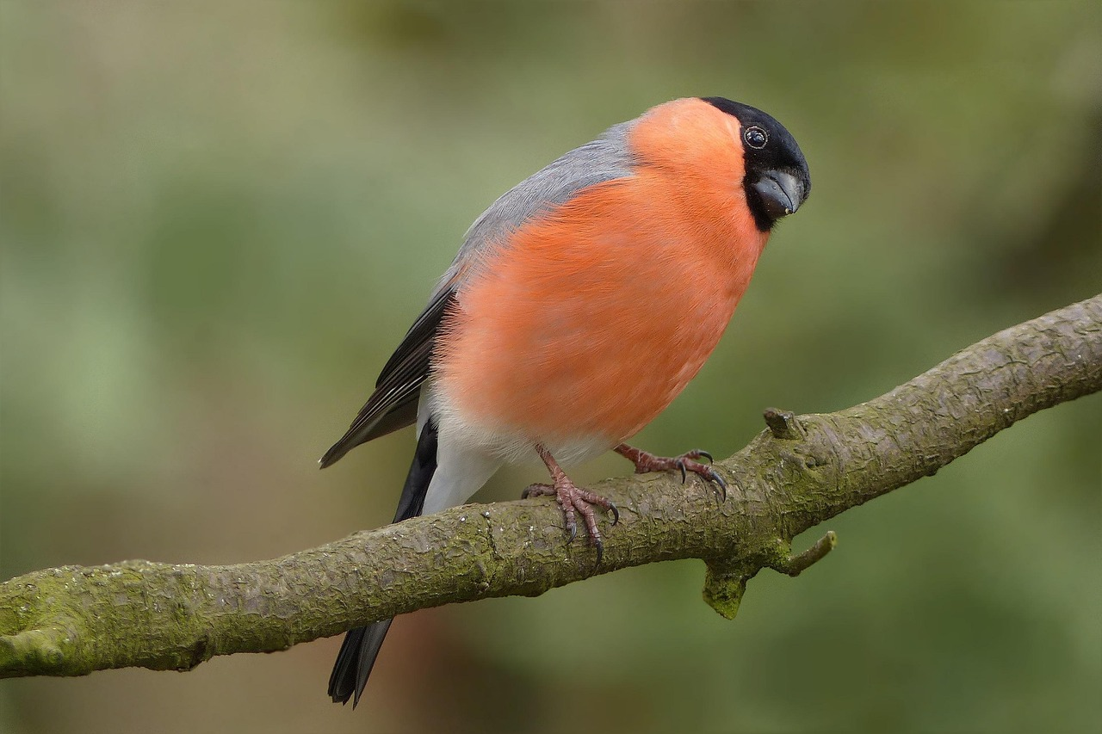
Foraging, navigation and ecological roles
Present foraging strategies: solitary scouting, systematic search, and mass foraging with trail networks. Discuss navigation mechanisms: pheromone cues, path i…
Foraging modes: solitary scouting, trail-based mass foraging
Navigation tools: pheromones, landmarks, path integration
Ecosystem services: soil aeration, seed dispersal, predation
Case narrative: seed-harvesting influences plant recruitment
Visuals: maps, overlays and flow diagrams
Notes:
Present foraging strategies: solitary scouting, systematic search, and mass foraging with trail networks. Discuss navigation mechanisms: pheromone cues, path integration, visual landmarks, and polarized light orientation in some species. Connect ant foraging to broader ecosystem services: soil aeration, seed dispersal (myrmecochory), predation on pests, and nutrient recycling. Research context: Twinkl 'All About Ants' resources and CrystalGraphics template listings informed practical suggestions on visualizing ecological functions and the role of ants in food webs. Emphasize that ecological impacts vary widely by species and environment and avoid overgeneralization. Include a case example narrative: a seed-harvesting ant species moving seeds to nest caches thereby altering local plant recruitment patterns. Include recommended visuals: food-source maps, foraging range overlays, and simple flow diagrams showing ecosystem service pathways.

Slide 10

Habitats, global distribution and diversity notes
Summarize the wide range of habitats ants occupy: tropical rainforests, temperate woodlands, deserts, grasslands, urban environments and agricultural systems. …
List typical ant habitats and reasons for ubiquity
Qualitative global richness: tropics as high-diversity areas
Use world map with qualitative richness shading and insets
Mention invasive species as ecological disruptors cautiously
Select habitat photos for visual contrast
Notes:
Summarize the wide range of habitats ants occupy: tropical rainforests, temperate woodlands, deserts, grasslands, urban environments and agricultural systems. Discuss why ants are ubiquitous: behavioral flexibility, social organization, and diverse nesting strategies. Research context: The Genially presentation and CrystalGraphics template collection provided guidance on mapping global distributions and choosing representative habitat photography. When presenting global distribution, emphasize qualitative patterns—high species richness in tropical regions and diverse functional groups—without fabricating exact species counts. Suggest a slide visual: world map shaded qualitatively for richness gradients with inset photos of typical habitats (leaf-litter, canopy, savanna mound, urban pavement). Include an ecological caution: invasive ant species can dramatically alter local communities; mention Solenopsis invicta (red imported fire ant) as an example if discussing invasives, but avoid asserting unreferenced numeric impacts.

Slide 11
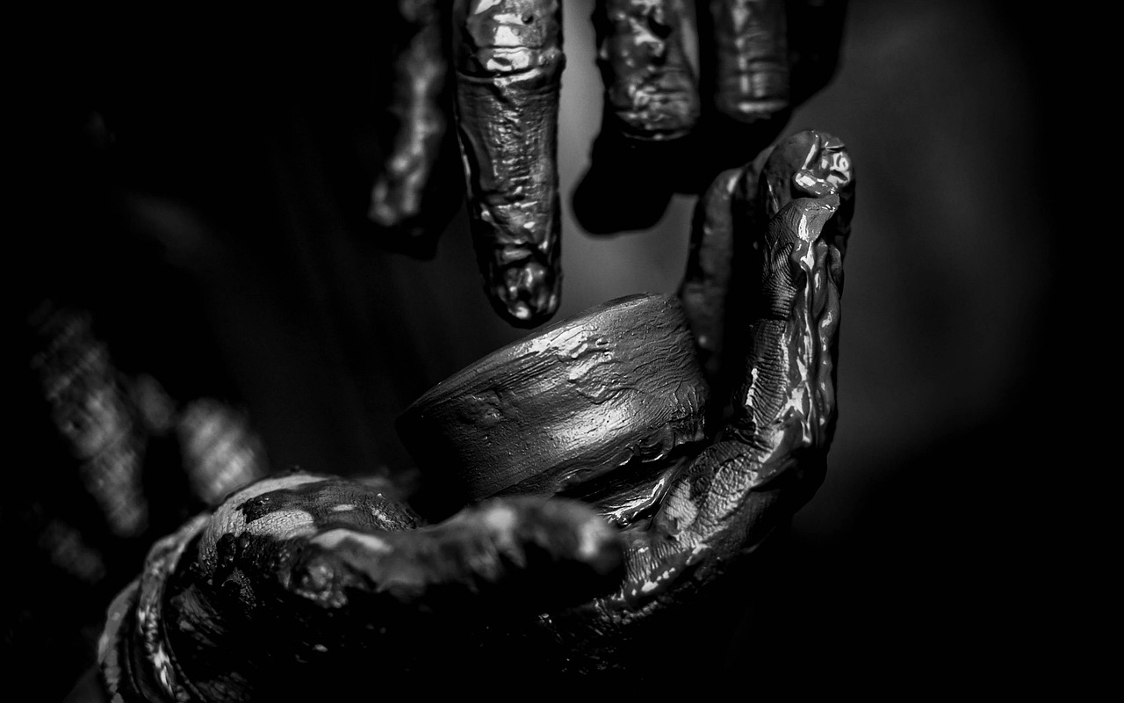
Human interactions: benefits, nuisances and management
Address the complex relationship between ants and people: ecosystem services (soil turnover, biological control) versus nuisances and hazards (structural pests…
Balance benefits (ecosystem services) with pest concerns
Practical management: sanitation, exclusion, targeted baiting
Promote IPM: identify, assess, use least-harmful methods
Safety note: stings, allergies, and professional referrals
Ethical considerations for conservation contexts
Notes:
Address the complex relationship between ants and people: ecosystem services (soil turnover, biological control) versus nuisances and hazards (structural pests, invasive colonies, stinging species). Provide practical advice on coexistence and management: sanitation and exclusion, non-toxic deterrents, targeted baiting when necessary, and when to contact pest management professionals. Research context: The SlideShare and Twinkl educational materials influenced the framing of human-focused content to balance positive ecological roles and management strategies for common problem species. Discuss ethical considerations for control in conservation contexts and suggest integrated pest management (IPM) principles: identify species, assess risk, use the least harmful effective method, and monitor. Include recommended resources for local identification and professional referral. Speaker notes: stress safety (allergies, stings) and legal/ethical constraints when treating ant colonies in natural areas.

Slide 12
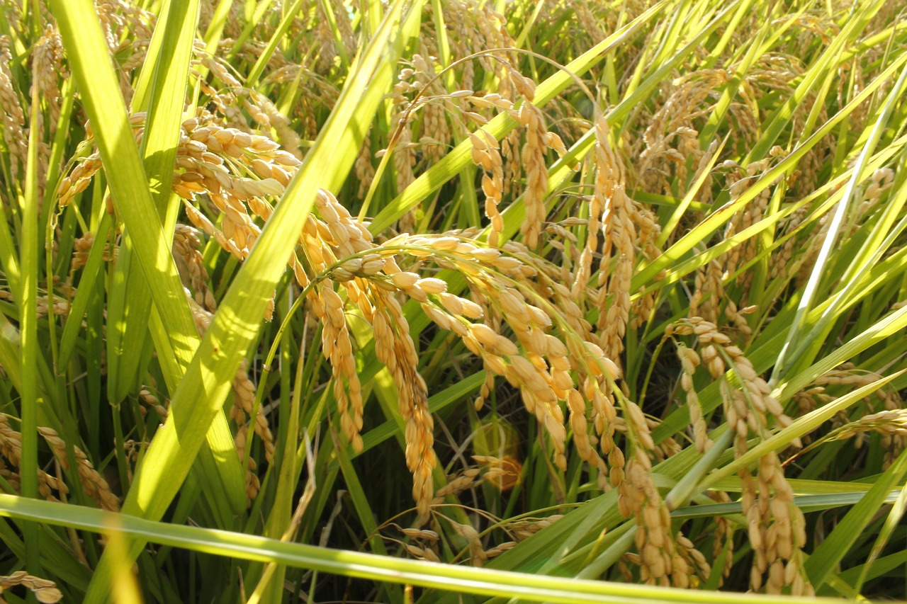
Designing the PPTX: visuals, accessibility and interactivity
Provide concrete layout and design guidance to convert this outline into a polished PPTX file suitable for classroom or public talks. Recommend slide dimension…
Slide specs: 16:9, large headings, sans-serif fonts
Use short videos, progressive reveals and high-res photos
Accessibility: alt text, transcripts, avoid color-only cues
Interactivity: polls, think-pair-share, formative checks
Cite templates (Genially, CrystalGraphics) for design choices
Notes:
Provide concrete layout and design guidance to convert this outline into a polished PPTX file suitable for classroom or public talks. Recommend slide dimensions (16:9 widescreen), clear visual hierarchy (large headings, short subheads), readable fonts (sans-serif, 24–28 pt for body), and consistent color contrast for accessibility. Research context: The Genially template example and CrystalGraphics/PoweredTemplate resources influenced recommendations for template procurement and interactive asset selection; cite these sources when choosing slides and animations. Offer suggestions for multimedia: short embedded videos (10–30 seconds) for behavior examples, progressive reveals for diagrams, and high-resolution photos for anatomy slides. Accessibility tips: add alt text for images, provide a printable handout or transcript, and avoid color-only coding. Interactivity: include simple formative checks (two-question polls, a 1-minute think-pair-share) and optional quizzes. Speaker notes: include timing cues and slide-specific prompts to facilitate transitions and audience engagement.

Slide 13

Classroom activities, demos and assessment ideas
Offer hands-on and low-prep activities tailored to grade level: life-cycle flipcards, supervised ant farm observation protocols, trail-following experiments us…
Hands-on: life-cycle flipcards, ant-farm observation, trail demos
Assessment: quizzes, concept maps, reflection prompts
Safety: ethical handling, containment, and legal notes
Rubric: observation clarity, vocabulary, replication, reflection
Adaptations by grade: K-2, middle, high school
Notes:
Offer hands-on and low-prep activities tailored to grade level: life-cycle flipcards, supervised ant farm observation protocols, trail-following experiments using sugar solutions, and habitat microcosm comparisons using soil samples. Provide assessment suggestions: short quizzes matching vocabulary, a concept map assignment linking behavior to ecosystem roles, and reflective prompts. Research context: The Slidesgo and Twinkl educational templates informed many of these activity suggestions by demonstrating age-appropriate tasks and assessment scaffolds used in classroom-ready materials. Emphasize safety and ethical considerations for live-animal activities (no wild-colony destruction, proper containment, and local regulations). Provide a short rubric template for teacher use: clarity of observation, use of scientific vocabulary, evidence of replication and reflection. Speaker notes: recommend duration and materials lists for each activity and suggest adaptation levels for K-2, middle school, and high school audiences.

Slide 14

References, credits and next steps for presenters
Conclude with a concise references slide listing key resources used to build the presentation and where to find supplemental templates and media. Provide guida…
List of source URLs for templates and educational content
Practical next steps: build PPTX, test media, create handout
Image-credit and citation formatting guidance
Presenter contact and 5-minute practice script
Encourage downloading templates from listed sources
Notes:
Conclude with a concise references slide listing key resources used to build the presentation and where to find supplemental templates and media. Provide guidance for next steps: create and host the PPTX, test media on the presenting machine, prepare a one-page handout, and gather local identification guides. Research context: The following web resources materially informed the outline and slide recommendations—Genially 'Ants PRESENTATION III', SlideShare 'AntsPresentation for School Students.pptx', Slidesgo 'Ant Life Cycle for Pre-K', Twinkl 'All About Ants', CrystalGraphics ant templates list, and PoweredTemplate 'Ants' template. Include URLs for each resource so presenters can download templates, images, or classroom-ready slides as allowed by the source. Also include recommended citation and image-credit formatting rules. Final speaker note: provide contact info for follow-up and suggest a short practice script for the first five minutes of the talk.

Slide 15
References
https://view.genially.com/650060cbc8f6df001bdb381c/presentation-ants-presentation-iii
https://www.slideshare.net/slideshow/ants_presentation-for-school-students-pptx/283163465
https://slidesgo.com/theme/ant-life-cycle-for-pre-k
https://www.twinkl.com/resource/all-about-ants-powerpoint-google-slides-for-k-2nd-grade-us-s-1691087653
https://crystalgraphics.com/templates/ants.html
https://poweredtemplate.com/02718/0/index.html
https://www.teacherspayteachers.com/browse/Search:free resources about ants
https://www.slideteam.net/top-10-ant-powerpoint-presentation-templates
https://www.microsoft.com/en-us/microsoft-365-life-hacks/presentations/powerpoint-tips-its-easier-than-you-think
https://www.microsoft.com/en-us/microsoft-365/powerpoint/ai-powerpoint-generator

