Slide 1
Ants: Biology, Behavior, and Ecological Importance — A 10-Slide Overview
Generated by Agent Diaz AI

Slide 2

Title: Why Study Ants?
This opening slide frames the objectives for a concise, research-grounded presentation on ants. We will introduce ants as members of the family Formicidae, out…
Introduce ants as Formicidae and set learning objectives
Explain relevance: ecology, agriculture, and behavior studies
Preview anatomy, social structure, life cycle, and roles
State use of SlideShare summaries as primary research context
Define expected takeaways for diverse audiences
Notes:
This opening slide frames the objectives for a concise, research-grounded presentation on ants. We will introduce ants as members of the family Formicidae, outline learning goals, and explain why ants matter to biology, ecology, and society. Drawing on material summarized from SlideShare presentations, this slide notes that ants evolved from wasp-like ancestors and emphasizes their global abundance and ecological roles. The audience will be told what to expect in subsequent slides: taxonomy and evolution, anatomy and physiology, social structure and castes, life cycle and reproduction, nest architecture and colony organization, ecological services, and human interactions. The slide will also state the pedagogical approach: combining descriptive biology with applied examples and cited SlideShare summaries to ground claims in accessible sources.

Slide 3
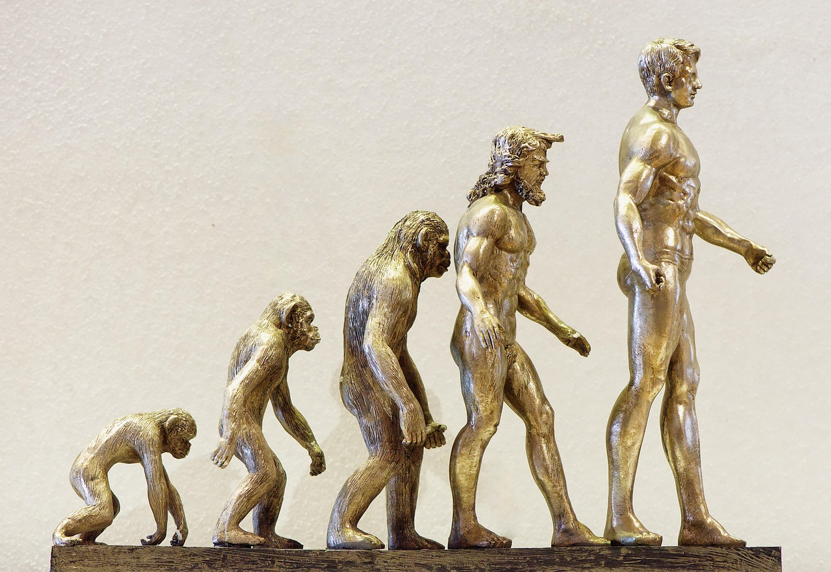
Taxonomy and Evolutionary Origins
This slide summarizes the taxonomic placement and evolutionary history of ants. Present ants as eusocial insects within the order Hymenoptera and family Formic…
Place ants within order Hymenoptera and family Formicidae
Summarize evidence for origin from wasp-like ancestors
Note estimated divergence 100 million years ago
Highlight major subfamilies and global diversity
Connect evolution to emergence of eusociality
Notes:
This slide summarizes the taxonomic placement and evolutionary history of ants. Present ants as eusocial insects within the order Hymenoptera and family Formicidae, with evolutionary roots traced back to wasp-like ancestors more than 100 million years ago. The research context from SlideShare presentations emphasizes this deep evolutionary origin and provides accessible statements that ants evolved from wasp-like ancestors; several summaries included in the research context reinforce the timeline and phylogenetic relationship. The slide will clarify major subfamilies and note the diversity of species and ecological niches. It will explain how morphological and molecular evidence supports the divergence of ants and the adaptive significance of traits such as social living, partitioned reproductive roles, and specialized castes.

Slide 4
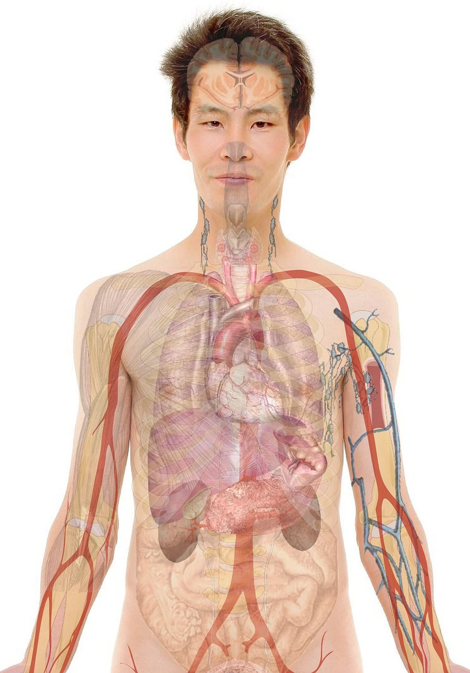
Anatomy: Body Plan and Key Adaptations
This slide provides a detailed look at ant morphology and physiology, using content themes present in the research context. Ants have a characteristic three-pa…
Describe three-part body plan: head, thorax, abdomen
Explain two-stomach system: crop (storage) and digestive stomach
List sensory structures: antennae and compound eyes
Note mandibles, exoskeleton, and pheromone glands
Relate morphology to caste specialization and function
Notes:
This slide provides a detailed look at ant morphology and physiology, using content themes present in the research context. Ants have a characteristic three-part body plan—head, thorax, and abdomen—six legs, compound eyes, antennae, and a chitinous exoskeleton. SlideShare summaries referenced in the research context repeatedly highlight unique physiological features such as two stomachs (a crop for storage and a digestive stomach for personal nutrition), strong mandibles for manipulation, and sensory antennae used for chemical communication. The slide will explain anatomical features that support social life, including specialized glands for pheromone production, muscle adaptations for carrying heavy loads relative to body size, and morphological caste differences between workers, soldiers, and queens.

Slide 5

Social Structure and Colony Castes
This slide analyzes the social organization of ant colonies and the roles of distinct castes. Drawing on several SlideShare summaries that describe colony comp…
Identify typical castes: workers, soldiers, queens, drones
Explain division of labor by age, morphology, and signal
Describe queen’s reproductive role and colony regulation
Note colony size variation from dozens to millions
Discuss pheromones as social and behavioral regulators
Notes:
This slide analyzes the social organization of ant colonies and the roles of distinct castes. Drawing on several SlideShare summaries that describe colony composition, explain that colonies typically contain sterile female workers, specialized soldiers, reproductive queens, and, at certain times, male drones. The research context emphasizes that a colony is fundamentally cooperative, with workers performing brood care, nest maintenance, foraging, and defense while a queen or queens focus on reproduction. This slide will discuss how division of labor is often age- or morphology-dependent, how pheromonal regulation maintains social order, and how colony size can vary dramatically from a few dozen individuals to millions depending on species and ecological context.

Slide 6
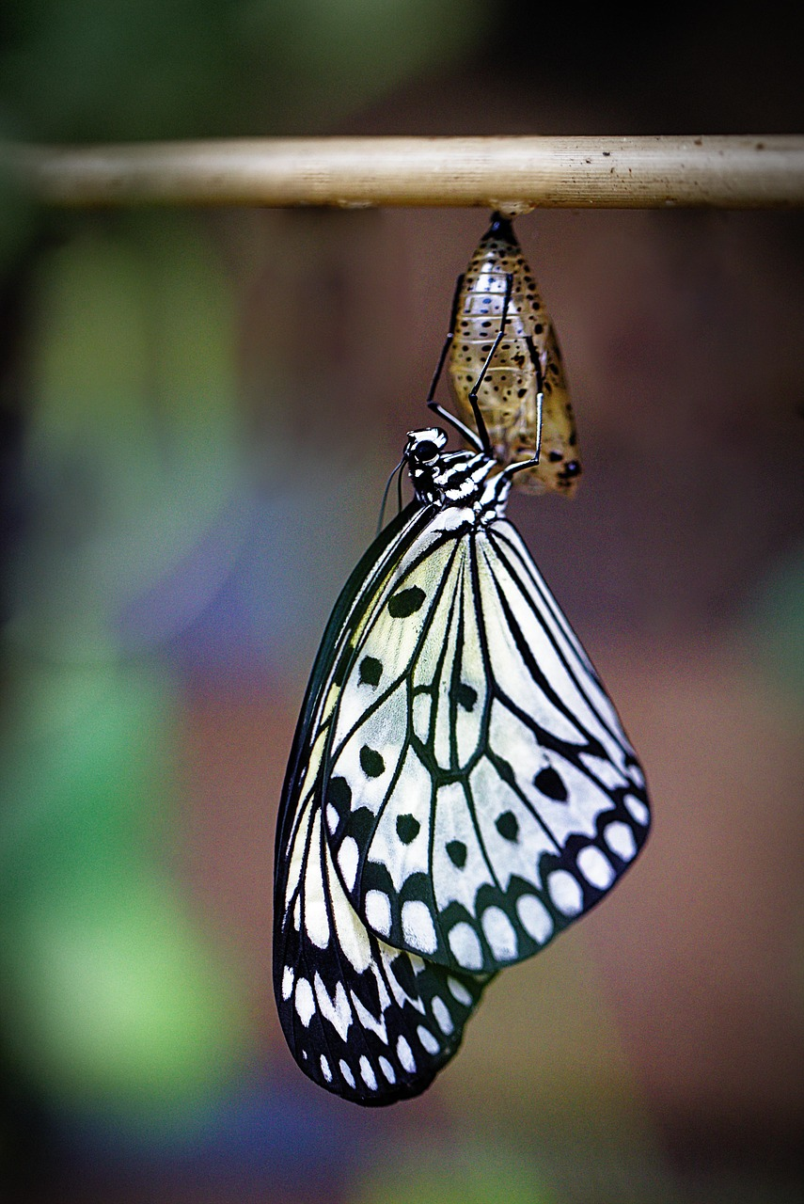
Life Cycle and Reproduction
This slide presents the life cycle stages of ants and reproductive strategies. Using material from SlideShare summaries, it outlines the egg-larva-pupa-adult p…
Outline egg → larva → pupa → adult developmental stages
Explain factors shaping caste determination: nutrition and cues
Describe nuptial flights and colony founding strategies
Note lifespan differences between queens, workers, and males
Connect reproduction to colony growth and dynamics
Notes:
This slide presents the life cycle stages of ants and reproductive strategies. Using material from SlideShare summaries, it outlines the egg-larva-pupa-adult progression and explains that caste destiny can be influenced by nutrition, temperature, and colony needs. The research context summaries indicate that queens lay eggs that become larvae, and workers care for brood and develop adults suited to colony roles. The slide will also describe nuptial flights, a common reproductive behavior where winged males and queens mate, after which queens found new colonies or join existing ones depending on species. It will address lifespan variability—queens may live for years while workers and males often have much shorter lifespans—and how reproductive cycles influence colony dynamics and expansion.

Slide 7
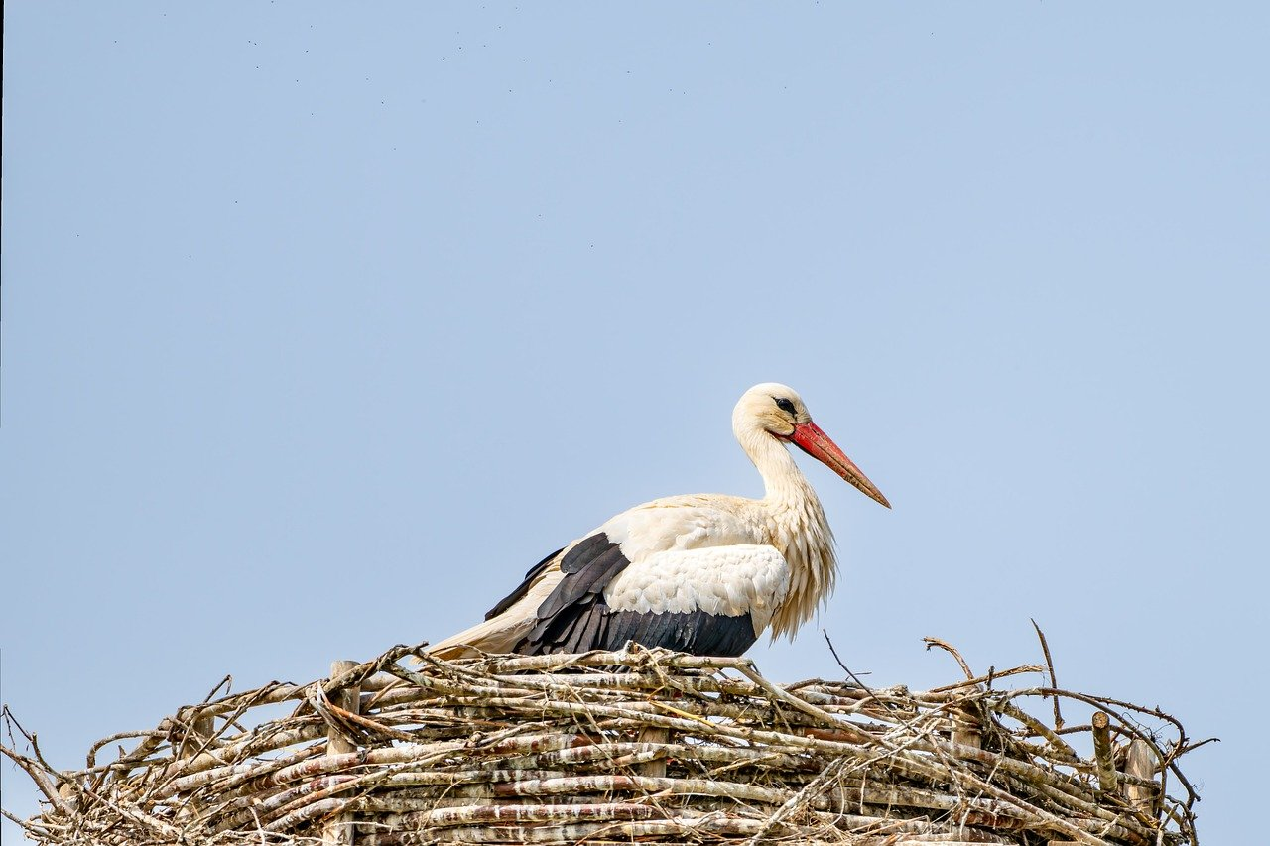
Nest Architecture and Colony Organization
ventilation tunnels, chambers that regulate humidity, and structural features that support communal living. Workers maintain and expand nests, allocate space f…
Describe common nest types: subterranean, carton, leaf-structured
Explain internal chambers for brood, storage, and activities
Note architectural adaptations for ventilation and humidity
Highlight worker roles in construction and maintenance
Relate nest design to species ecology and colony scale
Notes:
ventilation tunnels, chambers that regulate humidity, and structural features that support communal living. Workers maintain and expand nests, allocate space for different life stages, and optimize resource flow. The slide will discuss species variation in nest construction, from carton nests and leaf nests to massive underground constructions, and will emphasize how nest design is tightly linked to colony size, foraging strategy, and environmental conditions.

Slide 8
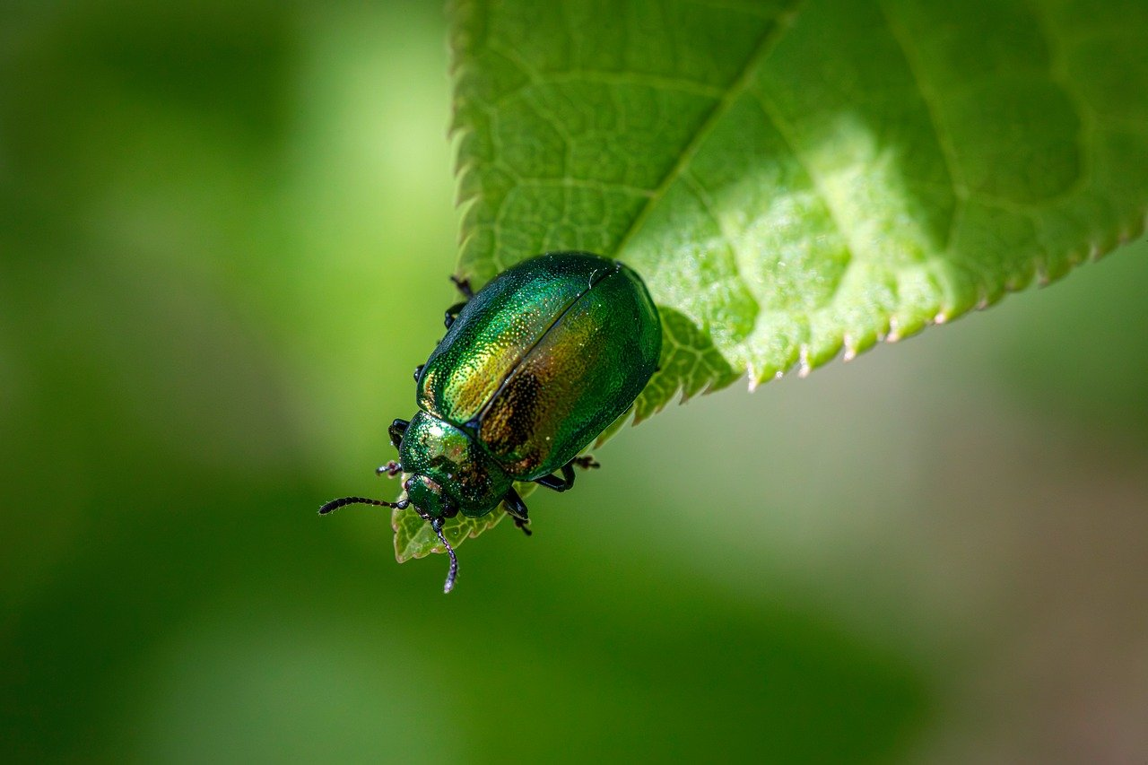
Foraging, Communication, and Cooperative Behavior
This slide examines how ants find food, communicate, and coordinate large-scale cooperative behaviors—topics emphasized in the SlideShare research context. Ant…
Explain pheromone trails and recruitment mechanisms
Describe scouting, trail reinforcement, and food exploitation
Discuss cooperative transport and coordinated construction
Note conflict management and defense strategies
Connect individual rules to emergent colony decisions
Notes:
This slide examines how ants find food, communicate, and coordinate large-scale cooperative behaviors—topics emphasized in the SlideShare research context. Ants use pheromone trails, tactile signals, and sometimes visual cues to recruit nestmates and coordinate group foraging. The research context highlights cooperative tasks such as collective transport, coordinated nest building, and division of labor in foraging teams. This slide will explain pheromone deposition and trail reinforcement, the role of scouting individuals, and how colony-level decisions—such as exploiting food patches or relocating nests—emerge from local interactions. It will also touch on conflict resolution within colonies and strategies for interspecific competition and defense.

Slide 9
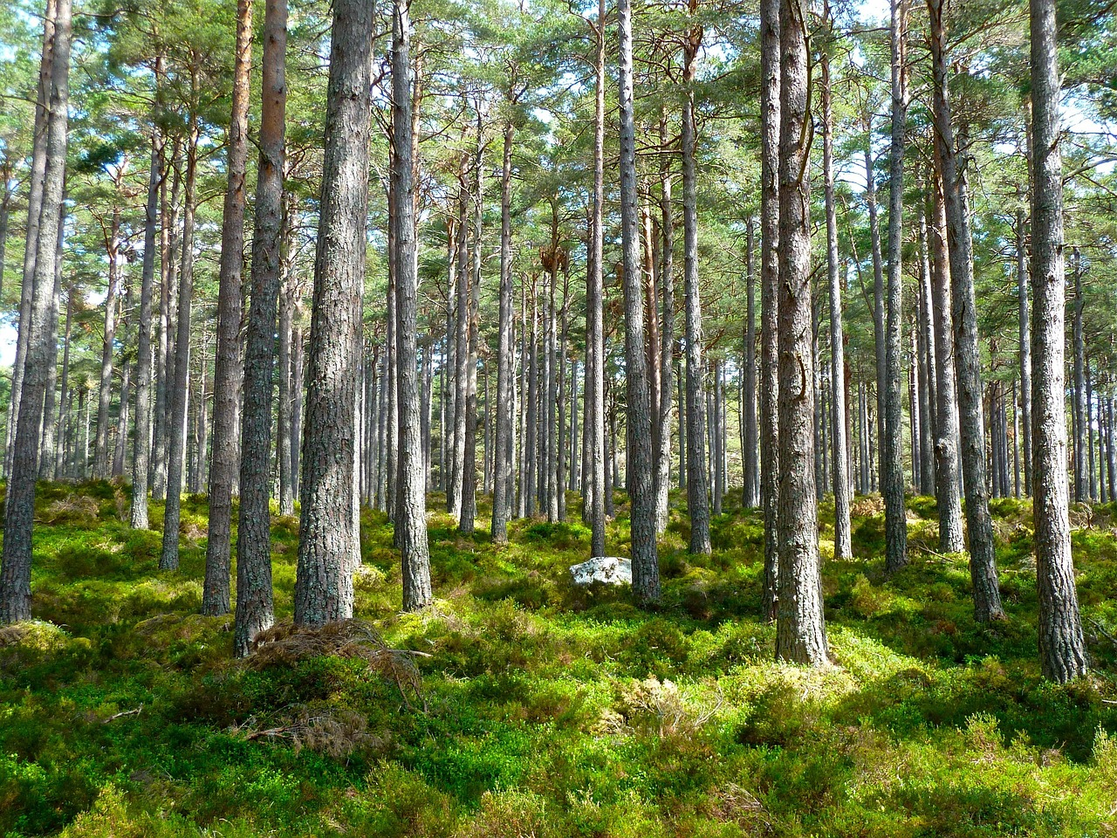
Ecological Roles and Ecosystem Services
This slide highlights ants’ functional importance in ecosystems, synthesizing claims from SlideShare summaries which stress soil enrichment and broader ecologi…
Summarize soil enrichment via excavation and organic turnover
Describe ants as predators, scavengers, and seed dispersers
Note mutualisms: aphid tending and plant protection roles
Discuss positive and negative impacts on agriculture
Link ant activity to broader biodiversity and ecosystem resilience
Notes:
This slide highlights ants’ functional importance in ecosystems, synthesizing claims from SlideShare summaries which stress soil enrichment and broader ecological roles. Ants contribute to soil aeration and nutrient cycling through nest excavation and organic matter redistribution, act as predators and seed dispersers, and can influence plant community structure through seed caching and tending mutualistic organisms such as aphids. The research context mentions that ants play a crucial role in ecosystems and help enrich soils. This slide will elaborate on these ecosystem services, quantify general impacts qualitatively (e.g., influence on soil turnover and seed fate), and discuss how ant-mediated processes affect biodiversity, ecosystem resilience, and agricultural systems—both beneficially and, in some cases, as pests.

Slide 10

Human Interactions, Management, and Cultural Significance
This slide addresses how humans interact with ants, drawing on the research context which notes ants’ cultural significance and their roles in human-modified e…
List benefits: pest control, soil services, research models
Enumerate problems: invasive species, structural and crop damage
Outline management: integrated pest management principles
Mention cultural depictions and educational uses
Address ethics and environmental considerations in control
Notes:
This slide addresses how humans interact with ants, drawing on the research context which notes ants’ cultural significance and their roles in human-modified environments. Ants have both beneficial roles (biological control agents, soil engineers) and negative impacts (structural pests, agricultural pests, invasive species). SlideShare summaries mention cultural significance and the necessity to manage certain species in urban and agricultural settings. This slide will review integrated pest management approaches, the challenges posed by invasive species, and ethical considerations in research and control. It will also summarize examples of ants in cultural narratives and education, noting how their cooperative behavior is often invoked in lessons about teamwork and social organization.

Slide 11

Sources and Further Reading
This final slide provides the sources used to assemble the presentation and recommends further reading. The primary research context is drawn from SlideShare u…
List of SlideShare URLs used as the primary research context
Recommendation to consult peer-reviewed literature for depth
Encourage cross-referencing and critical evaluation of sources
Offer keywords for further searches: Formicidae, eusociality, ant ecology
Invite questions and directions for follow-up research
Notes:
This final slide provides the sources used to assemble the presentation and recommends further reading. The primary research context is drawn from SlideShare uploads and summaries, which provided key descriptions of ant anatomy, social systems, evolution, and ecological roles. For transparency and follow-up study, the slide lists the actual URLs consulted, enabling the audience to review the SlideShare materials directly. It also suggests additional authoritative sources for deeper inquiry, such as academic reviews on ant phylogeny, ecology, and behavior, and encourages cross-referencing SlideShare content with peer-reviewed literature for rigorous study. The URLs below represent the SlideShare presentations used in the research context and are provided verbatim for direct access.

Slide 12
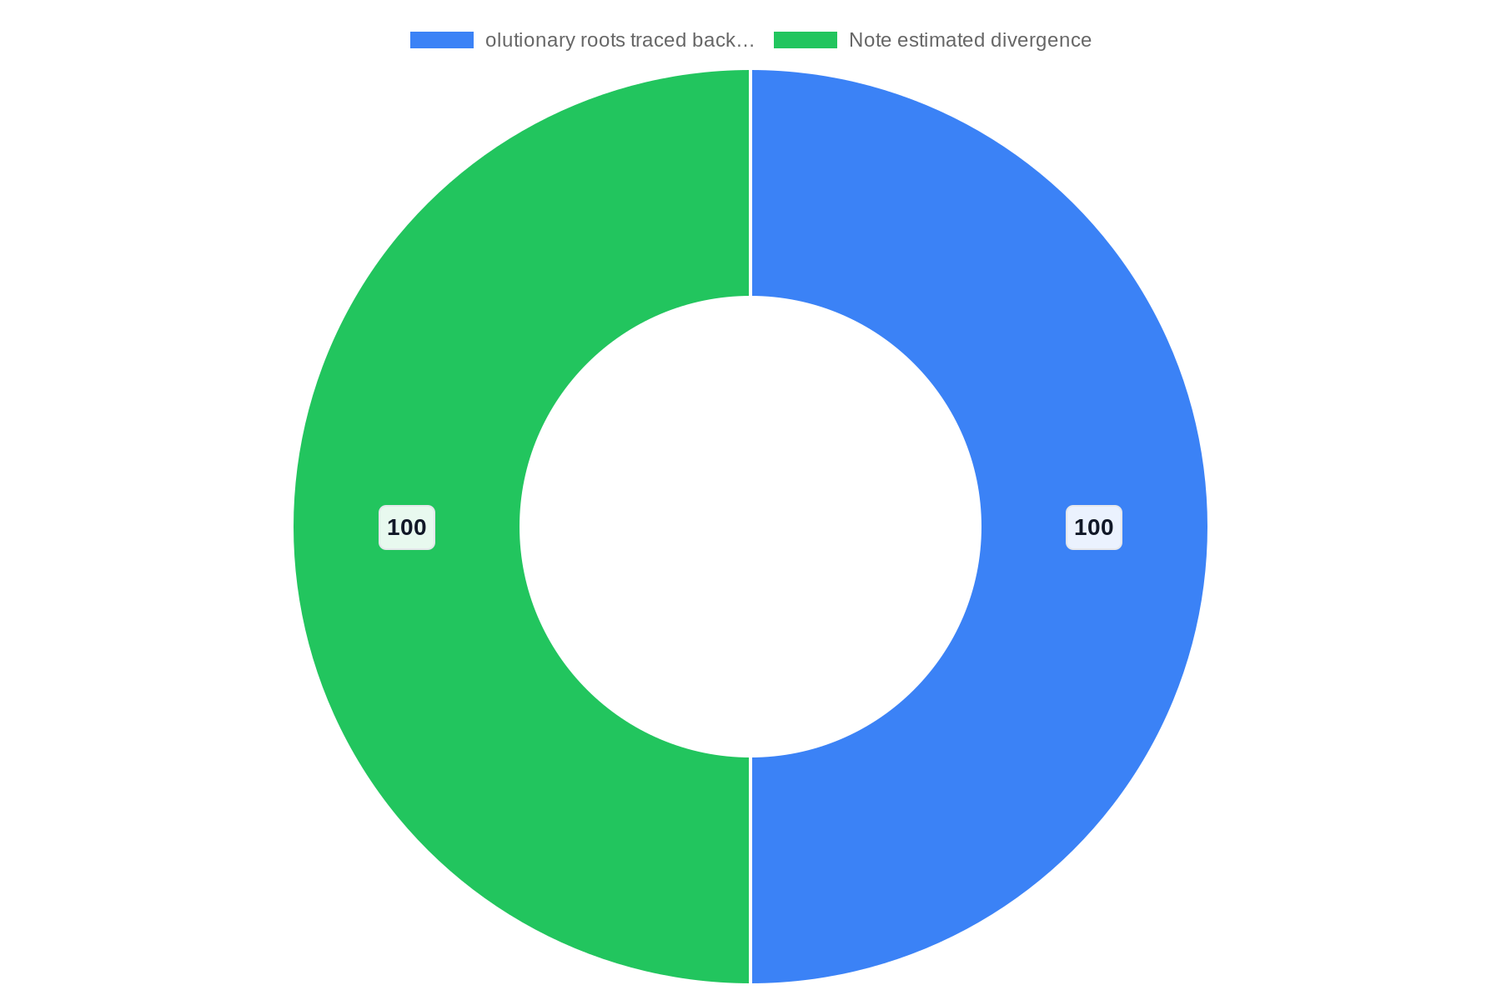
Distribution

Slide 13
References
https://www.slideshare.net/slideshow/presentation-on-ant/37050902
https://www.slideshare.net/slideshow/ants-29482656/29482656
https://www.slideshare.net/slideshow/ants-35904458/35904458
https://www.slideshare.net/slideshow/ants_presentation-for-school-students-pptx/283163465
https://www.slideteam.net/top-10-ant-powerpoint-presentation-templates
https://www.slideshare.net/slideshow/ant-life-cycle-for-pre-k-by-slidesgo-pptx/270535194
https://poweredtemplate.com/02718/0/index.html
https://crystalgraphics.com/templates/ants.html
https://slidesgo.com/theme/ant-life-cycle-for-pre-k
https://myfreeslides.com/themes/ant/

