Slide 1
Designing and Delivering Professional, Evidence-Based Presentation Slides
Generated by Agent Diaz AI

Slide 2

Title slide — Purpose and presentation roadmap
This opening slide sets the stage: concise title, presenter name and role, date, and a one-line purpose statement that orients the audience. Research-informed …
One-line purpose statement under the title
Presenter name, role, and date in footer
Single visual cue to preview agenda
Avoid dense text or additional bullet lists
Ensure consistent branding and readable fonts
Notes:
This opening slide sets the stage: concise title, presenter name and role, date, and a one-line purpose statement that orients the audience. Research-informed guidance stresses that the first slide should clarify intent and reduce cognitive load later, as highlighted in the paper Ten simple rules for effective presentation slides which advises economy on titles and immediate context. The UC San Diego Evidence-Based Presentation Design Recommendations also advise establishing clear objectives early to prime viewers. Practical note: include a subtle visual or organizational graphic to preview the flow (no dense text). For consistency, place contact or affiliation information in a smaller footer and avoid crowding the central frame. This approach follows Microsoft Support’s suggestion to choose a clear structure and prepares the audience for the narrative arc of the talk. Keep the visual hierarchy obvious: title largest, subtitle smaller, metadata smallest.

Slide 3

Rule-driven slide structure: applying the 'Ten Simple Rules'
Translate the 'Ten simple rules for effective presentation slides' into actionable structure for the deck. This slide explains how to operationalize rules such…
Map each slide to a single, explicit message
Use section headers to signal shifts
Design degenerated master templates for consistency
Prefer visuals + brief caption over long paragraphs
Keep slides as audience-facing aids, not transcripts
Notes:
Translate the 'Ten simple rules for effective presentation slides' into actionable structure for the deck. This slide explains how to operationalize rules such as limiting content per slide, focusing on one message, using high-contrast visuals, and rehearsing delivery. The article explicitly recommends planning slides as visual aids for storytelling rather than as handouts; adopt that mindset when structuring each section: hook, evidence, implication, and call to action. Evidence-Based Presentation Design Recommendations from UC San Diego complement these rules by providing concrete design practices — for example, recommended line lengths and visual emphasis patterns for slides. Microsoft’s guidance on slide clarity reinforces the need to remove extraneous text and use speaker notes instead. Operational tips: create a master template with consistent margins, reserve one slide for primary takeaways, and use section header slides to reset attention between topics. This framework reduces cognitive overload and enhances retention.

Slide 4

Know your audience and sharpen the core message
Audience analysis drives slide content, pacing, and technical depth. The 'Ten simple rules' article emphasizes tailoring slide density and jargon to expected d…
Segment slide depth by audience expertise
Prepare alternate versions for key technical slides
Use signpost slides to preview and recap
Anticipate questions and add clarifying visuals
Align examples with audience priorities
Notes:
Audience analysis drives slide content, pacing, and technical depth. The 'Ten simple rules' article emphasizes tailoring slide density and jargon to expected domain knowledge; align examples and data granularity to audience expertise. UC San Diego’s evidence-based guidance recommends pre-assessing attention spans and structuring content into bite-sized segments with clear transitions. Microsoft’s tips for effective presentations advise anticipating audience questions and placing clarifying visuals where they reduce misunderstanding. Practically, create 2–3 alternative slide variants for critical technical slides: one brief for general audiences, one detailed for technical audiences, and one summary for executives. Also, place signpost slides—concise statements that preview what comes next—to help listeners mentally model the talk. This slide gives tactics to capture attention early, re-establish relevance mid-talk, and finish with the explicit value proposition tailored to listeners’ priorities.

Slide 5

Simplicity and minimal text: reduce cognitive load
Simplicity is a recurring theme in both the Ten simple rules piece and the UC San Diego recommendations. These sources recommend short, headline-style slide ve…
Headline-style primary message per slide
3–5 concise bullets max when needed
Move supporting detail to speaker notes or handouts
Progressively disclose complex ideas
Prioritize readability: font size and spacing
Notes:
Simplicity is a recurring theme in both the Ten simple rules piece and the UC San Diego recommendations. These sources recommend short, headline-style slide verbs and minimal supporting text to avoid cognitive overload. Microsoft reinforces removing extraneous bullets and using the slide as a complement to the spoken narrative. This slide outlines actionable tactics: convert long paragraphs to a single headline plus a supporting subhead; limit bullet lists to three to five succinct points; and use progressive disclosure where necessary so that the audience sees only what is needed at each moment. Also discuss using speaker notes to capture supporting evidence rather than cluttering the slide. Empirical design guidance suggests that audience retention improves with focused slides that scaffold the talk; avoid reproducing full reports on slides. Use consistent, generous spacing and avoid tiny fonts—readability trumps decorative density.

Slide 6
Visual hierarchy, typography, and layout principles
Effective visual hierarchy directs viewer attention and reduces ambiguity. The Ten simple rules article and UC San Diego guidance emphasize consistent typograp…
Two-tier typography and consistent sizes
Grid-based layout for predictable eye flow
High contrast text and readable typefaces
Reserve whitespace; avoid centered long text
Define style tokens in the slide master
Notes:
Effective visual hierarchy directs viewer attention and reduces ambiguity. The Ten simple rules article and UC San Diego guidance emphasize consistent typography, clear size differences for title, headings, and body text, and purposeful whitespace. Apply a two-tier typographic system: one typeface for headings and a compatible body face for captions; keep bold emphasis sparing and predictable. Use a grid-based layout to align images, captions, and bullets so eyes move along expected paths. Microsoft’s tips also recommend high-contrast text and avoiding decorative typefaces that harm legibility. This slide presents layout heuristics: left-align body text for languages read left-to-right, reserve the top-left area for the primary message, and avoid centering long text blocks. Ensure headers and footers are subtle and consistent. Finally, document style tokens (headline size, caption size, color tokens) in the slide master for team consistency.

Slide 7

Color, contrast, and accessible palettes
Color choices affect readability, emotional tone, and accessibility. Both the Ten simple rules paper and UC San Diego’s evidence-based recommendations discuss …
Use accessible contrast ratios and test them
Avoid encoding meaning with color alone
Limit palette to primary + accent + neutral
Favor high-contrast palettes for projection
Record palette tokens in the master template
Notes:
Color choices affect readability, emotional tone, and accessibility. Both the Ten simple rules paper and UC San Diego’s evidence-based recommendations discuss contrast ratios and color-blind friendly palettes as essential. Microsoft also highlights accessible color combinations in its presentation guidance. This slide covers practical steps: test foreground/background contrast to meet accessibility thresholds, avoid using color alone to encode critical distinctions (add shapes or labels), and choose palettes with adequate saturation for projection environments. Also advise creating a limited color palette (primary, accent, background, neutral) and using accent color sparingly to emphasize rather than overwhelm. Include guidance for projected-light conditions — cooler, higher-contrast palettes often work better — and recommend accessible-check tools. Documenting accessible color choices in the template improves consistency across presenters.

Slide 8

Data visualization best practices and chart selection
Presenting data effectively requires selecting the right chart type, simplifying visuals, and calling attention to the key insight. The Ten simple rules articl…
Select chart type that matches analytical question
Annotate charts with an explicit takeaway caption
Remove chart junk (3D, unnecessary gridlines)
Use direct data labels when clarity improves
Prepare simplified and appendix chart versions
Notes:
Presenting data effectively requires selecting the right chart type, simplifying visuals, and calling attention to the key insight. The Ten simple rules article highlights that charts should show one clear message and avoid extraneous decoration; UC San Diego adds concrete guidance such as preferring bar or line charts for categorical and temporal comparisons respectively. Microsoft’s guidance emphasizes labeling axes and using direct data labels when feasible to reduce cognitive translation. This slide outlines a decision checklist: choose bar charts for discrete comparisons, line charts for trends, scatter plots for correlations, and tables only for precise values when necessary. Emphasize removing chart junk (gridlines and 3D effects), using consistent scales, and annotating charts with a short takeaway caption. Recommend preparing simplified 'audience' and 'appendix' versions: the first highlights the main insight, the second contains full data for Q&A.

Slide 9

Imagery, icons, and photography: purposeful visuals
Visuals are persuasive only when they support the message. The Ten simple rules guidance and UC San Diego best practices both warn against decorative images th…
Choose images that add semantic value, not decoration
Consistent iconography and cropped, high-res photos
Include alt text and image credits for accessibility
Use diagrams instead of photos for complex data
Optimize images to balance quality and file size
Notes:
Visuals are persuasive only when they support the message. The Ten simple rules guidance and UC San Diego best practices both warn against decorative images that distract. This slide prescribes choosing imagery that aligns semantically with the slide headline, cropping for clarity, and ensuring images have sufficient resolution for large screens. Use iconography to symbolize recurring concepts (process, risk, outcome) and keep icon style consistent across the deck. Microsoft’s tips recommend alt text for images to improve accessibility and including image credits where appropriate. For data-heavy slides, prefer simplified diagrams or annotated screenshots over full-screen photos. Also provide practical sourcing notes: use licensed photo libraries or properly attributed creative commons assets, and compress images in the master file to keep presentation size manageable without degrading projected quality.

Slide 10

Slide layout consistency and using templates effectively
Templates and master slides are productivity multipliers when used with discipline. The Ten simple rules article and UC San Diego recommendations both advocate…
Create 4–6 disciplined layout variants in the master
Lock positional elements; expose only content regions
Embed fonts and test cross-platform compatibility
Maintain template versioning and a change log
Provide brief how-to notes for team users
Notes:
Templates and master slides are productivity multipliers when used with discipline. The Ten simple rules article and UC San Diego recommendations both advocate creating a limited set of slide layouts (title, two-column content, visual + caption, data slide, and section header) and enforcing consistent spacing, color usage, and typography through the master. This slide details a template plan: define 4–6 layout variants, lock positional elements in the master, and expose only the editable content regions to presenters. Microsoft advises saving a clean handout-friendly version and embedding fonts when cross-platform compatibility is required. For teams, maintain a change log for template updates and version the master to avoid inconsistent decks. Training short how-to notes reduce misuse and preserve slide quality at scale.

Slide 11

Delivery: rehearsal, speaker notes, and slide timing
Strong delivery ties design to impact. The Ten simple rules piece underscores rehearsing with slides to align speech timing and avoid reading slides verbatim.
Rehearse with slides to align timing and transitions
Annotate speaker notes with cues and audience prompts
Use presenter view to monitor time and notes
Prepare contingency slides for Q&A or time shifts
Iteratively simplify slides during rehearsals
Notes:
Strong delivery ties design to impact. The Ten simple rules piece underscores rehearsing with slides to align speech timing and avoid reading slides verbatim. UC San Diego recommends timing controls and practicing transitions to reduce cognitive friction for viewers. Microsoft’s support article gives practical rehearsal tips including pacing and slide advance strategies. This slide offers a rehearsal regimen: time each slide for a target cadence, annotate speaker notes with cues and anticipated audience prompts, and rehearse with the actual presentation environment where possible. Include contingency slides (brief recap, extra detail) to handle Q&A or time variations. Also mention the use of presenter view to monitor elapsed time and see notes while keeping slides clean for the audience. Practice also helps identify slides that require simplification or additional visual emphasis.

Slide 12

Accessibility and inclusivity considerations
Designing for accessibility broadens reach and reduces friction. Both the Ten simple rules article and UC San Diego recommendations highlight accessible color …
Validate contrast and include alt text for all images
Use semantic heading structure and readable fonts
Provide downloadable handouts and captioned video
Avoid color-only encodings; add labels or shapes
Include accessibility checklist in reviews
Notes:
Designing for accessibility broadens reach and reduces friction. Both the Ten simple rules article and UC San Diego recommendations highlight accessible color contrast, readable font sizes, and descriptive alt text. Microsoft provides practical steps such as using slide layouts that work with assistive technologies and avoiding reliance on color alone for meaning. This slide enumerates concrete actions: validate contrast ratios, include alt text on all images, structure headings semantically in the slide outline, and provide downloadable handouts with full details for attendees who prefer text. Also consider captioned videos and pacing slides slowly enough for non-native speakers. For team presentations, incorporate an accessibility checklist into the final review process. These steps improve comprehension for everyone and are consistent with evidence-based presentation design.

Slide 13

Handouts, appendix slides, and post-presentation follow-up
Separate the in-presentation narrative from the post-presentation materials. The Ten simple rules guidance suggests preserving detail for handouts or appendice…
Keep detailed charts and methods in an appendix
Provide one-page executive summary handout
Distribute deck with speaker notes for later review
Label backup slides clearly for Q&A
Include next steps and contact information
Notes:
Separate the in-presentation narrative from the post-presentation materials. The Ten simple rules guidance suggests preserving detail for handouts or appendices rather than crowding main slides; UC San Diego echoes this by recommending an appendix with detailed charts and methodological notes for interested readers. Microsoft also advises preparing handout-friendly versions and embedding references. This slide outlines a workflow: prepare an appendix with labeled backup slides, provide a one-page executive summary handout, and distribute a full slide deck that includes speaker notes for later review. Include clear next steps and contact information to facilitate follow-up. For research or technical talks, append technical methods and raw data links rather than placing them on primary slides. This strategy keeps the live presentation focused while serving diverse post-talk information needs.

Slide 14

Practical checklist and next steps for presenters
End with a concise, actionable checklist to prepare the final delivery. Drawing together recommendations from Ten simple rules, UC San Diego’s evidence-based g…
Validate readability and run accessibility checks
Rehearse with presenter view and do a tech dry run
Finalize template and verify image licenses
Assign roles and prepare appendix slides for Q&A
Follow timeline: draft, rehearse, finalize
Notes:
End with a concise, actionable checklist to prepare the final delivery. Drawing together recommendations from Ten simple rules, UC San Diego’s evidence-based guidelines, and Microsoft’s practical tips, this slide offers a pre-presentation checklist: validate slide readability at typical viewing distances, run accessibility checks (contrast and alt text), rehearse with the slide deck and presenter view, verify image licenses and file size, and ensure the template master is finalized. Include a short timeline for finalizing content (e.g., draft complete three days before, rehearsal two days before, final edits one day before). Recommend assigning roles for team presentations (main speaker, slide operator, Q&A lead) and performing a technical dry run in the delivery environment. Finish with the explicit call to action: confirm audience needs and iterate content accordingly.

Slide 15
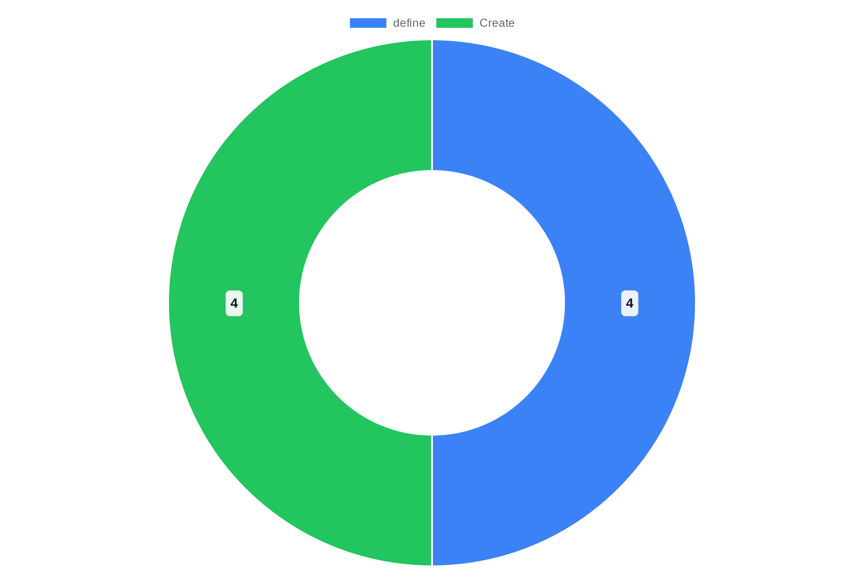
Distribution

Slide 16
References
https://pmc.ncbi.nlm.nih.gov/articles/PMC8638955/
https://multimedia.ucsd.edu/best-practices/presentation-design.html
https://support.microsoft.com/en-us/office/tips-for-creating-and-delivering-an-effective-presentation-f43156b0-20d2-4c51-8345-0c337cefb88b
https://slideuplift.com/blog/professional-presentation-tips-to-make-a-professional-presentation/
https://pitchworx.com/how-to-create-professional-powerpoint-presentations-expert-tips/
https://blog.hubspot.com/marketing/easy-powerpoint-design-tricks-ht
https://pressbooks.bccampus.ca/businesspresentationskills/chapter/6-creating-effective-slides/
https://www.pageon.ai/blog/how-to-make-visual-presentation-in-powerpoint
https://24slides.com/presentbetter/design-professional-presentation
https://24slides.com/presentbetter/best-presentation-design-trends

