Slide 1
The Life Cycle of Salmon — Presentation Outline for PowerPoint
Generated by Agent Diaz AI

Slide 2
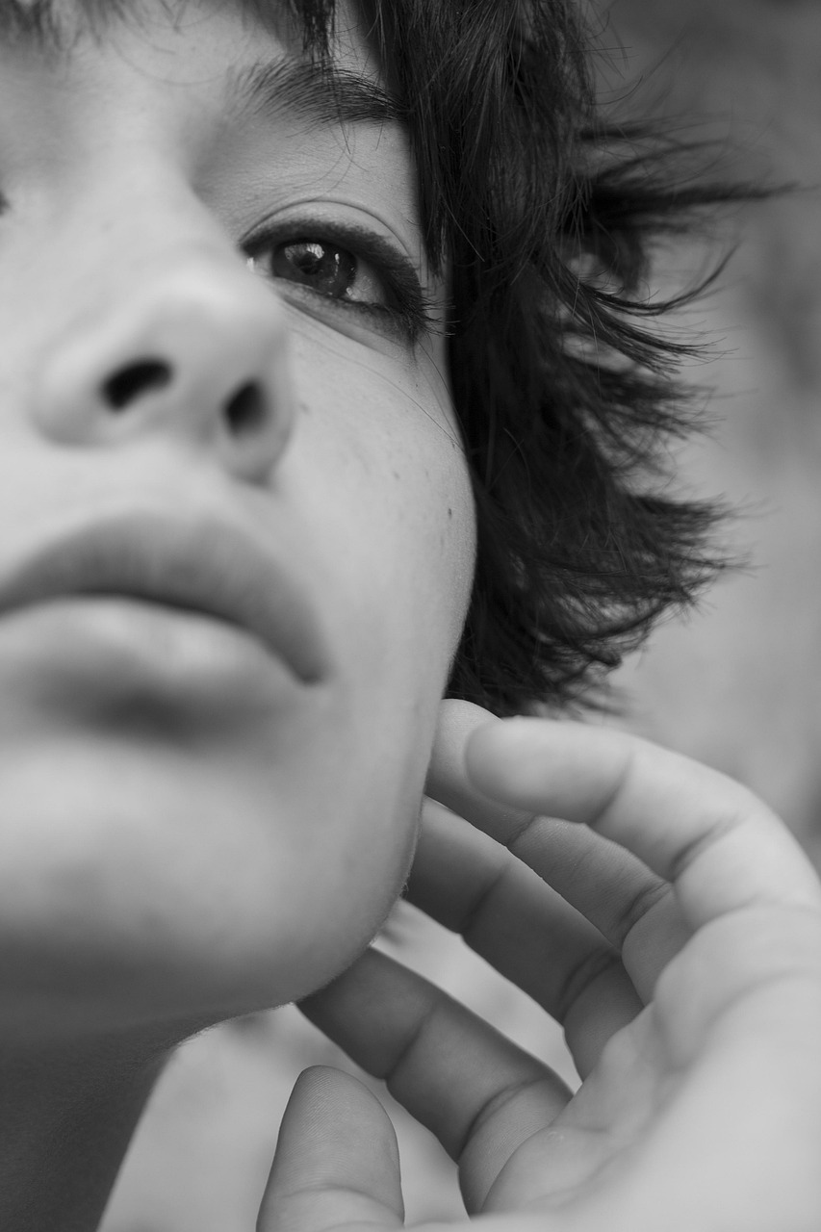
Title & Presentation Overview
This opening slide sets expectations for the audience and provides the title, presenter, and a concise overview of the talk. It should state that the presentat…
Title, presenter, date and institutional logo
One-line learning objectives (3 items)
Suggested timing and target audience
High-quality hero image and credits
Notes:
This opening slide sets expectations for the audience and provides the title, presenter, and a concise overview of the talk. It should state that the presentation covers the full anadromous life cycle of salmon from egg through to adult spawning and mortality, and highlight learning outcomes: understand the six life stages, recognize habitat needs at each stage, and identify human impacts and conservation responses. The slide can include a single representative image of salmon in a stream. In preparing content I reviewed multiple existing teaching resources including the Slideserve 'The Life Cycle of Salmon' presentation available at https://www.slideserve.com/oleg-barnett/the-life-cycle-of-salmon and the SlideShare 'The salmon life cycle' file at https://www.slideshare.net/slideshow/the-salmon-life-cycle/24955928 to align terminology and staging commonly used in classroom materials.

Slide 3
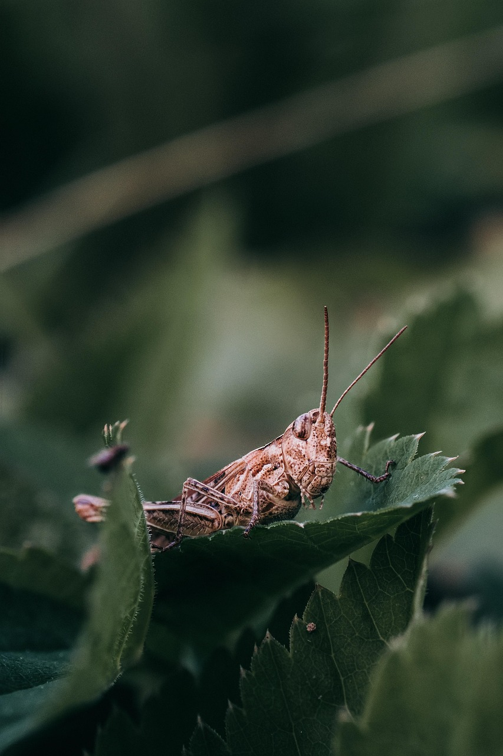
Salmon Basics: Biology and Anadromy
they hatch in freshwater, migrate to the ocean to grow, then return to natal freshwater to spawn and die. Use concise definitions of terms such as anadromous, …
Define 'anadromous' and 'natal stream'
Species variation: six Pacific Northwest species
Chinook as an example of size variation
Role of freshwater and marine habitat
Notes:
they hatch in freshwater, migrate to the ocean to grow, then return to natal freshwater to spawn and die. Use concise definitions of terms such as anadromous, natal stream, and smolt. Incorporate species-level context: the Slideserve resource notes there are six Pacific Northwest species and highlights Chinook as the largest, with mature individuals occasionally reaching very large sizes; this helps explain life-history variation across species and informs a discussion of migratory potential and mortality rates. Reference the Oregon Department of Fish and Wildlife resource (https://www.dfw.state.or.us/fish/STEP/docs/E2FVolunteerGuidePP1SalmonidLifeCycle.ppt) for common terminology used by fisheries educators.

Slide 4
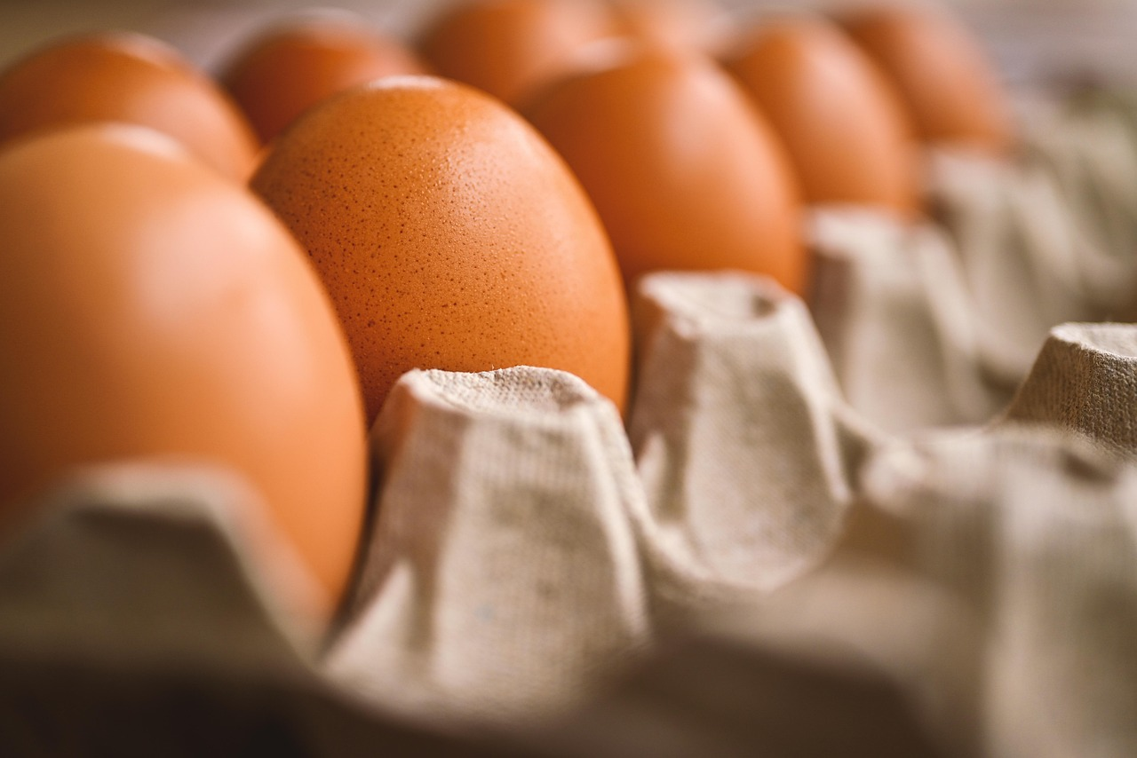
Stage 1 — Eggs and Spawning Behavior
Describe redd construction, egg deposition, and early embryo development. Salmon spawn in flowing, oxygenated gravel beds where females dig redds and males fer…
Redd construction and egg deposition process
Incubation conditions: oxygen, temperature, gravel
Time to hatch varies by species and stream temperature
Adult spawning behavior and post-spawn mortality
Notes:
Describe redd construction, egg deposition, and early embryo development. Salmon spawn in flowing, oxygenated gravel beds where females dig redds and males fertilize eggs. Eggs incubate in gravel, protected from predators and provided with oxygenated water; incubation time varies with temperature and species. The Slideshare and Slideserve summaries note that eggs are laid in gravel and hatch after weeks to months depending on conditions, and that spawning is typically a fatal terminal event for adults in many Pacific salmon species. Use the ODFW teaching PPT as a frame for classroom explanations of egg survival factors (siltation, temperature, flow, and predation). Provide speaker notes for emphasizing timing variability and local examples where available.

Slide 5
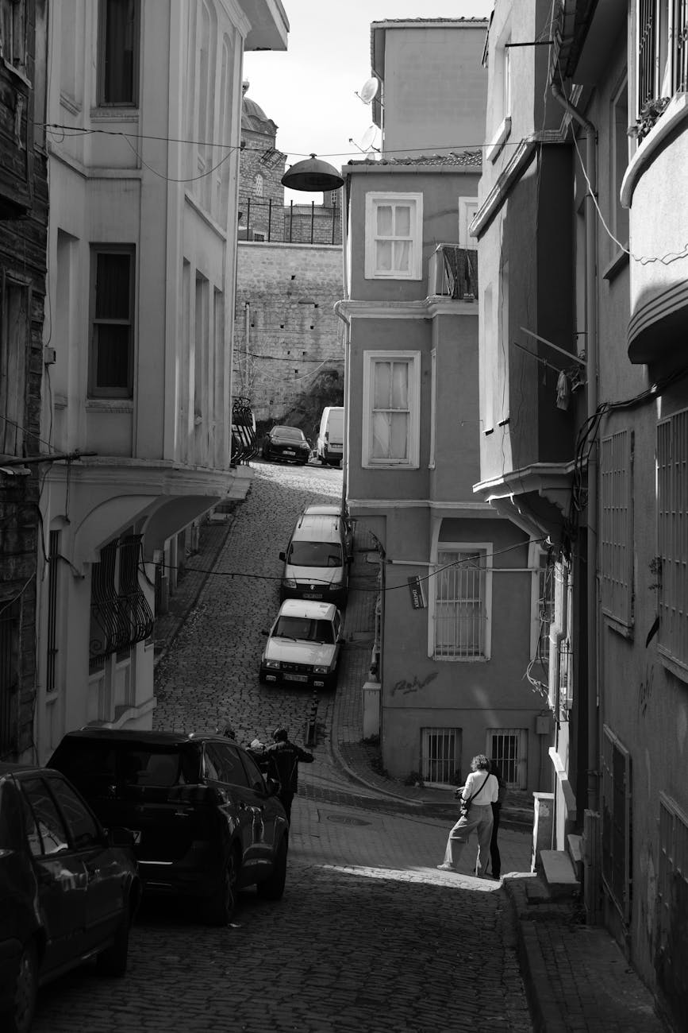
Stage 2 — Alevin: Yolk-Dependent Larvae
Explain the alevin stage: newly hatched salmon retain a yolk sac for nutrition while remaining in the gravel. Alevin are not free-swimming foraging juveniles; …
Alevin: yolk-sac–dependent and stay in gravel
Critical habitat: stable gravel and oxygenated water
Vulnerabilities: siltation and temperature spikes
Transition cue: yolk sac absorbed → emergence
Notes:
Explain the alevin stage: newly hatched salmon retain a yolk sac for nutrition while remaining in the gravel. Alevin are not free-swimming foraging juveniles; instead they absorb the yolk sac while they develop. The SlideShare resource describes this stage as alevin with large yolk sacs that support early development until emergence. This slide should present micro-habitat needs (stable gravel, low siltation, cold, well-oxygenated water) and vulnerabilities (nest disturbance, poor water quality). Provide visuals: a labeled diagram showing yolk sac and timing, and speaker notes referencing the SlideShare and Slideserve materials for common classroom imagery and language.

Slide 6
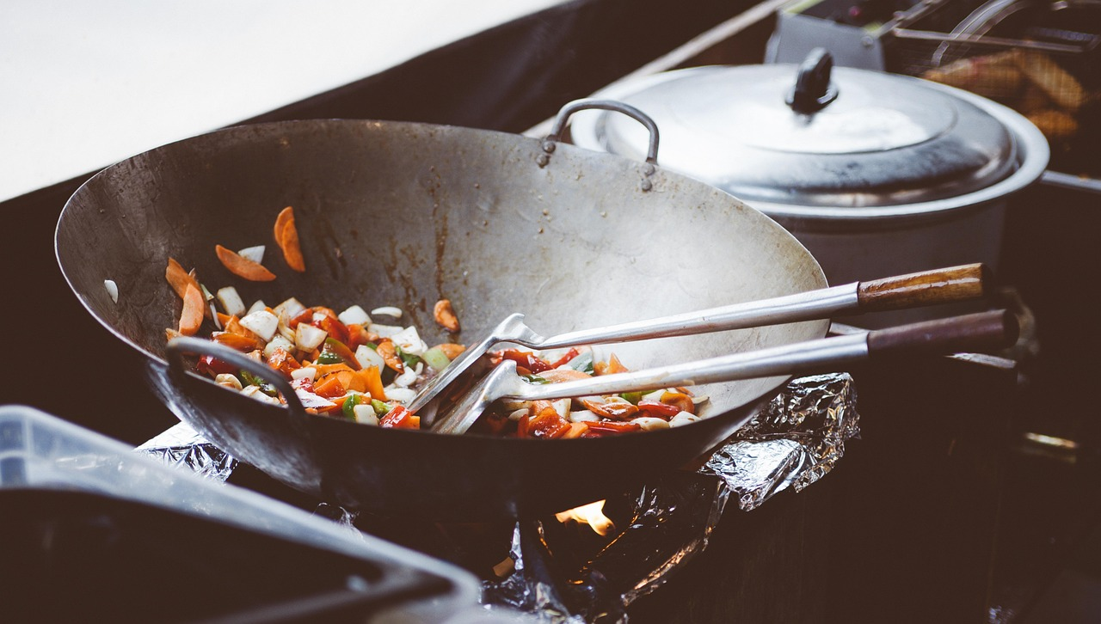
Stage 3 — Fry and Parr: Freshwater Rearing
After consuming the yolk sac, young salmon emerge as fry and begin active feeding on invertebrates and plankton. Over weeks to months many species develop parr…
Fry emerge and begin external feeding
Parr develop camouflaging vertical bars
Freshwater rearing sites: pools, riffles, cover
Activity: compare rearing time across species
Notes:
After consuming the yolk sac, young salmon emerge as fry and begin active feeding on invertebrates and plankton. Over weeks to months many species develop parr marks—vertical bars that provide camouflage in streams. The Google Slides 'Salmon Life Cycle' presentation and the SlideShare summary outline this sequence from alevin to fry to parr and note the importance of stream food resources and complex habitat (pools, riffles, cover). This slide should explain growth rates in freshwater, typical behaviors (territoriality, microhabitat selection), and the ecological importance of invertebrate prey availability. Include classroom prompts to compare freshwater rearing durations across species and locales, referencing the ODFW volunteer guide for suggested activities.

Slide 7
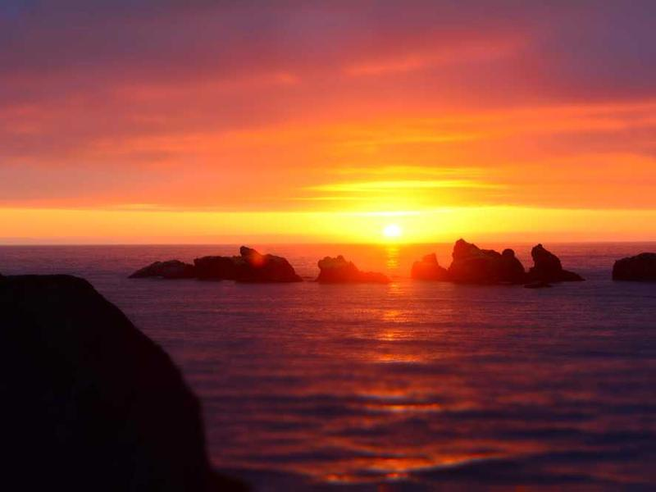
Stage 4 — Smoltification and Seaward Migration
Smoltification is the physiological and behavioral transformation allowing juveniles to move from freshwater to saltwater. During smolt stage fish silver and s…
Physiology: osmoregulation and silvering
Behavior: schooling and downstream migration
Triggers: photoperiod, growth thresholds, season
Threats: barriers, altered flows, predation in estuary
Notes:
Smoltification is the physiological and behavioral transformation allowing juveniles to move from freshwater to saltwater. During smolt stage fish silver and streamline, adjust osmoregulatory function, and may form schools for downstream migration. The SlideShare and Google Slides sources summarize this as fry turning silver as smolt before swimming to the ocean to grow. This slide should cover the triggers (photoperiod, size, seasonal cues), the timing of downstream migration, and habitat corridors needed for safe passage to estuaries. Include management issues such as barriers (dams, culverts) and altered flow regimes that increase mortality during migration; draw on the ODFW material for practical restoration examples and classroom activities showing migration corridor mapping.

Slide 8
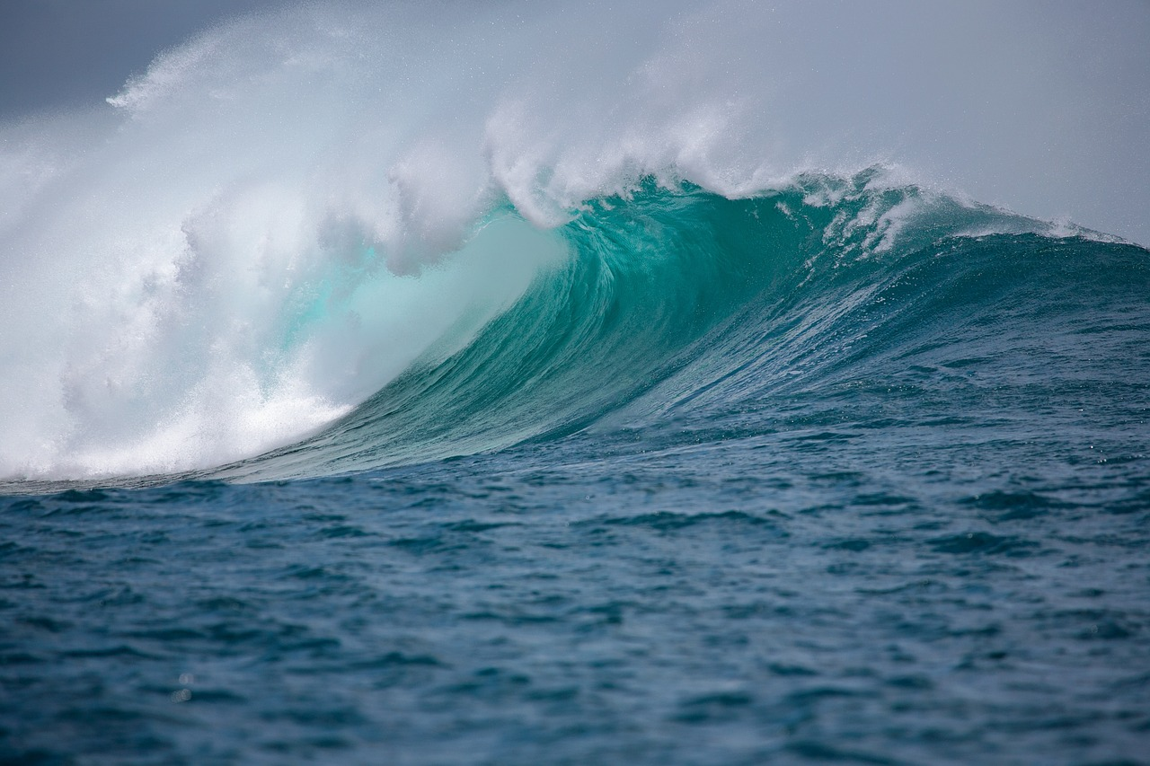
Stage 5 — Ocean Growth and Adult Maturation
In the ocean, salmon undergo most of their growth and reach sexual maturity. Use this slide to describe feeding ecology at sea, predator-prey relationships, an…
Major growth occurs at sea; time at sea is species-specific
Feeding ecology: forage fish and trophic links
Marine survival drives interannual run variability
Research tools: tagging, acoustic telemetry, ocean indices
Notes:
In the ocean, salmon undergo most of their growth and reach sexual maturity. Use this slide to describe feeding ecology at sea, predator-prey relationships, and variable marine survival that drives annual run size fluctuations. The Slideserve summary and other classroom presentations note that adults spend months to years at sea depending on species before returning to spawn. Emphasize that ocean conditions (temperature, food availability) strongly influence adult size and survival; for example, the Slideserve piece highlights species-level size variation with Chinook reaching very large sizes. Provide speaker notes on how marine research and tagging studies inform migration routes and growth patterns and include classroom activities to explore oceanographic indices and their correlation with salmon returns.

Slide 9
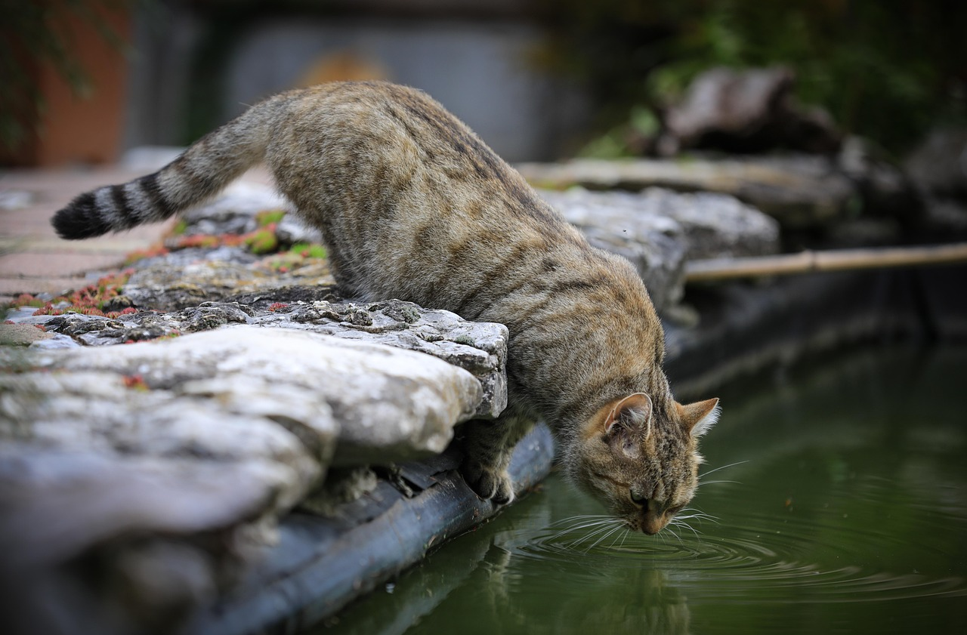
Stage 6 — Return Migration and Spawning Adults
Mature adults navigate back to natal streams to spawn, often overcoming substantial obstacles. This slide should explain homing, energetic costs of migration, …
Homing to natal streams and spawning migrations
Redd digging, egg deposition, and fertilization behavior
Semelparity: post-spawn mortality and nutrient transfer
Field safety and observational protocols for educators
Notes:
Mature adults navigate back to natal streams to spawn, often overcoming substantial obstacles. This slide should explain homing, energetic costs of migration, and changes in physiology and behavior during freshwater re-entry. The SlideShare and SlideServe summaries state that mature adults return to their home streams to spawn, dig nests, and then die in many Pacific salmon species; include that spawning often involves adults digging redds and depositing eggs. Discuss mortality patterns: many Pacific salmon are semelparous and die shortly after spawning, which imports marine-derived nutrients to freshwater ecosystems. Reference ODFW materials for visual aids and suggested in-stream observation protocols for field trips.

Slide 10
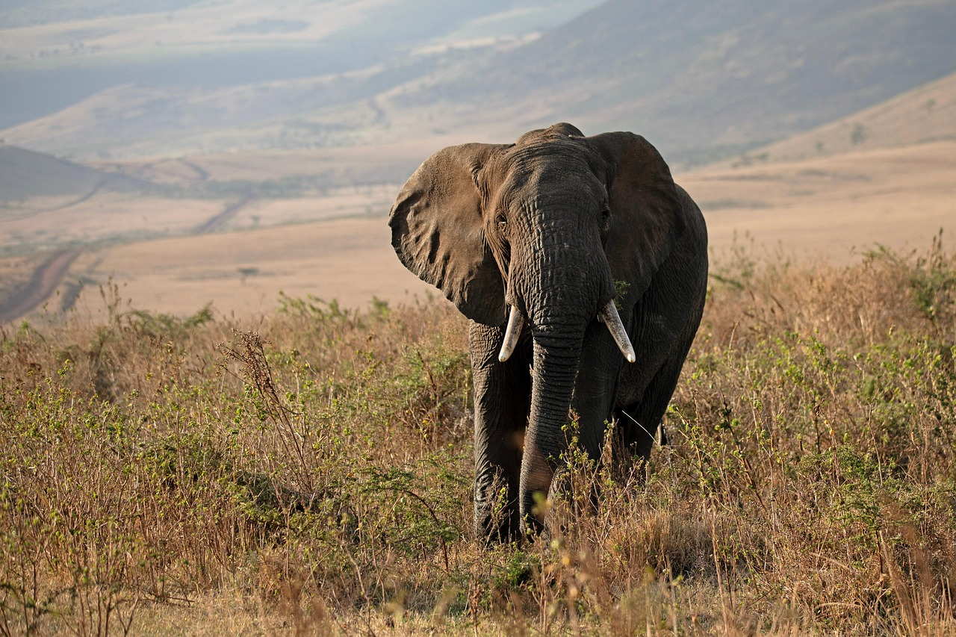
Human Impacts, Threats & Conservation Actions
threats include habitat loss (riparian removal, siltation), barriers to migration (dams, culverts), altered flow regimes, water quality changes, overfishing, a…
Threats mapped across life stages: freshwater to ocean
Restoration: riparian planting, sediment control, barrier removal
Policy tools: harvest limits, hatchery management, flow allocation
Community actions: monitoring, stewardship, education
Notes:
threats include habitat loss (riparian removal, siltation), barriers to migration (dams, culverts), altered flow regimes, water quality changes, overfishing, and climate-driven shifts in ocean conditions. Conservation responses span habitat restoration, barrier removal, flow management, hatchery supplementation with careful genetic oversight, and harvest regulation. The SlideServe and SlideShare classroom resources contain accessible examples and activity suggestions useful for community outreach; cite these as resources for local case studies and volunteer programs. Provide a short list of proven interventions with references to agency materials for further details.

Slide 11

Classroom Activities, Visuals & Assessment
Offer a menu of teaching activities and assessment strategies aligned to the life-cycle content. Draw from the ODFW PPT and the Google Slides educational prese…
Hands-on: redd model, egg incubation demonstration
Field: stream habitat survey and species ID
Data exercise: correlate returns with ocean indices
Assessments: quizzes, concept maps, project rubrics
Notes:
Offer a menu of teaching activities and assessment strategies aligned to the life-cycle content. Draw from the ODFW PPT and the Google Slides educational presentation for tested ideas: in-class models of redd construction, egg-incubation experiments, stream habitat mapping, smolt migration simulations, and data-analysis exercises using publicly available run-size and ocean index data. Suggest formative assessments (concept maps, staging quizzes) and summative assessments (mini-research projects, field trip reports). Provide reproducible handout templates and slide visuals recommendations (stage-by-stage photos, labeled diagrams). Include instructions for adapting content by grade level and accessibility considerations for visuals and hands-on materials.

Slide 12
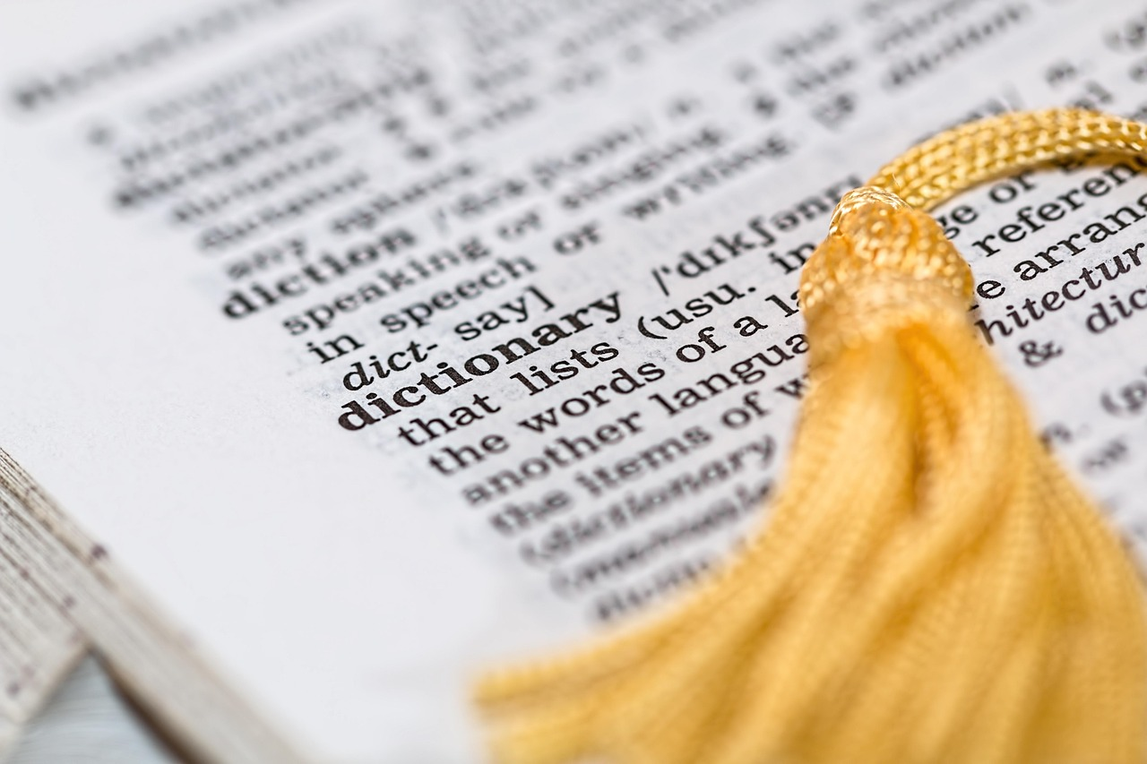
References, Resources & Next Steps
Conclude with a consolidated list of resources and a clear set of next steps for presenters who want a finished PowerPoint. Provide the authoritative resources…
Provide full resource links and attribution
Offer to produce finished .pptx with speaker notes
Ask for template, branding, and image preferences
Next step: confirm delivery method and file access
Notes:
Conclude with a consolidated list of resources and a clear set of next steps for presenters who want a finished PowerPoint. Provide the authoritative resources used during development: the Slideserve 'The Life Cycle of Salmon' presentation at https://www.slideserve.com/oleg-barnett/the-life-cycle-of-salmon, the SlideShare 'The salmon life cycle' at https://www.slideshare.net/slideshow/the-salmon-life-cycle/24955928, the Oregon Department of Fish and Wildlife teaching PPT at https://www.dfw.state.or.us/fish/STEP/docs/E2FVolunteerGuidePP1SalmonidLifeCycle.ppt, a Scribd lesson PDF at https://www.scribd.com/presentation/714397908/Life-Cycle-of-a-Salmon, a Google Slides classroom file at https://docs.google.com/presentation/d/16jl5JwAd-V4WbJINrBBsB9oqp5SM-Fq9yjjCA8W7jC4/htmlpresent, and a PowerShow public presentation at https://www.powershow.com/view/c704-YjBhN/SalmonLifeCyclepowerpointpptpresentation. Offer next steps: I can convert this outline into a downloadable .pptx built to a chosen slide template and add image-attribution footers—please confirm format preferences and whether you want speaker notes included.

Slide 13
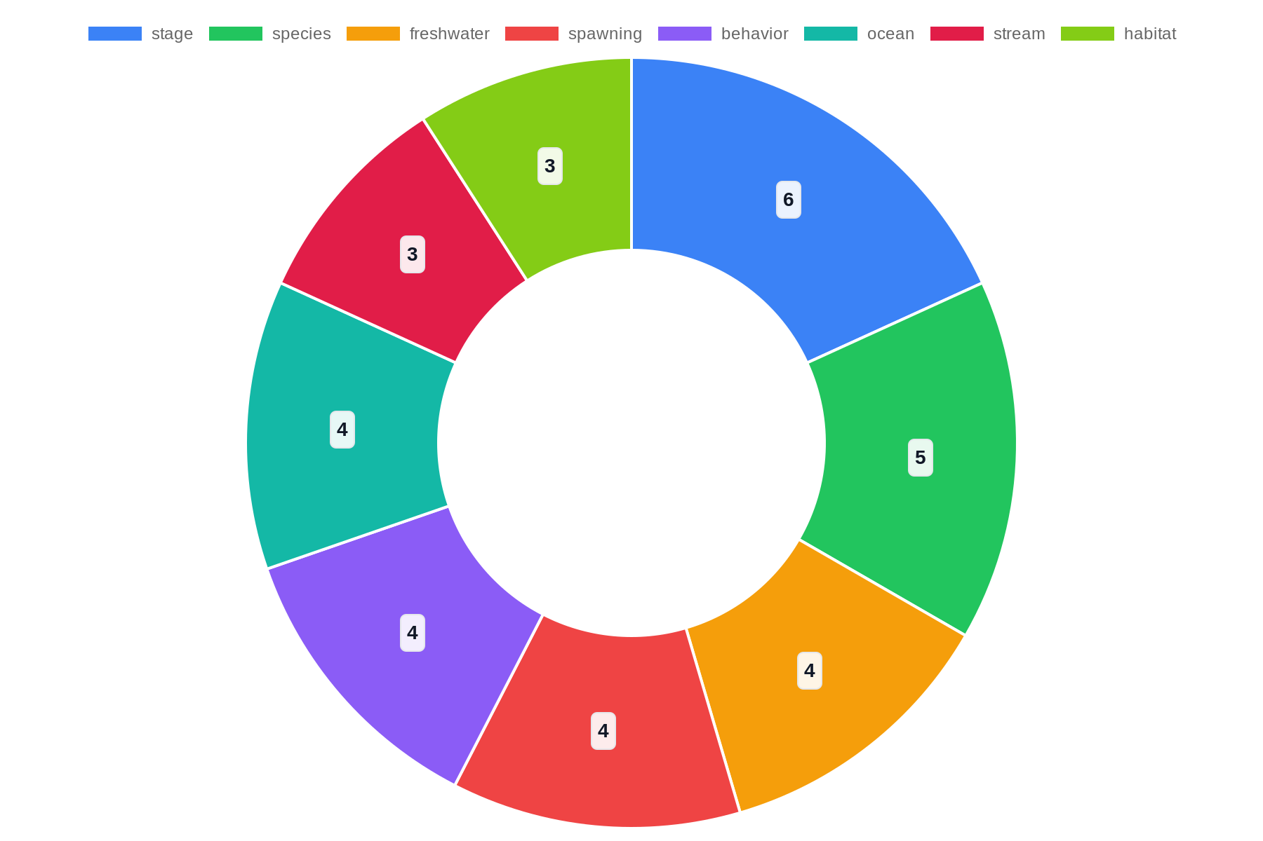
Top Topics

Slide 14
References
https://www.slideserve.com/oleg-barnett/the-life-cycle-of-salmon
https://www.slideshare.net/slideshow/the-salmon-life-cycle/24955928
https://www.dfw.state.or.us/fish/STEP/docs/E2F_Volunteer_Guide_PP1_Salmonid_Life_Cycle.ppt
https://www.scribd.com/presentation/714397908/Life-Cycle-of-a-Salmon
https://docs.google.com/presentation/d/16jl5JwAd-V4WbJINrBBsB9oqp5SM-Fq9yjjCA8W7jC4/htmlpresent
https://www.powershow.com/view/c704-YjBhN/Salmon_Life_Cycle_powerpoint_ppt_presentation
https://www.riverdee.org.uk/f/documents/Salmon-Life-Cycle-PPT-Lesson.pptx
https://www.slideshare.net/slideshow/the-salmon-powerpoint/24931994
https://www.powershow.com/view/6d9eb-NDk5O/Salmonid_Life_Cycle_powerpoint_ppt_presentation

