Slide 1
A) Token-level analysis
B) Sentence-level analysis
Klimaet
Klimaet
Klimaet
Klimaet
Pooled
”klima”
skal
skal
skal
skal
tages
tages
tages
tages
seriøst
seriøst
seriøst
seriøst
Klimaet
Pooled
”klima”
Output:
Output:

Slide 2
Mean of sentences describing ‘active’:
Sentence 1:
Sentence 2:
Sentence 3:
sum( ) = =
Sentence 4:
Sentence 5:
*transform to mean by dividing by n
Mean of sentences describing ‘passive’:
Sentence 1:
Sentence 2:
sum( ) = =
Sentence 3:
Sentence 4:
*transform to mean by dividing by n
Sentence 5:
‘Agency’ concept vector:
-
=

Slide 3




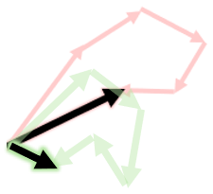





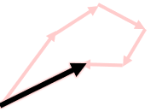
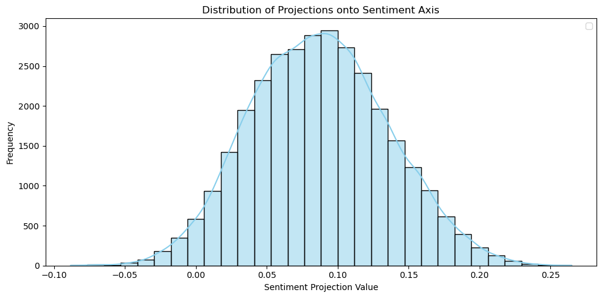

Positive corpus to mean positive vector
Difference as Concept Vector
Sentence projection onto concept vector
Generate concept corpus
Negative corpus to mean negative vector
Distribution of projection onto sentiment axis
Embedded Unlabeled Corpus
Corpus of interest
Embed corpus of interest

