Slide 1
Practical Business Python Lecture 3: Built-In Data Structures, Functions, and Files.
Iegor Vyshnevskyi
Woosong University
September 21, 2023

Slide 2
Agenda
Python Data Structure:
Tuple
List
Dictionary
Set
Python Functions
Files and the Operating System
In-class Assignment

Slide 3
1. Python Data Structure

Slide 4
Python’s data structures are simple but powerful.
Mastering their use is a critical part of becoming a proficient Pythonista.
We start with tuple, list, and dictionary, which are some of the most frequently used sequence types.

Slide 5
A. Python Tuple

Slide 6
Tuple basics
Tuple [ˈtjuːpəl] is a fixed-length, immutable sequence of Python objects which, once assigned, cannot be changed.
In some ways, a tuple is similar to a Python list in terms of indexing, nested objects, and repetition but the main difference between both is Python tuple is immutable, unlike the Python list which is mutable.
The easiest way to create one is with a comma-separated sequence of values wrapped in parentheses:
Source: Wes McKinney (2022)

Slide 7
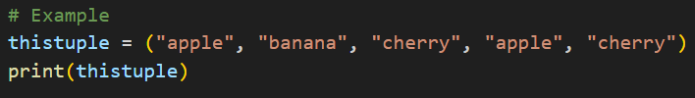
Tuple basics
Tuple items are ordered, unchangeable, and allow duplicate values.
Tuple items are indexed, the first item has index [0], the second item has index [1] etc.
When we say that tuples are ordered, it means that the items have a defined order, and that order will not change.
Tuples are unchangeable, meaning that we cannot change, add or remove items after the tuple has been created.
Since tuples are indexed, they can have items with the same value.
Source: W3Schools

Slide 8


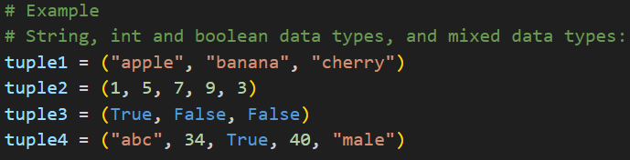
Tuple basics
Tuple Length
to determine how many items a tuple has, use the len() function:
Tuple With One Item
To create a tuple with only one item, you have to add a comma after the item, otherwise Python will not recognize it as a tuple (use type() function to check the type):
Tuple Items - Data Types
Tuple items can be of any data type:
Source: W3Schools

Slide 9
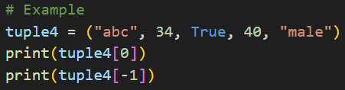
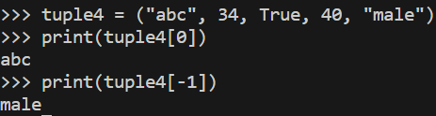
Tuple basics
The tuple() Constructor
It is also possible to use the tuple() constructor to make a tuple:
Tuple Indexing
We can use the index operator [] to access an item in a tuple, where the index starts from 0.
The index of -1 refers to the last item, -2 to the second last item and so on.
Source: W3Schools; Wes McKinney (2022); Programiz

Slide 10
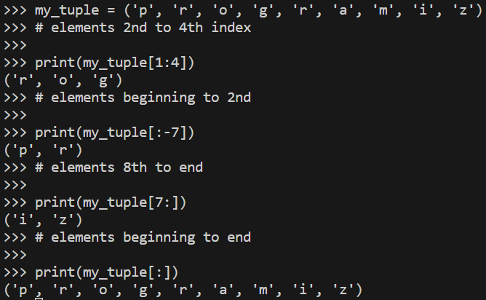
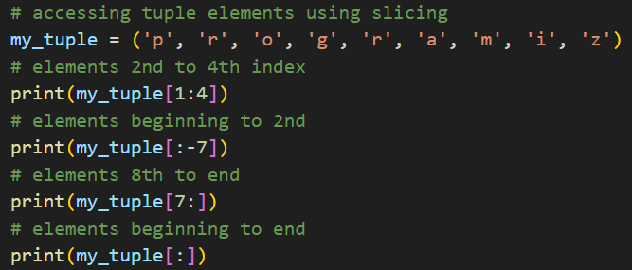
Tuple basics
Tuple Slicing
We can access a range of items in a tuple by using the slicing operator colon ‘:’.
Source: Programiz

Slide 11
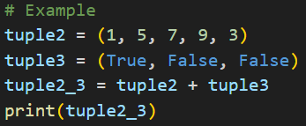
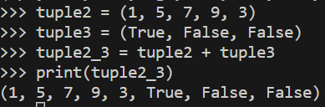
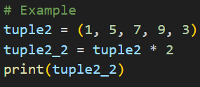
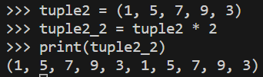
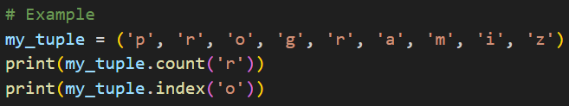
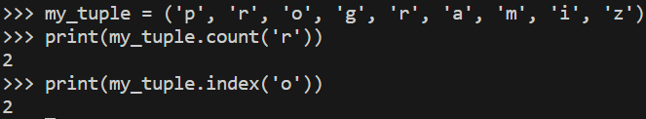
Tuple basics
Python Tuple manipulation and Methods
In Python ,methods that add items or remove items are not available with tuple.
You can concatenate tuples using the ‘+’ operator to produce longer tuples:
Multiplying a tuple by an integer, as with lists, has the effect of concatenating that many copies of the tuple:
You can count and index tuple’s elements.
Source: Wes McKinney (2022); Programiz

Slide 12
Tuple basics
Advantages of Tuple over List in Python
Since tuples are quite similar to lists, both of them are used in similar situations.
However, there are certain advantages of implementing a tuple over a list:
We generally use tuples for heterogeneous (different) data types and lists for homogeneous (similar) data types.
Since tuples are immutable, iterating through a tuple is faster than with a list. So there is a slight performance boost.
Tuples that contain immutable elements can be used as a key for a dictionary. With lists, this is not possible.
If you have data that doesn't change, implementing it as tuple will guarantee that it remains write-protected.
Source: Programiz

Slide 13
B. Python List

Slide 14
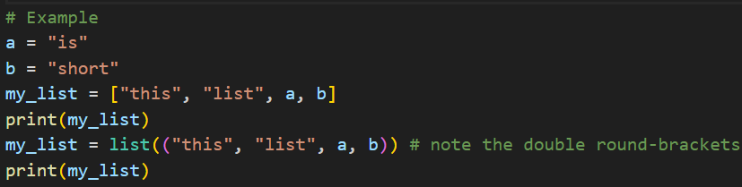
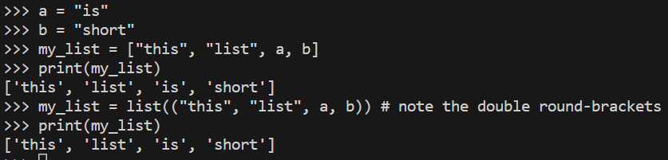
List basics
In contrast with tuples, lists are variable length and their contents can be modified in place. Lists are mutable.
As opposed to int, bool etc., a list is a compound data type; you can group values together. You can define them using square brackets [] or using the list type function.
Source: DataCamp; Wes McKinney (2022)

Slide 15
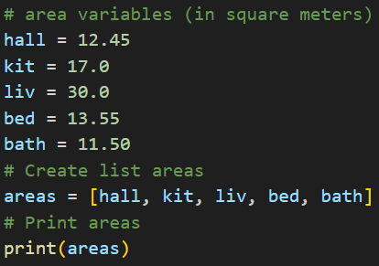
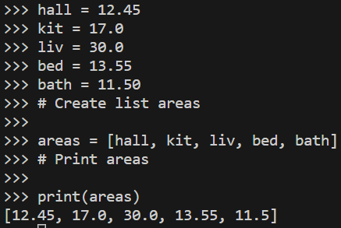
List basics
Example
After measuring the height of your family, you decide to collect some information on the house you're living in.
The areas of the different parts of your house are stored in separate variables for now, as shown in the script.
Source: DataCamp; Wes McKinney (2022)

Slide 16
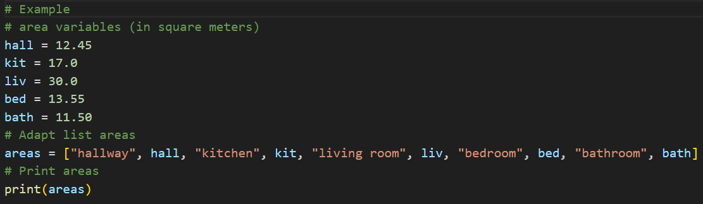
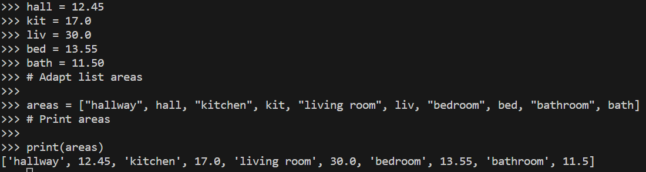
List basics
A list has the flexibility to accommodate various Python data types. While it's relatively uncommon, a list can even include a combination of Python types such as strings, floats, booleans, and more.
Example
Source: DataCamp; Wes McKinney (2022)

Slide 17
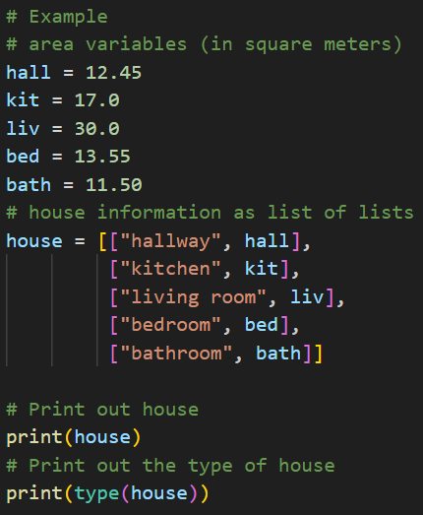
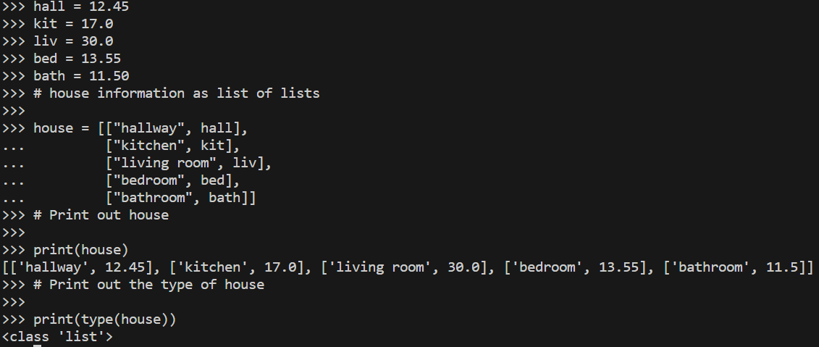
List basics
List of lists
Rather than forming a single list that combines strings and floats to represent room names and their respective areas in your house, you have the option to construct a list of lists.
Example
Source: DataCamp; Wes McKinney (2022)

Slide 18


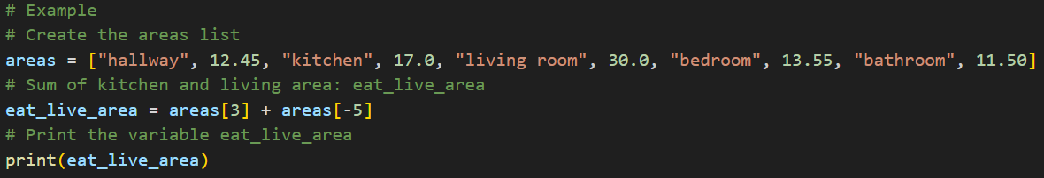
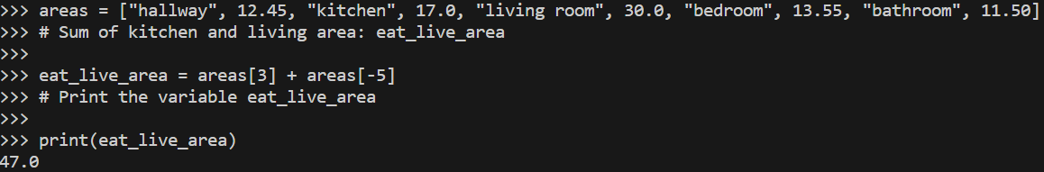
List basics
Subset and calculate
Getting separate elements of the list and perform some calculations:
Example
Source: DataCamp; Wes McKinney (2022)

Slide 19


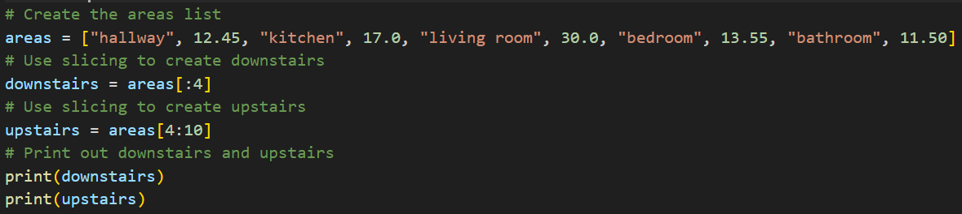
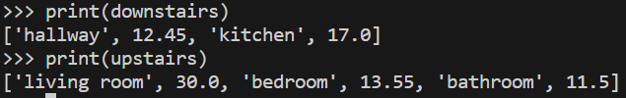
List basics
Slicing and dicing
You can also perform list slicing, which involves selecting multiple elements from your list. Utilize the following syntax for list slicing (The elements with index 1 and 2 are included, while the element with index 3 is not):
Example
Source: DataCamp; Wes McKinney (2022)

Slide 20
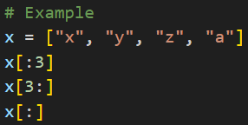
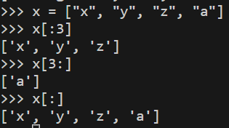
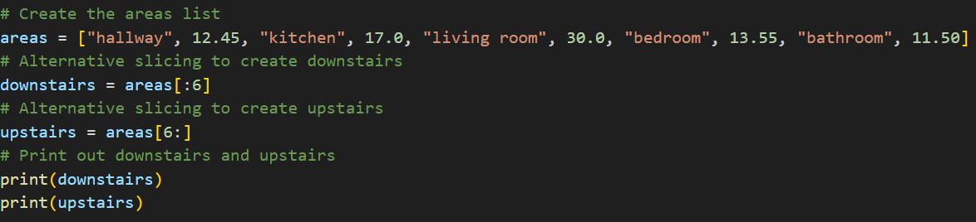
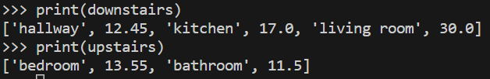
List basics
Slicing and dicing (2)
It’s possible not to specify start or end of the index, still using ‘:’.
Example
Source: DataCamp; Wes McKinney (2022)

Slide 21
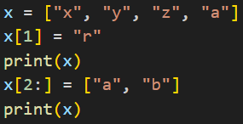
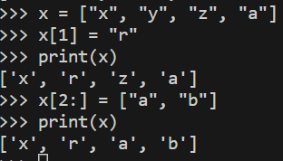
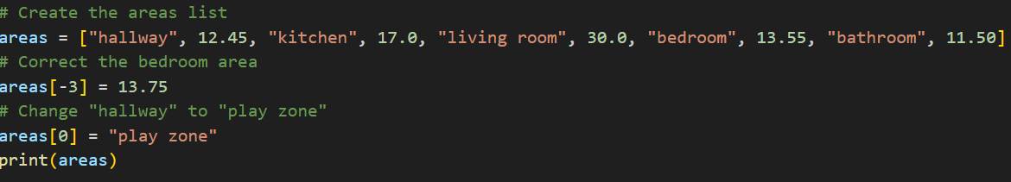
List basics
Replace list elements
Simply pick out a subset of the list and assign new values to that subset. You have the flexibility to select individual elements or modify entire slices of the list simultaneously.
Example
Source: DataCamp; Wes McKinney (2022)

Slide 22

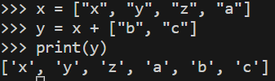
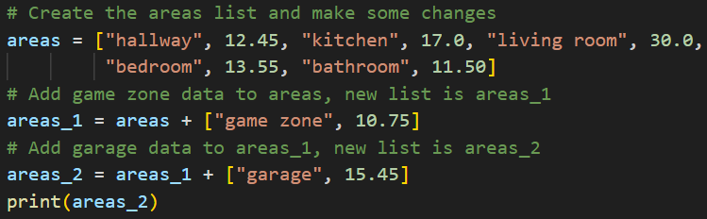
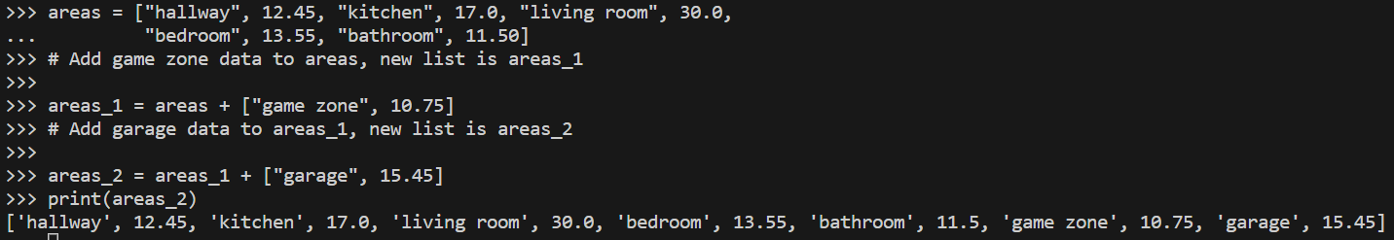
List basics
Extend a list
Add new elements to the list:
Example
Source: DataCamp; Wes McKinney (2022)

Slide 23

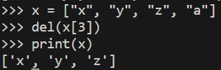
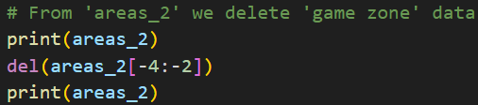
List basics
Delete list elements
We can also remove elements from your list with the del statement:
Example
Source: DataCamp; Wes McKinney (2022)

Slide 24
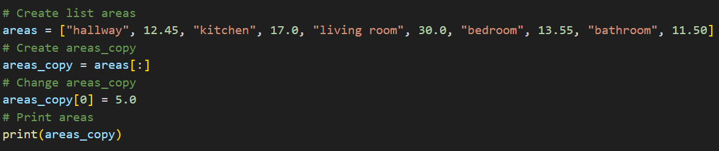
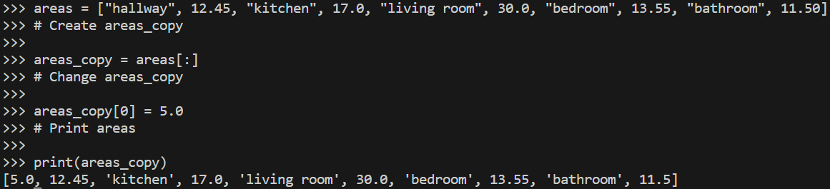
List basics
Copy list
By using [] and ‘:’ operators:
Source: DataCamp; Wes McKinney (2022)

Slide 25

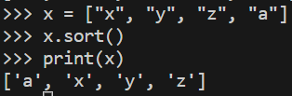
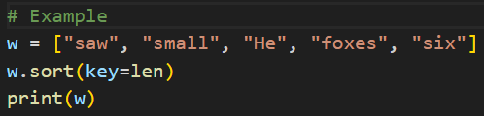

List basics
Sorting
You can sort a list in place (without creating a new object) by calling its sort function:
You can sort based on some requirements. Let’s sort by the elements lengths:
Source: DataCamp; Wes McKinney (2022)

Slide 26
C. Python Dictionary

Slide 27
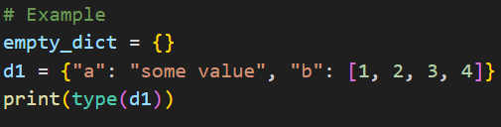

Dictionary basics
The dictionary or dict is important built-in Python data structure.
A dictionary stores a collection of key-value pairs, where key and value are Python objects.
Each key is associated with a value so that a value can be conveniently retrieved, inserted, modified, or deleted given a particular key.
One approach for creating a dictionary is to use curly braces {} and colons to separate keys and values:
Source: Wes McKinney (2022)

Slide 28
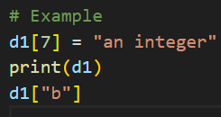
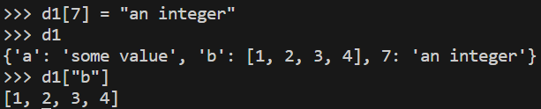


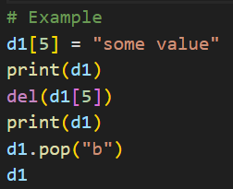
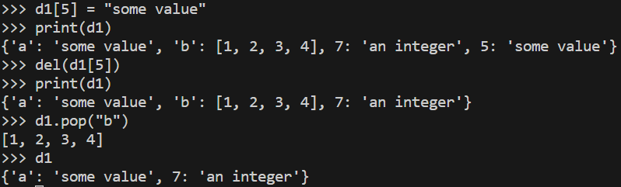
Dictionary basics
Operations
You can access, insert, or set elements using the same syntax as for accessing elements of a list or tuple:
You can check if a dictionary contains a key using the same syntax used for checking whether a list or tuple contains a value:
You can delete values using either the del keyword or the pop method (which simultaneously returns the value and deletes the key):
Source: Wes McKinney (2022)

Slide 29
D. Python Set

Slide 30


Set basics
A set is an unordered collection of unique elements.
A set can be created in two ways: via the set function or via curly braces:
Source: Wes McKinney (2022)

Slide 31
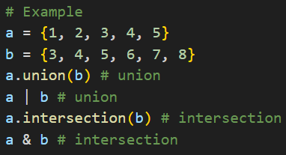
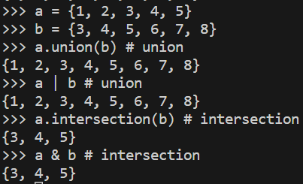
Set basics
Operations
Sets support mathematical set operations like union, intersection, difference, and symmetric difference.
Example
Source: Wes McKinney (2022)

Slide 32
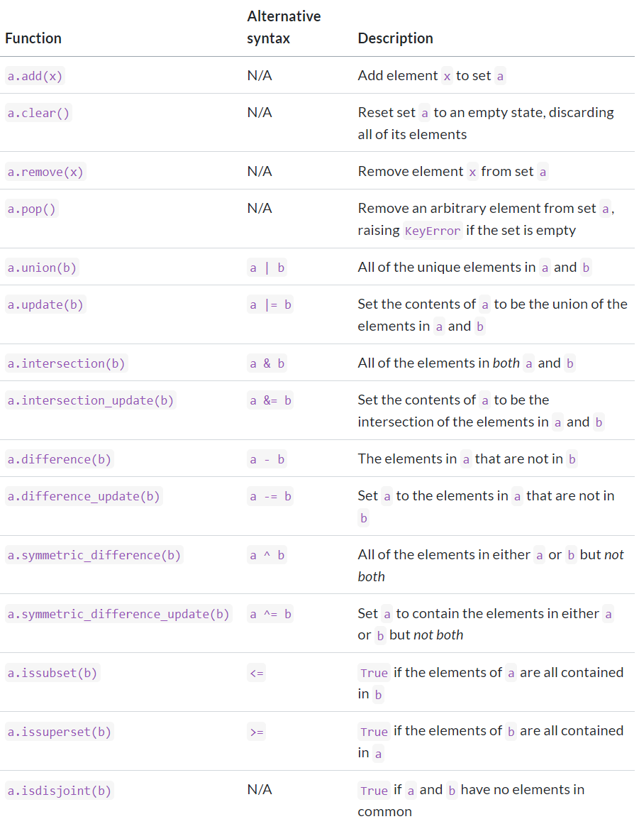
Set basics
Python set operations
Source: Wes McKinney (2022)

Slide 33
2. Python Functions

Slide 34
Functions basics
Functions are the primary and most important method of code organization and reuse in Python.
As a rule of thumb, if you anticipate needing to repeat the same or very similar code more than once, it may be worth writing a reusable function.
Functions can also help make your code more readable by giving a name to a group of Python statements.
Source: Wes McKinney (2022)

Slide 35
Functions basics
In-built functions
Python comes equipped with a variety of built-in functions designed to simplify the tasks of a data scientist.
You're already familiar with a couple of these functions: print() and type().
Additionally, you've employed functions like str(), int(), bool(), and float() to facilitate the conversion between different data types. These functions are also part of Python's built-in arsenal.
The general way for calling functions and saving the result to a variable is: output = function_name(input)
Source: Wes McKinney (2022)

Slide 36
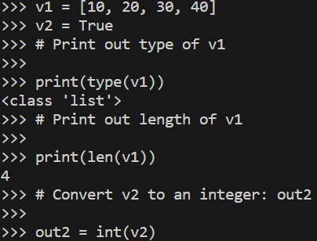
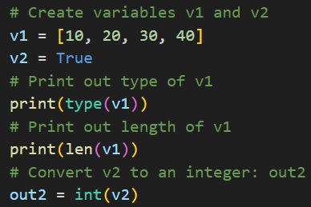
Functions basics
Example
Source: DataCamp; Wes McKinney (2022)

Slide 37


Functions basics
Help function
To find details about any function you may use help function:
Source: DataCamp; Wes McKinney (2022)

Slide 38
Functions basics
Multiple arguments
A function may have different attributes/arguments.
Take a moment to review the documentation for the sorted() function by entering help(sorted) in your Python environment.
You will observe that sorted() accepts three parameters: iterable, key, and reverse.
key=None means that if you don't specify the key argument, it will be None.
reverse=False means that if you don't specify the reverse argument, it will be False, by default.
Source: DataCamp; Wes McKinney (2022)

Slide 39


Functions basics
Multiple arguments
Example:
Source: DataCamp; Wes McKinney (2022)

Slide 40


Functions basics
String Methods
Strings are equipped with a variety of methods.
Example
Source: DataCamp; Wes McKinney (2022)

Slide 41


Functions basics
List Methods
Strings aren't the sole Python types that feature associated methods. Lists, floats, integers, and booleans are also data types that include a plethora of helpful methods. In this exercise, you'll have the opportunity to explore:
Example
Source: DataCamp; Wes McKinney (2022)

Slide 42


Functions basics
Writing a function
Sometimes it’s more efficient to write own function.
Example
Source: DataCamp; Wes McKinney (2022)

Slide 43


Functions basics
Import package
You can get much more functions from some specific packages.
Example
Source: DataCamp; Wes McKinney (2022)

Slide 44


Functions basics
Selective import from package
When you make general imports, such as import math, you gain access to all the functionality provided by the entire math package. However, if you prefer to use only a particular component of a package, you have the option to make your import more specific: ‘from math import pi’
Example
Source: DataCamp; Wes McKinney (2022)

Slide 45
Functions basics
Different ways of importing
There exist multiple approaches to importing packages and modules into Python. Depending on the specific import statement you choose, you will need to employ different Python code.
Example
Let's say you want to use the inv() function, which is located in the linalg subpackage of the scipy package, then to get it you run:
Source: DataCamp; Wes McKinney (2022)

Slide 46
3. Files and the Operating System

Slide 47
Files basics
It’s important to understand the basics of how to work with files in Python.
Fortunately, it’s relatively straightforward, which is one reason Python is so popular for text and file munging.
To open a file for reading or writing, use the built-in open function with either a relative or absolute file path and an optional file encoding.
We pass encoding="utf-8" as a best practice because the default Unicode encoding for reading files varies from platform to platform.
By default, the file is opened in read-only mode "r".
Source: Wes McKinney (2022)

Slide 48


Files basics
Example
We can then treat the file object f like a list and iterate over the lines like so:
Source: Wes McKinney (2022)

Slide 49

Files basics
Important Python file methods or attributes
Source: Wes McKinney (2022)

Slide 50
4. In-class Assignment

