Slide 1
Data Science Lecture 12: Trends and required skills
Iegor Vyshnevskyi
Woosong University
December 21, 2023

Slide 2
Agenda
Grading and Attendance
Data Science Facts & Trends
Skills Required in the Job Market
Predictions about the future of Data Science
Acknowledgment: Used a number of open sources and materials from the web.

Slide 3
1. Grading and Attendance

Slide 4


What is Forecasting?
1. Check LMS to see your in-class assignments, midterm & final exams grades.
2. Check your attendance app.
Today is your last chance to talk over your grades and attendance.

Slide 5
2. Data Science Facts & Trends

Slide 6
Quick facts
If we take into account all of the data that is currently available internationally, around 70% of it is user-generated, according to a DM News report.
According to one estimate, 1.145 trillion megabytes of data are produced daily.
Statista estimates that in 2021, there were around 79 Zettabytes of data/information created, consumed, collected, and duplicated globally.
According to forecasts made by CrowdFlower in its Data Scientist Report, text data makes up 91% of the data utilized in data science. According to the same survey, unstructured data consists of 33% images, 11% audio, 15% video, and 20% other types of data in addition to text.
The global datasphere has 90% replicated data and 10% unique data.
In the worldwide digital universe, between 80 and 90% of the data is unstructured, according to one of the articles published on CIO.
The BCG-WEF project report details the findings that 72 percent of manufacturing organizations use advanced data analytics to increase productivity.
The competition in their industry has changed as a result of data analytics, according to about 47% of McKinsey survey respondents, and data science has helped businesses gain a competitive advantage.
Source: https://www.simplilearn.com/data-science-facts-article

Slide 7
Companies using data science for customer analytics can outperform competitors by up to 23 times in certain indicators
Basically, what data science does is allow companies to gather important information on how best to act by processing vast amounts of raw data for hidden insights.
A recent study found that businesses successfully applying customer analytics were able to acquire up to 23 times more new customers. All in all, the chances of a company to succeed in sales and marketing double when a company uses customer analytics.
Source: https://webtribunal.net/blog/data-science-facts/#gref

Slide 8
Software trained to understand the sentiment behind emails can lead to 95% faster handling of customer requests
So, what is data science used for specifically?
How does it help companies grow?
Here’s one example: Contextor is a robotic process automation tool that understands the sentiment behind emails. Companies using it can then identify who are the unhappy customers and prioritize their response, thus improving “incident handling times” anywhere from 15% to 95%.
Happier customers typically means better business, so it’d be silly to pass on this opportunity.
Fun fact: Sentiment analysis is a useful tool for reputation management, too. Solutions like Brand24 scan what people are saying about your brand online as well as the sentiment behind their comments. That way, if you have a negative review, you can be proactive and do some damage control before it escalates.
Source: https://webtribunal.net/blog/data-science-facts/#gref

Slide 9
Data scientists spend 80% of their time organizing data
A good data scientist knows how to analyze data statistically—and they also know that’s but a tiny part of the job.
Approximately 80% of their time is spent looking for data, cleaning it up, and organizing it before it’s ready for analysis. It’s the final 20% that leads to the wringing of information to be used in the making of business decisions.
Source: https://webtribunal.net/blog/data-science-facts/#gref

Slide 10
69% of data scientists use Python
Data science and programming go hand in hand. After all, you’ll definitely need one programming language or another to analyze large quantities of data.
At the moment, Python is by far the most popular—69% of professionals in the industry use it. For comparison, 24% use R.
Fun fact: 75% of data science job postings ask for experience with Python—more than it’s actually used.
Source: https://webtribunal.net/blog/data-science-facts/#gref

Slide 11
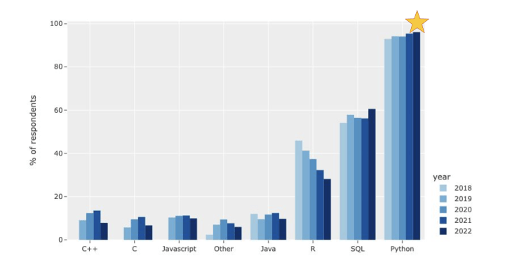
In 2022, Kaggle released the annual version of their Machine Learning and Data Science Survey.
Source: https://r-craft.org/why-python-is-the-best-data-science-language-in-2023/

Slide 12
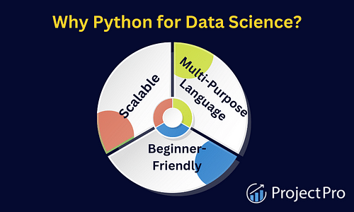
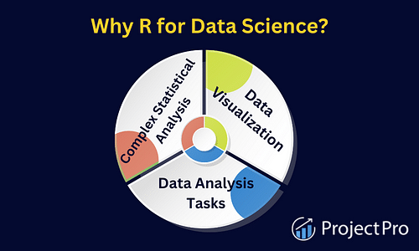
Yet, it depends…
Source: https://www.projectpro.io/article/data-science-programming-python-vs-r/128

Slide 13
The average number of data scientists working at large organizations worldwide rose from 28 in 2020 to 50 in 2021
As the data science industry grows, so does the number of people it employs. As recently as 2020, 40% of large businesses employed no more than 10 data scientists. A year later, 81% of those big companies employed at least 50 each.
In other words, the corporate world saw the average number of employed data scientists go from 28 to 50 in just a year.
Fun fact: As of 2022, just over 50 out of the 3,216 postsecondary schools in the US teach data science majors. Five years ago, practically none of them did.
Source: https://webtribunal.net/blog/data-science-facts/#gref

Slide 14
Demand for data scientists is three times higher than supply
Considering the sheer number of data science applications in multiple industries, it’s self-evident why the demand for specialists in the field is high.
And considering the substantial barrier to entry due to the vast range of skills necessary, it’s also clear why supply isn’t up to par.
Even now, there are three times as many job openings for data scientists as there are people looking for such working opportunities—which is at least partly why data science is such a well-paid career path.
Furthermore, the demand for these professionals is unlikely to abate any time soon. On the contrary, experts suggest it will rise another 28% by 2026.
Fun fact: In general terms, about 1%-2% of the world’s population has a PhD. Yet, specifically, 48% of data scientists have one. See what we mean by “substantial barrier to entry”?
Source: https://webtribunal.net/blog/data-science-facts/#gref

Slide 15
Only half a percent of all data is ever analyzed
Various data science stats suggest that we generate multiple petabytes of data every day. Yet, much of it remains unused, as professionals only ever analyze about 0.5% of the total.
Think about it this way—pre-election surveys, for instance, can be fairly accurate, but they don’t always correctly estimate a candidate’s final results (2016 was notorious for this).
Similarly, 0.5% of the immense volume of data in existence is undoubtedly fairly representative of reality, but it’s neither complete nor perfect. And since the role of a data scientist is to extract useful information from data, we can only imagine the magnitude of knowledge hidden within those 99.5%.
Fun fact: There will be 175 zettabytes of data by 2025 (one zettabyte = 1,000 exabytes = 1,000,000 petabytes = 1,000,000,000 terabytes).
Source: https://webtribunal.net/blog/data-science-facts/#gref

Slide 16
7 Key Data Science Trends For 2024-2027
1. Explosion In Deepfake Video And Audio
2. More Applications Created With Python
3. Increased Demand For End-To-End AI Solutions
4. Companies Hire More Data Analysts
5. Data Scientists Joining Kaggle
6. Increased Interest In Consumer Data Protection
7. AI Devs Combating Adversarial Machine Learning
Source: https://explodingtopics.com/blog/data-science-trends

Slide 17
3. Skills Required in the Job Market

Slide 18
Navigating the Job Market
The job market for data science professionals is dynamic and competitive. Here are some strategies for navigating a successful career in data science:
Build a Solid Foundation: Establish proficiency in statistics, mathematics, and programming languages like Python and R.
Specialise: Stand out in the job market by specialising in a specific data science area, such as machine learning, natural language processing, or big data.
Gain Hands-on Experience: Employers highly value practical experience, so engage in internships, personal projects, or data science competitions.
Continuous Learning: Stay current with the latest tools, techniques, and industry trends. Enroll in courses, attend conferences, and join online forums to stay connected with the data science community.
Network: Forge a robust professional network by attending industry events, participating in online communities, and connecting with field professionals.
Communication Skills: Hone effective communication skills to convey intricate findings clearly to both technical and non-technical audiences.
Source: https://pwskills.com/blog/future-of-data-science-trends-to-watch-in-2025/

Slide 19
The top 8 data analyst skills
Data cleaning and preparation
Data analysis and exploration
Statistical knowledge
Creating data visualizations
Creating dashboards and reports
Writing and communication
Domain knowledge
Problem solving
Source: https://www.dataquest.io/blog/data-analyst-skills/

Slide 20
Other view: Technical Skills
SQL
Tableau®
Data warehousing
Python® / Statistical programming languages (R, Python, Java, Scala, Matlab)
SAS®
Microsoft Power BI®
Project management
Extraction Transformation and Loading (ETL)
Oracle® Database
Data mining
Data modeling / Machine learning
Source: https://www.rasmussen.edu/degrees/technology/blog/data-analyst-skills/
https://www.indeed.com/career-advice/resumes-cover-letters/skills-for-data-analyst

Slide 21
Other view: Soft Skills
Communication
Problem-solving
Research
Attention to detail
Teamwork
A mind for math and numbers
Creative and analytical skills
Source: https://www.rasmussen.edu/degrees/technology/blog/data-analyst-skills/
https://brainstation.io/career-guides/what-skills-do-you-need-to-be-a-data-analyst

Slide 22
Soft Skills Beat Technical Skills in Data Analytics
The most important function of a Data Analyst is to drive business value to an organization in a measurable way. And it doesn't mean you need an impressive technical solution to do it.
It's inevitable that you will need technical skills to be successful in your role. Data never comes in a format where you can just SELECT * FROM perfect_table and call it a day. But just know that no one else but you will likely ever see the technical solution behind the report.
Source: https://towardsdatascience.com/soft-skills-beat-technical-skills-in-data-analytics-57f56ca91361

Slide 23
4. Predictions about the future of Data Science

Slide 24

1. The tasks of Data Scientists hired to augment business processes could be automated in the near future
The field of data science research is expected to grow at a 22% rate from 2020 to 2030, says the US Bureau of Labor Statistics.
This doesn’t mean that machines would replace data scientists entirely, but it shows that AI and other automation tools can help them relieve the work with augmentation.
Data scientists are still required to supervise, monitor, and interpret the outcomes of automated systems.
The no-code platforms and low-code programs will keep growing and organizations will largely adopt them more than anyone could think.
Source: https://www.usdsi.org/data-science-insights/future-of-data-science-10-predictions-you-should-know

Slide 25
2. Data Science will incorporate concepts from various fields like sociology and psychology– it will soon become interdisciplinary
Data science is a combination of many concepts like computer science, statistics, and mathematics.
But since the datasets are more complex, data scientists need to depend upon the concepts derived from other fields such as sociology, psychology, etc. to interpret the data easily.
With this interdisciplinary approach, the data science career lets you understand and analyze the data to make real-time business decisions.
Source: https://www.usdsi.org/data-science-insights/future-of-data-science-10-predictions-you-should-know

Slide 26
3. Social Media and other online platforms will become the source for the collection of more data
Data will be gathered mostly from Twitter, Facebook, and other social media platforms or websites.
These sources help businesses gain a great understanding of the thoughts and opinions of people about various topics.
Also, this data can help to make decisions about product development and marketing strategies.
Companies and organizations can customize the needs and wants of the customers when they get to know what people talk about online.
Source: https://www.usdsi.org/data-science-insights/future-of-data-science-10-predictions-you-should-know

Slide 27
4. Data Science will help businesses predict the consumer behavior
Data Science will be used more to understand and predict customer behavior.
Data Science helps to figure out the data patterns which helps in this process.
For instance, if a business knows a group of customers who buy a certain product and also search for another product to purchase, they can target these buyers to promote the second product.
Source: https://www.usdsi.org/data-science-insights/future-of-data-science-10-predictions-you-should-know

Slide 28
5. Data Science is moving into an era of becoming a team activity. It speaks not about creating a model, but what would you use it for once you build it
The major challenge lies in how you utilize the models and make them actionable.
Businesses should be able to leverage the functionality of the models and use them for real-time decisions.
The future of data science would think about this concern and form techniques to operationalize the models.
Source: https://www.usdsi.org/data-science-insights/future-of-data-science-10-predictions-you-should-know

Slide 29
6. Data Science will grow more conscious of the increased cybersecurity threats
Data scientists will face a rise in demand for cybersecurity skills.
Since the world has already begun chasing everything digitally, it is necessary to protect the information from intruders.
Data scientists should be aware of the cybersecurity techniques and tools to safeguard business data.
Source: https://www.usdsi.org/data-science-insights/future-of-data-science-10-predictions-you-should-know

Slide 30
7. Data Scientists will face a growing Cloud Computing prevalence
By 2025, about 463 exabytes of data will be produced per day– this is the same as 212,765,957 DVDs, says World Economic Forum.
Cloud computing gives data scientists access to computing resources, which they can use to process big datasets.
Since more businesses move to the cloud, the data science professional needs to understand and use cloud-based tools and techniques for data processing.
Source: https://www.usdsi.org/data-science-insights/future-of-data-science-10-predictions-you-should-know

Slide 31
8. Data Scientist’s jobs become more operationalized with advanced tools to capture their workflows and train enterprise on their best practices
New tooling is largely coming in to augment the workflows of data science professionals.
These can automate the workflows and create a platform to let companies train organizations based on how to utilize the workflows effectively.
This makes the job of a data scientist more operation-specific.
Source: https://www.usdsi.org/data-science-insights/future-of-data-science-10-predictions-you-should-know

Slide 32
9. Coding and AI skills will become more essential, and data scientists need to be more business-minded
Earlier, data scientists focused more on modeling and statistics, while less on coding.
However, with data science growing at a faster pace, the tools data scientists utilize for data analysis have become highly sophisticated.
Since datasets have become more complex, data scientists should develop a data science career with powerful coding skills in the future.
Source: https://www.usdsi.org/data-science-insights/future-of-data-science-10-predictions-you-should-know

Slide 33
10. Data Scientists will get the opportunity to initiate a “quantum leap”
Quantum computers can make data processing faster than conventional computers, which helps data scientists to make data analysis effective.
It uses a new algorithm with quantum mechanical properties to extract information.
The data scientists will focus on quantum algorithms and use them to solve real-time problems.
Source: https://www.usdsi.org/data-science-insights/future-of-data-science-10-predictions-you-should-know

Slide 34
Thank you and all the best!

