Slide 1

Networks and Network Analysis in R
Workshop Materials prepared for NSCR-R
January 22, 2022
Ieke de Vries, Ph.D.
Assistant Professor
Institute of Criminal Law
and Criminology
Leiden University
Source Picture: https://www.nature.com/collections/adajhgjece/

Slide 2
tidyverse: Basic data management and useful pipeline for code structure
igraph: Constructing network graphs
tidygraph: Using the tidyverse pipeline with igraph networks
ggraph: For better network visualizations
statnet: For ERGM models
Getting Ready: Packages in R

Slide 3
Assistant Professor at Leiden University
(previously at Florida State University & Northeastern University)
Background
Research Agenda: Social networks, spatial networks, victimization risk, human trafficking, dating violence, co-arrests
Teaching Agenda: Human trafficking; ecological context of crime; computational statistics (in R); programming in the social sciences (in Python)

Slide 4
Social Networks: A “finite set or sets of actors and the relation or relations defined on them.” (Wasserman & Faust 1994, p. 20).
What are Networks?

Slide 5

Networks
One-mode networks Two-mode networks
Workshop 1
takes the same workshop as
Node
Edge
i
j
i
j

Slide 6
Social Network Analysis (SNA): Tools to examine social relations (their structure, their formation and/or their influence on individual, group and system behavior).
Network and/or connections as dependent variables:
Individual and relationship characteristics explain the formation of ties

Slide 7
Social Network Analysis (SNA): Tools to examine social relations (their structure, their formation and/or their influence on individual, group and system behavior).
Network and/or connections as independent variables:
Explain or predict behaviors, opinions, experiences, attitudes

Slide 8
Reproducible, computationally efficient, more statistical analyses possible
Network Analysis in R
Origin for certain statistical packages (e.g. ERGM)

Slide 9

Exponential random graph models
Explains the odds of tie formation between any two nodes as a function of:
Node attributes
Edge attributes
Network attributes
Explaining Networks through Exponential Random Graph Models
$$\operatorname{Pr}\left(Y=y\right)= \left(\frac{1}{C}\right)\exp\left\{\sum_{a=1}^{A}{η_{a} g_{a} \left(y\right)}\right\}$$
Notes:
ERGMs estimate the probability of a set of ties, Y, as a function of nodes, node and dyad characteristics, and network terms. The parameters for these statistics are obtained through a stochastic process that compares the observed network with random networks. A basic ERGM is formalized as follows:
$$\operatorname{Pr}\left(Y=y\right)= \left(\frac{1}{C}\right)\exp\left\{\sum_{a=1}^{A}{η_{a} g_{a} (y)}\right\}$$
Here, $n_{a}$ is the sum of the coefficients for each network statistic $g_{a}$and a is the index for each included statistic in the network g(y) and c is the normalizing constant for the network distribution (Duxbury and Haynie 2018; Lusher et al. 2013; Papachristos and Bastomski 2018). Models that only include terms pertaining to the dyads and nodes were estimated through Maximum Pseudolikelihood Estimations (MPLE), which present regular logistic regression formats. Once higher-order network statistics were included, a maximum likelihood was estimated through Markov Chain Monte Carlo (MCMC) simulation methods. All data processing and analytical tasks were conducted in R, using the statnet suit of packages (Handcock et al., 2008) for ERGMs.

Slide 10

Not all networks are social networks

Slide 11
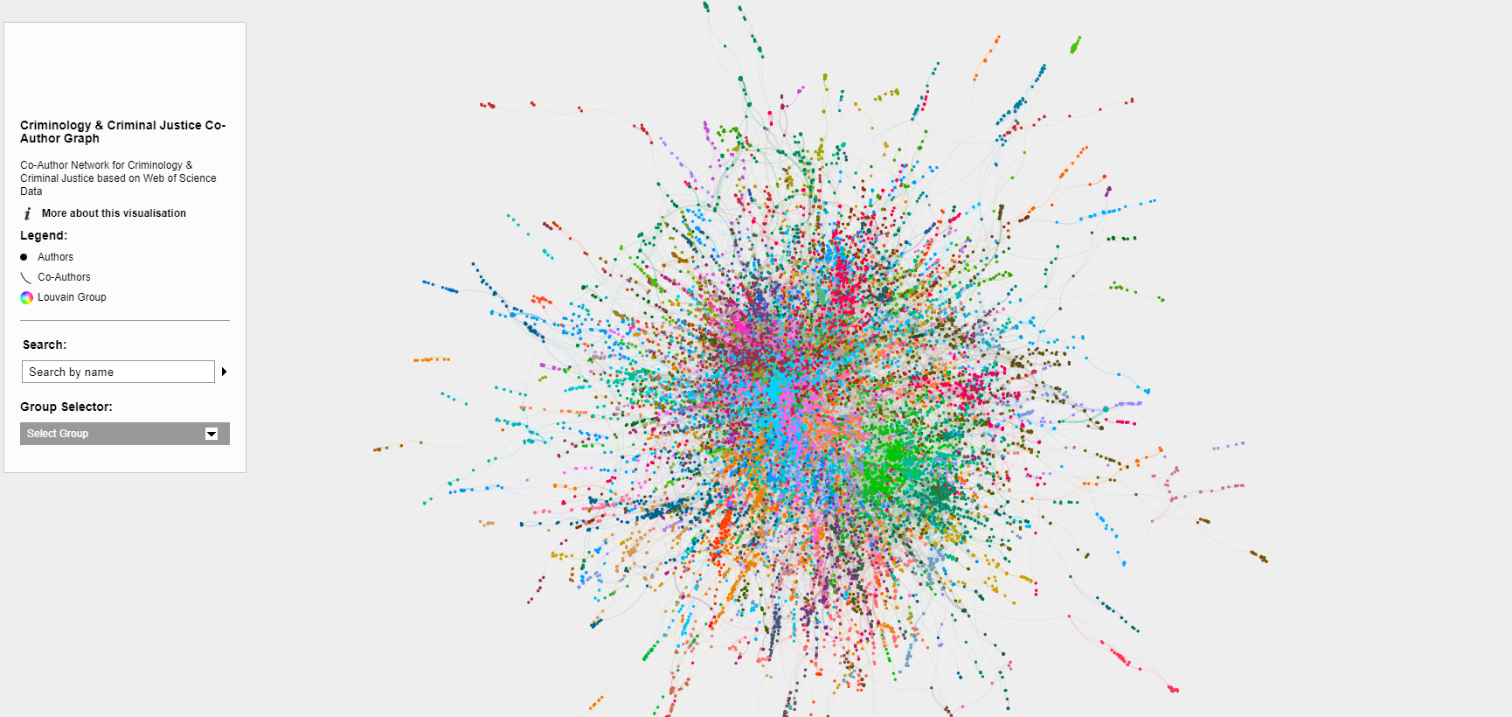
Example: Co-Author Network
https://apwheele.github.io/MathPosts/network/

Slide 12
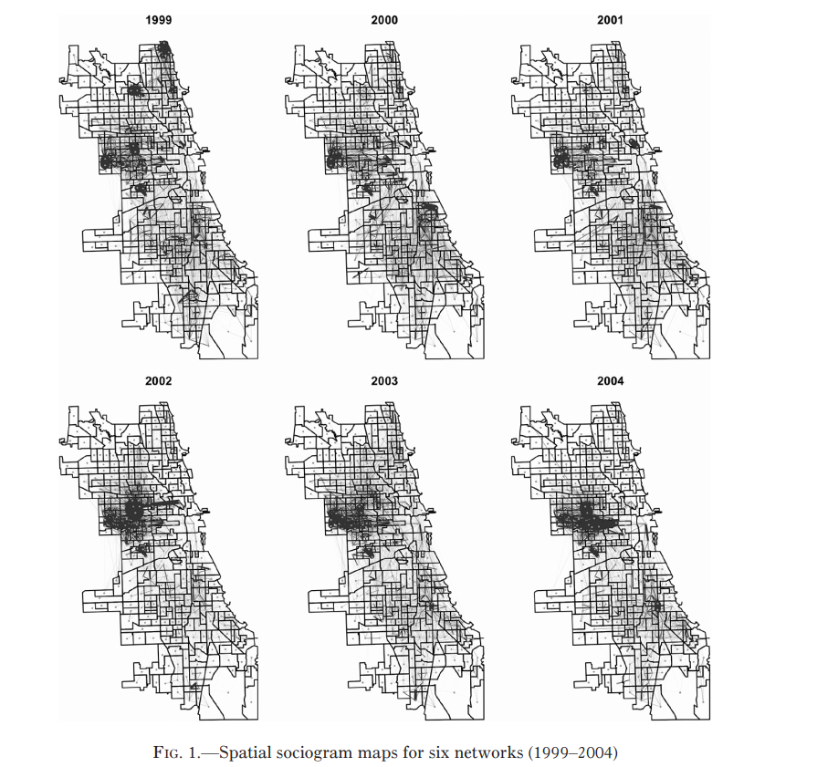
Example: Inter-neighborhood co-arrest networks (spatial networks)
Papachristos & Bastomski (2018)

Slide 13
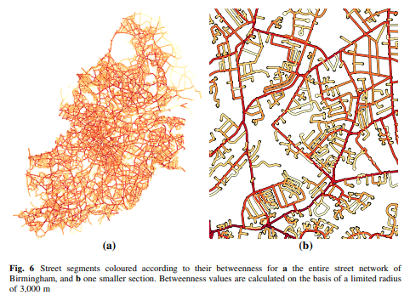
Example: Street networks
Davies & Johnson (2015)

Slide 14
tidyverse: Basic data management and useful pipeline for code structure
igraph: Constructing network graphs
tidygraph: Using the tidyverse pipeline with igraph networks
ggraph: For better network visualizations
statnet: For ERGM models
Packages in R

