Slide 1
Ethical Hacking
Written by Isaiah Ervin

Slide 2
01
Penetration Testing

Slide 3
Pen Testing: What and Why
Penetration testing is used to exploit vulnerabilities in order to help:
Uncover new vulnerabilities
Determine how they could be used against the organization
Provide more insight on their nature
A “pen test” can find deep vulnerabilities and attempts to exploit them using manual techniques that follow the thinking of threat actors
The most important element in a pen test is the first step, planning
A lack of planning can lead to expanding beyond the set of test’s limitations also known as creep
The most dangerous result of poor planning is creating unnecessary legal issues

Slide 4
Pen Testing: Who should conduct (1 of 3)
Internal Security Personnel
Advantages:
Little to no cost
Test can be conducted more quickly
Can enhance employee training and awareness of security risks
Disadvantages:
Inside knowledge
Lack of expertise
Reluctance to reveal vulnerabilities

Slide 5
Pen Testing: Who should conduct (2 of 3)
External Pen Tester Consultants
Advantages:
Expertise
Credentials
Experience
Focus
Disadvantages:
Contractors may receive sensitive information and how to access them
Could be sold to a competitor

Slide 6
Pen Testing: Who should conduct (3 of 3)
Crowdsourced Pen Testers
A bug bounty is a monetary reward given for uncovering software vulnerabilities
Bug bounty programs use crowdsourcing
Advantages:
Fast testing, resulting in faster remediation of vulnerabilities
Ability to rotate teams
Can conduct multiple pen test simultaneously

Slide 7
Performing a Pen Test
Performing a successful test involves determination, resolve, and perseverance
A variety of actions take place when performing a pen test, but they can be grouped into two phases:
Reconnaissance
Penetration

Slide 8
Reconnaissance
The first task is to gather information from outside the organization (footprinting) using active and/or passive reconnaissance
Active
Passive
Involves directly probing for vulnerabilities and useful information by searching for wireless signs while using a portable device (war driving) or by using drone (war flying). These probes tend to alert security professionals.
Occurs when the test uses tools that do not give any alerts, such as using public information from an open souce intelligence (OSINT) to reveal insight about the system.

Slide 9
Penetration
The initial system compromised usually does not contain the data the is the goal of the attack, but serves as a gateway into a network
Once inside the network, threat actors compromise other system until they reach their target
Lessons learn from these tests include:
Threat actors will pivot to another system after discovering a vulnerability
Vulnerabilities that are not part of the target, an still provide a gateway
Pen testers need to design attacks carefully since attacks are manual
Pen testers must be patent and persistent like threat actors

Slide 10
02
Rules of Engagement

Slide 11
Rules of Engagement
Rules of engagement in a penetration test are its limitations or parameters
Categories for rules of engagement are:
Timing
Scope
Authorization
Exploitation
Communication
Cleanup
Reports

Slide 12
Rules of Engagement
Timing
Scope
Sets when the testing will occur. Some considerations for timing parameters include: the start and stop dates of the test and should the active portions of the pen test be conducted during normal business hours.
Defines several elements of the test boundaries such as: the enviornment the test will be conducted it, internal targets, external targets, target locations, and other boundaries.

Slide 13
Rules of Engagement
Authorization
Exploitation
Communication
The receipt of written approval to conduct the pen test. This typically is a formal document that must be signed by all parties before a pen test begins.
The exploitation level in a pen test shoud be part of the scope that is discussed in the planning stage to determine how far the exploitation can go
The pen test should communicate with the organization during the initation, incident response, status, or emergency.

Slide 14
Rules of Engagement
Cleanup
Reporting
Pen tester must ensure that everything related to the test has been removed. This involves removing software agents, scripts, executable binaries, temporary files, and backdoors from all affected systems. Any creddential changes should be restored and usernames created should be removed.
Once the pen test is completed, a report should be generated to document its objectives, methods used, and results. The report should be divided into two parts: an executive summary for a less technical audience, and a technical summary for security professionals.

Slide 15
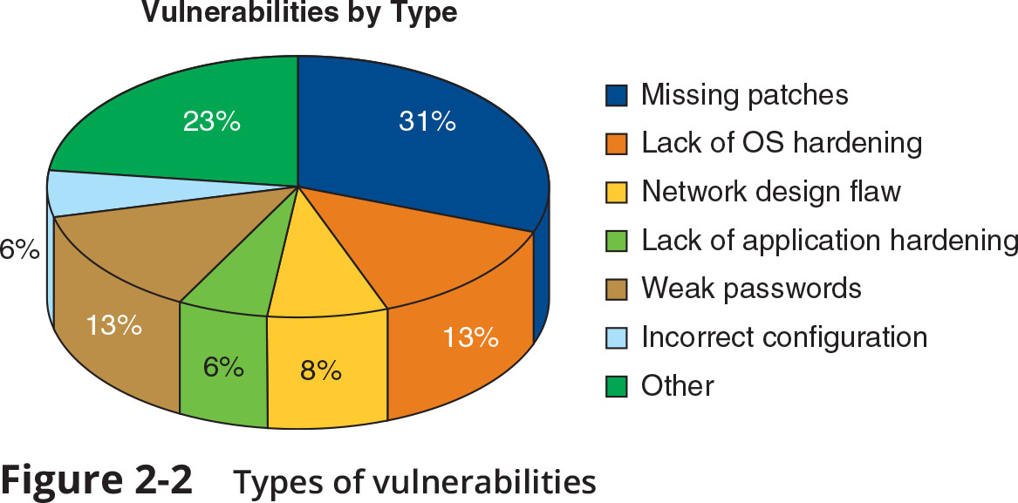
Types of Vulnerabilites
Exciting news! Our company has just released a cutting-edge product that is poised to revolutionize the industry. With this new technology, businesses can:
Optimize their workflow and increase productivity
Automate routine tasks and free up any valuable resources
Improve their bottom line by reducing costs and boosting profits
Stay tuned for more updates on this exciting development as we continue to innovate and push the boundaries of what's possible!

Slide 16
03
Vulnerability Scanning

Slide 17
What is Vulnerability Scanning (1 of 5)
A vulnerability scan is a frequent and ongoing process that identifies vulnerabilities and monitors cybersecurity progress
Conducting a vulnerability scan involves:
Knowing what to scan and how often
Selecting a type of scan
Interpreting vulnerability information
It is ideal not to conduct around-the-clock vulnerability scan due to workflow interruptions and technical constraints
Scanning the location of systems with high-value data more frequently leads to a more focused approach

Slide 18
What is Vulnerability Scanning (2 of 5)
Vulnerability scans should be limited, so a configuration review of software setting should be conducted before scanning:
Define the group of target devices to be scanned
Ensure that a scan should be designed to meet its goals
Determine the sensitivity level or depth of a scan
Specify the data types to be scanned

Slide 19
What is Vulnerability Scanning (3 of 5)
There are two major types of scans: credentialed and intrusive
Credentialed
Non-Credentialed
Valid authentication credentails are supplied to the vulnerability scanner to mimic a threat actor who posses them
Provides no such authenication information
Intrusive
Non-Intrusive
Attempts to employ any vulnerabilites it finds
Only records vulnerabilites that is discovers

Slide 20
What is Vulnerability Scanning (4 of 5)
When examining the results of a vulnerability scan, assess the importance of vulnerabilities
To identify which vulnerabilities need attention, one must ask:
Can the vulnerability be addressed in a reasonable amount of time
Can the vulnerability be exploited by an external threat actor
Would a threat actor be able to pivot using the vulnerability
Is data on the device sensitive or is it public
Is the vulnerability on a critical system

Slide 21
What is Vulnerability Scanning (5 of 5)
When examining the results of a vulnerability scan, it is also important to assess the accuracy of the results
Be sure to identify false positives, which is an alarm when there is no issue
To identify false positives, correlating the scan data with internal data points, such as log files to conduce log reviews, is the best approach

Slide 22
Data Management Tools (1 of 2)
Two data management tools that collect and analyze vulnerability scan data
SIEM
SOAR
Security Information and Event Management can perform sentiment analysis, which is the process of identifying and categorizing opinions to determine a writer’s attitude towards a topic
Security Orchestration, Automation, and Response combines more comprehensive data gathering and analytics to automate incident responses

Slide 23
Data Management Tools (2 of 2)
Both data management tools can also be used to collect:
Aggregation
Correlation
Automated alerting and triggers
Time synchronization
Event Duplication
Logs

Slide 24
RESOURCES
CompTIA Security+ Guide to Fundamental, 7th Edition
Amazon link to book

Slide 25


