Slide 1
Authentication: The Extra Step
Written by Isaiah Ervin

Slide 2
01
Types of Authentication

Slide 3
Types of Authenication Credentials
Element | Description | Example
Somewhere you are | Restricted Location | Military base
Something you are | Unique biological characters that cant be changed | Fingerprint scanner
Something you have | Possession of an item that no one else has | RFID card
Someone you know | Validated by another person | Hala knows Rao
Something you exhibit | Genetically determined characteristic | Rao’s jet black hair
Something you can do | Activity that cannont be exactly copied | Hand signature
Something you know | Knowledge that nobody else possesses | Combination for a lock

Slide 4
Something you know: Passwords
The most common type of IT authentication today, but only provide weak protection while constantly attacked
Passwords are vulnerable due to their weaknesses: Human memory
Users tend to use weak passwords like predictable sequences of characters (1234), or personal information
While long complex passwords are very effective, they are also the most difficult to remember
Humans also can only remember a limited number of items
Users have to remember different passwords for different accounts, since each password should be unique
Many policies mandate that passwords expire, forcing users to repeatedly memorize passwords
While attempting to make stronger passwords, users generally follow a predictable pattern:
Appending: using letters, number, or punctuation in conjunction of a common word
Replacing: using letters, number, or punctuation to replace characters (Leet/l33t code)

Slide 5
Attacks on Passwords
When users create passwords, a one-way hash algorithm creates a message digest of the password
Attackers work to steal the file of password digests
They can then use a stolen has to impersonate the user
They can also load that file onto their own computers and then use a password cracker
Password crackers create known digests called candidates

Slide 6
Types of Attacks on Passwords
Password Spraying
Brute Force
Rule
Selects one or a few common passwords and then enters the same password when trying to login to several user accounts
In an online attack, the same account is continuously attacked by entering different passwords, offline brute force attacks uses the stolen hash file
Conducts a statistical analysis on stolen passwords that is used to create a mask to break the largest number of passwords
Password Collections
Dictionary
Rainbow Tables
In 2009, an attacker used an SQL injection attack and 32 million user passwords were stolen, almost all password cracking software tools accept these stolen “wordlists”
The attacker creates digests of common dictionary words and compares against a stolen digest file
Create a large pre-generated data set of candidate digests using pre-computerized has functions and is faster than dictionary attacks

Slide 7
Something you have: Phones and Security Keys
Commonly used in conjunction of passwords: Multifactor authentication (MFA)
Most common items used for MFA are specialized devices, smartphones, and security keys
There are several specialized devices such as:
Smart cards like the common access card (CAC) issued by the US DoD
Some issues are that it needs specialized hardware, and is vulnerable to card cloning
One time passwords (OTP) which can either be used once or for a limited time
Smartphones can be used for authentication with:
Phone calls, SMS text message, or authentication app
OTP SMS message can be “phished”, and a malware infection could target the app
Security keys are dongles that are inserted into the USB port or Lightning port or held near the endpoint
A feature with security keys is attestation
A key pair that is “burned” into the security key during manufacturing and is specific to a device model

Slide 8
Something you are: Biometrics
Rarely used because of the cost of specialized hardware, have inaccuracies and can be tricked
Physiological biometrics uses unique physical characteristics for authentication
Specialized biometric
Retinal scanner maps the patterns of a retina by directing IR light into a person’s eye
Fingerprint scanner
Static takes a picture and compares the image on file
Dynamic uses a small slit or opening
Palm scanner maps the veins in the hand to identify on a scanning tablet
A person’s manner of walking can also be used
Standard Input devices
Voice recognition, iris scanner, and facial recognition

Slide 9
More Biometrics
Cognitive
Behavioral
Also known as knowledge-based authentication, it uses perception, thought process, and understanding of the user. An example of this is Picture Password from Microsoft which has users select a picture to use for which there should be at least 10 “points of interest” that could serve as “landmarks” or places to touch.
Authentication is determined by normal actions the user performs. A type of behavioral biometrics is keystroke dynamics which attempts to recognize user’s typing rhythm. Keystroke dynamics uses two unique typing variables: dwell time, which is the time it takes to press and release a key, and flight time is the time between keystrokes

Slide 10
02
Authentication Solutions

Slide 11
Protecting Password Digests
Passwords can be protected by adding a random string to a user’s cleartext password before it is hashed
These are referred to salts
Increases the time for dictionary and brute force attacks significantly
Limit impact of rainbow tables
Key stretching is another method
A specialized password hash algorithm that is designed to be slower
Two key stretching algorithms
bcrypt
PBKDF2

Slide 12
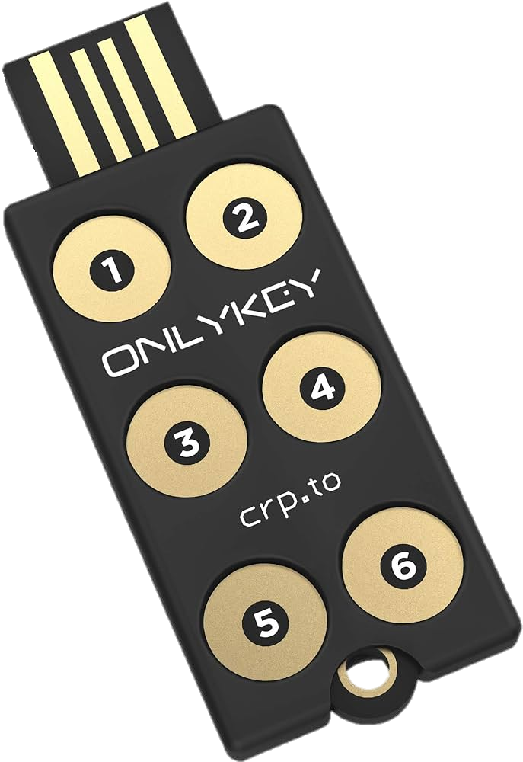
Managing passwords
Due to the limitations of human memory, security experts universally recommend using technology to store and manage passwords
Password Vaults
Password Keys
Hardware Security Module
A secure repository where users can store passwords. There are three basic kinds of password vaults: password generators, online vaults, and password management applications.
A secure hardware-based solution to store passwords.
A HSM is a removable external cryptographic device that includes an onboard random number generator and key storage facility. They can also perform encryption and can back up sensitive material in an encrypted form.

Slide 13
Secure Authentication Technologies
Single Sign-On
Uses only one authentication credentials to access multiple accounts/apps
RADIUS
Remote Authentication Dial In User Service
RADIUS client is typically a device such as a wireless AP that is responsible for sending user credentials and connection parameters to the RADIUS server
User profiles are stored in a central database that remote servers can share
Kerberos
Encryption and authentication for security
Ticket characteristics:
Difficult to copy
Contains information linking it to the user
It lists restrictions
Expires at some future date

Slide 14
More Secure Authentication Technologies
Terminal Access Control Access Control System+ (TACACS+)
An authentication service similar to RADIUS
Commonly used on UNIX devices that forwards user authentication information to a centralized server
Directory Service
A database stored on the network that contains information about users and network devices
Easier to grant privileges or permissions to network users and provide authentication
Security Assertion Markup Language (SAML)
An XML standard that allows secure web domains to exchange user authentication and authorization data
Allows a user’s login credentials to be stored with a single identity provider
used extensively for e-commerce business-to-business (B2B) and business-to-customer (B2C) transactions

Slide 15
More Secure Authentication Technologies
Authentication Framework Protocols
A framework for transporting authentication protocols is known as the Extensible Authentication Protocol (EAP)
EAP is a framework for transporting authentication protocols instead of the authentication protocol itself
EAP was created as a more secure alternative to Challenge-Handshake Authentication Protocol (CHAP), the Microsoft version of CHAP (MS-CHAP), and Password Authentication Protocol (PAP)

Slide 16
RESOURCES
CompTIA Security+ Guide to Fundamental, 7th Edition
Amazon link to book

Slide 17


