Slide 1
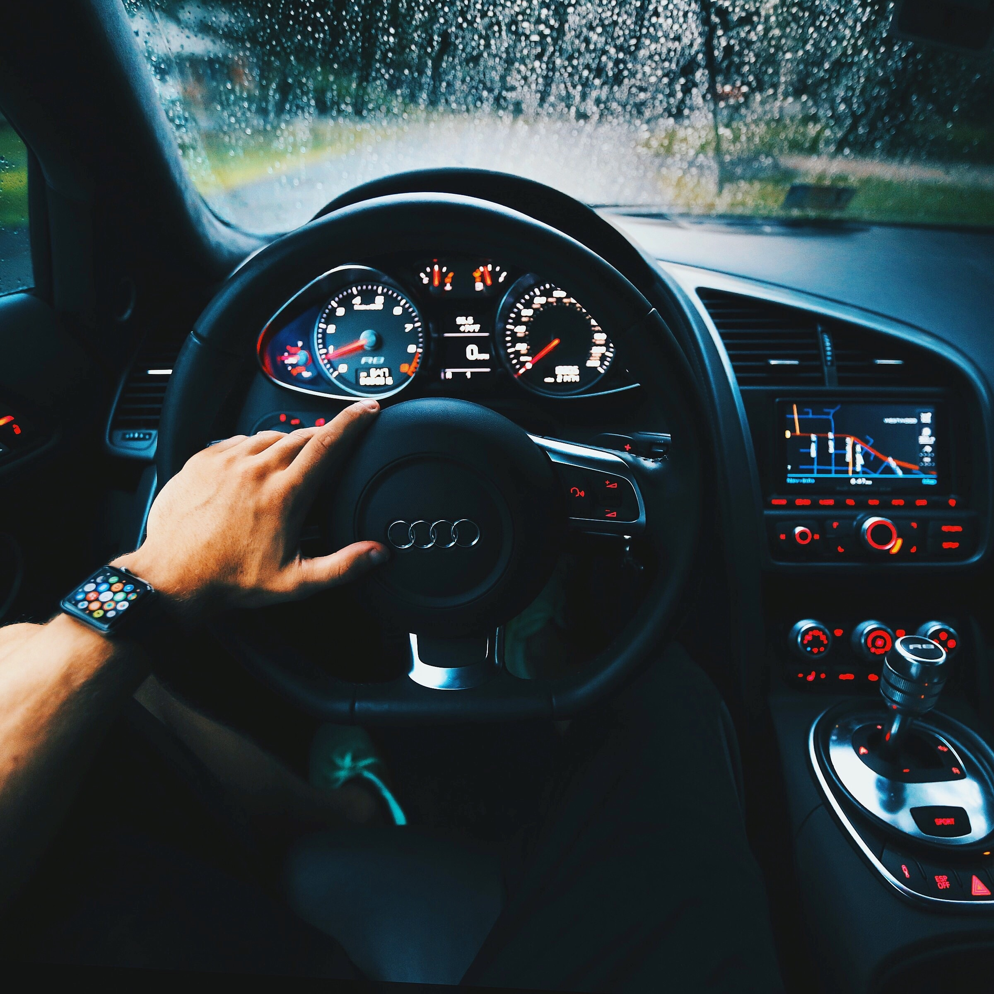
OVERSEE a driver state monitoring system
GOLF –A

Slide 2
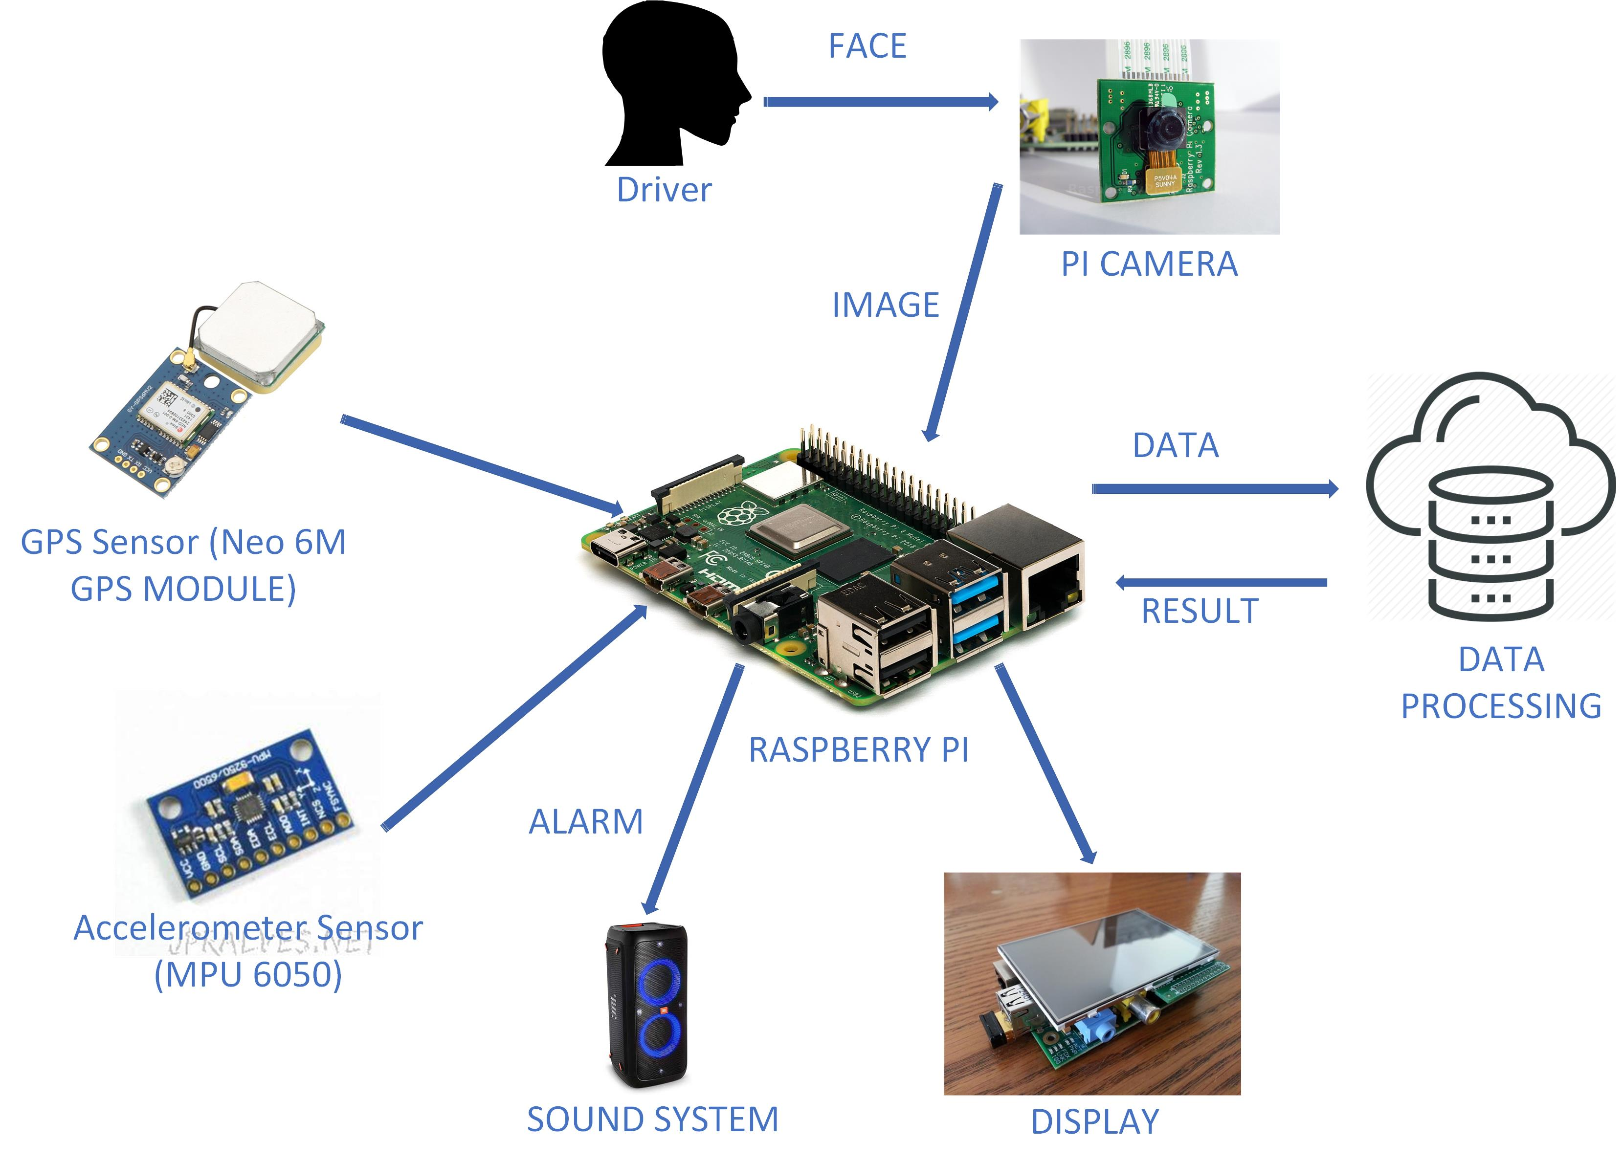
SYSTEM ARCHITECTURE

