Slide 1


Synchronous Clock System
CSE-306 Project

Slide 2
Group Members
Tasfia Tasnim 201814029
Tasneem Mubashshira 201814054
Ifath Ara 201814060
Fariha Fardina Amin 201814061

Slide 3
WHY SYNCHRONIZATION ?????? And HOW??

Slide 4
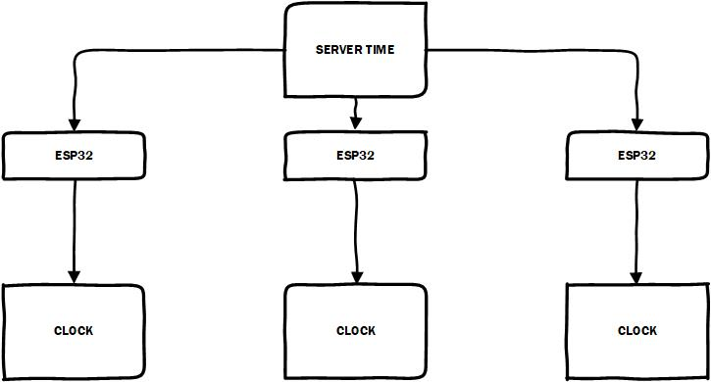

Slide 5
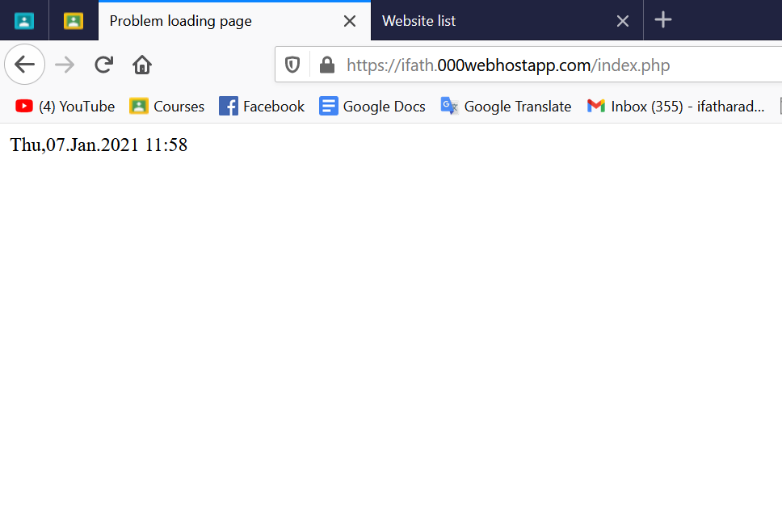

Slide 6
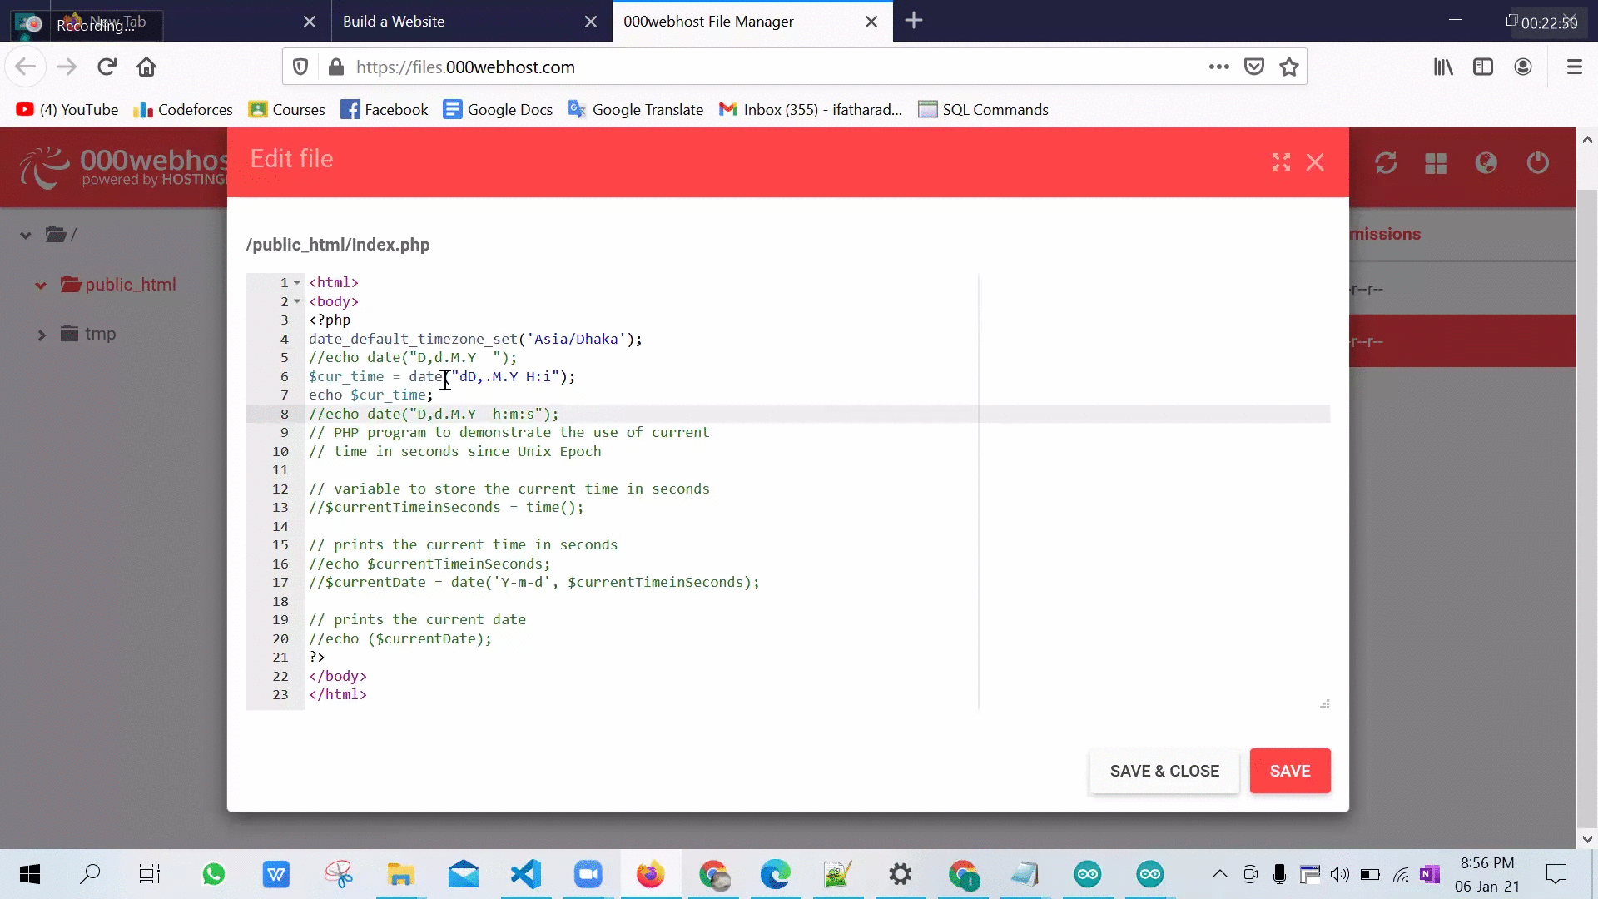

Slide 7
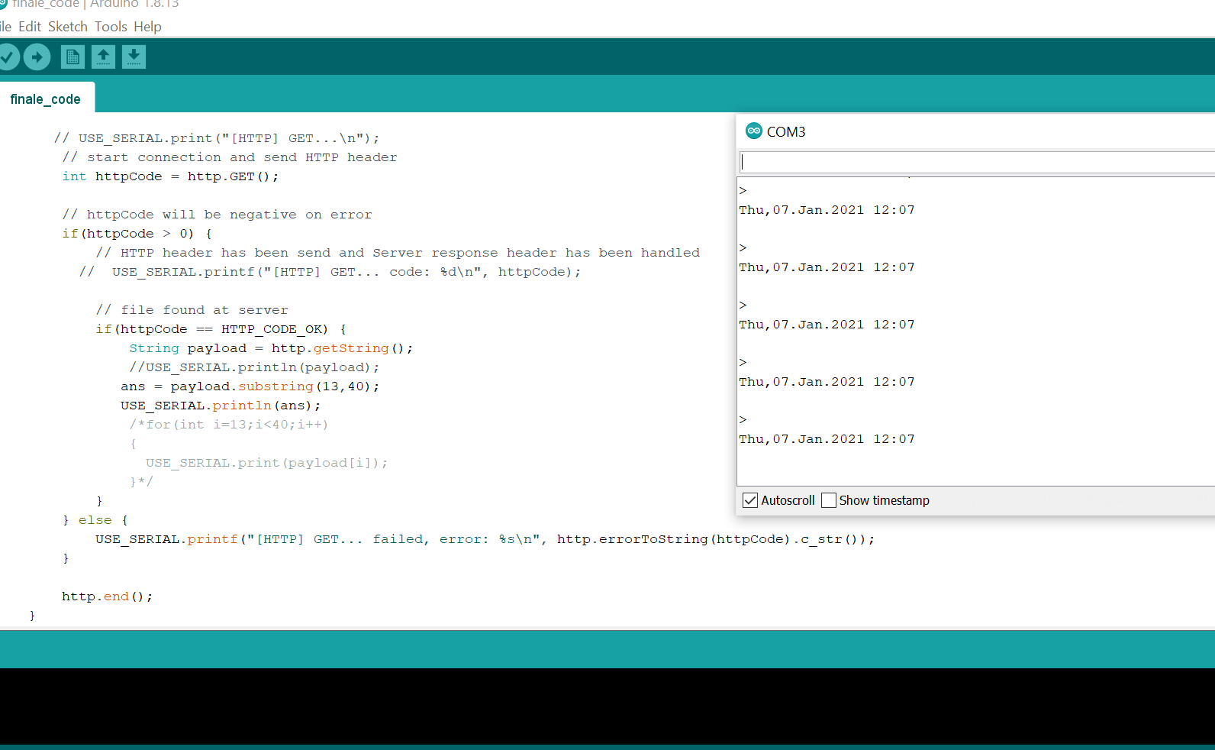

Slide 8
DISPLAY

Slide 9
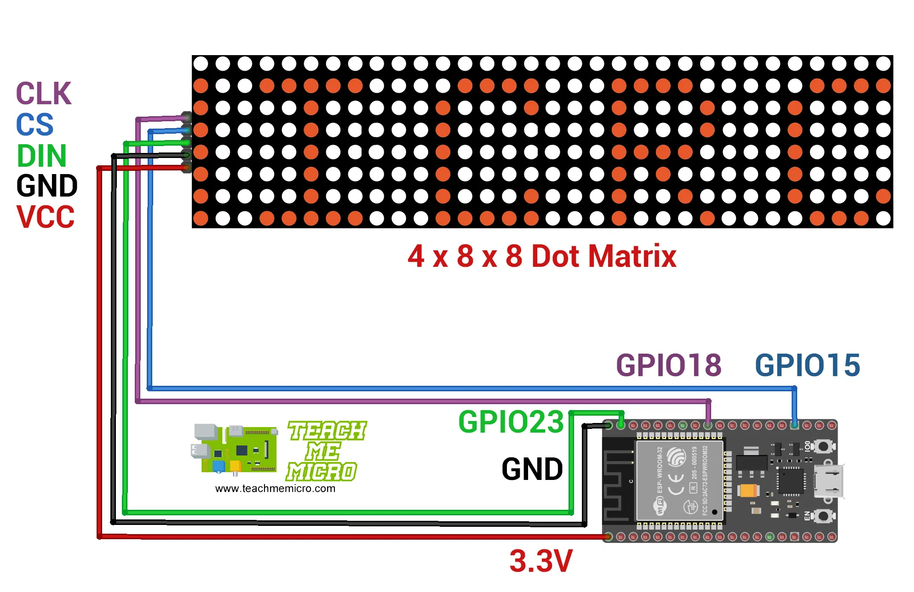

Slide 10
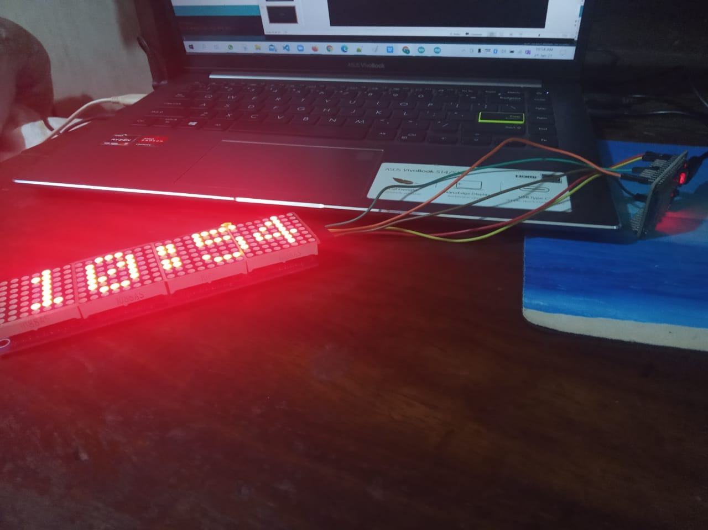

Slide 11
Thank you

