Slide 1


Machine Learning-driven Deep Brain Stimulation Programming
Esther Ademola, 5122738
Masters Artificial Intelligence
20.02.2024
Supervisor: Prof Dr. Magda Gregorova

Slide 2

Agenda
Background
Objective
Data description
Methodology
Evaluation
1

Slide 3



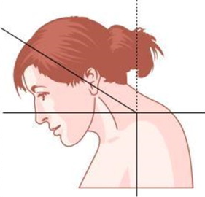
Background- Dystonia
DYSTONIA
SYMPTOMS
Dystonia is a neurological movement disorder characterized by involuntary muscle contractions. These contractions can affect one part of the body, multiple areas, or even the entire body.
Dystonia cannot be cured, but there are few medications to reduce the symptoms such as tremors, body twisting into unusual positions. These medications also have adverse side effects.
TYPES
Generalised dystonia
Cervical dystonia
2

Slide 4
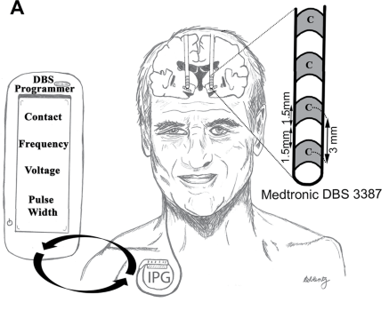
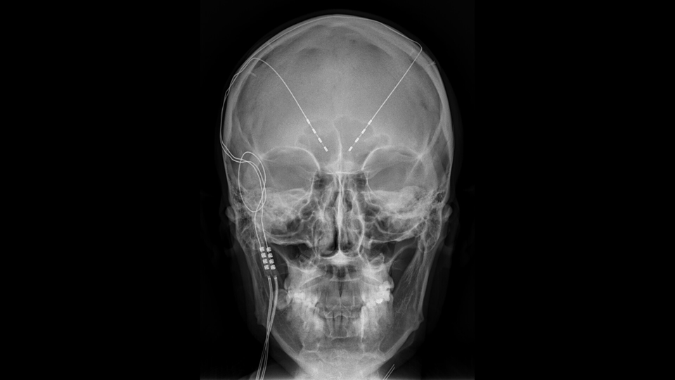
Background - Deep Brain Stimulation
Deep Brain Stimulation (DBS) is a surgical procedure that involves the implantation of a medical device to deliver electrical impulses to specific areas of the brain.
DBS programming is a process that involves manually adjusting stimulation parameters:
amplitude,
frequency,
pulse width, and
electrode location
in order to reduce motor symptoms while minimising side effects.
B
3

Slide 5
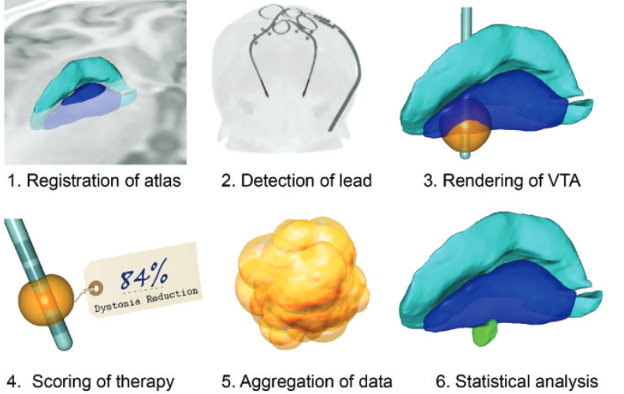
Background - Existing work
The image analysis workflow of the sweet spot analysis as performed by Reich et al.
4

Slide 6
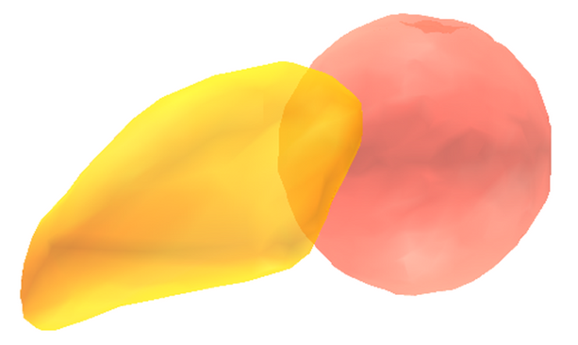
Objective
Optimise DBS programming by developing predictive models
for patients' dystonia improvement scores with the integration of patient-specific data, machine learning models.
5

Slide 7
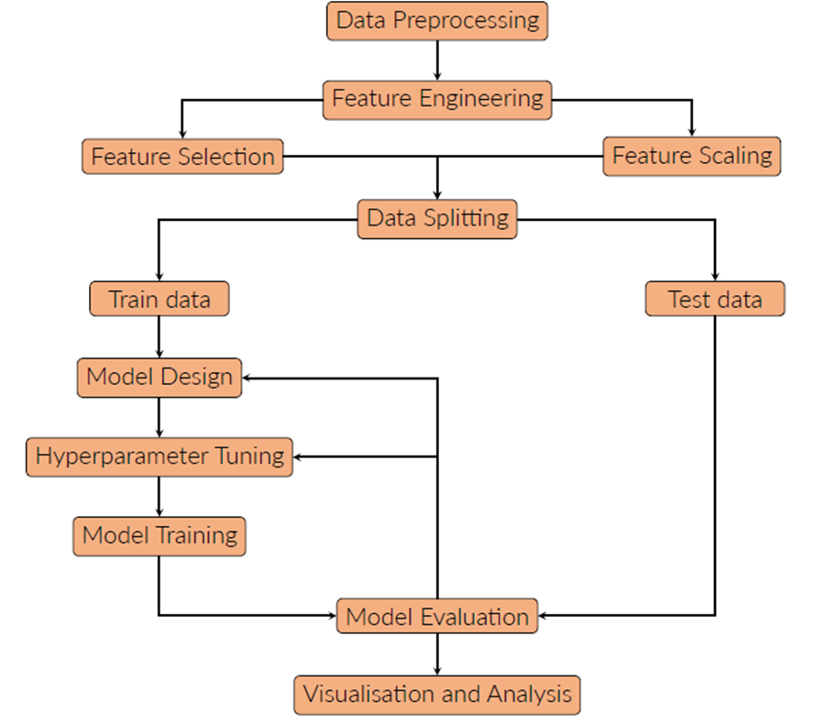
Methodology
6

Slide 8
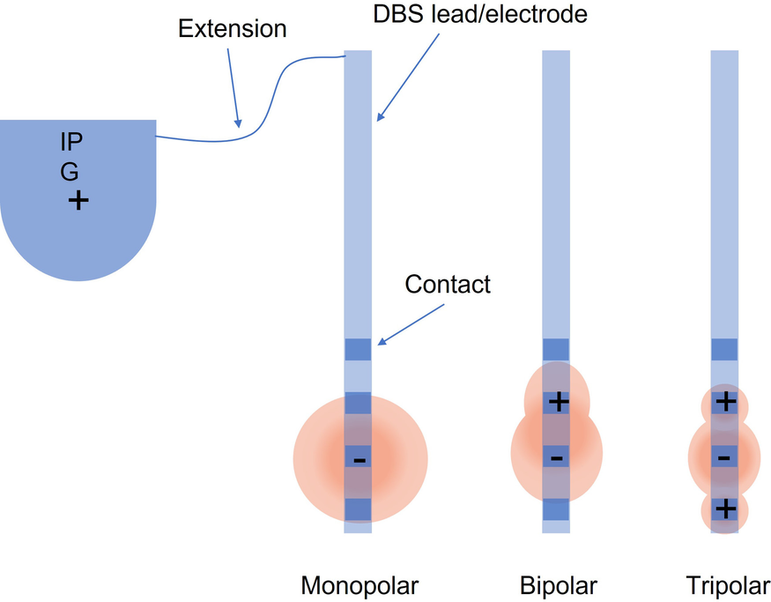
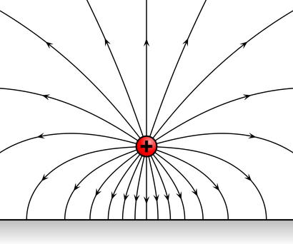
Data description
Characteristics | Cervical dystonia | Generalised dystonia
Quantity | 85 | 85
Improvement score, % | 59.4 (29.3) | 62.4 (31.5)
Stimulation parameters and Electrode localisation | Stimulation parameters and Electrode localisation | Stimulation parameters and Electrode localisation
Amplitude, mA | 3.4 (1.1) | 3.4 (1.1)
Pulsewidth, 𝜇𝑠 | 109.7 (47.0) | 100 (34.9)
Frequency, Hz | 153.4 (27.8) | 146.9 (29.2)
Lead tip localisation | [0.23, -2.8, 3.82] (19.69, 3.53, 1.93]) | [0.24,-2.46, -4.05] ([19.79, 1.41, 1.90])
Active contact localisation | [0.22, -4.85, -00.15] ([20.33, 1.63, 2.14]) | [0.24, -4.06, -0.22] ([20.31, 1.56, 2.03])
Electric field of an activated contact point
Activated contact
Data represented as mean (standard deviation)
7

Slide 9
Evaluation
Model | Mean deviation (MAE) % | Deviation range (STD.)
Benchmark | 16.9 | 11.6
Ridge regression | 24.75 | 4.92
LASSO | 24.16 | 15.17
Support vector regression | 23.6 | 16.96
Random forest | 9.54 | 6.08
XGBoost | 19.50 | 12.48
8

Slide 10
Thank you
for your attention!
9

Slide 11

Questions

