Slide 1
Exploring Community College Enrollment Trends
Prepared By: Albert Lee
Date Submitted: 7 January 2019

Slide 2
Community Colleges are important to the higher education ecosystem
~20 Percent of USA Colleges Are Community-Based
~37 Percent of Students In USA Are Enrolled In Community Colleges
Community College Graduates Are More Likely To Repay Loans
7175 Colleges Total
15.6 Million Students Total

Slide 3
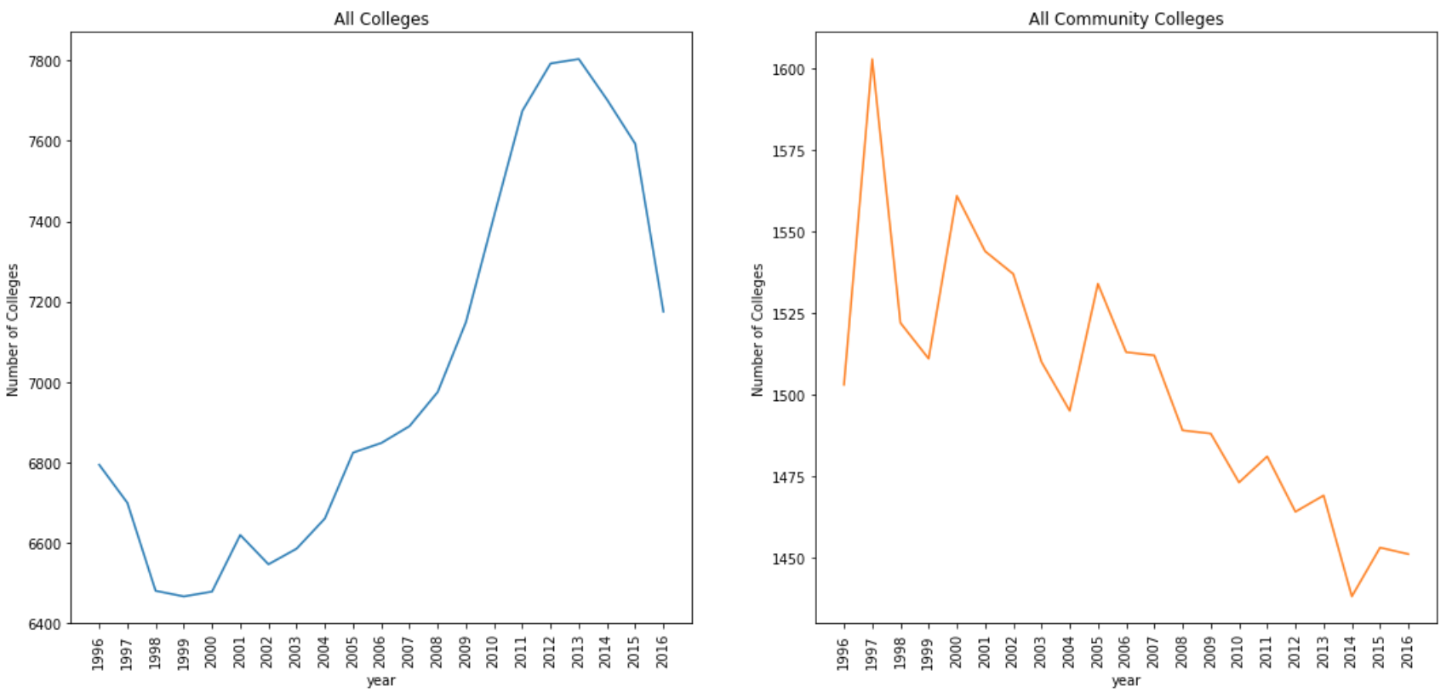
The number of community colleges is decreasing over time

Slide 4
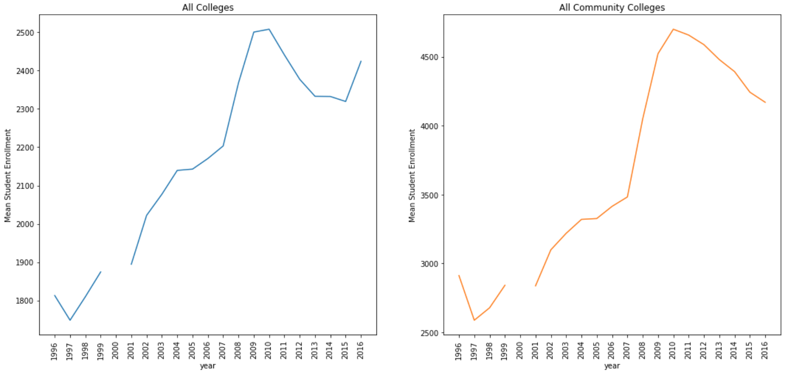
Enrollment in all colleges significantly increased during the recession
* Data from 2000 was unavailable

Slide 5
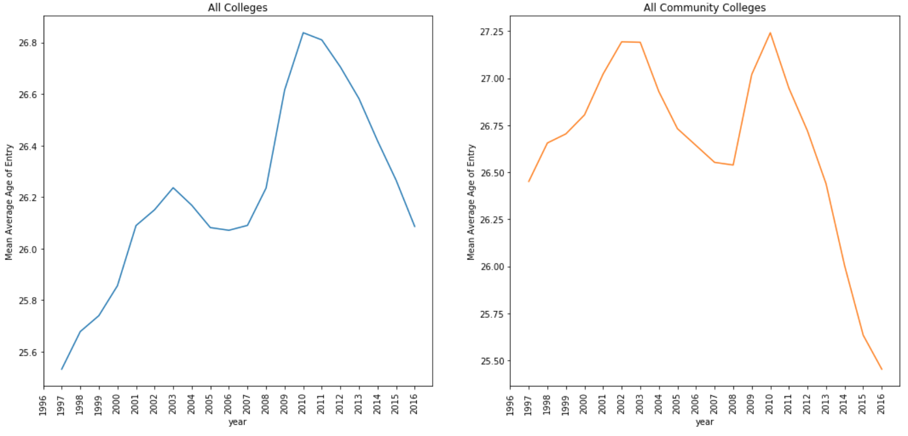
Average age of entry at community colleges is dropping

Slide 6
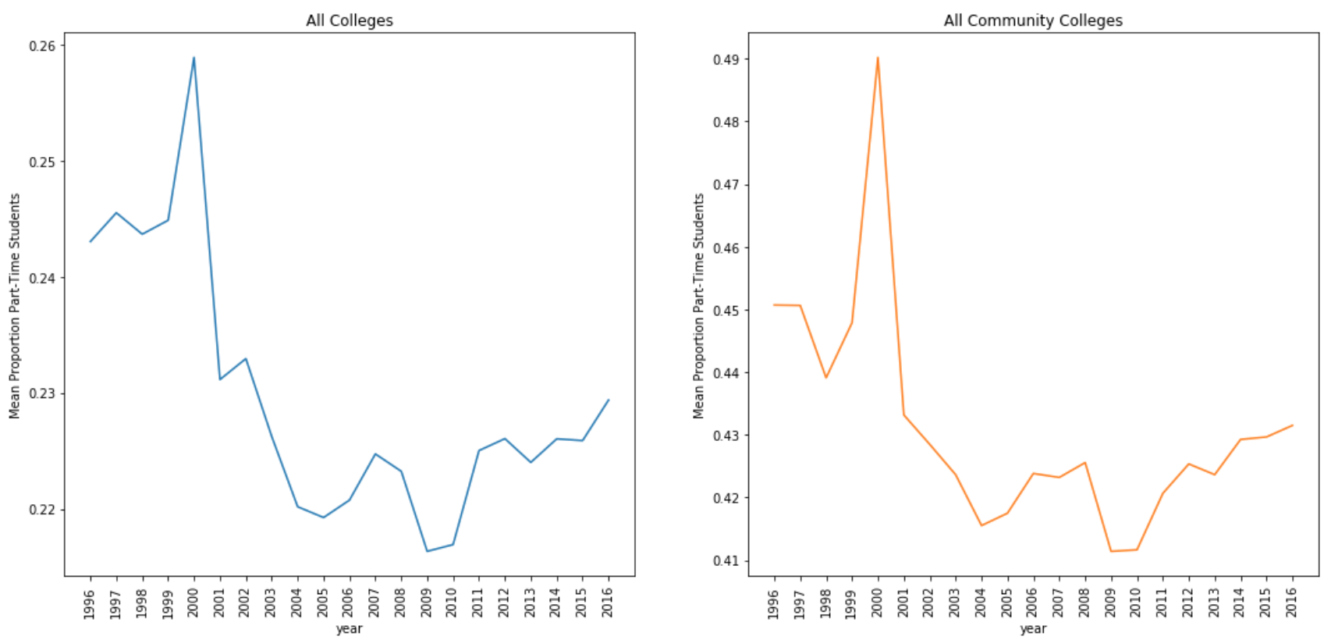
More students at community colleges are part time

