Slide 1
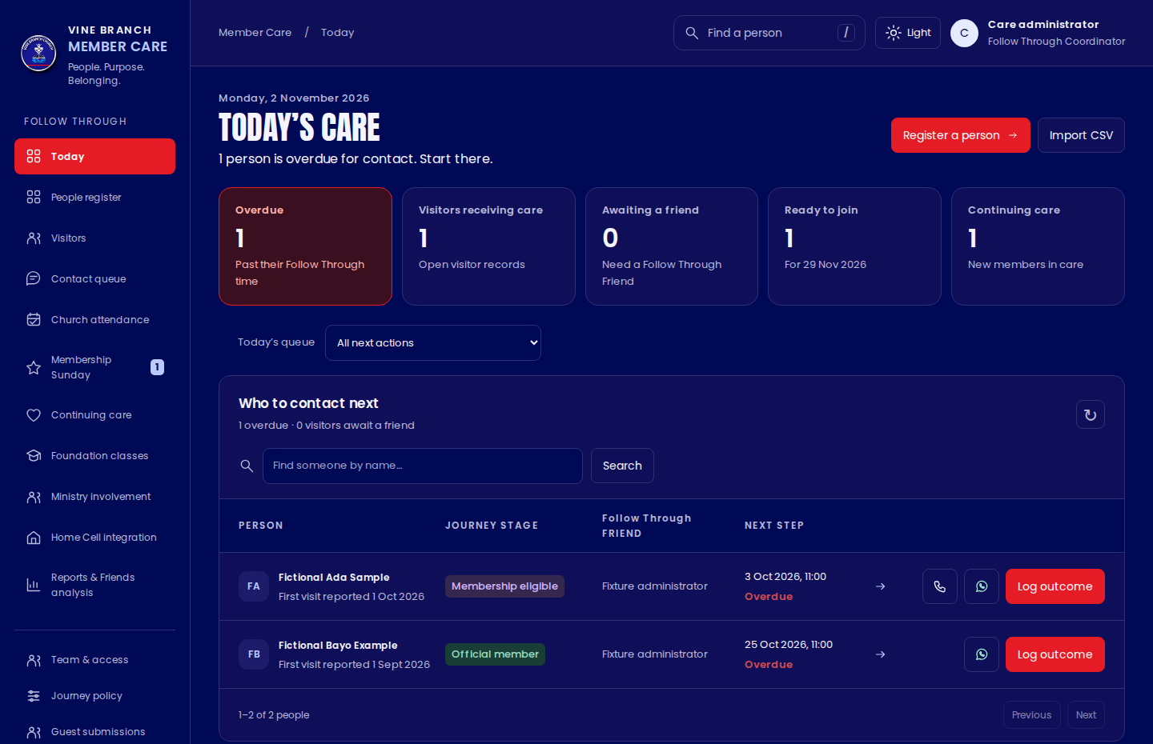
Follow Through dashboard
A practical, illustrated staff manual
FROM FIRST VISIT
TO BELONGING
What to click. What to record.
What each stage really means.
Vine Branch Church
Staff training edition · 2 November 2026
VBC Follow Through Manual · v4.1
01
Notes:
Audience: Follow Through Friends, Follow Through Coordinators, Foundation Class Coordinators and administrators. This manual explains the delivered v4.1 interface. A deployed installation may differ if it has not been updated. Learn with fictional records before using real information. Home Cell Office account administration is a separate module and is covered here only where it connects to Follow Through.
Source: VBC Member Care v4.1 source, src/components/JourneyDesk.tsx, JourneyExtensions.tsx and WhatsAppInvitations.tsx, src/lib/journey/model.ts, VBC_v3.8_SETUP.md, VBC_v3.9_WHATSAPP_SETUP.md and VBC_v4.1_FIXES.md. Screens are fictional training fixtures, not live church records.
Current reference: VBC_v4_1_SETUP.md and the v4.1 Follow Through registers. Screens use fictional training records.

Slide 2
Use this manual beside the dashboard
Step-by-step guidance using fictional training records.
If you need to… | Go to slides
Understand the journey, roles and labels | 3–10
Register, assign, contact and record attendance | 11–18, 36–37
Confirm membership and continue care | 19–24
Send a WhatsApp invitation safely | 25–28
Reports, mobile help and programmes | 29–35, 38–39
Start each working session on Today. Finish by saving a clear outcome and next step.
VBC Follow Through Manual · v4.1
02
Notes:
PowerPoint speaker notes contain additional click paths and edge cases. All named people in the illustrations are fictional. Screen dates are examples and do not prescribe service or membership dates. The manual describes current functionality, not a guarantee that official WhatsApp sending has been configured in a church account.
Source: VBC Member Care v4.1 source, src/components/JourneyDesk.tsx, JourneyExtensions.tsx and WhatsAppInvitations.tsx, src/lib/journey/model.ts, VBC_v3.8_SETUP.md, VBC_v3.9_WHATSAPP_SETUP.md and VBC_v4.1_FIXES.md. Screens are fictional training fixtures, not live church records.
Current reference: VBC_v4_1_SETUP.md and the v4.1 Follow Through registers. Screens use fictional training records.

Slide 3
One person moves through the journey
Keep the same record as their relationship with church develops.
Registration
Previous visit
Official joining
→
→
Review a submission or use direct registration. Check identity first.
Record church visit evidence. Keep unknown dates unknown.
Coordinator confirms the actual date and evidence.
AFTER OFFICIAL JOINING
Foundation classes
Continuing care
Community
Seven-week attendance and assessment.
At least six calendar months with a friend.
Ministry and Home Cell participation.
VBC Follow Through Manual · v4.1
03
Notes:
The first-timer submission is reviewed and linked to a central person. Registration does not itself prove attendance. One previous VBC church visit before the actual joining date is sufficient for joining eligibility. A Coordinator must explicitly confirm actual joining. Seven-week CFC and six calendar months of care run alongside community integration. No CFC certificate, ministry role or Home Cell assignment closes continuing care automatically.
Source: VBC Member Care v4.1 source, src/components/JourneyDesk.tsx, JourneyExtensions.tsx and WhatsAppInvitations.tsx, src/lib/journey/model.ts, VBC_v3.8_SETUP.md, VBC_v3.9_WHATSAPP_SETUP.md and VBC_v4.1_FIXES.md. Screens are fictional training fixtures, not live church records.
Current reference: VBC_v4_1_SETUP.md and the v4.1 Follow Through registers. Screens use fictional training records.

Slide 4
Your role determines what you can do
A missing button can be an access rule rather than a broken screen.
Role | Main responsibility | Typical scope
Follow Through Friend | Register people and record contact | Currently assigned people
Follow Through Coordinator | Assign friends, prepare joining and review care | Accessible journey cases and reports
Foundation Class Coordinator | Manage cohorts, attendance and completion | CFC and eligible official members
Church administrator | Manage access and historical corrections | Full authorized journey administration
Need broader access? Ask the church administrator to check Team & access.
VBC Follow Through Manual · v4.1
04
Notes:
Administrators can grant explicit journey capabilities from Team & access. A global editor role alone does not make someone a Follow Through Coordinator. A Follow Through Friend sees current assigned cases. Reassignment removes the old friend’s case access immediately. Foundation-only access does not expose private outreach, welfare notes or contact exports. Additional granted capabilities can expand a person’s scope. Home Cell Office leadership access is separate.
Source: VBC Member Care v4.1 source, src/components/JourneyDesk.tsx, JourneyExtensions.tsx and WhatsAppInvitations.tsx, src/lib/journey/model.ts, VBC_v3.8_SETUP.md, VBC_v3.9_WHATSAPP_SETUP.md and VBC_v4.1_FIXES.md. Screens are fictional training fixtures, not live church records.
Current reference: VBC_v4_1_SETUP.md and the v4.1 Follow Through registers. Screens use fictional training records.

Slide 5
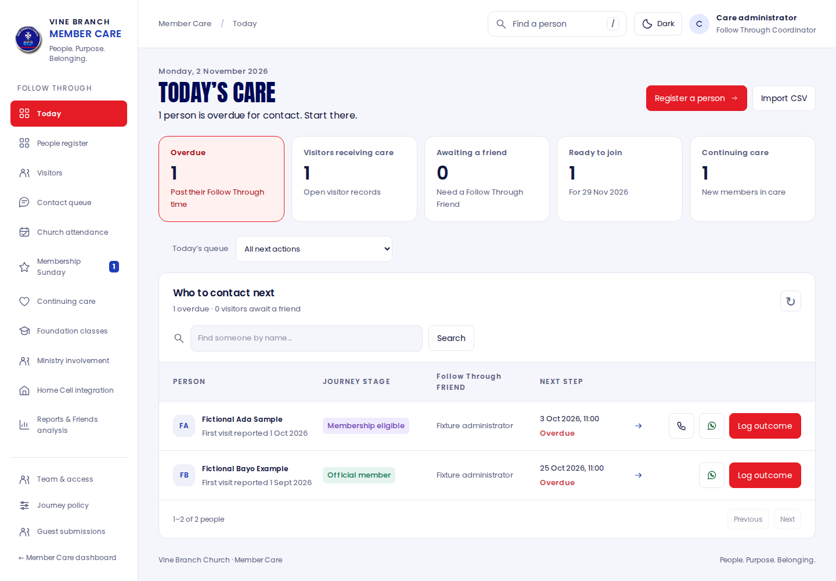
Enter through Member Care
Use your staff account, then open Follow Through.
01
Sign in
Use the staff account assigned to you.
02
Open Follow Through
Today’s care is the starting screen.
03
Check your role
Your name and capability appear at the top.
VBC Follow Through Manual · v4.1
05
Notes:
Use the existing Member Care staff sign-in. The separate Home Cell leader login does not automatically grant Member Care staff access. From the Member Care dashboard open Follow Through, or visit /followups on the same site after sign-in. You land on Today’s care. The sidebar groups daily outreach, membership, formation and reporting. The bottom sidebar links return to Member Care or open Home Cell Office. Do not share staff passwords.
Source: VBC Member Care v4.1 source, src/components/JourneyDesk.tsx, JourneyExtensions.tsx and WhatsAppInvitations.tsx, src/lib/journey/model.ts, VBC_v3.8_SETUP.md, VBC_v3.9_WHATSAPP_SETUP.md and VBC_v4.1_FIXES.md. Screens are fictional training fixtures, not live church records.
Current reference: VBC_v4_1_SETUP.md and the v4.1 Follow Through registers. Screens use fictional training records.

Slide 6
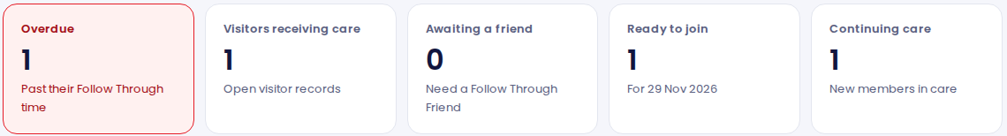
Read the five cards on Today
Each card answers a different operational question.
Card | Meaning
Overdue | A case has passed its Follow Through time.
Visitors receiving care | Open visitor records within your scope.
Awaiting a friend | Active visitors needing a Follow Through Friend.
Ready to join | Eligible for joining preparation, not yet confirmed members.
Continuing care | New members still receiving Follow Through.
VBC Follow Through Manual · v4.1
06
Notes:
Overdue uses the server’s overdue rule and opens the matching queue. Awaiting a friend opens active, unassigned visitors. Ready to join opens eligible people in the Membership Sunday queue. It is a preparation state, not official membership. Ordinary sidebar navigation resets special card filters. Card counts are scoped to your permissions. First-contact timing is explained on slide 15.
Source: VBC Member Care v4.1 source, src/components/JourneyDesk.tsx, JourneyExtensions.tsx and WhatsAppInvitations.tsx, src/lib/journey/model.ts, VBC_v3.8_SETUP.md, VBC_v3.9_WHATSAPP_SETUP.md and VBC_v4.1_FIXES.md. Screens are fictional training fixtures, not live church records.
Current reference: VBC_v4_1_SETUP.md and the v4.1 Follow Through registers. Screens use fictional training records.

Slide 7
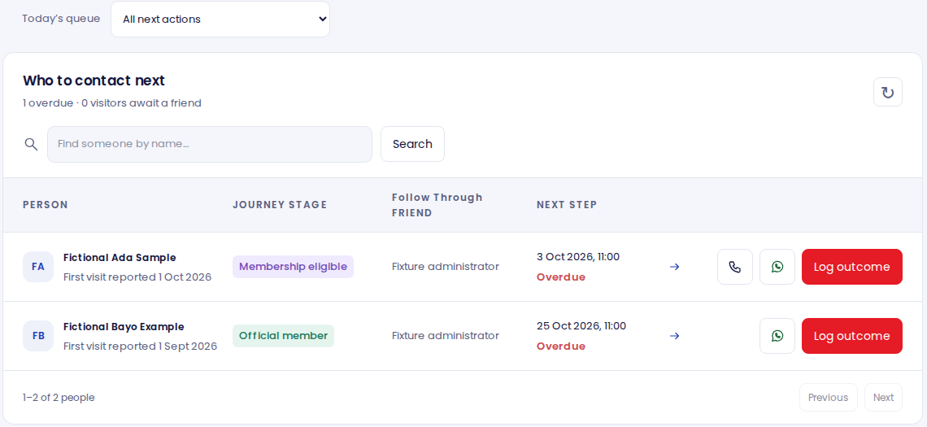
Work the queue one person at a time
Today → Who to contact next
01
Prioritize
Start with overdue cases.
02
Check context
Read the last note and permission.
03
Record the result
Save what happened and the next date.
A queue item is a care task. Completing it means recording the real outcome.
VBC Follow Through Manual · v4.1
07
Notes:
Choose All next actions or Overdue only. Search by name within the list when needed. Open the person before acting if identity or context is uncertain. Call opens the device’s calling tool. The WhatsApp shortcut opens the relevant invitation workflow. Log outcome records an attempt or conversation. A shortcut opening does not itself prove a call connected or a message was sent. Review pagination when the list has several pages.
Source: VBC Member Care v4.1 source, src/components/JourneyDesk.tsx, JourneyExtensions.tsx and WhatsAppInvitations.tsx, src/lib/journey/model.ts, VBC_v3.8_SETUP.md, VBC_v3.9_WHATSAPP_SETUP.md and VBC_v4.1_FIXES.md. Screens are fictional training fixtures, not live church records.
Current reference: VBC_v4_1_SETUP.md and the v4.1 Follow Through registers. Screens use fictional training records.

Slide 8
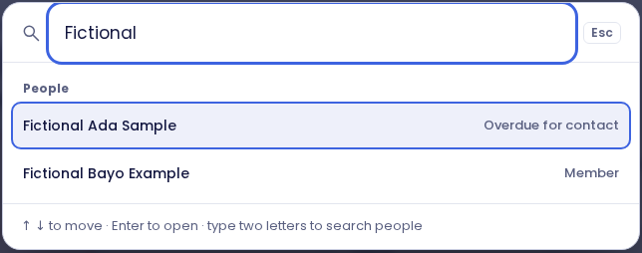
Find a person without creating a duplicate
Use Find a person, /, or Ctrl/Cmd + K.
01
Search
Enter a recognizable part of the name.
02
Confirm identity
Check the correct person before opening.
03
Open the profile
Read the existing history first.
VBC Follow Through Manual · v4.1
08
Notes:
Search only shows people and sections you are authorized to access. Type the name, wait for matching results, then select the correct person. Compare available identity details rather than trusting a similar name. Press Escape to close. If no result appears, check spelling and access before registering a new person. Register a person has a separate explicit identity-confirmation step and blocks duplicate contact details.
Source: VBC Member Care v4.1 source, src/components/JourneyDesk.tsx, JourneyExtensions.tsx and WhatsAppInvitations.tsx, src/lib/journey/model.ts, VBC_v3.8_SETUP.md, VBC_v3.9_WHATSAPP_SETUP.md and VBC_v4.1_FIXES.md. Screens are fictional training fixtures, not live church records.
Current reference: VBC_v4_1_SETUP.md and the v4.1 Follow Through registers. Screens use fictional training records.

Slide 9
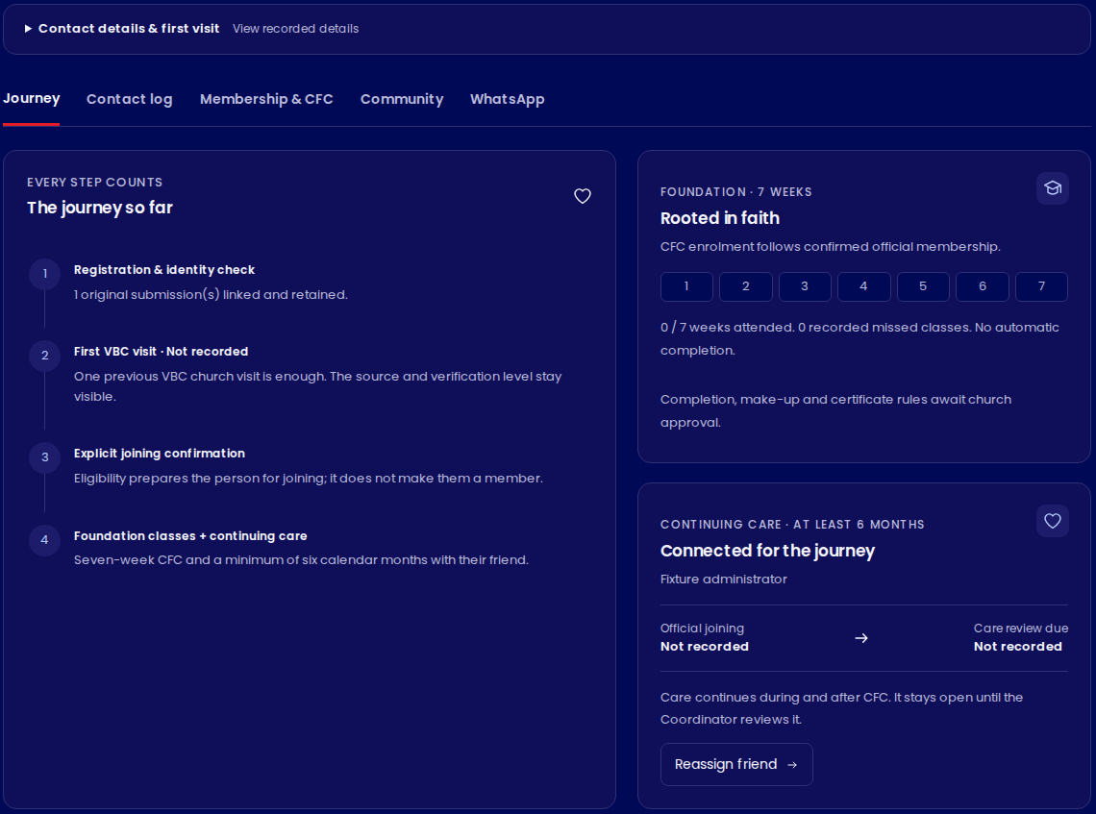
The profile has five working areas
Open a person, then choose the tab for the task.
01
Journey + Contact log
Overview, conversations and tasks.
02
Membership & CFC
Attendance, joining and class progress.
03
Community + WhatsApp
Continuing care, belonging and invitations.
VBC Follow Through Manual · v4.1
09
Notes:
Journey gives the overview. Contact log holds contact history, next actions, original guest submissions and audit activity. Membership & CFC contains church attendance, joining and Foundation Class tracking. Community contains continuing care, ministry, Home Cell links and private welfare needs. WhatsApp appears only with the necessary case permission. Expand Contact details & first visit to inspect recorded details. Exact actions depend on your role and the person’s state.
Source: VBC Member Care v4.1 source, src/components/JourneyDesk.tsx, JourneyExtensions.tsx and WhatsAppInvitations.tsx, src/lib/journey/model.ts, VBC_v3.8_SETUP.md, VBC_v3.9_WHATSAPP_SETUP.md and VBC_v4.1_FIXES.md. Screens are fictional training fixtures, not live church records.
Current reference: VBC_v4_1_SETUP.md and the v4.1 Follow Through registers. Screens use fictional training records.

Slide 10
These labels describe different things
Do not read every badge as the person’s membership level.
Label family | Examples | What it tells you
Membership stage | Visitor · Membership eligible · Official member | Whether actual membership is confirmed
Preparation intention | Interested · Invited · Confirmed · Deferred | What is planned before joining
Contact status | Active · Paused · Inactive · Declined contact | Whether outreach should continue
Care track | Ongoing · Review due · Completed | Whether continuing care remains open
Visit purpose | Exploring · Membership interest · Temporary | Context for a suitable conversation
VBC Follow Through Manual · v4.1
10
Notes:
A person can be an official member and still have paused outreach or ongoing care. Membership preparation intention is separate from actual membership. The confirmed preparation intention means readiness or stated intention, not a completed joining event. Membership eligible is a computed readiness flag. Visit purpose is a voluntary internal classification that never blocks membership.
Source: VBC Member Care v4.1 source, src/components/JourneyDesk.tsx, JourneyExtensions.tsx and WhatsAppInvitations.tsx, src/lib/journey/model.ts, VBC_v3.8_SETUP.md, VBC_v3.9_WHATSAPP_SETUP.md and VBC_v4.1_FIXES.md. Screens are fictional training fixtures, not live church records.
Current reference: VBC_v4_1_SETUP.md and the v4.1 Follow Through registers. Screens use fictional training records.

Slide 11
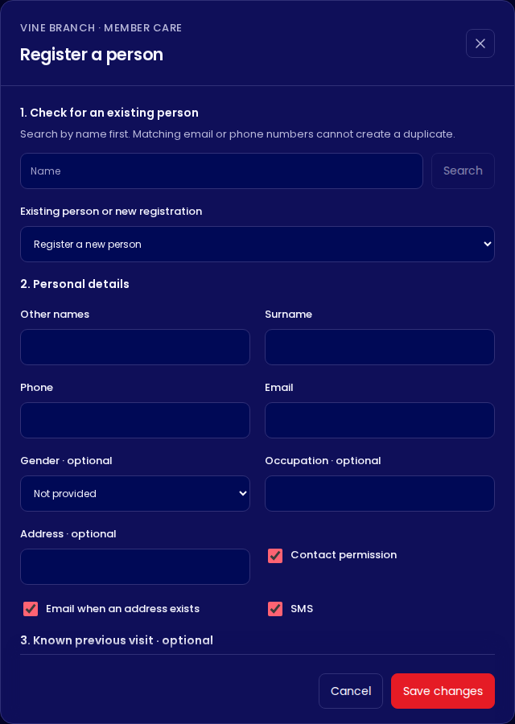
Register carefully and preserve identity
Friends and Coordinator · Register a person or Import CSV
01
Search first
Use an existing person when the identity matches.
02
Check the details
For a new person, enter name and phone or email.
03
Keep facts separate
Registration, attendance and joining need their own evidence.
VBC Follow Through Manual · v4.1
11
Notes:
Friends and Coordinators can register people directly and import reviewed CSV rows. New people created by a Friend are assigned to that Friend. Friends can reuse only records already within their case scope. A matching phone/email outside that scope needs Coordinator identity review. Import does not overwrite or reassign an existing person. Registration does not confirm church attendance or official membership. Existing preferences remain when a person is reused. Use the current CSV template and keep a partial import open for a safe retry. Source: v4.1 source and migrations 022–024.

Slide 12
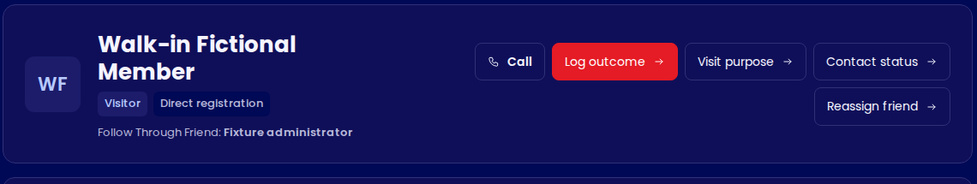
Assign a Follow Through Friend
Coordinator task · Open person → Reassign friend
01
Choose the friend
02
Explain the change
03
Save and verify
Select the correct staff member.
Record an assignment or reassignment reason.
Check the profile now names the right friend.
VBC Follow Through Manual · v4.1
12
Notes:
The Coordinator selects an available Follow Through Friend and records a reason. The new friend receives case access immediately, while prior contact history stays on the same person. The former friend loses access unless another authorized capability grants it. Assigning a friend is not the same as granting the staff member a journey capability. Use Team & access for the latter. A missing friend choice should be checked by the administrator rather than creating duplicate staff accounts.
Source: VBC Member Care v4.1 source, src/components/JourneyDesk.tsx, JourneyExtensions.tsx and WhatsAppInvitations.tsx, src/lib/journey/model.ts, VBC_v3.8_SETUP.md, VBC_v3.9_WHATSAPP_SETUP.md and VBC_v4.1_FIXES.md. Screens are fictional training fixtures, not live church records.
Current reference: VBC_v4_1_SETUP.md and the v4.1 Follow Through registers. Screens use fictional training records.

Slide 13
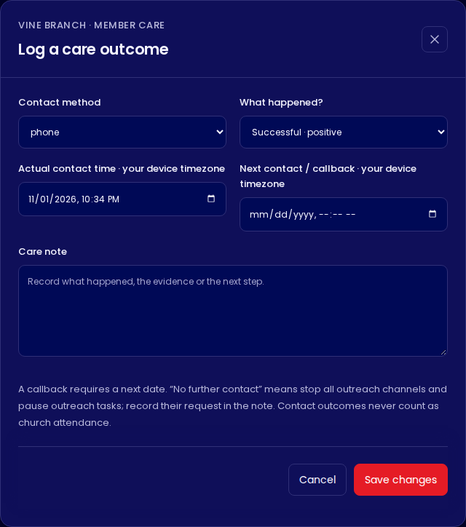
Log what actually happened
Person → Log outcome
01
Method + result
Select the channel and the truthful outcome.
02
Time + next date
Use actual contact time and the agreed callback.
03
Note + save
Write context, save, then check the history.
VBC Follow Through Manual · v4.1
13
Notes:
Choose the contact method and the actual result. Enter the actual contact time using the device timezone. Do not leave the default Successful · positive when a call was unanswered. Requested a callback requires a future next-contact date. Add a brief factual note and next action, then save. Wait for a successful save confirmation. Contact outcomes never count as church attendance. If saving fails, the entered details remain in the form for correction or retry.
Source: VBC Member Care v4.1 source, src/components/JourneyDesk.tsx, JourneyExtensions.tsx and WhatsAppInvitations.tsx, src/lib/journey/model.ts, VBC_v3.8_SETUP.md, VBC_v3.9_WHATSAPP_SETUP.md and VBC_v4.1_FIXES.md. Screens are fictional training fixtures, not live church records.
Current reference: VBC_v4_1_SETUP.md and the v4.1 Follow Through registers. Screens use fictional training records.

Slide 14
Choose the outcome that matches the conversation
An attempt and a successful conversation are different records.
Outcome | Use it when…
Successful · positive / undecided | You spoke and recorded their response.
No answer / Unreachable | The attempt did not reach the person.
Promised to return | They said they intend to attend again.
Requested a callback | They requested another contact time. Set the next date.
Not interested | They expressed no interest. Record the context accurately.
Requested no further contact | They asked for outreach to stop. All channels are disabled.
VBC Follow Through Manual · v4.1
14
Notes:
Successful · positive and Successful · undecided describe connected conversations. No answer and Unreachable record attempts. Promised to return records a stated intention, not attendance. Not interested records a response and must be interpreted respectfully without inventing a no-contact request. Requested no further contact is the explicit all-channel stop outcome. Choose it when the person asks for outreach to stop and record their request in the note.
Source: VBC Member Care v4.1 source, src/components/JourneyDesk.tsx, JourneyExtensions.tsx and WhatsAppInvitations.tsx, src/lib/journey/model.ts, VBC_v3.8_SETUP.md, VBC_v3.9_WHATSAPP_SETUP.md and VBC_v4.1_FIXES.md. Screens are fictional training fixtures, not live church records.
Current reference: VBC_v4_1_SETUP.md and the v4.1 Follow Through registers. Screens use fictional training records.

Slide 15
Understand targets and overdue dates
The dashboard’s timing rules have different purposes.
01
02
03
48 hours
7 days
Next due date
Aim to make the first contact after registration.
An untouched first-attempt case becomes overdue.
Afterward, work from the agreed contact or callback date.
Agree a useful next step with the person. Avoid contacting them simply to clear a card.
VBC Follow Through Manual · v4.1
15
Notes:
The first contact target is within 48 hours of the database registration timestamp. The first-attempt case is flagged overdue after seven days if no attempt has been logged. After contact begins, an agreed next due date governs overdue work. Before joining, 1–2 contacts a week is provisional guidance and must respect the person’s preference. The church has not yet approved a fixed six-month contact frequency. These rules do not justify overriding a refusal or opt-out.
Source: VBC Member Care v4.1 source, src/components/JourneyDesk.tsx, JourneyExtensions.tsx and WhatsAppInvitations.tsx, src/lib/journey/model.ts, VBC_v3.8_SETUP.md, VBC_v3.9_WHATSAPP_SETUP.md and VBC_v4.1_FIXES.md. Screens are fictional training fixtures, not live church records.
Current reference: VBC_v4_1_SETUP.md and the v4.1 Follow Through registers. Screens use fictional training records.

Slide 16
Respect the person’s contact choices
Pause, opt-out and privacy rules apply throughout the journey.
Situation | Action
They need a break | Use Contact status and record the context.
They ask for no more contact | Log Requested no further contact. Stop outreach.
They later agree to resume | Have authorized staff restore permission before resuming.
They share a welfare need | Community → Record support need. Keep it factual and private.
Contact permission, Contact status and WhatsApp API permission are separate checks.
VBC Follow Through Manual · v4.1
16
Notes:
Paused and inactive cases do not offer direct Call or WhatsApp shortcuts. Requested no further contact turns all channel preferences off and pauses outreach tasks. Resuming Follow Through requires restored contact permission recorded separately. A WhatsApp-specific opt-out blocks that channel. Official API sending additionally requires explicit WhatsApp permission and evidence. Private welfare/support notes are visible only to the assigned friend and Coordinator and are excluded from standard exports. Logging an email or SMS outcome does not automatically send a message.
Source: VBC Member Care v4.1 source, src/components/JourneyDesk.tsx, JourneyExtensions.tsx and WhatsAppInvitations.tsx, src/lib/journey/model.ts, VBC_v3.8_SETUP.md, VBC_v3.9_WHATSAPP_SETUP.md and VBC_v4.1_FIXES.md. Screens are fictional training fixtures, not live church records.
Current reference: VBC_v4_1_SETUP.md and the v4.1 Follow Through registers. Screens use fictional training records.

Slide 17
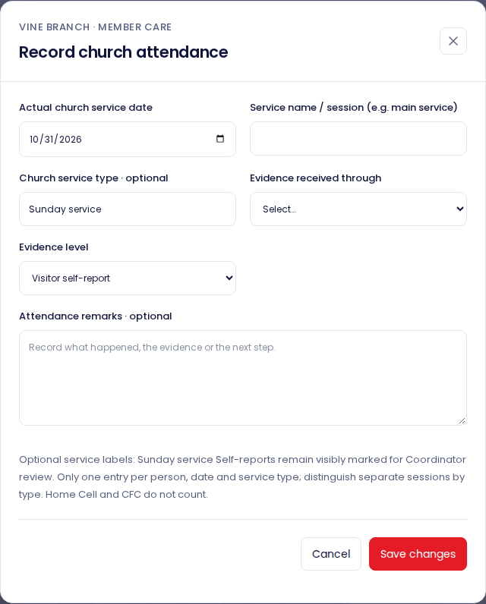
Record church attendance as its own evidence
Person → Membership & CFC → Add attendance
01
Use the actual date
A registration date is not a service date.
02
State the source
Distinguish self-report from staff verification.
03
Save the evidence
CFC and Home Cell attendance belong elsewhere.
VBC Follow Through Manual · v4.1
17
Notes:
Enter the actual church service date, session name where known, optional service type, evidence channel and evidence level. Visitor self-report remains visibly distinct from staff verification. Record remarks when they clarify the evidence. Do not fabricate a service date from the date a form was submitted or a message was sent. Home Cell meetings and CFC classes do not count as the previous VBC church service visit under current rules. Corrections retain the original evidence and correction reason.
Source: VBC Member Care v4.1 source, src/components/JourneyDesk.tsx, JourneyExtensions.tsx and WhatsAppInvitations.tsx, src/lib/journey/model.ts, VBC_v3.8_SETUP.md, VBC_v3.9_WHATSAPP_SETUP.md and VBC_v4.1_FIXES.md. Screens are fictional training fixtures, not live church records.
Current reference: VBC_v4_1_SETUP.md and the v4.1 Follow Through registers. Screens use fictional training records.

Slide 18
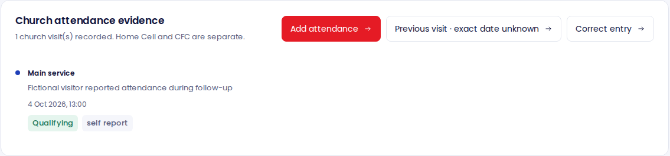
A previous visit is known, but its date is not
One previous VBC church visit before joining is enough. Keep unknown dates unknown.
Known date
Unknown exact date
Record a dated church attendance entry.
Record evidence and a date they had visited before. This is a boundary, not the service date.
VBC Follow Through Manual · v4.1
18
Notes:
This separate confirmation records evidence that the person visited before an exclusive date boundary. The field is labelled Known to have visited before this date · not the visit date. Example: a person credibly confirms a VBC church visit before 15 November, but cannot recall the exact date. Record that boundary and the source, not 15 November as an attendance event. It does not approve first-time same-day joining. For legacy official members with an unknown official joining date, the administrator must reconcile a supported historical date rather than guessing.
Source: VBC Member Care v4.1 source, src/components/JourneyDesk.tsx, JourneyExtensions.tsx and WhatsAppInvitations.tsx, src/lib/journey/model.ts, VBC_v3.8_SETUP.md, VBC_v3.9_WHATSAPP_SETUP.md and VBC_v4.1_FIXES.md. Screens are fictional training fixtures, not live church records.
Current reference: VBC_v4_1_SETUP.md and the v4.1 Follow Through registers. Screens use fictional training records.

Slide 19
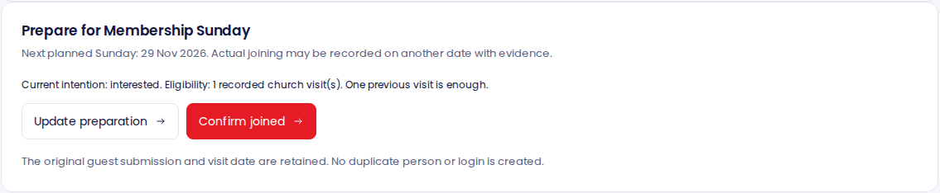
Prepare someone for Membership Sunday
Membership Sunday is a preparation queue.
01
Review eligibility
02
Update preparation
03
Wait for actual joining
Check a previous visit and its evidence.
Record the invitation or agreed intention.
Confirm joined only after it happened.
VBC Follow Through Manual · v4.1
19
Notes:
Open Membership Sunday from the sidebar or Ready to join from Today. The Ready to join card filters to eligible people. Update preparation records the person’s intention such as interested, invited, confirmed, deferred or did not join. Even Confirmed preparation does not promote them to an official member. The next planned Membership Sunday is shown, but actual joining may be recorded on another date with evidence. Current eligibility requires one previous VBC church visit before the actual joining date.
Source: VBC Member Care v4.1 source, src/components/JourneyDesk.tsx, JourneyExtensions.tsx and WhatsAppInvitations.tsx, src/lib/journey/model.ts, VBC_v3.8_SETUP.md, VBC_v3.9_WHATSAPP_SETUP.md and VBC_v4.1_FIXES.md. Screens are fictional training fixtures, not live church records.
Current reference: VBC_v4_1_SETUP.md and the v4.1 Follow Through registers. Screens use fictional training records.

Slide 20
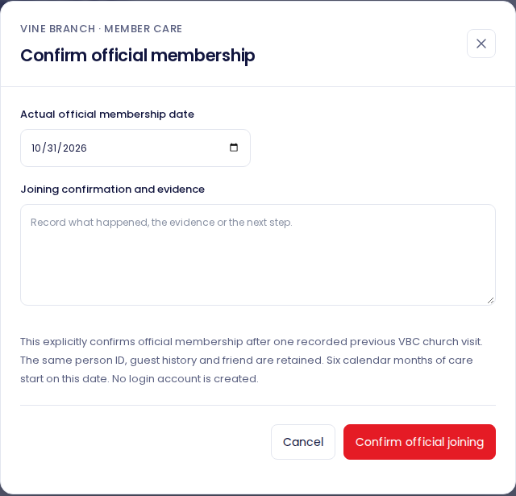
Confirm the actual official joining
Coordinator task · Membership & CFC → Confirm joined
01
Verify the event
Readiness or a promise is not actual joining.
02
Enter date + evidence
Use the day they officially joined.
03
Confirm and check
Look for the official membership date on the profile.
VBC Follow Through Manual · v4.1
20
Notes:
Check that the person actually joined and that there is a previous qualifying visit before the joining date. Enter the real official membership date and joining confirmation evidence. Confirm official joining updates the existing person from visitor to member and begins six calendar months of continuing care. No duplicate person or login account is created. The system blocks first-time same-day joining pending church approval. If the historical date is unknown, ask the administrator to review the supported evidence instead of guessing.
Source: VBC Member Care v4.1 source, src/components/JourneyDesk.tsx, JourneyExtensions.tsx and WhatsAppInvitations.tsx, src/lib/journey/model.ts, VBC_v3.8_SETUP.md, VBC_v3.9_WHATSAPP_SETUP.md and VBC_v4.1_FIXES.md. Screens are fictional training fixtures, not live church records.
Current reference: VBC_v4_1_SETUP.md and the v4.1 Follow Through registers. Screens use fictional training records.

Slide 21
The guest record stays linked after joining
The person grows into membership without losing their history.
01
02
Before joining
After joining
→
Same person ID
Guest submission
Visit and contact history
Assigned friend
Same person ID and retained guest history
Official member status + actual joining date
Same friend and ongoing contact history
Continuing care starts
Never delete the original guest record just because the person becomes a member.
VBC Follow Through Manual · v4.1
21
Notes:
Promotion changes the membership status of the same central person. The original guest submission, earlier visits, contact activity and assigned friend remain linked. The official membership date is stored separately from the original visit/intake information. Do not delete the guest record or create a second person after Membership Sunday. A ministry volunteer, worker or leader is not automatically created through this promotion. Authentication credentials are managed separately from church membership.
Source: VBC Member Care v4.1 source, src/components/JourneyDesk.tsx, JourneyExtensions.tsx and WhatsAppInvitations.tsx, src/lib/journey/model.ts, VBC_v3.8_SETUP.md, VBC_v3.9_WHATSAPP_SETUP.md and VBC_v4.1_FIXES.md. Screens are fictional training fixtures, not live church records.
Current reference: VBC_v4_1_SETUP.md and the v4.1 Follow Through registers. Screens use fictional training records.

Slide 22
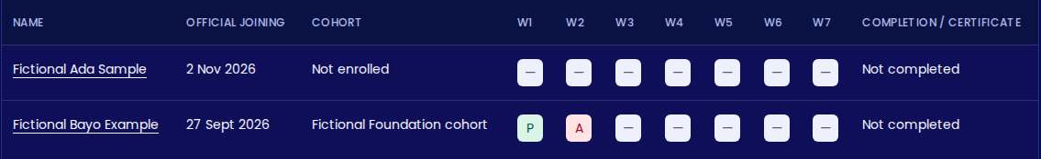
Track seven weeks of Foundation classes
Foundation role · Membership & CFC
01
Enrol in cohort
02
Record week
03
Assess and award
After official joining is confirmed.
Present, absent and no record are distinct.
Only under the approved CFC rules.
VBC Follow Through Manual · v4.1
22
Notes:
Official membership with a confirmed actual date is required for enrolment. The Foundation Class Coordinator creates/selects a cohort, enrols the person and records each week as present or explicitly absent. No record means unknown, not absent. Attendance corrections require an explicit correction reason. Completion is assessed under the church-approved policy rather than automatically after seven ticks. Record award follows completion, with certificate number and evidence. Unknown actual enrolment or award dates can remain blank. A recording timestamp is not a substitute historical event date.
Source: VBC Member Care v4.1 source, src/components/JourneyDesk.tsx, JourneyExtensions.tsx and WhatsAppInvitations.tsx, src/lib/journey/model.ts, VBC_v3.8_SETUP.md, VBC_v3.9_WHATSAPP_SETUP.md and VBC_v4.1_FIXES.md. Screens are fictional training fixtures, not live church records.
Current reference: VBC_v4_1_SETUP.md and the v4.1 Follow Through registers. Screens use fictional training records.

Slide 23
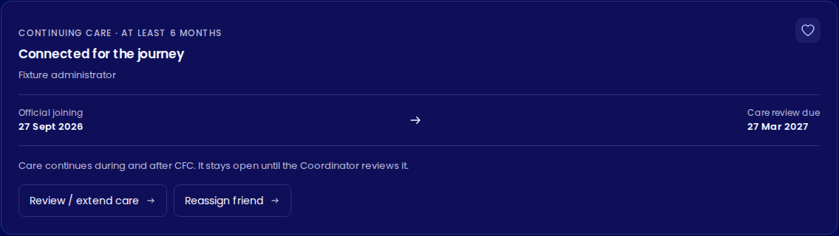
Continue care for at least six calendar months
Person → Community → Connected for the journey
01
Keep the relationship
Record meaningful contact and support.
02
Watch the review date
Due for review does not mean closed.
03
Coordinator reviews
Document completion or an extension.
VBC Follow Through Manual · v4.1
23
Notes:
Continuing care starts on the actual official joining date and retains the assigned friend. The review due date is six calendar months later. It runs alongside CFC and remains open until a Coordinator reviews it. At the review, document the evidence and complete or extend care under the approved church rules. A certificate, ministry assignment or Home Cell entry does not automatically complete it. Contact frequency during these six months is still a church policy decision.
Source: VBC Member Care v4.1 source, src/components/JourneyDesk.tsx, JourneyExtensions.tsx and WhatsAppInvitations.tsx, src/lib/journey/model.ts, VBC_v3.8_SETUP.md, VBC_v3.9_WHATSAPP_SETUP.md and VBC_v4.1_FIXES.md. Screens are fictional training fixtures, not live church records.
Current reference: VBC_v4_1_SETUP.md and the v4.1 Follow Through registers. Screens use fictional training records.

Slide 24
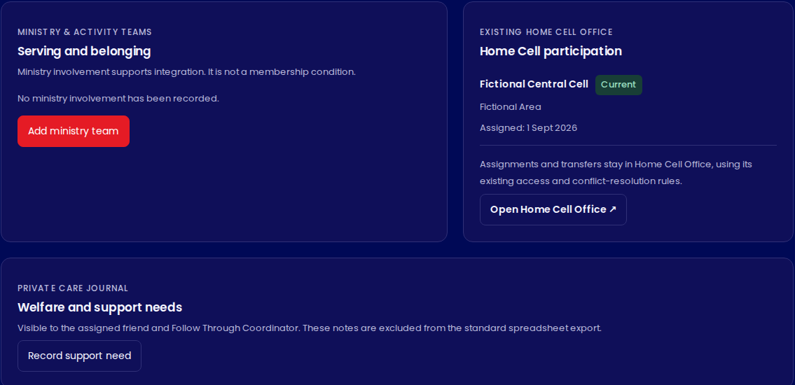
Record ministry and Home Cell participation
Community brings the integration tracks together.
01
Ministry
Add a team and responsibility. Keep unknown dates blank.
02
Home Cell
Use the existing module for assignment or transfer.
03
Private support
Record welfare needs in the restricted journal.
VBC Follow Through Manual · v4.1
24
Notes:
Coordinators may add more than one ministry/activity team, responsibility and actual joining date where known. Ending an assignment preserves history. The Home Cell panel reads the existing Home Cell Office records. Open Home Cell Office for edits using that module’s permissions. If a person belongs to another cell, submit the conflict for Coordinator/church administrator review. Keep the existing assignment until an approved transfer or keep decision. Central profile access does not itself grant Home Cell leadership permissions.
Source: VBC Member Care v4.1 source, src/components/JourneyDesk.tsx, JourneyExtensions.tsx and WhatsAppInvitations.tsx, src/lib/journey/model.ts, VBC_v3.8_SETUP.md, VBC_v3.9_WHATSAPP_SETUP.md and VBC_v4.1_FIXES.md. Screens are fictional training fixtures, not live church records.
Current reference: VBC_v4_1_SETUP.md and the v4.1 Follow Through registers. Screens use fictional training records.

Slide 25
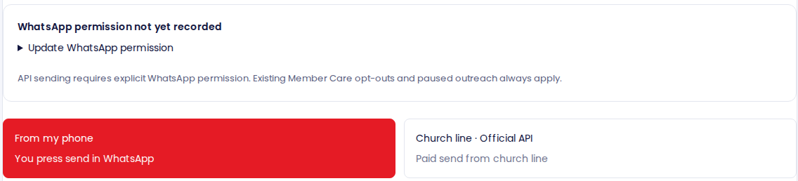
Choose the right WhatsApp route
Person → WhatsApp · Both options respect outreach permission.
From my phone
Church line · Official API
You review and press Send inside WhatsApp.
The configured church line sends an approved template.
VBC Follow Through Manual · v4.1
25
Notes:
From my phone prepares a handoff to the device’s WhatsApp account. Staff must attach the flyer, press send and record the result. It does not need Meta API credentials and has no API sending fee, though data and staff time remain. Church line · Official API sends an individual paid message from the configured church line, available to the Coordinator only when Meta configuration, billing, approved template and webhook requirements are satisfied. The delivered app does not implement automatic registration campaigns or bulk dispatch.
Source: VBC Member Care v4.1 source, src/components/JourneyDesk.tsx, JourneyExtensions.tsx and WhatsAppInvitations.tsx, src/lib/journey/model.ts, VBC_v3.8_SETUP.md, VBC_v3.9_WHATSAPP_SETUP.md and VBC_v4.1_FIXES.md. Screens are fictional training fixtures, not live church records.
Current reference: VBC_v4_1_SETUP.md and the v4.1 Follow Through registers. Screens use fictional training records.

Slide 26

Send the flyer with staff assistance
From my phone → Prepare WhatsApp handoff
01
Review and download
Check the invitation and save the flyer.
02
Attach and send
Use the flyer first with the message as its caption.
03
Return and record
Log the real outcome and the next step.
Opening WhatsApp is not proof that the invitation was sent.
VBC Follow Through Manual · v4.1
26
Notes:
Select the invitation and review its text. Download the flyer and prepare the WhatsApp handoff. Open the chat, attach the downloaded flyer and put the invitation text with it as the caption where possible, so the image appears first. The text handoff alone does not attach the image automatically. Verify the recipient and the active sending account, then press Send in WhatsApp. Return to the dashboard and record sent, replied or unsent, along with the actual outcome and next date. Conversations remain in WhatsApp unless staff record them.
Source: VBC Member Care v4.1 source, src/components/JourneyDesk.tsx, JourneyExtensions.tsx and WhatsAppInvitations.tsx, src/lib/journey/model.ts, VBC_v3.8_SETUP.md, VBC_v3.9_WHATSAPP_SETUP.md and VBC_v4.1_FIXES.md. Screens are fictional training fixtures, not live church records.
Current reference: VBC_v4_1_SETUP.md and the v4.1 Follow Through registers. Screens use fictional training records.

Slide 27
Use the official API only when it is ready
Coordinator task · Church line · Official API
01
02
03
Recipient ready
Church line ready
Review then send
Active outreach and explicit WhatsApp permission, with recorded evidence.
Configured account, billing, approved template and webhook.
Check recipient, template and flyer before a paid individual dispatch.
If setup is incomplete, use the authorized staff-assisted route while the administrator resolves it.
VBC Follow Through Manual · v4.1
27
Notes:
Setup requires server-side Meta credentials, the church phone/business identifiers, billing, an approved image-header template and a verified webhook. The API checks exact approved template text and explicit recipient WhatsApp consent with evidence. Sending is individual, not automatic bulk messaging. The daily cap defaults to 100 across all staff in Lagos time. A disabled API button is expected while setup or consent is incomplete. Never paste service-role keys or Meta access tokens into a staff form or slide. This manual does not claim the live church account is configured.
Source: VBC Member Care v4.1 source, src/components/JourneyDesk.tsx, JourneyExtensions.tsx and WhatsAppInvitations.tsx, src/lib/journey/model.ts, VBC_v3.8_SETUP.md, VBC_v3.9_WHATSAPP_SETUP.md and VBC_v4.1_FIXES.md. Screens are fictional training fixtures, not live church records.
Current reference: VBC_v4_1_SETUP.md and the v4.1 Follow Through registers. Screens use fictional training records.

Slide 28
Read message status before retrying
An API receipt and a pastoral conversation are different evidence.
Status | What staff should understand
Queued / Sending | The request is waiting or being processed.
Accepted / Sent | Accepted or sent by the provider, not proof of reading.
Delivered / Read | Provider receipt confirms delivery or reading where available.
Failed | Read the reason and any safe retry instruction.
Unknown / uncertain | Do not send again blindly. Check status with the Coordinator.
Read the actual reply, then log a truthful care outcome.
VBC Follow Through Manual · v4.1
28
Notes:
Queued and sending are processing states. Accepted means the provider accepted a request and does not prove delivery. Sent, delivered and read are progressively different provider receipts. Definite pre-acceptance rejection can offer Review safe retry. Unknown or uncertain acceptance blocks repeat sends while callbacks/provider evidence are checked. There are no automatic paid retries. STOP, UNSUBSCRIBE and CANCEL opt the person out of WhatsApp. API replies are visible only within authorized scope, and a receipt does not automatically count as a successful Follow Through conversation.
Source: VBC Member Care v4.1 source, src/components/JourneyDesk.tsx, JourneyExtensions.tsx and WhatsAppInvitations.tsx, src/lib/journey/model.ts, VBC_v3.8_SETUP.md, VBC_v3.9_WHATSAPP_SETUP.md and VBC_v4.1_FIXES.md. Screens are fictional training fixtures, not live church records.
Current reference: VBC_v4_1_SETUP.md and the v4.1 Follow Through registers. Screens use fictional training records.

Slide 29
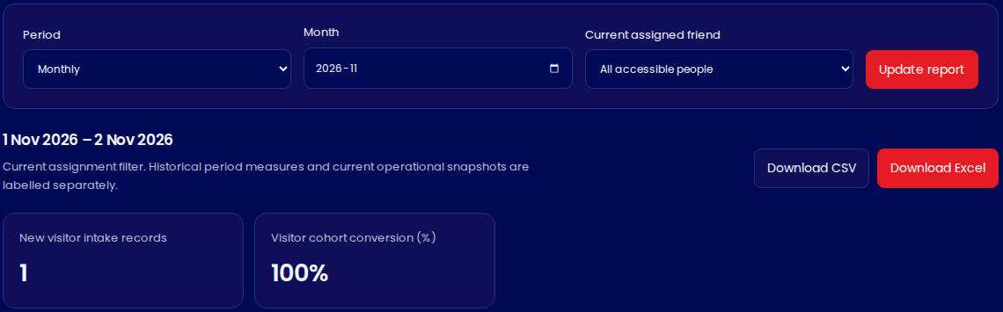
Build a report for the question you are answering
Reports & Friends analysis → Date range → Friend filter → Export
01
Choose the period
Use a range that matches the question.
02
Check the scope
Friend means the current case owner.
03
Read then export
Use Excel for the detailed sheets or CSV for People.
Excel: seven sheets · CSV: People summary
VBC Follow Through Manual · v4.1
29
Notes:
Choose monthly, quarterly, annual or custom dates through today in Lagos time. Apply a friend filter if you need current owner scope. Read the scoreboard definitions before presenting figures. Download Excel gives seven sheets: Scoreboard, People, Contacts, Church attendance, Ministry and Home Cells. CSV is the People summary. Standard exports exclude private welfare needs and free-text contact notes and respect current contact preferences. Scope depends on the staff role. Exports above 10,000 people require a narrower period or friend filter.
Source: VBC Member Care v4.1 source, src/components/JourneyDesk.tsx, JourneyExtensions.tsx and WhatsAppInvitations.tsx, src/lib/journey/model.ts, VBC_v3.8_SETUP.md, VBC_v3.9_WHATSAPP_SETUP.md and VBC_v4.1_FIXES.md. Screens are fictional training fixtures, not live church records.
Current reference: VBC_v4_1_SETUP.md and the v4.1 Follow Through registers. Screens use fictional training records.

Slide 30
Do not mix conversion, activity and “now” figures
Report definitions protect against misleading comparisons.
Report term | Read it as…
Visitor conversion | Joined people from the matching visitor cohort ÷ that cohort.
Direct joiners | Separate from the visitor conversion denominator.
Friend filter | The person’s current assigned friend.
“Now” figures | The current operational position, even for a past period.
Unknown dates | Unknown facts, not dates to estimate for a tidier report.
VBC Follow Through Manual · v4.1
30
Notes:
Visitor conversion compares joining by period end with the matching visitor-intake cohort. Direct joiners are reported separately and excluded from the visitor denominator. Unknown legacy sources are identified separately. The cohort date uses the earlier reported/recorded first visit, or an explicitly labelled registration fallback if unknown. Worker filters use current assignment rather than historical staff attribution. Figures labelled now describe the current snapshot even when the date range is historical. Coordinator reports retain archived historical records. Do not use the friend filter as a historical productivity league table.
Source: VBC Member Care v4.1 source, src/components/JourneyDesk.tsx, JourneyExtensions.tsx and WhatsAppInvitations.tsx, src/lib/journey/model.ts, VBC_v3.8_SETUP.md, VBC_v3.9_WHATSAPP_SETUP.md and VBC_v4.1_FIXES.md. Screens are fictional training fixtures, not live church records.
Current reference: VBC_v4_1_SETUP.md and the v4.1 Follow Through registers. Screens use fictional training records.

Slide 31
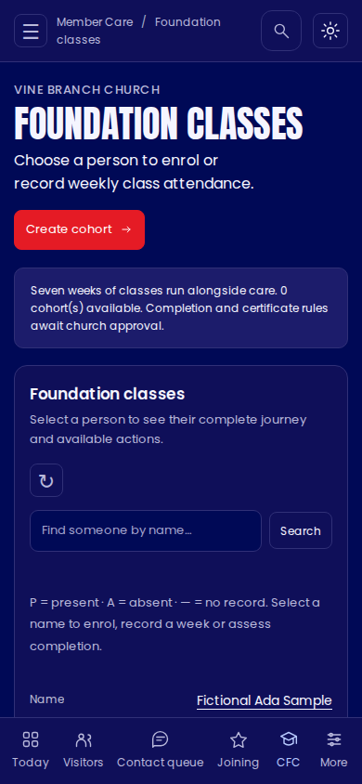
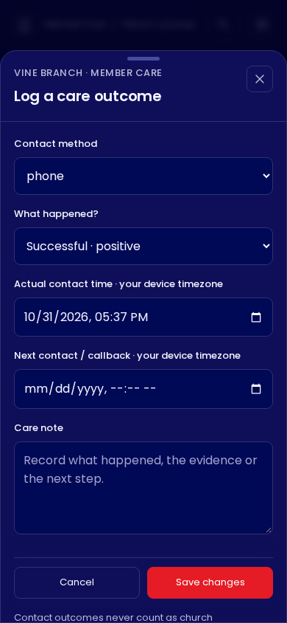
Use the dashboard comfortably on a phone
The same journey uses smaller screens and fixed actions.
01
Use the mobile views
The register and class grid adapt to the smaller screen.
02
Scroll the form
Check every required field before saving.
03
Switch the theme
Choose light or dark for comfortable contrast.
VBC Follow Through Manual · v4.1
31
Notes:
On mobile, use the bottom navigation and profile tabs. Call, WhatsApp and Log outcome stay above the bottom navigation where permissions allow. Forms open as bottom sheets. Scroll inside a long form to reach all fields. The light/dark toggle changes presentation, not form data. Dark mode uses the approved navy #000956 with #0f0f59 cards. Home Cell Office has its own theme state. Date/time fields use the device timezone, so check the device setting when working across timezones.
Source: VBC Member Care v4.1 source, src/components/JourneyDesk.tsx, JourneyExtensions.tsx and WhatsAppInvitations.tsx, src/lib/journey/model.ts, VBC_v3.8_SETUP.md, VBC_v3.9_WHATSAPP_SETUP.md and VBC_v4.1_FIXES.md. Screens are fictional training fixtures, not live church records.
Current reference: VBC_v4_1_SETUP.md and the v4.1 Follow Through registers. Screens use fictional training records.

Slide 32
When something does not save or looks wrong
Check the message and the history before repeating the action.
What you see | What to do
Validation or connection error | Read the message. Check retained fields and history.
Record changed elsewhere | Refresh, review the newer record, then edit again.
Missing or disabled action | Check role, permission, prerequisites and approved policy.
Paid message uncertain | Refresh status. Ask the Coordinator before another send.
Unexpected duplicate conflict | Search the existing person and resolve identity first.
VBC Follow Through Manual · v4.1
32
Notes:
For ordinary care forms, read the validation message, keep the entered details and correct the relevant field. If the connection failed, check the person’s history before deciding whether to retry. A stale edit means the record changed elsewhere, so refresh and review it. Do not repeatedly dispatch paid API messages when acceptance is uncertain. A missing action can reflect the role, consent, Contact status, prerequisite or policy gate. If reporting an error, provide the screen, action, time and displayed message without passwords, keys or unnecessary personal details.
Source: VBC Member Care v4.1 source, src/components/JourneyDesk.tsx, JourneyExtensions.tsx and WhatsAppInvitations.tsx, src/lib/journey/model.ts, VBC_v3.8_SETUP.md, VBC_v3.9_WHATSAPP_SETUP.md and VBC_v4.1_FIXES.md. Screens are fictional training fixtures, not live church records.
Current reference: VBC_v4_1_SETUP.md and the v4.1 Follow Through registers. Screens use fictional training records.

Slide 33
Some buttons wait for an approved church policy
The software should not invent pastoral decisions.
Confirmed workflow
Still needs church approval
One previous church visit, explicit joining, retained history and at least six months of care.
Same-day exceptions, six-month cadence and CFC make-up/completion/award rules.
If a policy-dependent button is disabled
Ask the Coordinator or administrator to confirm the approved rule.
Do not enter false attendance, dates or permissions to bypass it.
VBC Follow Through Manual · v4.1
33
Notes:
Current rules require one previous VBC church visit before joining. First-time same-day joining exceptions are not approved. CFC completion, make-up and certificate rules await church approval where the relevant policy gate is unset. The six-month contact frequency and completion evidence also require church decisions. Additional activities counting as first visits, ministry leader editing and central Home Cell editing are not silently enabled. Use the existing roles and modules. Administrators should record the approved policy before enabling gated actions and communicate it to staff.
Source: VBC Member Care v4.1 source, src/components/JourneyDesk.tsx, JourneyExtensions.tsx and WhatsAppInvitations.tsx, src/lib/journey/model.ts, VBC_v3.8_SETUP.md, VBC_v3.9_WHATSAPP_SETUP.md and VBC_v4.1_FIXES.md. Screens are fictional training fixtures, not live church records.
Current reference: VBC_v4_1_SETUP.md and the v4.1 Follow Through registers. Screens use fictional training records.

Slide 34
Practice with a fictional person first
Use an authorized fictional record in a training environment.
01
Find and read
Open the correct fictional person. Identify their friend and stage.
02
Log an attempt
Choose No answer, enter actual time and a sensible next action.
03
Explain the next stage
Show where attendance, joining and CFC would be recorded.
04
Check your understanding
Explain which record stays after joining and how care continues.
VBC Follow Through Manual · v4.1
34
Notes:
Use a non-production training environment or an authorized fictional record. Never create fictional church history on a real person to test the system. The friend practices reading and logging contact. The Coordinator explains assignment and joining without falsely confirming membership. The Foundation lead explains the class track. Ask each trainee to explain why a WhatsApp handoff is not a delivery receipt. Discuss the answer before granting independent working access.
Source: VBC Member Care v4.1 source, src/components/JourneyDesk.tsx, JourneyExtensions.tsx and WhatsAppInvitations.tsx, src/lib/journey/model.ts, VBC_v3.8_SETUP.md, VBC_v3.9_WHATSAPP_SETUP.md and VBC_v4.1_FIXES.md. Screens are fictional training fixtures, not live church records.
Current reference: VBC_v4_1_SETUP.md and the v4.1 Follow Through registers. Screens use fictional training records.

Slide 35
Keep this daily reference close
Find the person → Read the history → Act → Record → Set the next step
I want to… | Open…
Know who needs attention | Today → Overdue / Who to contact next
Record a call or conversation | Person → Log outcome
Add visit evidence or confirm joining | Person → Membership & CFC
Record continuing care, support or ministry | Person → Community
Send an invitation and record its result | Person → WhatsApp
Review figures and download a workbook | Reports & Friends analysis
VBC Follow Through Manual · v4.1
35
Notes:
The dashboard supports a continuing relationship rather than a one-time conversion event. Before ending a session, check that recorded outcomes are truthful and next dates are appropriate. Escalate identity conflicts, access issues, historical date uncertainty and policy questions. Respect the person’s preferences even when a queue item remains open. Home Cell leadership/password administration and deployment are outside the main scope of this Follow Through manual.
Source: VBC Member Care v4.1 source, src/components/JourneyDesk.tsx, JourneyExtensions.tsx and WhatsAppInvitations.tsx, src/lib/journey/model.ts, VBC_v3.8_SETUP.md, VBC_v3.9_WHATSAPP_SETUP.md and VBC_v4.1_FIXES.md. Screens are fictional training fixtures, not live church records.
Current reference: VBC_v4_1_SETUP.md and the v4.1 Follow Through registers. Screens use fictional training records.

Slide 36
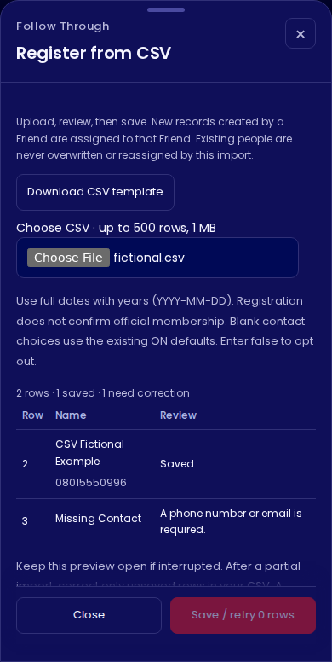
Registration from CSV
People register or Today · Import CSV
01
Start with the template
Keep its headings. Use one person per row.
02
Review before saving
Read each row’s status and correct missing details.
03
Check the saved count
Successful rows stay saved. Retry unfinished rows in the same preview.
VBC Follow Through Manual · v4.1
36
Notes:
Download the template, fill one row per person and save a comma-separated CSV. Preview supports 1–500 rows up to 1 MB. A phone or email is required. Only full known dates with a year are accepted. Blank contact choices keep the current defaults. Valid rows can be saved while invalid rows remain clearly marked. Successful rows remain saved after an interruption. Retry unfinished rows in the same open preview. Stop after current batch pauses a large import. When correcting a file after partial success, include only unsaved rows. Conflicts need identity review.
Source: VBC v4.1 application, migrations 022–024 and VBC_v4_1_SETUP.md. Structural reference: SPRING GUESTS 2025 (1).xlsx, Sheet1 headers. Historical personal rows were not imported or used in the illustrations.

Slide 37
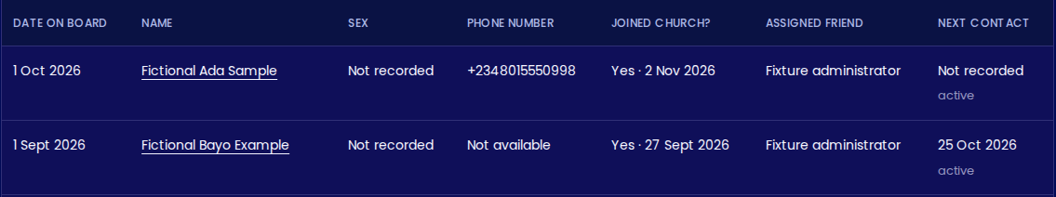
The People register
A working table based on the guest workbook’s familiar headings
01
Choose a name
02
Read the date correctly
Open the person to record a contact or update their journey.
Date on board is registration. Official joining has its own date.
VBC Follow Through Manual · v4.1
37
Notes:
People register includes all people within staff scope, while Visitors remains the active visitor care queue. Date on board means the central record registration date and is not a claim about the first church visit. Joined church is confirmed official joining or a legacy member with an unknown date. Blank joining is shown as Not confirmed, rather than assuming No. Phone visibility follows current contact permission. The original Target? label has no defined rule in the workbook and is not used as an eligibility gate. Original dates without a year and unclear historical assignments have not been guessed or imported.
Source: VBC v4.1 application, migrations 022–024 and VBC_v4_1_SETUP.md. Structural reference: SPRING GUESTS 2025 (1).xlsx, Sheet1 headers. Historical personal rows were not imported or used in the illustrations.

Slide 38
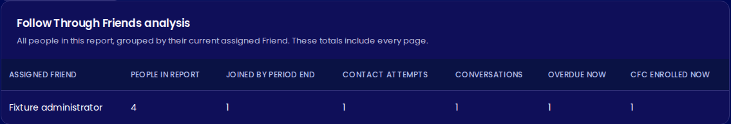
Friends analysis
Reports & Friends analysis · Select a period and current Friend
01
Review the selected period
02
Understand current ownership
Attempts and conversations describe activity during that period.
The grouping uses the assigned Friend now. Page changes do not change totals.
VBC Follow Through Manual · v4.1
38
Notes:
The summary groups every person in the selected report population by current case owner and does not depend on which 30-row page is visible. People in report is the selected report population, not all-time assigned workload. Contact attempts and conversations use the selected period. Joined by period end differs from joining within the period. Overdue now and CFC enrolled now are current snapshots. The Friend filter is current ownership, not a historical staff productivity ranking. Excel includes the same Friends analysis as its seventh sheet. Private welfare notes and free-text contact notes remain excluded.
Source: VBC v4.1 application, migrations 022–024 and VBC_v4_1_SETUP.md. Structural reference: SPRING GUESTS 2025 (1).xlsx, Sheet1 headers. Historical personal rows were not imported or used in the illustrations.

Slide 39
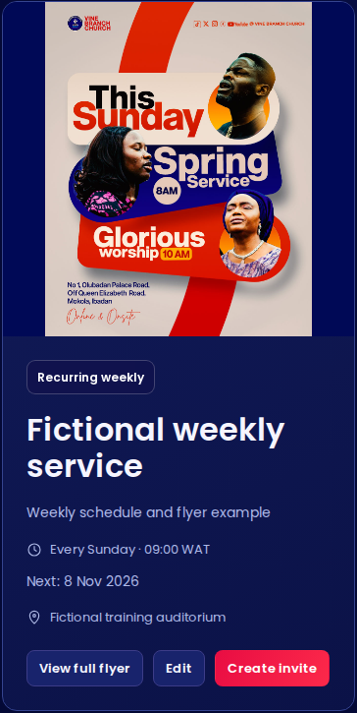
Saved programmes and recurring services
Programmes · Create programme or Edit
01
Choose the schedule
Use an actual date for one-off events, or a weekday for weekly services.
02
Add the actual flyer
Upload a JPG, PNG or WebP image of up to 4 MB.
03
Save and find it again
The programme stays on this page after refresh and appears on Overview.
VBC Follow Through Manual · v4.1
39
Notes:
Programme records persist in the original church database table and appear again after refresh. Overview uses the same saved programme feed. Choose One-off programme for an actual date, or Recurring weekly for a weekday and time without a fixed date. The display calculates the next weekly occurrence in Lagos time. Upload JPG, PNG or WebP up to 4 MB. The flyer remains fully visible and opens through View full flyer. Artwork is public, so upload programme materials only. Switching schedule type preserves other form fields. A failed save keeps the entered details. Creating an invitation opens the existing composer and does not send a message automatically.
Source: VBC v4.1 application, migrations 022–024 and VBC_v4_1_SETUP.md. Structural reference: SPRING GUESTS 2025 (1).xlsx, Sheet1 headers. Historical personal rows were not imported or used in the illustrations.

