Slide 1
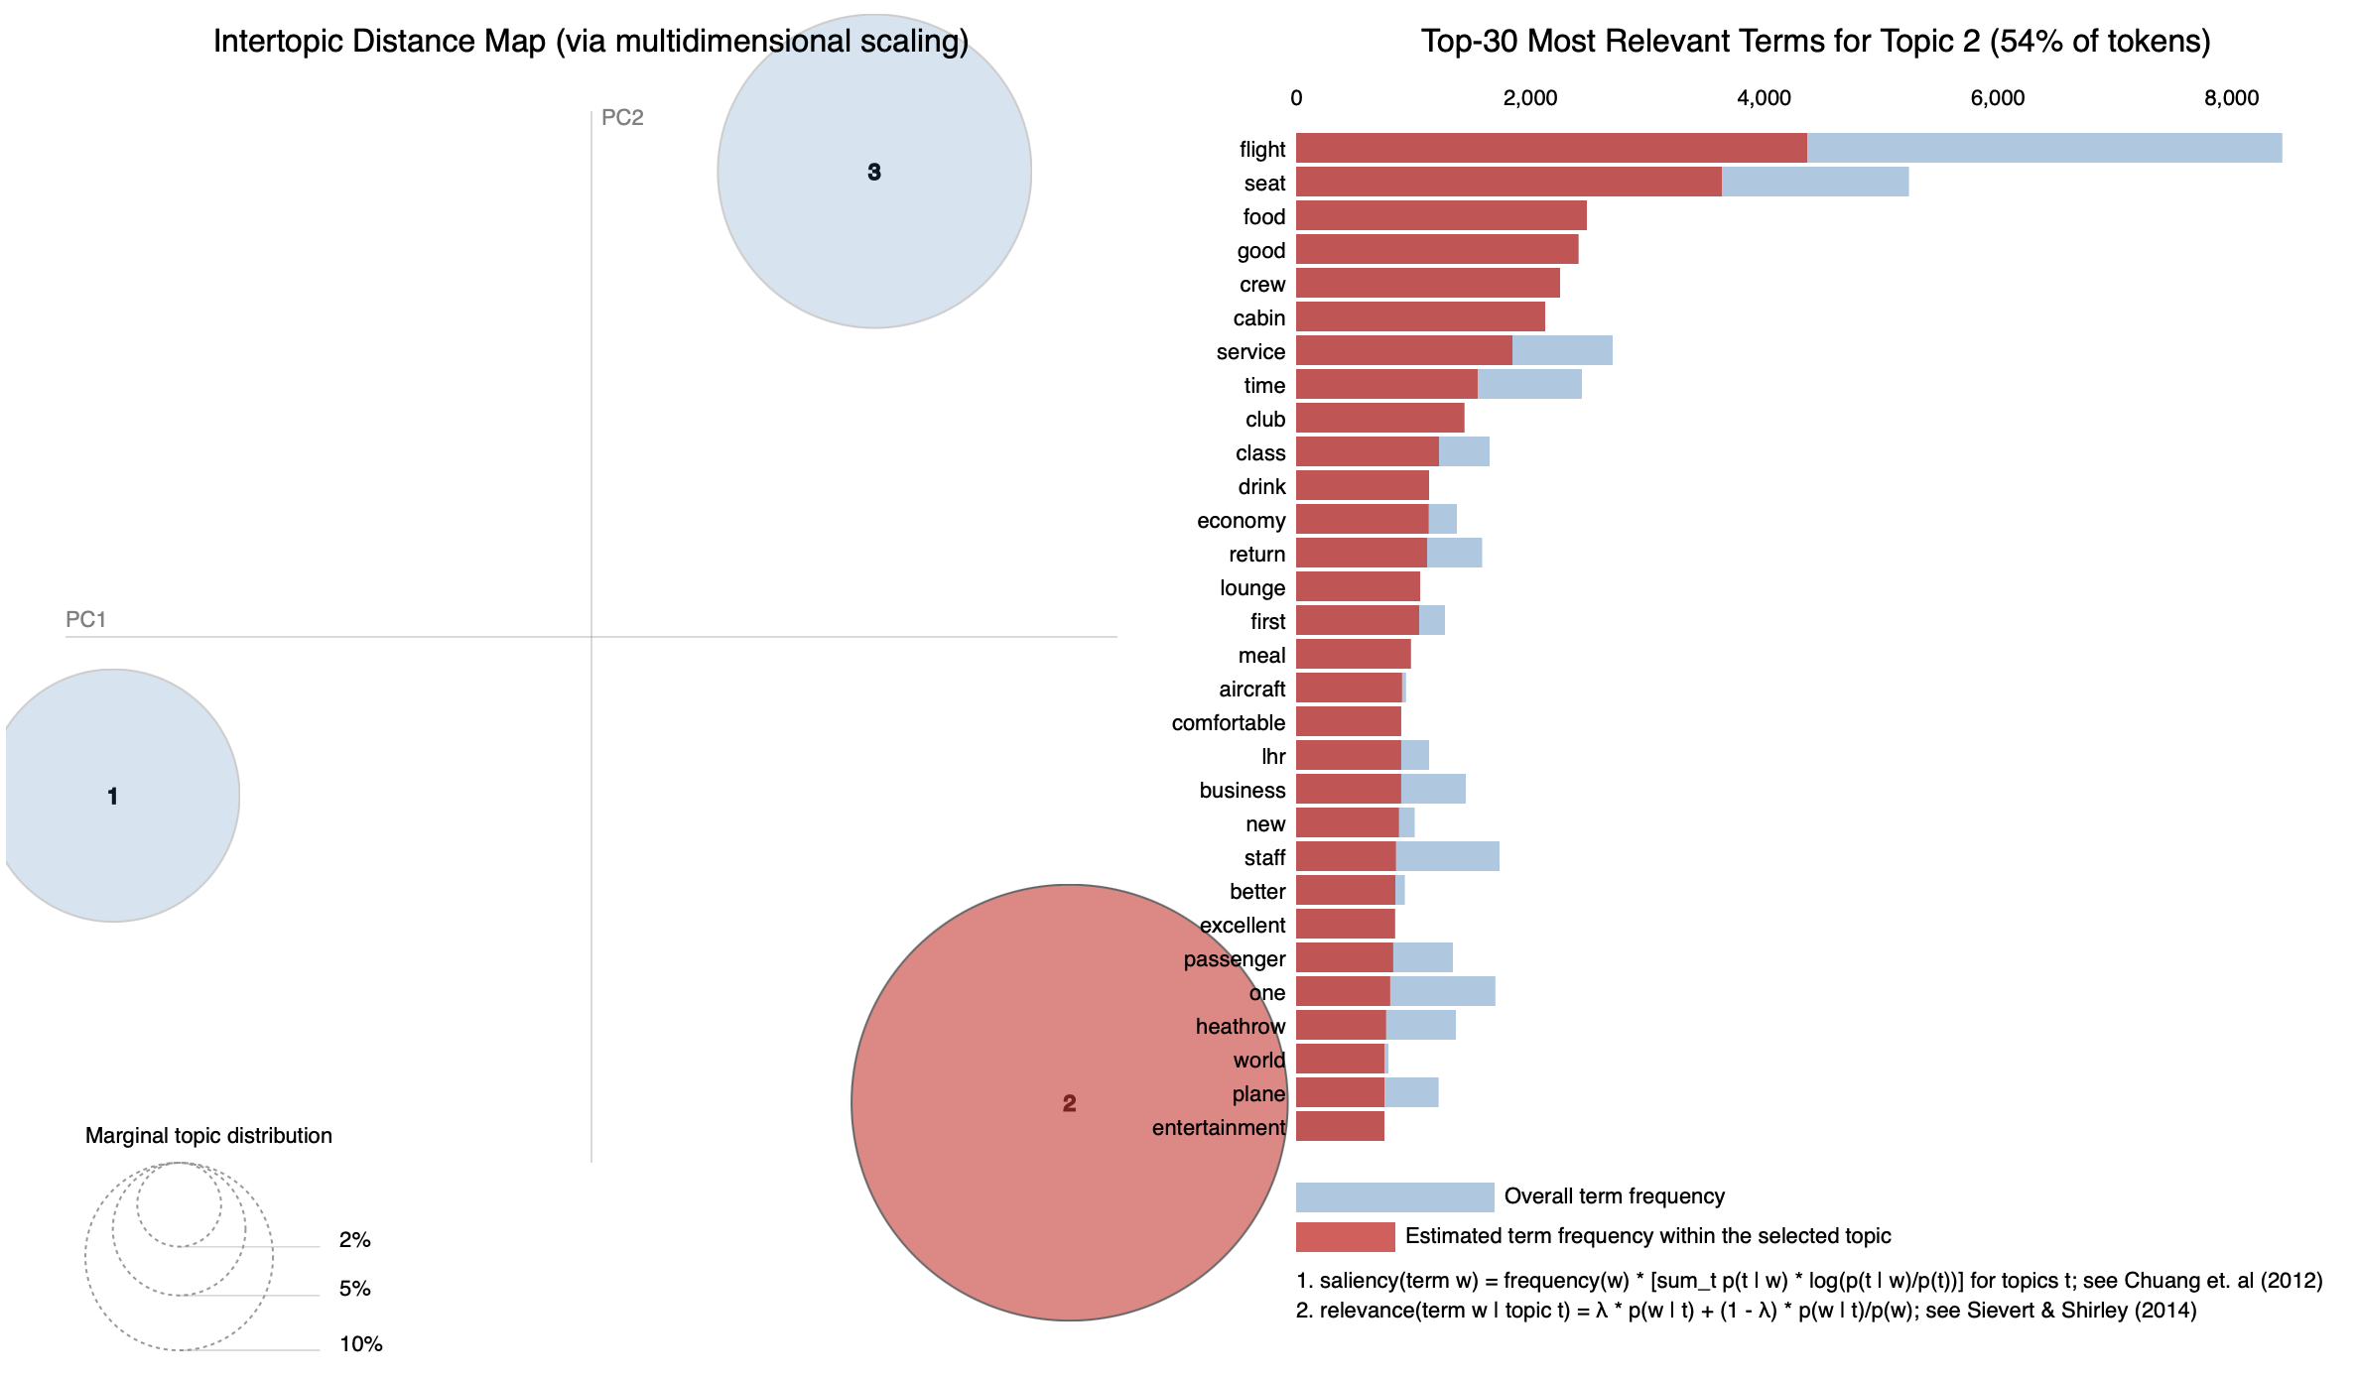
Mining Customer Insights: Unveiling Key Themes in 3,912 Customer Reviews Using LDA
Overview
Data Collection:
Scraped 3,912 customer reviews.
Data Preparation:
Cleaned and pre-processed the reviews.
Topic Modelling:
Applied Latent Dirichlet Allocation (LDA) to uncover three distinct topics.
Visualization:
Used pyLDAviz to display an inter-topic distance map where circle size indicates topic prevalence, and a bar chart showing top relevant terms, with Topic 2 highlighted for detailed analysis.
Topic 1: Airline seating, class differentiation and Fare-Value
Business Implication:
Topic 1 seems to capture customer conversations around the trade-offs between seating options, fare classes, and the overall value for money. Addressing these aspects can help the airline fine-tune their product offerings, pricing models, and customer service strategies, leading to improved satisfaction and competitive positioning.
Top terms: seat, airline, British, airway, fly, business, year, money, class, American, pay, paid, customer, service, extra, economy, premium, travel, booked, cost
Topic 2: Holistic In-Flight Experience & Service Excellence
Business Implication:
The prevalence of this topic suggests that the in-flight experience, encompassing seating comfort, quality meals, and excellent service is a key determinant of customer satisfaction. An investment in these areas would position the airline to benefit from improved customer loyalty, a stronger competitive position, and overall enhanced brand reputation.
Top terms: flight, seat, food, good, crew, cabin, service, time, club, class, drink, economy, return, lounge, first, meal, aircraft, comfortable, business, staff
Topic 3: Operational Delays and Communication Breakdowns in Air Travel.
Business Implication:
Topic 3 highlights significant concerns about flight delays, baggage issues, and the quality of communication from staff. Addressing these areas can help improve operational efficiency, enhance customer satisfaction, protect brand reputation, and positively impact the bottom line.
Top terms: flight, hour, told, check, time, bag, staff, day, minute, airport, heathrow, delayed, London, back, luggage, late, airway, service

