Slide 1
Predicting Customer Buying Behaviour: Insights from Machine Learning

Slide 2
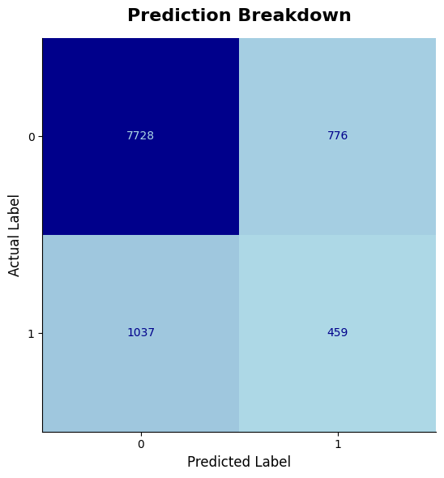
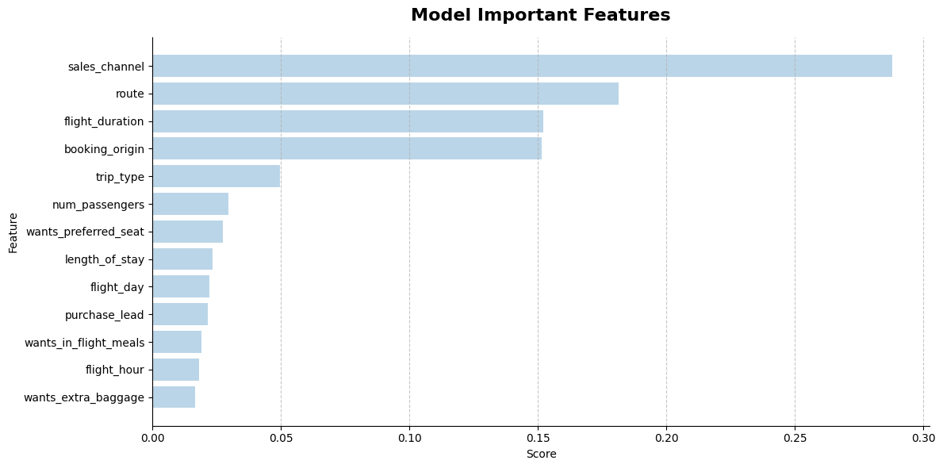
Result
The model was evaluated on 9,963 customer observations.
Out of 8,504 customers who did not buy, the model correctly predicted 7,728 (90.8%) but misclassified 776 (9.2%).
Out of 1,459 customers who bought, the model correctly predicted only 459 (30.6%), while 1,037 (69.4%) were misclassified. This shows that the model needs improvement.
The graph below highlights the most important features and their contribution to the model’s performance. The top contributing features are sales channel, route, flight duration, booking origin and trip type.

