Slide 1
INTRODUCTION
OVERVIEW
This data analytics project centers around direct marketing campaigns conducted by a Portuguese banking institution through phone calls. The primary objective is to glean valuable insights and descriptive patterns within the dataset, with a specific focus on predicting client subscription to a term deposit, denoted by the variable 'y.’
OBJECTIVES
Descriptive Analysis: Performed descriptive statistics and exploratory data analysis to understand the distribution and relationships between variables.
Segmentation Analysis: Segmented the data to understand how different customer groups respond to marketing campaigns.
Temporal Patterns: Explored temporal trends in marketing campaign success by analyzing month and day-of-the-week effects.
Methodology: Deployed Python data analysis libraries to perform exploratory and descriptive data analysis and developed a model to predict the campaign outcome using SK-learn.

Slide 2
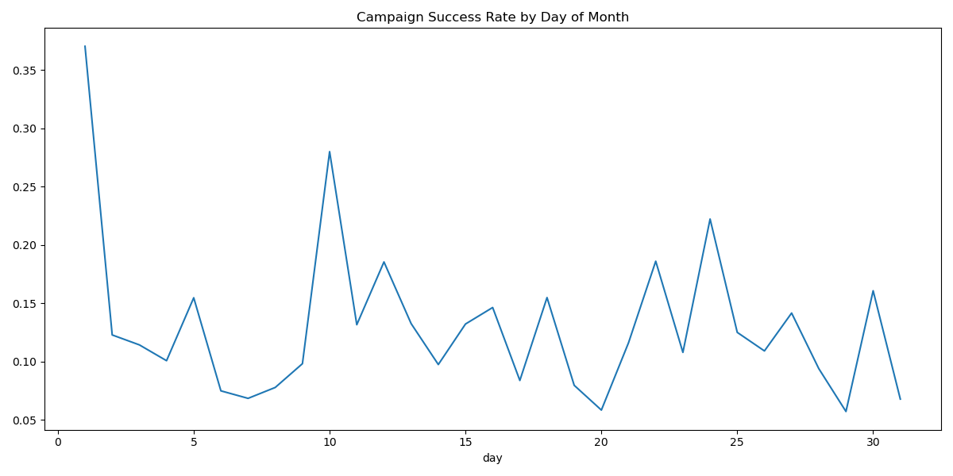
SUCCESS BY DAY KEY INSIGHT The highest success rate appears at the very beginning of the month (day 1), reaching about 37%. Around day 10-11 (approximately 28%). Near day 24-25 (about 22%). Around day 30 (roughly 15%). Notable valleys or low points occur: Around days 6-8 (about 7%) Near day 20 (approximately 6%) Around day 28 (about 6%)
Pattern Analysis:
There's a sharp decline in success rates during the first few days of the month, dropping from 37% to about 12%
The middle of the month (days 12-18) shows moderate stability, fluctuating between 10-15%
The pattern appears somewhat cyclical, with peaks and troughs occurring roughly every 5-7 days
The overall trend suggests that campaign success is highest at the start of the month and generally declines, though with regular fluctuations

Slide 3
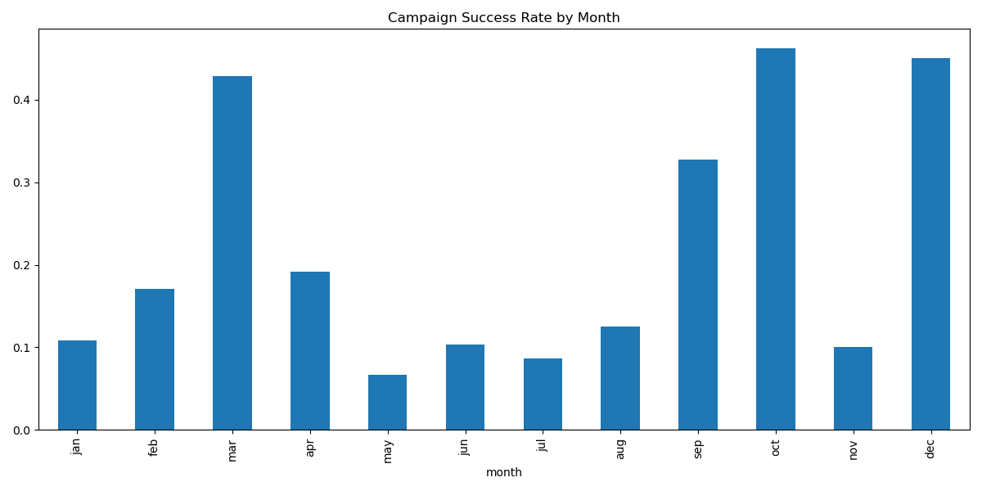
SUCCESS BY MONTH KEY INSIGHT There are notable peaks in: March (around 0.43 or 43%) October (around 0.45 or 45%) December (around 0.44 or 44%) The lowest success rates occur in: May (approximately 0.07 or 7%) July (approximately 0.08 or 8%)
There's a clear pattern of fluctuation throughout the year, with success rates generally:
Starting low in January
Peaking in March
Declining through spring and early summer
Rising again in late summer through fall
Dropping in November before rising again in December
The overall range of success rates varies from about 7% at the lowest to 45% at the highest, showing significant variability in campaign performance throughout the year.

Slide 4
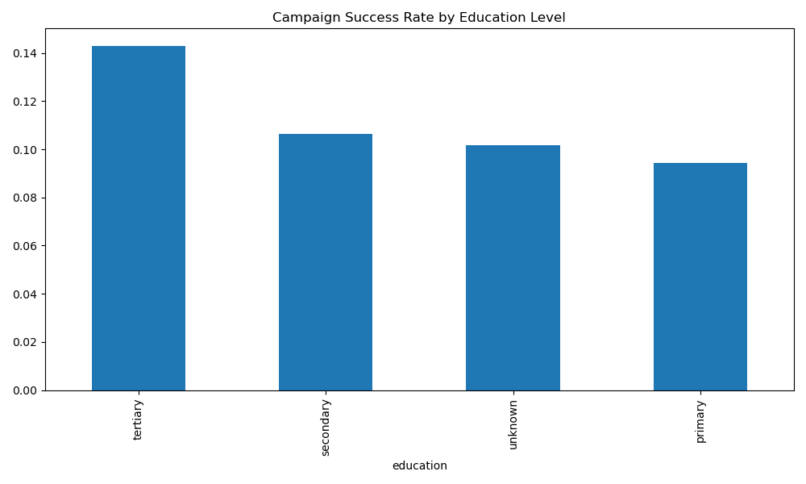
SUCCESS BY EDU Key Insight Clear positive correlation between education level and campaign success Tertiary education holders are 50% more likely to subscribe than primary education holders. Tertiary-educated customers are the most promising segment (highest success rate and balance). Secondary education segment has the largest customer base but lower success rate. Primary education segment might need different marketing approaches
Education-Success Correlation:
Success Rates by Education:
Tertiary (highest): 14.30% success rate. Secondary: 10.62% success rate. Unknown: 10.16% success rate, Primary (lowest): 9.44% success rate.
Customer Distribution:
Secondary education is the largest segment (2,306 customers). Tertiary education is the second-largest (1,350 customers). Primary education has 678 customers. Unknown education level is the smallest group (187 customers)
Correlations:
Average Balance by Education:
Tertiary: Highest at €1,948.64
Unknown: €1,860.43
Primary: €1,531.24
Secondary: Lowest at €1,290.86
Average Age by Education:
Primary: Oldest at 46.83 years
Unknown: 45.30 years
Secondary: 40.06 years
Tertiary: Youngest at 39.65 years

Slide 5
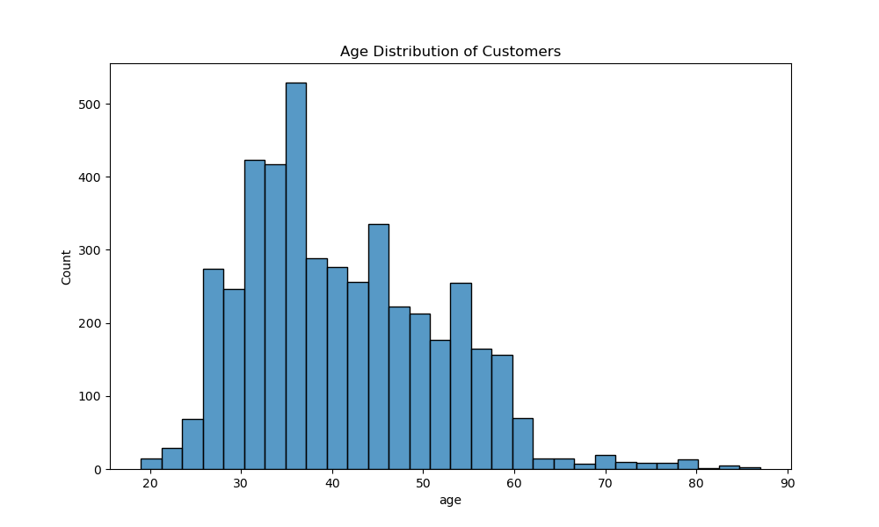
AGE DISTRIBUTION Key Insight The bank's primary customer segment is working-age adults in their 30s and 40s. Young adult market (20-30) could be underserved.
Overall Distribution Shape: Age
The distribution is roughly bell-shaped but slightly right-skewed (has a longer tail towards older ages). The bulk of customers are between ages 30-60. Peak concentration is around age 35-40
Specific Age Groups:
Young Adults (20-30): Relatively small portion, gradually increasing
Prime Working Age (30-50): Largest concentration
Clear peak around age 35-40 with 525 customers
Strong representation in 30-45 range
Middle Age (50-65): Steady decline but still significant numbers
Senior (65+): Gradual tapering off, with very few customers over 80
Key Statistics
Mean age: 41.17 years, Age range: 19-87 years. Highest concentration: 35-40 age bracket with over 500 customers

Slide 6
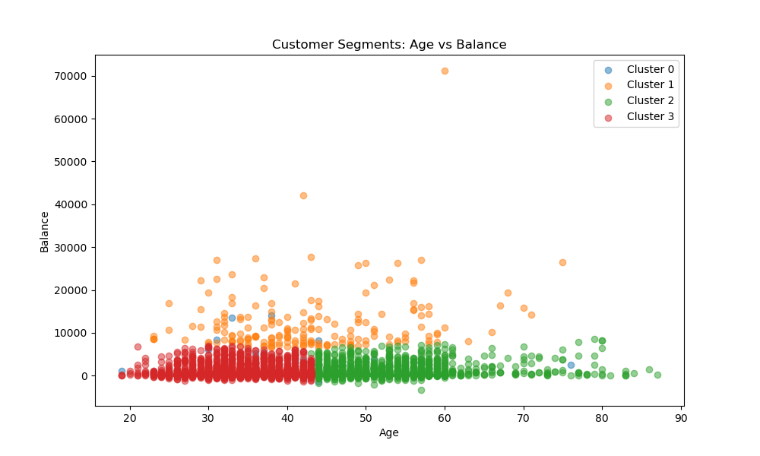
CLUSTER SUMMARY Key Insights The majority of customers maintain relatively low balances, regardless of age. The bank has a good mix of customer ages, suggesting successful customer acquisition across generations.
Cluster 0 (Blue): Kmeans model result
Not prominently visible in the graph, suggesting this may be a small segment or overlapping with other clusters
Cluster 1 (Orange):
Contains customers with notably higher account balances (ranging from 10,000 to 70,000). Spread across all age groups but seems to have more concentration in the 30-60 age range. Represents the "high-value" customer segment with significantly higher balances. Shows some outliers with very high balances (around 70,000)
Cluster 2 (Green):
Primarily older customers (concentrated in the 45-90 age range). Moderate account balances (mostly under 10,000). Shows a pattern of steady, modest savings among older clients
Cluster 3 (Red):
Predominantly younger to middle-aged customers (20-50 age range). Lower account balances (mostly under 5,000). Represents the largest cluster by volume. Likely consists of regular retail banking customers

Slide 7
RECOMMENDATION
Develop targeted products for each cluster. Identifying opportunities for upselling or cross-selling based on cluster characteristics and tailoring marketing strategies for different age/wealth segments.
The campaign should focus heavily on the 30-50 age group, where most customers are. Consider specific campaigns to attract younger customers.
Prioritize marketing to tertiary-educated customers, develop tailored approaches for the secondary education segment given its large size, and create simplified products/messaging for the primary education segment. Consider age-specific strategies since education levels correlate with age.
Campaign should be done in the month of March, October, and December and in the early days of each month (1-11) and towards ending (24-25)

Slide 8
CONCLUSION
The campaign banking data was successfully analyzed and the following conclusion can be drawn from the data:
The bank's primary customer segment is working-age adults in their 30s and 40s
Tertiary-educated customers have the highest success rate of subscription to the term deposit
First day of March, October and December is most preferred to carried out marketing campaign.

