Slide 1
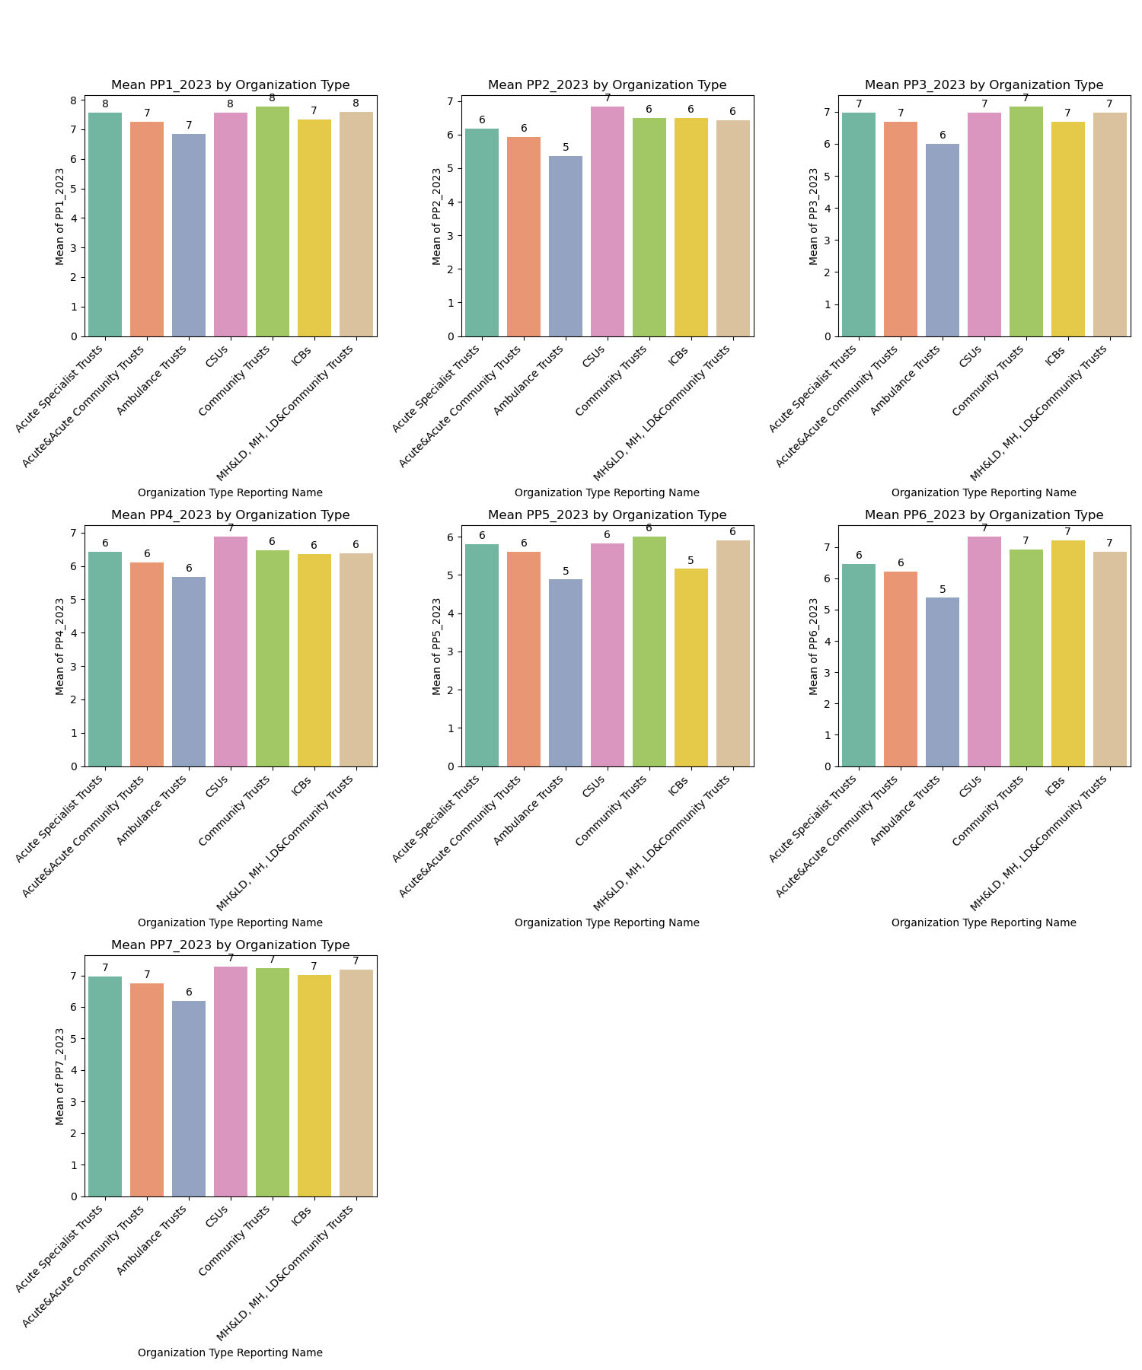
RESULTS
(Average score of the indicators of PPE across the different organisational type)
On average, staff in all organisations show compassion and inclusivity, with PPE1 scores between 7 and 8.
In 2023, staff in CSUs have the highest average score of 7 for PPE2, indicating that the staffs been recognized and rewarded.
Team work spirit was observed in all organization types with average score of 7 for PPE 3 and 7, except for ambulance trust, which has an average score of 6.
PPE 4 and 5 has a range of score between 5 to 7 implies staffs does not feel moderate satisfied with the safety, healthy and building up their career through learnings.
In general, across the 7 PPEs, the organisations benchmark groups have scores between 5 to 8, which establish a moderate score among the group

Slide 2
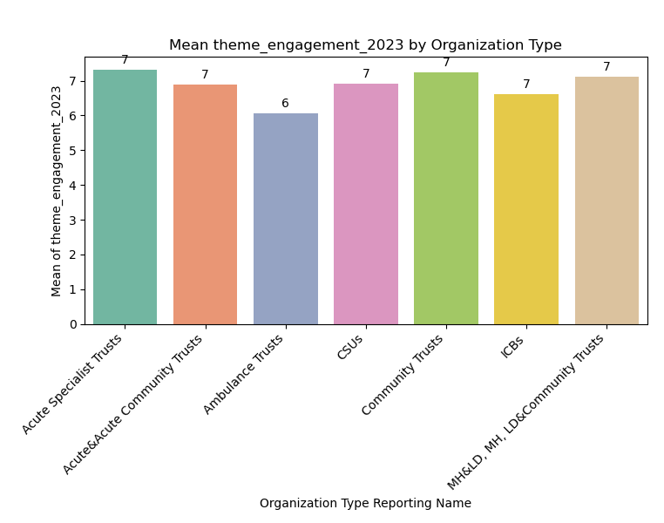
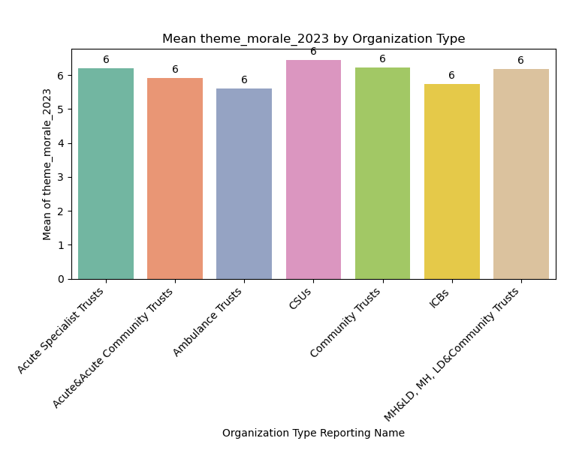
RESULT (Average score of the indicators of theme across the different organisational type)
Staff engagement implies their involvement, motivation towards work and advocacy.
Staff Morale implies staff not thinking of leaving not pressured or stressed at work.
Theme engagement has an average score of 7 except for Ambulance Trust organization benchmark with 6.
Approximately, all the organization benchmark has the same average score for Theme moral

Slide 3
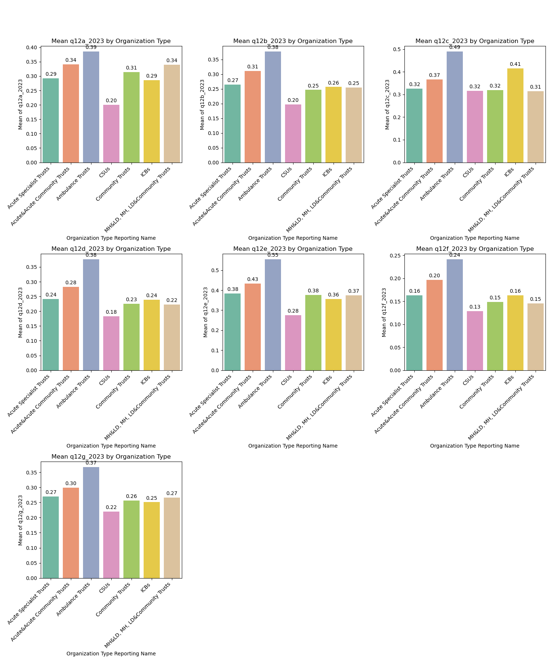
RESULT (Average percentage of staff stress experience on job in the different organisational type )
Stress at work is not a dominant issue for many staff in organisations, with most responses ranging between 0.1 to 0.5.
CSUs have low mean percentages in most categories, suggesting a low level of stress.
Acute & Community Trusts and Ambulance Trusts experience higher levels of stress due to their demanding job roles and systemic differences in managing workload and staff well-being.

Slide 4
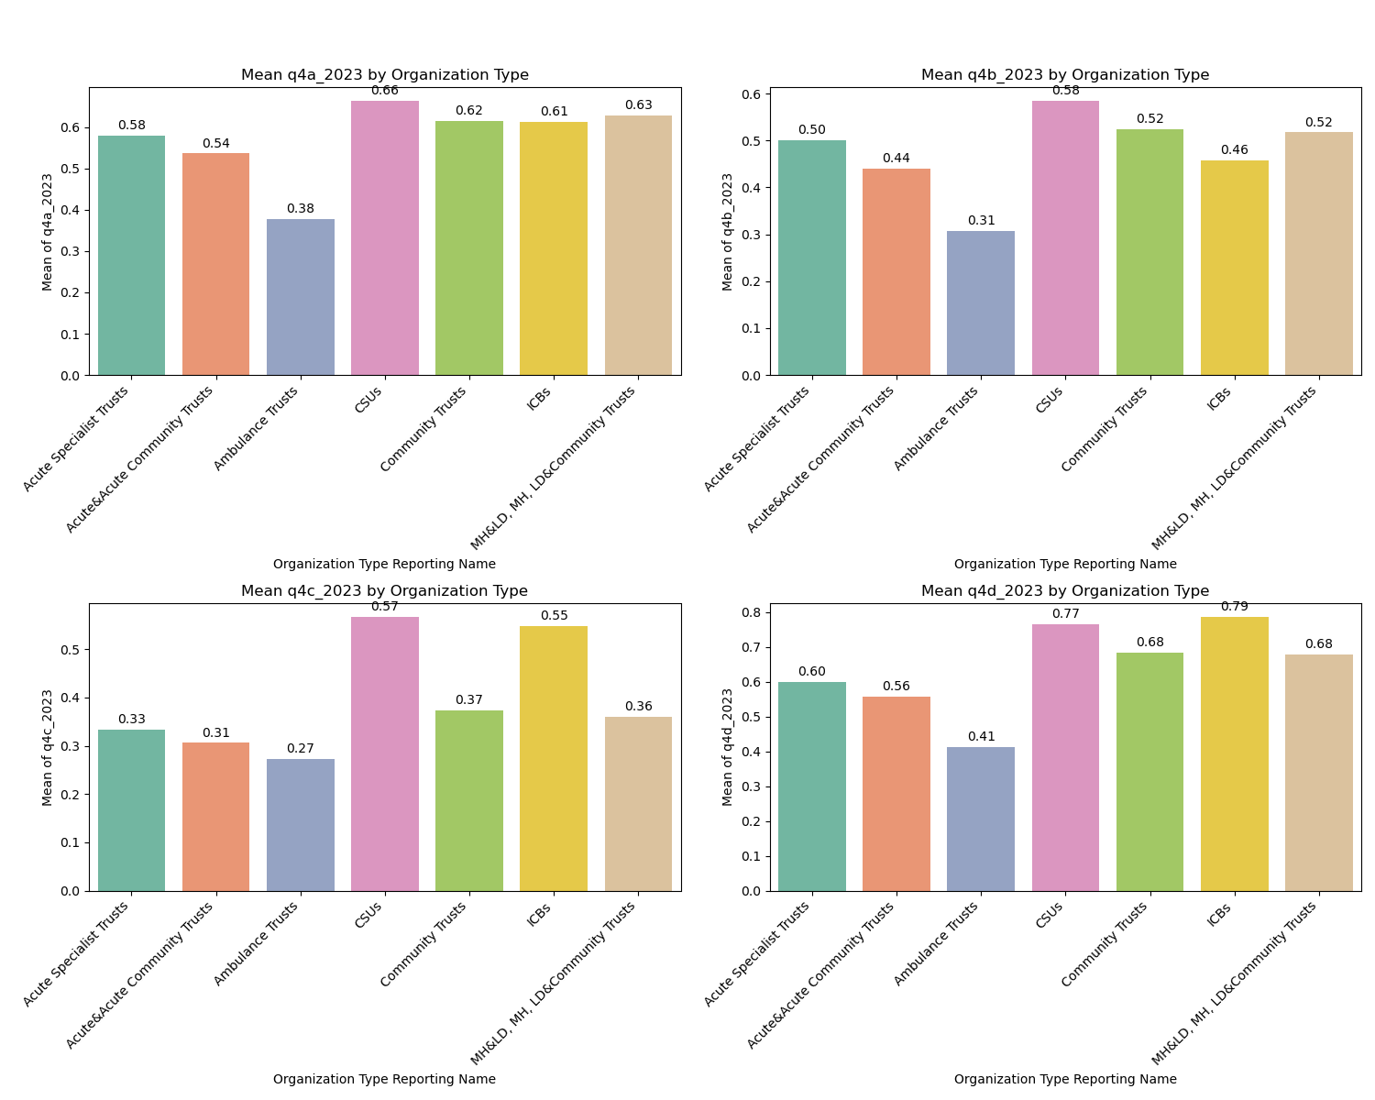
RESULT (Average percentage of staff experiencing satisfaction in their job across different organisational type )
Ambulance Trusts and Community Trusts report high job satisfaction in recognition, value, and flexible working patterns.
CSUs, Community Trusts, ICBs, and MH&LD report lowest satisfaction in the way their work has been recognized and value.
Staff in CSUs and ICBs are motivated to work as their payment is more satisfied than others who tend to be moderately satisfied with their pay.

Slide 5
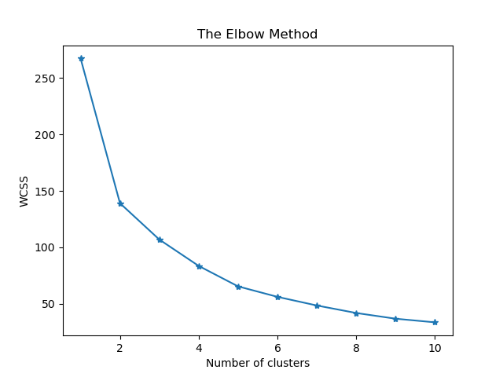
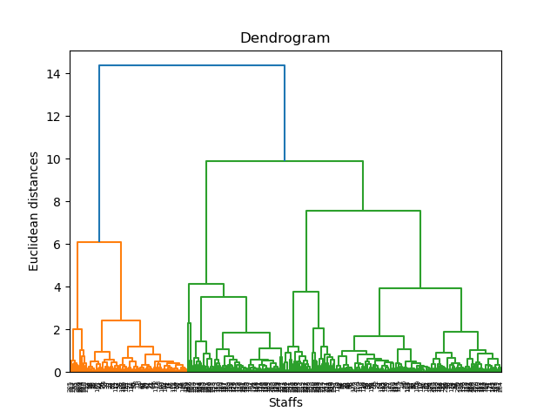
RESULT (Cluster Analysis)
Clustering Analysis based on PPE
the elbow method and the dendrogram plot shows two distinct groups;
Groups with high PPE scores;
Groups with moderate PPE scores;
Existence of comparable patterns among staffs in the orgransation.

Slide 6
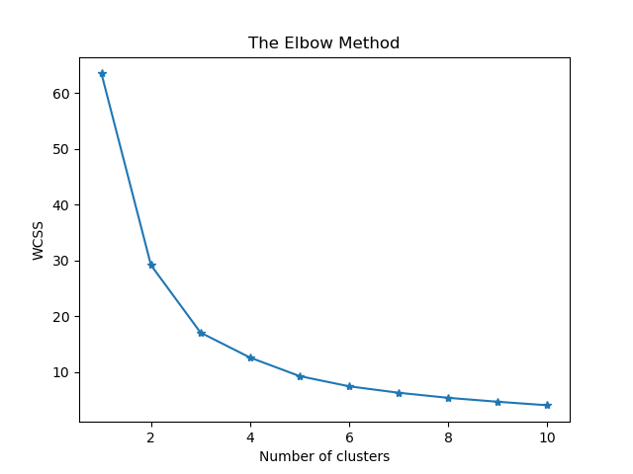
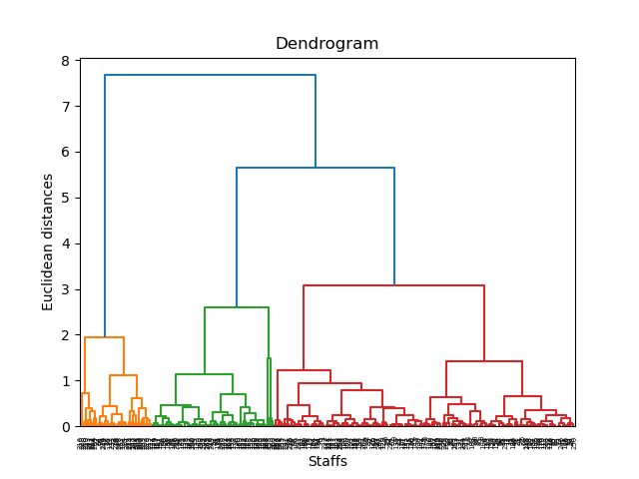
RESULT (Cluster Analysis)
Clustering based on Staff Engagement and Morale
The "elbow" of the curve is observed at three clusters
Three colours observed in the dendrogram plot
The distance between the clusters could agreed to grouping like:
highly engaged staff who demonstrate strong morale
moderately engaged with moderate morales
Low Morales with low engagement

Slide 7

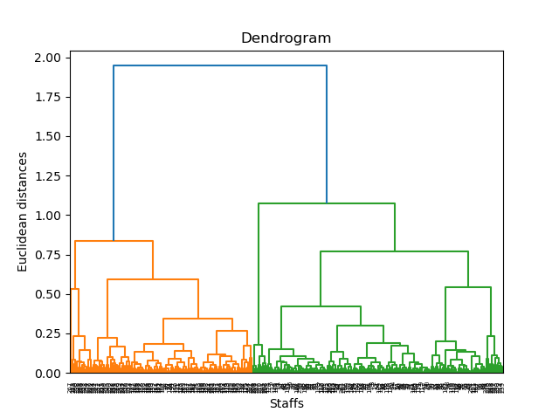
RESULT (Cluster Analysis)
Clustering based on Stress on Job
The "elbow" of the curve and the colors in degndrogram suggested two distinits groups.
Management can develop targeted strategies to address the unique stressors present in each group
Level of inadequate support structures, unrealistic expectations, or ineffective leadership styles could contribute to the stress among staff within the clusters.

Slide 8
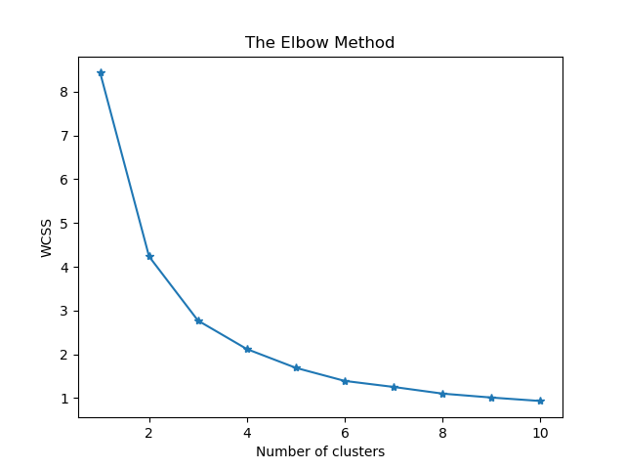
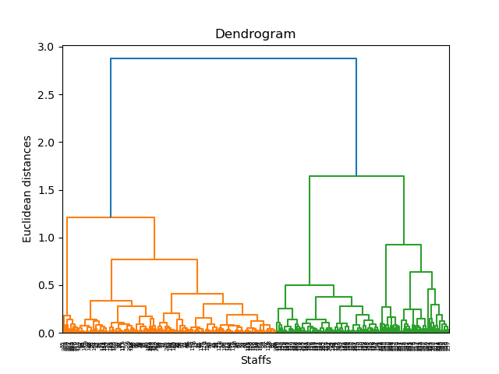
RESULT (Cluster Analysis)
Clustering based on Job Satisfaction
The "elbow" of the curve and the colors in dendrogram suggested two distinct groups
clusters represent distinct groups with common job satisfaction characteristics
reviewing the organization culture, enhanced communication and feedback mechanisms, increasing employee participation in decision-making and empowering employees to take ownership of their work and contribute meaningfully to organizational goals may address underlying dissatisfaction

Slide 9
Dimensionality Reduction using Principal Component Analysis
Table 1: Percentage of explained variance of the 7 indicators of PPE
Principal Component | PC1 | PC2 | PC3 | PC4 | PC5 | PC6 | PC7
Explained Variance percentage | 78.37% | 16.69% | 2.24% | 1.18% | 0.77% | 0.41% | 0.35%
Table 1 highlights the percentage of explained variance of the seven indicators related to PPE across different organisations.
PC1 (compassionate and inclusive), has the highest contribution, in differentiating organisational types. It explained 78.37% of the total variance.
PC2 (recognised and rewarded), contributes 16.69% to the variance in differentiating organisational bench mark.

Slide 10
Dimensionality Reduction using Principal Component Analysis
Table 2 Percentage of explained variance among the organisation based on the theme score.
Principal Component | PC1 | PC2
Explained Variance percentage | 94.41% | 5.59%
Table 2 reveals that staff engagement plays a critical role in explaining the variation between organisations based on their theme scores.
staff engagement, accounts for 94.41% while staff morale explains only 5.59% of the total variance in the theme score across that organization
The large disparity between these two components highlights the dominant role that staff engagement plays in shaping organisational differences.

Slide 11
Dimensionality Reduction using Principal Component Analysis
Table 3: Percentage of explained variance of the 7 questions related to stress
Principal Component | PC1 | PC2 | PC3 | PC4 | PC5 | PC6 | PC7
Explained Variance percentage | 80.27% | 11.13% | 3.77% | 2.99% | 0.89% | 0.52% | 0.43%
Table 3 presents the percentage of total variance explained by the principal components derived from the dataset on stress. The analysis identifies the key factors contributing to stress among staff across seven organisations
Emotional exhaustion plays a significant role in the stress levels experienced by staff and it account for 80.27% of the variance.
The second principal component (PC2), contribute 11.13% of the variance, highlights the impact of burnout as a factor that causes stress.

Slide 12
Dimensionality Reduction using Principal Component Analysis
Table 4: Percentage of explained variance of the 4 questions related to job satisfaction
Principal Component | PC1 | PC2 | PC3 | PC4
Explained Variance percentage | 77.43% | 17.39% | 4.31% | 0.87%
Table 4 presents the percentage of total variance explained by the principal components derived from the dataset on job satisfaction.
The first principal component (PC1), which accounts for 77.43% of the variance, reveals that staff feel very satisfied when their work is recognised.
The second principal component (PC2), contributing 17.39% of the variance, highlights the impact of satisfaction felt by the staffs when the organisation values their work.

