Slide 1
EAST WEST UNIVERSITY
Train Ticket Reservation System
Course: CSE207 (Data Structure)
Submitted to:
Dr. Md. Rezaul Karim
Professor, CSE Dept.
Team members | ID
Iffat Tasnim | 2020-2-60-004
Nurzahan Akter Munni | 2020-2-60-176

Slide 2

CONTENTS
Introduction
Objective of the project
Data Structure
Implementation modules
Results
Advantages
Future Enhancements

Slide 3

Introduction
This system is basically concerned with the reservation of railway tickets to the passengers.
In this we will discuss how the reservation is done with the feature of cancelling.
In the project we are going to include entities like
Reservation
Cancellation
Display the reserved passengers.

Slide 4
OBJECTIVE OF THE PROJECT
Data Structure
All the manual work should be converted into computerized -load of employees will be decreased.
The data should be stored in computer rather than in register manually.
Booking can be done by sitting at your home only -no need to visit the booking counter.

Slide 5
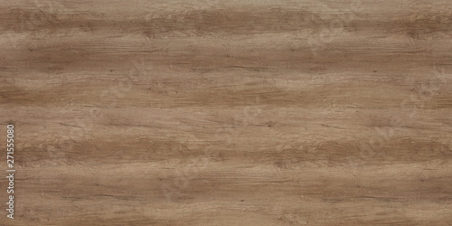
Singly Linked List
Linked List is a sequential collection of nodes.Which is faster than array in terms of deletion of nodes. It’s memory is dynamically allocated in runtime. This saves time and space.
Each node consists of four different data field :
#Name
#Age
#Registration Number
#Link to the next node

Slide 6
Queue
Queue is a data structure in which insertion and deletion takes place from the ends. It follows First In First Out Principle(FIFO).
It is also known as Last In Last Out (LIFO).
Queue data structure is used here for inserting a reservation and cancelling a reservation
Queue data structure also can be used to store the waiting list passengers details. If anyone cancels their ticket then that seat is allocated to the first passenger in the queue.

Slide 7
LINEAR QUEUE
A Queue is a linear structure which follows a particular order in which the operations are performed. The order is First In First Out (FIFO) .In a queue, we remove the item the least recently added.
Queue Insertion and deletion
happen on different ends
Rare
Front
Enqueue
Dequeue
First in, First out

Slide 8
Implementation modules
void display();
int reserve(node*);
node* deq();
int create();
int cancel(int);
void enq(node*);

Slide 9
Implementation modules
typedef struct NODE
{
int reg_no;
int age;
char name[20];
struct NODE *next;
}
node;
int create( )
{
node *new;
new=(node *)malloc(sizeof(node));
new->reg_no=1;
printf("Name: ");
scanf("%s", new->name);
printf("Age : ");
scanf("%d", &new->age);
if(new->age>=90 || new->age<=10) {
free(new);
return -1;
}
start=new;
new->next=NULL;
num++;
return 1;
}

Slide 10
Implementation modules
int reserve(node *start){
int temp;
if(start==NULL){
temp = create(start);
return temp;
}
else {
node *temp, *new_node;
temp=start;
while(temp->next!=NULL){
temp=temp->next;
}
new_node=(node *)malloc(sizeof(node));
printf("Name: ");
scanf("%s", new_node->name);
printf("Age : ");
scanf("%d", &new_node->age);
if(new_node->age >=90 || new_node>age<=10) {
return -1;
}
new_node->next=NULL;
if(num<=size){
num++;
new_node->reg_no=num;
temp->next=new_node;
return 1;
}
else{
enq(new_node);
return 0;
}
}
}

Slide 11
Implementation modules
int cancel(int reg)
{
node *ptr, *preptr, *new;
ptr=start;
preptr=NULL;
if(start==NULL)
return -1;
if(ptr->next==NULL && ptr->reg_no==reg)
{
start=NULL;
num--;
free(ptr);
return 1;
}
else{
while(ptr->reg_no!=reg && ptr->next!=NULL)
{
preptr=ptr;
ptr=ptr->next;
}
if(ptr==NULL && ptr->reg_no!=reg)
return -1;
else
preptr->next=ptr->next;
free(ptr);
new=deq();
while(preptr->next!=NULL)
preptr=preptr->next;
preptr->next=new;
num--;
return 1;
}
}

Slide 12
Implementation modules
void enq(node *new_node)
{
if(rear==NULL)
{
rear=new_node;
rear->next=NULL;
front=rear;
}
else
{
node *temp;
temp=new_node;
rear->next=temp;
temp->next=NULL;
rear=temp;
}
count++;
}
node* deq(){
node *front1;
front1=front;
if(front==NULL)
return NULL;
else{
count-- ;
if(front->next!=NULL){
front=front->next;
front1->next=NULL;
return front1;
}
else{
front=NULL;
rear=NULL;
return front1;
}}
}

Slide 13
Implementation modules
void display()
{
node *temp;
temp=start;
while(temp!=NULL)
{
printf("\nRegistration Number: %d\n", temp->reg_no);
printf("Name : %s\n\n", temp->name);
temp=temp->next;
}
}

Slide 14
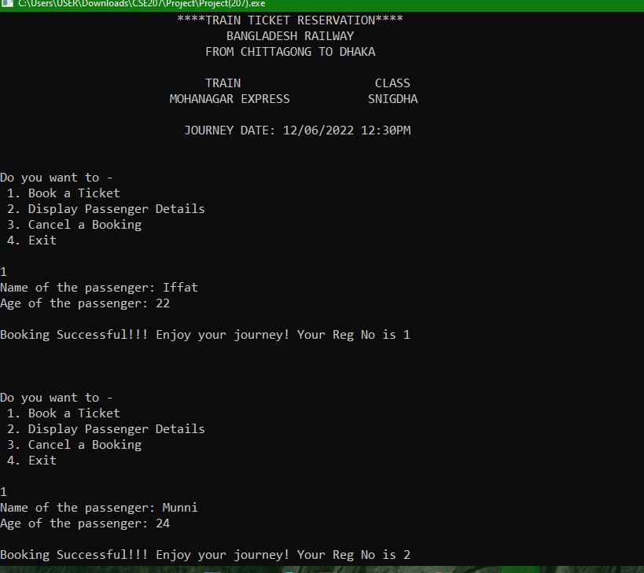
Result

Slide 15
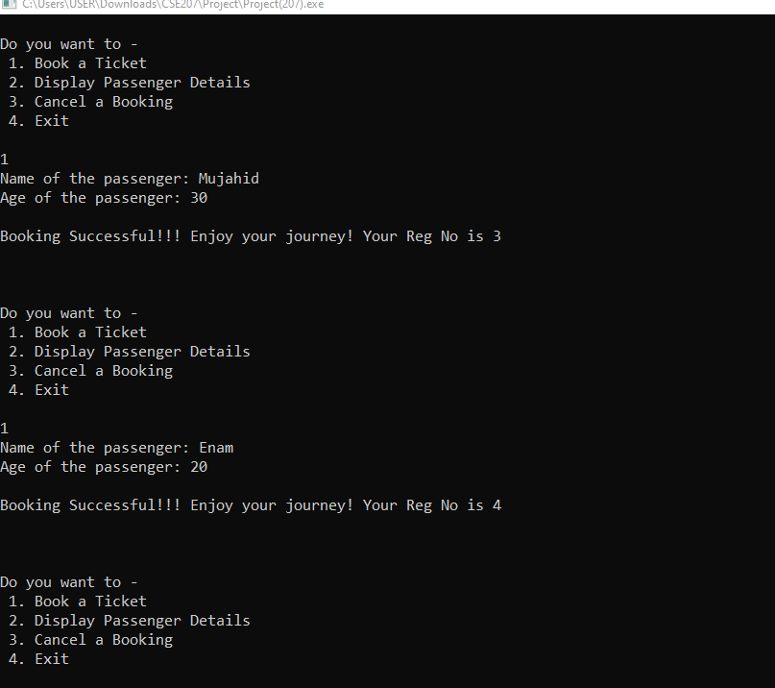

Slide 16
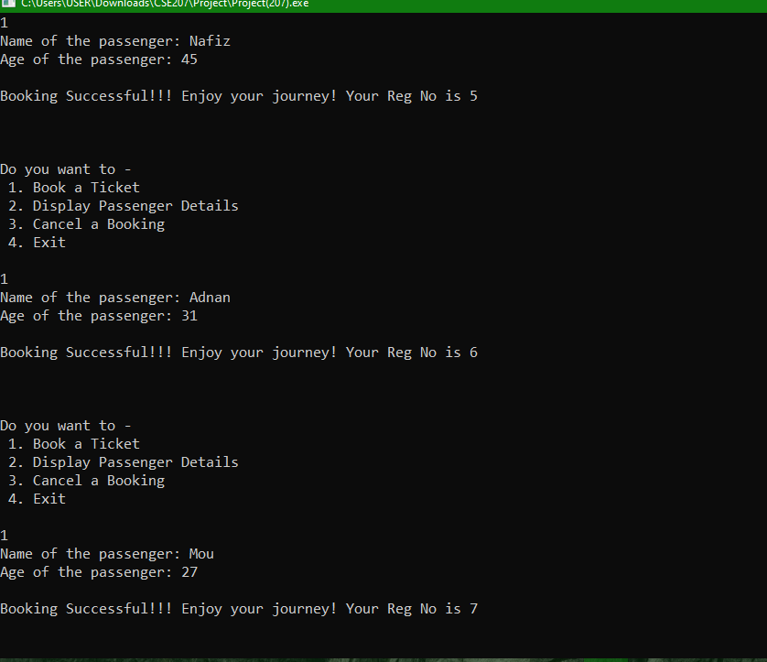

Slide 17
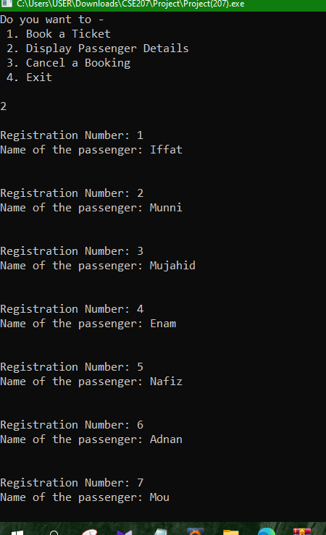
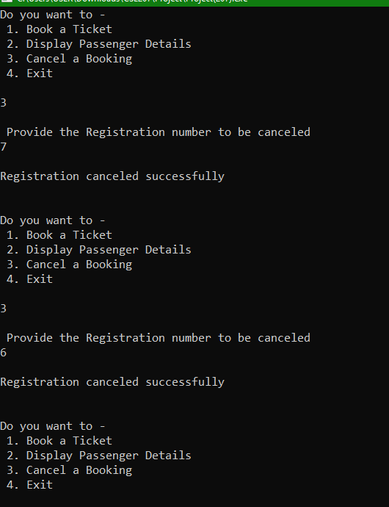

Slide 18
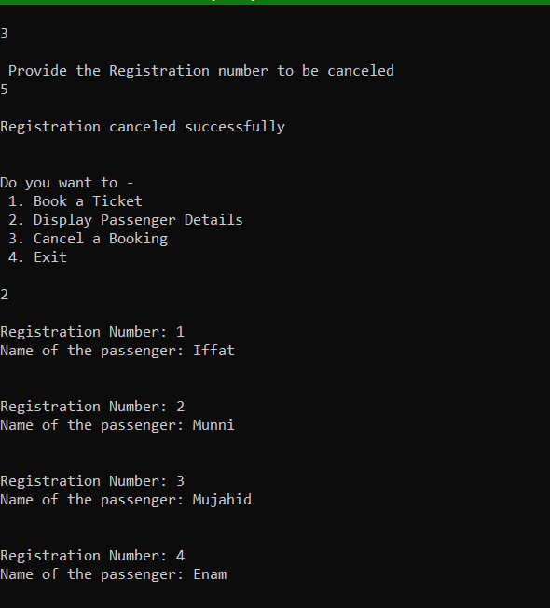
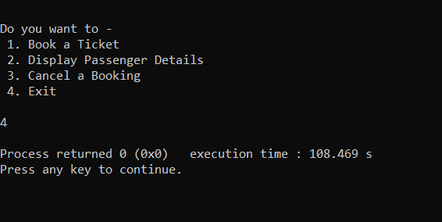

Slide 19
ADVANTAGES
Reduces the burden of waiting in the booking counter.
User-friendly.
Convenient.
Time savings.
Helpful during COVID.

Slide 20
Future Enhancements
We can add features such as prioritising on the basis of age or railway employees and gender.
We can provide this solution on online portal.
We can optimise our time complexity using some different data structure.
We can add feature of immediately reservation.

Slide 21

Thank You

