Slide 1

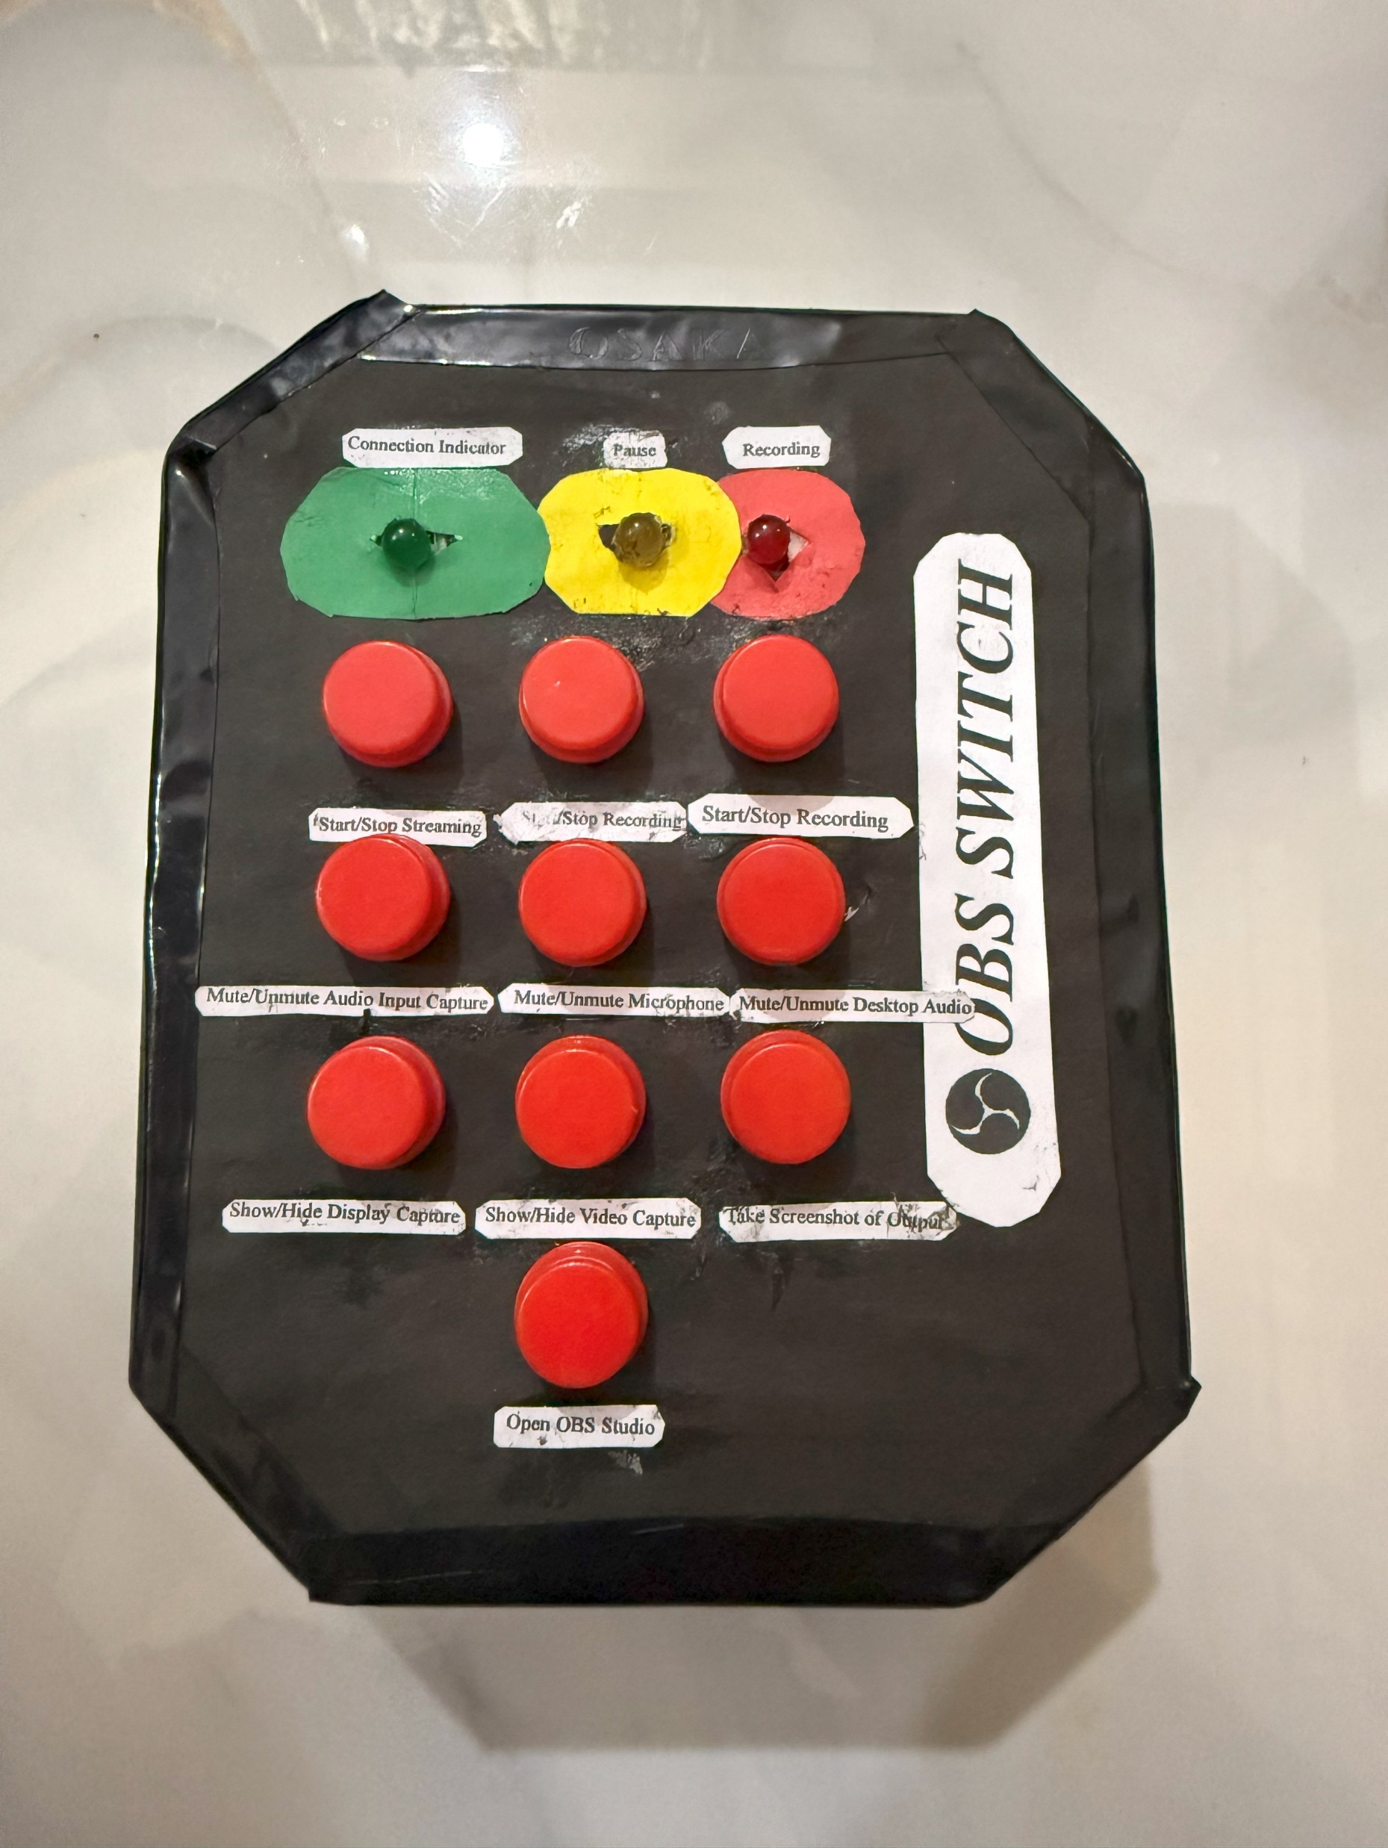
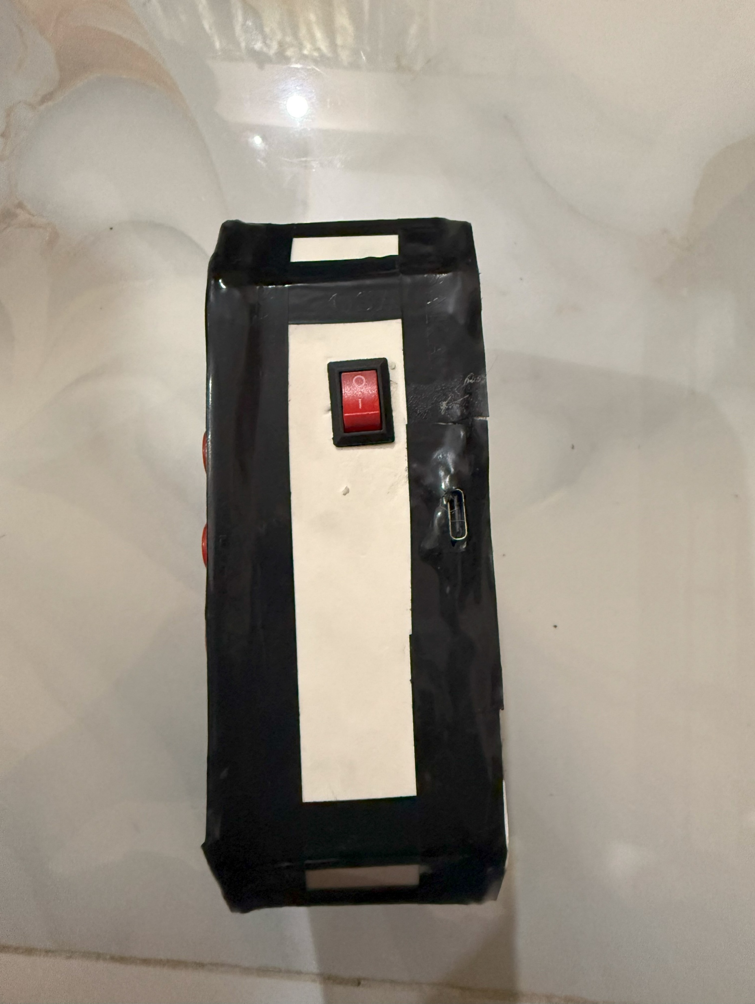
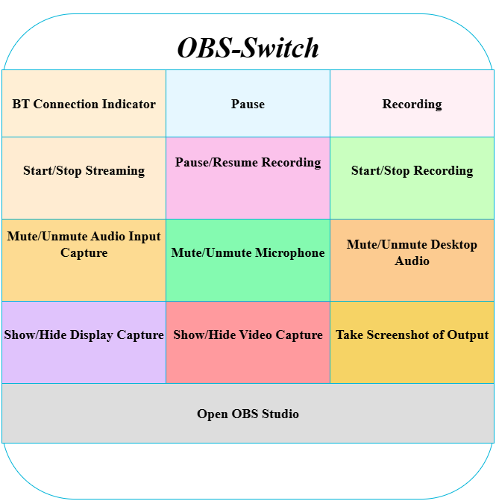
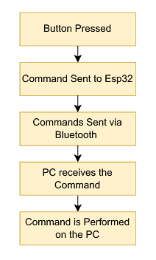
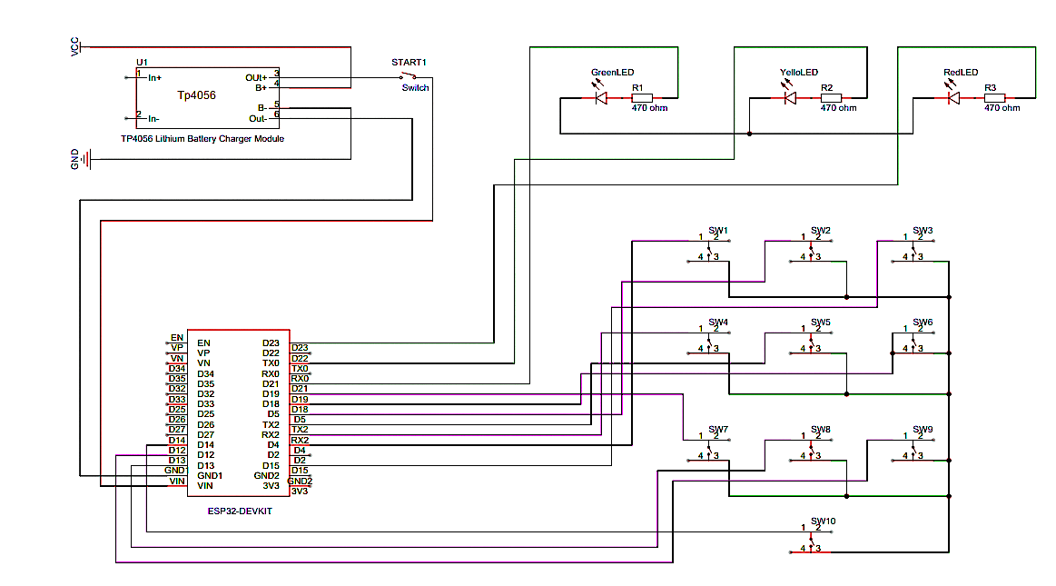
OBS-Switch for OBS Studio Control
A Hardware-Based HCI Solution for OBS Studio Control
Khondaker Iffti Hasan Turjo
Abstract
The OBS Switch project presents a simple yet powerful hardware controller designed to manage live broadcasts in OBS Studio. Powered by an ESP32 microcontroller, the device provides ten dedicated physical buttons to execute essential functions such as streaming, recording, pausing, muting and toggling video sources. Built-in LED indicators deliver immediate visual feedback, while the TP4056 battery module ensures portability and ease of use. By replacing complex keyboard shortcuts with a tangible, user-friendly interface, OBS Switch enhances productivity, reduces user effort and improves the overall broadcasting experience..
Hardware Implementation
Future Enhancements
1. OLED or LCD Display Integration
Show real-time status and recording, streaming, scene name.
Add visual feedback like timers or audio levels.
2. RGB Backlit Buttons
Color-coded feedback
Helps in low-light conditions.
3. Touchscreen Interface
Replace physical buttons with a customizable touchscreen panel.
4. Wireless/Bluetooth Connectivity
Operate without USB cables — ideal for flexible setups.
5. Haptic Feedback
Vibration feedback for confirming button presses.
Introduction
Problem
During live streaming or recording, broadcasters often rely on keyboard shortcuts and mouse clicks to manage OBS Studio. This method can be slow, unintuitive, and distracting, as streamers must constantly shift focus between creating content and handling technical controls.
Objective
To simplify OBS Studio control using a dedicated hardware button interface.
To provide real-time feedback with LED indicators for user awareness.
To make the system portable with a rechargeable battery setup.
To enhance Human–Computer Interaction by improving efficiency and usability for streamers.
OBS Switch Buttons and LEDs Layout
Conclusion
The OBS Switch Controller offers a simple, low-cost solution for streamlining OBS functions, making live streaming more efficient. It successfully combines hardware and software to improve user control and experience. With room for future enhancements like displays or wireless features, this project is a strong foundation for more advanced stream control tools. By reducing reliance on complex keyboard shortcuts, it allows streamers to focus more on content creation. The device also demonstrates how Human–Computer Interaction principles can make technical processes easier, faster, and more accessible.
System Architecture
References
1. OBS Studio Official Documentation
OBS Project. (n.d.). OBS Studio Help Guide. Retrieved from https://obsproject.com/help
2. Arduino Microcontroller Documentation
Arduino. (n.d.). Arduino UNO Rev3. Retrieved from https://docs.arduino.cc/hardware/uno- rev3
3. HID Keyboard Emulation with Arduino Arduino. (n.d.). Keyboard Library. Retrieved from
https://www.arduino.cc/reference/en/language/functions/usb/keyboard/
4. DIY Stream Deck Using Arduino
Electromaker. (2020). Build Your Own Stream Deck Using an Arduino Pro Micro. Retrieved from https://www.electromaker.io/project/view/diy-stream-deck-using-arduino-pro-micro
5. USB HID Communication Overview
USB.org. (n.d.). Human Interface Device Class Definition. Retrieved from https://www.usb.org/documents
6. User Interface Design Principles
Nielsen, J. (1995). 10 Usability Heuristics for User Interface Design. Nielsen Norman Group. Retrieved from https://www.nngroup.com/articles/ten-usability-heuristics/
7. ESP32 Bluetooth HID Keyboard Espressif Systems. (n.d.). ESP32 BLE HID Keyboard Example. Retrieved from https://github.com/T-vK/ESP32-BLE-Keyboard
9. OBS Studio Keyboard Shortcuts OBS Project. (2021). Keyboard Shortcuts. OBS Knowledge Base. Retrieved from https://obsproject.com/kb/keyboard-shortcuts.
Hardware Components
ESP32 – x1
LED Indicator – x3
Push Buttons – x10
TP4056 Lithium Battery Charger (Type-C) – x1
Battery Case – x1
Li-ion Battery – x1
ON/OFF Switch – x1
Wires
Key Mapping
Key | Action | Command Triggered
1 | Start/Stop Streaming | Ctrl + Shift + S
2 | Pause/Resume Recording | Ctrl + Shift + P
3 | Start/Stop Recording | Ctrl + Shift + R
4 | Mute/Unmute Audio Input Capture | Ctrl + Shift + A
5 | Mute/Unmute Microphone | Ctrl + Shift + M
6 | Mute/Unmute Desktop Audio | Ctrl + Shift + D
7 | Show/Hide Display Capture | Shift + D
8 | Show/Hide Video Capture | Shift + V
9 | Take Screenshot of Output | Shift + S
10 | Open OBS Studio | Ctrl + Shift + O
Hardware Simulation
Acknowledgement
We gratefully acknowledge our respected faculty member,…., for his invaluable guidance and continuous support throughout this project. This work was carried out with dedication and teamwork from all members involved.
Department of Computer Science, Faculty of Science and Technology.
American International University-Bangladesh (AIUB)

