Slide 1

Project Title: Movie Success Prediction System using Python
Group members:
Muhammad Adeel Feroz (Fa20-bscs-0031)
Sidrah Sadiq Sufi (Fa19-bsse-0086)
Ifham Ahmed Khan (Fa20-bscs-0024)

Slide 2
Table of content:
Problem Statement
Introduction
How we are solving this problem
Dataset
Training structure
Graph
Project code explanation
Conclusion

Slide 3
Problem statement
The movie industry is a highly competitive and constantly evolving market, with the success of a movie largely determined by its box office performance. However, predicting the box office success of a movie is a challenging task. By doing so, we aim to provide valuable insights to movie studios and investors, helping them make more informed decisions on which movies to produce and invest in.

Slide 4
Introduction
The movie industry has been a major part of the entertainment world for over a century, with billions of dollars being invested each year in the production of new movies. The success of a movie is largely determined by its box office performance, which is influenced by various factors such as genre, cast, director, and marketing budget. With so many factors involved, predicting the box office success of a movie can be a challenging task. However, the ability to accurately predict a movie's box office performance can provide valuable insights to movie studios and investors, helping them make informed decisions on which movies to produce and invest in.

Slide 5
How we are solving this problem?
Read movie metadata from "movie_metadata.csv"
Clean the data by removing rows with missing values
Extract the main genre of each movie
Calculate the number of genres for each movie
Select relevant features for prediction (e.g., critic reviews, duration, user reviews, etc.)

Slide 6
Dataset
Source:
Movie metadata collected from "movie_metadata.csv"
Features:
num_critic_for_reviews: Number of critical reviews
duration: Duration of the movie in minutes
num_voted_users: Number of users who have voted
num_user_for_reviews: Number of user reviews
movie_facebook_likes: Number of likes on the movie's Facebook page
director_facebook_likes: Number of likes on the director's Facebook page
genres: List of genres associated with the movie
title_year: Year of movie release
imdb_score: IMDb rating of the movie

Slide 7
Training structure
Data Preparation:
Pop the gross column because it contains huge number of null values (884)
Split the dataset into training (0.8) and testing sets (0.2)
Ensure appropriate feature scaling if needed (e.g., using StandardScaler)
Regression Models:
Linear Regression
Decision Tree Regressor
Support Vector Regressor
K-Nearest Neighbors Regressor
Train and evaluate each model using mean squared error (MSE) and mean absolute error (MAE)

Slide 8
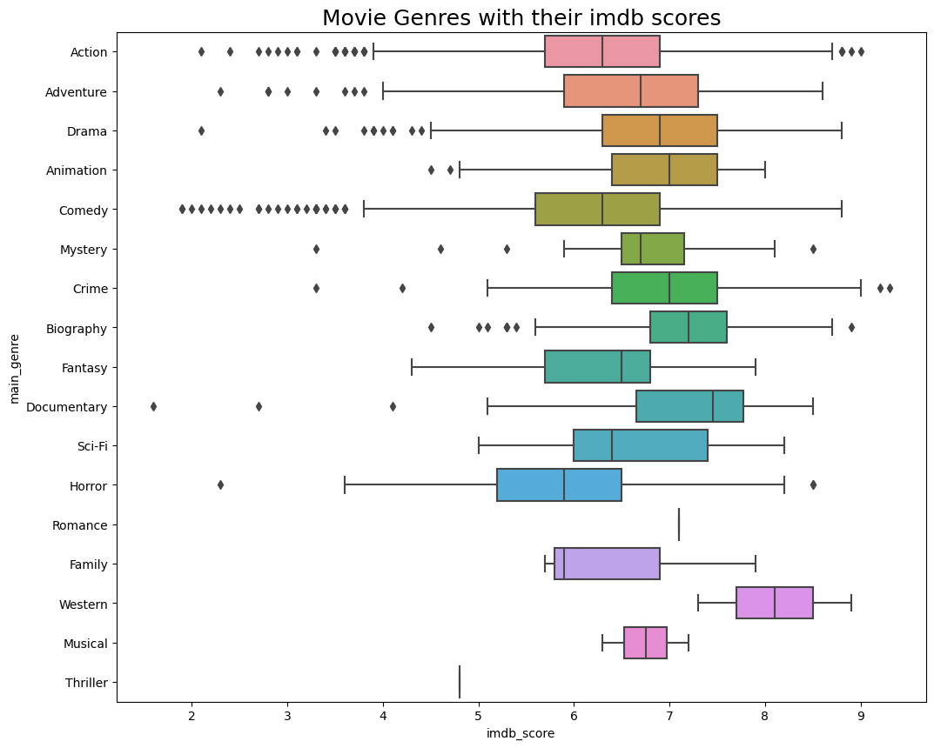
Graphs

Slide 9
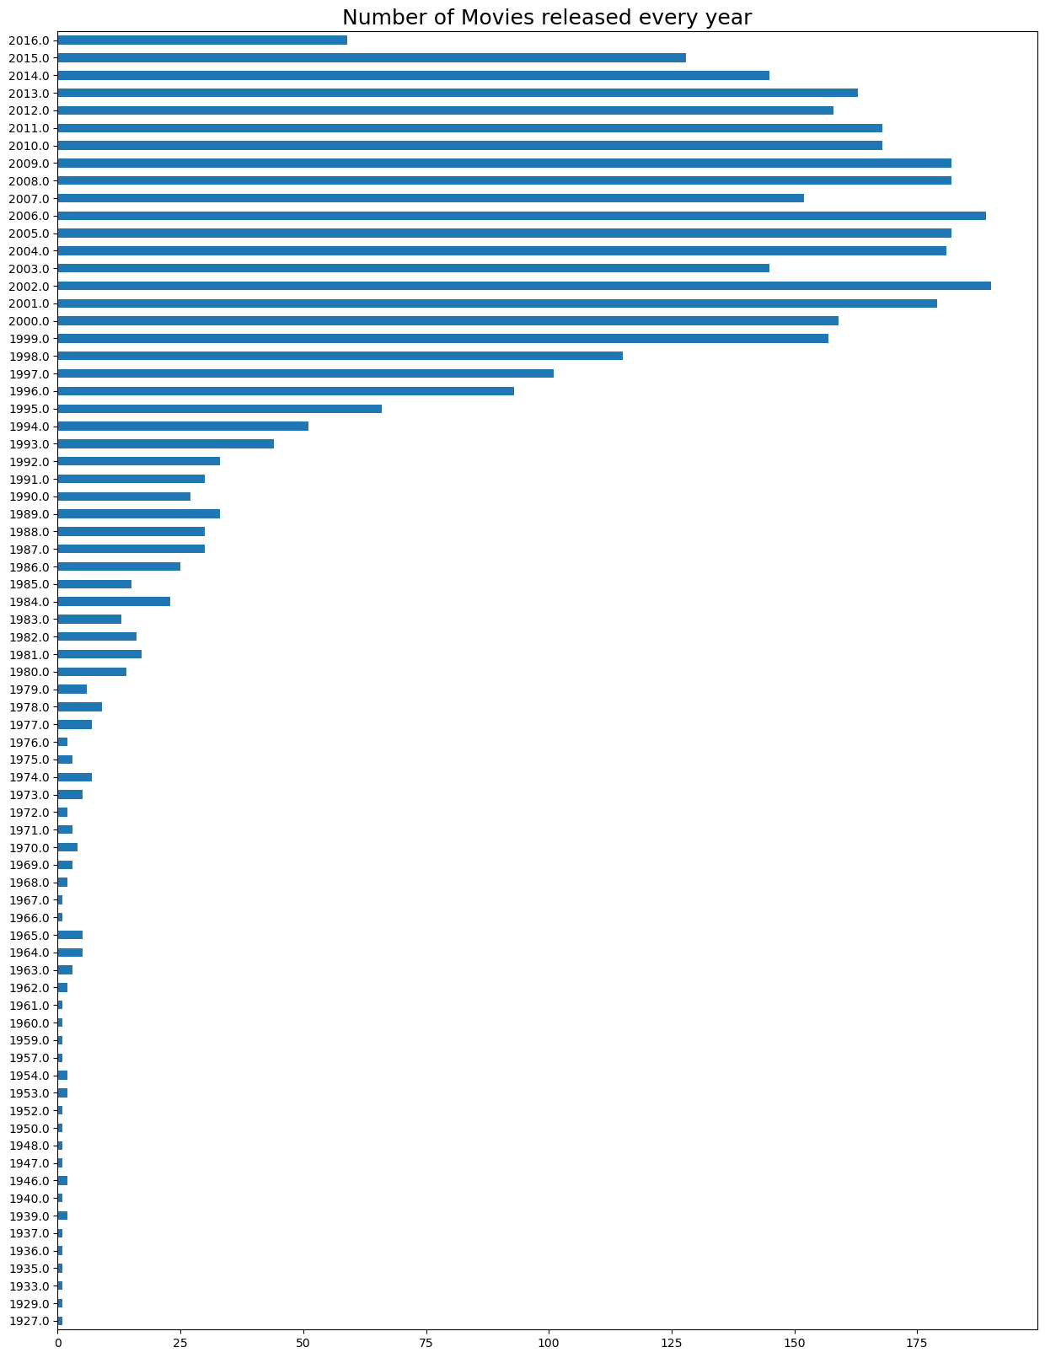

Slide 10
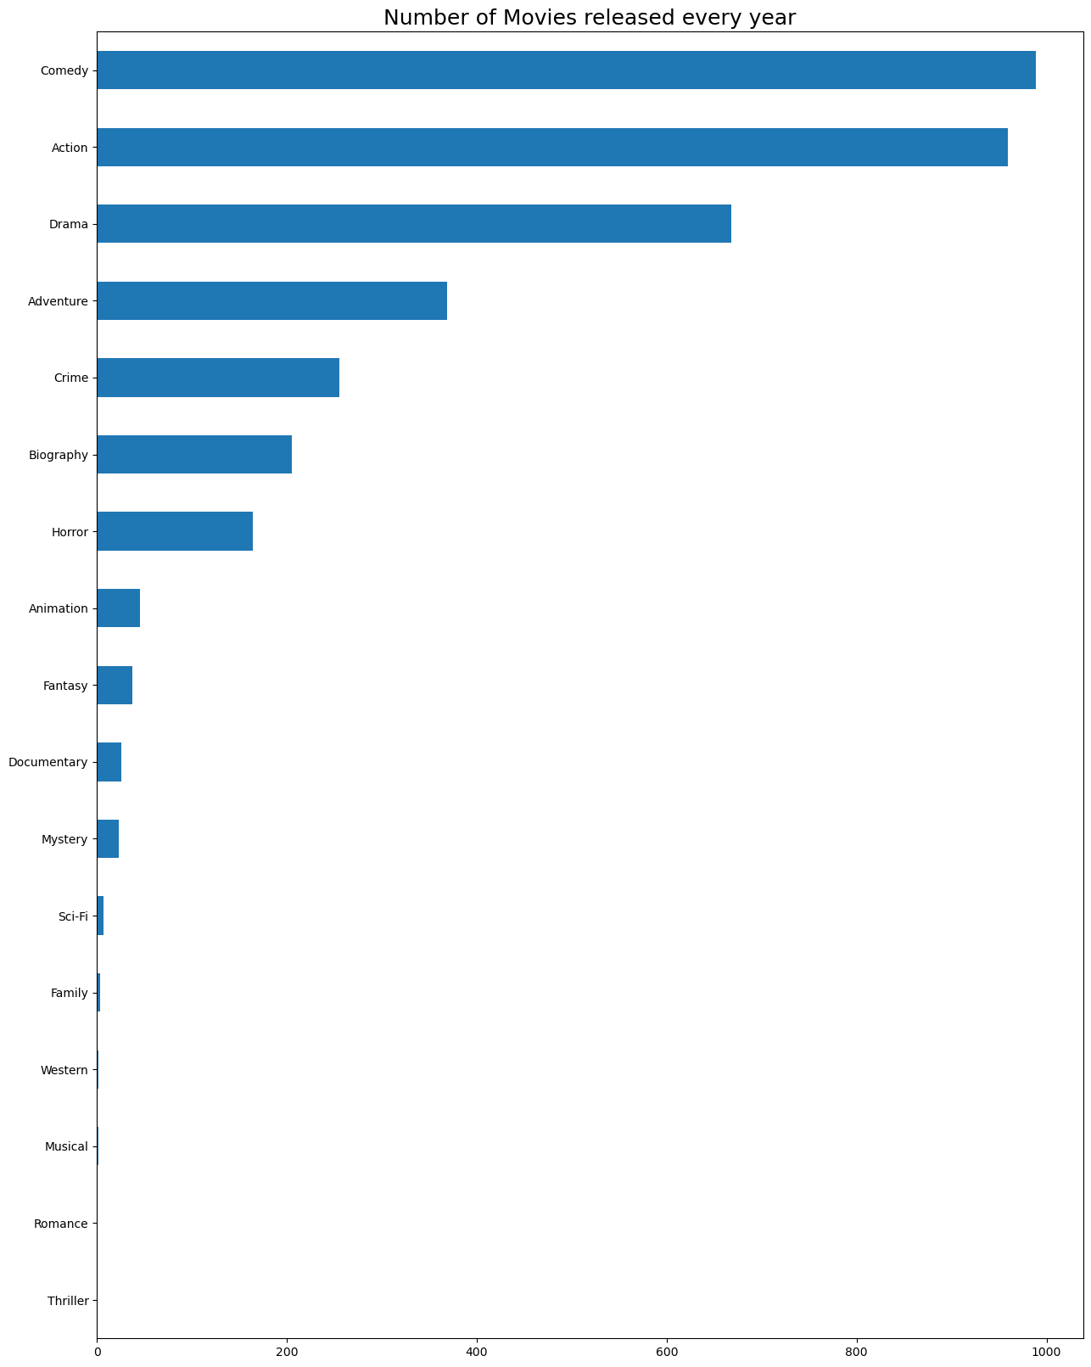

Slide 11
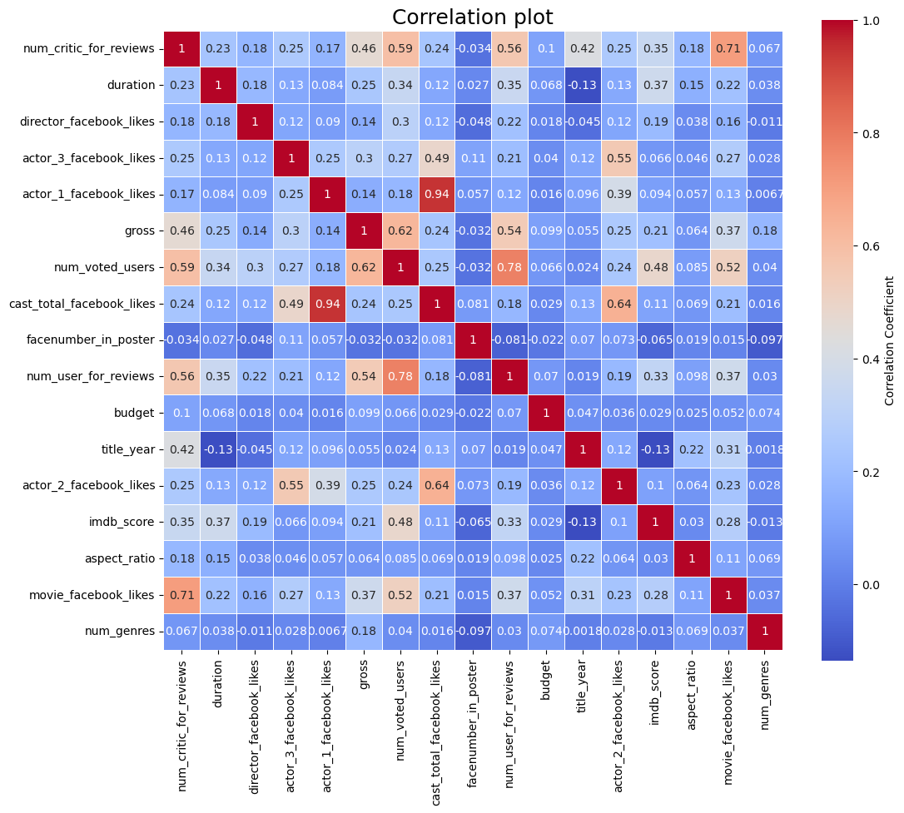

Slide 12
Project code explanation

Slide 13
Conclusion
In conclusion, predicting the box office performance of a movie is a complex task that involves numerous factors. However, with the advancement of machine learning algorithms, we can develop models that can accurately predict a movie's box office performance based on historical data. This has the potential to provide valuable insights to movie studios and investors, helping them make more informed decisions on which movies to produce and invest in.

