Slide 1

NAVIGATING THE TECH HORIZON
SURVEY INSIGHTS FOR INNOVATION
SAURABH SAGAR
AUGUST 14TH, 2025

Slide 2



OUTLINE
Executive Summary
Introduction
Methodology
Results
Visualization – Charts
Dashboard
Discussion
Findings & Implications
Conclusion
Appendix

Slide 3

EXECUTIVE SUMMARY
Top Languages
JavaScript, SQL, HTML/CSS lead in usage
Python and TypeScript dominate future interest
Databases
PostgreSQL ranks highest in both usage and desirability—suggests long-term viability
Supabase shows rapid growth, especially among younger developers—worth monitoring
Platforms
AWS is most used and most desired
Vercel and Netlify gaining traction
Frameworks
React & Node.js continue to anchor full-stack development
FastAPI, Django, and Next.js is showing strong future demand
Demographics
Majority aged between 18-34 with Bachelor’s/Master’s degree
Younger Devs favor stacks like Rust, Go, Supabase

Slide 4

INTRODUCTION
Purpose
To analyze developer technology preferences and trends using Stack Overflow survey data, enabling data-driven decisions in tooling, hiring, and platform strategy.
Target Audience
Engineering managers & Tech leads
Product owners & Platform strategists
Developer relations & Community teams
Value
Identifies top-used and most-desired technologies across languages, databases, platforms, and frameworks.
Highlights demographic insights to align tooling with developer segments
Supports strategic planning for tech stack evolution and developer engagement

Slide 5

METHODOLOGY
Data Source
Stack Overflow Developer Survey 2024
65,000+ global responses across tech and demographics
Collection Method
Online survey
Questions on tools, roles, education, preferences
Data Wrangling
Cleaned nulls, standardized columns
Exploded multi-value fields (e.g. languages, databases)
Mapped values for readability
Compressed CSV uploaded to Cognos
Dashboard Logic
Multi-tab layout: Languages, Databases, Platforms, Frameworks, Demographics
Top-N filters, conditional palettes, grouped visuals

Slide 6

RESULTS
Top Technologies Used
Languages: JavaScript, SQL, HTML/CSS most used
Databases: PostgreSQL highest in usage and desirability
Platforms: AWS most used; Vercel and Netlify rising
Frameworks: React & Node.js top usage; FastAPI, Django, Next.js highly desire.
Demographic Snapshot
Age: Majority between 18–34Education: Mostly Bachelor’s/Master’s degrees
Preferences: Younger devs lean toward Rust, Go, Supabase
Trend Highlights
Cloud-native and open-source tools gaining traction
AI/ML frameworks and DevOps tools show rising adoption
TypeScript and Rust gaining momentum among newer developers

Slide 7
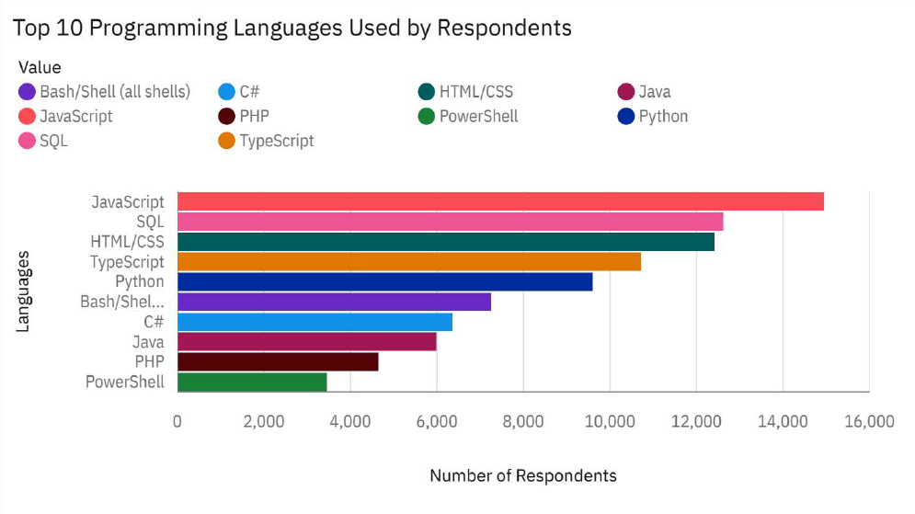
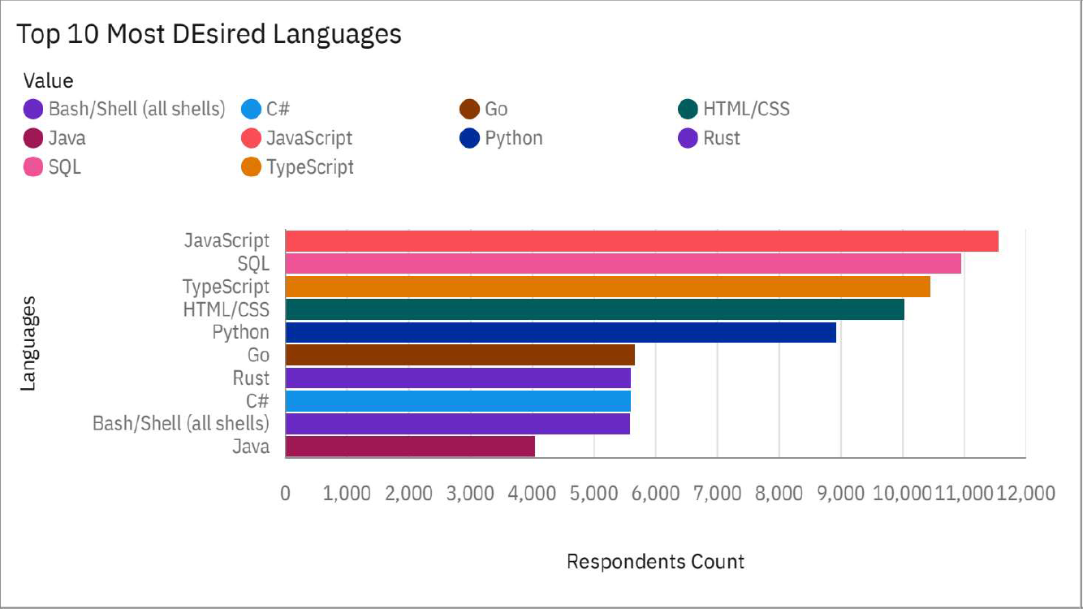
PROGRAMMING LANGUAGE TRENDS
Current Year
Next Year

Slide 8
PROGRAMMING LANGUAGE TRENDS - FINDINGS & IMPLICATIONS
Key Findings
Implications
JavaScript leads in both usage and desire—remains the universal language
TypeScript shows rising interest—desire exceeds current usage
Rust ranks high in desire but low in usage—signals emerging adoption
SQL is widely used but less desired—seen as essential, not aspirational
Java & C# used more than desired—reflect legacy enterprise reliance
Upskill in TypeScript, Rust, Go to align with developer aspirations
Modernize legacy stacks to retain talent and stay competitive
Support popular languages in tooling, hiring, and platform strategy
Balance foundational skills (SQL, Python) with emerging tech focus

Slide 9
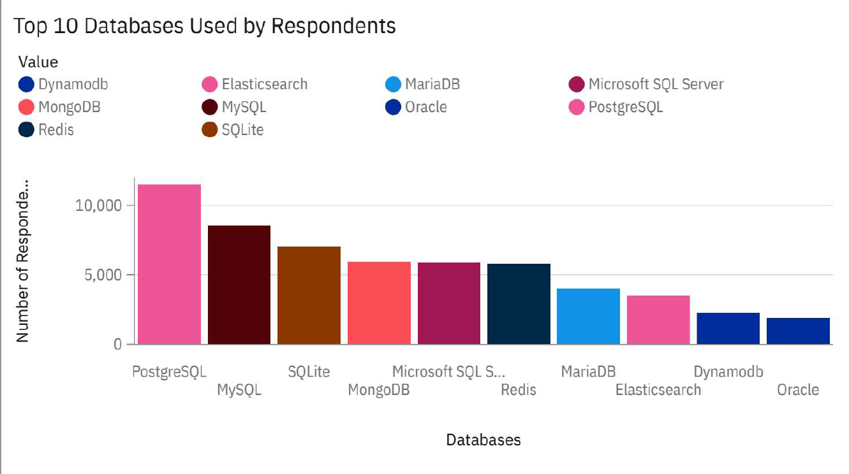
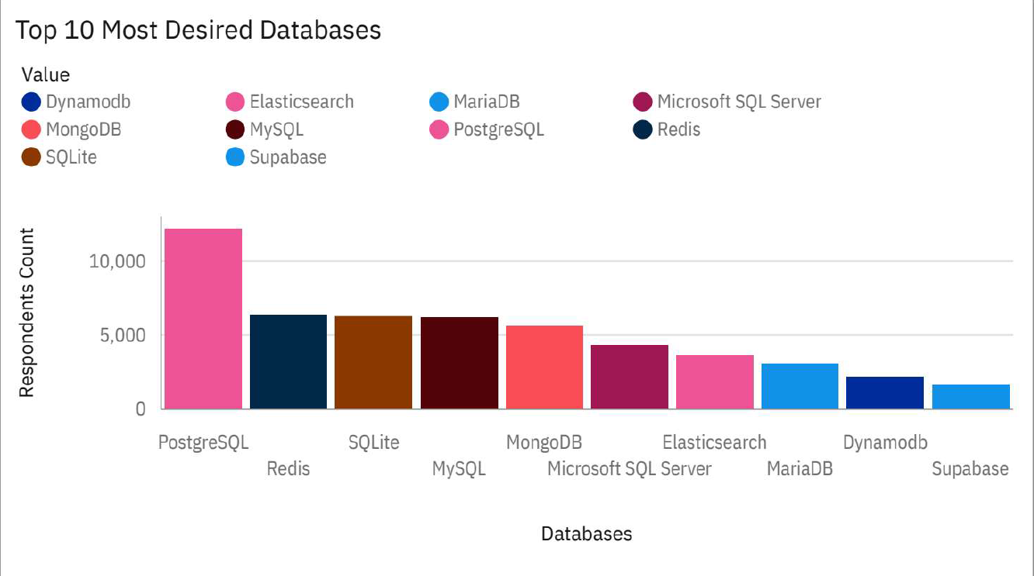
DATABASE TRENDS
Current Year
Next Year

Slide 10
DATABASE TRENDS - FINDINGS & IMPLICATIONS
Key Findings
PostgreSQL tops both usage and desire—clear leader.
Redis is highly desired but underused—signals growing interest.
Supabase is emerging—developer-friendly and gaining traction.
Oracle is used but not desired—likely legacy-driven.
Elasticsearch shows declining appeal despite high usage.
Implications
Prioritize PostgreSQL and Redis for future-proof tech stacks.
Upskill teams in high-demand tools like PostgreSQL, Redis, MongoDB.
Watch Supabase—could be a strategic asset for agile development.
Reevaluate legacy tools like Oracle for cost and relevance

Slide 11

DASHBOARD
StackOverFlow-survey-capston-project/3_Dashboard/cognos_dashboard_survey.pdf at main · Ifsaurabh/StackOverFlow-survey-capston-project

Slide 12
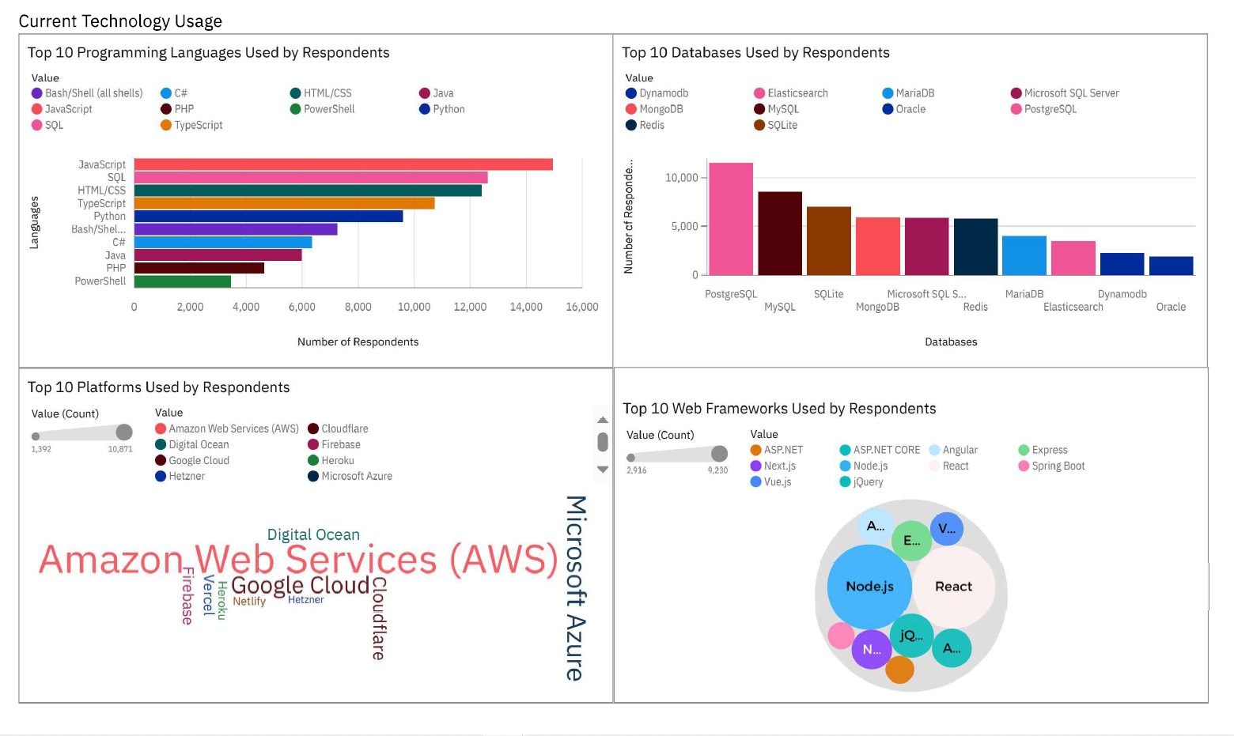
CURRENT TECHNOLOGY TREND

Slide 13
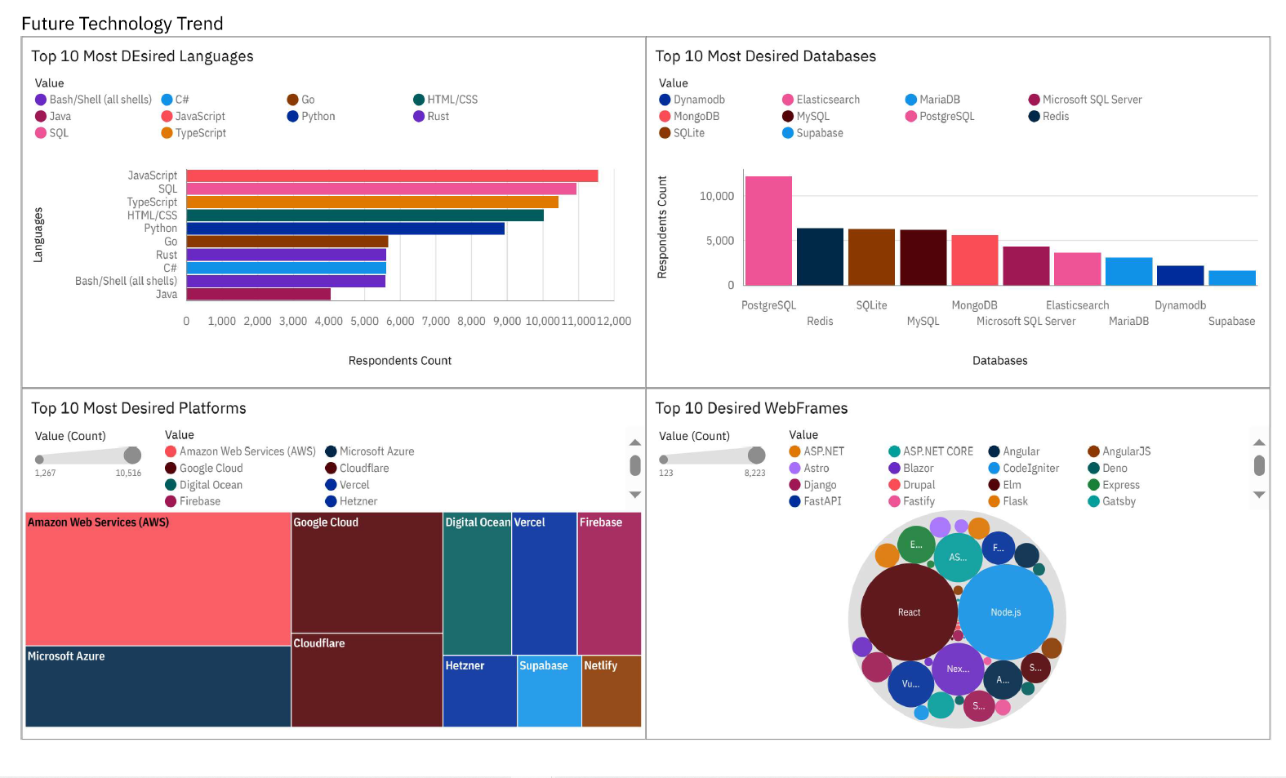
FUTURE TECHNOLOGY TREND

Slide 14
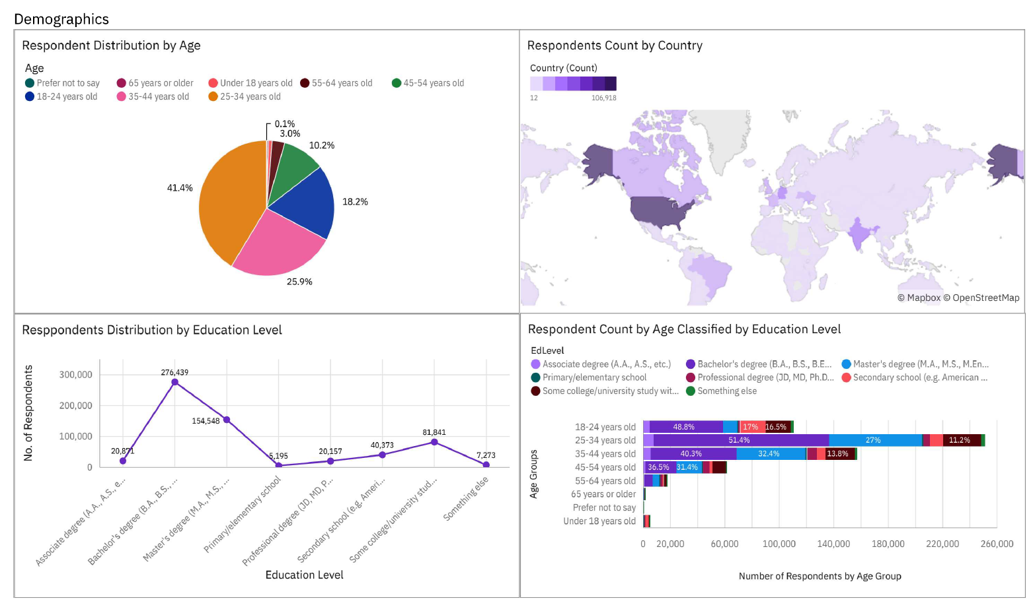
DEMOGRAPHICS

Slide 15
Insights from Dashboard
JavaScript leads across the stack, reinforcing its role in full-stack development.
Cloud platforms (AWS, Azure, GCP) are both widely used and highly desired—cloud-native is the norm.
PostgreSQL dominates, but interest in Redis and Supabase signals a shift toward real-time and flexible data solutions.
Framework trends show evolution, with React and Next.js favored, and rising curiosity in Svelte and Astro.
Demographics reveal a skilled, global, mid-career developer base—ideal for driving adoption of emerging tech.

Slide 16
OVERALL FINDINGS & IMPLICATIONS
Findings
Modern stacks dominate: JavaScript, React, PostgreSQL, and AWS are central to developer workflows, reflecting industry-wide adoption.
Emerging tools gaining ground: Supabase, Vercel, and Astro show strong future interest, especially among younger developers and startups.
Developer demographics: Respondents are mostly aged 25–34, hold Bachelor’s or Master’s degrees, and represent a globally distributed, technically skilled audience.
Preference trends: Developers favor tools that are fast, scalable, and community-supported—indicating a shift toward open-source and cloud-native solutions.
Implications
Tool alignment: Prioritize support and optimization for widely used and rising technologies to stay relevant and developer-friendly.
Talent targeting: Focus hiring, training, and outreach on mid-career professionals with experience in modern stacks and cloud platforms.
Strategic positioning: Invest in integrations, documentation, and partnerships with trending platforms and frameworks to enhance adoption.
Product roadmap: Consider developer preferences when shaping future features—speed, simplicity, and flexibility are key drivers.

Slide 17

CONCLUSION
The developer ecosystem is anchored in JavaScript, cloud platforms, and relational databases.
Future trends point toward performance-focused languages, real-time databases, and modern frameworks.
The community is young, educated, and globally diverse—well-positioned to shape the next wave of technological evolution.
Organizations should align their tech strategies with these preferences to attract talent and stay competitive.

Slide 18

APPENDIX
Dataset Summary
Source: Stack Overflow Developer Survey 2024Responses: ~65,000 globally
Format: CSV with multi-select columns (e.g. languages, databases)
Wrangling: Cleaned nulls, exploded multi-value fields, mapped values for readability
Upload: Compressed CSV imported into Cognos
Dashboard Logic
Platform: IBM Cognos Analytics
Structure: Multi-tab layout—Languages, Databases, Platforms, Frameworks, Demographics
Techniques Used:
Top-N filtering
Conditional palettes
Grouped visuals by experience and region

Slide 19
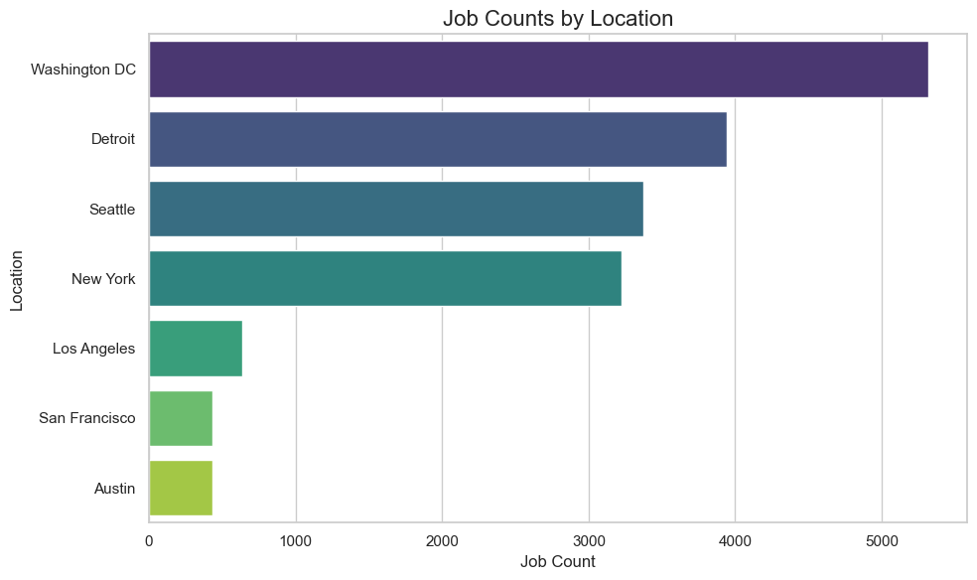
JOB POSTINGS

Slide 20
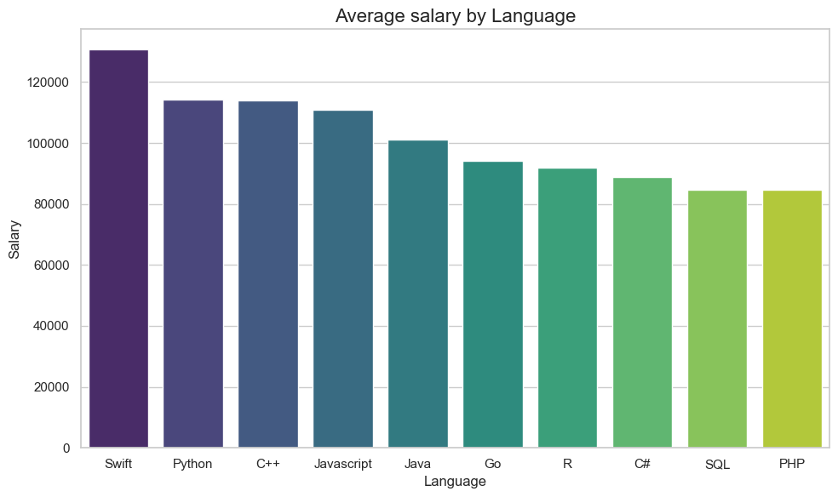
POPULAR LANGUAGES

