Slide 1
Transformers

Slide 2
Transformers
Transformers are the latest generation of deep networks to emerge
Vaswani et al., in their paper “Attention Is All You Need” (https://arxiv.org/pdf/1706.03762.pdf), popularized the idea.
Transformer models that have significantly outperformed other models in the NLP domain
Knowing the inner workings of the Transformer model is a must for anyone who wants to excel at using deep learning models to solve real-world problems

Slide 3
Representing text as numbers
The challenge is essentially how you can transform text to numbers for machine translation models
How can we make a computer understand characters, words, or sentences?

Slide 4
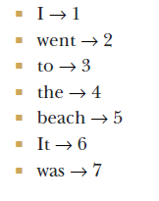

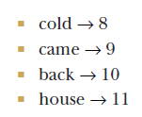
Assign each word an ID
I went to the beach. It was cold. I came back to the house.

Slide 5
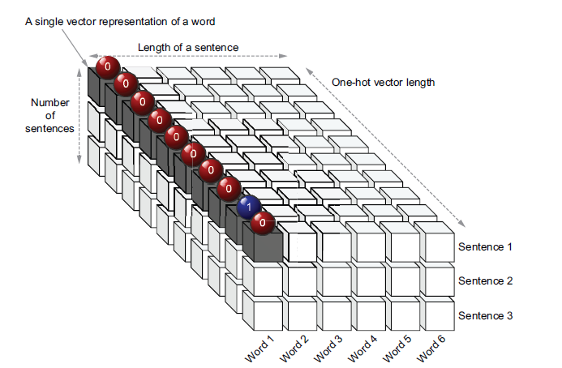

Slide 6
Why not feed the word IDs directly
The value ranges the neural network sees are very large (0–100,000+) for a realworld problem. This will cause instabilities and make the training difficult.
Feeding in IDs would falsely indicate that words with similar IDs should be alike (e.g., word ID 4 and 5). This is never the case and would confuse the model and lead to poor performance.

Slide 7
Vector Respresentation
Therefore, it is important to bring words to some vector representation.
There are many ways to turn words into vectors, such as one-hot encoding and word embeddings
When we represent words as vectors, our 2D matrix becomes a 3D matrix.
For example, if we set the vector length to 4, you will have a 3 × 6 × 4 3D tensor

Slide 8
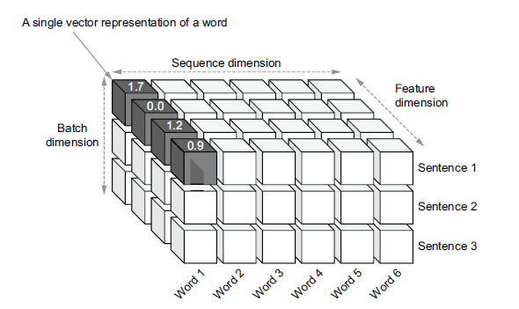

Slide 9
Understanding the Transformer model

Slide 10
Encoder Decoder Architecture
architecture. The encoderdecoder pattern is common in deep learning for certain types of tasks (e.g., machine translation, question answering, unsupervised image reconstruction).
The idea is that the encoder takes an input and maps it to some latent (or hidden) representation (typically smaller), and the decoder constructs a meaningful output using latent representation.

Slide 11
Example
For example, in machine translation, a sentence from language A is mapped to a latent vector, from which the decoder constructs the translation of that sentence in language B. You can think of the encoder and decoder as two separate machine learning models, where the decoder depends on the output of the encoder.

Slide 12
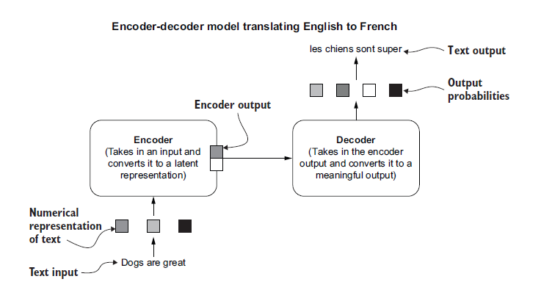

Slide 13
Diving Deeper
The encoder and the decoder individually act like multilayered deep neural networks.
They consist of several layers, where each layer comprises sublayers that encapsulate certain computations done on inputs to produce outputs. The output of the previous layer feeds as the input to the next layer.
It is also important to note that inputs and outputs of the encoder and the decoder are sequences, such as sentences. Each layer within these models takes in a sequence of elements and outputs another sequence of elements

Slide 14
Encoder Layer
Each encoder layer comprises two sublayers:
Self-attention layer
Fully connected layer

Slide 15
The Self Attention Layer
The self-attention layer produces its final output similarly to a fully connected layer
A typical fully connected layer will take all elements in the input sequence, process them separately, and output an element in place of each input element.
But the self-attention layer can select and combine different elements in the input sequence to output a given element.

Slide 16
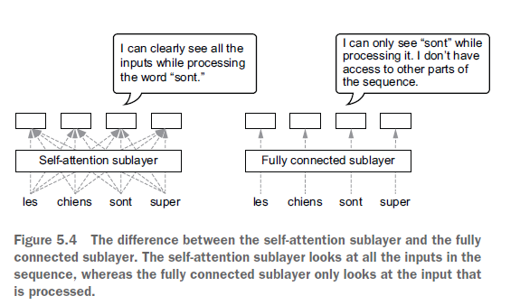

Slide 17
The FCLs
The fully connected layer takes the output elements produced by the selfattention sublayer and produces a hidden representation for each output element in an element-wise fashion.
This make the model deeper, allowing it to perform better.

Slide 18
Example
Assume the task of translating the sentence “Dogs are great” (English) to “Les chiens sont super” (French).
First, the encoder takes in the full sentence “Dogs are great” and produces an output for each word in the sentence. The self-attention layer selects the most important words for each position, computes an output, and sends that information to the fully connected layer to produce a deeper representation.

Slide 19
Example
The decoder produces output words iteratively, one after the other.
To do that, the decoder looks at the final output sequence of the encoder and all the previous words predicted by the decoder.
Assume the final prediction is <SOS> les chiens sont super <EOS>.
Here, <SOS> marks the start of the sentence and <EOS> the end of the sentence.

Slide 20
Example
The first input it takes is a special tag that indicates the start of a sentence (<SOS>), along with the encoder outputs, and it produces the next word in the translation: “les.” The decoder then consumes <SOS> and “les” as inputs, produces the word “chiens,” and continues until the model reaches the end of the translation (marked by <EOS>).

Slide 21
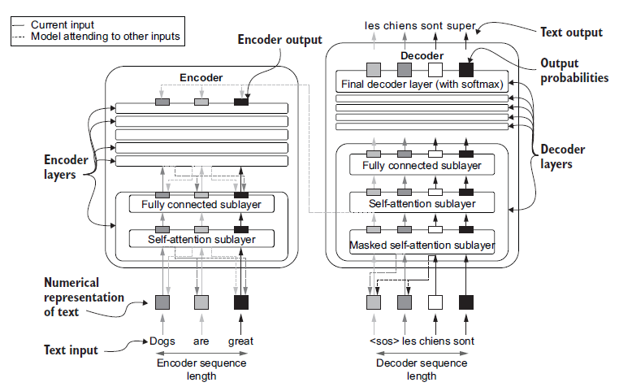

Slide 22
The Self Attention layer
We have covered the purpose of the self-attention layer at an abstract level of understanding.
the layer needs to determine the importance of all the other words (indexed by i) for every word (indexed by t).

Slide 23
The Self Attention layer
A query—The query’s purpose is to represent the word currently being processed.
A key—The key’s purpose is to represent the candidate words to be attended to while processing the current word.
A value—The value’s purpose is to compute a weighted sum of all words in the sequence, where the weight for each word is based on how important it is for understanding the current word

Slide 24
The Self Attention layer
For a given input sequence, query, key, and value need to be calculated for every position of the input. These are calculated by an associated weight matrix with each entity
Next, we will understand how exactly a self-attention layer goes from an input sequence to a query, key, and value tensor and finally to the output sequence

Slide 25
The Self Attention layer Steps
The input word sequence is first converted to a numerical representation using word embedding lookup.
Word embeddings are essentially a giant matrix, where there’s a vector of floats (i.e., an embedding vector) for each word in your vocabulary.
Typically, these embeddings are several hundreds of elements long.

Slide 26
The Self Attention layer Steps
For a given input sequence, we assume the input sequence is n elements long and each word vector is dmodel elements long. Then we have a n × dmodel matrix.
There are three weight matrices in the self-attention layer: query weights (Wq), key weights (Wk), and value weights (Wv)
Wq is dmodel × dq, Wk is dmodel × dk, and Wv is dmodel × dv.
Let’s define these elements in TensorFlow assuming a dimensionality of 512, as in the original Transformer paper. That is,
dmodel = dq = dk = dv = 512

Slide 27
The Self Attention layer Steps
We will first define our input x as a tf.constant, which has three dimensions (batch, time, feature).
Wq, Wk, and Wv are declared as tf.Variable objects, as these are the parameters of the self-attention layer

Slide 28
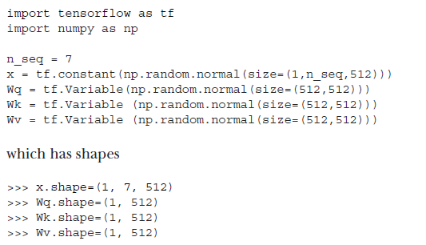

Slide 29
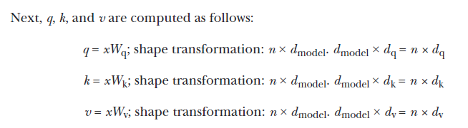
The Self Attention layer Steps

Slide 30
The Self Attention layer Steps
It is evident that computing q, k, and v is a simple matrix multiplication away.
Remember that there is a batch dimension in front of all the inputs (i.e., x) and output tensors (i.e,. q, k, and v) as we process batches of data. But to avoid clutter, we are going to ignore the batch dimension.

Slide 31

The Self attention layer steps
The we compute the final output of the self attention layers

Slide 32
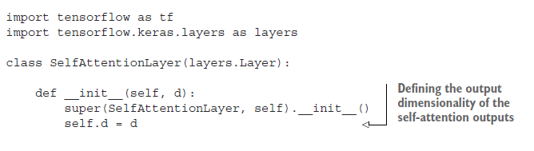
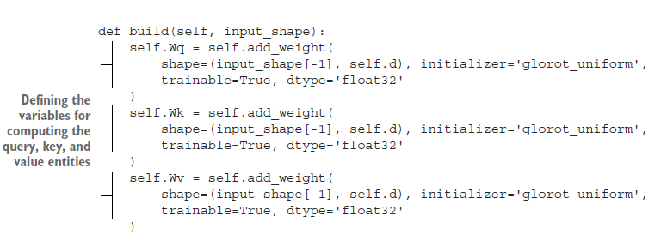

Slide 33
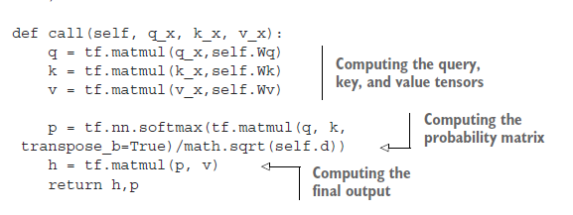


Slide 34
Understanding self-attention with scalers
To understand and visualize what this layer is doing, we will assume a feature dimensionality of 1.
That is, a single word is represented by a single value (i.e., a scalar).

Slide 35
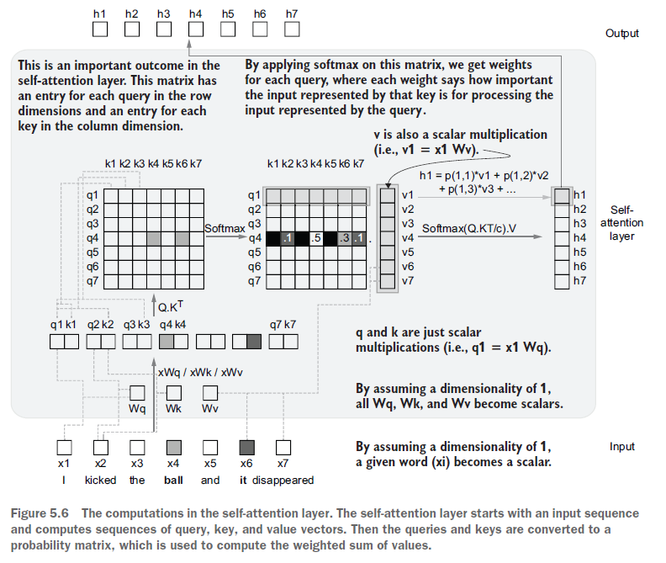

Slide 36
A concrete example
Figure 5.6 visualizes the computations that happen in the self-attention layer if we assume a singleinput sequence and the dimensionality of inputs (dmodel), query length (dq), key length (dk), and value length (dv) is 1
we start with an input sequence x, which has seven words (i.e., n × 1 matrix). Under the assumptions we’ve made, Wq, Wk, and Wv will be scalars

Slide 37
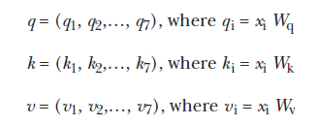
A concrete example

Slide 38
A concrete example
Next, we need to compute the P = softmax ((Q.KT) / √(dk))
Q.KT is essentially an n × n matrix that has an item representing every query and key combination
Then, by applying the softmax, this matrix is converted to a row-wise probability distribution.
√(dk) appearing within the softmax transformation is a normalization constant that helps prevent large gradient values and achieve stable gradients.

Slide 39

A Concrete example
Finally we compute the final output

Slide 40
Query
Query—Helps build a probability matrix that is eventually used for indexing values (v). Query affects the rows of the matrix and represents the index of the current word that’s being processed.

Slide 41
Key
Key—Helps build a probability matrix that is eventually used for indexing values (v). Key affects the columns of the matrix and represents the candidate words that need to be mixed depending on the query word.

Slide 42
Value
Value—Hidden (i.e., attended) representation of the inputs used to compute the final output by indexing using the probability matrix created using query and key

Slide 43
Self attention vs RNNs
Before Transformer models, RNNs governed the domain of NLP.
RNNs perform more and more poorly as the length of the sequence increases.
This is because by the time the RNN gets to the end of the sequence, it has probably forgotten what it saw at the start.
You can see that this problem is alleviated by the self-attention mechanism, which allows the model to look at the full sequence at a given time. This enables Transformer models to perform much better than RNN-based models.

Slide 44
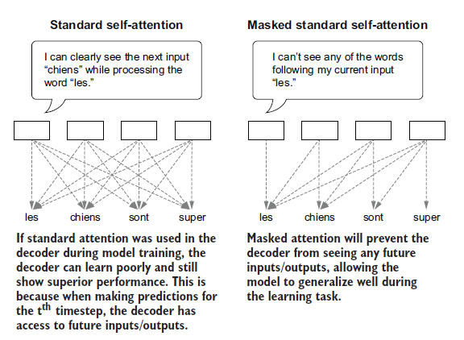
Masked Self-attention layer

Slide 45
Multi-head attention
The idea is simple once you understand the self-attention mechanism. The multi-head attention creates multiple parallel self-attention heads.
The motivation for this is that, practically, when the model is given the opportunity to learn multiple attention patterns (i.e., multiple sets of weights) for an input sequence, it performs better.

Slide 46
Multi-head attention
For a single attention head
dq = dk = dv = 512
With multi-head attention, assuming we are using eight attention heads,
dq = dk = dv = 512/8 = 64
Then the final outputs of all attention heads are concatenated to create the final output, which will have a dimensionality of 64 × 8 = 512
H = Concat (h1,h2,...,h8)

Slide 47
Putting everything together
https://colab.research.google.com/github/thushv89/manning_tf2_in_action/blob/master/Ch05-Fundamentals-of-Transformers/5.1.Transformer.ipynb

