Slide 1
Tensorflow

Slide 2
Core features
Very similar to numpy
Supports distributed computing
Includes a JIT compiler to optimize computation graphs for speed and memory usage
Implements revese-mode autodiff

Slide 5
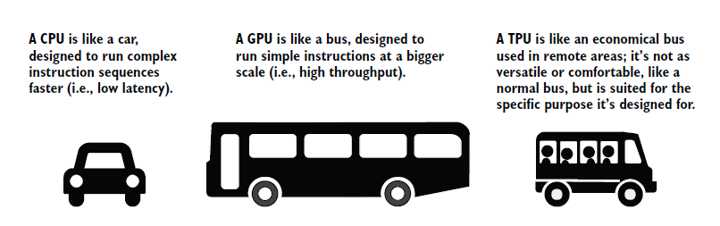
CPU vs GPU vs TPU

Slide 6
In machine learning, particularly in deep learning, we mostly need to perform many matrix multiplications repeatedly to train and infer from models.
Matrix multiplication is a functionality GPUs are highly optimized for
TPUs were invented by Google and can be thought of as stripped-down GPUs. They are application-specific integrated circuits (ASICs) targeted for machine learning and AI applications. They were designed for low-precision high-volume operations

Slide 7
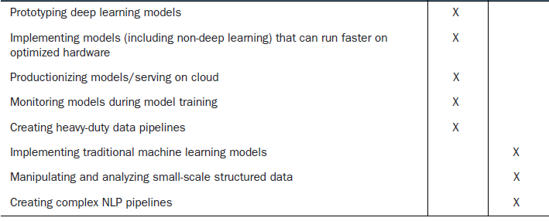
Pros and Cons

Slide 8
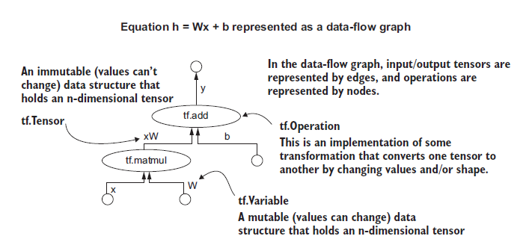

Slide 9
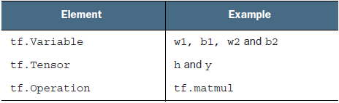
Building blocks

Slide 10
Tf.Variable
v1 = tf.Variable(tf.constant(2.0, shape=[4]), dtype='float32')
print(v1)
v2 = tf.Variable(np.ones(shape=[4,3]), dtype='float32')
print(v2)
v3 = tf.Variable(tf.keras.initializers.RandomNormal()(shape=[3,4,5]),
dtype='float32')
print(v3)

Slide 11
Change the value
v = tf.Variable(np.zeros(shape=[4,3]), dtype='float32’)
v = v[0,2].assign(1)
v = v[2:, :2].assign([[3,3],[3,3]])
Can you write the code to create a tf.Variable that has the following values and has type int16? You can use np.array() for this purpose.
1 2 3
4 3 2

Slide 12
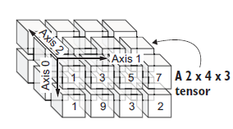
Tf.Tensor
tf.Tensor is the output of performing a TensorFlow operation on some data (e.g., on a tf.Variable or a tf.Tensor).
v = tf.Variable(np.ones(shape=[4,3]), dtype='float32')
b = v * 3.0
print(type(b).__name__)
assert isinstance(b, tf.Tensor)
The key difference between a tf.Variable and a tf.Tensor differ is tf.Variable is mutable while tf.Tensor is immutable

Slide 13
Tf.Tensor
RaggedTensor—A type of data used for variable sequence-length data sets that cannot be represented as a matrix efficiently
TensorArray—A dynamic-sized data structure that can start small and stretch as
more data is added (similar to a Python list)
SparseTensor—A type of data used to represent sparse data (e.g., a user-by-movie
rating matrix)
Can you write the code to create a tf.Tensor that is initialized with values sampled from a normal distribution and that has the shape 4 × 1 × 5? You can use np.random.normal() for this purpose.

Slide 14
Tf.Operation
The backbone of TensorFlow that allows you to do useful things with the data are the operations available
you have basic arithmetic operations such as addition, subtraction, multiplication, and division.
you have reduction operators that allow you to reduce a tensor (e.g., minimum/maximum/sum/product) on a specific axis or all axes

Slide 15
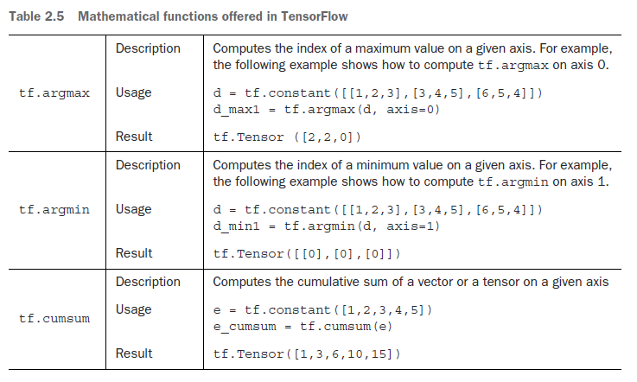

Slide 16
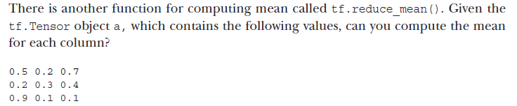
Exercise

Slide 17
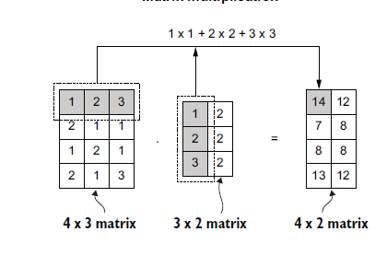
Matrix multiplication
Tf.matmul – can use this to convert an image to grayscale

Slide 18
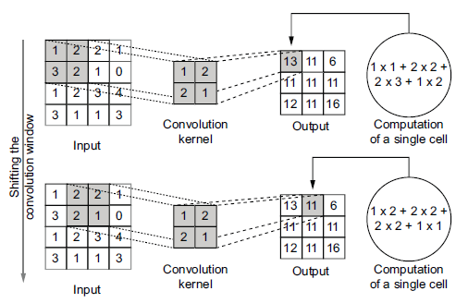
Convolution operation
The convolution operation is essential in convolutional neural networks, which are deep networks heavily utilized for image-related machine learning tasks (e.g., image classification, object detection). A convolution operation shifts a window (also known as a filter or a kernel) over the data while producing a single value at every position

Slide 19
Kernels
Depending on the values you choose for the convolution window, you can produce some unique effects.
https://setosa.io/ev/image-kernels/.

Slide 20
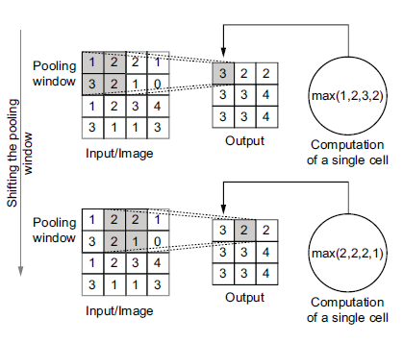
Pooling operation

Slide 21
Exercise
You are given a grayscale image img of size 256 × 256 and a convolution filter f of size 5 × 5. Can you write the tf.reshape() function calls and the tf.nn.convolution()operation? What would be the size of the output?

