Slide 1
Project Title Genetic basis of reduced vancomycin susceptibility in Staphylococcus epidermidis
D. Ashley Robinson’s lab
UMMC

Slide 2
Significance and Overall goal of the project:
Laboratory testing for vancomycin intermediate susceptible staphylococci (VISA and VISE) can be laborious and inconclusive.
The genetic basis for VISA and VISE is poorly understood, especially VISE.
We propose to use genetic association study to find markers/variants for reduced vancomycin susceptibility.

Slide 3
Pairwise Comparisons using Scoary software * analyzes phylogenetically independent pairs of strains for genotype-phenotype association * built-in consideration of population structure * detects variants that arise repeatedly and with large effect
Method for genetic association study

Slide 4
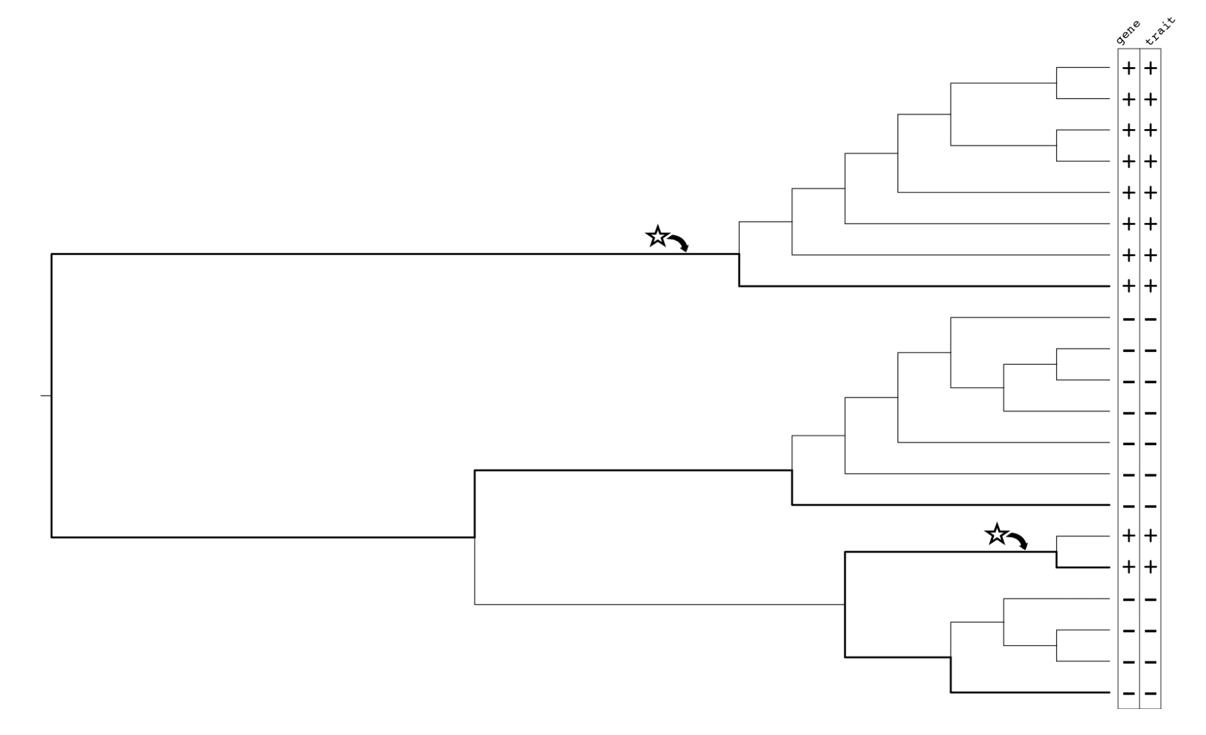
Pairwise Comparison for GWAS: How it works

Slide 5
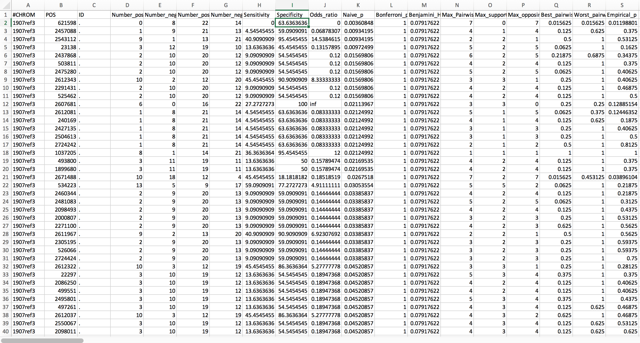
SCOARY OUTPUT FILE

Slide 6
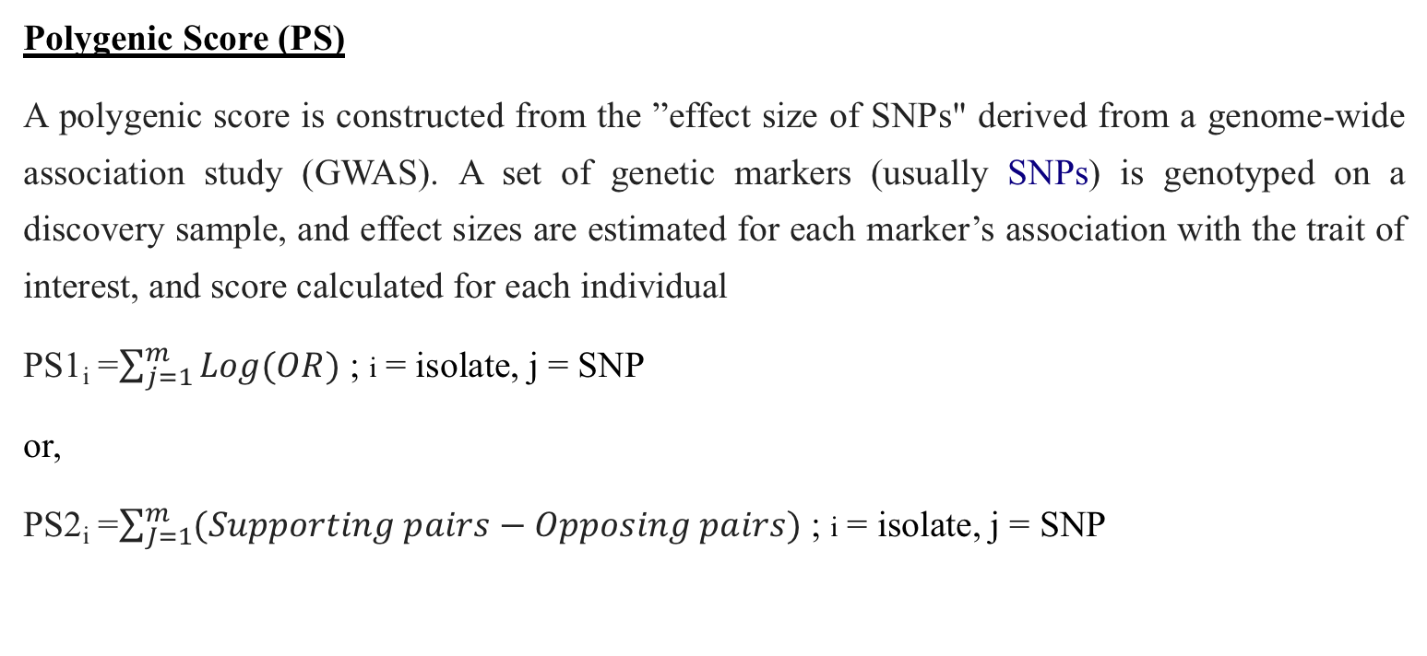
Novel Approach
Polygenic Score (PS)
A polygenic score is constructed from the ”effect size of SNPs" derived from a genome-wide association study (GWAS). A set of genetic markers (usually SNPs) is genotyped on a discovery sample, and effect sizes are estimated for each marker’s association with the trait of interest, and score calculated for each individual
PS1_{i} =$\sum_{j=1}^{m}{Log(OR)}$ ; i = isolate, j = SNP
or,
PS2_{i} =$\sum_{J=1}^{m}{(Supporting pairs−Opposing pairs)}$ ; i = isolate, j = SNP

Slide 9
Results summary
Resistant isolates have higher median PS than sensitive strains
PS2 looks better than PS1
Data are not normally distributed
Outliers in PS2

Slide 10
Summary and Future Directions
PS approach looks promising but more work is needed
Naïve vs Population structure-informed, Normalization of weights and scores, New weights
Examine other sources of variation, eg indels, accessory genes, combined variants
Sample improvements
St. Jude discovery sample – contamination and sequencing issues, no ability to retest phenotype
Independent testing sample – to test the scoring system developed with St. Jude sample
Functional confirmation
Test leading candidates for their effect on phenotype

