Slide 1
DIU

Slide 2

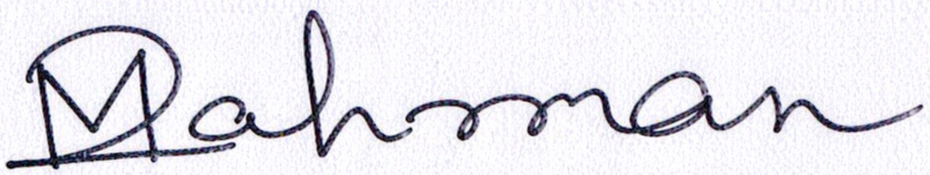

Slide 3
ঢাকা ইন্টারন্যাশনাল ইউনিভার্সিটি
Dhaka International University

Slide 4
DIU
Knowledge is Power
Estd. 7th April, 1995

Slide 5
DIU
Knowledge is Power
Estd. 7th April, 1995

Slide 6
Prof. Dr. A.T.M. Mahobubur Rahman Sharker
Dean (Acting)
Faculty of Science & Engineering
Dhaka International University

Slide 7
Prof. Dr. Md. Abdul Based
Chairman (Acting)
Department of CSE
Dhaka International University

Slide 8

Knowledge Is Power
Dhaka International University
★
★
★
★

