Slide 2
Overview
Computer vision system that is able to analyze images/stored videos/ live IP camera streams in order to detect, notify and compute statistics about the presence of illegal transport of wood (inspired from the Recorder documentary)
Intended for NGOs, civic initiatives, ordinary people.

Slide 3
Objectives
Fast analysis of large video files that results in a report or notifications
Modular, scalable p2p framework ( for any kind of data for any kind of analysis)
Cost-free analysis, open source.
Web based, not desktop app.

Slide 4
Functional requirements
Real time processing is not critical. Results can be delayed with a day
Notifications on whatsapp or email
Data security is not critical in the initial stage, as not many people will use it, however on the medium term, if this gets popular, some authorization mechanisms should be implemented when joining a p2p network
Fault tolerance is not critical. A 24 hour movie that takes 8 hours to be processed should will not annoy too much if something is breaking and the process will be restarted.

Slide 5
Performance requirements
GPU processing for best prediction quality, high recall and precision.
Real time processing in the sense that a 24 hour movie should not take more that 24 hours to be analysed.

Slide 6
Usability requirements
Browser interface(local service or Electron?)
A few buttons to monitor the submitted movies, monitor the network state
The direct results (images with bounding boxes and vehicles tracking id) and some statistics

Slide 7
Out of scope
Real time communication
Training new deep learning models
Mobile application
Neural network low level optimization

Slide 8
Milestones
Finish p2p framework
Integrate with notification
Better statistics
CPU based if the above cannot be done in useful time.
March final release

Slide 9
Current solutions
Inspectorul padurii (satelitary images, not sure how it works or if it ever worked)
Forest guardians ( could benefit a computer vision solution, however it is manual analysis of satelitary images)
Sumal(large scale gov system but on hold. it’s purpose it to video monitor trucks, but it seemed to be centralized, not sure how it works or if it works)
http://www.creeaza.com/referate/informatica/calculatoare/SUMAL-Agent-EXEMPLU-DE-UTILIZA413.php
http://60relbnsu.blogspot.com/p/dupa-ce-s-instalat-aplicatia-sumal.html

Slide 10
Tech stacks advantaged and disadvantages
WebRTC
Fast, mature, tested real time p2p communication framework.
Javascript based and some python (unofficial) bindings
A bit hard for me to grasp the know how as I don’t know javascript that much
Maybe with a team of experienced engineers this job could be done, but not alone
As realtime processing is not critical, this is more than the project needs.
Analyzing a 24 hour stream would take longer to process because of network traffic and additional overheads of synchronization. Frames should not be skipped. The truck detector works best in batchmode ( running over about 25 frames in a single forward pass, but also the batchsize depends on the GPU VRAM)
Has some similarities to my current implementation (STUN, TURN servers for signalling and relaying packets for nodes behind NATs)

Slide 11
GRPC
Interoperability between multiple languages. Is more efficient because of protocol buffers.
However not even now I don’t think that frame based prediction is feasible over the network, blob based prediction seems the easiest to implement and fastest

Slide 12
ZeroMQ
Fast, efficient, elegant network framework for anything that is message based.
A p2p framework could be more or less simply implemented there, actually there are some examples in their python tutorials
Again, it would be really good for real time processing, however this is not the case.

Slide 13
Ray
Very powerful framework for distributed processing
Has support for any cloud provider, Kubernetes cluser. 9K stars on github
Has authentication, but the actual data is not encrypted
Is similar to what I am currently doing. Not sure why I haven’t picked this method in the first place.
Easy to define functions, has nice serialization
Not sure how it handles large data or the nodes behind NATs or network discovery (broker pattern)
Not sure on which node a function will be executed. What if the node is overloaded with work
Has autoscaler that makes deploying a Ray cluster simple
Has automatic port-forwarding
Not webbased, thus low interoperability with other languages, however some APIs could still be defined (not sure that this would be necessary)
Probably I will switch to using this, because the flow of processing might be easier (using generators(coroutines)), or maybe use a hybrid solution that uses this and my method.
https://www.oreilly.com/ideas/ray-a-distributed-execution-framework-for-emerging-ai-applications-full-keynote-post
Has task dependency graph
No support for Windows. Needs at least Ubuntu subsystem for Windows

Slide 14
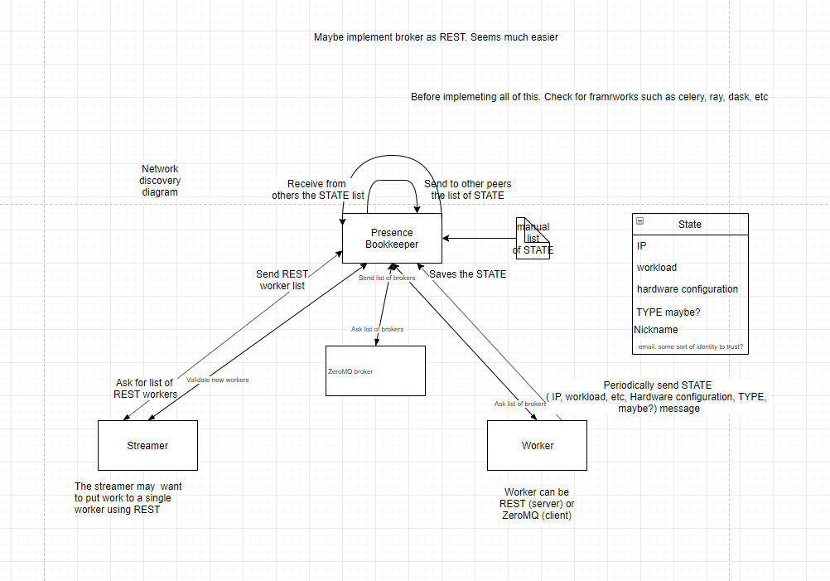
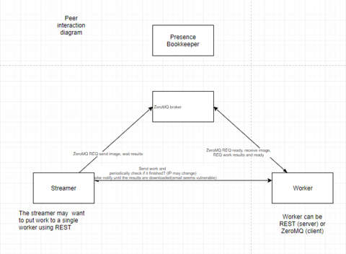
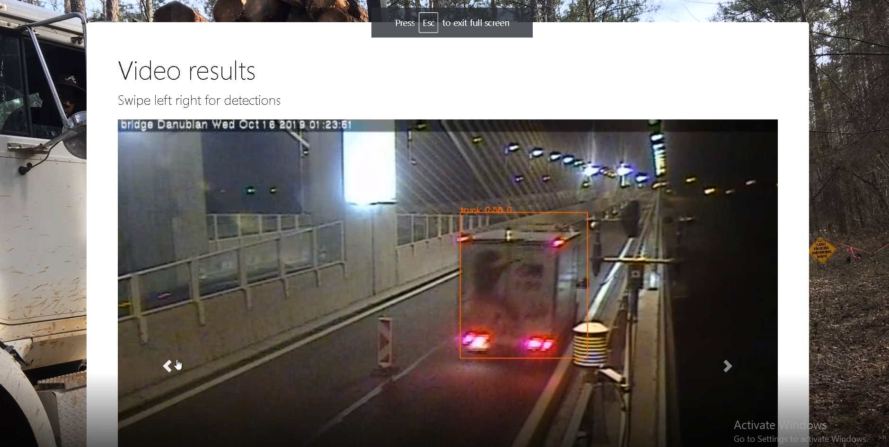
My own implementation
Inspired after bitcoin

Slide 15
