Slide 1
Title: Predicting House Prices Using Machine Learning Model
Subtitle: A Data-Driven Approach to Understanding Housing Market Dynamics in California
Name: Ifunanya Deborah Ngwoke
Email: ifunanyangwoke@gmail.com
Student ID: ALT/SOD/023/1138
Date: 15th August, 2024

Slide 2
Introduction
Project Overview:
Objective: To develop a machine learning model that predicts house prices based on various features such as median income, proximity to the ocean, and population density.
Importance: Accurate house price predictions are crucial for making informed decisions for real estate investors, developers, and policy-makers.
Business Case:
Why This Matters: The housing market is influenced by numerous factors, and understanding these can help stakeholders in pricing, purchasing, and investment strategies.

Slide 3
Business Problems and Hypotheses
Key Questions:
How do house size, proximity to the ocean, median income, and house age impact house prices?
What is the relationship between population density and house prices?
Hypotheses:
Larger houses (more rooms and bedrooms) are more expensive.
Houses closer to the ocean are more expensive.
Higher median income leads to higher house prices.
Older houses might have lower market values.
Higher population density might decrease house prices.

Slide 4
Data Overview
Dataset:
Source: California Housing Dataset (from the Kaggle https://www.kaggle.com/datasets/camnugent/california-housing-prices).
Features: Median income, proximity to the ocean, house age, population, etc.
Target Variable: Median house value.
Data Preparation:
Cleaning: Handling missing values, and outliers.
Feature Engineering: Created new features like population density, median house value class, bedroom per room, and rooms per household.
Encoding: One-hot encoding for categorical features like ocean_proximity.
Notes:
we used imputers (median) to fill in the nan values in the total_bedroom column. We didn’t remove the outliers because we feel it’s important to our analysis

Slide 5
Methodology
Model Selection:
Models Tested: Linear Regression, Decision Tree, Random Forest, Gradient Boosting.
Reasoning: Different models were chosen to balance simplicity (Linear Regression) and complexity (Random Forest, Gradient Boosting).
Evaluation Metrics:
RMSE: Measures the model's prediction error.
MAE: Captures the average error in prediction.
R² Score: Indicates how well the model explains the variance in house prices.

Slide 6
Model Performance
Model Comparison: The models were evaluated using performance metrics such as Root Mean Squared Error (RMSE), Mean Absolute Error (MAE), and R² Score.
Linear Regression:
RMSE: 69177.43
MAE: 50256.87
R² Score: 0.6548
Decision Tree:
RMSE: 73709.06
MAE: 46645.18
R² Score: 0.6081
Random Forest:
RMSE: 50737.77
MAE: 32778.05
R² Score: 0.8143
Gradient Boosting:
RMSE: 53868.31
MAE: 36916.90
R² Score: 0.7907
Best Model: Random Forest was the best performer with the highest R² Score and lowest RMSE.

Slide 7
Results
Best Model Performance:
RMSE: 50620.10
MAE: 32617.53
R² Score: 0.8152
Top Features:
Median Income: 48.39% importance.
Proximity to Ocean (Inland): 14.57% importance.
Population Density: 12.16% importance.
Interpretation:
Key Findings:
Median Income: Strongest predictor; higher income leads to higher house prices.
Proximity to Ocean: Inland properties are significantly cheaper.
Population Density: More densely populated areas tend to have higher house prices.
The model aligns with most of our initial hypotheses, confirming the importance of median income, population density, and location.

Slide 8
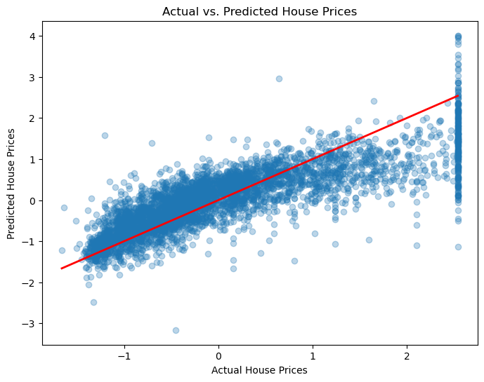
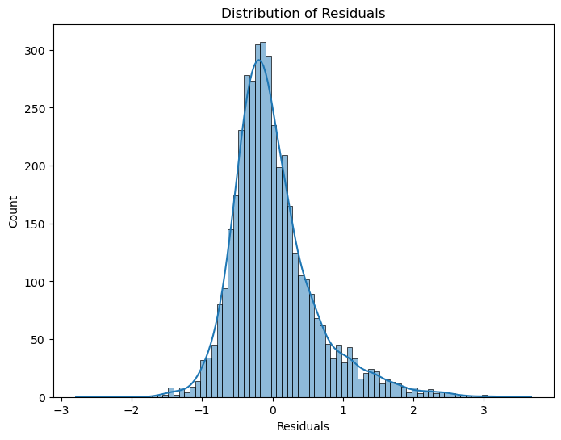
Visualizations
Actual vs. Predicted Prices: Scatter plot showcasing the model's performance.
Residual Distribution: Histogram showing the residuals, confirming the model’s unbiased predictions.
Notes:
Scatter Plot: The plot shows how well the model's predictions align with actual house prices.
Observation: Most points lie close to the 45-degree line, indicating good model performance.
Histogram: Shows the distribution of residuals (prediction errors).
Observation: Residuals are approximately normally distributed around zero, suggesting unbiased predictions.

Slide 9
Conclusion
Key Findings:
Median Income, Proximity to Ocean, and Population Density are the most influential factors in predicting house prices.
Model Performance: Random Forest provided the most accurate predictions.
Business Implications:
Real estate professionals can use these insights for pricing strategies and investment decisions.
Policymakers can better understand how socioeconomic factors influence housing markets.
Conclusions:
The model provides a reliable prediction of house prices with an R² score of 0.8152.
Next Steps:
Potential deployment of the model for real-time predictions.
Exploration of more sophisticated models or additional data to further improve accuracy.

Slide 10
Questions & Discussion
The End.
Thanks
Notes:
Discussion Points: Engage the audience and discuss challenges faced during the project.

