Slide 1
EXPLORATORY DATA ANALYSIS ON MPOX CASES
TABLE OF CONTENTS
INTRODUCTION………………………………………………………………………… 1
DATA COLLECTION…………………………………………………………………….. 4
DATA MIGRATION……………………………………………………………………… 5
DATA CLEANING………………………………………………………………………… 6
EXPLORATORY DATA ANALYSIS…………………………………………………… 9
RECOMMENDATION

Slide 2
INTRODUCTION
This dataset contains information on monkeypox cases and deaths across different locations from May 2022 to May 2023. The data includes 94253 rows and 17 columns (but reduced to 15), with each row representing a unique combination of location, date, and corresponding monkeypox cases and deaths. The dataset is sourced from the Our World in Data project and has no missing values.
Column Name | Description
location | Name of the location (continent or country)
iso_code | ISO 3166-1 alpha-3 code of the location
date | Date of observation
total_cases | Total number of monkeypox cases reported in the location until that date
total_deaths | Total number of deaths due to monkeypox reported in the location until that date
new_cases | Number of new monkeypox cases reported on the date of observation
new_deaths | Number of new deaths due to monkeypox reported on the date of observation

Slide 3
new_cases_smoothed | 7-day smoothed average of new monkeypox cases reported on the date of observation
new_deaths_smoothed | 7-day smoothed average of new deaths due to monkeypox reported on the date of observation
new_cases_per_million | Number of new monkeypox cases reported per million population on the date of observation
total_cases_per_million | Total number of monkeypox cases reported per million population until the date of observation
new_cases_smoothed_per_million | 7-day smoothed average of new monkeypox cases reported per million population on the date of observation
new_deaths_per_million | Number of new deaths due to monkeypox reported per million population on the date of observation
total_deaths_per_million | Total number of deaths due to monkeypox reported per million population until the date of observation
new_deaths_smoothed_per_million | 7-day smoothed average of new deaths due to monkeypox reported per million population on the date of observation

Slide 4
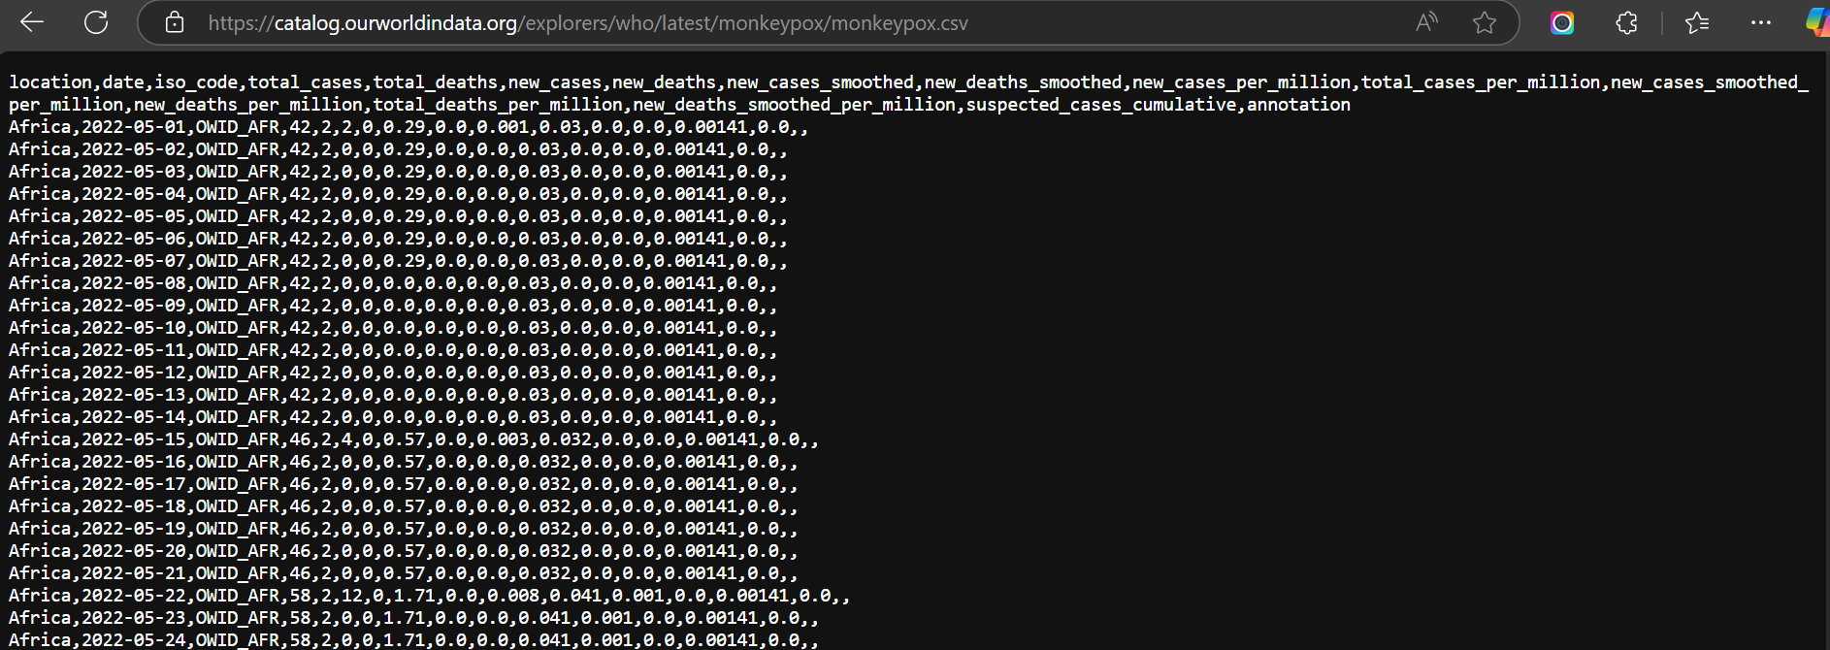
DATA COLLECTION
URL
catalog.ourworldindata.org/explorers/who/latest/monkeypox/monkeypox.csv
Raw CSV/ Text state

Slide 5
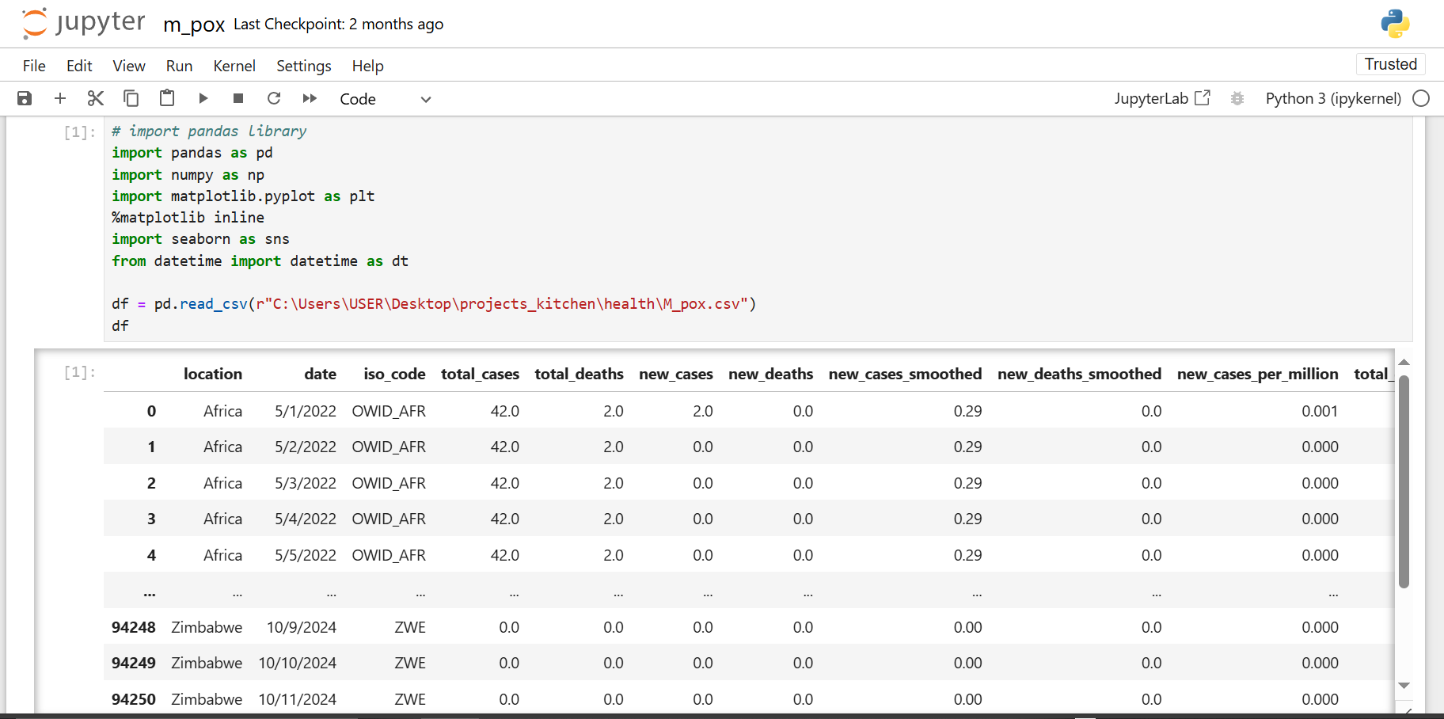
DATA MIGRATION
The CSV/Text dataset was then migrated into Jupyter NoteBook

Slide 6
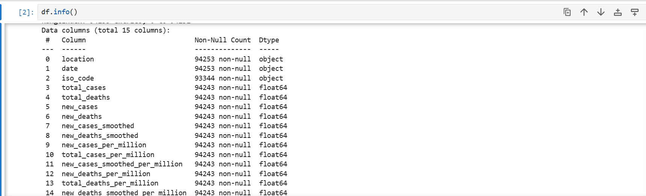
DATA CLEANING
Determining column headers and values

Slide 7
Shaping data
Removal of duplicates

Slide 8
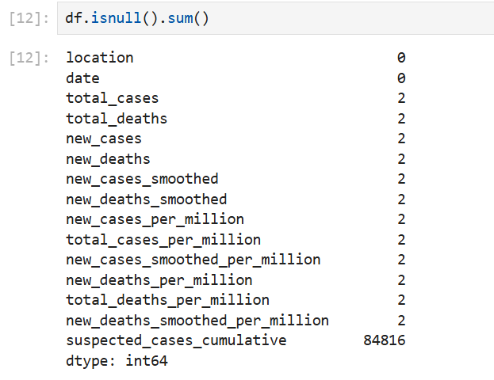
Removal of null values

Slide 9
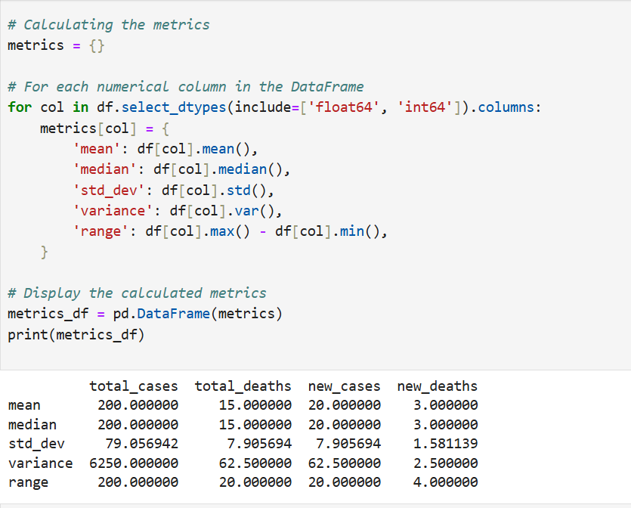
EXPLORATORY DATA ANALYSIS
1. SUMMARY OF STATISTICS
Calculating mean, median, standard deviation, variance, range, etc for the numerical columns.

Slide 10
Insights:
The insights derived from the calculated metrics for each column provide a summary of the spread, central tendency, and distribution of the data. Here’s a breakdown of each metric and the insights they offer for each variable in this dataset:
Mean:
Gives an average value for each column.
For example, a mean of total_cases around 200 indicates that the average total cases across the data points is 200.
Median:
Represents the middle value when data is sorted.
Since the data is symmetric and seems linearly increasing, the mean and median are close, suggesting a balanced spread without extreme outliers.
Standard Deviation (std_dev):
Measures how spread out the values are around the mean.
For new_cases, a smaller standard deviation compared to total_cases would indicate that new_cases is less spread out, suggesting a more consistent daily increase in cases.

Slide 11
Range:
The difference between the maximum and minimum values.
For example, a range of 200 for total_cases indicates the total cases fluctuate by this amount across observations. A larger range for total_cases compared to new_cases and new_deaths suggests broader variability in the cumulative count.
Overall Insight
The metrics show a gradual increase across all columns, meaning there is a consistent rise in both cases and
deaths over the dataset, with limited fluctuations (suggested by relatively low standard deviations). The data
reflects a steady trend rather than sudden spikes or drops, indicating a somewhat predictable progression in
cases and deaths within this sample.

Slide 12
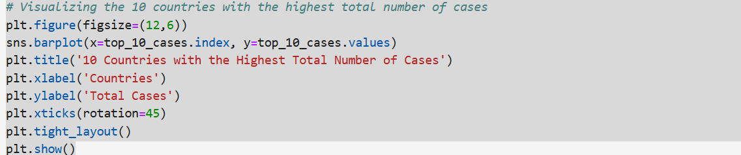
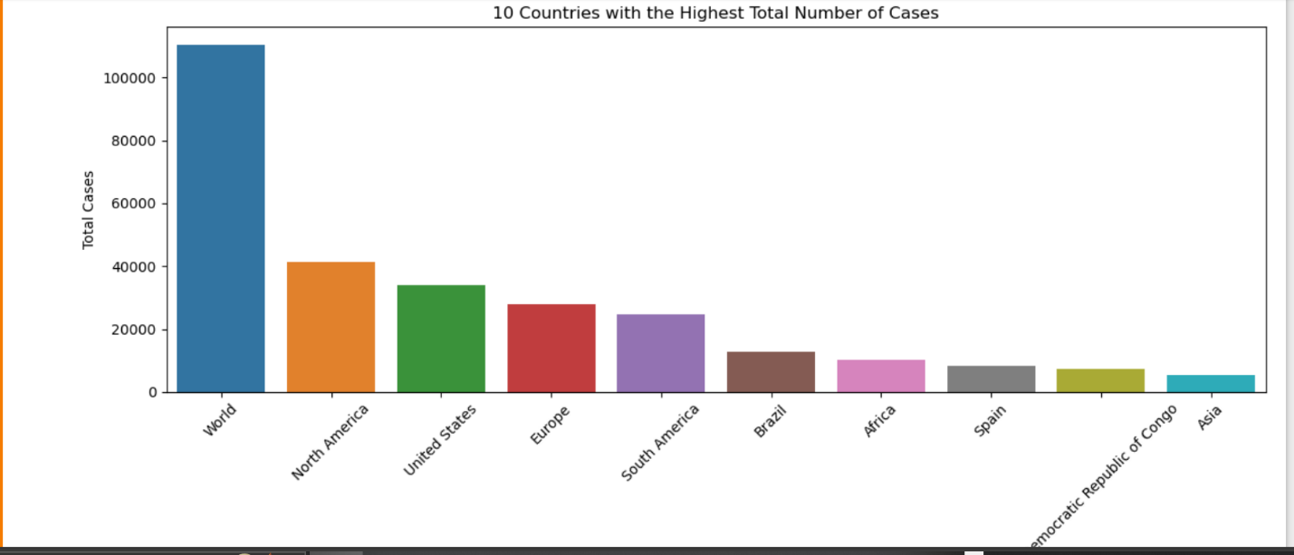
2. VISUALIZING THE 10 COUNTRIES WITH THE HIGHEST TOTAL NUMBER OF CASES

Slide 13
INSIGHT:
The code snippet is visualizing the top 10 countries with the highest total number of Mpox cases. This bar chart provides insights into which countries have been most affected by the pandemic in terms of total reported cases.
Key insights from the visualization:
Countries with the Most Cases: The chart identifies the specific countries with the highest case counts, showing their relative ranking.
Magnitude of Cases: By comparing bar heights, we can gauge how much each country’s case numbers differ, helping us see if the cases are spread evenly or if a few countries have disproportionately high totals.
Trends in Global Hotspots: Recognizing countries with the highest totals can point to regions where Mpox impact has been more severe, possibly due to population density, healthcare infrastructure, or government responses.

Slide 14
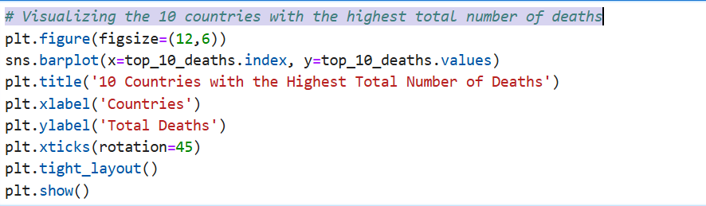
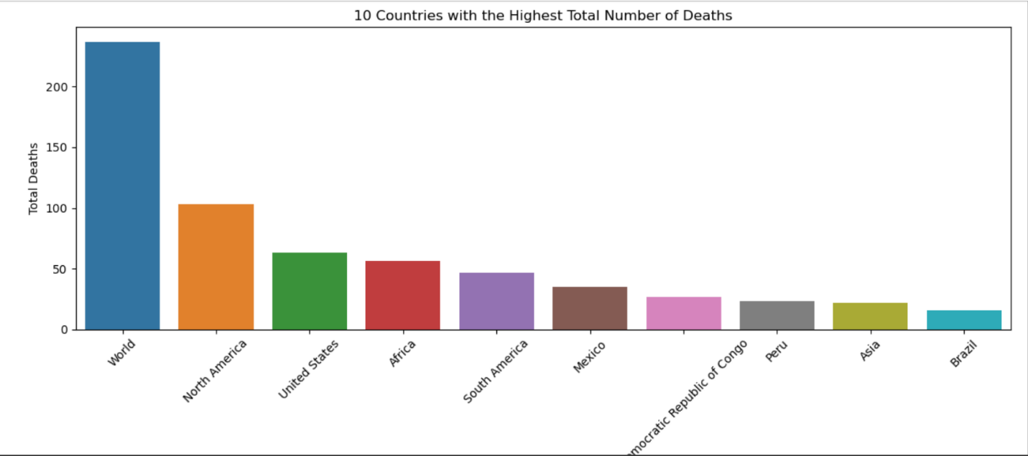
3. VISUALIZING THE 10 COUNTRIES WITH THE HIGHEST TOTAL NUMBER OF DEATHS

Slide 15
INSIGHT:
This bar chart visualizes the top 10 countries with the highest total Mpox deaths, offering insight into the global impact in terms of mortality.
Key insights from this visualization:
Countries with Highest Mortality: It highlights which countries have recorded the most Mpox deaths, indicating areas with the greatest loss of life during the pandemic.
Comparative Severity: By examining the bar heights, we can see the differences in death tolls between these top 10 countries. A few countries might have notably higher death totals, signaling possible differences in population age structure, healthcare quality, pandemic response, or data reporting practices.
Mortality vs. Cases: Comparing this chart with the one for total cases can reveal patterns. Some countries with high cases might not appear in the top 10 for deaths, suggesting better healthcare responses or a younger population less prone to severe outcomes. Conversely, countries with high deaths and moderate case counts might indicate underlying vulnerabilities.

Slide 16
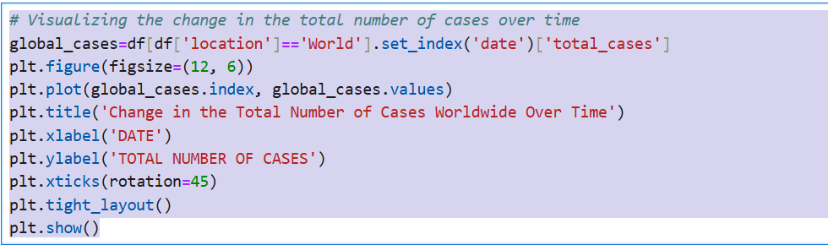
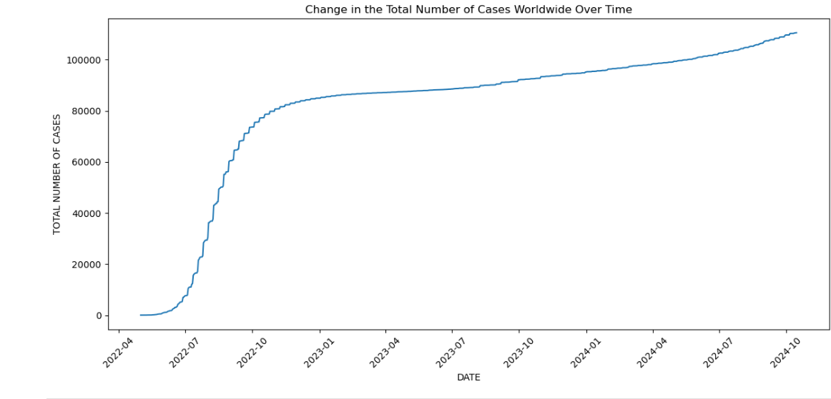
4. VISUALIZING THE 10 CHANGE IN THE TOTAL NUMBER OF CASES OVER TIME

Slide 17
INSIGHT:
This line chart visualizes the change in the total number of Mpox cases worldwide over time, capturing the progression of the pandemic on a global scale.
Key insights from this visualization:
Exponential Growth Patterns: The chart may reveal an initial period of slow growth followed by an acceleration, characteristic of exponential growth. This pattern often reflects the spread of the virus before widespread interventions or vaccinations.
Impact of Waves and Interventions: You might observe periods of steeper increases, corresponding to waves of the pandemic, and flatter sections, possibly following global efforts like lockdowns, vaccine rollouts, or other mitigation measures.
Long-Term Trend: The cumulative nature of this curve shows that the number of cases continually rises, though the rate of increase may vary. A flattening toward the end would suggest a slowdown, possibly due to herd immunity, vaccination, or effective containment strategies.
Milestone Points: Significant surges or shifts in the curve could correspond with the emergence of new variants, holiday periods, or easing of restrictions in some regions.
This chart is valuable for understanding the pandemic’s progression and evaluating the effects of global health responses over time. Would you like to delve into specific time periods or compare this with death rates over time.

Slide 18
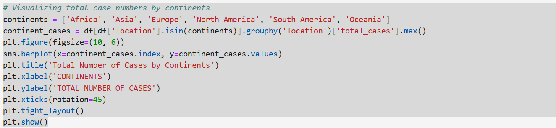
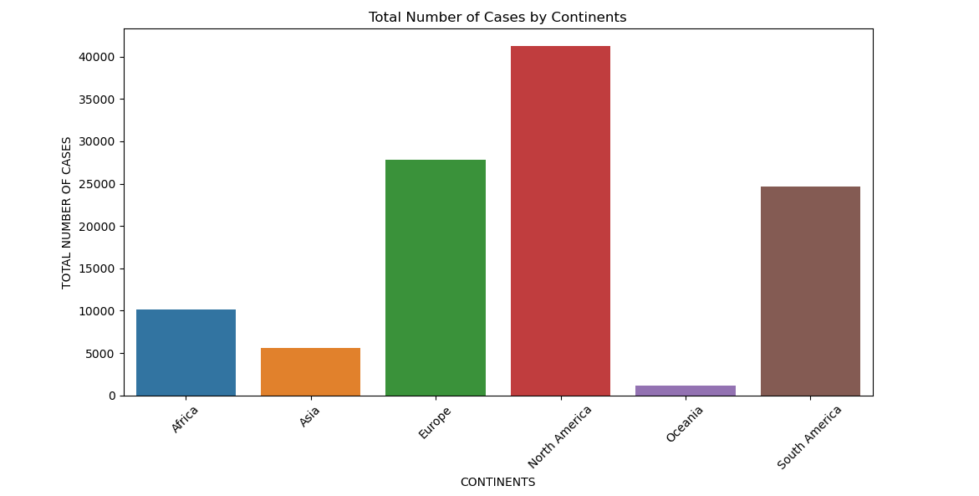
5. VISUALIZING TOTAL CASE NUMBERS BY CONTINENTS

Slide 19
INSIGHT:
This bar chart visualizes the total number of Mpox cases by continent, providing insight into how the pandemic affected different regions globally.
Key insights from this visualization:
Variability Across Continents: The chart highlights which continents had the highest and lowest total cases, suggesting where Mpox spread most widely. For instance, continents with high population densities and significant international connectivity, such as Asia, North America, and Europe, may show higher case totals.
Population vs. Total Cases: High case numbers in certain continents may correlate with their larger populations. However, some regions with smaller populations but high total cases could indicate a more intense per capita impact, possibly reflecting higher rates of transmission or lower levels of restrictions or healthcare infrastructure.
Pandemic Trends by Region: A comparison across continents can hint at regional pandemic trends and responses. For example, continents with lower cases might have had effective early containment measures, lower population densities, or other factors that limited the virus’s spread.
Limitations of Total Case Counts: While total cases give an overview, this metric does not account for differences in population size, testing capacity, or healthcare quality, which can affect reported totals. Normalizing cases per capita or adjusting for regional factors could provide additional insights.

Slide 20
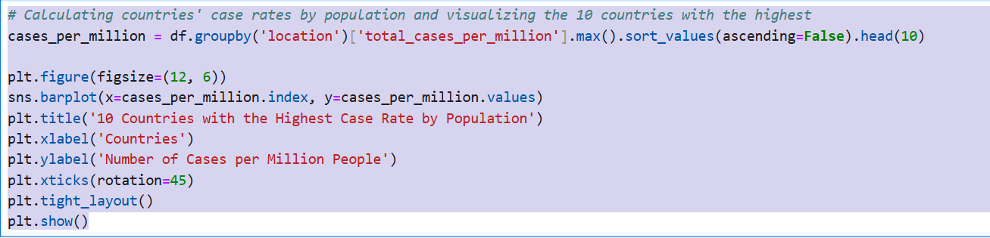
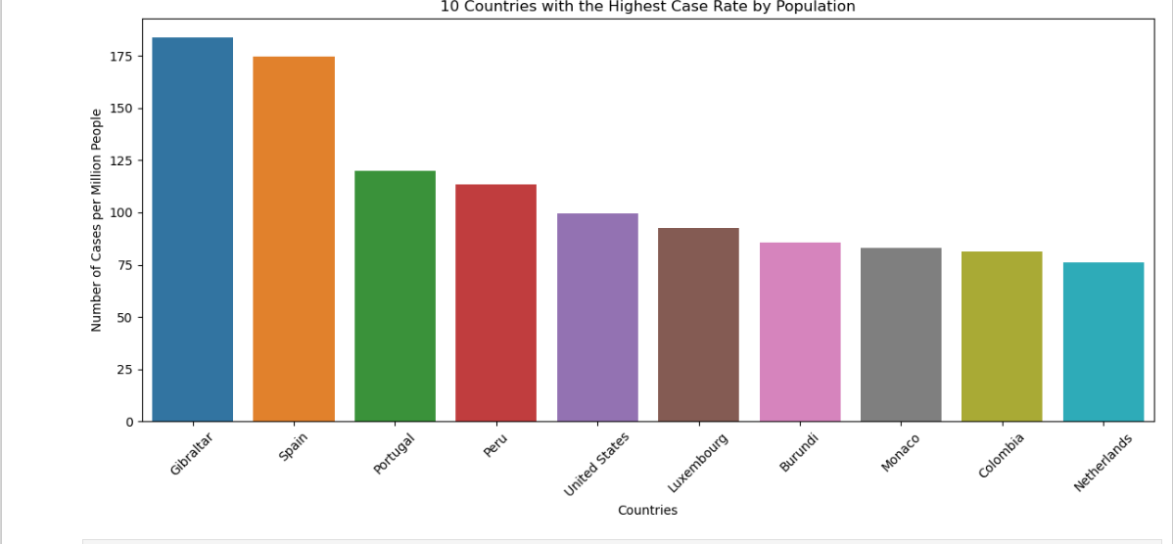
6. CALCULATING COUNTRIES’CASE RATES BY POPULATION

Slide 21
INSIGHT:
This bar chart visualizes the 10 countries with the highest Mpox case rates per million people, providing insights into how intensely the pandemic impacted populations on a per capita basis.
Key insights from this visualization:
Per Capita Impact: This metric reveals countries where Mpox cases have been proportionally higher relative to population size, highlighting regions that faced particularly high transmission rates.
Smaller or Densely Populated Countries: Often, countries with smaller populations but dense urban centers or high mobility might appear in this list. Such nations may have experienced more rapid spread due to close contact in urban areas or a high degree of international travel.
Comparative Severity: Unlike total cases, which can be influenced by a country’s population size, cases per million normalize for population, making it easier to compare impact across countries of different sizes.
Effectiveness of Mitigation Strategies: Countries with high cases per million may reflect areas where mitigation measures were challenging to enforce or where healthcare systems were less equipped to handle the pandemic.
Healthcare and Testing Disparities: High case rates per million can also reflect robust testing practices. However, it may also indicate regions where outbreaks overwhelmed healthcare systems or where measures were delayed.

Slide 22
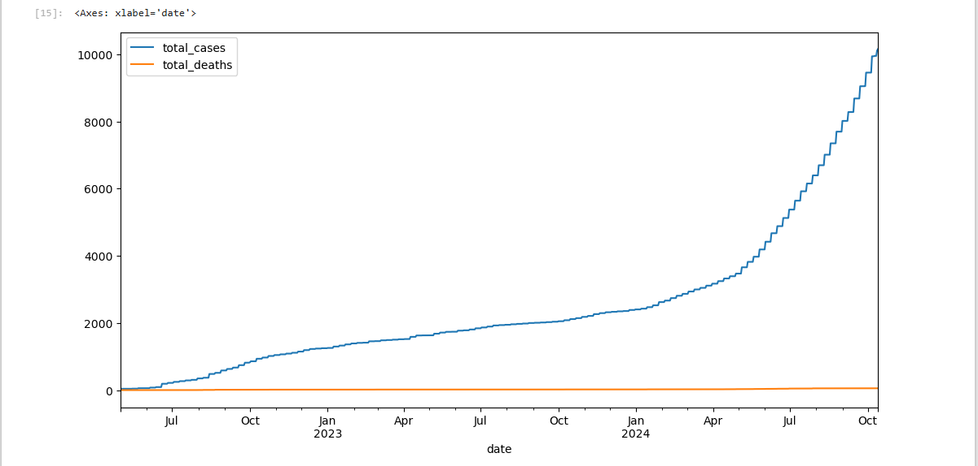
7. TOTAL CASES AND DEATHS FOR THE AFRICA CONTINENT

Slide 23
INSIGHT:
This line chart visualizes the total Mpox cases and deaths in Africa over time, highlighting the pandemic’s progression across the continent.
Key insights from this visualization:
Progression Over Time: The line chart typically shows a cumulative rise in both cases and deaths, reflecting the continued spread and impact of the virus. Notable inflection points in the curves could correspond to surges in cases or waves.
Deaths vs. Cases Growth Rate: The rate of increase in total deaths compared to cases can provide insights into the severity and lethality of the virus in Africa. If the gap between cases and deaths widens over time, it may indicate improvements in healthcare interventions, such as hospital capacity, treatments, or vaccination.
Potential Waves: Spikes or plateaus in the cases line might signify distinct waves or phases of the pandemic, possibly due to new variants, changes in health policies, or seasonal effects. Similar patterns in the death curve would suggest high mortality during certain waves.
Healthcare System Strain: Periods with high growth in deaths could point to healthcare challenges, such as limited ICU beds, access to medical supplies, or lower vaccination rates.
Public Health Response: Fluctuations, especially in the deaths line, may correlate with interventions like lockdowns or vaccination campaigns. A slowing increase or leveling off in deaths may indicate the impact of effective public health measures over time.
This visualization is valuable for assessing the cumulative impact and trends of Mpox in Africa and understanding how different phases of the pandemic affected the region.

Slide 24
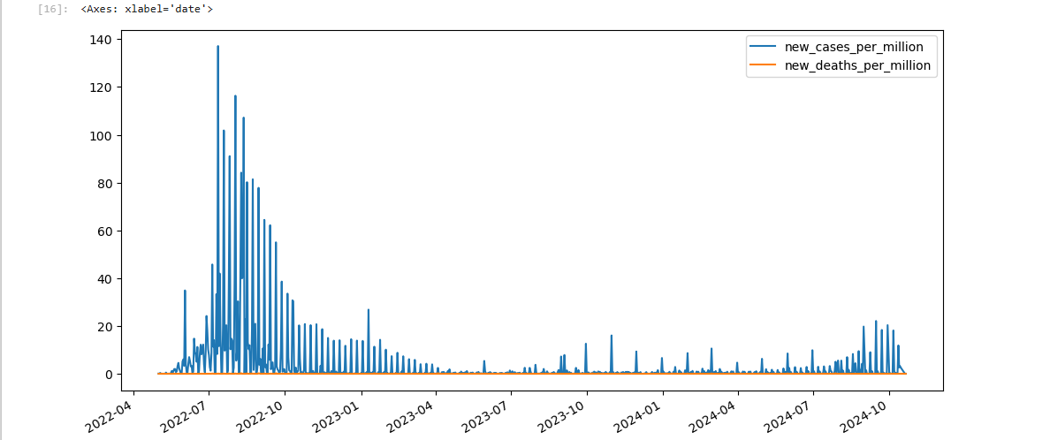
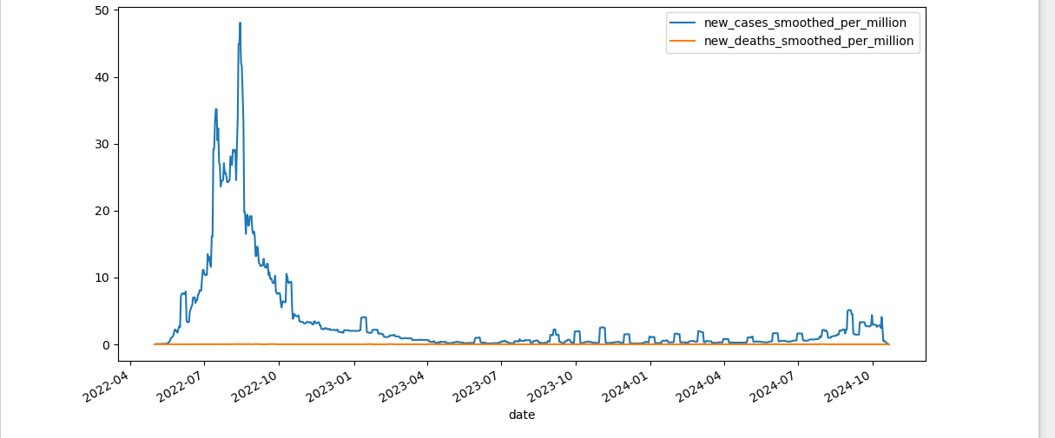
8. NEW AND SMOOTHED AVERAGES OF CASES AND DEATHS PER MILLION OVER TIME

Slide 25
INSIGHT:
These two line-harts provide insights into the trajectory of Mpox’s spread and mortality rate globally, focusing on the new cases and deaths per million population over time.
Insights from New Cases and Deaths per Million Over Time:
Spike Patterns: Peaks in the "new cases per million" and "new deaths per million" charts correspond to waves of Mpox spread and associated mortality. Each spike generally represents a wave, potentially linked to factors like new variants, seasonal trends, or changes in public health measures.
Comparing Cases and Deaths: If peaks in cases are not always matched by proportional increases in deaths, this may indicate improvements in treatment, vaccination, or perhaps milder variants.
Magnitude and Frequency of Waves: By assessing both the height and frequency of spikes, we gain a sense of how intense and frequent Mpox surges were. This pattern reveals the timing of different pandemic waves across the population.
Insights from Smoothed Averages of New Cases and Deaths per Million Over Time:
Smoothing for Trends: The smoothed averages help to remove daily fluctuations, allowing a clearer view of underlying trends. This can reveal sustained increases or decreases, providing more reliable information on whether Mpox spread or mortality was rising, stable, or declining over time.
Public Health Impact: Plateaus or declines in smoothed values might reflect the positive impact of public health measures, such as lockdowns, mask mandates, or vaccinations.
Declining Deaths Relative to Cases: If smoothed new deaths per million show a consistent decline even as cases remain high, it may reflect improved healthcare responses, such as better treatment protocols or high vaccination rates, particularly among vulnerable groups.

Slide 26
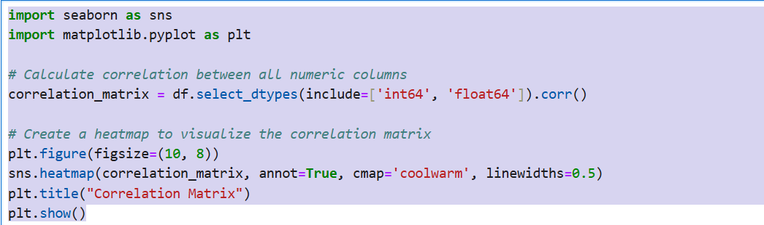
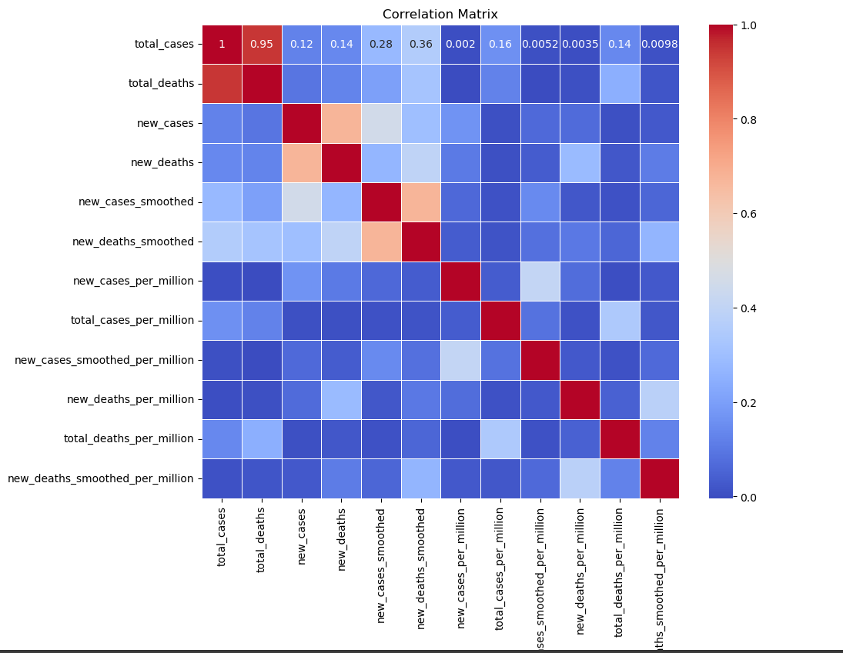
9. CORRELATION BETWEEN NUMERIC VALUES

Slide 27
INSIGHT:
The heatmap of the correlation matrix shows the relationships between various numeric Mpox metrics, providing insights into how different variables are interconnected.
Key insights from the correlation matrix:
Total Cases and Total Deaths: A strong positive correlation is expected between total_cases and total_deaths, indicating that as cases increase, deaths tend to increase proportionally. This relationship is common in pandemic data, where higher case counts often result in higher mortality.
New Cases and New Deaths: A positive correlation between new_cases and new_deaths suggests that spikes in new cases are often followed by increases in new deaths. However, the strength of this correlation may vary depending on healthcare interventions and treatment advances.
Cases and Population-Adjusted Rates: Variables like total_cases_per_million may show a positive correlation with total_cases, but high variability in population sizes across locations can influence this relationship. This relationship helps identify whether absolute case numbers are consistent with per capita rates.
Smoothed Metrics: The new_cases_smoothed and new_deaths_smoothed metrics are likely to be positively correlated with their non-smoothed counterparts, but smoothing averages out short-term fluctuations, so these relationships may not be perfect. Smoothed metrics provide more stable insights for trend analysis.
Case Fatality Indicators: High correlation between death-related metrics, such as total_deaths_per_million and new_deaths_per_million, can reveal relationships between fatality rates and factors like case severity or healthcare capacity.

Slide 28
RECOMMENDATION
Based on the insights from the Mpox dataset, here are several data-driven recommendations for policy, healthcare management, and public health strategies:
Focus on Reducing Case Counts to Minimize Mortality:
Since total cases and total deaths are highly correlated, efforts to reduce new infections could directly impact the fatality rate. Measures such as early case detection, quarantine procedures, and effective treatment should be prioritized to prevent the escalation of cases into fatalities.
Implement Surveillance in Regions with High Per Capita Cases:
The positive correlation between cases and population-adjusted rates (total_cases_per_million) suggests that regions with a high case-per-million rate should be monitored more closely. Resources like testing kits, healthcare personnel, and educational materials on prevention can be concentrated in these high-risk areas to prevent spread and minimize the impact.
Regularly Update Smoothed Case and Death Averages for Trend Analysis:
Using smoothed metrics (new_cases_smoothed and new_deaths_smoothed) can provide a more accurate representation of trends over time by reducing short-term fluctuations. Regular monitoring of these trends enables quicker detection of shifts in infection or death rates, allowing health systems to adjust response strategies effectively.
Targeted Healthcare Interventions in High Fatality Regions:
The correlation between total_deaths_per_million and new_deaths_per_million suggests that regions with high fatality indicators should be supported with enhanced healthcare resources. Improving access to critical care facilities, ventilators, and treatment options could help lower death rates in these areas.
Leverage Predictable Progression for Resource Planning:
Given the consistent progression in cases and deaths without severe fluctuations, healthcare facilities can anticipate resource needs with better accuracy. This predictability allows for efficient allocation of medical supplies, ICU beds, and healthcare workers to ensure adequate response capacity.
Public Health Communication and Awareness:
Given the data's steady increase in cases, public health messaging should focus on long-term prevention strategies and sustainable practices, like vaccination (if available), personal protective measures, and hygiene practices, to control the spread.
Data-Driven Resource Allocation:
The calculated variability across metrics like total cases and deaths indicates where public health and medical resources are most needed. High-variance locations could be prioritized for rapid response teams and additional healthcare facilities.
These recommendations emphasize a proactive, data-informed approach, with a focus on containment, consistent monitoring, and targeted healthcare support to reduce Mpox transmission and mortality rates.

Slide 29
4. Targeted Healthcare Interventions in High Fatality Regions:
The correlation between total_deaths_per_million and new_deaths_per_million suggests that regions with high fatality indicators should be supported with enhanced healthcare resources. Improving access to critical care facilities, ventilators, and treatment options could help lower death rates in these areas.
5. Leverage Predictable Progression for Resource Planning:
Given the consistent progression in cases and deaths without severe fluctuations, healthcare facilities can anticipate resource needs with better accuracy. This predictability allows for efficient allocation of medical supplies, ICU beds, and healthcare workers to ensure adequate response capacity.
6. Public Health Communication and Awareness:
Given the data's steady increase in cases, public health messaging should focus on long-term prevention strategies and sustainable practices, like vaccination (if available), personal protective measures, and hygiene practices, to control the spread.
7. Data-Driven Resource Allocation:
The calculated variability across metrics like total cases and deaths indicates where public health and medical resources are most needed. High-variance locations could be prioritized for rapid response teams and additional healthcare facilities.
These recommendations emphasize a proactive, data-informed approach, with a focus on containment, consistent monitoring, and targeted healthcare support to reduce Mpox transmission and mortality rates.

