Slide 1
EDA_Bank_Statement

Slide 2
TABLE OF CONTENTS
INTRODUCTION……………………………………………………………………….. 3
DATA PREPARATION AND CLEANING…………………………………………. 4
EXPLORATORY DATA ANALYSIS………………………………………………..... 7
VISUALIZATION…………………………………………………………………………. 24
RECOMMENDATION………………………………………………………………….. 25

Slide 3
INTRODUCTION
This is an Excel project. It marks the beginning of my journey into understanding and working with data. I am eager to learn and use Excel to uncover insights regarding one of my bank accounts used primarily for handling short term miscellaneous activities, and make things better. My exploration reveals fascinating insights into several key aspects: from account average cumulative balance to categorization of entries and their balances. We delve into questions such as which category of entries has the highest average cumulative balance and which has the lowest average cumulative balance, etc.
For this project, I utilized my Accessbank transactions’ statement. It was downloaded from my bank app in PDF file. I then converted it into an Excel file. The dataset, organized in an Excel spreadsheet, includes the following columns:
Posted Date: The date of transaction entry.
Description: The nature of posted transaction entry
Debit: Transaction entries depicting the “outflow” of funds from the said account.
Credit: Transaction entries depicting the “inflow” of funds into the said account.
Balance: The average cumulative amount at a given point in time

Slide 4
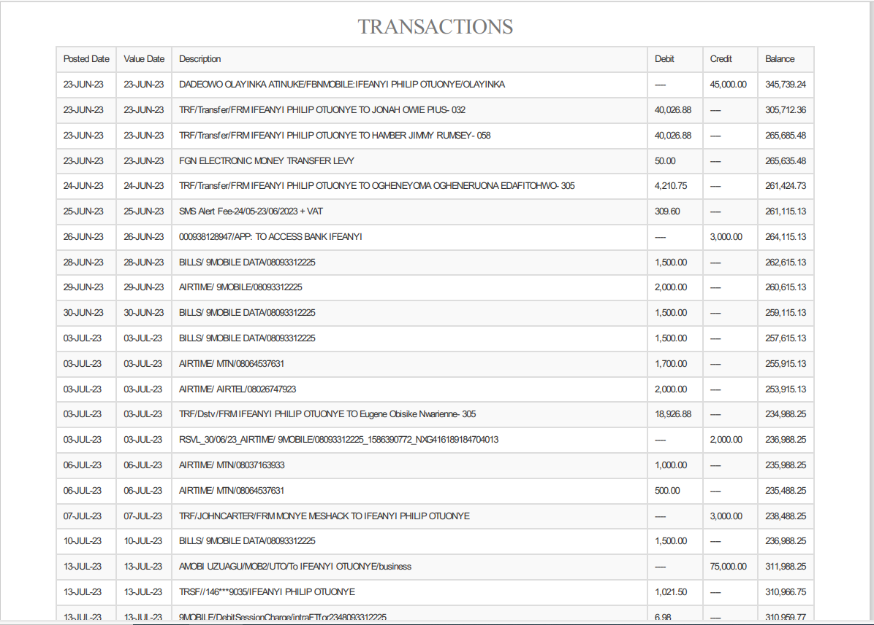
DATA PREPARATION AND CLEANING
I had to download the bank statement from my mobile app in PDF file type, before converting it into Excel file type.

Slide 5
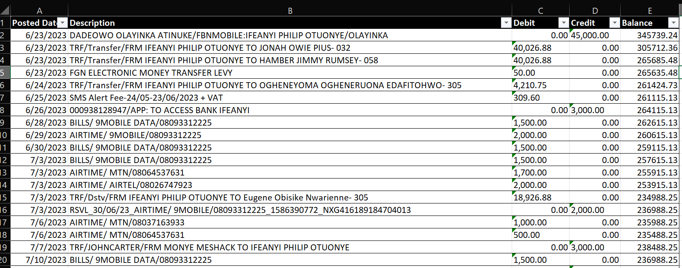
Deletion of an unwanted column
Shape of Data frame
This provides immediate insight into the size of the dataset, revealing the number of rows and columns. There are 5 columns and 444 rows.

Slide 6
EXPLORATORY DATA ANALYSIS
Exploratory Data Analysis serves as a critical phase in the data analysis process, offering an in-depth look into the dataset’s characteristics and uncovering pivotal insights. In this stage, I thoroughly examined the data to spot trends, anomalies, and relationships that inform my subsequent analysis. The EDA phase helped me to: Gain a clear understanding of the dataset’s structure, including its size and key characteristics. Spot and remove duplicates, unwanted column, etc. to ensure the accuracy of my findings
Let’s go into analysis of questions that will assist us in identifying insights and areas of improvement. The following questions will serve as our guide:
Q1. What is the total average balance for the period?
Q2. Which category of entries has the highest amount of average balance?
Q3. Which has the lowest amount?
Q4. Which category has the highest frequency of activities?

Slide 7
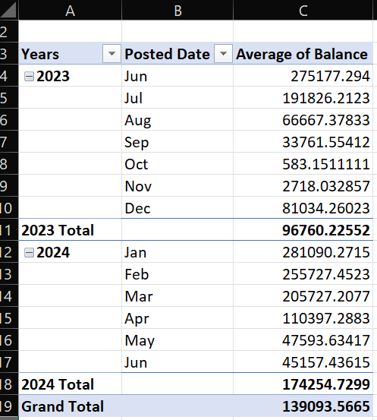
W H A T I S T H E T O T A L A V E R A G E B A L A N C E F O R T H E P E R I O D ?
INSIGHT:
The data on average balance by month from 2023 to mid-2024 reveals key insights about the balance

Slide 8
trend, seasonality, and potential external influences impacting account balance variations:
Insights
1. Sharp Decline Mid-2023 Followed by Recovery in 2024
Observation: The average balance declines sharply from June 2023, dropping significantly by October 2023 (from 275,177 in June to just 583 in October). It then shows a partial recovery in November and a more substantial increase by December.
Implication: This could indicate a seasonal or situational impact (e.g., tax payments, market fluctuations, or annual business expenses) leading to lower balances during mid-to-late 2023. The uptick by December might reflect a restoration of funds, possibly due to year-end inflows, bonuses, or seasonal gains.
2. Higher Average Balances in Early 2024
Observation: Starting in January 2024, the average balance increases substantially, reaching a peak in January (281,090) and remaining relatively high in the first quarter before gradually decreasing in the second quarter.

Slide 9
Implication: This rise suggests a seasonal pattern where balances increase at the start of the year, potentially due to factors like annual income cycles, budget allocations, or fiscal adjustments. The decrease by June could indicate recurring expenses, business outflows, or mid-year reallocation.
3. Cumulative Growth Between 2023 and 2024
Observation: The total average balance for 2024 (174,254) is significantly higher than the total average for 2023 (96,760), suggesting improved balance levels year-over-year.
Implication: The growth in cumulative balance might indicate stronger financial inflows, improved account management, or an increase in funds relative to the previous year. This trend could be due to better cash flow management or business growth.
4. Possible Cash Flow Seasonality
Observation: There is a cyclical trend where balances are higher in early months of each year and taper off towards mid-year.
Implication: This may imply that cash flow is influenced by seasonal business cycles, possibly aligning with budget allocations or income cycles that replenish balances at the start of each year.

Slide 10
This knowledge could be helpful for planning resource allocation or forecasting cash availability throughout the year.
Conclusion
This data highlights seasonal trends, with early-year balance peaks and mid-year troughs. The year-over-year increase suggests financial improvement, while the month-to-month variations reveal potential influences like recurring expenses or income cycles. Understanding these patterns can guide financial planning, allowing for better preparation during low-balance months and capitalizing on high-balance periods.

Slide 11
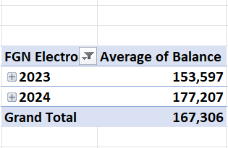
W H I C H C A T E G O R Y O F E N T R I E S H A S T H E H I G H E S T A M O U N T O F A V E R A G E B A L A N C E ?
INSIGHT:
1. Year-over-Year Growth in Average Balance
Observation: The average balance increased from 153,597 in 2023 to 177,207 in 2024, representing an approximate 15% growth.
Implication: This steady increase could indicate financial growth or better management practices, suggesting stronger inflows, higher income, or controlled expenses in 2024 compared to 2023. Such growth reflects positively on financial health and can improve liquidity and investment potential.

Slide 12
2. Overall Financial Stability
Observation: The grand total average balance across both years stands at 167,306, demonstrating a stable financial baseline.
Implication: The consistent balance average suggests financial resilience, providing a reliable foundation for planning and forecasting. A stable average may also indicate that there is effective budget management or that adjustments were made to maintain liquidity across both years.
3. Incremental Improvement Strategy
Observation: The increase in the average balance from 2023 to 2024, even if moderate, points to potential financial adjustments that contributed to this positive change.
Implication: If this incremental improvement is part of a strategic effort, it may reflect an intentional approach to building reserves or adjusting spending practices. This pattern, if sustained, could set a precedent for future increases in cash reserves or investment capacity.

Slide 13
Conclusion
The upward trend in average balance from 2023 to 2024 reflects positive financial growth, resilience, and potential improvements in income or expense management. This pattern indicates a favorable trajectory, supporting long-term financial planning and highlighting effective resource management strategies.

Slide 14
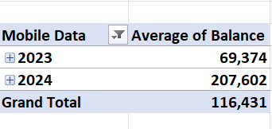
W H I C H C A T E G O R Y O F E N T R I E S H A S T H E LOWEST A M O U N T O F A V E R A G E B A L A N C E ?
INSIGHT:
The data on average balances related to mobile data expenses for 2023 and 2024 shows significant growth, which suggests several potential patterns and implications.
Insights
1. Sharp Increase in Average Balance from 2023 to 2024
Observation: The average balance rose significantly from 69,374 in 2023 to 207,602 in 2024, an almost 200% increase.
Implication: This suggests a substantial increase in mobile data spending or allocation. The growth may reflect greater demand for digital connectivity, possibly due to expanded operations, increased usage,

Slide 15
, or broader access initiatives. It may also imply that mobile data has become a more prioritized or critical expense area.
2. Grand Total Growth Trend
Observation: The grand total average balance over both years is 116,431, with 2024’s average balance much higher than this overall figure.
Implication: This trend indicates a sharp upward shift in mobile data allocation, suggesting a potential adjustment in strategy toward enhanced digital operations or reliance on mobile technology. The high balance in 2024 may point to a future where digital and mobile infrastructure is more central, hinting at continued or even expanded spending in this category.
3. Possible Drivers Behind Increased Mobile Data Allocation
Observation: The marked increase in 2024 could be due to several factors, such as digital transformation initiatives, remote working adaptations, or higher data rates.

Slide 16
Implication: The rise might reflect strategic investment in mobile data to support growing needs for connectivity or digital services. If this trend continues, it could suggest a shift toward a more data-driven, mobile-enabled operational model, with increasing budget allocations likely to follow.
Conclusion
The significant increase in mobile data balance from 2023 to 2024 signals an intensified focus on digital and mobile data needs. This trend suggests a possible digital transformation, highlighting mobile data as a strategic priority. To sustain this growth effectively, ongoing evaluation of data usage and cost efficiency may be beneficial, especially if mobile data demands continue to rise.

Slide 17
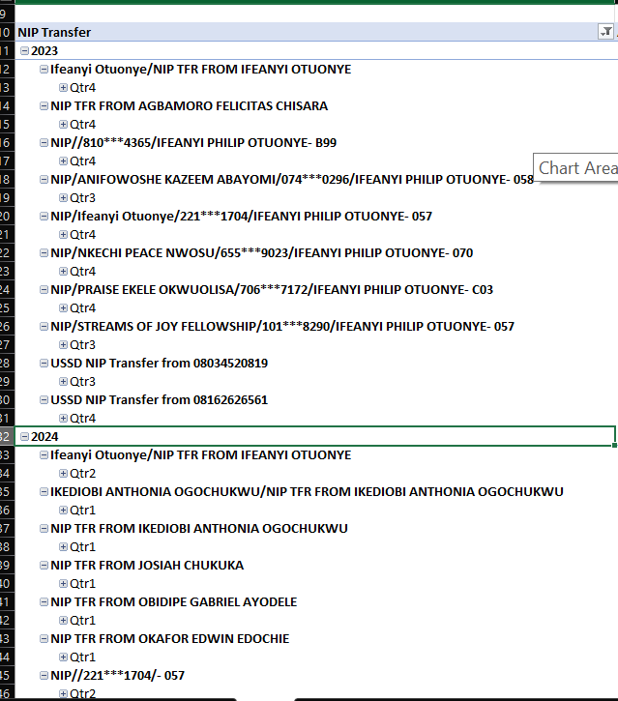
W H I C H C A T E G O R Y O F E N T R I E S H A S T H E H I G H E S T F R E Q U E NCY O F ACTIVITIES ?

Slide 18
INSIGHT:
The data on NIP (Nigeria Interbank Payment) Transfers for the years 2023 and 2024, which include multiple entries of transfers involving Ifeanyi Philip Otuonye and other individuals or entities, offers insights into transfer patterns, frequency, and potential sources of funds or transactions. Here are the key observations:
Insights
1. Consistent Transactions Involving Ifeanyi Otuonye
Observation: Both years have frequent transfers involving Ifeanyi Otuonye, either as a direct sender or as the recipient. This recurring pattern implies that Ifeanyi Otuonye is a central participant in these transactions, possibly acting as a primary account holder or a business-related account for multiple incoming funds.
Implication: The consistency in transfers suggests a structured relationship with the listed individuals and entities, potentially indicating either a personal or business-related setup where Otuonye facilitates or receives regular transfers.

Slide 19
2. Wide Range of Transaction Sources
Observation: In both years, transactions involve various individuals and entities, such as "Streams of Joy Fellowship," "Dunamis Int'l Gospel Centre," and "Glorious Overcomers Intl Assembly," as well as private individuals like "Kazeem Abayomi," "Praise Ekele Okwuolisa," and others.
Implication: The variety of transaction sources implies that these transfers could be related to contributions, donations, or support from multiple sources. The presence of fellowship and church groups points to potential funding or contributions from religious or community-based groups.
3. Growth in Transaction Sources in 2024
Observation: The data for 2024 shows an expanded list of transaction sources compared to 2023, with new entries such as "Josiah Chukuka," "Okafor Edwin Edochie," and others.
Implication: This increase in unique transaction sources may indicate growing

Slide 20
engagement or network expansion, where Ifeanyi Otuonye is receiving or facilitating more transactions. This could reflect an expansion in operations, contacts, or network reach in 2024.
4. Use of USSD Transfers
Observation: Both years show the use of USSD NIP transfers from mobile numbers, suggesting the use of mobile banking for fund transfers.
Implication: The presence of USSD transfers indicates ease of access and convenience in using mobile banking options, possibly for smaller, frequent transactions. This could reflect either regular contributions from individuals using mobile banking or a preference for quick, on-the-go transactions.

Slide 21
5. Potential Patterns of Contributions or Business Transactions
Observation: The recurring nature of transfers from certain individuals (e.g., Nkechi Peace Nwosu and Praise Ekele Okwuolisa appear in both years) hints at established relationships.
Implication: The repetition of certain sources may indicate either a series of scheduled transactions, such as subscription-like contributions or regular payments. If these are contributions, they may signify committed donors or associates.
Conclusion
The data suggests a network of transactions involving Ifeanyi Otuonye, characterized by multiple consistent and some growing connections in 2024. The list of contributors, including both individuals

Slide 22
and religious organizations, points to either a structured funding or business relationship where funds are channeled for specific purposes. The growth in 2024 reflects increased engagement or expansion of financial connections, possibly implying a growing scope or scale of activity for Otuonye or the related entities.

Slide 23
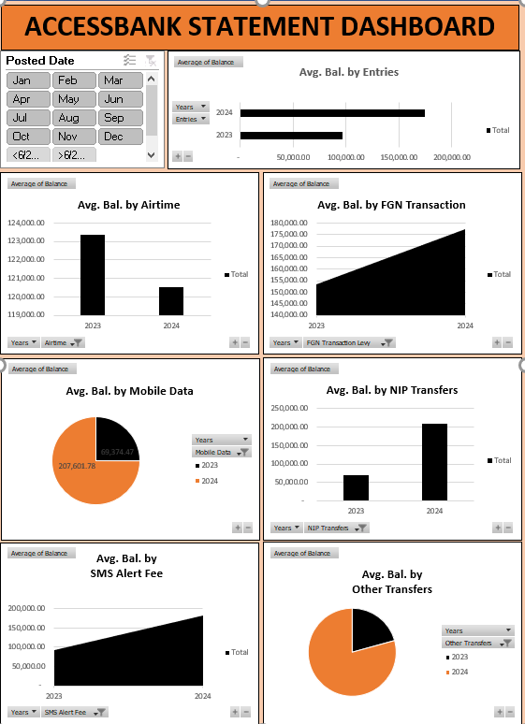
VISUALIZATION

Slide 24
RECOMMENDATION
Here are recommendations based on the insights derived:
1. Financial Management and Planning Strategy:
Plan for Seasonal Balance Variations: To address the mid-year decline in balances, implement measures such as setting aside reserves during peak months (early in the year) to manage potential troughs in June and October. The pattern suggests that balance fluctuations may stem from annual expense cycles, so planning for these predictable low-balance periods can help maintain liquidity and operational stability.
Leverage Early-Year Balance Peaks: Utilize early-year balance peaks for investments, expansions, or large-scale purchases. With balances rising significantly in the first quarter, this period can be strategically used for key expenditures or to allocate funds towards high-yield investments.
Monitor Year-Over-Year Growth: The steady growth in the average balance from 2023 to 2024 reflects sound financial management. To maintain this upward trend, continue monitoring

Slide 25
inflows and adjusting expenditure practices as necessary to sustain incremental improvements.
2. Mobile Data Budget and Digital Transformation Strategy:
Adjust Budget for Increased Digital Needs: With a sharp increase in mobile data expenses from 2023 to 2024, ensure that the mobile data budget aligns with operational needs and the potential growth in digital services. As mobile data has become a critical expense area, consider whether there are options for bulk purchasing or long-term data plans to optimize costs.
Explore Cost-Efficiency for Data-Driven Operations: If mobile data demands continue to increase, implement periodic evaluations of data usage to ensure cost efficiency. As digital reliance grows, identify areas where expenses can be optimized (e.g., using Wi-Fi where feasible, negotiating better rates with providers, or utilizing data monitoring tools).
Invest in Digital Infrastructure: The surge in mobile data spending may indicate a shift towards digital transformation. Invest in tools and infrastructure that support this trend (e.g., mobile-based communication platforms, virtual meeting tools, cloud storage), enhancing connectivity and operational efficiency in line

Slide 26
with evolving digital needs.
3. NIP Transfers and Network Expansion Strategy:
Enhance Relationship Management with Consistent Contributors: For recurring contributors (e.g., “Nkechi Peace Nwosu” and “Praise Ekele Okwuolisa”), consider formalizing these relationships by implementing regular payment schedules or agreements. This can strengthen the funding base and allow for better forecasting of cash inflows.
Capitalize on Expanding Network: The growth in transaction sources in 2024 suggests an expanding network. Build on this momentum by deepening connections with existing contributors and exploring new sources. This can include outreach initiatives, strengthening donor relationships, or expanding partnerships with new entities or individuals.
Promote Mobile Banking Options: The frequent use of USSD transfers reflects the importance of mobile banking for convenience. Continue promoting mobile banking as a fast and accessible option for contributors, especially for those who may prefer smaller, frequent transactions. Consider offering guidance or technical support for mobile banking to increase ease of use and user confidence.

Slide 27
Regularize and Communicate Transaction Patterns: With recurring transactions involving specific individuals and entities, establish transparent communication to keep contributors informed about fund utilization. This can reinforce trust and encourage ongoing contributions, particularly from religious or community-based groups that may appreciate regular updates on how funds are being managed and allocated.
Conclusion:
These recommendations leverage seasonal balance trends, digital transformation demands, and NIP transfer patterns to create a balanced approach to financial planning, operational efficiency, and relationship management. By aligning strategies with observed patterns, these actions can drive both financial resilience and growth, ensuring that cash flow, digital requirements, and contributor engagement are well-supported.

