Slide 1
EXPLORATORY DATA ANALYSIS ON RETAIL ACTIVITIES

Slide 2
TABLE OF CONTENTS
INTRODUCTION……………………………………………………………………………… 3
DATA PREPARATION AND CLEANING………………………………………………. 4
EXPLORATORY DATA ANALYSIS……………………………………………………….. 5
RECOMMENDATION……………………………………………………………………….. 17

Slide 3
INTRODUCTION
In the retail industry, effective decision-making hinges on precise and insightful data analysis, particularly when it comes to understanding financial performance and predicting future outcomes. Key datasets—such as budgeted, actual, and forecast data—play a critical role in this process, enabling retailers to monitor financial health, adapt strategies, and stay competitive in a dynamic marketplace.
Budgeted data reflects the financial planning and goals set by the organization for a given period, serving as a benchmark for measuring financial success. Actual data captures real-time financial outcomes, highlighting how current operations align with the planned budget. Meanwhile, forecast data leverages historical trends, current market conditions, and future projections to anticipate upcoming financial performance. By comparing budgeted, actual, and forecast data, retailers gain a comprehensive view of variances, assess resource allocation, and identify areas for optimization.
Together, these datasets provide a holistic view that empowers retailers to make data-driven decisions, enhance operational efficiency, and achieve sustainable growth, all while adapting to evolving consumer behaviors and economic shifts.

Slide 4
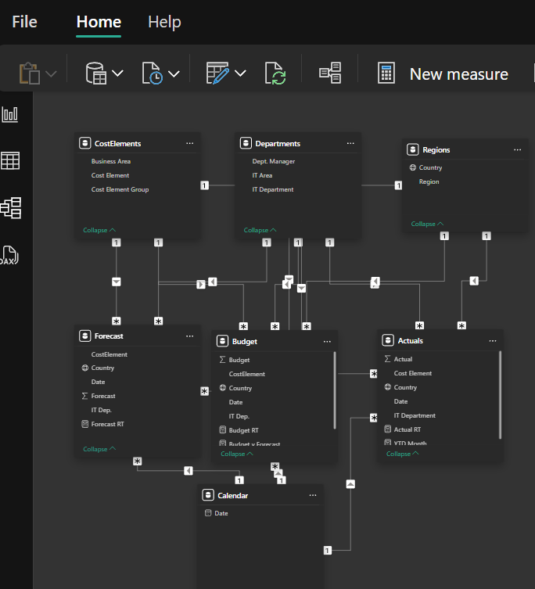
For this project the datasets were sourced from: https://youtu.be/Z2t7l8b1uWU
The datasets were then imported into Power BI, where they were merged, transformed and relationships among the datasets were established.

Slide 5
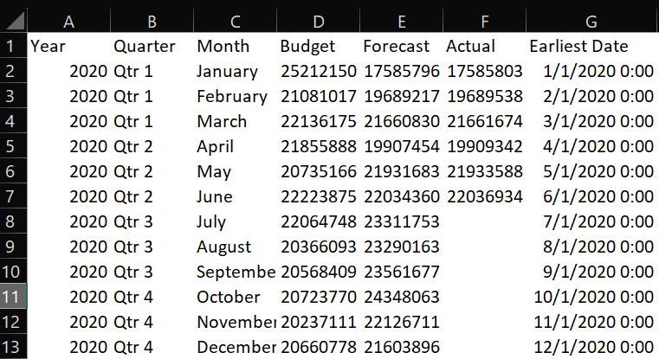
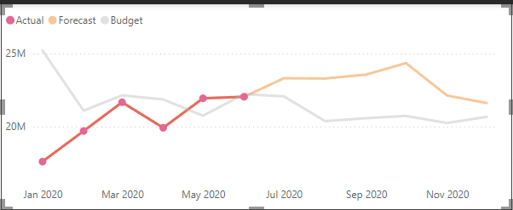
EXPLORATORY DATA ANALYSIS
BUDGET Vs ACTUAL Vs FORECAST
INSIGHT:
Analyzing the budgeted, forecast, and actual data across quarters in 2020 highlights several important trends and insights in retail financial performance:

Slide 6
1.
Q1 (January - March):
Close Alignment in Forecasts and Actuals: In Q1, forecasted and actual values are closely aligned, with minor differences. Actuals slightly exceed forecasts, suggesting accurate forecasting for early 2020, possibly reflecting stable demand during this period.
Budget vs. Actual Variances: Actuals are consistently below budget across Q1, with January showing a notable gap. This indicates that initial budget expectations may have been optimistic or set higher than achievable during this period.
2.
Q2 (April - June):
Increased Accuracy in Forecasts: Forecast values in Q2 are closely matched with actuals, with a slight positive variance in May and June, where actuals slightly exceeded forecasts. This consistency suggests well-aligned planning.

Slide 7
Recovery in May and June: In April, actuals are significantly lower than budget, likely impacted by economic shifts or seasonality, but recovery occurs in May and June. This may indicate effective demand adjustments as the quarter progressed, reflecting adaptability in retail operations.
3.
Q3 (July - September):
Forecasting but Missing Actuals: Q3 has forecast data, but actuals are missing, potentially due to data collection issues or external factors interrupting the reporting process. Without actuals, it is challenging to validate forecast accuracy, making it essential to investigate any reporting gaps for a comprehensive analysis.
Higher Forecasts in Q3: Forecasts rise notably compared to Q2, possibly in response to anticipated demand peaks, reflecting expectations of growth. This period may have targeted strategic campaigns or anticipated seasonal increases in demand.
4.
Q4 (October - December): Rising Forecasts Across the Quarter: Forecasts continue to increase each month, reaching the highest point in October and November. This suggests a strategic focus on year-end sales and holiday demand expectations, likely factoring in traditional Q4 retail performance boosts.

Slide 8
Absence of Actual Data: Similar to Q3, actuals are missing in Q4, which again complicates the ability to validate forecast accuracy and budget alignment. Reinstating actuals for these months would provide valuable insights into whether high forecasts were met, exceeded, or fell short.

Slide 9
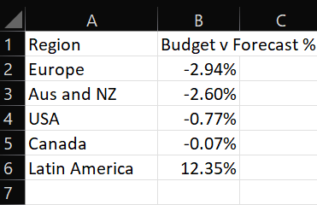
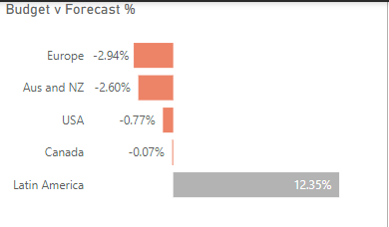
BUDGET Vs FORECAST %
INSIGHT:
Analyzing the "Budget vs. Forecast %" for each region reveals key insights into financial performance expectations and variances across global markets:
1. Negative Variances in Europe, Australia & NZ, USA, and Canada:
Europe (-2.94%) and Australia & NZ (-2.60%): These regions show the largest negative variances, with forecasts below budget. This could indicate that market conditions in these areas were overestimated, potentially due to slower economic growth, changes in consumer behavior, or regional challenges.

Slide 10
Adjusting budgets closer to forecasts in these regions could improve alignment and help avoid inflated expectations.
USA (-0.77%) and Canada (-0.07%): The smaller negative variances suggest these markets have forecast values that are closely aligned with budgets, indicating a more stable and predictable performance. The minimal difference in Canada especially highlights an accurate forecasting approach in that market, possibly due to strong, stable demand or effective budget planning.
2. Positive Variance in Latin America (12.35%):
Latin America shows a significant positive variance, with forecasted results surpassing the budget by 12.35%. This variance implies strong performance in this region, potentially due to growth opportunities, favorable economic conditions, or under-budgeting relative to demand. This positive trend could indicate a high-growth opportunity market, warranting increased investment or revised budgeting strategies to capitalize on this potential.

Slide 11
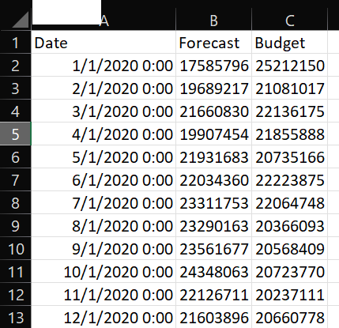
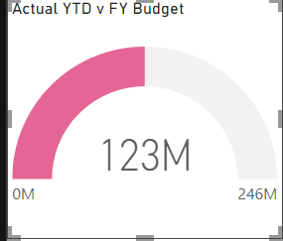
FORECAST AND BUDGET BY DATE
INSIGHT:
Analyzing the monthly forecast and budget data from January to December 2020 reveals several insights into the forecasted vs. budgeted trends:

Slide 12
1. Initial Underperformance (January - April):
The forecasted figures are consistently lower than the budget from January through April, indicating an underperformance against the budget during the first four months of 2020. For example, January shows a significant gap with a budget of 25,212,150 compared to a forecast of 17,585,796. This trend may suggest that initial expectations were optimistic, possibly due to unexpected market challenges or overestimation in budgeting.
2. Shifts to Overperformance Starting in May:
From May onward, the forecast begins to either align closely or exceed the budget, with forecasted figures surpassing budget amounts from May to December. This shift suggests either improved performance or better alignment with realistic budgeting as the year progressed. For instance, in July, the forecast was 23,311,753, well above the budget of 22,064,748.
3. Steady Forecast Exceeding Budget in the Second Half:
The forecasted values remain consistently higher than the budget from July through December, indicating a stable period of exceeding budget expectations. This sustained positive variance suggests a possible adjustment in strategy that allowed for better-than-expected performance in the latter half of the year.

Slide 13
4. Consistent Growth from August to October:
Forecasted values steadily increase each month from August (23,290,163) to October (24,348,063), indicating strong growth momentum in the third quarter. This could imply a peak performance period, possibly due to seasonal factors, increased demand, or successful initiatives.
5. Closing the Year with Lower Forecasts than Prior Months:
November and December show a slight dip in forecasted values compared to the October peak, but still above the budget. This suggests a seasonal slowdown as the year-end approaches but maintains positive performance relative to budget.

Slide 14
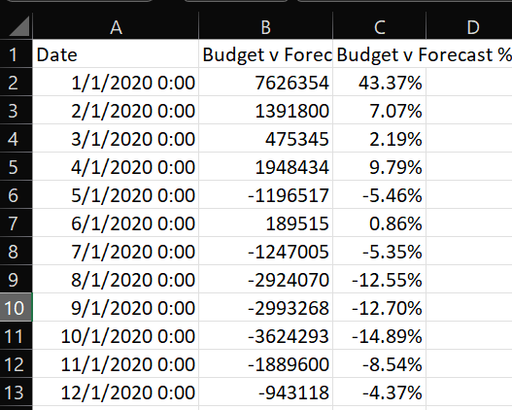
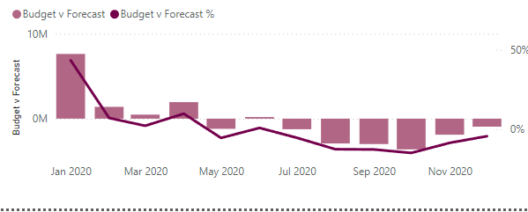
BUDGET Vs FORECAST_BUDGET Vs FORECATS %
INSIGHT:
The analysis of monthly budget vs. forecast discrepancies (both in absolute terms and as percentages) from January to December 2020 reveals key insights about the forecasting accuracy, seasonality, and the direction of variance between budgeted and forecasted figures:

Slide 15
Significant Positive Variance in Early 2020 (January - April):
January has the highest positive variance, with the forecast falling 43.37% below the budget. This difference (7,626,354) highlights a substantial overestimation in the budget, which continues in February (7.07%) and March (2.19%), although to a lesser degree. This early trend indicates that the budgeting assumptions may have been optimistic relative to market conditions.
2. Shift to Negative Variance from May Onwards:
Beginning in May, forecasted figures begin to exceed budgeted figures, resulting in negative variances, such as -5.46% in May. This pattern of over-performance against budget persists throughout the rest of the year, suggesting a notable shift, possibly due to operational or market improvements that allowed actual performance to exceed initial expectations.
3. Worsening Negative Variance in Q3 (July - September):
Negative variance increases significantly in Q3, peaking in September with a -12.70% difference (a 2,993,268 shortfall in budget vs. forecast). This steady increase in variance might reflect strong seasonal performance or adjustments that led to sustained outperformance, possibly linked to higher demand or efficiency gains.

Slide 16
4. Largest Negative Variance in October:
October shows the highest negative variance, with forecasted values exceeding budget by 14.89% (a gap of 3,624,293). This peak could indicate a particularly strong demand period or unexpected gains that led to forecasts surpassing the budgeted figures by a wide margin.
5. Decrease in Negative Variance in November and December:
The negative variance decreases in the final two months of the year, ending with a smaller discrepancy in December (-4.37%). This reduction suggests a slowdown or alignment in forecasted vs. budgeted expectations toward the year-end.

Slide 17
RECOMMENDATION
Based on the detailed insights, here are key recommendations to improve retail financial performance, forecasting, and budgeting practices:
Refine Budgeting Targets for Realistic Expectations:
The early-year discrepancies between budget and actual performance indicate that initial budgets may have been set too high. Consider aligning future budgets closer to historical and observed trends to set realistic, achievable targets.
For example, Q1 budgets could be adjusted downward to better reflect conservative early-year demand patterns, minimizing large positive variances.
Implement Dynamic, Mid-Year Budget Adjustments:
Given the shift from underperformance to overperformance starting in May, a mid-year budget review process could be beneficial. This approach would allow for adjustments based on actual trends, aligning budget expectations with current market dynamics.
Adding a formal reforecasting stage mid-year can capture adjustments based on H1 performance and anticipated H2 growth, ensuring that budgets stay relevant and achievable.

Slide 18
4. Enhance Forecasting Models with Seasonal Adjustments:
Seasonal trends, especially with the consistent increase in forecasts from August to October, suggest the need to incorporate seasonality into forecasting models. Adjusting for demand peaks (like those seen in Q3) can improve forecast accuracy and enable proactive planning for inventory, staffing, and marketing.
Develop seasonally adjusted forecast models that consider both year-end holiday peaks and typical slower periods to better align forecasts with demand cycles.
5. Address Data Gaps in Q3 and Q4 for Comprehensive Analysis:
The absence of actual data for Q3 and Q4 limits the ability to assess the accuracy of high forecast expectations during peak periods. Ensuring comprehensive data collection and reporting for all months is essential to validate forecasts, analyze variances, and plan effectively for year-end performance.
Invest in data integrity processes, perhaps incorporating automated data validation checks, to ensure that actual data is consistently captured across all periods.

Slide 19
6. Optimize Resource Allocation for Peak Performance Periods:
With consistent growth seen in Q3 and a slight dip in Q4, resource allocation should align with these performance trends. Prioritize marketing and operational resources during peak times (August through October) and scale down in slower periods to maximize efficiency and ROI.
Budgeting for specific growth strategies, like seasonal promotions or targeted advertising, during peak demand periods can amplify the impact of these strategies and further enhance overperformance.
7. Implement Continuous Forecast Adjustments:
As seen from October to December, the gradual narrowing of forecast-to-budget variances shows that real-time adjustments to forecasts may improve alignment with actual performance. Establish a process for ongoing forecast updates, perhaps quarterly or bi-annually, to respond to shifts in market conditions and demand trends.

