Slide 1
EXPLORATORY DATA ANALYSIS ON HR

Slide 2
TABLE OF CONTENTS
INTRODUCTION…………………………………………………………………………………… 3
DATA CLEANING AND PREPARATION……………………………………………………. 4
SUMMARY OF STATISTICS……………………………………………………………………. 5
CATEGORICAL ANALYSIS………………………………………………………………………. 11
COMPARATIVE ANALYSIS……………………………………………………………………… 14
VISUALIZATIONS…………………………………………………………………………………… 18
RECOMMENDATION……………………………………………………………………………… 20

Slide 3
INTRODUCTION
The dataset provided for this project contains information about employees from an organization, with each row representing an individual employee's data. It consists of the following columns:
Gender: Indicates the gender of the employee, with entries including Male, Female, and Other.
Age: Age of the employee in years.
Rating: Performance rating of the employee, classified as Exceptional, Above-average, Average, or Poor.
Date Joined: The date when the employee joined the organization, recorded in a standard date format.
Department: Department within the organization to which the employee is assigned, such as Website, Procurement, Finance, Sales, and HR.
Salary: The annual salary of the employee, given in USD with currency formatting.
Country: The country code for the employee's location, here all are labeled as IND and NZL, indicating both India and New Zealand.
This dataset is suitable for exploratory data analysis (EDA) as it includes both categorical and numerical variables that allow for a range of insights. Analyses can focus on salary distribution across departments, gender-based comparisons, the relationship between performance ratings and salary, and tenure trends based on the date of joining.

Slide 4
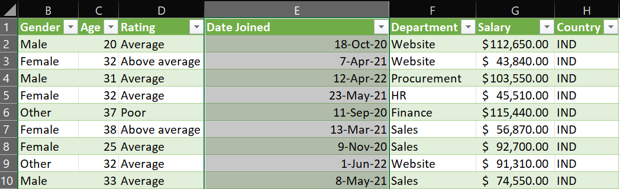
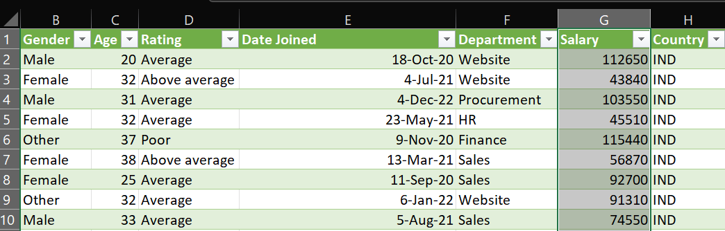
DATA CLEANING AND PREPARATION
Convert Date Format
Ensure the Date Joined column is in date format to allow for chronological analysis
Remove Currency Symbols: Remove the “$” symbol from the Salary column and convert it to a numeric format.

Slide 5
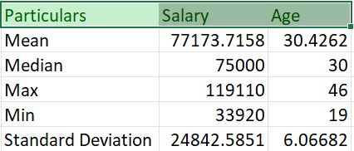
SUMMARY OF STATISTICS
Descriptive Statistics
Use Excel's tool to generate insights on age and salary. This provides mean, median, min, max, standard deviation, etc., for a quick overview.
INSIGHT:
From this data summary, here are some insights:
1. Mean Salary and Age:
The average salary is approximately $77,174, with an average age of 30.4 years. This suggests that, in general, the employees are in their early 30s and earning around $77,000.

Slide 6
2. Salary and Age Distribution:
The median salary is $75,000, very close to the mean. This indicates a relatively balanced salary distribution without extreme outliers heavily skewing the data.
The median age is 30 years, which aligns closely with the mean age, suggesting a balanced age distribution as well.
3. Salary Range:
Salaries range from $33,920 to $119,110. The minimum salary is less than half the mean, while the maximum salary is nearly 1.5 times the mean. This indicates a broad salary range within the company, possibly reflecting varying levels of experience or roles within different departments.
4. Age Range:
The ages range from 19 to 46 years, indicating a workforce spanning early-career individuals to those approaching mid-career or senior positions.
5. Standard Deviation:
The salary standard deviation is around $24,843, which is relatively high. This shows significant variation in salaries, likely reflecting different job levels, seniority, and department-specific compensation.
The age standard deviation of 6.07 years indicates moderate age variation, showing a mix of employees at different career stages, with most clustered around the average age.

Slide 7
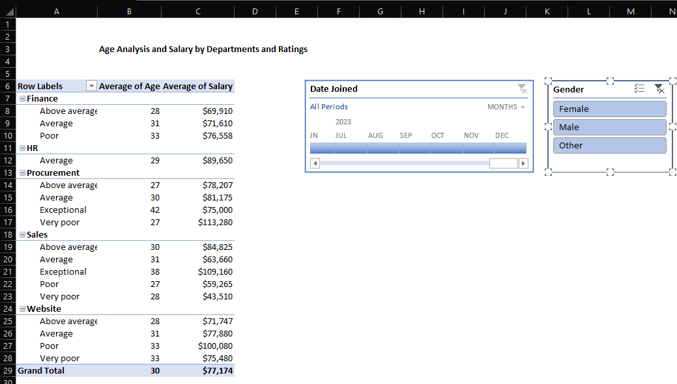
Overall Insights:
This dataset reflects a diverse workforce, both in terms of age and salary. The broad range in salaries and age suggests the organization has a mix of entry-level, mid-career, and experienced employees across potentially varying roles and departments.
Analysis of Age and Salary across Different Ratings and Departments

Slide 8
INSIGHT:
This summary provides insights into how age and salary vary by rating and department:
Finance Department:
Average Salary and Age: Employees rated "Average" and "Above Average" are younger (around 28–31) with moderate salaries (~$69,910–$76,558).
Poor Ratings: Employees with a "Poor" rating are slightly older (33 years) and earn a higher average salary, which might suggest longer tenure or higher experience, though perhaps with performance issues.
HR Department:
High Average Salary: HR employees rated "Average" earn a relatively high salary ($89,650) compared to other departments. This might indicate that HR roles are valued or require higher qualifications, even for those with an average rating.
Procurement Department:
Varied Ratings:
The "Very Poor" rating in Procurement shows an unusually high salary of $113,280 for an average age of 27. This anomaly could suggest a specialized or senior-level role that experienced performance issues but still commands a high salary.

Slide 9
Exceptional Rating: Employees rated "Exceptional" are the oldest group (42 years), possibly reflecting senior or experienced roles with moderate salaries ($75,000).
Overall Salary Range: The average salaries across ratings are fairly consistent, around $75,000–$81,175.
4. Sales Department:
Exceptional Ratings: Employees with an "Exceptional" rating are older (38 years) with a higher average salary ($109,160), reflecting that experience and high performance may lead to top earnings in Sales.
Very Poor Ratings: The "Very Poor" rating shows the lowest average salary in Sales ($43,510), indicating that lower performance here is associated with lower compensation.
Salary Range by Performance: Sales shows the largest variance in salary by performance rating, from $43,510 to $109,160.
5. Website Department:
Poor Ratings with Higher Salaries: Website employees with a "Poor" rating average a higher salary ($100,080), which might imply roles with higher starting pay or tenure-based increases despite performance challenges.

Slide 10
Key Insight:
Performance ratings impact salaries differently by department, with Sales and Website showing stronger ties between performance and pay, while Procurement and HR appear more influenced by role or tenure. High salaries among poorly rated employees in Website and Procurement departments may reflect specialized roles or tenure-based pay.

Slide 11
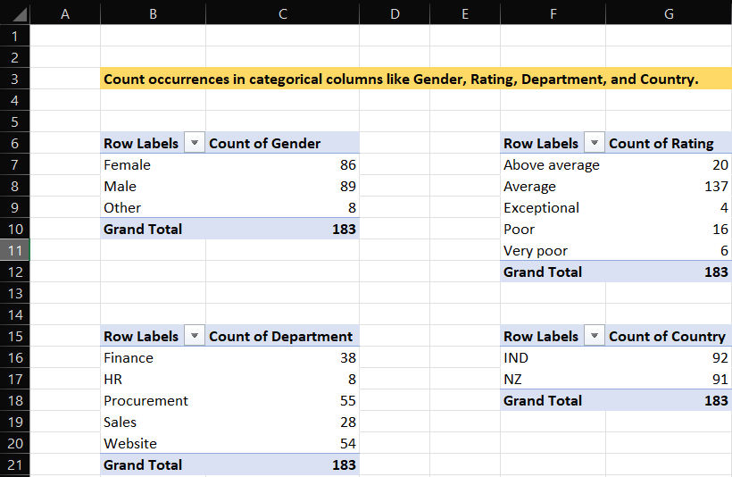
CATEGORICAL ANALYSIS
INSIGHT:
From the summary, here are key insights on the distribution across Gender, Rating, Department, and Country:
Gender Distribution
Male and Female employees are nearly evenly distributed, with Male employees at 89 and Female employees at 86.

Slide 12
Other gender identities make up a smaller portion, with 8 employees.
Insight: The gender distribution is fairly balanced between Male and Female, though individuals identifying as Other are underrepresented.
Rating Distribution
The majority of employees, 137 out of 183, have an Average rating.
20 employees are rated as Above Average, while only 4 are rated Exceptional.
16 employees have a Poor rating, and 6 have a Very Poor rating.
Insight: Most employees fall into the Average rating category, with fewer employees in the Above Average or Exceptional categories, suggesting room for performance improvement.
Department Distribution
Procurement has the largest number of employees with 55 people, followed by Website with 54 and
Finance with 38.
HR has the lowest representation at 8 employees, and Sales has 28.
Insight: The largest departments, Procurement and Website, likely reflect priority areas for the organization. The relatively small HR department may imply limited human resources functions compared to other operational areas.

Slide 13
Country Distribution
There is an even distribution across countries, with 92 employees in India (IND) and 91 in New Zealand (NZ).
Insight: The organization has balanced its workforce across the two countries, potentially indicating parallel operational bases or a focus on maintaining diversity in location.
This breakdown provides an overview of workforce composition across these key attributes,
highlighting areas for potential resource adjustments or performance development strategies.

Slide 14
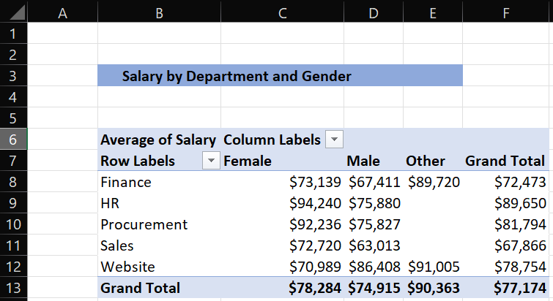
COMPARATIVE ANALYSIS
Salary by Department and Gender
INSIGHT:
This table of average salary by department and gender provides insights into salary trends across the company, revealing some potential disparities and patterns:
Gender Salary Gaps by Department:
In Finance and Procurement, females have a higher average salary than males ($73,139 vs. $67,411 in Finance and $92,236 vs. $75,827 in Procurement).
In Sales, females again earn more on average ($72,720 vs. $63,013 for males), showing a notable difference.

Slide 15
In Website, however, males ($86,408) and other gender categories ($91,005) have higher average salaries than females ($70,989), indicating a reverse pattern.
2. Department-Wise Salary Disparities:
HR shows the highest average salary for females at $94,240, indicating this department may offer a higher salary range for this gender.
Website has the highest average salary for other gender categories at $91,005, suggesting greater earning potential in this department across diverse gender groups.
3. Overall Salary Patterns:
The Grand Total shows that "Other" gender averages the highest salary overall at $90,363, followed by females at $78,284, and males at $74,915.
Departments like Procurement and HR offer some of the highest average salaries for females, while Website is comparatively lucrative for males and other gender categories.
This insight can inform HR about potential areas where gender pay equity should be reviewed, particularly in departments like Website, where females appear to earn less on average.

Slide 16
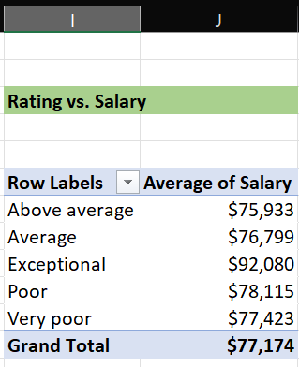
Rating vs. Salary
INSIGHT:
The insights from this PivotTable reveal subtle differences in average salaries across different performance ratings:
Higher Salaries for Exceptional Ratings:
Employees with an "Exceptional" rating have the highest average salary at $92,080. This indicates that the organization may reward top-rated employees with notably higher salaries, likely to incentivize exceptional performance.

Slide 17
2. Narrow Salary Range Across Other Ratings:
For the other ratings, such as "Above average," "Average," "Poor," and "Very poor," the average salaries range more narrowly between $75,933 and $78,115, with "Poor" employees averaging slightly more than "Above average" employees. This suggests that performance ratings may have less influence on salary differences outside of the "Exceptional" category.
3. Minimal Salary Differentiation Across Most Ratings:
The minimal variation among non-exceptional ratings could point to a relatively flat salary structure where salaries aren’t strongly differentiated by performance rating for the majority of employees.
4. Grand Total Below the Exceptional Rating:
The overall average salary ($77,174) sits below the average salary of employees rated "Exceptional," highlighting that only top-performing individuals receive a significant salary increase, while others maintain a similar pay level.
This pattern suggests a structured incentive for exceptional performers but a relatively uniform salary structure for other performance levels.

Slide 18
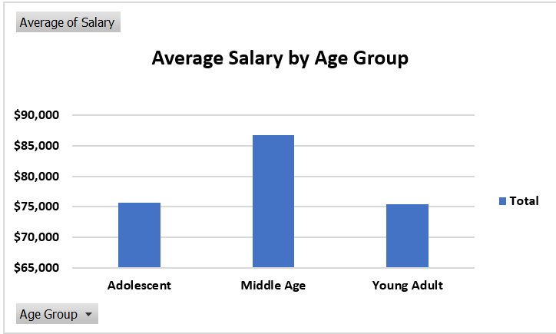
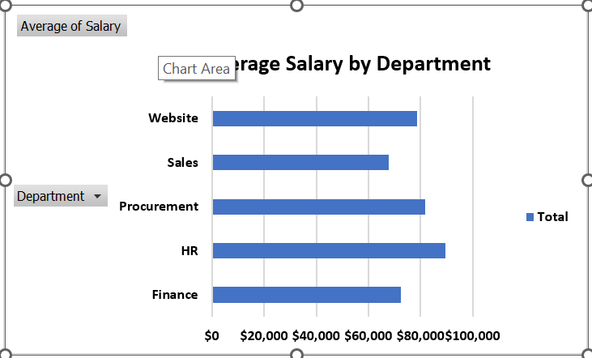
VISUALIZATIONS
Age and Salary Distribution
Department-Wise Average Salary

Slide 19
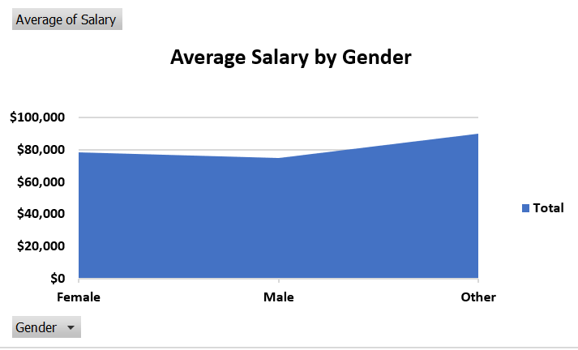
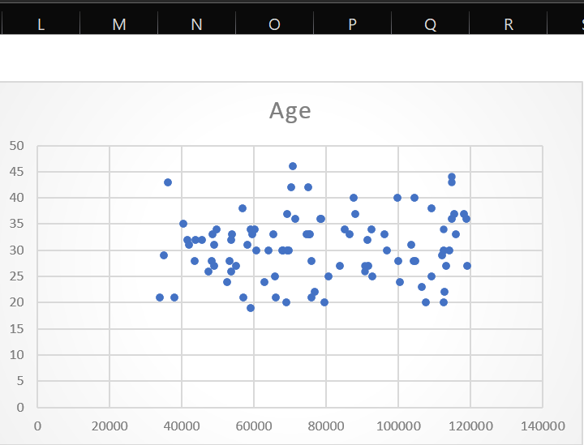
Gender vs. Salary by Rating
Correlation Scatter Plot

Slide 20
RECOMMENDATION
Based on these insights, here are recommendations for the organization to address salary patterns, gender pay equity, performance incentives, and employee retention strategies:
1. Review Gender Pay Equity:
Evaluate Gender Disparities in Website Department: Females in the Website department earn significantly less than males and other gender categories. Investigate whether this is due to role distribution, experience, or potential biases. Adjust salary structures if needed to ensure equitable pay across genders.
Consider Structured Pay Reviews for Procurement and Finance: Females earn more than males in Procurement and Finance, but it’s essential to understand the cause. This could be due to specific roles or levels held by gender groups; if not, standardizing pay bands might help address any unintended disparities.
2. Align Salary and Performance Ratings:
Revisit Pay Structure for “Above Average” and “Poor” Ratings: Employees with “Poor” ratings in Finance and Website departments are earning slightly more than “Above Average” performers, which could impact motivation for mid-tier performers. A clearer link between performance and pay, especially for non-exceptional ratings, might help enhance productivity and morale.
Increase Performance-Based Incentives for Exceptional Performers in Procurement: Procurement has experienced employees with “Exceptional” ratings who earn moderate salaries. Offering performance bonuses or additional benefits might help retain these experienced high performers.

Slide 21
3. Optimize Compensation for Age and Experience:
Review High Salaries for Poor Ratings in Procurement and Website: High salaries in these departments for poorly rated employees could indicate tenure-based pay scales or specialized roles where compensation is less performance-dependent. Consider whether these roles would benefit from performance-based incentives or training programs to elevate their ratings and align their contributions with compensation.
Develop Salary Progression Paths in Sales: Sales shows a wide salary range by performance rating, with "Exceptional" ratings yielding significantly higher earnings. Ensure that high-performing employees have a structured progression path to maintain their engagement, while lower-rated employees receive targeted performance support or training.
4. Address Broad Age Range with Targeted Career Development:
Implement Development Programs for Younger Employees: Given the relatively young workforce (average age 30.4 years), offering professional development opportunities for career growth can help retain early-career employees and encourage long-term engagement.
Consider Succession Planning for Senior Employees in Sales and Procurement: Older, highly rated employees in these departments are likely senior staff. Establish mentorship or knowledge-sharing programs to prepare younger team members for future leadership roles.

Slide 22
5 . Ensure Transparency in Compensation:
Enhance Clarity in Pay Structure: Given the varying salary structures across departments and the minimal differentiation between most performance ratings, transparency around compensation decisions and career advancement opportunities could enhance trust and clarity within the organization.
Regular Compensation Audits: Conduct annual audits to continually monitor pay equity across gender, role, department, and performance ratings, addressing any emerging disparities proactively.
6. Tailor HR Initiatives by Department:
Focus on Retention in High-Salary Departments like HR and Procurement: With HR and Procurement offering some of the highest average salaries, ensure these departments maintain high levels of employee engagement through regular feedback, development, and performance recognition.
Encourage Continuous Improvement in Departments with Flat Salary Structures: For departments with relatively flat salary ranges despite different performance ratings, such as Sales and Website, consider introducing skill-enhancement training or flexible pay bands that better reward incremental improvements and achievements.

