Slide 1
EXPLORATORY DATA ANALYSIS ON SOCIAL MEDIA USAGE AND EMOTIONAL STATE OF USERS

Slide 2
TABLE OF CONTENTS
INTRODUCTION……………………………………………….. 3
DATA PREPARATION………………………………………… 4
DESCRIPTIVE STATISTICS………………………………… 5
CATEGORIZATION OF VARIABLES……………………... 7
MEAN ANALYSIS……………………………………………….. 13
GROUP COMPARISONS………………………………………. 16
VISUALIZATIONS……………………………………………….. 18
RECOMMENDATION…………………………………………… 22

Slide 3
INTRODUCTION
This unique dataset was meticulously researched and prepared by AI Inventor Emirhan Bulut. This dataset captures valuable information on social media usage and the dominant emotional state of users based on their activities. The dataset is ideal for exploring the relationship between social media usage patterns and emotional well-being.

Slide 4
DATA PREPARATION
For this project, I leverage on Kaggle.com to retrieve this dataset, which contains a rich trove of information regarding the usage of social media and the dominant emotional state of users based on their activities, offering valuable opportunity to extract meaningful insights. After which unwanted records were removed, and a new record with a titled column: “Age Bracket” was created. The ‘transformed’ dataset is then imported into IBM SPSS, where our exploratory data analysis is being carried out.

Slide 5
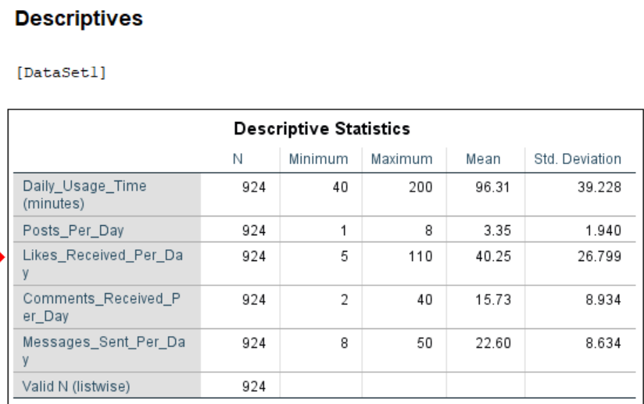
DESCRIPTIVE STATISTICS
INSIGHT This descriptive statistics table provides insights into social media usage patterns based on several metrics: Daily Usage Time, Posts Per Day, Likes Received Per Day, Comments Received Per Day, and Messages Sent Per Day. Here’s a closer look at the insights.

Slide 6
1. Daily Usage Time Mean: 96.31 minutes per day, with a standard deviation of 39.228 minutes Range; Usage time varies from 40 minutes (minimum) to 200 minutes (maximum). Insight: Most users are spending an average of about 1.5 hours daily, with substantial variation. A high standard deviation indicates that usage time differs significantly among users, with some spending much longer than others, possibly indicating varying levels of user engagement.
2. Posts Per Day Mean: 3.35 posts, with a standard deviation of 1.940. Range: From 1 to 8 posts daily. Insight: The average user posts about 3 times per day, with relatively low variability. This suggests a consistent posting behavior across users. Users who post more frequently than the average (near 8 posts) may be highly active or influencers.
3. Likes Received Per Day Mean: 40.25 likes, with a standard deviation of 26.799. Range: From 5 to 110 likes daily.
Insight: Users receive an average of 40 likes per day, but the high standard deviation indicates significant variation in engagement levels. Some users are likely receiving substantially more likes, possibly indicating higher popularity or more engaging content.

Slide 7
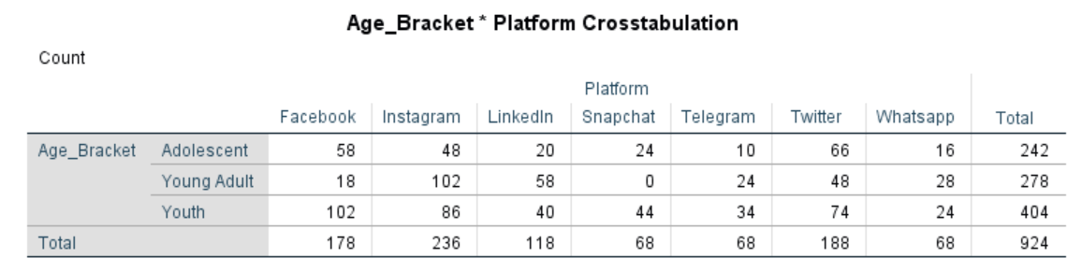
CATEGORIZATION OF VARIABLES
INSIGHT: This crosstabulation provides insights into social media platform usage across different age brackets: Adolescent, Young Adult, and Youth. Here’s an analysis based on the counts for each platform within each age bracket:
1. Platform Popularity Across Age Brackets Instagram: The most popular platform among all age brackets, especially among Young Adults (102) and Youth (86). This indicates that Instagram appeals broadly across these younger demographics, likely due to its visual and interactive content.

Slide 8
Facebook: Also widely used, especially by Youth (102) and Adolescents (58). Despite perceptions of Facebook being used less by younger demographics, this data shows it retains popularity among Youth, potentially for its connectivity features and groups. Twitter: Similarly popular across all age groups but is used most by Youth (74) and Adolescents (66), indicating an interest in platforms that allow quick, text-based interaction.
2. Age-Specific Platform Preferences Adolescents: Favor Twitter (66) and Facebook (58) more than other platforms, suggesting that these platforms meet their social interaction needs. Snapchat (24) and Instagram (48) are also relatively popular, highlighting an interest in platforms that offer visual content and real-time interaction. Young Adults: Have the highest usage of Instagram (102), followed by LinkedIn (58) and Twitter (48). The relatively high use of LinkedIn by Young Adults suggests they may be starting to focus on professional networking, while Instagram and Twitter remain top for social interaction.
Youth: Represent the largest group and show balanced use across all platforms. They are especially active on Facebook (102), Instagram (86), and Twitter (74), suggesting these platforms meet various social and informational needs. Snapchat and WhatsApp also show moderate use, likely for casual and private interactions.
3. Platform-Specific Insights LinkedIn: Primarily used by Young Adults (58), highlighting its appeal as a professional networking platform. It’s less used by Adolescents, which aligns with this age group being earlier in their academic or career paths.

Slide 9
Snapchat: Has moderate popularity among Youth (44) and Adolescents (24), indicating it appeals primarily to younger users who value visual, ephemeral content. Telegram and WhatsApp: Used consistently across all age brackets, albeit at lower rates. This shows these platforms are more specialized, perhaps for direct messaging or specific group communication needs rather than as primary social media platforms.
4. Total Platform Usage Patterns Instagram, Facebook, and Twitter are the top platforms overall, suggesting they are critical for broad-reaching engagement strategies. WhatsApp, Telegram, and LinkedIn see relatively lower but consistent use, which may imply that they serve more specific, supplementary roles in users' social media habits.
Summary Insights: Young Adults and Youth are the most active users on platforms like Instagram, Facebook, and LinkedIn, showing a blend of social and professional engagement. Adolescents lean towards platforms like Twitter and Facebook but still show interest in Snapchat and Instagram, suggesting a preference for visual content and real-time social interaction. Platform Usage Strategy: Brands and content creators targeting different age demographics could use Instagram and Facebook to reach a wide audience, while LinkedIn, Snapchat, and Twitter offer targeted engagement with specific age groups. These insights could help shape social media strategies, focusing on platform-specific content that resonates with each age bracket.

Slide 10
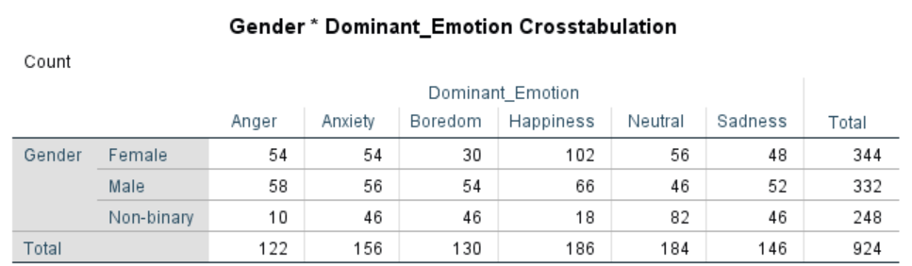
INSIGHT: This crosstabulation of Gender and Dominant Emotion provides insights into emotional expression patterns among different gender groups: Female, Male, and Non-binary. Here’s a breakdown of the observations:
1. Overall Emotion Distribution Happiness: The most frequently observed emotion (186), with more females (102) reporting happiness than males (66) or non-binary individuals (18). This suggests that happiness is a more prominent emotion among females in this sample. Neutral: The second most common emotion (184), with non-binary individuals showing the highest frequency (82). Neutral emotions may indicate a baseline emotional state or less intense emotion, particularly common among non-binary respondents. Anxiety and Sadness: Anxiety (156) and sadness (146) are both frequently reported emotions, suggesting significant levels of emotional distress or vulnerability across the sample.

Slide 11
2. Gender-Specific Emotional Patterns
Female: Highest reported emotion: Happiness (102), followed by Neutral (56) and Anxiety (54). Insight: Females display a higher occurrence of positive emotions (happiness) but also report notable levels of anxiety and sadness, suggesting a complex emotional profile where positive and negative emotions coexist prominently.
Male: Highest reported emotions: Boredom (54), Anxiety (56), and Anger (58), with relatively lower levels of happiness (66). Insight: Males in this sample report a wider spread across negative emotions like anger, boredom, and anxiety. The lower count for happiness may indicate emotional experiences are more skewed toward these other states.
Non-binary: Highest reported emotion: Neutral (82), followed by Anxiety, Sadness, and Boredom (46 each). Insight: Non-binary respondents display a high frequency of neutral emotions, potentially indicating less intense emotional expression or a higher baseline emotional state. The presence of significant anxiety and sadness may suggest unique stressors or emotional experiences specific to this group.
3. Patterns in Negative Emotions (Anger, Anxiety, Sadness) Anxiety: Commonly reported across all genders, particularly among non-binary individuals (46) and females (54).

Slide 12
Sadness: Also prevalent across genders, with non-binary individuals (46) and males (52) having similar sadness levels. Insight: Anxiety and sadness levels are considerable across all gender groups, possibly indicating widespread emotional challenges. This could suggest a need for mental health support or emotional resources across these groups. Summary Insights: Mental Health Focus: The high levels of anxiety and sadness across gender groups indicate a need for emotional well-being resources, particularly for males and non-binary individuals who report these emotions significantly. Emotional Support by Gender: Females may benefit from positivity-focused content, while males and non-binary individuals could find value in support for managing neutral or negative emotions. Program Development: Programs targeting emotional health could consider these patterns to address the specific emotional landscapes of each gender group effectively.

Slide 13
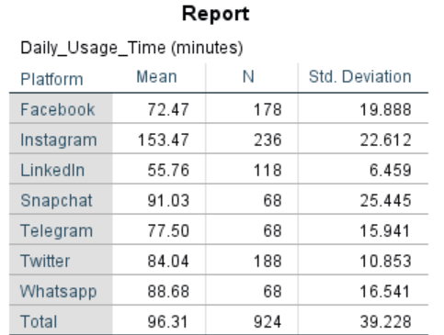
COMPARE MEAN ANALYSIS
INSIGHT:
This report provides insights into Daily Usage Time across different social media platforms, showing the average time spent per platform, number of users (N), and standard deviation. Here’s an analysis based on these statistics:
1. Most and Least Used Platforms Most Used Platform: Instagram, with an average of 153.47 minutes per day.

Slide 14
The high average usage time, coupled with a moderate standard deviation (22.612), suggests that users are highly engaged on Instagram. This platform has the largest user count (236), indicating it’s both widely popular.
2. Platform Engagement Patterns Moderate Usage Platforms: Platforms like Snapchat (91.03 minutes), Twitter (84.04 minutes), and WhatsApp (88.68 minutes) fall in the mid-range of daily usage times. This indicates that while these platforms see regular engagement, they don’t hold users’ attention for as long as Instagram. Facebook and Telegram: Both have moderate daily usage times (72.47 and 77.5 minutes, respectively), but with different levels of consistency. Facebook’s higher standard deviation (19.888) suggests more variability in usage among its users, while Telegram has a narrower range (15.941), indicating more uniform engagement.
3. Engagement Consistency (Standard Deviation) Most Consistent Platforms: LinkedIn and Twitter have the lowest standard deviations (6.459 and 10.853, respectively). This suggests that users generally spend a predictable amount of time on these platforms daily, possibly logging on briefly to check updates without prolonged engagement. Most Variable Platform: Snapchat shows the highest standard deviation (25.445), reflecting significant variation in daily use. This may indicate that users’ engagement with Snapchat depends on specific factors, such as interactions or viewing stories, which may vary widely day to day

Slide 15
4. Overall Usage Trends Average Usage Across All Platforms: The total average daily usage time is 96.31 minutes, with a standard deviation of 39.228. This indicates substantial variability, reflecting that while some users are highly engaged on platforms like Instagram, others engage in shorter, more intermittent use, especially on platforms like LinkedIn. Summary Insights: High Engagement: Instagram’s high average usage time and large user base highlight it as a major platform for daily engagement, making it key for strategies targeting extended user interaction. Consistent, Moderate Use: Twitter and LinkedIn show more consistent but moderate usage, ideal for regular updates or brief interactions rather than prolonged sessions. Targeted Platform Strategies: Understanding these usage times and consistencies can help optimize platform-specific strategies, such as more frequent, brief updates for LinkedIn and Twitter or immersive, engaging content on Instagram and Snapchat. These insights suggest different user behaviors across platforms, where Instagram and Snapchat attract long-duration engagement, while LinkedIn and Twitter see shorter, more consistent use.

Slide 16
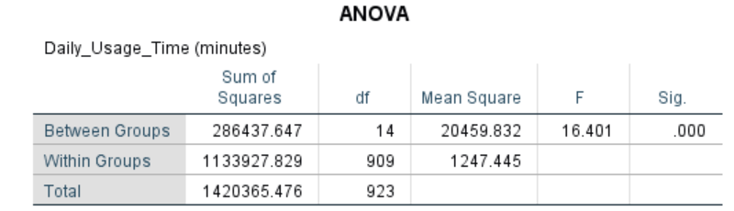
GROUP COMPARISONS
INSIGHT:
The ANOVA analysis for Daily Usage Time (minutes) provides insight into whether there are significant differences in daily usage times across different groups (likely the platforms). Here’s what the results suggest:
1. Statistical Significance (Sig. Value) p-value (Sig.): The p-value is .000, which is less than the standard significance level of .05. This indicates that the differences in daily usage time across the groups (platforms) are statistically significant. In other words, there is a statistically significant difference in how much time users spend daily on different platforms.

Slide 17
2. F-Statistic (F) F-Value: The F-statistic is 16.401, a relatively high value, indicating that the variability in daily usage time between groups (platforms) is large relative to the variability within each group. This reinforces the finding that daily usage time differs meaningfully across platforms.
3. Between-Group vs. Within-Group Variation Between Groups Sum of Squares (286,437.647): This represents the variation in daily usage time attributed to differences between platforms. A high value suggests that platforms are indeed associated with different daily usage times. Within Groups Sum of Squares (1,133,927.829): This reflects variation within each platform group, indicating individual differences in how much time people spend on each platform.
4. Practical Implications The results suggest that users engage with different platforms for significantly different amounts of time daily. Given the statistical significance, it’s likely that each platform’s unique features and user experience drive varied user engagement times. This can guide platform-specific engagement strategies, with content tailored to capture and retain attention according to each platform's typical usage pattern.

Slide 18
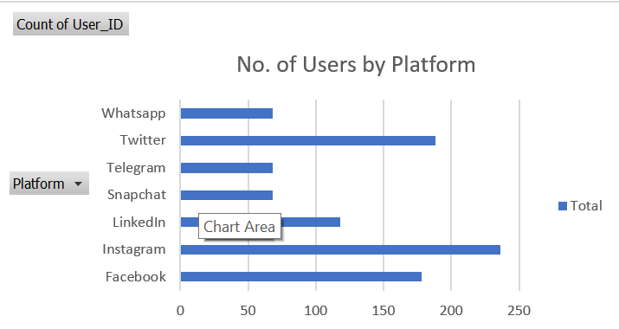
VISUALIZATIONS
1. Users VS Platform

Slide 19
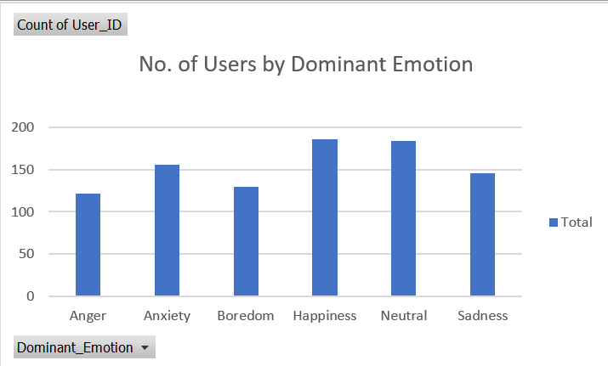
2. Users VS Dominant Emotion

Slide 20
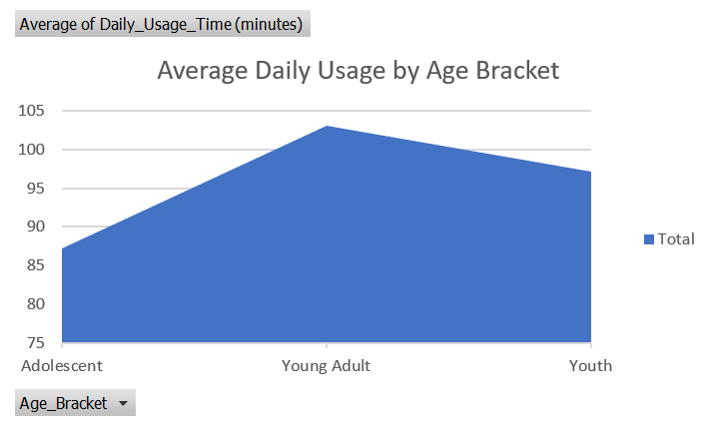
3. Daily Usage VS Age Bracket

Slide 21
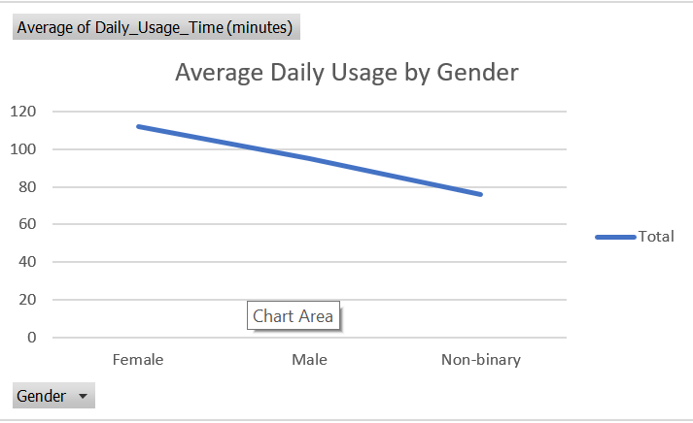
4. Daily Usage VS Gender

Slide 22
RECOMMENDATION
1. Platform-Specific Content Strategies Instagram: With high daily usage (153.47 minutes) and a large user base, prioritize visual and interactive content that captures users' attention for longer periods. Strategies could include: More interactive features like polls, Q&A, and stories that encourage daily engagement. Collaborations with influencers and micro-influencers to boost user interaction, given Instagram's active user base. LinkedIn: Lower daily usage time (55.76 minutes) suggests users quickly check updates or engage professionally. Prioritize: Concise, high-impact content, such as professional tips or industry insights. Regular updates at strategic times (e.g., morning or lunch breaks) to capitalize on shorter, consistent engagement periods.
2. Encourage Consistent Usage on Moderate-Engagement Platforms Snapchat, Twitter, and WhatsApp: Encourage daily use with features that fit their moderate engagement patterns (91.03, 84.04, and 88.68 minutes, respectively).
Snapchat: With high variability in usage, create time-sensitive content or exclusive stories to maintain daily engagement. Twitter: Regular, brief updates and real-time discussions (e.g., trending topics or live tweeting events) could drive consistent usage. WhatsApp: Promote groups and community chats to increase daily message engagement without overwhelming users.

Slide 23
3. Targeted Marketing Campaigns by User Engagement Levels Highly Engaged Users: Platforms with long daily usage times (Instagram and Snapchat) are ideal for promotional campaigns and brand storytelling. Leverage these platforms to build brand loyalty and deliver engaging, serial content. Less Engaged or Professional Users: Platforms like LinkedIn are better suited for targeted professional content, such as career-building resources, business news, and relevant ads during high-traffic hours.
4. Optimize for User Engagement Variability High Variability Platforms: Snapchat, with its highest standard deviation, should focus on time-limited, exclusive content that drives engagement spikes. Experiment with limited time promotions and engaging content that aligns with user interests. More Consistent Platforms: LinkedIn and Twitter, with low standard deviations, are better suited for a steady stream of predictable content—daily briefings, news updates, and key insights that encourage brief but consistent visits.
5. Enhance Direct Communication Features Given high usage on messaging platforms (e.g., WhatsApp and Telegram), enhance messaging features with functionalities like polls, inline replies, and multimedia sharing. This aligns with the observation that direct messaging plays a vital role in user interaction and retention

Slide 24
6. Segment Users Based on Usage Patterns for Targeted Outreach Differentiate users who exhibit high engagement (such as those who post and interact frequently) from low-engagement users. Tailor engagement strategies to retain high engagement users while implementing reminders, prompts, or easy navigation for less engaged users.
7. Cross-Platform Engagement Analysis for Broader Reach Understanding that users may spend more time on certain platforms, consider cross promoting content across these channels (e.g., a longer Instagram story that leads to a LinkedIn article). This can help retain users across multiple platforms and cater to different engagement preferences.
8. Leverage High-Likes and High-Comments Content Insights Posts that attract higher likes and comments reveal engagement trends and can inform content optimization for other platforms. Encourage content creators to replicate successful content themes, styles, and timing across multiple channels for consistency in user engagement. These recommendations provide a framework for leveraging user engagement data across social media platforms to optimize content, outreach, and platform-specific strategies, ultimately enhancing user retention and satisfaction

