Slide 1
EDA_agricultural_yield

Slide 2
TABLE OF CONTENTS
INTRODUCTION……………………………………………………….. 3
DATA PREPARATION………………………………………………….. 4
EXPLORATORY DATA ANALYSIS………………………………….. 7
RECOMMENDATION…………………………………………………. 18

Slide 3
INTRODUCTION
The science of training machines to learn and produce models for future predictions is widely used, and not for nothing. Agriculture plays a critical role in the global economy. With the continuing expansion of the human population understanding worldwide crop yield is central to addressing food security challenges and reducing the impacts of climate change.
Crop yield prediction is an important agricultural problem. The Agricultural yield primarily depends on weather conditions (rain, temperature, etc.), pesticides and accurate information about history of crop yield is an important thing for making decisions related to agricultural risk management and future predictions.
All dataset(publicly available dataset) here are taken form FAO (Food and Agriculture Organization) and World Data Bank. http://www.fao.org/home/en/ https://data.worldbank.org/

Slide 4
DATA PREPARATION
1. Create the Tables in MySQL Work Bench
CREATE TABLE Pesticides (
domain VARCHAR(50),
area VARCHAR(50),
element VARCHAR(50),
item VARCHAR(50),
year INT,
unit VARCHAR(50),
value DECIMAL(10, 2)
);
CREATE TABLE Rainfall (
area VARCHAR(50),

Slide 5
year INT,
average_rainfall_mm_per_year DECIMAL(10, 2)
);
CREATE TABLE Temperature (
year INT,
country VARCHAR(50),
avg_temp DECIMAL(10, 2)
);
CREATE TABLE Yield (
domain_code VARCHAR(10),
area_code INT,
area VARCHAR(50),
element_code INT,

Slide 6
element VARCHAR(50),
item_code INT,
item VARCHAR(50),
year_code INT,
year INT,
unit VARCHAR(50),
value DECIMAL(10, 2)
);
2. Insert Data
INSERT INTO PesticidesUse (domain, area, element, item, year, unit, value)
VALUES
('Pesticides Use', 'Albania', 'Use', 'Pesticides (total)', 1990, 'tonnes of active ingredients', 121),
('Pesticides Use', 'Albania', 'Use', 'Pesticides (total)', 1991, 'tonnes of active ingredients', 121),
-- Add remaining rows here;
Similar insertions were repeated for Rainfall, Temperature, and Yield.

Slide 7
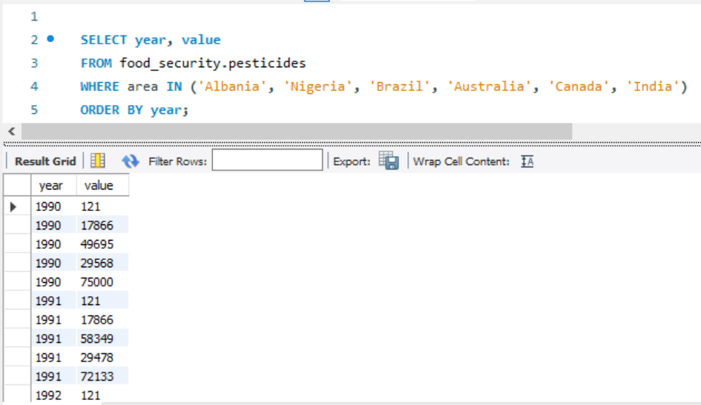
EXPLORATORY DATA ANALYSIS
Trend of Pesticides Use in Albania, Nigeria, Brazil, Australia, Canada and India over time

Slide 8
INSIGHT:
To analyze this data and gain insights, you could look at the following aspects:
Trends in Pesticide Use Over Time:
Look for any general trends in pesticide use in each country over the years. For instance, are there increasing or decreasing trends in specific countries? This could indicate changes in agricultural practices, regulations, or environmental concerns.
Comparison Between Countries:
Compare pesticide use between countries to see if certain countries have significantly higher or lower pesticide usage. For example, does India or Brazil have a higher pesticide usage compared to Canada or Australia? This could reflect different crop types, farming scales, and reliance on pesticides.
Yearly Fluctuations:
Identify any years with unusually high or low pesticide use for each country, which may indicate unusual
agricultural conditions, such as pest outbreaks, droughts, or shifts in policy affecting pesticide
application.

Slide 9
4. Correlation with Other Factors:
If other datasets are available (like crop yield, rainfall, or temperature data), you can investigate if higher pesticide use correlates with specific agricultural conditions. For instance, a drought year might show decreased pesticide use or vice versa.
5. Sustainability and Environmental Impact:
Countries showing a consistent or steep increase in pesticide use might be of concern from a sustainability perspective. Countries with stable or decreasing pesticide use could be shifting towards sustainable practices or more integrated pest management strategies.

Slide 10
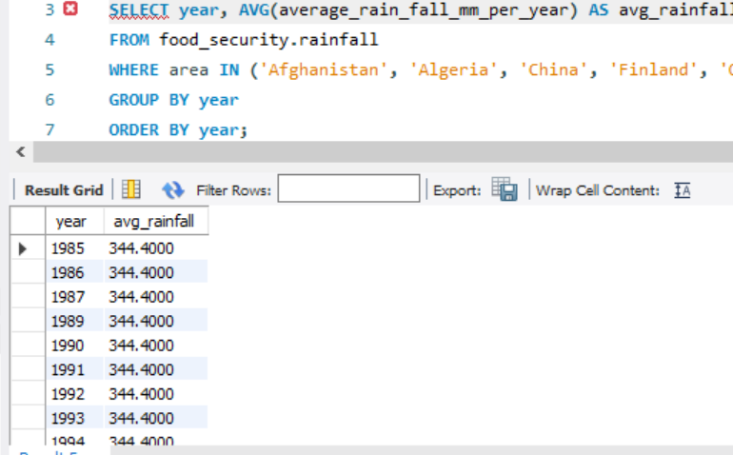
2. Average Rainfall Over the Years in Afghanistan, Algeria, China, Finland and Oman

Slide 11
INSIGHT:
Annual Trend in Rainfall:
You may see if average rainfall is increasing, decreasing, or staying stable over time for these countries collectively. For example, a steady decline could indicate broader regional droughts, while an increase might suggest wetter periods.
Climate Patterns:
If you compare the rainfall data to historical climate events (e.g., El Niño, La Niña), you might see correlation patterns. For example, some years might experience anomalies due to these climate events, leading to higher or lower than usual rainfall.
Regional Comparisons:
Although this query doesn’t break down rainfall by country within each year, the average could give a sense of how rainfall patterns for this group of countries might vary from global or other regional averages.
Variability in Rainfall:
By comparing individual country data (using a similar query without averaging across countries), you could assess if rainfall changes are evenly distributed or if certain countries contribute to the variability in average rainfall.

Slide 12
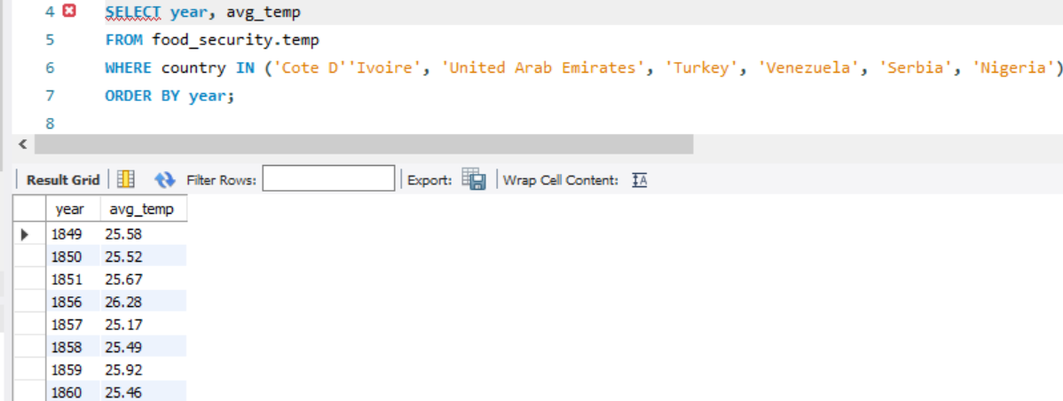
3. Average Temperature in Côte d'Ivoire, United Arab Emirates, Turkey, Venezuela, Serbia and Nigeria Over Time

Slide 13
INSIGHT:
This query retrieves the average temperature (avg_temp) for each year across six countries: Côte d'Ivoire, United Arab Emirates, Turkey, Venezuela, Serbia, and Nigeria. By ordering results by year, the query allows you to observe temperature trends over time for each country. Here are some insights you could derive from this data:
1. Temperature Trends Across Countries: Comparing the yearly average temperatures may reveal if certain regions experience similar temperature patterns, possibly due to shared climate characteristics or geographical proximity.
2. Climate Change Effects: If the average temperatures show a consistent upward trend over the years for most or all of these countries, it might suggest a warming trend, possibly linked to climate change.
3. Country-Specific Anomalies: Look for any unusual changes or anomalies in specific countries during particular years, which could indicate events like droughts, heat waves, or cold snaps.
4. Seasonal Consistency: If temperatures vary consistently within a predictable range year after year for some countries, it could indicate stable climate conditions.

Slide 14
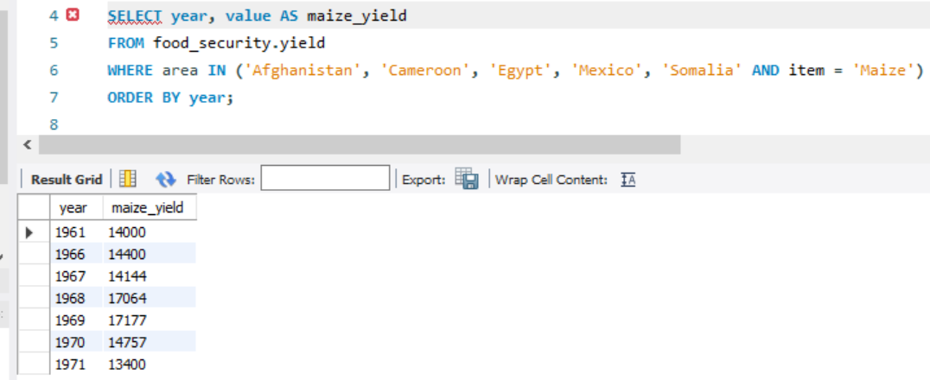
4. Maize Yield in Afghanistan, Cameroon, Egypt, Mexico and Somalia by Year

Slide 15
INSIGHT:
This query retrieves maize yield data (renamed as maize_yield) over time for Afghanistan, Cameroon, Egypt, Mexico, and Somalia. Here’s what insights you can extract:
Comparative Maize Productivity:
This data allows you to compare maize yield trends across the five countries, observing which countries have higher productivity and whether these trends shift over the years.
Identifying Growth Patterns:
If certain countries show consistent yield increases, it might indicate improvements in agricultural practices, investments, or favorable weather conditions.
Impact of Environmental and Economic Factors:
Drops or spikes in yields in particular years might be linked to external factors, such as droughts, conflict, or agricultural policy changes. For example, Somalia, often impacted by droughts, may have more variable yields compared to Egypt, which has more irrigation resources.
Potential Climate Impact:
A consistent downward or upward trend could hint at broader climate influences, especially if multiple countries exhibit similar changes over the same period.

Slide 16
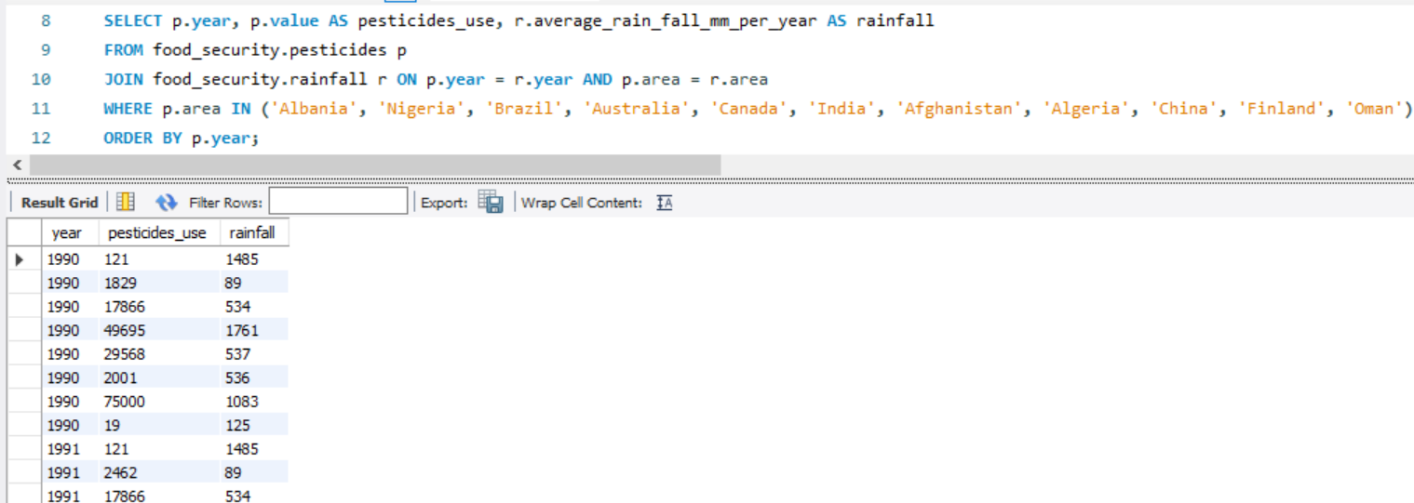
5. Comparing Pesticides Use and Rainfall in Albania, Nigeria, Brazil, Australia, Canada, India, Afghanistan, Algeria, China, Finland and Oman

Slide 17
INSIGHT:
This query combines pesticide use and average rainfall data for each selected country by year. Here’s what you can interpret:
Relationship between Pesticide Use and Rainfall:
By observing the values of pesticide use alongside rainfall, you might detect whether high rainfall years correlate with higher or lower pesticide use in each country. For example, heavier rainfall might reduce pesticide need due to reduced pest activity, or it could increase pesticide application due to higher crop productivity.
Country-Level Patterns:
Certain countries may show unique trends, such as increased pesticide use despite fluctuating rainfall, which could indicate reliance on pesticides regardless of weather conditions.
Potential Environmental Impact:
For countries with consistently high pesticide use and rainfall, there might be implications for water pollution or soil health, as increased pesticide runoff could affect ecosystems.
Agricultural Dependence on Climate:
Some countries may exhibit a more direct relationship between climate factors and pesticide use, which could reveal agricultural dependency on specific weather conditions.

Slide 18
RECOMMENDATION
The recommendations based on these insights should consider both immediate agricultural practices and broader environmental sustainability. Here are some tailored suggestions for each insight:
1. Pesticide Use and Rainfall Relationship
Promote Sustainable Pesticide Practices: For countries with high pesticide use and rainfall, encouraging integrated pest management (IPM) practices could reduce environmental impacts, such as pesticide runoff that may contaminate water bodies.
Monitor High-Rainfall Areas: For countries with high rainfall where pesticide use remains high, monitoring water quality in surrounding ecosystems is crucial to identify potential risks to biodiversity and public health.
2. Maize Yield Patterns
Invest in Climate-Resilient Farming: In countries like Somalia, where yields may be affected by drought, investments in drought-resistant maize varieties or better irrigation practices can stabilize yields.
Encourage Knowledge Exchange on Agricultural Best Practices: Countries showing consistent yield growth could share successful farming techniques with others, particularly around sustainable irrigation, fertilizer use, and crop rotation.

Slide 19
3. Temperature Trends and Climate Change Effects
Adaptation Measures for Rising Temperatures: Countries with upward temperature trends should consider adaptation measures, such as crop diversification and heat-resistant crop varieties, to maintain food security as temperatures rise.
Early Warning Systems for Temperature Extremes: In regions prone to anomalies, establishing early warning systems for heatwaves or cold snaps can help farmers prepare and minimize crop loss.
4. Annual Rainfall Trends
Water Management Programs: In areas where rainfall is decreasing, implementing efficient water management strategies (like rainwater harvesting or drip irrigation) can mitigate the impact of drought.
Climate Adaptation Planning: For countries showing more variability, broader climate adaptation plans that address water scarcity, irrigation infrastructure, and potential flooding risks are critical.
5. General Trends and Yearly Fluctuations in Pesticide Use
Regular Monitoring and Policy Adjustments: Countries with high pesticide usage might benefit from regular pesticide monitoring and revisiting policies on pesticide application to ensure that the practices align with sustainability goals.

Slide 20
Support for Organic and Reduced-Pesticide Farming: Encouraging organic farming and offering incentives to farmers who reduce pesticide use could promote sustainability while reducing environmental impacts.
6. Cross-Country Comparisons
Benchmarking and Policy Alignment: Comparing countries with lower pesticide usage and more stable yields to those with high usage can help create benchmarks and align agricultural policies towards more sustainable practices.
Resource-Sharing Initiatives: Countries with effective rainfall and temperature adaptation practices could lead training and resource-sharing initiatives for those facing more environmental challenges.
These recommendations aim to promote a balanced approach to maintaining agricultural productivity while safeguarding environmental and public health. Implementing sustainable practices, improving resource management, and fostering knowledge sharing will collectively strengthen food security and ecosystem health across these regions.

