Slide 1
EXPLORATORY DATA ANALYSIS ON Debt Sustainability OF Low Income Countries
TABLE OF CONTENTS
BACKGROUND……………………………………………………………………………………. 2
DATA COLLECTION…………………………………………………………………………………. 3
DATA MIGRATION…………………………………………………………………………………… 4
EXPLORATORY DATA ANALYSIS……………………………………………………………….. 7
RECOMMENDATION………………………………………………………………………………. 19

Slide 2
1. BACKGROUND
This project focuses on debt distress vulnerability classifications for thirty Sub-Saharan African countries that have been granted debt relief under the Heavily Indebted Poor Countries (HIPC) initiative. At the turn of the century, heavily indebted countries (most of which were located in Sub-Saharan Africa) were granted large-scale cancellations of external debt owed to the World Bank, International Monetary Fund, and African Development Bank. Since then, the debt sustainability of these countries has been closely monitored by the IMF and World Bank under the Debt Sustainability Analysis for Low Income Countries (DSA for LIC). This DSA has been conducted in Low-Income countries since 2005.This dataset contains the external debt distress classifications for 30 Sub-Saharan African countries that have been granted debt reductions under the HIPC scheme from 2005 to 2019. If there was no DSA conducted in a year, the DSA classification of the previous year is shown.

Slide 3
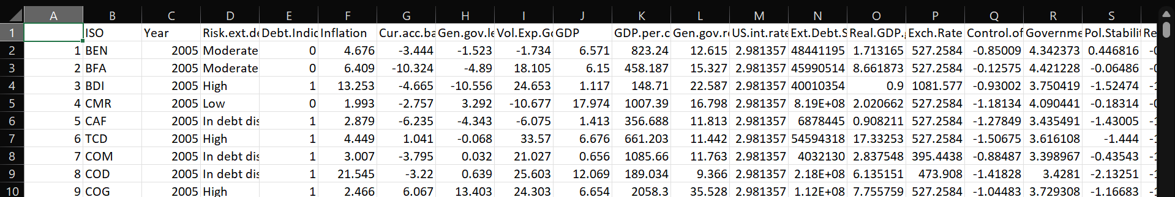
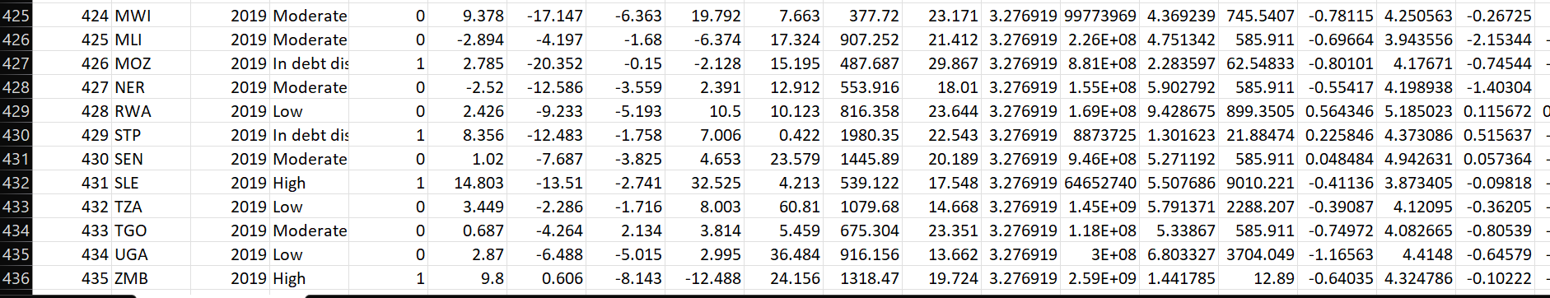
Data collection
The dataset for this project was sourced from Kaggle.com with the below sourced path:
African countries with risk of unsustainable debt (kaggle.com)
Also, there are screenshots of both the Header and Tail of the dataset in Excel format.

Slide 4
Data MIGRATION
The sourced dataset in Excel format is then imported into MySQL Work-bench, where data cleaning and exploratory data analysis (EDA) took place.
Creating a Table in MySQL
CREATE TABLE country_data (
id INT PRIMARY KEY,
country_code VARCHAR (3),
iso_year INT,
risk_ext_debt_distress VARCHAR (50),
debt_indicator TINYINT,
inflation FLOAT,
cur_acc_bal FLOAT,
gen_gov_len_bor FLOAT,
vol_exp_goods FLOAT,

Slide 5
gdp FLOAT,
gdp_per_cap FLOAT,
gen_gov_rev FLOAT,
ext_debt_serv FLOAT,
exch_rate FLOAT);
2. Inserting the Data
INSERT INTO country_data VALUES
(1, 'BEN', 2005, 'Moderate', 0, 4.676, -3.444, -1.523, -1.734, 6.571, 823.24, 12.615, 48441194.6, 527.2583626),
(2, 'BFA', 2005, 'Moderate', 0, 6.409, -10.324, -4.89, 18.105, 6.15, 458.187, 15.327, 45990513.7, 527.2583626),
(3, 'BDI', 2005, 'High', 1, 13.253, -4.665, -10.556, 24.653, 1.117, 148.71, 22.587, 40010353.8, 1081.577167),
-- Continue inserting all rows

Slide 6
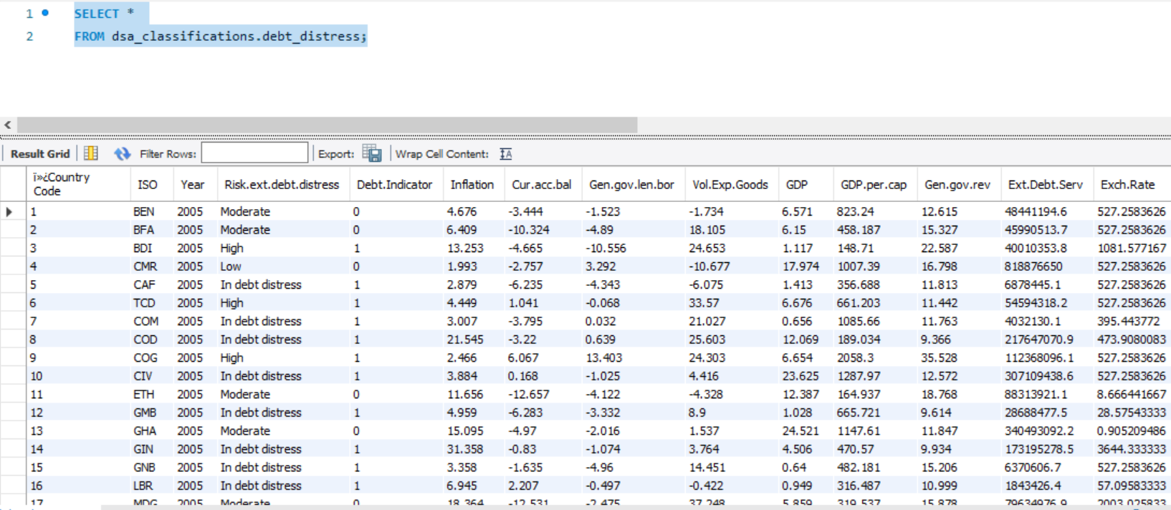
3. Structured dataset created on MySQL

Slide 7
EXPLORATORY DATA ANALYSIS
Once the data is being loaded into the MySQL, the following exploratory data analysis is to be carried out with SQL queries.
Furthermore, we shall be performing our analysis with the following outlines.
1. Determine the summary of statistics for some numerical columns
2. Assess the nature of debt risk.
3. Inflation and GDP correlation.
4. Ascertain some of the countries in debt distress.
5. Present yearly GDP growth.

Slide 8
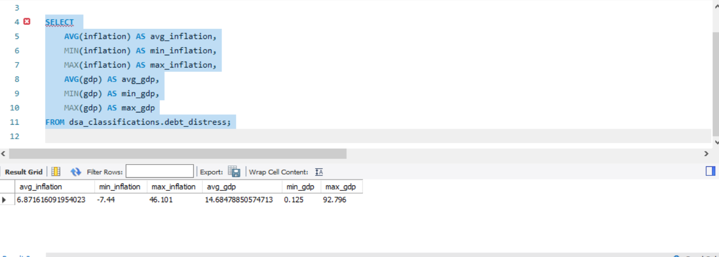
1. SUMMARY OF STATISTICS
This SQL query is aggregating inflation and GDP data from a table (dsa_classifications.debt_distress) to provide statistical summaries. The query calculates the following metrics:
Average Inflation (avg_inflation): Shows the general level of inflation across the dataset. It helps indicate how much prices have increased on average over time.
Minimum and Maximum Inflation (min_inflation and max_inflation): Identifies the lowest and highest recorded inflation rates, providing insight into the range of inflation fluctuations.

Slide 9
3. Average GDP (avg_gdp): Shows the average Gross Domestic Product (GDP), which helps assess the economic size or average economic performance in the dataset.
4. Minimum and Maximum GDP (min_gdp and max_gdp): Shows the lowest and highest GDP values recorded, indicating economic stability or volatility.
Insights from this Query:
1. Economic Stability: By analyzing the range of inflation and GDP values, we can understand if the dataset represents a stable economy (low inflation volatility and relatively steady GDP) or if it’s prone to economic instability (high inflation variation and wide GDP range).
2. Economic Performance: The average GDP can provide a sense of the general economic size across the observations. Combined with inflation, it offers insight into whether the economy is growing (moderate inflation, rising GDP) or struggling (high inflation, stagnant GDP).
3. Inflation’s Economic Impact: If the max inflation value is high relative to the average, it could suggest periods of economic stress. The contrast between min_inflation and max_inflation could also reveal how extreme events, like economic crises or periods of hyperinflation, impact overall economic health.
4. This query helps identify economic trends and anomalies, potentially flagging countries or periods that need further analysis.

Slide 10
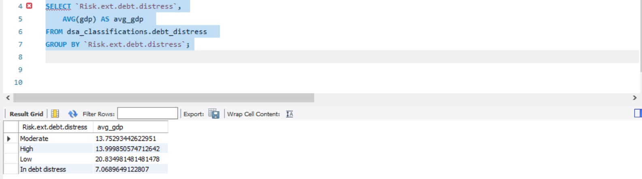
2. NATURE OF DEBT RISK
This SQL query is grouping records by Risk_ext_debt_distress, which likely categorizes different levels of external debt distress risk, and calculating the average GDP for each risk category in the dsa_classifications.debt_distress table.
Insights from this Query:
Relationship between Debt Distress Risk and Economic Performance: The average GDP (avg_gdp) for each Risk_ext_debt_distress level gives insight into whether there is a trend between a country’s economic size or performance and its external debt distress risk. For instance:

Slide 11
(a). High-Risk Category: If countries with a high risk of external debt distress also have low average GDP, this might suggest that smaller or struggling economies are more susceptible to debt distress.
(b). Low-Risk Category: Conversely, if the low-risk category shows a higher average GDP, it may imply that stronger economies are less prone to external debt distress.
2. Debt Sustainability and Economic Resilience: By examining how GDP correlates with debt distress risk, this query may help understand if higher GDP economies are more resilient to debt pressures or if certain economic thresholds contribute to lower risk levels.
3. Targeted Policy Analysis: This breakdown could inform policymakers on which risk levels might need more attention. For example, if countries in the high-risk category generally have low GDP, targeted policies or financial support could be focused on boosting economic resilience in these economies to reduce debt distress risks.
In summary, this query could reveal significant patterns between GDP size and debt distress levels, offering valuable information for economic stability and risk mitigation strategies.

Slide 12
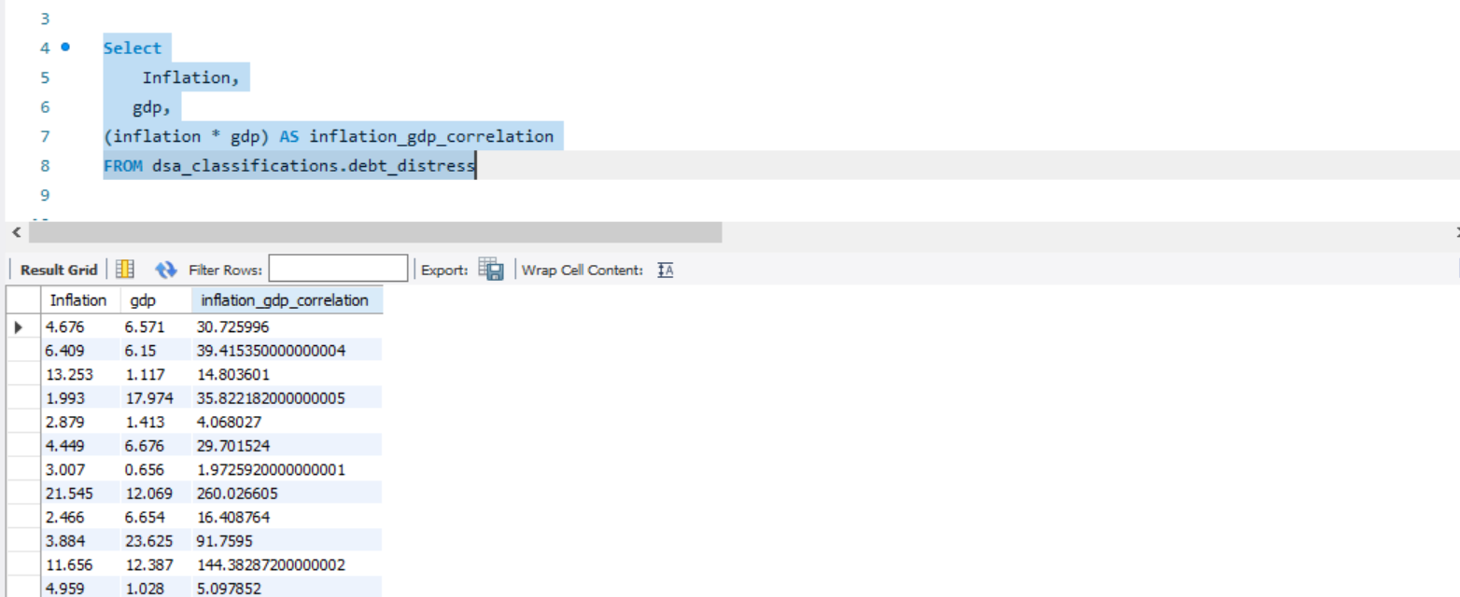
3. INFLATION AND GDP
This SQL query calculates the product of inflation and GDP (inflation * gdp) for each record in the dsa_classifications.debt_distress table, labeling it as inflation_gdp_correlation. While this is not a formal correlation calculation, the result provides an exploratory metric to see how inflation and GDP values might move together.
Insights from this Query:
1. Magnitude Interaction: The inflation_gdp_correlation field represents the combined effect (or interaction) between inflation and GDP for each entry. High values in this field may indicate

Slide 13
(records with high inflation or high GDP (or both), potentially highlighting periods or countries where inflation had a strong economic impact.
Identifying Economic Anomalies: Observing very high or very low values in inflation_gdp_correlation may reveal extreme economic scenarios. For example: a high inflation_gdp_correlation could indicate situations of high inflation in a high-GDP economy, which may suggest inflationary pressures even in economically strong regions. Low or negative GDP combined with high inflation (resulting in a relatively high correlation score) could indicate economic distress in struggling economies, possibly needing attention for stabilization.
Comparing Economic Contexts: By analyzing variations in inflation_gdp_correlation across records, you can identify countries or time periods that deviate from average inflation-GDP dynamics. These outliers may warrant further analysis to understand the economic conditions leading to unusually high or low inflation_gdp_correlation values.
4. Foundation for Further Analysis: While this calculation is not a true correlation (which would require statistical analysis of how inflation and GDP vary together over time), it provides a simple metric to observe how these variables interact. If patterns emerge, it could indicate a need for further statistical methods to explore inflation's impact on economic performance.
This query helps initiate exploratory analysis, potentially flagging unusual inflation-GDP scenarios for deeper investigation.

Slide 14
4. COUNTRIES IN DEBT
This SQL query retrieves data on Country Code, Risk of External Debt Distress (Risk_ext_debt_distress), GDP, and Inflation from the dsa_classifications.debt_distress table. The goal here is likely to analyze how each country’s economic indicators (GDP and inflation) relate to its level of external debt distress risk.
Insights from this Query:
1. Country-Level Economic Assessment: By having the Country Code, each row provides country-specific insights, allowing you to compare countries’ debt distress risks in the context of their economic performance (GDP and inflation). This can help determine which countries have high or low risk and if it correlates with GDP or inflation levels.

Slide 15
Risk and GDP Relationship: Observing GDP values alongside Risk_ext_debt_distress helps identify if larger or smaller economies are more vulnerable to external debt distress.
3. High-Risk, Low-GDP: Smaller economies with high debt distress risk may indicate that smaller economies struggle more with managing external debt.
4. Low-Risk, High-GDP: High-GDP countries with low debt distress risk may suggest that larger economies are better able to manage debt.
5. Inflation as an Economic Pressure: Including inflation values allows analysis of whether high inflation is associated with higher debt distress risk. Countries with both high inflation and high debt distress risk could be experiencing economic instability, making them more susceptible to financial crises.
6. Identifying Outliers: This query enables the identification of outliers, such as countries with unusually high or low GDP and inflation relative to their debt distress risk. Outliers may signify unique economic conditions or policy environments and could provide important case studies.
7. Cross-Comparative Analysis: This data can be used to make cross-country comparisons. Countries with similar Risk_ext_debt_distress values but differing GDP or inflation might point to differences in economic resilience or the impact of external factors.
This query provides foundational data for identifying patterns or trends between economic performance indicators and debt distress risk across different countries, potentially revealing areas for targeted economic policy interventions.

Slide 16
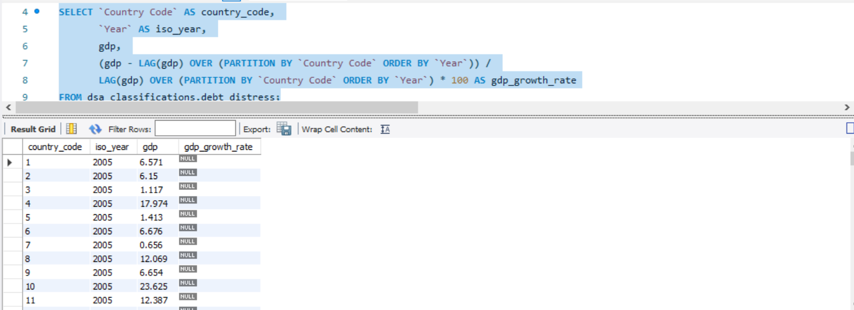
5. YEARLY GDP GROWTH
This SQL query calculates the year-over-year GDP growth rate for each country in the dsa_classifications.debt_distress table by comparing the current year’s GDP with the previous year’s GDP. Here’s a breakdown of what each component achieves and the insights it offers
Insights from this Query:
1. GDP Growth Rate Calculation:
The column gdp_growth_rate provides the annual GDP growth rate as a percentage. This measure allows for a clear understanding of economic expansion or contraction for each country, year by year.

Slide 17
Positive growth rates indicate periods of economic expansion, while negative values suggest periods of economic contraction, which could signal economic challenges.
2. Economic Trends Analysis:
By examining GDP growth trends across multiple years, this query can reveal long-term economic trends for each country. For example, consistent positive growth could indicate a stable and expanding economy, while fluctuations or periods of negative growth may suggest economic volatility.
3. Identifying Economic Resilience or Instability:
The ability to compare growth rates by country (via the country_code partition) enables the identification of countries that exhibit economic resilience versus those that may be vulnerable to economic downturns.
This data could highlight which countries have robust economic performance and which are more prone to fluctuations, potentially signaling the need for economic reform or support.
4. Cross-Country Comparisons:
By having growth rates calculated in this standardized format, you can compare countries on a like-for-like basis, regardless of their absolute GDP sizes.
This allows for insight into how different countries recover from downturns, grow over time, or respond to global economic events.

Slide 18
5. Foundation for Further Analysis:
With the year-over-year growth rate data, further analysis could be done to correlate GDP growth rates with other economic indicators, such as debt levels, inflation, or external economic shocks.
This analysis could be crucial for identifying potential predictors of economic performance or distress.
This query is valuable for understanding economic health and trends, identifying resilient economies, and comparing growth rates across countries and years, forming the foundation for targeted economic and financial analysis.

Slide 19
19. RECOMMENDATIONS
Based on the insights derived from analyzing GDP, inflation, debt distress risk, and GDP growth rates, here are several recommendations that could be helpful for policymakers, economists, and stakeholders aiming to foster economic resilience and sustainable growth:
1. Stabilize Economies with High Inflation and Low GDP
Recommendation: Countries with high inflation and low GDP should focus on policies that promote price stability, such as monetary policy adjustments, inflation targeting, and prudent fiscal management. Supporting sectors that can spur economic growth, such as infrastructure, technology, or manufacturing, may also help stabilize these economies.
Impact: Lower inflation in low-GDP economies can make debt more manageable, attract investment, and support a stable economic environment.
2. Monitor and Support Economies at High Risk of Debt Distress
Recommendation: For economies with high debt distress risk and low average GDP, international support programs, restructuring of debt terms, and conditional financial assistance may be necessary to alleviate debt pressures. Strengthening debt management practices and improving transparency in public finance could also improve resilience.

Slide 20
Impact: Reducing debt distress risk can allow these economies to allocate more resources to development rather than debt servicing, improving long-term economic stability.
3. Encourage Diversification and Innovation in Economies Showing Volatile Growth Patterns
Recommendation: For countries exhibiting significant GDP growth rate fluctuations, diversification into various economic sectors and promotion of innovation could reduce dependency on volatile industries. Policy incentives for industries less affected by global market cycles (like technology or services) might help smoothen economic growth.
Impact: Economic diversification helps stabilize income sources, making economies more resilient to both domestic and external shocks.
4. Focus on Economic Reforms in Economies with Low Resilience
Recommendation: Countries with consistently low or negative growth rates may benefit from economic reforms, such as enhancing the business environment, investing in education and workforce skills, and improving governance. Support from international organizations and trade agreements may also help integrate these economies more effectively into global markets.
Impact: Such reforms can help create a foundation for economic stability, stimulate investment, and improve the country’s overall economic outlook.

Slide 21
5. Enhance Inflation Monitoring in Economically Strong Regions Showing High Inflation
Recommendation: Economically strong regions experiencing high inflation should enhance inflation monitoring, and potentially tighten monetary policies to prevent long-term economic distortion. Improving the supply chain and incentivizing production can reduce price pressures in key industries.
Impact: Managing inflation in strong economies helps maintain purchasing power and consumer confidence, contributing to sustained growth.
6. Implement Early-Warning Systems Based on Economic Indicators
Recommendation: Countries could benefit from setting up early-warning systems that monitor GDP growth rates, debt distress levels, and inflation. Such systems would alert policymakers to potential economic instability early, allowing for proactive measures.
Impact: Early intervention can prevent economic crises, allowing policymakers to mitigate potential economic downturns effectively.
7. Prioritize Cross-Country Comparisons and Best Practices Exchange
Recommendation: By examining and learning from the policies of countries with similar debt distress levels but differing GDP or inflation rates, governments can identify and adopt best practices suited to their unique economic environments.

Slide 22
Impact: Sharing best practices and lessons learned enables countries to leverage successful strategies from similar economies, speeding up progress and avoiding common pitfalls
8. Targeted Financial Assistance and Investment in Economies Needing Support for Economic Expansion
Recommendation: International organizations and investors could focus on high-risk, low-GDP economies that show potential for growth. Targeted investments in infrastructure, technology, and education, combined with policy support, can boost these economies’ productive capacity.
Impact: Targeted assistance can significantly uplift struggling economies, helping them reduce debt distress and enhancing long-term sustainability.
Summary
This analysis recommends a mix of stabilization policies, debt management strategies, economic reforms, and international support for economies with specific vulnerabilities. Implementing these measures could improve economic stability, foster sustainable growth, and build resilience to both internal and external economic shocks.

