Slide 1
EXPLORATORY DATA ANALYSIS ON ENERGY EMISSIONS

Slide 2
TABLE OF CONTENTS
BACKGROUND……………………………………………………………… 3
DATA PREPARATION……………………………………………………… 5
EXPLORATRY DATA ANALYSIS………………………………………... 7
RECOMMENDATION……………………………………………………… 20

Slide 3
BACKGROUND
This dataset provides a multi-dimensional look at energy production, consumption, and associated carbon emissions metrics for two specific countries: Algeria and Argentina, spanning from 1990 to 2020. The data encompasses environmental, economic, and energy-specific metrics, which are essential in understanding these countries' contributions to global emissions, energy usage patterns, and progress toward renewable energy integration over time. Key variables in the dataset include:
Region CO2 Emissions: The annual CO2 emissions (in unspecified units) from energy consumption in Algeria and Argentina, reflecting the environmental impact of fossil fuel reliance within each country's respective region.
Average CO2 Emission Factor: This factor illustrates the carbon intensity of the energy mix, signifying how much CO2 is emitted per unit of energy generated, providing insights into each country’s efficiency and reliance on carbon-intensive fuels.
CO2 Intensity at Constant Purchasing Power: This value adjusts emissions relative to the economic output (purchasing power) of each country, giving a perspective on emissions efficiency in relation to the economy.

Slide 4
4. Total Energy Production and Consumption: These columns indicate the overall energy produced and consumed by each country (in unspecified units), serving as a benchmark for understanding domestic energy sufficiency and dependency.
5. Share of Renewables in Electricity Production: This metric represents the percentage of electricity production derived from renewable sources, an indicator of each country’s transition towards cleaner energy.
6. Share of Electricity in Total Final Energy Consumption: This value shows the proportion of total energy consumption represented by electricity, highlighting trends in electrification and energy usage patterns.
Algeria, located in the Arab States region, and Argentina in South/Latin America, offer contrasting examples of developing economies with different energy profiles and paths towards energy sustainability. Algeria relies significantly on fossil fuels due to its vast hydrocarbon resources, whereas Argentina has historically integrated a substantial portion of renewable energy in electricity production. This dataset sheds light on how these two countries have evolved in terms of energy production, carbon intensity, and the renewable transition over a 30-year period.

Slide 5
DATA PREPARATION
After downloading the dataset from Kaggle.com as a Comma Separated Values (CSV) File. Some columns with unwanted records were removed.
MIGRATION
The dataset was then imported into PG Admin 4. Below are SQL queries used in importing the dataset.
CREATE TABLE energy_emissions (
country VARCHAR(50),
year INT,
region VARCHAR(50),
region_co2_emissions FLOAT,
avg_co2_emission_factor FLOAT,
co2_intensity FLOAT,
total_energy_production FLOAT,

Slide 6
total_energy_consumption FLOAT,
renewables_share FLOAT,
electricity_share FLOAT )
Then, the appropriate data were inserted into this table.

Slide 7
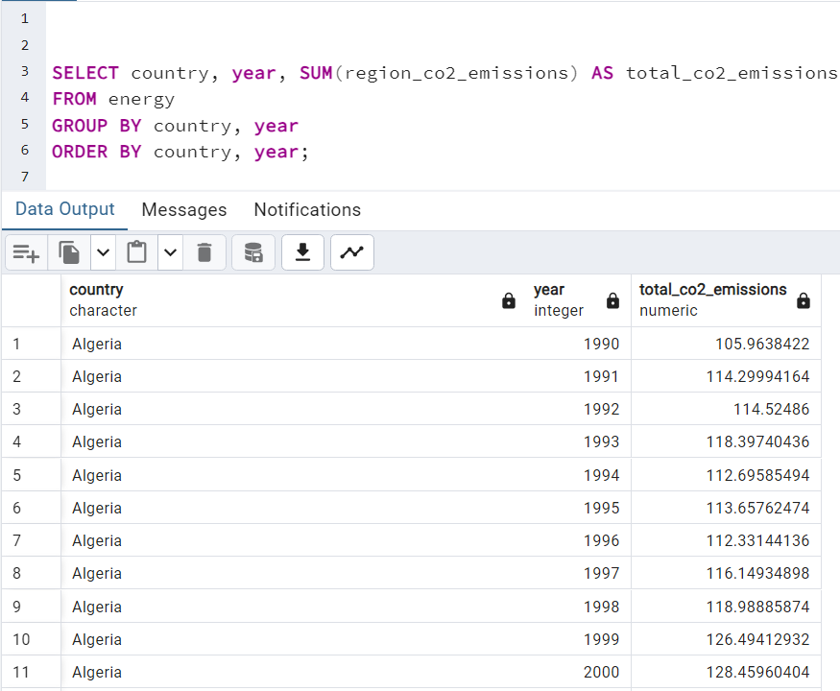
EXPLORATORY DATA ANALYSIS
Yearly CO₂ Emissions by Country

Slide 8
INSIGHT:
The SQL query provided is designed to calculate the total CO₂ emissions for each country by year, using the region_co2_emissions field. Here’s what this query reveals:
Annual CO₂ Emissions Trends:
By aggregating the region_co2_emissions for each country per year, this query shows the yearly CO₂ emissions trends for both Algeria and Argentina. This data allows us to observe whether emissions are generally increasing, decreasing, or stable over time for each country. For instance, steady increases would suggest growing energy demand or continued reliance on fossil fuels, while declines might indicate successful emission reduction efforts or a shift towards cleaner energy sources.
2. Comparison of CO₂ Emissions Between Countries:
The query output will show side-by-side annual emission totals for Algeria and Argentina. This comparison is useful in evaluating how each country’s emissions change relative to the other. Given their different economic profiles, energy sources, and policies, we may expect varied trends. For example, if Argentina has a significant portion of renewables, its CO₂ emissions might be more stable or show slower growth than Algeria's if Algeria primarily uses fossil fuels.
3. Impact of Policies and Events:
By observing specific years where emissions rise or fall sharply, it may be possible to correlate these shifts with energy policies, economic events, or global energy trends. For instance, global economic recessions or international agreements on emissions reduction could lead to noticeable changes in emissions.

Slide 9
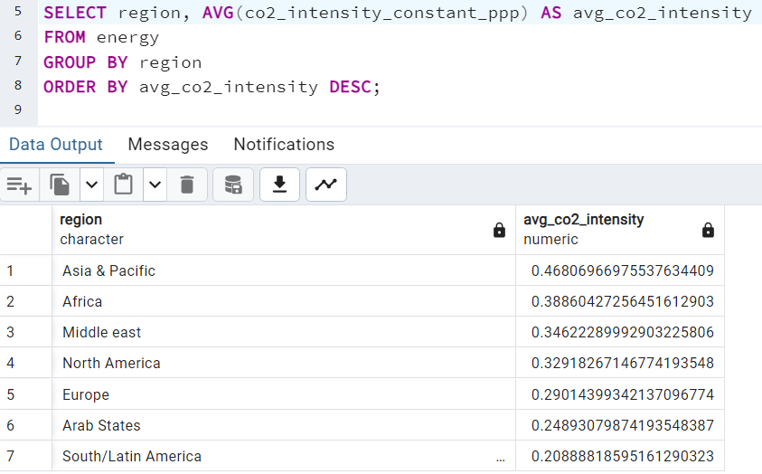
Long-Term Emission Patterns:
With a 30-year timeline, the query helps track long-term trends, showing if either country has made progress toward reducing its carbon footprint. By examining these trends over three decades, it’s easier to assess whether Algeria or Argentina is moving toward lower emissions or if they are still on a trajectory of high-carbon energy dependence.
Overall, the insights derived from this query would contribute to understanding both countries’ CO₂ emissions profiles and offer a basis for assessing the effectiveness of their energy and environmental policies over time.
Average CO₂ Intensity by Region

Slide 10
INSIGHT:
The SQL query provided calculates the average CO₂ intensity (measured at constant purchasing power parity, or PPP) for each region, ordered from highest to lowest. This reveals a few key insights about regional energy efficiency and carbon intensity:
Regional Comparison of CO₂ Intensity: By averaging co2_intensity_constant_ppp for each region, this query highlights which regions have the highest and lowest CO₂ intensity values, adjusted for economic output. Higher CO₂ intensity suggests a region relies more on carbon-intensive energy sources (like coal or oil) relative to its economic output, while lower CO₂ intensity could indicate a greater reliance on cleaner energy sources or higher energy efficiency.
Economic Efficiency in Energy Use: Regions with lower CO₂ intensity at constant PPP are using energy more efficiently in terms of economic output, producing less CO₂ for the same level of purchasing power. This is typically seen in regions that have invested in energy efficiency or a transition toward renewable energy.
Identifying Regions for Potential Policy Focus: Regions with high average CO₂ intensity might be prime candidates for policies aimed at reducing emissions, especially if they rely heavily on fossil fuels. Lower-intensity regions may serve as models for effective energy and environmental policies.
Broad Trends Across Regions: Ordering regions by average CO₂ intensity also allows for the identification of any large disparities, which can highlight gaps in technology, resources, or policy adoption across regions. This could support analyses on the potential for knowledge and technology sharing between regions.

Slide 11
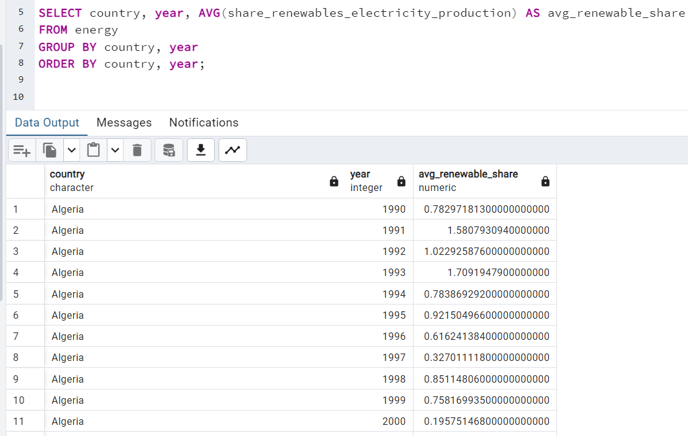
Overall, this query provides an overview of where each region stands in terms of CO₂ efficiency relative to economic output, helping identify areas for improvement and regions that are leading in energy efficiency and low-carbon development.
Trend of Renewable Energy Share in Electricity Production Over Time
INSIGHT:
INSIGHT:
The SQL query calculates the average share of renewable energy in electricity production for each country and year, providing insights into the progression of renewable energy adoption by country over time:

Slide 12
Annual Renewable Energy Trends: The query gives a year-by-year view of the average percentage of electricity generated from renewable sources for each country. By comparing this value across years, we can observe whether a country is increasing, stagnating, or decreasing its reliance on renewable energy.
Country-Level Comparisons: By grouping by country, the data can reveal which countries lead or lag in renewable electricity adoption. Those with higher average renewable shares are more likely investing in clean energy infrastructure or have natural advantages (like hydro or wind resources).
Tracking Progress Toward Energy Transition Goals: This data can be compared against policy targets for renewable energy to see how close each country is to achieving its goals. Trends in renewable share could indicate how effective policies and investments in renewable infrastructure have been.
Identifying Seasonal or Policy-Driven Changes: Annual fluctuations in renewable share could point to seasonal dependencies (e.g., hydroelectric power may vary with rainfall) or the impact of policy implementations that encourage or subsidize renewables.
Sustainability Benchmarking: Tracking average renewable shares over time also benchmarks the sustainability of each country's electricity production. Countries with increasing renewable shares are generally making strides toward reducing greenhouse gas emissions and reliance on fossil fuels.
Overall, this analysis allows for the tracking of each country’s renewable energy trajectory, offering insights into the pace of their energy transition and the effectiveness of their renewable energy strategies.

Slide 13
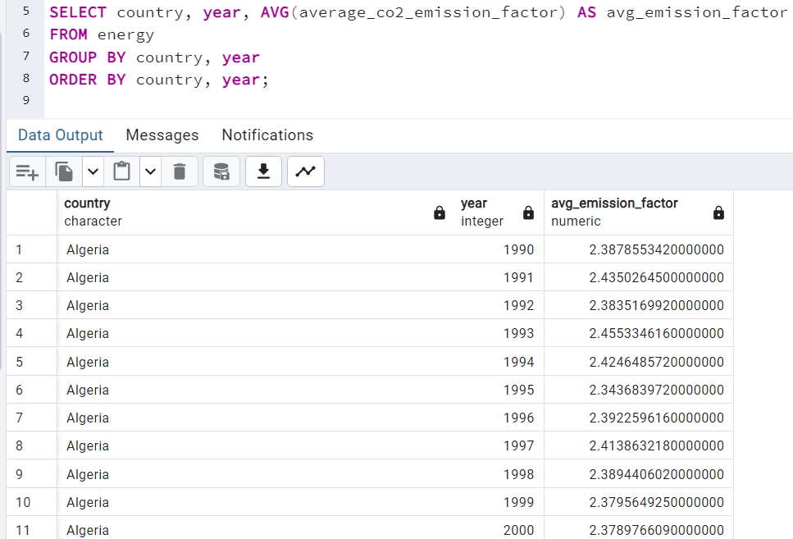
CO₂ Emission Factor Trends by Country Over Time
INSIGHT:
Key Insights from This Query
Tracking Emission Efficiency: The emission factor reveals how much CO₂ is produced per unit of energy. Lower average emission factors indicate that a country is producing energy more efficiently (in terms of emissions) or using cleaner energy sources. Conversely, higher values indicate less efficiency or reliance on high-emission energy sources like coal.

Slide 14
2. Yearly Trends in Carbon Intensity: By examining the year-over-year average for each country, we can identify whether countries are improving their emission factors over time. A downward trend could signal a shift toward cleaner technologies or more efficient energy use.
3. Energy Source Transition Impact: Countries shifting to renewable or lower-carbon energy sources (e.g., natural gas instead of coal, or renewables instead of fossil fuels) often see a reduction in their average emission factors. This can indicate the success of renewable energy adoption or policies aimed at reducing emissions.
4. Comparison Across Countries: This allows for a comparison of emission efficiency across countries. Countries with similar economic development levels but differing emission factors can provide case studies on effective strategies for reducing carbon intensity in energy production.
5. Benchmarking and Policy Effectiveness: Observing changes in the average emission factor over time can help assess the impact of environmental regulations, emission reduction targets, and technological advancements within each country. Countries with a marked decrease in emission factors may have implemented effective policies or made advances in energy technology.
In summary, this analysis offers a look at each country’s progress in reducing carbon intensity in energy production, shedding light on both environmental impacts and the effectiveness of clean energy strategies.

Slide 15
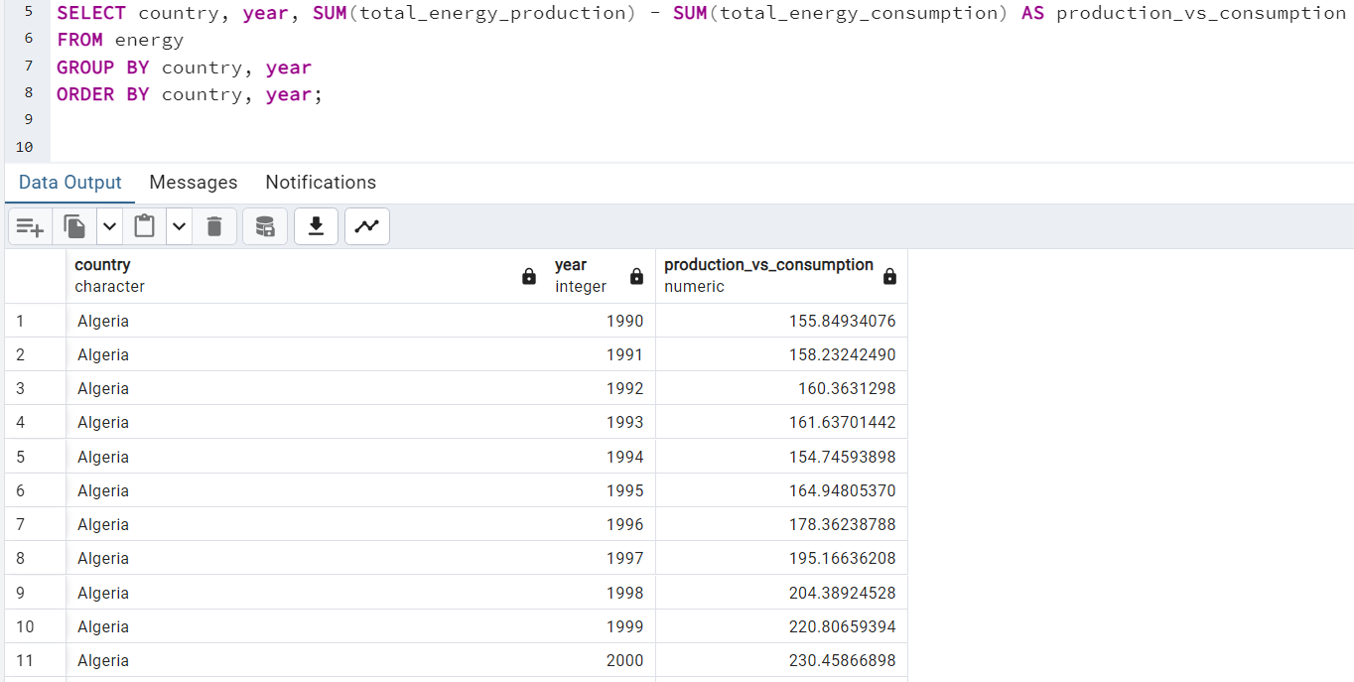
Comparison of Energy Production vs. Consumption
INSIGHT:
This query calculates the difference between total energy production and total energy consumption for each country by year. The result, production_vs_consumption, reveals whether a country produces more energy than it consumes (surplus) or consumes more than it produces (deficit).
Energy Surplus or Deficit:
A positive value for production_vs_consumption indicates an energy surplus—the country is producing more energy than it consumes. This could mean the country has the capacity to export energy.

Slide 16
A negative value indicates an energy deficit—the country consumes more energy than it produces and likely relies on energy imports to meet demand.
2. Self-Sufficiency:
Tracking this value over time highlights a country's energy self-sufficiency or dependency. Countries with consistent surpluses are likely energy self-sufficient, while those with deficits rely on imports, which may make them vulnerable to fluctuations in international energy markets.
3. Economic and Policy Impact:
Energy Exporting Nations: For countries with a consistent surplus, energy exports might play a significant role in the economy. For example, many oil-rich countries or those with strong renewable energy outputs may see high production values and thus, high exports.
Energy Importing Nations: Deficits indicate that energy imports are needed, affecting trade balance and energy security. For such countries, high deficits could drive policies focused on increasing local production or improving energy efficiency to reduce reliance on imports.
4. Energy Transition and Production Shifts:
Changes in production vs. consumption levels can reflect energy transition efforts. A country that shifts from a surplus to a deficit may be phasing out domestic fossil fuel production while building renewable infrastructure. Conversely, a country reducing its deficit could be scaling up local production or implementing energy efficiency measures.

Slide 17
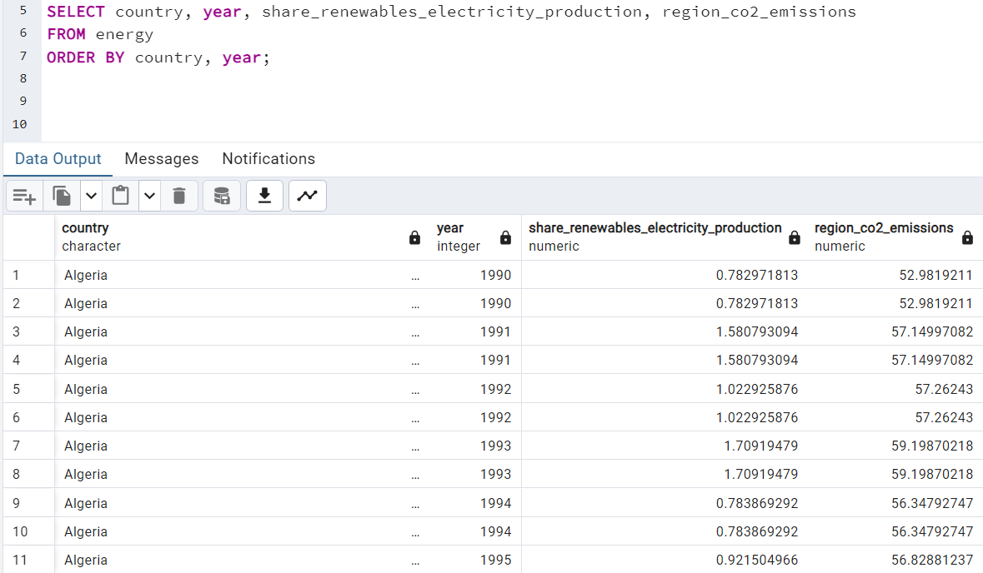
5. Impact of Economic and Industrial Growth:
Rapid industrial growth often leads to increased energy consumption, potentially turning an energy surplus country into a deficit one. Conversely, if a country’s energy production capabilities grow due to new resources or technological investments, it may shift from a deficit to a surplus.
In summary, this analysis provides insights into each country’s energy independence, economic reliance on energy exports or imports, and progress in achieving energy self-sufficiency, all of which are essential for strategic energy planning and economic stability.
Renewable Energy and CO₂ Emissions Correlation

Slide 18
INSIGHT:
This query displays data on each country’s share of renewables in electricity production and its CO₂ emissions by region, ordered by country and year. This view helps us analyze the relationship between renewable energy adoption and CO₂ emissions over time.
Correlation Between Renewable Share and CO₂ Emissions:
By comparing the share of renewables in electricity production with CO₂ emissions for each country and year, we can observe if higher renewable adoption is associated with lower CO₂ emissions. Generally, an increase in the share of renewables should correlate with reduced emissions, reflecting a shift towards cleaner energy sources.
2. Trends Over Time in Renewable Energy Adoption:
Tracking the share of renewables over several years can reveal if a country is transitioning toward greener energy. For example, consistent growth in renewable energy use indicates an ongoing shift toward sustainability, which is essential for long-term emissions reductions.
3. Regional Impact on CO₂ Emissions:
By grouping by region, the data can show whether regions with higher renewable energy adoption are achieving lower CO₂ emissions. It allows for regional comparisons, which may reveal differences based on geographic or policy factors, such as government incentives or resource availability (e.g., access to hydropower or wind).

Slide 19
4. Effectiveness of Renewable Energy in Emission Reduction:
The data helps gauge the effectiveness of renewables in reducing CO₂ emissions. In cases where CO₂ emissions remain high despite an increase in renewable share, it could indicate a dependency on fossil fuels or an increase in total energy demand that offsets renewable gains.
5. Impact of Policy Changes on Energy Composition and Emissions:
By examining specific years, we can identify possible impacts of policy changes or external factors (e.g., economic shifts, global agreements) on both renewable share and emissions. If renewable share increases suddenly in a year, it may coincide with government initiatives or international treaties aimed at reducing emissions.
6. Energy Transition Pathways:
This view offers insight into each country’s energy transition pathway by showing how much renewables are contributing to the electricity mix and the associated regional emissions. For instance, a high share of renewables with low emissions suggests effective transition, while low renewable shares with high emissions may signal a need for stronger energy policy intervention.
In summary, this analysis provides a snapshot of each country’s progress in adopting renewable energy and its impact on emissions. It can be used to track the effectiveness of renewable energy in reducing emissions, understand regional differences, and identify areas where policies or resources could help accelerate the transition to cleaner energy.

Slide 20
RECOMMENDATION
Based on the insights derived from each query and analysis, here are key recommendations for countries aiming to optimize their energy production, reduce CO₂ emissions, and enhance renewable adoption:
Strengthen Policies to Promote Renewable Energy:
For countries with low renewable shares and high CO₂ emissions, implementing stronger incentives or subsidies for renewable energy sources (e.g., solar, wind) could significantly lower emissions.
Consider targeted policies to facilitate renewable energy adoption, particularly in sectors where emissions are highest.
2. Encourage Regional Cooperation for Clean Energy Access:
Regions with limited access to renewable resources could benefit from cross-border clean energy agreements or shared projects, such as regional solar or wind farms, to lower collective emissions.
3. Support Research and Development in Renewable Technologies:
Investment in innovative energy storage and grid integration technology could help countries with high renewable share but fluctuating CO₂ emissions. This would enable them to better manage renewable

Slide 21
sources and stabilize emissions over time.
4. Enhance Energy Self-Sufficiency:
Countries with consistent energy deficits should invest in local energy resources to improve self-sufficiency. This may include tapping into renewables or improving energy efficiency to reduce reliance on imports, enhancing energy security.
5. Promote Export Opportunities for Surplus Nations:
Nations with a consistent energy surplus could explore export markets for energy, especially renewable-based electricity, to boost their economy. Establishing cross-border electricity grids or selling surplus energy to neighboring countries can enhance trade balance and economic growth.
6. Encourage Diversification of Energy Sources:
For countries reliant on single energy sources, diversifying their energy mix, especially towards renewables, could reduce the economic and environmental risks associated with volatile energy markets.
7. Implement Emissions Reduction Targets:
For countries with rising CO₂ emissions, establishing concrete emissions reduction targets tied to specific years could help track and accelerate progress. This should be complemented by sector-specific emissions goals for higher-polluting sectors, such as transport and industry.
8. Adopt Carbon Pricing Mechanisms:
Carbon taxes or cap-and-trade systems could encourage industries to reduce emissions and invest in cleaner

Slide 22
technology. Revenue from carbon pricing could support green infrastructure development and renewable energy projects.
9. Increase Public Awareness and Industry Accountability:
Public campaigns and industry regulations aimed at emissions reduction can improve accountability and motivate change. Educating businesses and citizens on the benefits of low-carbon practices can foster a culture of sustainability.
10. Invest in a Long-Term Clean Energy Transition:
For countries like Algeria and Argentina with varying emissions trajectories, developing a 20–30-year energy transition plan that phases out fossil fuels and scales up renewables is essential for lasting emission reductions.
11. Focus on Energy Efficiency Improvements:
Implement energy efficiency standards for buildings, vehicles, and manufacturing processes to reduce overall energy demand, particularly in countries facing rising emissions.
12. Monitor and Adjust Policies Regularly:
Track the impact of energy and environmental policies annually to adjust approaches based on effectiveness. Responsive adjustments can ensure the country stays on track toward emission reduction goals.

Slide 23
In summary, these recommendations address both short- and long-term strategies to enhance renewable energy use, reduce CO₂ emissions, improve energy independence, and foster sustainable economic growth. Countries that adapt these measures based on their unique energy profiles and regional contexts are more likely to succeed in creating a resilient, low-carbon energy future.

