Slide 1
EXPLORATORY DATA ANALYSIS ON USED CARS

Slide 2
TABLE OF CONTENTS
1. BACKGROUND………………………………………………. 3
2. DATA COLLECTION…………………………………………. 4
3. DATA MIGRATION…………………………………………… 5
4. DATA TRANSFORMATION…………………………………... 6
5. EXPLORATORY DATA ANALYSIS…………………………… 11
6. RECOMMENDATION…...................................................... 27

Slide 3
BACKGROUND
Companies across the used-car market’s value chain can use data and analytics to tap into growth opportunities and improve margins. As used-car companies emerge from complicated market dynamics caused by the pandemic, they have been thrust into a new and complex environment, contending with changing consumer preferences, evolving supply-and-demand dynamics, and economic pressures. These influences will make it more difficult for players across the used-car ecosystem to grow and will increase pressure to maintain elevated margins from the pandemic period.
To tap into customer demand, protect margins, and improve performance, companies across the used-car value chain—namely B2B and B2C dealers, OEMs, and financing and leasing companies—must reinvent and redesign business approaches to be more analytically savvy if they want to stay ahead of the competition.
Using a dataset about the India’s used car industry, we want to uncover insights and make appropriate recommendations with top performing brands that resonate with the market’s needs in the city of Chennai.

Slide 4
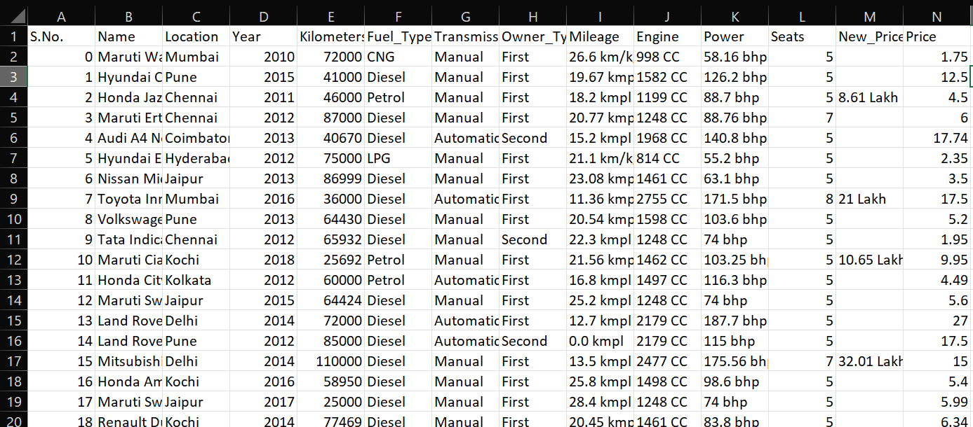
DATA COLLECTION
The dataset for this project was fetched from a folder with the source path below: "C:\Users\USER\Desktop\projects_kitchen\automotive\used_cars_data.csv“. Below is also a snippet of the dataset.

Slide 5
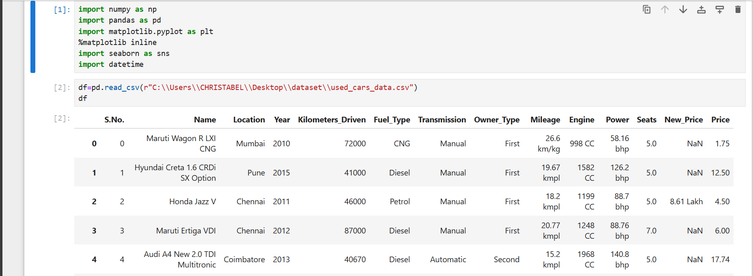
DATA MIGRATION
The dataset is then imported into Jupiter Notebook for other data analytics using of numpy, pandas, matplotlib and seaborn libraries.

Slide 6
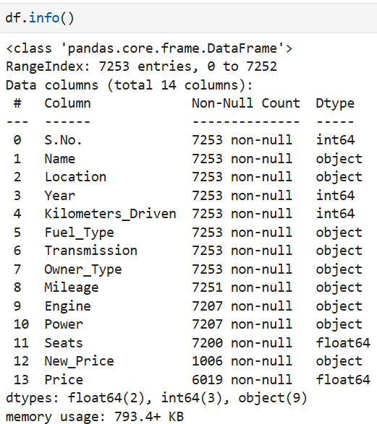
DATA TRANSFORMATION
This next thing is to carry out the necessary data cleaning. Data Cleaning is a fundamental aspect of data analysis. It sets the foundation for accurate uncovering of insights and decision-making.
(a). Determining column headers and data type

Slide 7
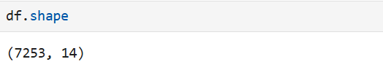
From the above, the dataset has been cleaned to have the following column headers with their corresponding data types: S/No., Year, Kilometer driven, with integers. Name, Location, Fuel type, Transmission, Owner type, etc. with object data type; and Seats and Price with float.
(b). Shape of dataset
The dataset has 7253 rows and 14 columns.

Slide 8
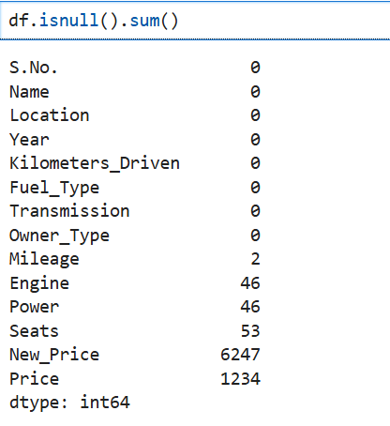
(c). Check for missing values

Slide 9
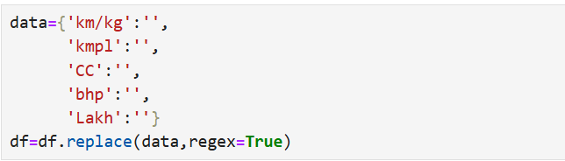
Only the Mileage, Engine, Power, Seats, New Price, and Price columns have missing values. Others do not have missing values
(d). Replacement of values
From the above, the following were replaced.

Slide 10
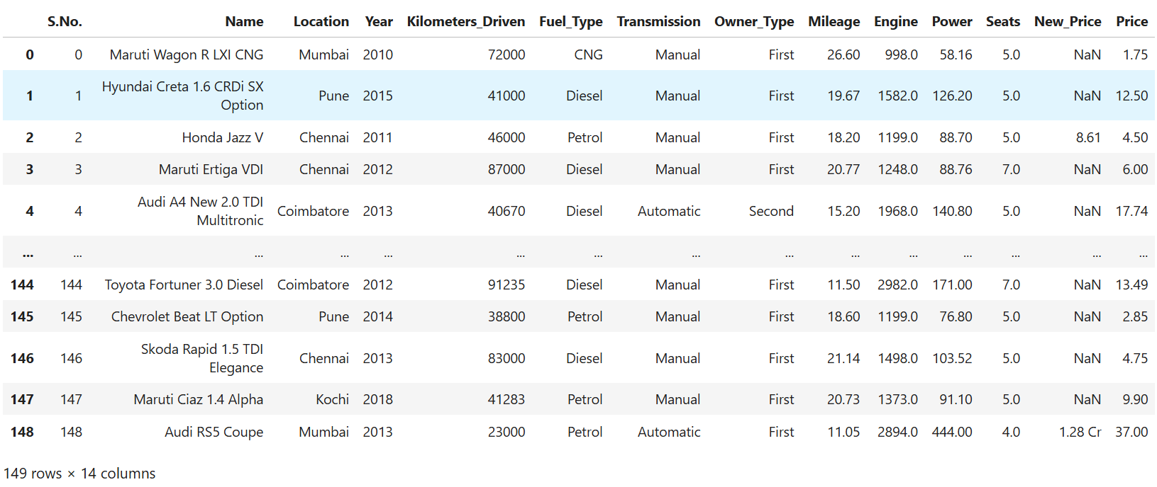
(e). Cleaned dataset

Slide 11
EXPLORATORY DATA ANALYSIS
This Chapter focuses on exploratory data analysis. To do this successfully, below are some questions to serve as guide:
1. What are the Top ten (10) best cars based on Engine in Chennai?
2. What are the Top ten (10) best cars based on Power in Chennai?
3. What are the Top ten (10) best cars based on Transmission in Chennai?
4. What are the Top ten (10) best cars based on Mileage in Chennai?
5. How many automatic cars in Chennai and what are their prices?

Slide 12
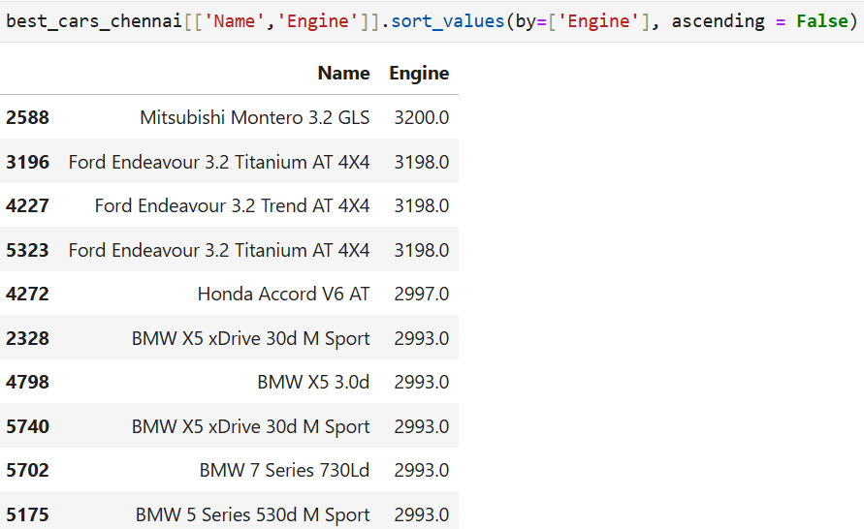
1. WHAT ARE THE TOP TEN (10) BEST CARS BASED ON ENGINE IN CHENNAI

Slide 13
Insights:
Here are some insights derived from the data on engine sizes and vehicle models:
Consistent Engine Sizes Within Brands:
BMW: Across multiple models (X5 and 7 Series), BMW consistently uses a 2993 cc engine. This suggests that BMW employs a standardized engine size for various models, potentially to streamline production costs and provide consistent performance characteristics across its luxury SUV and sedan segments.
Ford: The Ford Endeavour models, including the Titanium and Trend trims, all feature a 3198 cc engine. This consistency reflects a standardized approach for their 4x4 vehicles, likely tailored to meet the demands of off-road and high-performance driving.
2. Engine Size and Vehicle Type:
The Mitsubishi Montero has the largest engine size (3200 cc), positioning it as a high-powered option among the vehicles listed, which aligns with its reputation as a rugged SUV suited for off-road conditions.

Slide 14
The Honda Accord V6 AT has a 2997 cc engine, making it the only sedan on the list with a relatively high engine capacity for its class. This positions the Accord as a powerful sedan option, especially in comparison to the SUVs listed.
3. Power Differentiation by Vehicle Purpose:
The data shows that SUVs and off-road vehicles tend to have higher engine capacities, with the Mitsubishi Montero (3200 cc) and Ford Endeavour (3198 cc) fitting this trend. In contrast, luxury models like the BMW X5 and 7 Series maintain a slightly smaller engine size, indicating a balance between power and efficiency for urban or highway driving.
4. Brand and Model Focus:
BMW appears to emphasize versatility within a specific engine range across multiple vehicle types (SUVs and sedans), appealing to customers who value luxury and consistency.
Ford's approach with the Endeavour lineup suggests a commitment to delivering power and performance for rugged applications.

Slide 15
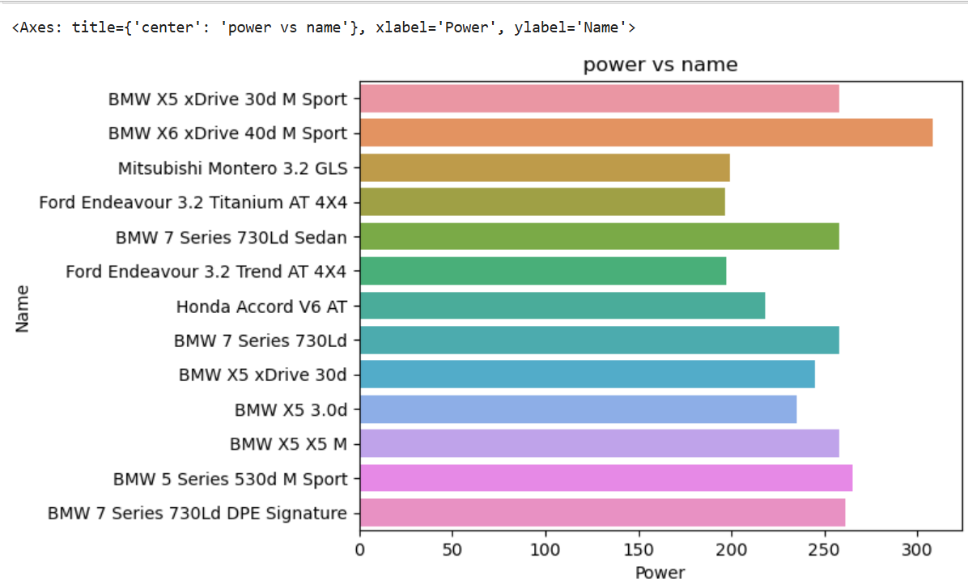
2. WHAT ARE THE TOP TEN (10) BEST CARS BASED ON POWER IN CHENNAI?

Slide 16
Insights:
Here are insights derived from the data on power output across different BMW models:
Consistent Power Output Across Models:
Multiple BMW models, including the X5 xDrive 30d, 7 Series 730Ld, and X5 M, have a consistent power output of 258 HP. This reflects a strategic approach by BMW to standardize power within certain model ranges, likely to offer a balanced mix of performance and efficiency that meets the needs of a wide array of customers without over-complicating the engine options.
Higher Power for Sport and Premium Models:
The BMW X6 xDrive 40d M Sport has the highest power output at 308.43 HP, differentiating it as the sportiest and most powerful option within this lineup. This model is likely positioned as a performance SUV, appealing to customers seeking a combination of luxury and high performance.
The BMW 5 Series 530d M Sport and 7 Series 730Ld DPE Signature have slightly reduced power outputs at 265 HP and 261.49 HP, respectively. These variations may reflect the brand's effort to provide additional premium or performance configurations within the 5 Series and 7 Series, with slight differences tailored to the specific demands of these models.

Slide 17
3. Power Consistency in Luxury and Performance Focused Models:
For luxury sedans like the 7 Series and high-end SUVs like the X5, BMW provides a consistent power output (258 HP), which is sufficient for premium performance while maintaining fuel efficiency. This standardized power output across models offers a reliable, predictable driving experience that aligns with BMW’s brand values of smooth and efficient performance.
4. Gradual Power Scaling:
BMW seems to use a gradual scaling in power: from 258 HP for standard models to 265 HP in the 5 Series M Sport, and up to 308.43 HP in the sportier X6 M Sport. This allows BMW to cater to varying customer preferences, from efficient luxury to performance-oriented driving.
Conclusion:
BMW’s power distribution strategy in these models appears to be carefully planned. The consistent power output of 258 HP across multiple models shows a focus on delivering balanced performance in luxury vehicles, while higher outputs in models like the X6 and 5 Series M Sport are aimed at more performance-driven customers. This structure aligns BMW's offerings with market needs, balancing efficiency and premium performance.

Slide 18
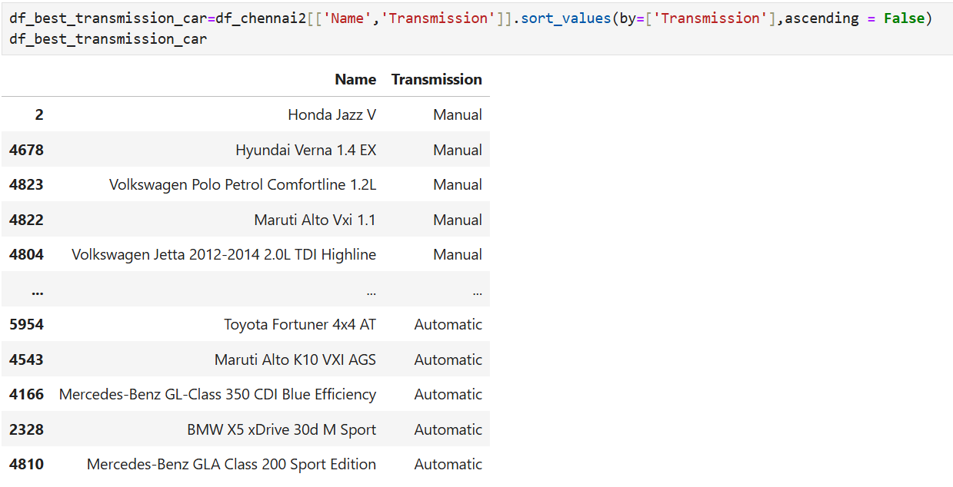
3. WHAT ARE THE TOP TEN (10) BEST CARS BASED ON TRANSMISSION IN CHENNAI ?

Slide 19
Insights:
Here are insights drawn from the data on transmission types across various car models:
Manual Transmission in Compact and Mid-Range Models:
Models like the Honda Jazz V, Hyundai Verna 1.4 EX, Volkswagen Polo, Maruti Alto Vxi, and Volkswagen Jetta are all equipped with manual transmissions. These vehicles are often aimed at a cost-sensitive market segment where manual transmissions are more popular due to their affordability and better fuel efficiency. This aligns with customer expectations in compact and mid-range vehicles, where manual transmission helps control costs and offers a traditional driving experience.
2. Automatic Transmission in Premium and SUV Models
Higher-end models and SUVs, such as the Toyota Fortuner 4x4 AT, Mercedes-Benz GL-Class, and the Maruti Alto K10 VXI AGS, feature automatic transmissions. This trend reflects the market’s increasing preference for the convenience and ease of automatic transmission in premium vehicles. Automatic transmission has become a common feature in SUVs and luxury cars, catering to customers who prioritize comfort, especially in urban environments where automatic transmissions are preferred for handling stop-and-go traffic

Slide 20
Brand Positioning and Transmission Types:
Some brands use transmission type as part of their positioning strategy. For instance, Volkswagen and Toyota offer automatic options in their premium models, reflecting their aim to appeal to comfort-oriented consumers. Honda and Maruti primarily offer manual options in their compact models, aiming for affordability and greater control, which are typically valued by entry-level buyers.
Market Trends in Transmission Preferences:
This dataset indicates a clear split between transmission preferences based on vehicle type and segment: compact and budget-friendly cars favor manual transmissions, while premium, SUV, and luxury vehicles are predominantly automatic. This division is reflective of broader automotive trends, where manual transmission is generally found in smaller, economical vehicles, and automatic transmission is favored in larger, high-end vehicles.
Conclusion:
The data on transmission types suggests that the choice between manual and automatic is largely influenced by vehicle segment and target market. Compact and budget-friendly cars tend to have manual transmissions, balancing cost and control, while higher-end SUVs and luxury vehicles opt for automatic transmissions to enhance convenience and comfort.

Slide 21
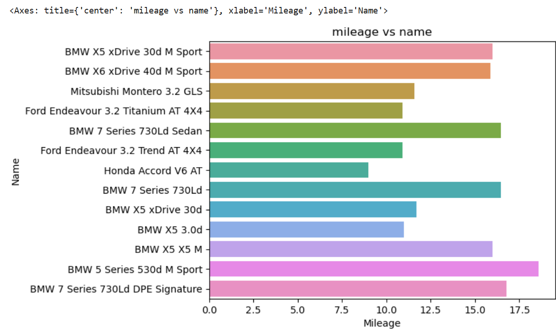
4. WHAT ARE THE TOP TEN (10) BEST CARS BASED ON MILEAGE IN CHENNAI ?

Slide 22
Insights:
High Mileage Models Primarily Diesel:
The top models in terms of mileage, such as the Maruti Dzire AMT ZDI Plus, Maruti Swift AMT DDiS VDI, Maruti Ciaz ZDi SHVS, and Honda Jazz VX Diesel, all offer high mileage above 27 km/l. This is typical for diesel engines, known for their fuel efficiency, especially in longer commutes or highway driving. Diesel engines generally yield higher fuel efficiency than petrol, especially in the Indian market where cost-per-kilometer is a priority.
Maruti Dominates High Mileage Segment:
Most of the high-mileage models in this list are from Maruti Suzuki (e.g., Dzire, Swift, Ciaz), which reflects Maruti’s focus on fuel efficiency. As the brand is positioned to appeal to cost-conscious consumers, its dominance in the high-mileage segment indicates an effective alignment with market demand for economical cars. Maruti’s strong engineering in fuel efficiency has made it popular for customers looking to minimize fuel costs.
3. Mild Hybrid Technology in Ciaz:
The Maruti Ciaz ZDi SHVS model incorporates SHVS (Smart Hybrid Vehicle by Suzuki). technology, a mild hybrid system that enhances fuel efficiency by reducing engine load. This demonstrates Maruti’s approach to incorporating hybrid technology to further boost mileage in diesel models, giving it a competitive edge in efficiency without full electric capability.

Slide 23
Ford's Competitive Mileage Offering:
The Ford Figo Aspire 1.5 TDCi Titanium, with a mileage of 25.83 km/l, stands out as one of the few non-Maruti models with competitive mileage. This makes it an appealing choice for buyers interested in high fuel efficiency but looking beyond the Maruti lineup.
Preference for Mileage in Compact and Sedan Segments:
The high-mileage models are primarily compact cars or sedans, which are typically lighter and optimized for fuel efficiency. The data suggests a strong demand for fuel-efficient vehicles within these segments, especially for everyday use where mileage can significantly impact ownership costs.
Conclusion:
Maruti Suzuki leads the high-mileage segment, especially with diesel and mild hybrid models, catering to a market with strong preferences for fuel efficiency. Models like the Ciaz and Dzire showcase Maruti’s engineering focus on economical performance, while Ford’s Figo Aspire offers an alternative for fuel-efficient non-Maruti options. This data highlights that, in the Indian market, compact and sedan buyers prioritize high mileage, influencing car manufacturers to innovate in fuel efficiency for competitive advantage.

Slide 24
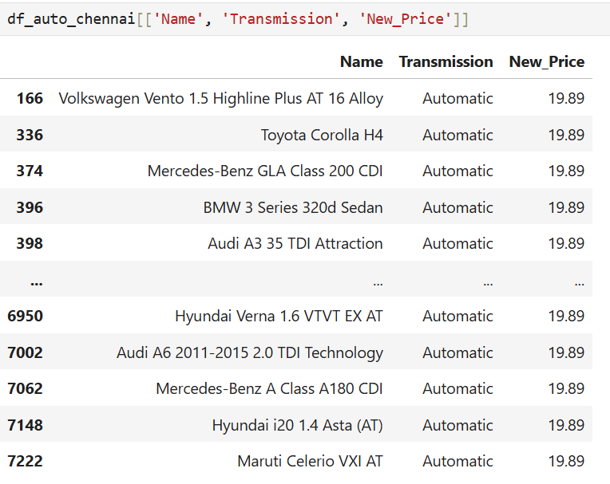
5. HOW MANY AUTOMATIC CARS IN CHENNAI AND WHAT ARE THEIR PRICES?

Slide 25
Insights:
Insights from this data on transmission type and new price for various car models reveal several points:
High-End Models with Automatic Transmission in a Similar Price Range:
Multiple models from premium brands like Volkswagen, Toyota, Mercedes-Benz, BMW, and Audi are listed at the same new price (₹19.89 lakhs) with automatic transmissions. This suggests a competitive price positioning for entry-level or base models among luxury or semi-premium brands. The uniform pricing might indicate a market effort to make premium brands more accessible to a broader audience interested in luxury features.
Automatic Transmission Standard in Premium Segment:
All cars in this price range come with automatic transmission, reflecting the standardization of automatic gearboxes in the premium segment. This aligns with consumer preferences in higher price brackets, where convenience and comfort are prioritized over the traditionally fuel-efficient manual transmissions.
Diverse Brand Offerings at ₹19.89 Lakhs:
Brands from Volkswagen to Hyundai offer models at this price point, suggesting that automakers are targeting the 20-lakh price segment as a sweet spot for consumers looking for an affordable entry into luxury or feature-rich vehicles. It might also indicate competitive positioning among brands to capture consumers at a price-sensitive point in the premium market.

Slide 26
Price Stability in Premium Segment:
The data shows that various models, some spanning multiple model years, are listed at ₹19.89 lakhs. This could point to a pricing strategy that maintains stable prices across newer and slightly older models, making luxury brands more accessible without frequent price hikes. It could also signal the inclusion of discounts or competitive pricing strategies to increase the appeal of these models in the market.
Conclusion
The uniform price of ₹19.89 lakhs for automatic transmission cars from various premium brands suggests a competitive entry-level pricing strategy in the luxury and semi-premium segment. Automatic transmissions are standard in this bracket, catering to comfort and convenience-focused consumers. The data also shows that these brands aim to capture market share by offering diverse brand options within a narrow price range, balancing luxury appeal with affordability.

Slide 27
RECOMMENDATION
These are some recommendations that could help in fine-tuning marketing, sales, and product strategies.
1. Standardize Entry-Level Premium Offerings with Automatic Transmission
Recommendation: Continue positioning entry-level premium models with automatic transmissions at a consistent price point, like ₹19.89 lakhs, to maintain accessibility to luxury for a wider audience. Focus marketing efforts on the convenience of automatic transmission for city driving, especially targeting young professionals and urban consumers who prioritize comfort.
Rationale: The uniform pricing for automatics across brands in this bracket indicates that luxury brands are effectively creating an entry-level price point, appealing to consumers seeking an affordable luxury option.
2. Highlight Engine Performance and Differentiation by Vehicle Purpose
Recommendation: Differentiate marketing messaging based on engine capacity and intended use:
SUVs and off-road models (e.g., Ford Endeavour, Mitsubishi Montero): Emphasize power, rugged performance, and off-road capability.
Luxury sedans and crossovers (e.g., BMW X5, 7 Series): Focus on smooth urban driving, refined power, and efficiency.

Slide 28
Rationale: Engine capacity reflects vehicle purpose, with off-road vehicles benefiting from larger engines while luxury vehicles prioritize a balance between power and efficiency.
3. Position High-Power Models for Performance Enthusiasts
Recommendation: Market high-power models, like the BMW X6 xDrive 40d M Sport with 308.43 HP, toward performance-oriented customers who value both luxury and high-output engines. For these models, emphasize attributes like acceleration, handling, and sportiness in advertising and dealership experiences.
Rationale: High-power models cater to a niche but lucrative segment of luxury buyers seeking peak performance, differentiating them from standard models.
4. Leverage Consistent Power Output in Standard Models for Brand Identity
Recommendation: Highlight the balanced, reliable performance in standard models with a consistent power output (258 HP across the X5, 7 Series, and other BMW models). This can reinforce BMW’s brand reputation for dependable performance in the luxury segment.
Rationale: Standardizing power output in multiple models signals reliability, which can strengthen customer loyalty and meet the expectations of those looking for consistent driving experiences.

Slide 29
5. Adopt a Gradual Power Scaling Strategy Across Model Variants
Recommendation: Continue a gradual power scaling approach from base to performance-oriented variants. This provides customers with clear options based on performance needs, encouraging upgrades and promoting brand loyalty.
Rationale: Gradual power increases across models, from 258 HP in standard to 308 HP in sport versions, give customers flexibility and cater to a range of driving preferences.
Summary
By implementing these recommendations, the company can optimize its offerings across different customer segments, from entry-level premium buyers to high-performance seekers. This approach also strengthens each brand's market positioning, balancing the appeal of consistent performance, power, and accessibility in the luxury automotive market.

