Slide 1
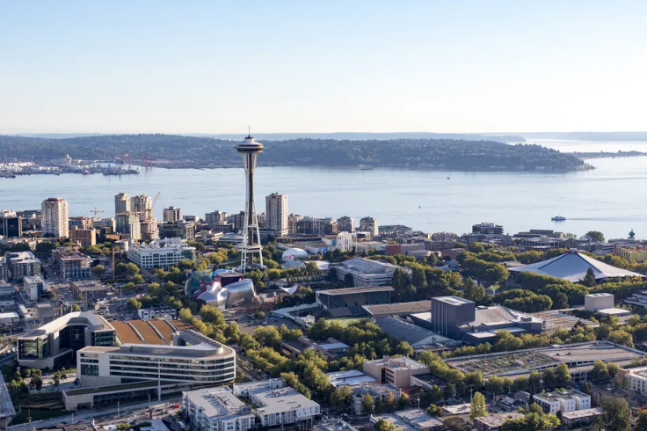
Central Seattle
expensive houses and how to sell them …
Igor, hh-ds-23-1, 24.02.2023

Slide 2
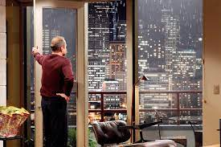
Client:
Timothy Stevens: Seller,
Owns expensive houses in the center of Seattle,
Needs to get rid
Interested in best timing within a year
Open for renovation when profits rise

Slide 3
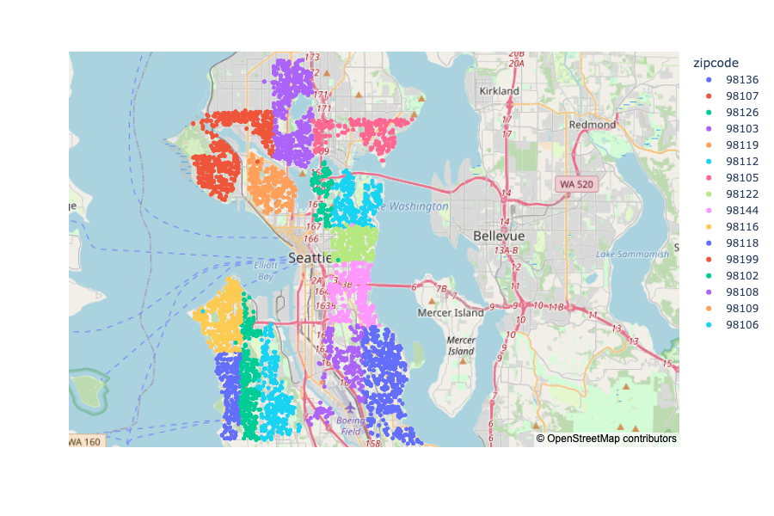
Centre of Seattle:

Slide 4
EDA overview:
Timothy Stevens: Seller,
Owns expensive houses in the center of Seattle,
Needs to get rid
Interested in best timing within a year
Open for renovation when profits rise
What builds the price of a house in central Seattle?
How house prices depend on renovation or condition of the houses?
Is the best selling time of the year also indicates best price?
How much profit should we expect and how fast can we sell a house

Slide 5
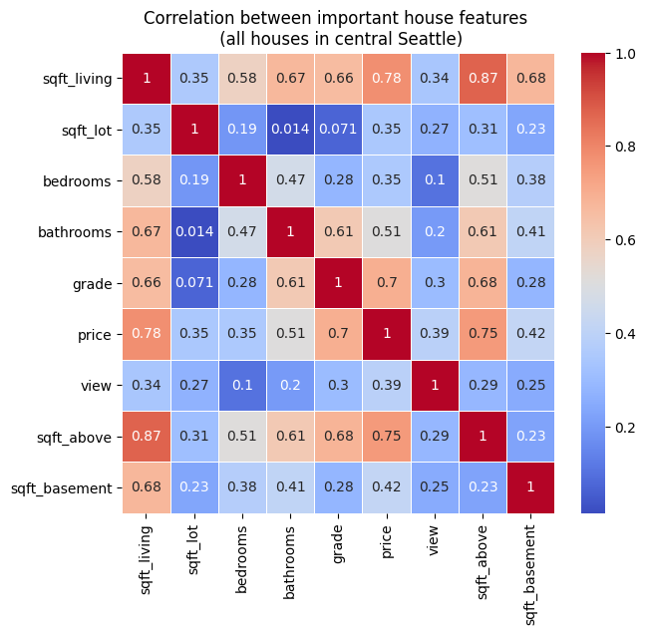
What builds the price of a house in central Seattle?
House prices depend on the square footage of the house

Slide 6
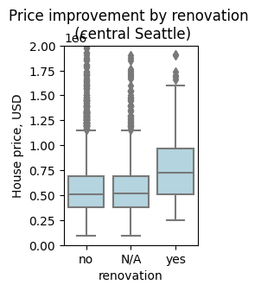
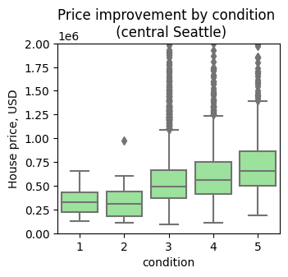
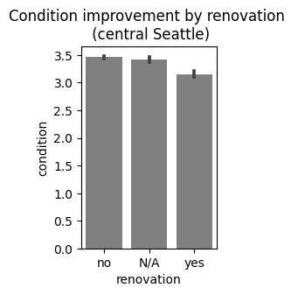
What builds the price of a house in central Seattle?
Houses in central Seattle have higher price after renovation, as well as houses in good conditions (3 or above)

Slide 7
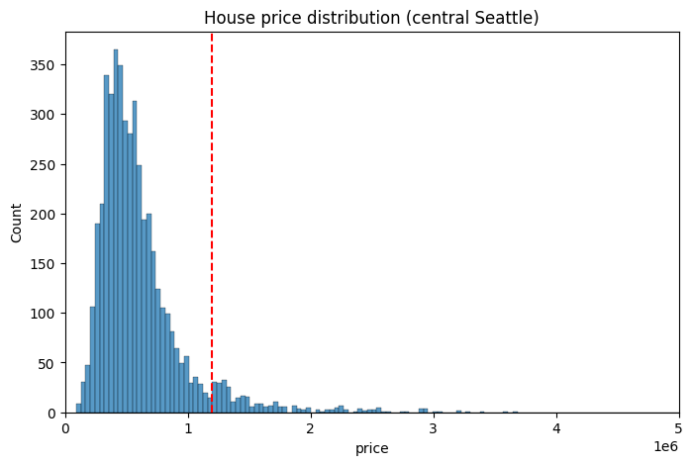
Let’s have a look on expensive houses?

Slide 8
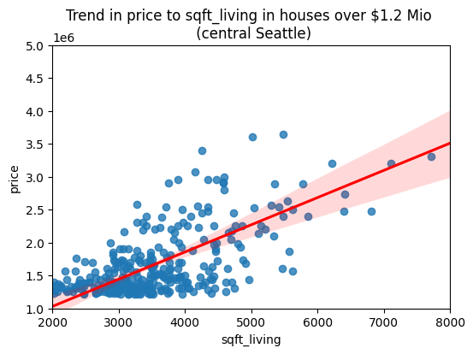
Let’s have a look on expensive houses?

Slide 9
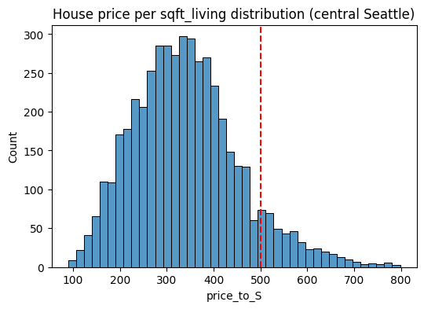
Let’s have a look on expensive houses?
Expensive House:
House price over $1 Mio
OR
Price_per_S over $500

Slide 10
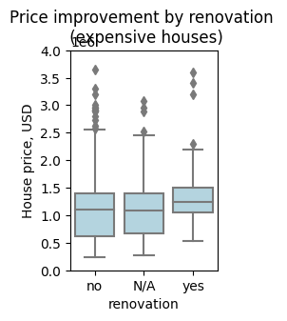
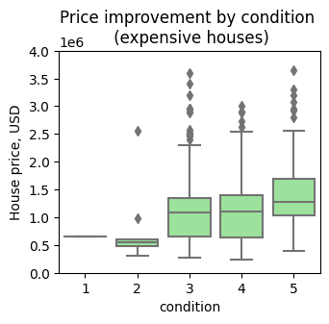
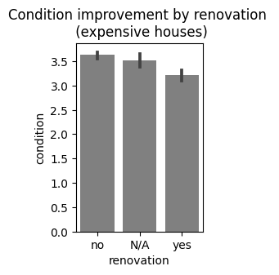
Conditions and renovation of expensive houses
Expensive houses fetch higher prices when in good condition or renovated

Slide 11
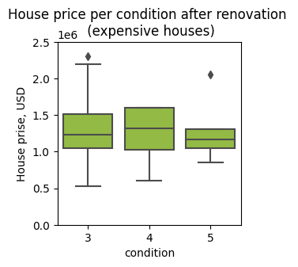
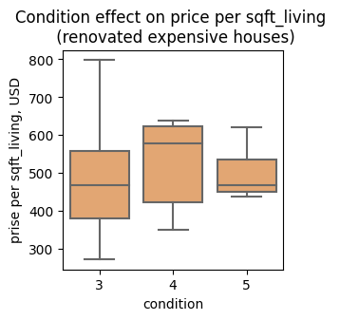
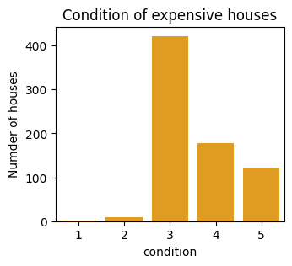
Conditions and renovation of expensive houses
Renovation up to a good condition is usual, further renovation can increase the price

Slide 12
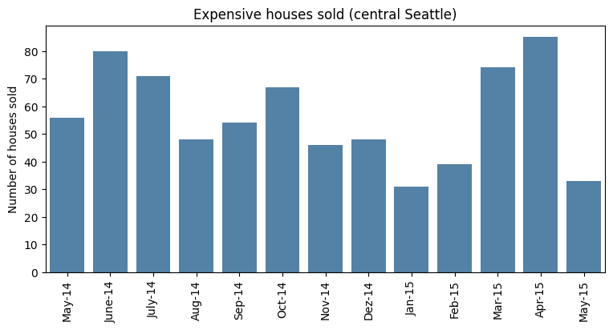
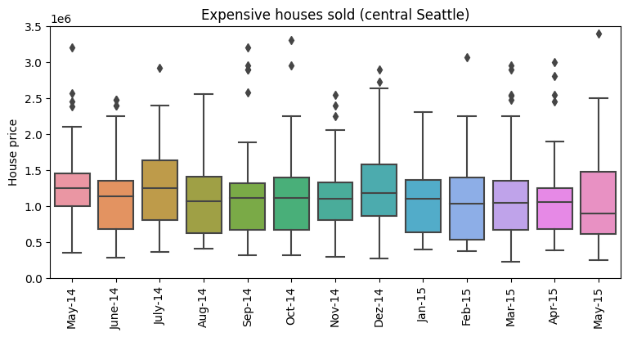
Is the best selling time of the year also indicates best price?

Slide 13
Is the best selling time of the year also indicates best price?

Slide 14
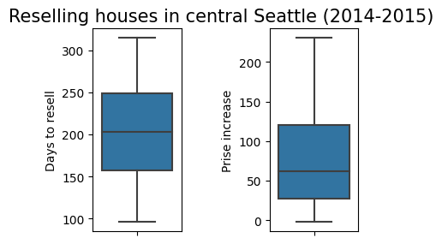
Is the best selling time of the year also indicates best price?

Slide 15
Conclusions:
Expensive houses in central Seattle were sold in good conditions(above 3)
Renovated houses had higher price, even higher when renovation acquired very good condition (4)
Best selling time is spring and summer, higher prices were acquired in July.
During fast reselling (about 200 days) in central Seattle prices were increased about 60-80%

