Slide 1
Are We Embedded Yet?
Implementing tiny HTTP server on a microcontroller
Notes:
My little journey

Slide 2
whoami
Maor Malka -
Electronics Engineer and Maker
Currently working as a Digital Design Engineer @ ARBE
Doing Embedded Code , Hardware Design and Logic Design for the past 11 Years
Trying to add Rust as a part of my toolbox

Slide 3


Agenda
Microcontrollers quick glance
The challenge with rust
Use case
Creating the Driver
Creating the build environment
Debugging
Results/Demo
Conclusions

Slide 4
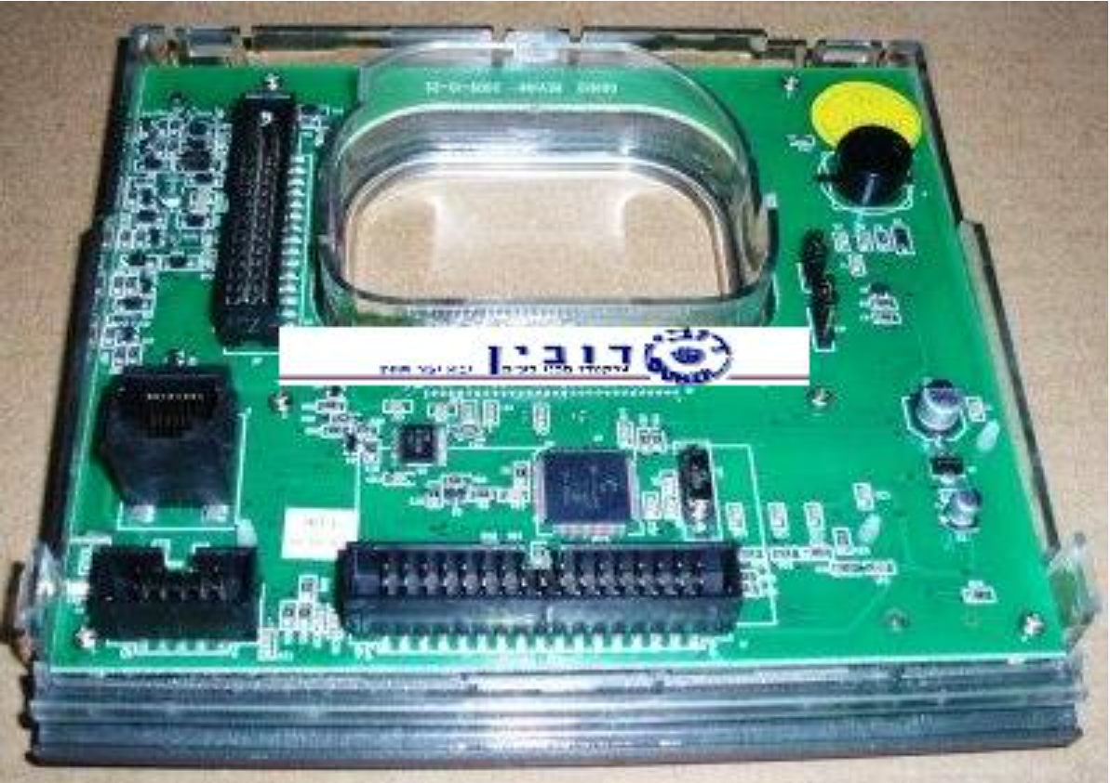
What are microcontrollers?
Microcontrollers are compact, self-contained computing devices.
They consist of a processor memory,peripherals, and sometimes additional specialized hardware, all integrated onto a single chip.
Designed for real-time operations- Most microcontrollers run either a Bare metal environment running a basic task loop or an interrupt driven loop; or use an RTOS which will ensure consistent, deterministic behaviour
They are engineered for low power consumption, making them suitable for battery-operated and energy-efficient devices.
And yes, they are everywhere.
This one.

Slide 5
What types are there?
Microcontrollers come in many many variants, and is a constant battle between performance,power and price
Here are some example of the possible processor architectures you can find in microcontrollers used today:
8 Bit: AVR (classic arduino), PIC (microchip), 8051
16 Bit: MSP430(TI), dsPIC (microchip)
32 Bit: ARM(M series),RISC-V, MIPS
Memory is scarce, and can vary as low as 8KB of FLASH and 512 bytes of RAM
You can still buy one time programmable ones, as cheap as 0.03$ per piece!
Notes:
Mention peripheral examples (usb camera displays etc)
8051 parking gates

Slide 6
What About Rust?

Slide 7
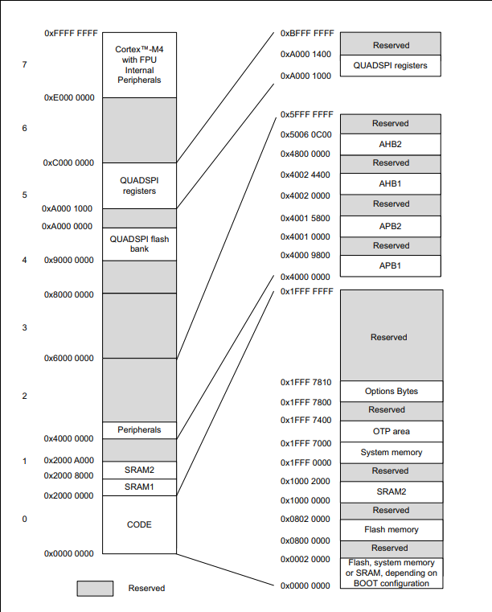
Most microcontrollers implement a
single address space for Everything.
This includes Your Code, RAM, and Peripherals.
That means that to access the perierpals
we read and write to certain address spaces.
Why is that a problem?
Notes:
No MMU

Slide 8
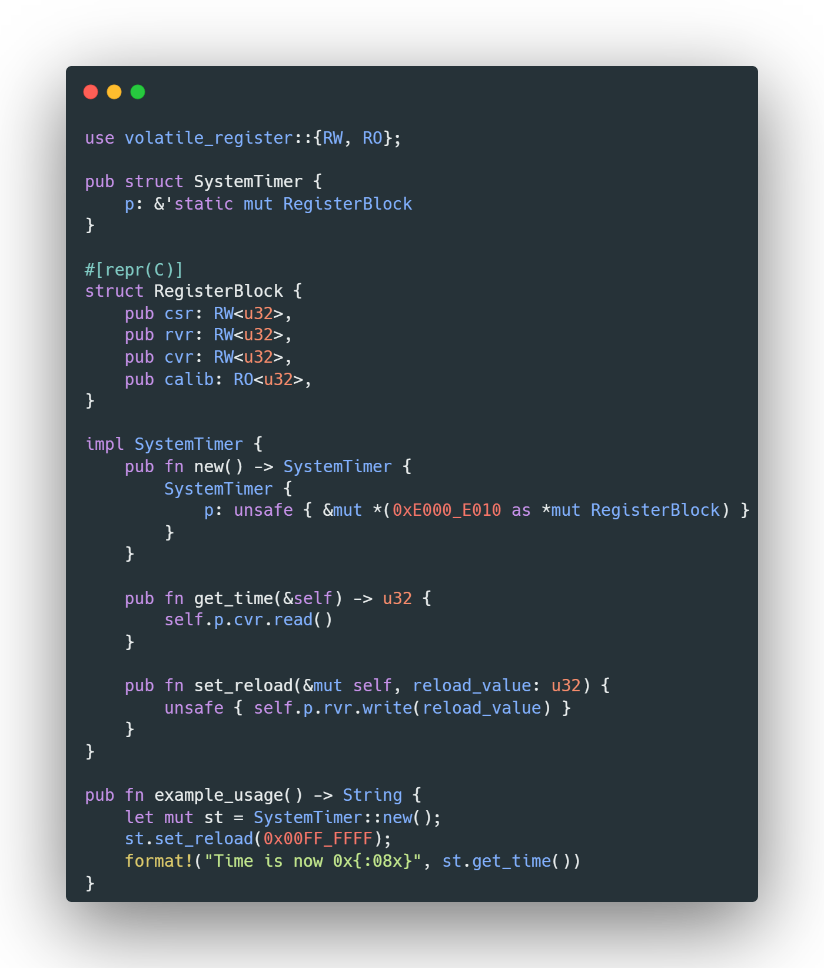
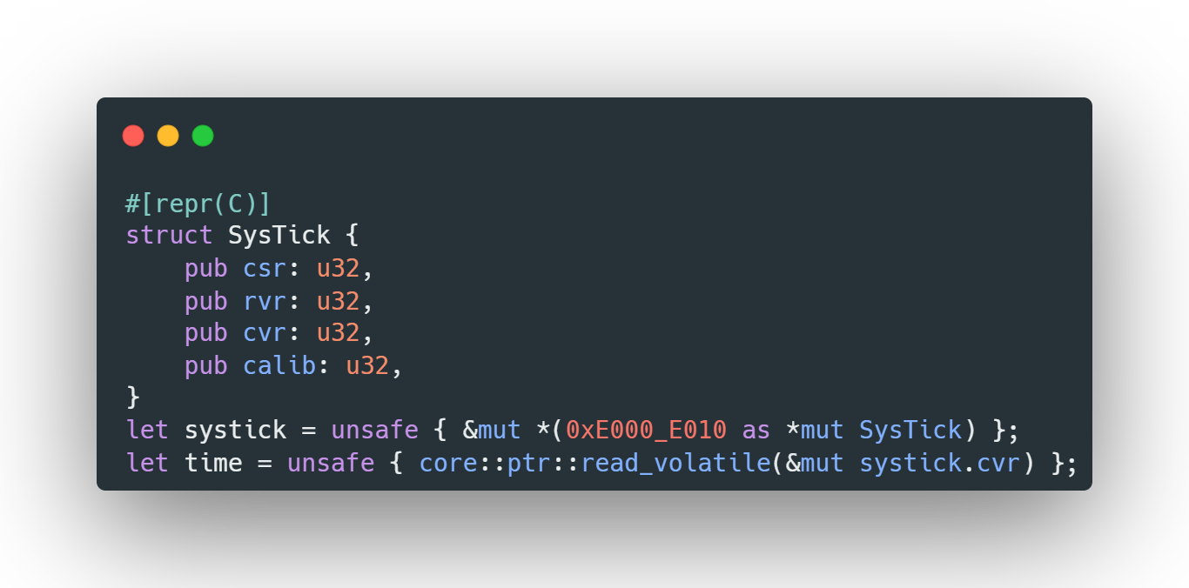
Systick, located at 0xE000_E010
Offset | Name | Description | Width
0x00 | SYST_CSR | Control and Status Register | 32 bits
0x04 | SYST_RVR | Reload Value Register | 32 bits
0x08 | SYST_CVR | Current Value Register | 32 bits
0x0C | SYST_CALIB | Calibration Value Register (Read only) | 32 bits
BUT WHAT ABOUT THE BORROW CHECKER?
Notes:
Due to this being mem access the compiler will try to optimize out the accesses
dereferences a mutable raw pointer obtained from the hexadecimal address 0xE000_E010, treating it as a SysTick object, and returns a mutable reference to it.

Slide 9
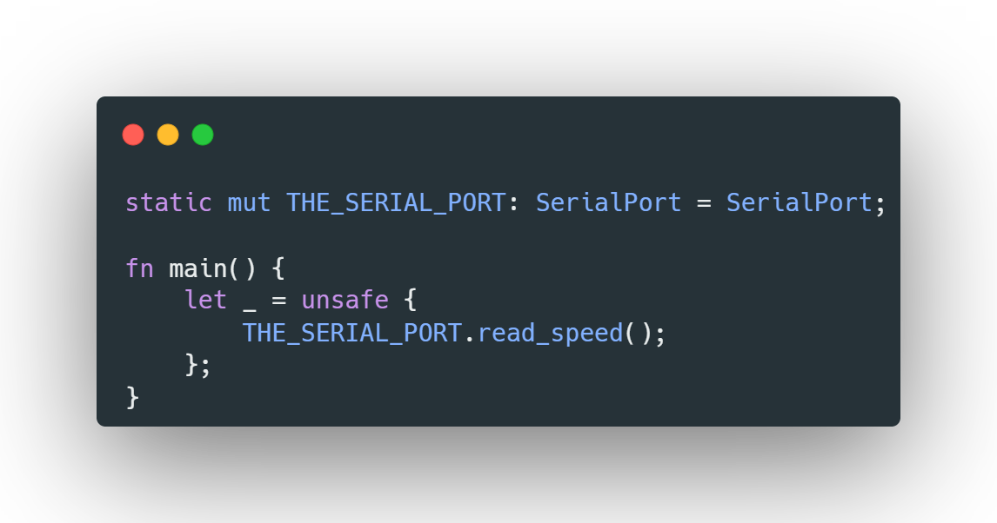
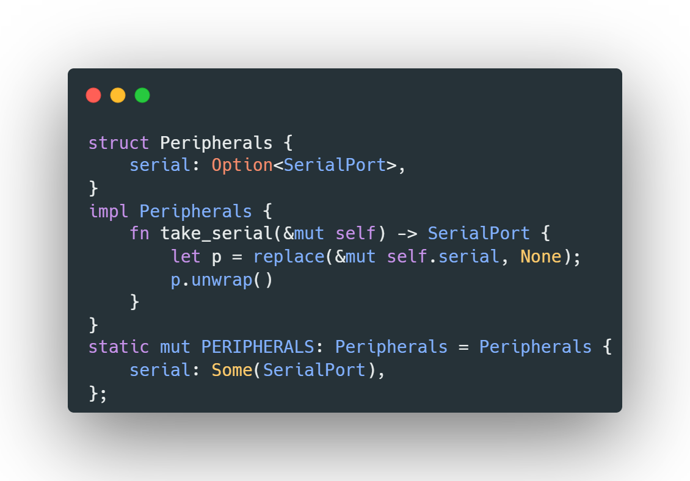
How to handle borrow checking on the peripherals?
Why not make peripherals a global mutable static variable?
The User Can borrow access to the peripherals
Any additional borrow will cause a panic.

Slide 10
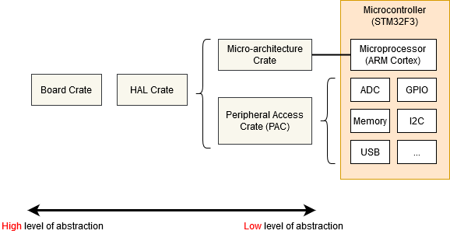
HAL 9000
The methodology of using all of these peripherals will require us to write a lot of code to access all these peripherals.
Luckly, most microcontroller designers also provide an SVD file, which describes all the peripherals, their addresses, and fields.
This SVD file can be converted to the Peripheral Access Crate, which creates the necessary structs and mapping to allow for proper access to the peripherals.
This however is not enough as you’ll still need a lot of manual register writes to perform tasks on the peripherals, and thus, a Hardware Abstraction Library (HAL) is written to allow the user to perform basic operations on the peripherals.
Notes:
SVD python joke

Slide 11
Use case
I wanted try and create a somewhat useful project using embedded rust to show several aspects
Reuse The ability to use cargo to save a lot of time making code blocks
Size Even when using rust we can still fit in small sized microcontrollers
Safety
Leveraging rust to ensure no funny business is done unknowingly

Slide 12
The Task?
Implement a working “web server” on an STM32.
Why? To allow GUI usage without needing additional SW*
The Problem?
Our microcontroller (STM32l412):
Has no networking hardware.
Has no file system support.
Has only 128 KB of Flash and 40 KB of RAM.
Notes:
Archaic languages C# joke

Slide 13
#![no_std]
Given the Space limitations, it is very common to use #![no_std] in embedded rust projects.
This implies that we need to additional steps to get basic functions of rust working (such as Vec,Panics)
This also implies that any crate we choose to use has to support running in #![no_std] mode.

Slide 14
So what are we doing?
The plan is to use the USB interface of the STM32 microcontroller to create a compliant CDC-NCM device, AKA- USB-Ethernet Dongle
Next, we will need to get a TCP/IP stack working on the board and create a network interface adapter that will support our USB interface
Finally, We will create a server with two sockets:
A HTTP socket which will serve the website and handle GET/POST requests
A DHCP socket which will give the computer which the device is connected to an IP.

Slide 15
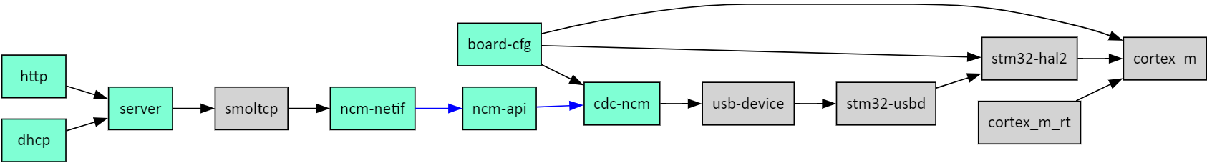
Kind of like this
Gray: Crates
Lightblue: Code we need to write

Slide 16
Creating the driver
CDC-NCM Driver
Writing an CDC-NCM descriptors as per the USB spec supported by usb-device crate
Building an API handler to parse the incoming USB traffic and convert it to ethernet packets and vise-versa
As packets arrive in small chunks (64 bytes), we need to buffer and slowly parse the messages, this was done using a concurrent queue
Smoltcp netif
Smoltcp expects the crate user to create a network interface and connect it by providing tx/rx tokens it will consume
This was implemented by creating a concurrent queue between the NCM-API handler and the NETIF

Slide 17
The Bare Metal build environment
Cross-compiler toolchain
Runtime
Memory.x (Linker Script)
Build.rs (to force rustc to use the linkers script)
Our Main.rs which contains:
Entry point for our code
A Panic Handler
Global Allocator
Hardware Exception Handlers
Notes:
Elf
Cortex-m-rt
The memory layout of the program. In particular, it populates the vector table so the device can boot correctly, and properly dispatch exceptions and interrupts.
Initializing static variables before the program entry point.
Enabling the FPU before the program entry point if the target is -eabihf.

Slide 18
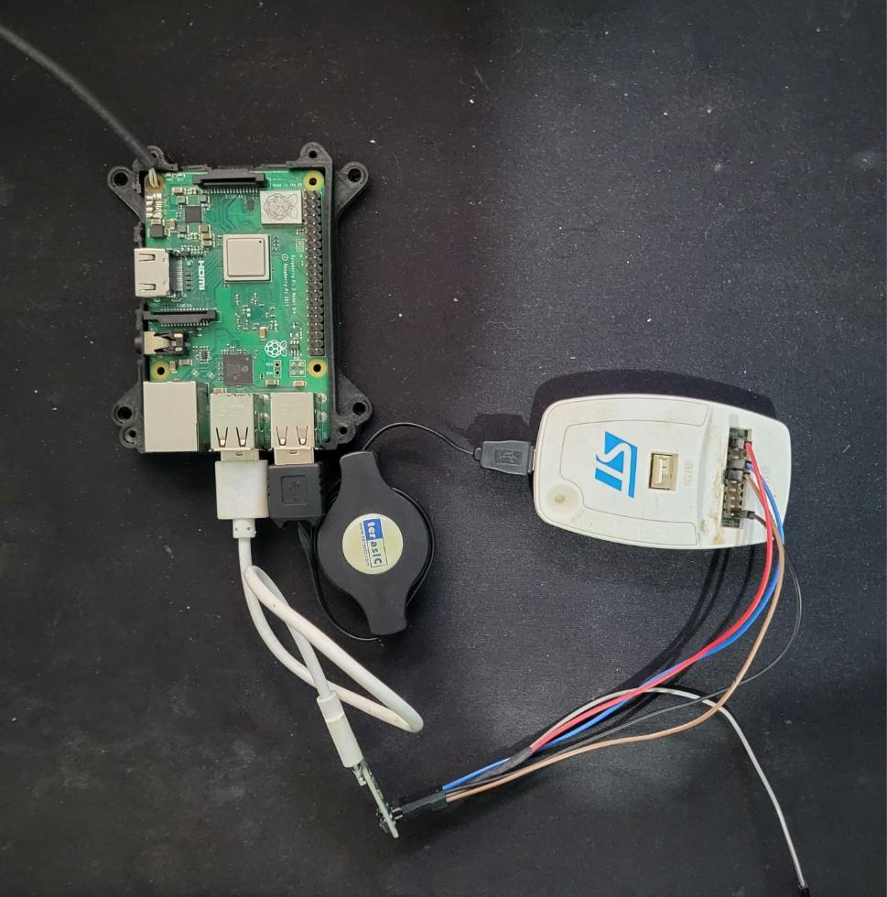
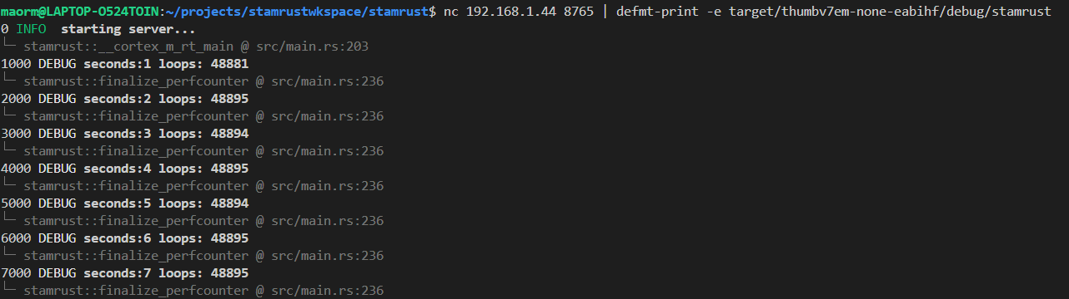
Debugging
Debugging is super easy; If you have the right tools.
As rust supports GDB, we can easily setup a GDB server using openOCD which interfaces to the board via a jtag debugger
As the microcontroller uses a modern ARM core, we also have access to the RTT (real-time trace)
That coupled with ferrous-systems defmt allows us to get logs and even panics printed out to our console!
Notes:
Most people use uart for debugging
Usb enumeration fucks with windows

Slide 19
Safety?
Global variables
As common as sand in embedded projects
Being forced to use a mutex
Concurrency
Can’t do it otherwise
Interrupt driven ready
Compilation/Panic gotchas
overflow/underflow
Invalid api sizes
Notes:
Concurrent queue
Compilation gotcas

Slide 20
Demo Time!
Notes:
93KB of flash of which ~6KB is the website
16KB of RAM used for heap

Slide 21
Conclusions
Are the goals covered?
Yes! we have a working project, which is fast, light and safe!
Embedded engineers are a tough nut.
Experience and insanity will make it very difficult to shift embedded software engineers to attempt new languages other than C (or C++ on embedded linux).
However… are we embedded?
Professional safe environments
Automotive - ISO26262, ferrous systems has created a certified rustc which can be used on automotive systems
Aerospace -DO178 has not yet been adopted
Medical - IEC 60601 has not yet been adopted
Military?
The customer-vendor problem
As long as customers do not request usage of rust, the support and toolchains will be stuck in open source support
RTOS in rust
Embassy
RTIC
lilos
RTOS in C
FreeRTOS (21 Years)
AzureRTOS (27 Years)
uC/OS (33 Years)
Notes:
https://community.nxp.com/t5/i-MX-RT/Embedding-Rust-Language-applications-on-the-i-MX-RT/m-p/1291581

Slide 22
Thank you!
questions?

