Slide 1
Music store DB
Database Design and Maintenance– Final Project Presentation

Slide 2
CONTENT
Music Store DB – ER Diagram
Queries – Statements and Execution
Additional Scenarios - Statements and Execution

Slide 3
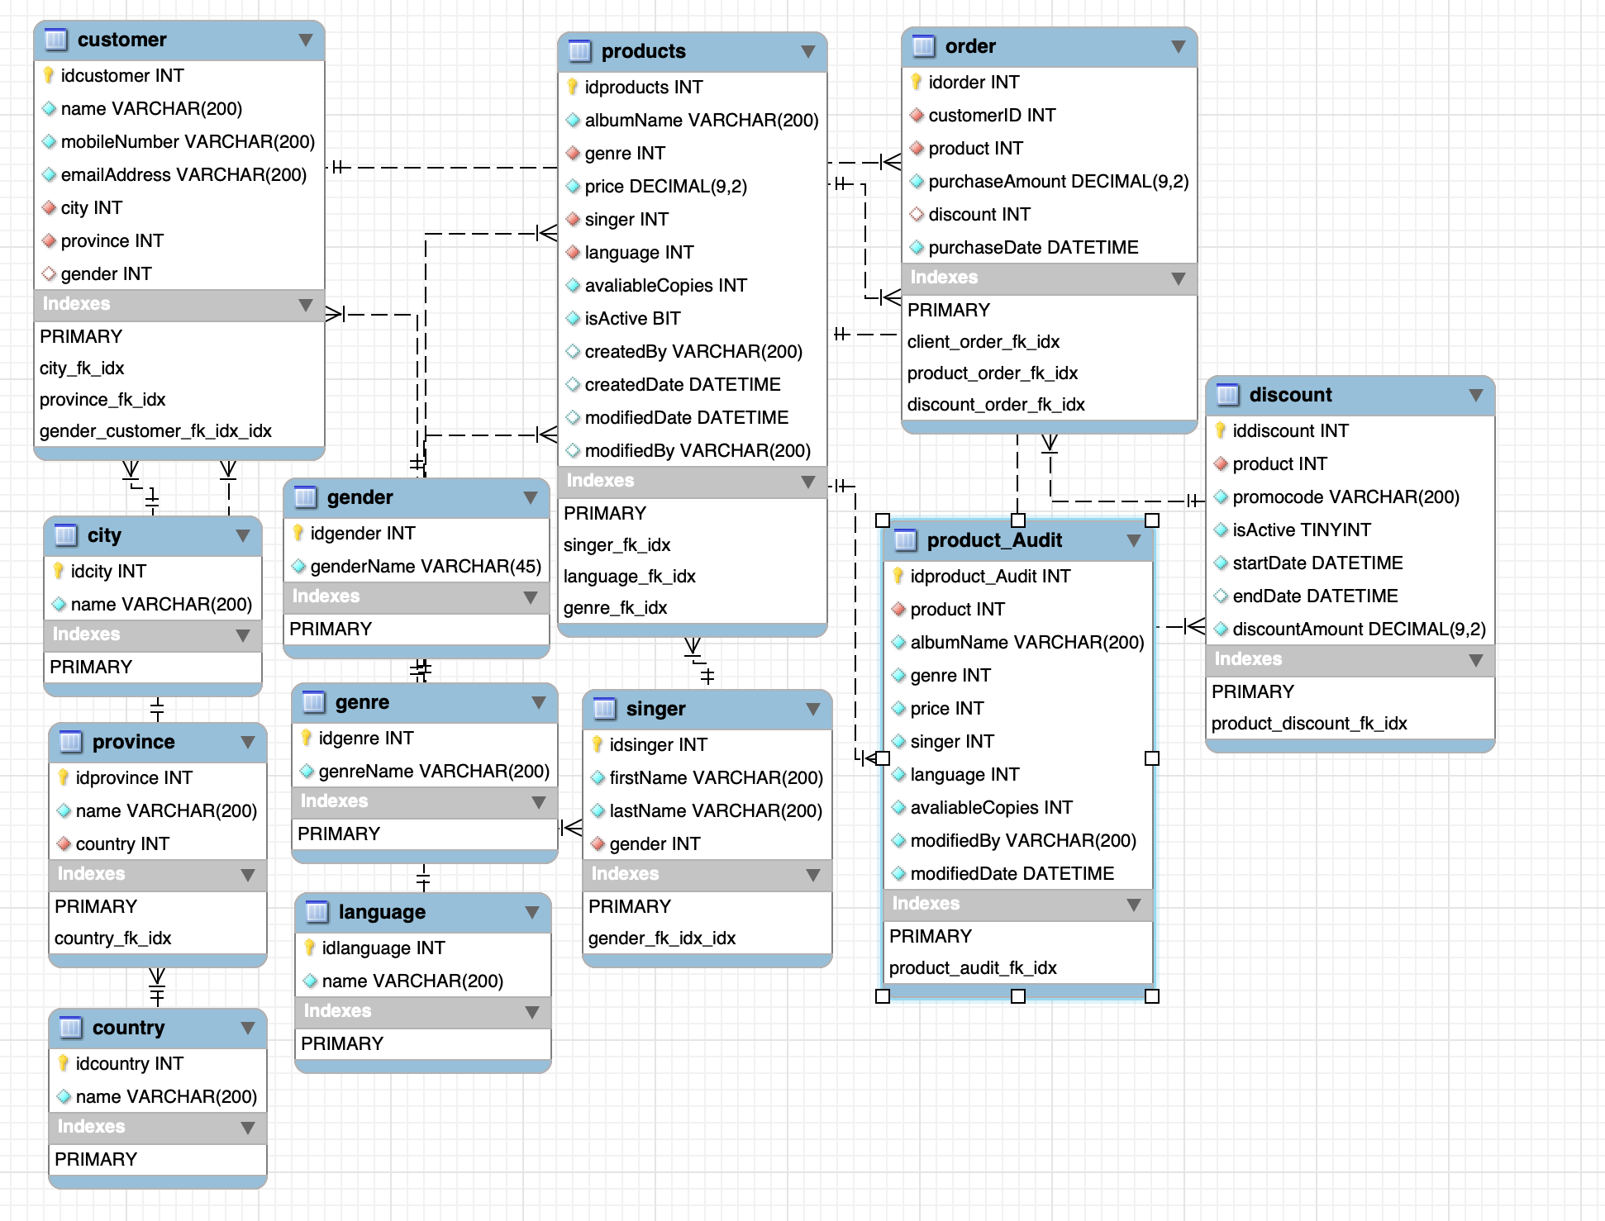
Music Store DB – ER Diagram

Slide 4
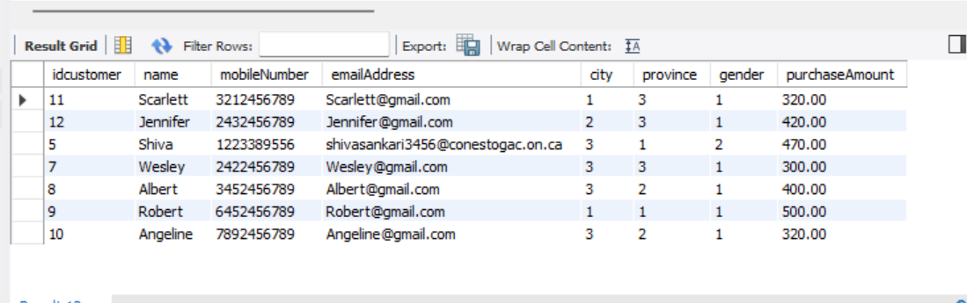
Query 1 - Display a list of clients that spent more than the average spent by client in the past month.
Statement
Result Set
select c.*,O.purchaseAmount
from `order` O
inner join customer C on C.idcustomer = O.customerid
where O.purchaseAmount > (select P.AverageAmount from (select AVG(purchaseAmount) AS AverageAmount,
DATE_FORMAT(purchaseDate, "%M-%Y") AS PurchaseMonth
from `order`
where MONTH(purchaseDate) = MONTH(CURRENT_DATE - INTERVAL 1 MONTH)
group by DATE_FORMAT(purchaseDate, "%M-%Y")) AS P);

Slide 5
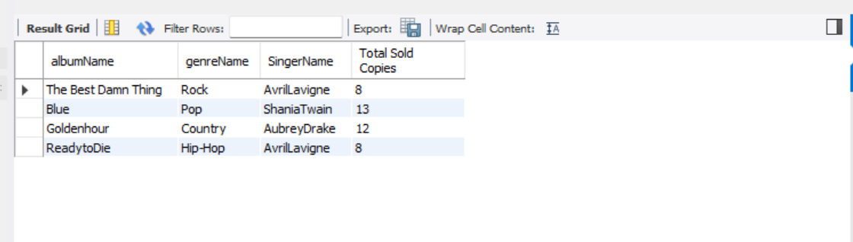
Query 2 - The top sold products and least sold products over a week.
Statement
Result Set
SELECT P.albumName,G.genreName,CONCAT(S.firstname, S.lastname) AS SingerName
,SUM(OO.Count) as `Total Sold Copies`
FROM products P
INNER JOIN (SELECT * FROM (SELECT COUNT(O.product) AS Count, O.product
FROM `ORDER` O
WHERE DAY(O.purchaseDate) BETWEEN (DAY(O.purchaseDate) - 7) AND DAY(O.purchaseDate)
GROUP BY O.product) AS O) OO on OO.product = P.idproducts
INNER JOIN genre G ON G.idgenre = P.genre
INNER JOIN singer S ON S.idsinger = P.singer
GROUP BY P.albumName,G.genreName,CONCAT(S.firstname, S.lastname);

Slide 6
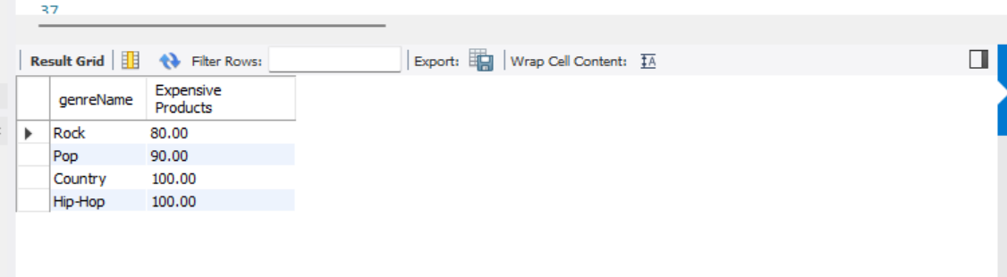
Query 3 - The maximum price of products in the same genre (for example, rock, pop, country, hip-hop). Use GROUP BY to list all the genres and their maximum price.
Statement
Result Set
SELECT G.genreName,MAX(P.price) AS `Expensive Products`
FROM products P
INNER JOIN genre G ON G.idgenre = P.genre
GROUP BY G.genreName

Slide 7
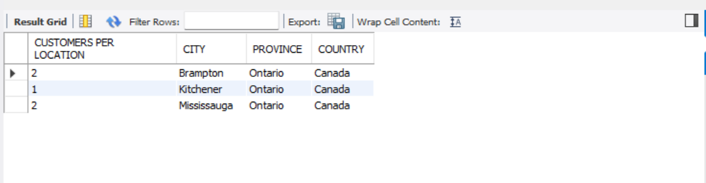
Query 4 - List how many customers the system has by location (Country, Province, and City), and then sort them.
Statement
Result Set
SELECT COUNT(IDCUSTOMER) AS "CUSTOMERS PER LOCATION",
C.NAME AS CITY, PR.NAME AS PROVINCE, COU.NAME AS COUNTRY FROM CUSTOMER CU JOIN CITY C ON C.IDCITY = CU.CITY JOIN PROVINCE PR ON PR.IDPROVINCE = CU.PROVINCE JOIN COUNTRY COU ON COU.IDCOUNTRY = PR.COUNTRY GROUP BY CITY ORDER BY CITY, PROVINCE,COUNTRY

Slide 8
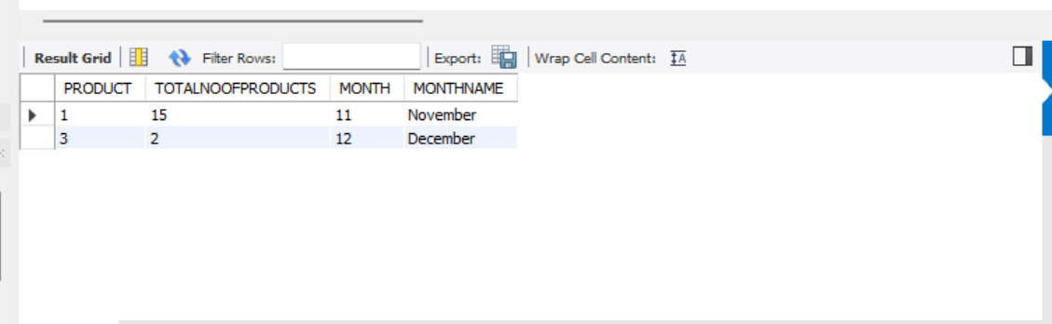
Query 5 - List how many products the store has sold for a particular month.
Statement
Result Set
SELECT PRODUCT, COUNT(*) AS TOTALNOOFPRODUCTS, EXTRACT(MONTH FROM PURCHASEDATE) AS MONTH, monthname(PURCHASEDATE) AS MONTHNAME FROM MUSIC_STORE.ORDER ORD JOIN MUSIC_STORE.PRODUCTS PR ON PR.IDPRODUCTS=ORD.PRODUCT GROUP BY MONTH(PURCHASEDATE)

Slide 9
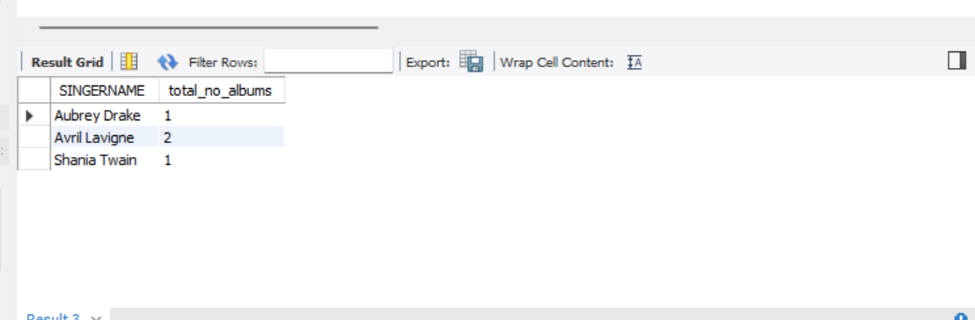
Query 6 - List how many distinct albums each singer has.
Statement
Result Set
SELECT CONCAT(S.FIRSTNAME, ' ', S.LASTNAME) AS SINGERNAME, COUNT(DISTINCT ALBUMNAME) AS total_no_albums FROM PRODUCTS P JOIN SINGER S ON P.SINGER=S.IDSINGER GROUP BY IDSINGER ORDER BY SINGERNAME

Slide 10
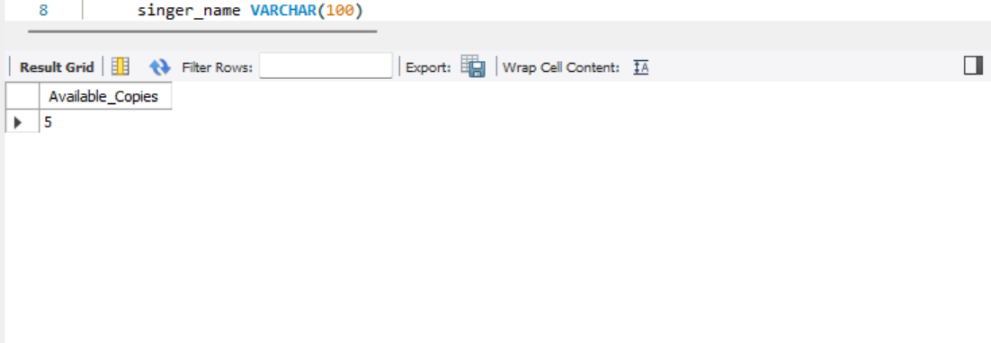
Query 7 - List how many copies of an album are available of a particular singer.
Statement
Result Set
DELIMITER // DROP FUNCTION IF EXISTS available_copies; CREATE FUNCTION available_copies ( singer_name VARCHAR(100) ) RETURNS INT NOT DETERMINISTIC READS SQL DATA BEGIN DECLARE no_of_copies INT; SELECT SUM(avaliableCopies) INTO no_of_copies FROM music_store.products WHERE music_store.products.singer = (SELECT idsinger FROM singer WHERE CONCAT(music_store.singer.firstName, ' ', music_store.singer.lastName) = singer_name); RETURN no_of_copies; END//
--QUERY
SELECT P.albumName AS ALBUMNAME,SUM(available_copies(CONCAT(S.firstName, ' ', S.lastName))) as AVAILABLECOPIESFROM singer SINNER JOIN products P ON P.singer = S.idsingerWHERE idsinger = 1GROUP BY p.albumname

Slide 11
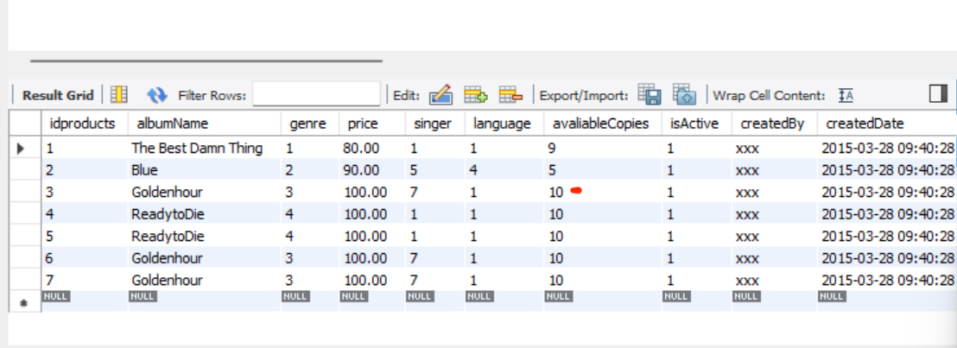
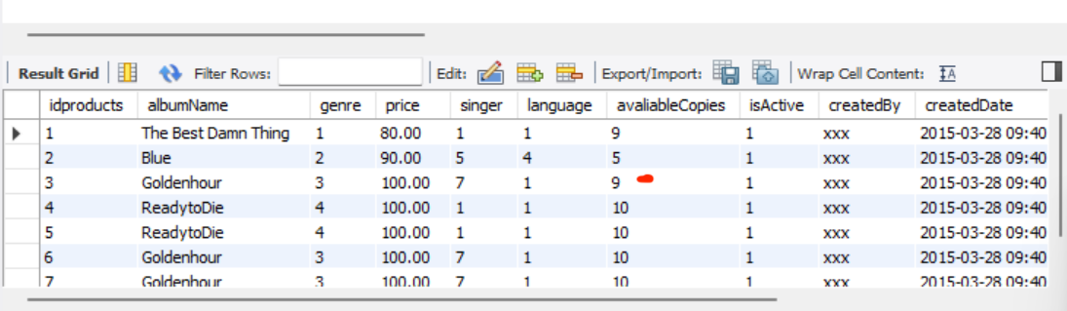
Scenario 1 - Automatic Update of the Available copies with respect to the Order update.
Statement
Result Set
DELIMITER // DROP TRIGGER IF EXISTS update_pending_copies;
CREATE TRIGGER update_pending_copies AFTER INSERT ON music_store.order FOR EACH ROW BEGIN DECLARE product_id INT; DECLARE available_copies INT; SET product_id = NEW.product; SELECT avaliableCopies INTO available_copies FROM music_store.products WHERE idproducts = product_id; UPDATE music_store.products SET music_store.products.avaliableCopies = available_copies -1 WHERE idproducts = product_id; END//

Slide 12
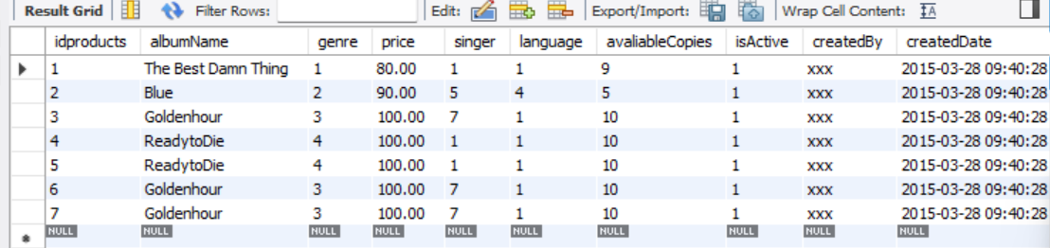
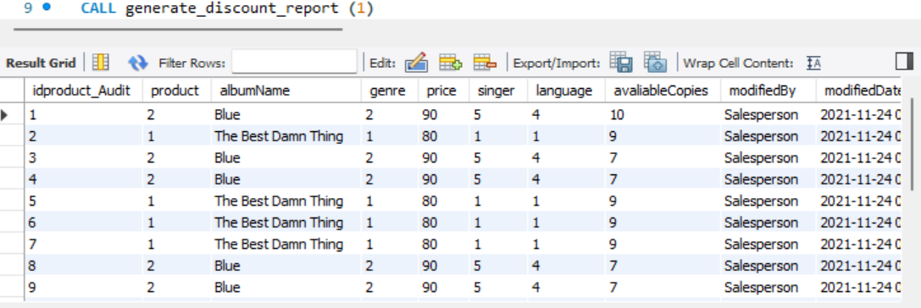
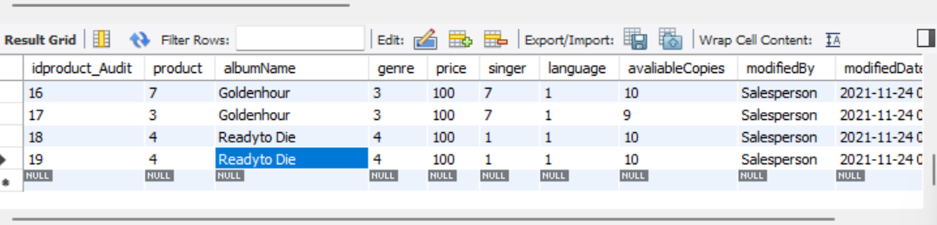
Scenario 2 - Automatic update of the Product Audit table for every update occurring in the product table.
Statement
Result Set
DELIMITER //
DROP TRIGGER IF EXISTS update_product_audit_table;
CREATE TRIGGER update_product_audit_table
AFTER UPDATE ON products
FOR EACH ROW
BEGIN
INSERT INTO product_Audit
(product, albumName, genre, price, singer, language, avaliableCopies, modifiedBy, modifiedDate)VALUES
(OLD.idproducts, OLD.albumName, OLD.genre, OLD.price, OLD.singer, OLD.language,
OLD.avaliableCopies, OLD.modifiedBy, NOW());
END//

Slide 13
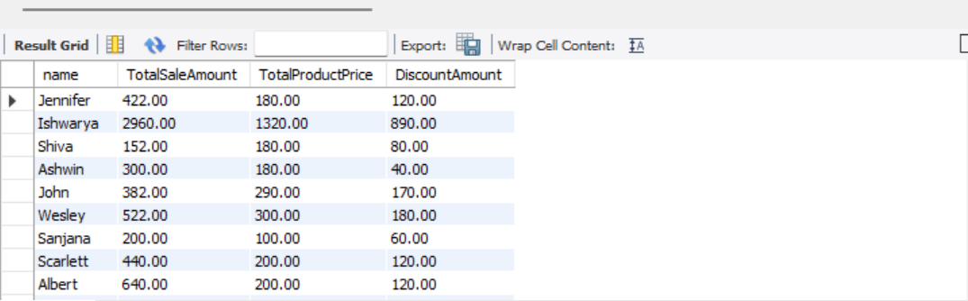
Scenario 3 – View to see the discount report – Customer wise
Statement
Result Set
CREATE VIEW CustomerDiscountReport AS SELECT P.name,SUM(O.purchaseAmount) AS TotalSaleAmount,SUM(C.price) AS TotalProductPrice ,SUM(D.discountAmount) AS DiscountAmount FROM `order` O INNER JOIN customer P ON P.idcustomer = O.customerID INNER JOIN discount D ON D.iddiscount = O.discount INNER JOIN products C ON C.idproducts = O.product WHERE O.discount IS NOT NULL GROUP BY P.name;

Slide 14
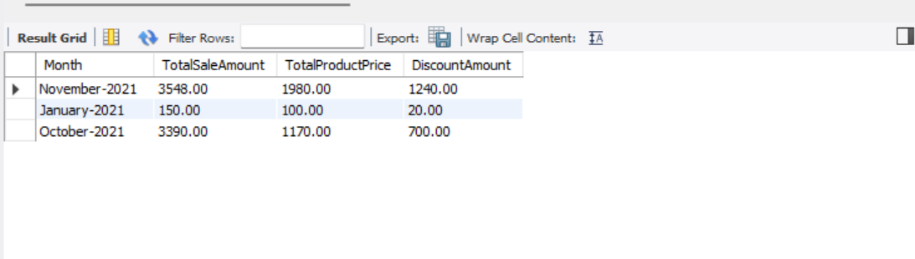
Scenario 3 – View to see the discount report – Month wise
Statement
Result Set
CREATE VIEW MonthWiseDiscountReport AS SELECT DATE_FORMAT(purchaseDate, "%M-%Y") as `Month`,SUM(O.purchaseAmount) AS TotalSaleAmount,SUM(C.price) AS TotalProductPrice ,SUM(D.discountAmount) AS DiscountAmount FROM `order` O INNER JOIN customer P ON P.idcustomer = O.customerID INNER JOIN discount D ON D.iddiscount = O.discount INNER JOIN products C ON C.idproducts = O.product WHERE O.discount IS NOT NULL GROUP BY DATE_FORMAT(purchaseDate, "%M-%Y")

Slide 15

Thank YOU !!

