Slide 1
Summary project Airport X
data analyst course Analiza intelligence-Cyber-Data
Name: Igal Itshaki
March 2023

Slide 2
Background
The goal is to evaluate the success of the company’s and various products. For this goal in this project performed analysis of different manners of the company and its products that will able to give insights on todays company situation, on general and with respect to the various products and to understand what should be done in the future.
First question deal with analysis of the sales performances of the company in general and in specific to the products, the category they belong and and their manufacturer.
As an intermediate product for the continue analysis was developed a dashboard for tracking sales shows the different aspects and enables to gain insights.
Second analysis that was done is about profits, profit of the company and profits of products, also in resolution of categories and the manufacturers.
Third analysis aimed to explain the business distribution geographically in the various states, by analyzing costs of shipping/tax in the purchasing and the sales phases.

Slide 3
Question1 for analysis
Question 1- sales analysis
what are sales performances of all company products and especially most successful products?
The question divided to sub-questions.

Slide 4
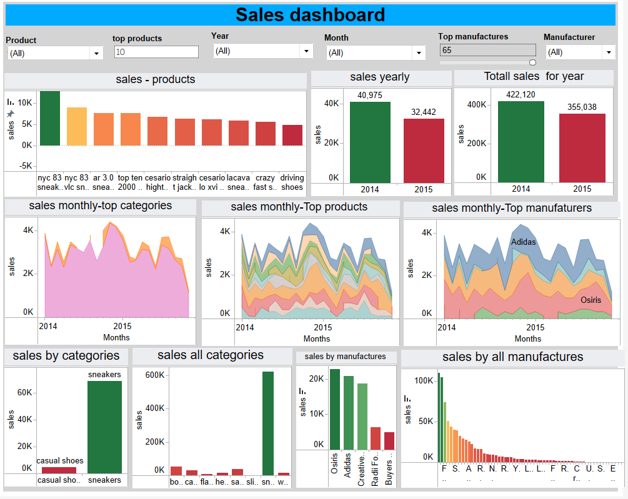
Question 1- results and conclusions
Sales dashboard

Slide 5
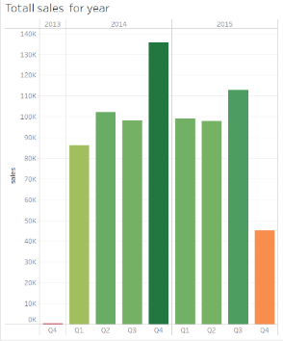
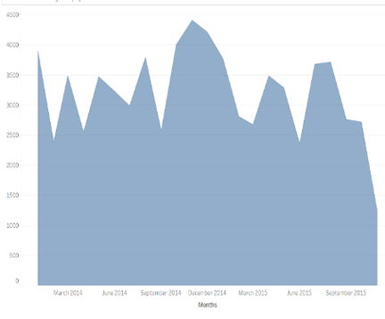
Question 1- results and conclusions
Sales dashboard
- According to data 2014 sales performances are higher, 422K$ and 2015 355K$
- No data on December 2015 sales
- Sales of quarters -2015 performance higher, Q4 have missed data on December 2015
- Sales performances trend spoused to be improved after adding December data,
Without doing changes in the company.
Sales by quarters
Sales monthly

Slide 6
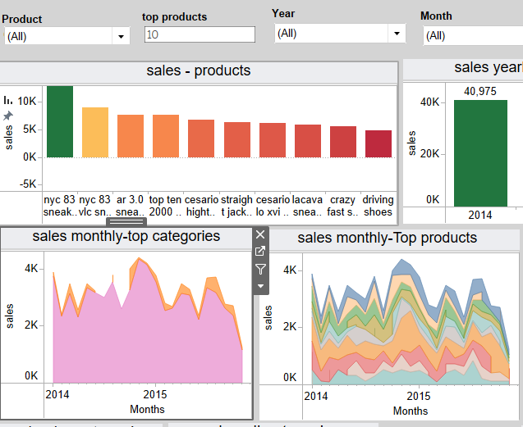
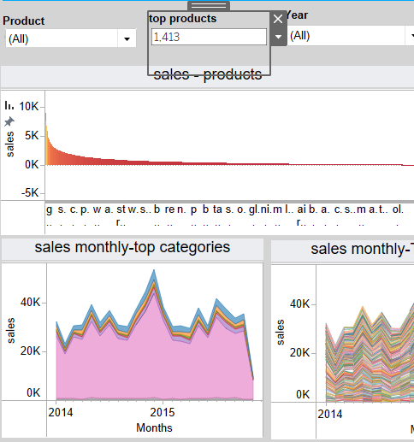
Question 1- results and conclusions
Sales dashboard
-core category: Most of products sales are belong to sneakers category, and it can be seen for in all levels of product quantities.
-Here an example (left side) of top 10 products and the other one(right side) the data
is on maximum number of products at the company. In two cases sneakers category
leads while other categories are seen less. As for these situation we recommend to improve the marketing of other categories in order to improve sales.

Slide 7
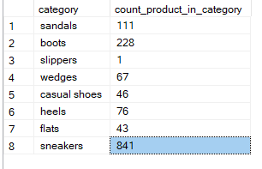
Question 1- results and conclusions
Continue -Sales of non sneakers categories: Further examination of this point that boots category has 228 products and it expected in relate to sneakers category to have much higher sales, more then three time sales. also sandals expected to achieve more sales in relates to sneakers performances, approximately 2 time sales.
- As we don’t have data for the aspect of marketing , it can be assumed that needed a marketing plan or price reductions, or the other option recomaanded is to remove products and bring new products for sale.
category | Products quantity | Amount sales | Sales for 1 product
sneakers | 841 | 620,005 | 737
boots | 228 | 52,222 | 229
sandals | 111 | 37,095 | 334

Slide 8
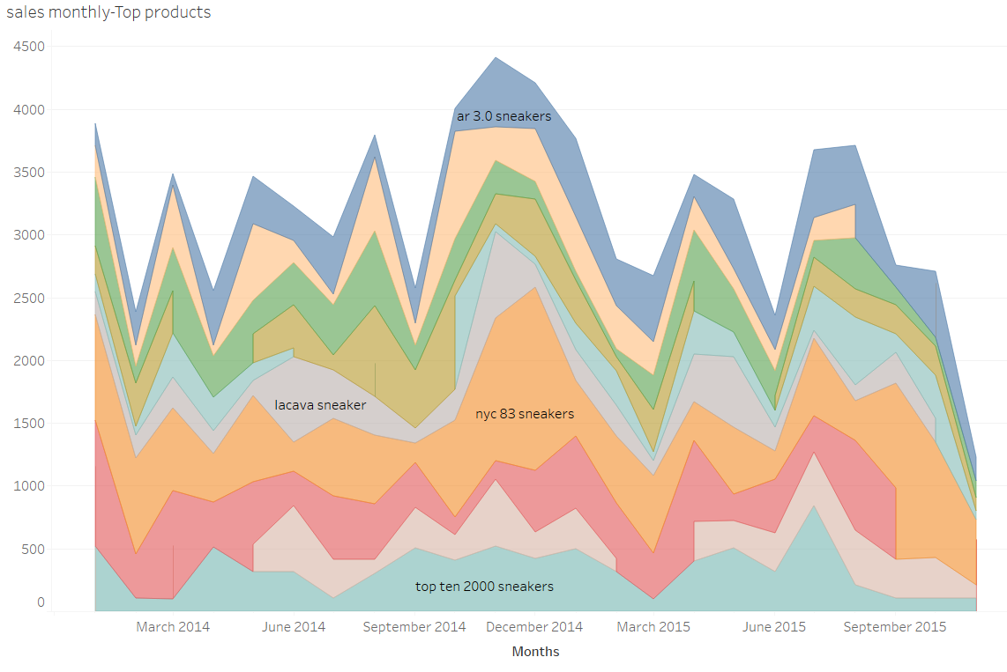
Question 1- results and conclusions
-top products: For product top 10 breakdown by time it can be see that there are products that have, in relative manner to others – ‘hard demand’ and have high demand in relative to other products (the nyc 83 series). Recomanded to continue purchasing sufficient quantity for inventory and sell more from those products, preferably purchasing in high amounts agreements from manufacturer in order to achieve better prices.
-the predictable sales for end of year is
High sales and it need to be also taken
Into account in inventory plan.

Slide 9
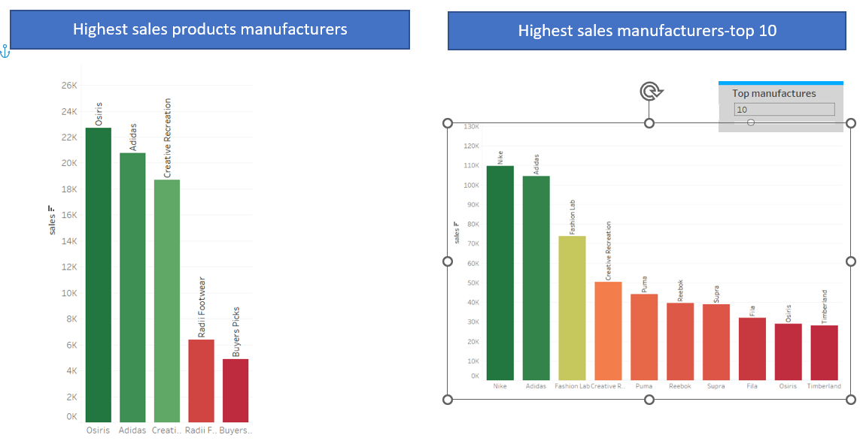
Question 1- results and conclusions
- diversity: In the manufacturers aspect, it arise that not necessarily the manufacturers that produce the best sellers products are also be the best sellers manufacturers in relation to all company manufacturers. Osiris company owe the 2 highest sales products but only in the nine place in sales among the rest manufacturers.
The top manufactures of
products hold more products
And thus have more sales.
It recommend to Increase
number of products Especially
top products owners.

Slide 10
Question 1- results and conclusions
- Marketing: Another aspect, as reflect from the manufacturers sales graph that NIKE and Adidas are in the first two places in sales. it is well known that this outstanding brands like them assist constantly with big stars.
It recommended to invest in marketing of product/ brands and assist famous figure in order to improve sales performances.

Slide 11
Question2 for analysis
what are profit performances of all company products and especially most successful products?
this question split for 2 cases- 1. with salaries and wages costs 2. without salaries and wages costs.
The question divided to sub-questions.
Assumptions:
Purchasing process costs: cost for purchasing products by airport_X, shipping costs are also paid by Airport_X company.
Sales: shipping and tax are paid by customers.

Slide 12
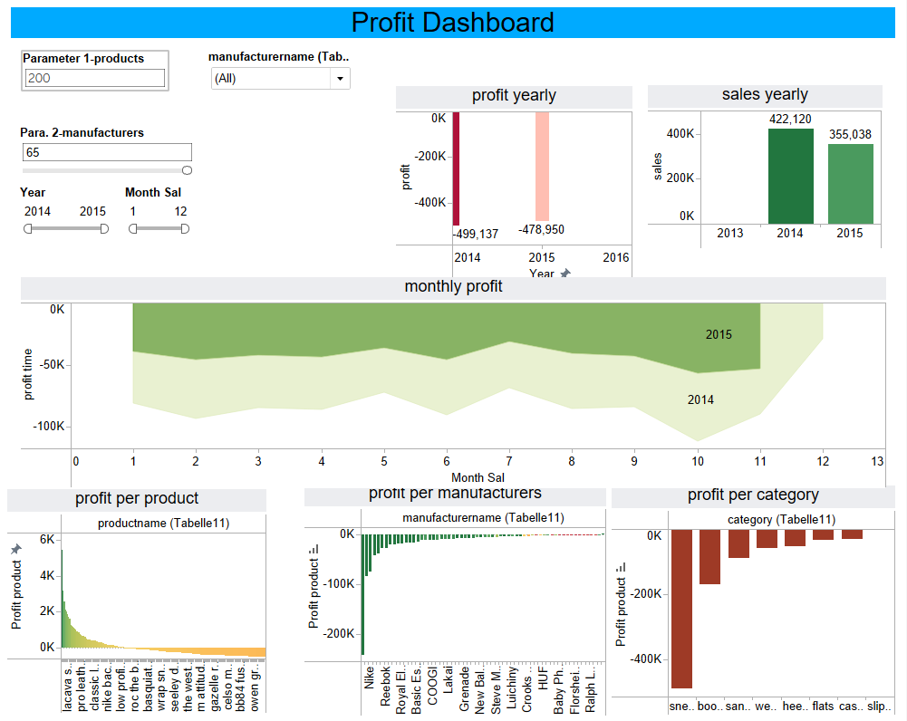
Question 2- results and conclusions
Case 1- costs included salaries and wages

Slide 13
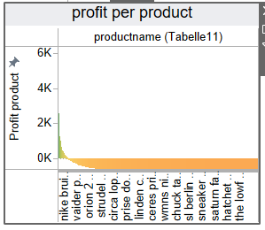
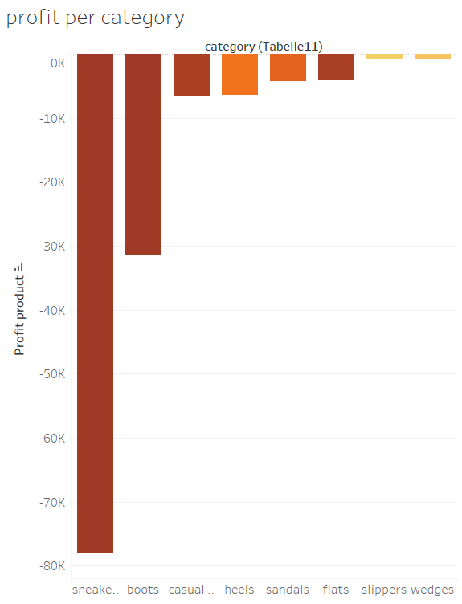
Question 2- results and conclusions
Case 1- costs included salaries and wages
-The results show that the sales aren’t sufficient as consider the investment.
There is a loss constantly and every month it become bigger.
- The top products still show profits but the
quantity of this products isn’t sufficient
-The majority of products don’t succeed to have profit enough, it can be seen in the graph below:
That most of products aren’t profitable.
-This situation is also reflected on categories and manufacturer graphs. The more products manufacturer /category have the more “expectetions” for sale are much more.
-

Slide 14
Question 2- results and conclusions
The recommendation is for cost reduction by cutting the work force in order To minimize the costs to appropriate level of the annually sales.
Also recommended to start and collect data on how much time spent on the various products/category in order to be able to evaluate the cost of products more accurately.

Slide 15
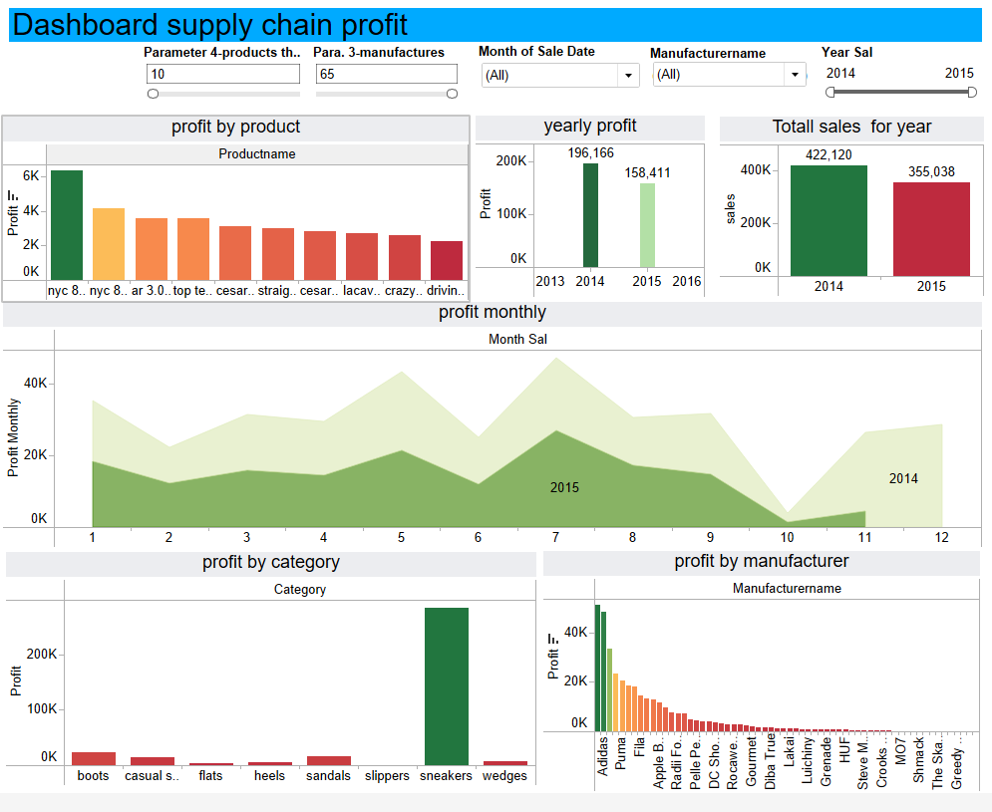
Question 2- results and conclusions
Case 2- costs without salaries and wages

Slide 16
Question 2- results and conclusions
Case 2- costs without salaries and wages
- We can see that in general 2015 was less profitable. From the monthly graph understood that no data on last year what influence dramatically on all year average sales, as we see that December 2014 has the highest profits.
-We can see that all products that lead are from sneekers category except 10 th place which belong to casual show.
Top manufacturers are nike, adidas and fashion lab.
-it is recomanded to improve sales of other categories as in compare to sneakers are less sold and less profitable.
Especially that the profits were hurt in last couple month It is important to make other categories stronger to improve the stability of the company, as the core category doent always sufficient.
.

Slide 17
Question3 for analysis
Question 3- additional cost analysis
How the map sales look like and the connection of additional costs for sales?
What are the purchasing shipping cost distribution from the various manufacturers which placed at the various states in the country, and the differences between them?
What are the sales shipping cost distribution throughout the country and the differences between them?

Slide 18
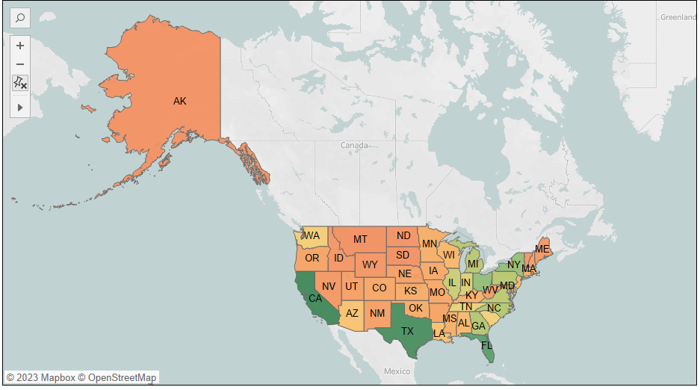
Question 3- results and conclusions
Heatmap -Sales in U.S
In the graph below we can see an heatmap show sales with dividing to states.
The goal is to analyze the additional cost to search a connection for the low performances of sales in most states in US.

Slide 19
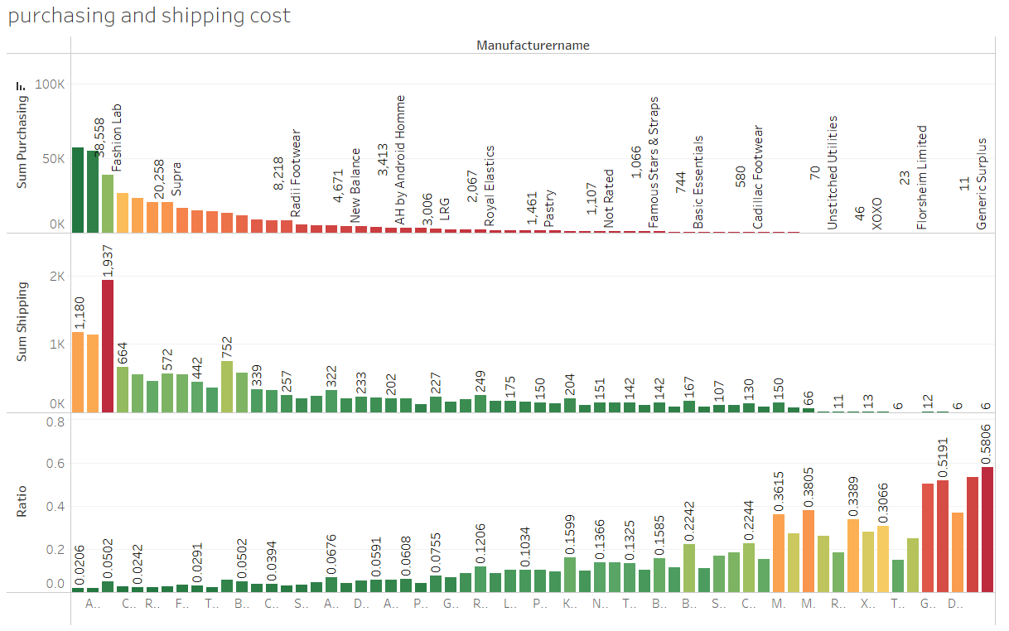
Question 3- results and conclusions
-the trend in ratio graph is higher
In cases less purchasing from the manufacturers committed.
Recommended to stop purchase from this suppliers.
correlation calculated -0.43771
means there is no significant connection between total purchasing to ratio but there is a negative connection between them, logically.

Slide 20
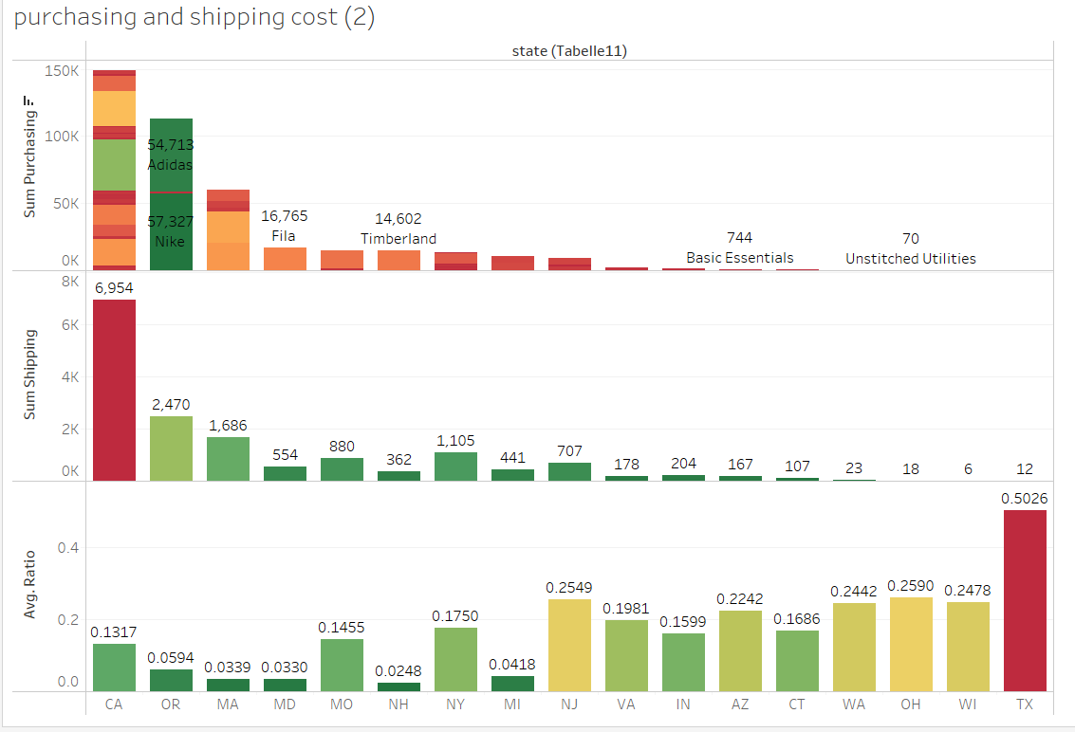
Question 3- results and conclusions
-in the graph we can see the data presented by states. We can see again high ratio of shipping cost to purchasing on the right side,especially from manufacturer from Texas with a ratio of above 0.5.
on the other side states that have more frequent purchase from their manufacturers , characterized by lower ratio of shipping/purchasing. California with ratio of 0.1317 is above the states in her scale of business with our company.

Slide 21
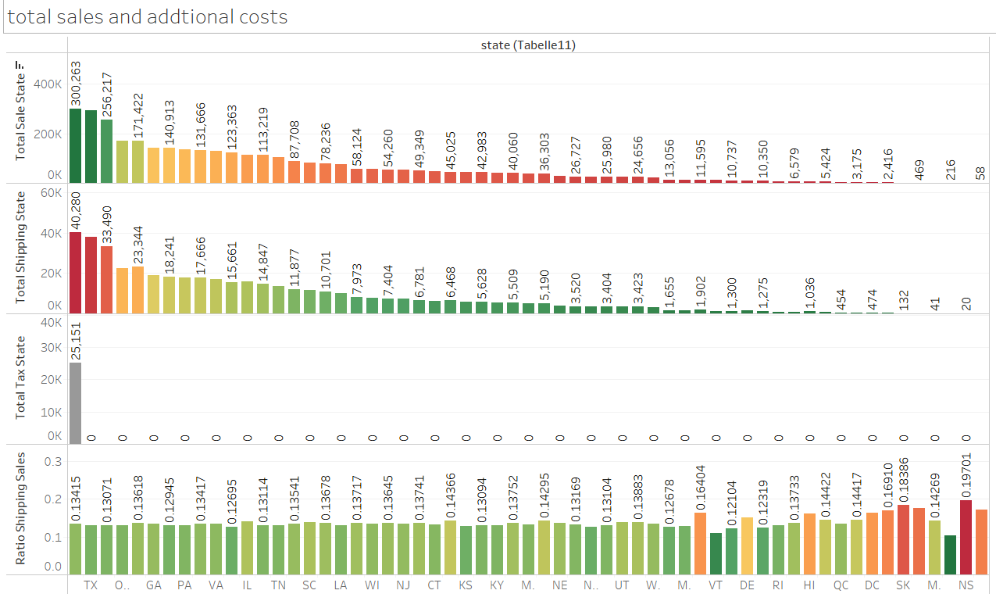

Question 3- results and conclusions
Conclusion
To remove or purchase less from manfacturers that have high ratio of shipping/purchasing, but also To take into account other aspects like purchasing volume which indicates on high/low sales performances.
Part 2-shipping costs and tax in sales
Here we can see that as the sales are less to a certain state the ratio of shipping/purchasing cost is higher. we do not have data why sales are low in the right side- is this because of marketing absence? Or shipping cost that are influence the customer decision to buy less as the shipping costs are higher.

Slide 22
Question 3- results and conclusions
Conclusion-shipping cost in sale
As the cost of shipping defined in this project as a customer cost, we have a choice to continue sell to states with relatively high shipping ratio, but need to perform improvement of marketing.
In case marketing isn’t change the sales picture, it might confirm that the cost of shipping may be a factor For the customer not to buy.
About tax- only California hold this cost. From not clear reason it Doesn’t hurt the sales performance, and large amount from sales are performed at this state.

