Slide 1
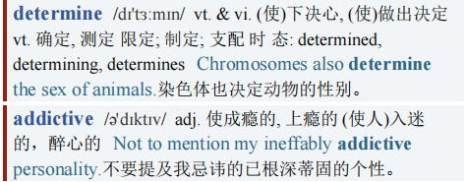
Share the data 共享数据
Gaming
Share the data
It’s the best way to determine whether video games are addictive
游戏
共享数据
共享数据是判断电子游戏是否会让人上瘾的最佳方式

Slide 2
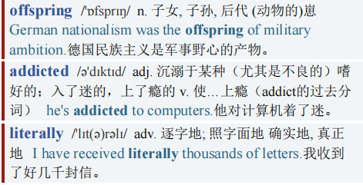
Share the data 共享数据
【1】No business would welcome being compared to Big tobacco or gambling. Yet that is what is happening to makers of video games. For years parents have casually complained that their offspring are “addicted” to their PlayStations and smartphones. Today, however, ever more doctors are using the term literally.
没有一个行业情愿被比作大型烟草业或赌博业。然而，这正是电子游戏制造商所面临的事情。多年来，父母们偶尔会抱怨孩子们对游戏机和智能手机“上瘾”。而如今，越来越多的医生也开始正儿八经地使用“上瘾”这个词了。

Slide 3
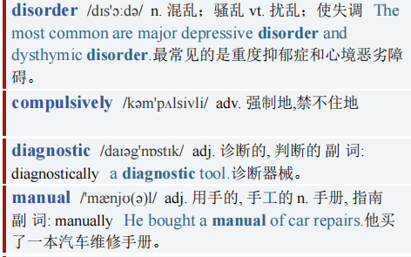
Share the data 共享数据
【2】On January 1st “gaming disorder”—in which games are played compulsively, despite causing harm—gains recognition from the World Health Organisation (WHO), as the newest edition of its diagnostic manual comes into force.
1月1日，随着世界卫生组织(WHO)最新版诊断手册生效，正式将“游戏障碍”定义为一种疾病。“游戏障碍”指的是在明知游戏有危害的情况下仍然控制不住玩游戏的行为。

Slide 4
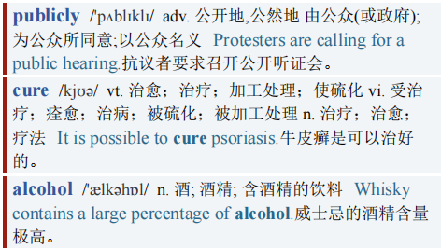
Share the data 共享数据
A few months ago China, the world’s biggest gaming market, announced new rules limiting children to just a single hour of play a day on Friday, Saturday and Sunday, and none the rest of the week. Western politicians worry publicly about some games’ similarity to gambling. Clinics are sprouting around the world, promising to cure patients of their habit in the same way they might cure them of an addiction to alcohol or cocaine.
中国拥有世界最大的游戏市场，在几个月前宣布了新的规定，限制孩子只能在周五、周六和周日玩游戏，且每天不超过一个小时，其余时间不能玩。对于某些游戏与赌博有相似之处，西方政治家公开表示担忧。诊所在世界各地如雨后春笋般涌现，它们承诺会像治疗酗酒者和瘾君子那样帮助病人摆脱游戏上瘾的习惯。

Slide 5
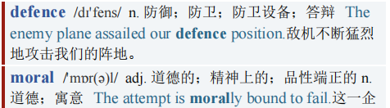
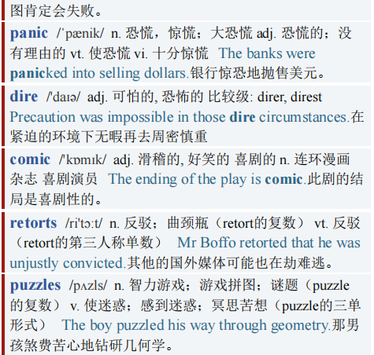
Share the data 共享数据
【3】Are games really addictive? psychologists are split. The case for the defence is that this is just another moral panic. Killjoys of yore issued similarly dire warnings about television, rock ’n’ roll, jazz, comic books, novels and even crossword puzzles.
游戏真的会让人上瘾吗？心理学家们众说纷纭。辩方称，这只是又一次道德恐慌罢了。昔日，那些煞风景的人对电视、摇滚乐、爵士、漫画书、小说甚至填字游戏也发出了类似的严重警告。

Slide 6
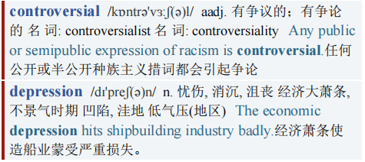
Share the data 共享数据
As the newest form of mass media, gaming is merely enduring its own time in the stocks before it eventually ceases to be controversial. Furthermore, defenders argue, the criteria used to diagnose gaming addiction are too loose. Obsessive gaming, they suggest, is as likely to be a symptom (of depression, say) as a disorder in its own right.
作为大众媒体的最新形式，游戏只不过是在走它的必经之路罢了，最终这些争议会烟消云散。此外，辩方认为，诊断游戏成瘾的标准过于宽泛。他们认为，游戏成瘾可能本身就是一种疾病，同样也可能是某种疾病(比如抑郁症)的症状。

Slide 7
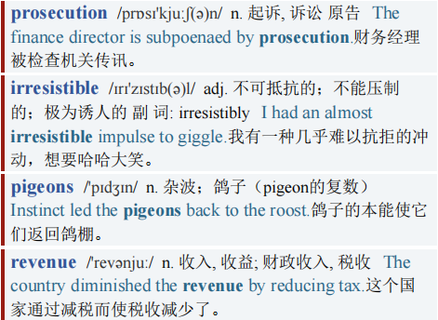
Share the data 共享数据
【4】The prosecution retorts that, unlike rock bands or novelists, games developers have both the motive and the means to engineer their products to make them irresistible. The motive arises from a business-model shift. In the old days games were bought for a one-off, upfront cost. These days, many use a “freemium” model, in which the game is free and money is made from purchases of in-game goods. That ties playtime directly to revenue.
控方反驳称，与摇滚乐队或小说家不同，游戏开发商既有动机也有方法把游戏设计得让人上瘾。其动机源于商业模式的转变。过去，游戏交易多为一次性预付消费。而如今，许多游戏采用“免费增值”模式，即游戏是免费的，开发商通过用户购买游戏中的商品来赚钱。这直接将游戏时长与收益挂钩。

Slide 8
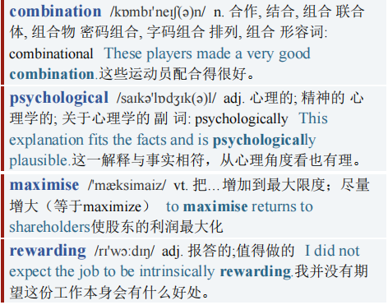
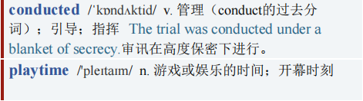
Share the data 共享数据
【5】The means is a combination of psychological theory and data that helps games-makers maximise that playtime. psychologists already know quite a lot about the sorts of things that animals, including humans, find rewarding (thanks to a long line of experiments, stretching back decades to those conducted on rats and pigeons by B.F. Skinner).
这种将心理学理论和数据相结合的方法，帮助游戏开发者最大化游戏时长。心理学家已经很了解，哪些事情会让包括人类在内的动物获得成就感（这要归功于几十年前斯金纳( B.F. Skinner) 用老鼠和鸽子所做的一系列实验)。

Slide 9
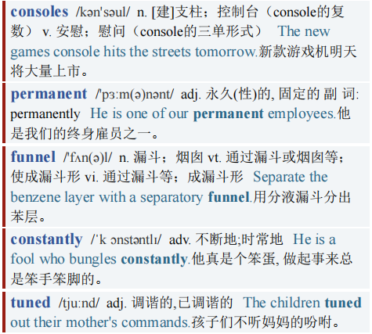
Share the data 共享数据
Smartphones and modern consoles use their permanent internet connections to funnel gameplay data back to developers. That allows products to be constantly fine-tuned and tweaked to boost spending. The industry is even beginning to use the argot of the gambling business. The biggest spenders are known as “whales”—a term that originated in casinos.
智能手机和现代游戏机一直联网，游戏开发者可以获得游戏数据，不断调整游戏以刺激消费。这个行业甚至开始使用博彩业的行话。花钱最多的人被称为“鲸鱼玩家”——这个词最早在赌场使用。

Slide 10
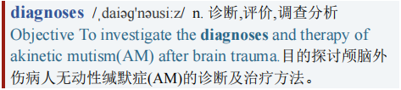
Share the data 共享数据
【6】While psychologists argue the finer points of what exactly counts as addiction, and whether gaming’s design tricks cross the line, the industry should recognise that, in the real world, it has a problem, and that problem is growing. Now that gaming addiction comes with an official WHO code, diagnoses will become more common.
尽管心理学家们就成瘾的定义细节以及游戏的设计技巧是否越界存在争议，但游戏行业应该认识到，现实世界中存在游戏成瘾的问题，而且这个问题愈发严重。既然世卫组织将游戏成瘾列入疾病分类，那么对此的诊断将会更加常见。

Slide 11
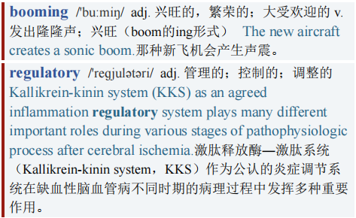
Share the data 共享数据
Clinics are already reporting booming business, as lockdowns have given gamers more time to spend with their hobby. The regulatory climate for tech is getting chillier. And being lumped in the public mind, fairly or not, with gambling and tobacco will not do the industry any favours.
诊所的生意蒸蒸日上，因为疫情封锁让玩家有更多的时间玩游戏。科技行业的监管形式正变得越来越严峻。无论公平与否，公众把游戏行业和赌博和烟草业混为一谈对游戏行业来说有弊无利。

Slide 12
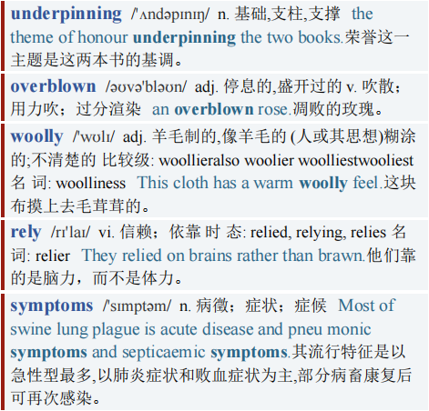
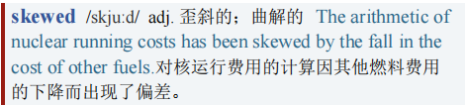
Share the data 共享数据
【7】It would be wise to get ahead of the discussion. A good place to start would be with hard data. Many of the studies underpinning the contention that games are addictive in a medical sense are woolly: they rely on self-reported symptoms, contested diagnostic criteria, skewed samples and so on.
提前讨论是明智的，可以先从硬数据着手。许多研究支持游戏在医学意义上具有成瘾性这一论点，但这些研究是模糊的：它们依赖于玩家自述的症状、有争议的诊断标准、不准确的样本等等。

Slide 13
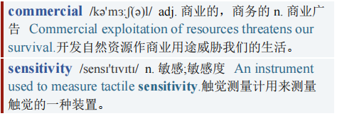
Share the data 共享数据
Even basic questions about the amount of time and money spent by users are hard to answer. The industry has an abundance of data that could help. But gaming firms mostly keep details of how gamers behave secret, citing commercial sensitivity.
即使是玩家花费的时间和金钱这样的基本问题也很难得到回答。游戏行业有大量的数据可以帮助我们，但游戏公司大多以商业敏感性为由对玩家行为的细节保密。

Slide 14
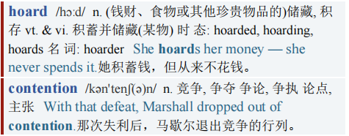
Share the data 共享数据
【8】In the long run, that will prove unwise. Gaming firms should make more of their data hoard available to researchers. If—as seems likely—worries about addictiveness are overblown, it is hard to think of a clearer way of showing it. And if not, it is better for firms to recognise the problem now, and do something about it voluntarily.
从长远来看，保密是不明智的。游戏公司应该向研究人员提供更多的数据。如果对游戏成瘾被夸大(这似乎很有可能) ，那么就没有比公开数据更为一目了然的证明方式。如果游戏成瘾没有被夸大，那么企业最好现在就认识到这个问题，并主动采取行动解决它。

Slide 15
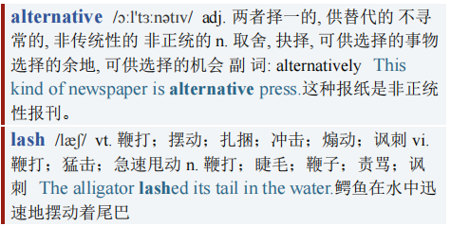
Share the data 共享数据
The alternative is that regulators will force them to act. And as China has shown, once a government is seized by a fit of moral panic, it can lash out.
否则，监管机构将迫使游戏公司采取行动。正如中国所表现的那样，一旦政府陷入道德恐慌，就会使出雷霆手段。

Slide 16
Share the data 共享数据
感谢观看
想要获取视频文章PPT、PDF、Word版本的朋友
可以私信up主
记得按时打卡

