Slide 1

Poxy reasoning 梅毒推理
Sexually transmitted diseases
Poxy reasoning
Why syphilis isn’t other people’s problem
性传播疾病
梅毒推理
为什么梅毒不是别人的问题

Slide 2
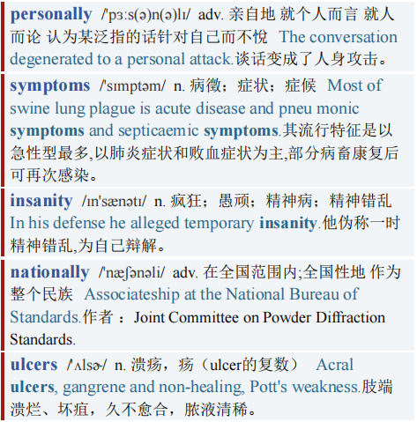
Poxy reasoning 梅毒推理
【1】No one wants syphilis. Not personally—its symptoms include ulcers and insanity—and not nationally. The “French disease” as the English long called it, is an infamously “othered” illness.
没人想感染上梅毒，其症状包括溃疡和精神失常，梅毒既不是个人问题，也不是国家问题。英国人长期以来称之为“法国病”，其实是一种臭名昭著的“他人”病。

Slide 3
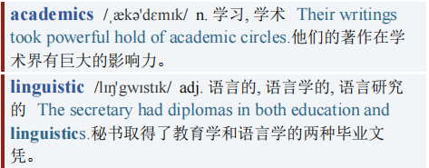
Poxy reasoning 梅毒推理
In 2014 academics in Bucharest traced its linguistic history and found that, even as the English used to call it the French disease, the French called it the Neapolitan one.
2014年，布加勒斯特（罗马尼亚首都）的学者们对其语言史进行了追溯，发现尽管英国人曾称梅毒为“法国病”，但法国人却称之为“那不勒斯病”。（文章来自于公众号：考研英语外刊学习）

Slide 4
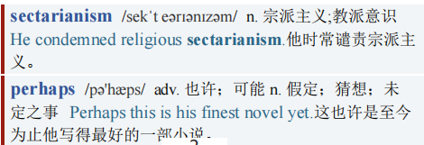
Poxy reasoning 梅毒推理
【2】The othering didn’t stop there. The Russians called it Polish, the Poles called it German, the Germans called it French and the Danish called it Spanish. The Turks eschewed nationalism for sectarianism, calling it the “Christian disease”, while, as the researchers observed: “in Northern India, the Muslims blamed the Hindu for the outbreak of the affliction. However, the Hindu blamed the Muslims and in the end everyone blamed the Europeans.” Not, perhaps, without cause.
“他化行为”并没有就此结束。俄国人称之为波兰病，波兰人称之为德国病，德国人称之为法国病，丹麦人称之为西班牙病。土耳其人因教派而避开民族主义，称之为“基督教疾病”，然而，正如研究人员所观察到的那样:“在印度北部，穆斯林将这种疾病的爆发归咎于印度人。”然而，印度人指责穆斯林，最后所有人指责欧洲人。”（事实）也许不是这样，毫无原因。

Slide 5
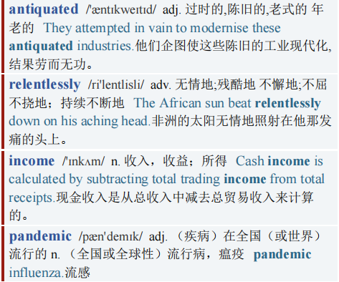
Poxy reasoning 梅毒推理
【3】Syphilis also feels like an antiquated disease. It is not. Cases have been rising relentlessly for 20 years in Britain. As a recent paper in Nature Microbiology observed, over the past decade rates have risen by about 150% in some high-income countries. In 1999, 415 cases were reported at clinics in England and Wales. In 2019 there were 8,011 in England alone. (The pandemic makes later figures unreliable.) The numbers are still low. But the rise is worrying. Ironically, some of the reasons are probably positive.
梅毒也像是一种过时的疾病。其实，并不是。20年来，英国梅毒病例不断增加。正如《自然微生物学》(Nature Microbiology)杂志最近发表的一篇论文所观察到的那样，过去十年里，一些高收入国家的梅毒发病率上升了约150%。1999年，英格兰和威尔士的诊所报告了415例梅毒病例。2019年，仅在英国就有8011人患病。(因新冠疫情，后来的数据并不可靠。)梅毒患病人数仍然处于低位，但其病例的增长速度着实令人担忧。具有讽刺意味的是，有些引起梅毒的原因可能是乐观造成的。

Slide 6
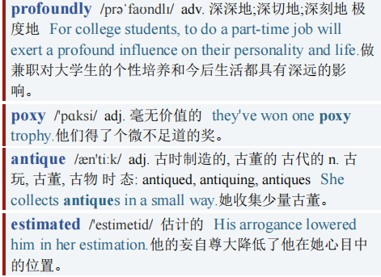
Poxy reasoning 梅毒推理
【4】In the 18th and 19th centuries, Britain was a profoundly poxy place. Accurate antique syphilis rates are hard to come by (doctors avoided mentioning it on death certificates as it upset the relatives), but it is estimated that almost 8% of Victorians suffered from it.
18、19世纪的英国是一个被梅毒荼毒颇深的地方。很难获得古时梅毒的准确发病率 (医生们在死亡证明上避免提及梅毒，因为这让亲属们感到不快)，但据估计，维多利亚时代近8%的人患有此病。

Slide 7
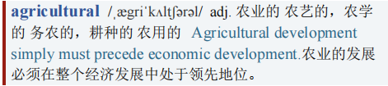
Poxy reasoning 梅毒推理
Rates were lowest among agricultural labourers and much higher among the upper classes. Lord Elgin is famous today for defacing the profile of the Parthenon: in his own time he was known for his own defaced profile. His nose was so eaten away by “the pox” (as Byron put it) that he had to retire from public life.
农业劳动者中梅毒发病率最低，而在上流社会中发病率则高得多。今天，埃尔金勋爵因破坏帕特农神庙的雕像而出名：在他那个年代，他也因自己受损的形象而闻名。因为埃尔金勋爵的鼻子被“痘”病(用拜伦的话说)感染得很严重，以至于他不得不退出公众生活。

Slide 8
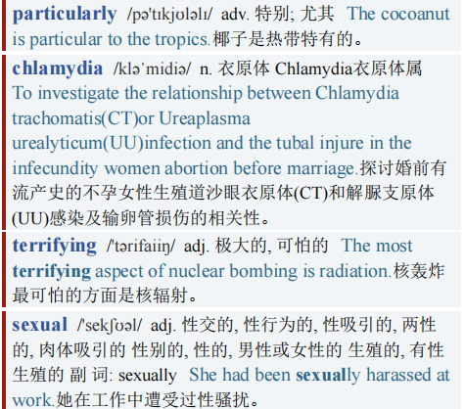
Poxy reasoning 梅毒推理
【5】Effective 20th-century treatments, particularly penicillin, changed that and syphilis rates tumbled. The terrifying arrival of HIV caused rates to collapse as people avoided sexual risk.
20世纪有效的治疗方法，特别是青霉素疗法，改变了当时的状况，梅毒发病率大幅下降。可怕的艾滋病病毒的到来，让梅毒发病率骤降，因为人们规避了性行为风险。

Slide 9

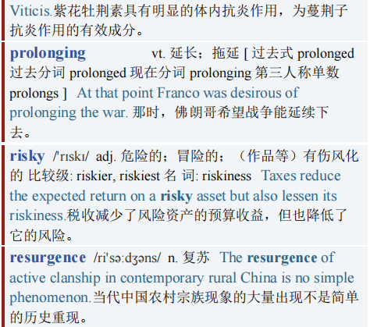
Poxy reasoning 梅毒推理
Now, says Michael Marks, a researcher at the London School of Hygiene and Tropical Medicine (LSHTM) and one of the Nature Microbiology paper’s authors, drugs for HIV are highly effective at prolonging healthy life—and that seems to have led to rises in risky sexual behaviours, especially sex without condoms. That, in turn, has contributed to a resurgence of syphilis, especially among men who have sex with men.
如今，伦敦卫生和热带医学学院(LSHTM)的研究员、《自然微生物学》杂志上那篇论文的作者之一迈克尔·马克斯(Michael Marks)说，治疗艾滋病毒的药物在延年益寿方面非常有效——他的话似乎导致了高风险性行为的增加，尤其是不使用避孕套的性行为的增加。这反过来又导致了梅毒的死灰复燃，尤其是在男男性行为人群中。

Slide 10
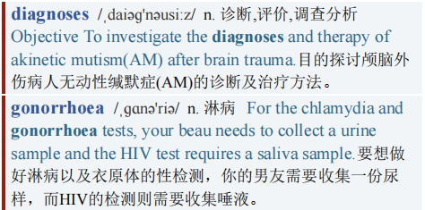
Poxy reasoning 梅毒推理
Such factors have also led to rises in other sexually transmitted infections (stis). In 2018 diagnoses of chlamydia, the commonest, rose by 2%, despite a drop in testing, while gonorrhoea diagnoses rose by 26%.
这些因素也导致了其他性传播感染病的增加。2018年，最常见的衣原体诊断上升了2%，尽管检测数量下降，但淋病诊断上升了26%。

Slide 11
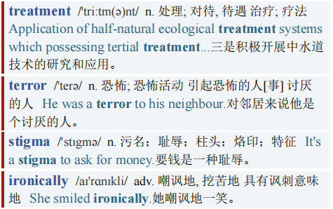
Poxy reasoning 梅毒推理
【6】Better treatment and waning terror are clearly good things. But other reasons for rising cases are less positive. sexual-health services have seen their funding slashed in recent years. Shame, moreover, means new infections are less likely to be diagnosed and treated quickly. “It’s an area full of stigma,” says Emma Harding-Esch, another researcher at the lshtm. “STIS, ironically, are not considered sexy diseases.”
更好的治疗方案和恐惧的减轻显然是好事。但导致梅毒病例增加的其他原因就不那么乐观了。近年来，性健康服务的资金被大幅削减。而且，羞耻就意味着新感染梅毒不太可能被迅速诊断和治疗。“梅毒是个满是污名的病症，”LSHTM的另一位研究员艾玛·哈丁-埃施(Emma Harding-Esch)说。讽刺的是，性传播感染并不被认为是性病。

Slide 12
Poxy reasoning 梅毒推理
【7】And syphilis is one of the least sexy. Even now, when its days of linguistic othering are over, it is still seen as “something that affects other people,” says Dr Marks. That needs to change: the “French disease” is becoming a British disease again.
梅毒是最无法引起性冲动的疾病之一。马克斯博士说，即使是现在语言上的“他化”时代已经结束，梅毒仍然被视为“影响他人的东西”。这种情况需要改变:“法国病”正再次成为英国病。

Slide 13
Poxy reasoning 梅毒推理
感谢观看
想要获取视频文章PPT、PDF、Word版本的朋友
可以私信up主
记得按时打卡

