Slide 1
Scala
Java as you wished it would be

Slide 2
Agenda

Slide 3
Java-based Scalable Language
Conceived in 2001 by one of the main authors of Java
Runs on JVM
Compiles into bytecode
Full interoperability with Java

Slide 4

“bye java”
scalac / scala
javap
java

Slide 5
Scala Installation
JAVA / JDK
  JAVA_HOME / PATH
  java / javac
Binaries
  http://www.scala-lang.org/downloads
REPL
    >$ scala
    scala> println("Bye-bye Java!")
    Bye-bye Java!
IDE
  http://scala-ide.org/
Lightbend Activator (browser-based or command-line tool)

Slide 6
While you are installing …
Poetry on Scala from Rod Johnson
https://youtu.be/DBu6zmrZ_50?t=325

Slide 7
Scala IDE
classes
app
worksheet

Slide 8
Scalable Language
Object-oriented
Functional
Statically typed

Slide 9
Object-oriented
Every value is an object
  Primitives
  Functions
  “Empty” value
  No “static”
Mixin-based composition

Slide 10


OOP Pattern Disclosure

Slide 11
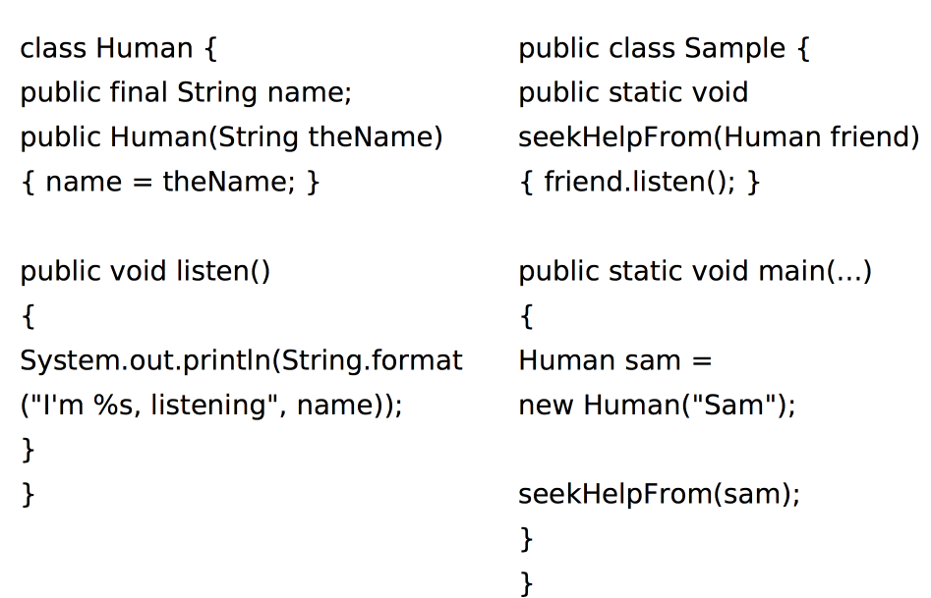
OOP Pattern Disclosure

Slide 12
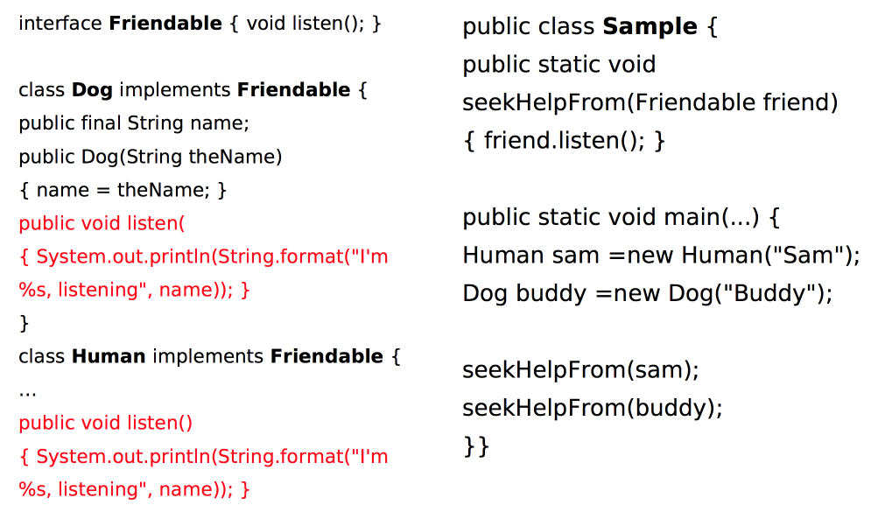
OOP Pattern Disclosure

Slide 13
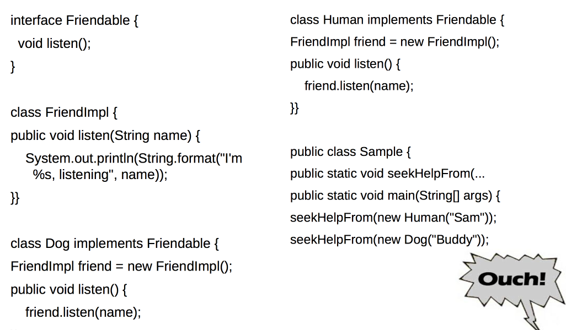
OOP Pattern Disclosure

Slide 14
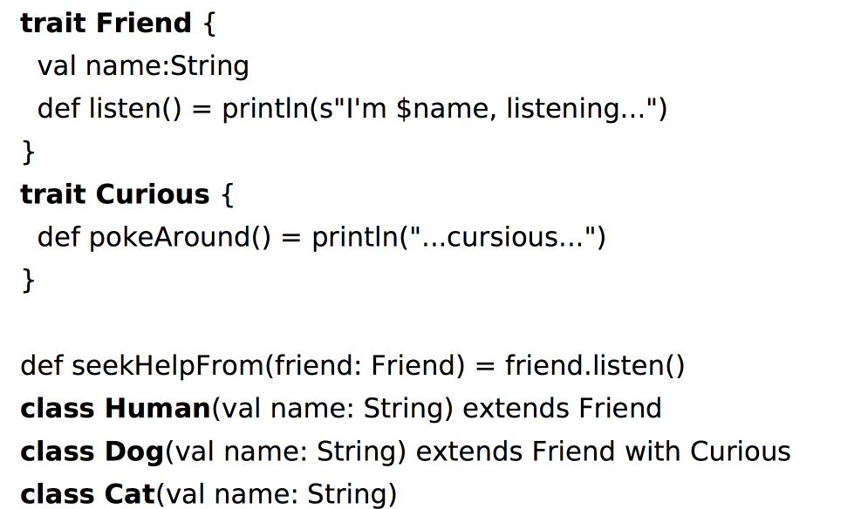
OOP Pattern Disclosure

Slide 15
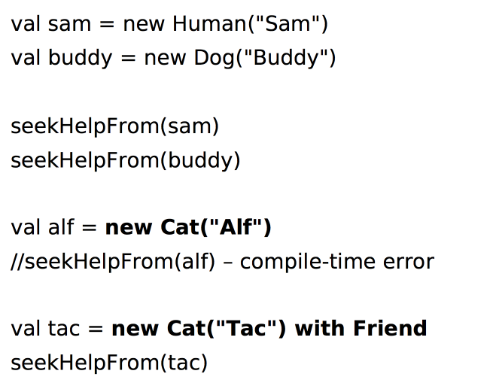
OOP Pattern Disclosure

Slide 16
Basics: Scala Beans
Class (same old stuff, but POJOs are leaner
  No need for accessors/mutator - can be added on demand
Object
  singleton of a class
  cute way of being static
Trait (interface a-la java8)
  Represent a distinct feature or aspect
  Multiple inheritance
  State inheritance

Slide 17
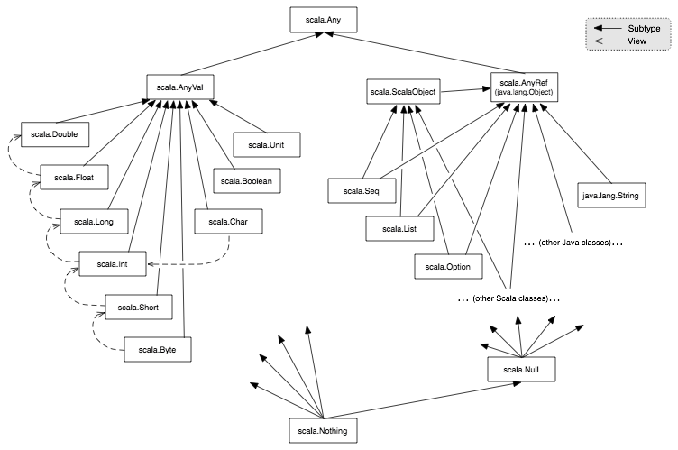

Slide 18
Functional
Higher-order functions
Nested-functions
Currying
Anonymous functions definitions

Slide 19
Strictly-typed
  Generics++ (Cage[Lion] can extend Cage[Animal])
    List[+A]
    ListBuffer[A]

Slide 20
Main Design Principles
Strive for immutability
  val
  immutable collections
  you can still work in a usual way, if you’re so inclined
Everything is an expression
  no ifs, no buts

Slide 21
Syntactic sugar
No ;
No returns
a.apply(x, y) -> a(x, y)

Slide 22
Basics: Case Classes
Immutable
Provide some basic functionality
  toString()
  copy()
  ==

Slide 23
Basics: Tuple
immutable sequence of values of multiple types
val idUsername = ( “VasjaBu“, 1990-04-23)

Slide 24
Case-classes++
Pattern-matching
Functions

