Slide 1
Scala
Java as you wished it would be

Slide 2
Agenda

Slide 3
Java-based Scalable Language
Conceived in 2001 by one of the main authors of Java
Runs on JVM
Compiles into bytecode
Full interoperability with Java

Slide 4

“bye java”
scalac / scala
javap
java

Slide 5
Scala Installation
JAVA / JDK
JAVA_HOME / PATH
java / javac
Binaries
http://www.scala-lang.org/downloads
REPL
>$ scala
scala> println("Bye-bye Java!")
Bye-bye Java!
IDE
http://scala-ide.org/
Lightbend Activator (browser-based or command-line tool)

Slide 6
While you are installing …
Poetry on Scala from Rod Johnson
https://youtu.be/DBu6zmrZ_50?t=325

Slide 7
Scala IDE
classes
app
worksheet

Slide 8
Scalable Language
Object-oriented
Functional
Statically typed

Slide 9
Object-oriented
Every value is an object
Primitives
Functions
“Empty” value
No “static”
Mixin-based composition

Slide 10
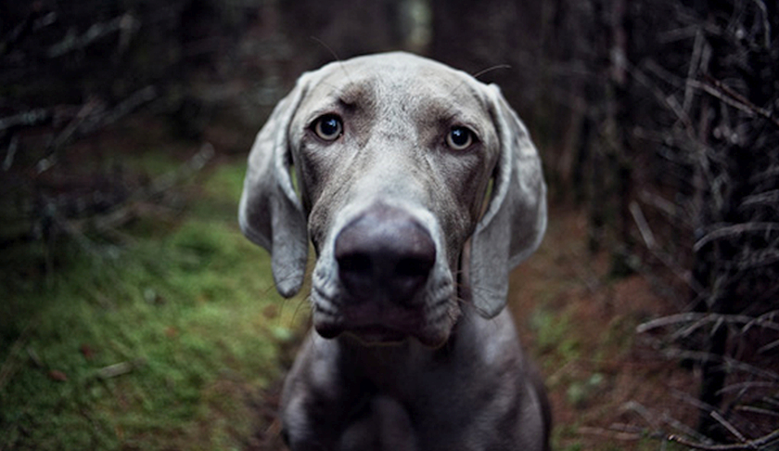
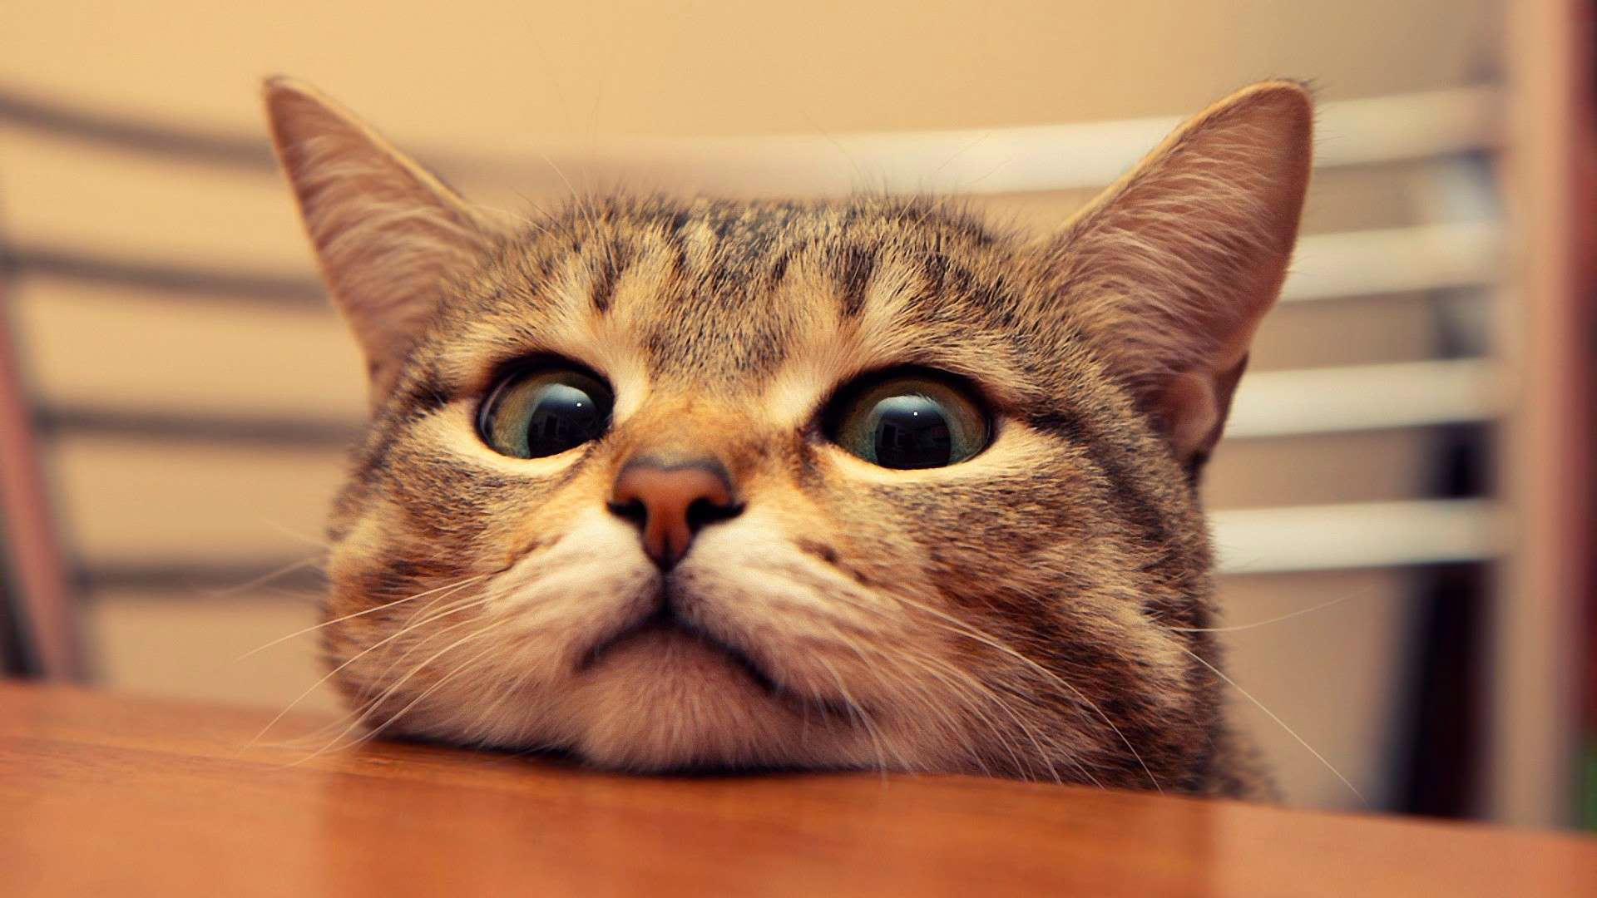
OOP Pattern Disclosure

Slide 11
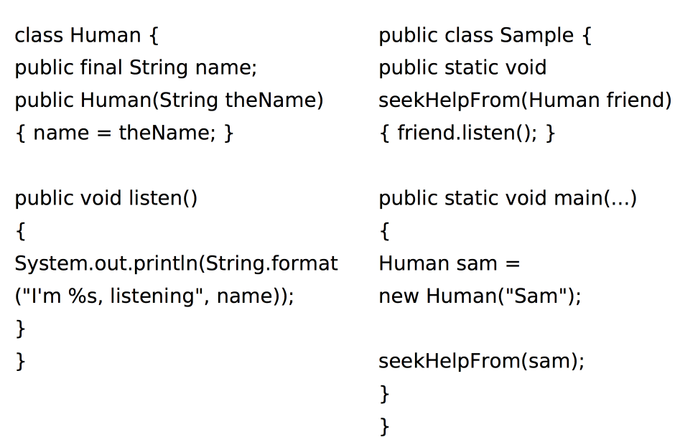
OOP Pattern Disclosure

Slide 12
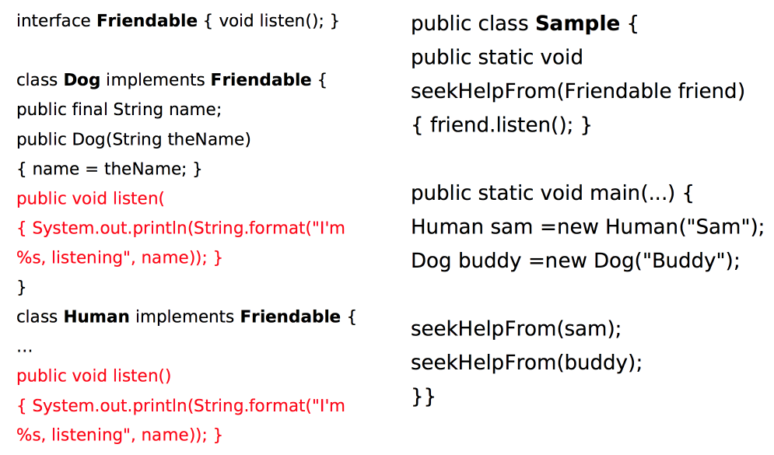
OOP Pattern Disclosure

Slide 13
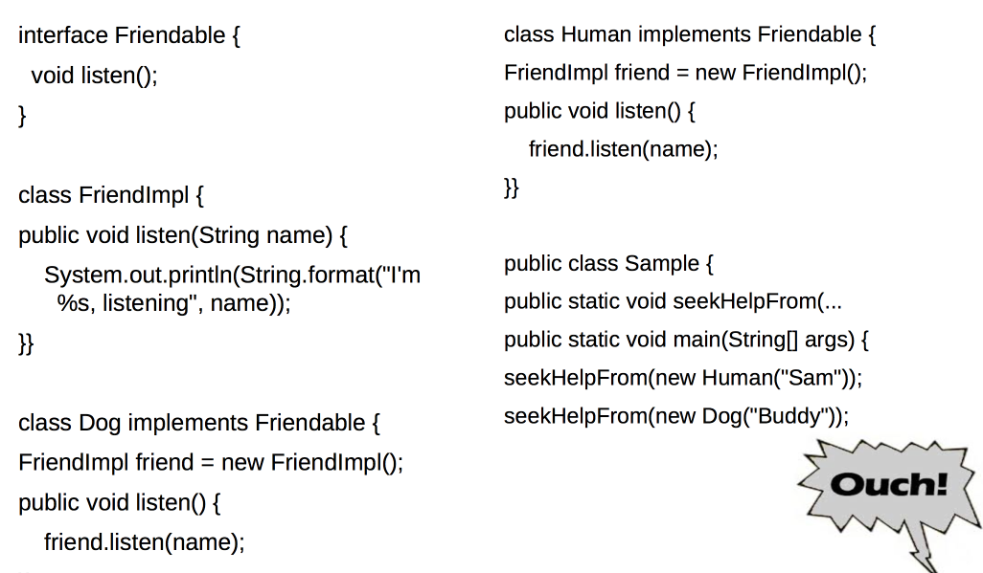
OOP Pattern Disclosure

Slide 14
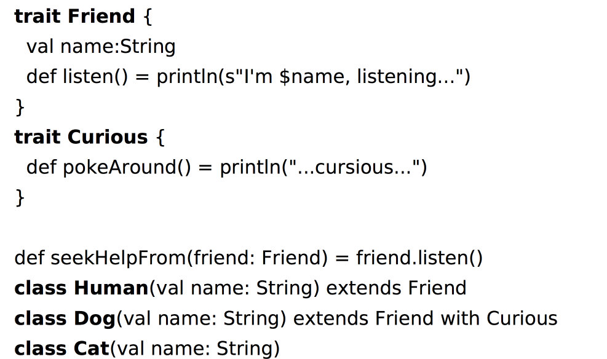
OOP Pattern Disclosure

Slide 15
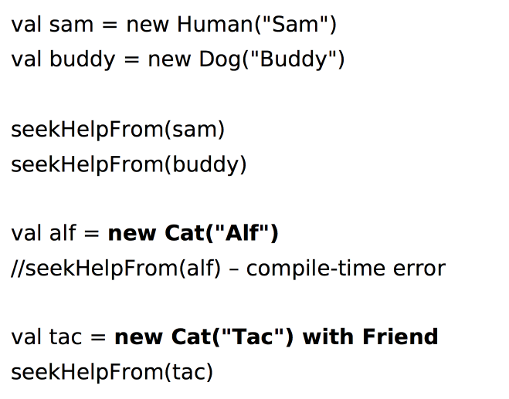
OOP Pattern Disclosure

Slide 16
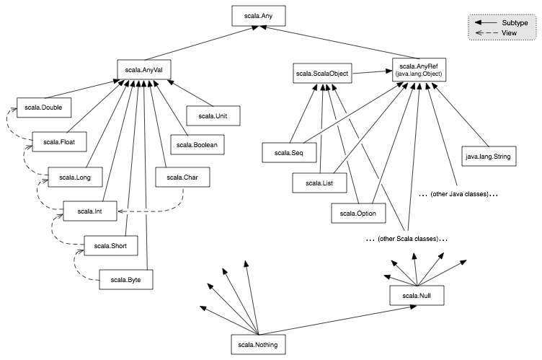

Slide 17
Functional
Higher-order functions
Nested-functions
Currying
Anonymous functions definitions

Slide 18
Strictly-typed
Generics++ (Cage[Lion] can extend Cage[Animal])
List[+A]
ListBuffer[A]

Slide 19
Main Design Principles
Strive for immutability
val
immutable collections
you can still work in a usual way, if you’re so inclined
Everything is an expression
no ifs, no buts

Slide 20
Syntactic sugar
No ;
No returns
a.apply(x, y) -> a(x, y)

Slide 21
Basics: Scala Beans
Class (same old stuff, but POJOs are leaner
No need for accessors/mutator - can be added on demand
Object
singleton of a class
cute way of being static
Trait (interface a-la java8)
Actually, rather a mixin
Multiple inheritance
State inheritance

Slide 22
Basics: Case Classes
Immutable
Provide some basic functionality
toString()
copy()
==

Slide 23
Basics: Tuple
immutable sequence of values of multiple types
val idUsername = ( “VasjaBu“, 1990-04-23)

Slide 24
Case-classes++
Pattern-matching
Functions

