Slide 1
Scala
Java as you wished it would be

Slide 2
Java-based
Conceived in 2001 by one of the main authors of Java
Runs on JVM
Compiles into bytecode
Full interoperability with Java

Slide 3
Object-oriented
Every value is an object
Primitives
Functions
“Empty” value

Slide 4
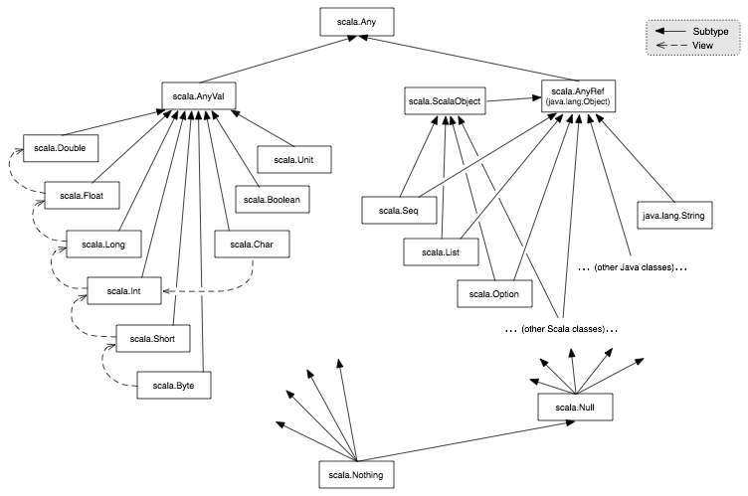

Slide 5
Functional
Higher-order functions
Nested-functions
Currying
Anonymous functions definitions

Slide 6
Strictly-typed
Generics++ (Cage[Lion] can extend Cage[Animal])
List[+A]
ListBuffer[A]

Slide 7
Main Design Principles
Strive for immutability
val
immutable collections
you can still work in a usual way, if you’re so inclined
Everything is an expression
no ifs, no buts

Slide 8
Syntactic sugar
No ;
No returns
a.apply(x, y) -> a(x, y)

Slide 9
Basics: Scala Beans
Class (same old stuff, but POJOs are leaner
No need for accessors/mutator - can be added on demand
Object
singleton of a class
cute way of being static
Trait (interface a-la java8)
Actually, rather a mixin
Multiple inheritance
State inheritance

Slide 10
Basics: Case Classes
Immutable
Provide some basic functionality
toString()
copy()
==

Slide 11
Basics: Tuple
immutable sequence of values of multiple types
val idUsername = ( “VasjaBu“, 1990-04-23)

Slide 12
Case-classes++
Pattern-matching
Functions

